Slide 1
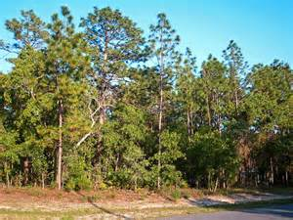
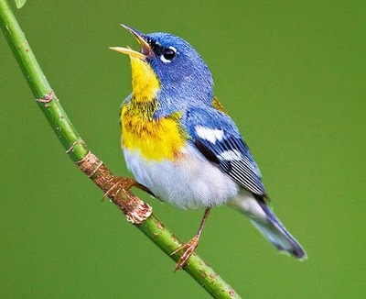

Structural Equation Modeling (SEM) and Path Analysis
Measured
γ₁₁
β₂₁
Measured
Latent Variable
Pedro Lourenco

Slide 2
Multivariate Models
Model Technique
y = x1 + x2 + … x Regression, ANOVA
y1 + y2 + … yi = x Multivariate ANOVA , MANTEL
Discriminant Analysis, CART
y1 + y2 + … yi = x1 + x2 + … xj Redundancy Analysis,
Can. Correspondence Analysis
y1 + y2 + … yi Ordination, Cluster Analysis
Multivariate Statistics

Slide 3
Types of Variables
Our multivariate (and univariate) models make the distinction
between response and explanatory variables.
In the “real world” the distinction may not be so straight forward.
Response
Explanatory
Explanatory
=
+
Pedro Lourenco
=
+
Bird Abundance
Canopy Height
Rainfall

Slide 4
Types of Variables
Our multivariate (and univariate) models make the distinction
between response and explanatory variables.
In the “real world” the distinction may not be so straight forward.
Response
???
Explanatory
=
=
Pedro Lourenco
=
=
Bird Abundance
Canopy Height
Rainfall

Slide 5
Structural Equation Modeling (SEM)
Provides a method of testing hypotheses that takes into account the
complexities we see in the “real world”.
=
=
Pedro Lourenco
=
=
Bird Abundance
Canopy Height
Rainfall

Slide 6
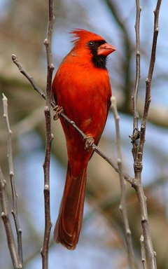
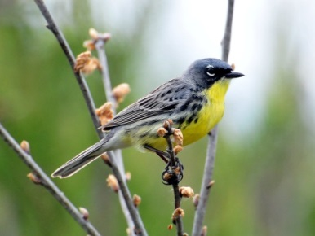
Structural Equation Modeling (SEM)
Extension of multiple regression that allows for multiple
response variables (i.e., multivariate).
Pedro Lourenco
Ken Thompson

Slide 7
Structural Equation Modeling (SEM)
Extension of multiple regression that allows for variables to be both
response and explanatory variables.
Pedro Lourenco
Ken Thompson

Slide 8

Structural Equation Modeling (SEM)
Extension of multiple regression that allows for latent variables (sensu factor analysis)
Pedro Lourenco
Gestalt
Ken Thompson

Slide 9
Structural Equation Modeling (SEM)
Allows for simultaneous testing of multiple regression equations.
Confirmatory Factor Analysis
Path Analysis – when all variables are measured (i.e. no latent variables)
Develop hypotheses to be tested using path diagrams.

Slide 10
Structural Equation Modeling (SEM)
Two approaches:
Co-variance based (e.g., lavaan in R)
Local Equation estimation (piecewiseSEM in R)

Slide 11
Structural Equation Modeling (SEM)
Steps:
Develop models representing hypothesis with path diagrams
Fit models to the observed data to obtain coefficient estimates
Test goodness of fit of the model to the data
Compare competing hypotheses (i.e., path models)

Slide 12
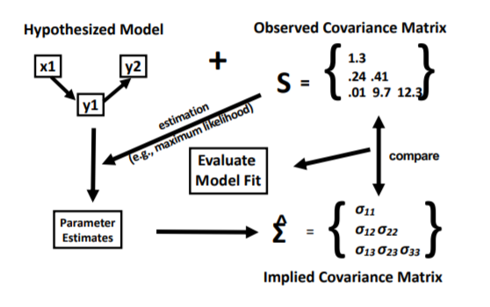
SEM with Covariance Matrix
Slide courtesy of Jarret Byrnes

Slide 13
Path Diagrams
Pedro Lourenco

Slide 14
Path Diagrams
Pedro Lourenco
Exogenous Variable: Values determined by factors external to the model

Slide 15
Path Diagrams
Pedro Lourenco
Endogenous Variable: Values determined by factors internal to the model

Slide 16
Path Diagrams
Pedro Lourenco
Bird = γ₁₀ + β₁₁*Canopy + ζ₁
Error
Response Variable
Intercept
Regression coefficient relating endogenous variables

Slide 17
Path Diagrams
Pedro Lourenco
Canopy = γ₂₀ + γ ₂₁*Rainfall + ζ₂
Error
Response Variable
Intercept
Regression coefficient relating endogenous
variables to exogenous variables

Slide 18
Path Diagrams
Pedro Lourenco
Bird = γ₁₀ + β₁₁*Canopy + ζ₁
Canopy = γ₂₀ + γ ₂₁*Rainfall + ζ₂

Slide 19
Test Competing Hypotheses
Pedro Lourenco
Bird = γ₁₀ + β₁₁*Canopy + γ ₁₁*Rainfall + ζ₁
Canopy = γ₂₀ + γ₂₁*Rainfall + ζ₂

Slide 20
Test Competing Hypotheses
Pedro Lourenco
Bird = γ₁₀ + γ₁₁*Canopy + γ ₁₂*Rainfall + ζ₁

Slide 21
SEM and Path Analysis
Measured
Measured
Latent Variable
Measured
Measured variables are represented by squares and latent (unmeasured) variables
are represented by circles.

Slide 22
SEM and Path Analysis
Measured
γ₁₁
Measured
β₂₁
Latent Variable
γ₁₂
Measured
Arrows are associated with regression coefficients

Slide 23
SEM and Path Analysis
Endogenous
Measured
γ₁₁
Measured
β₂₁
Exogenous
Latent Variable
γ₁₂
Measured

Slide 24
SEM and Path Analysis
ζ₁
ζ₂
Measured
γ₁₁
Measured
β₂₁
Latent Variable
γ₁₂
Measured
The endogenous variables have a disturbance term, ζ, which is an error term.

Slide 25
SEM and Path Analysis
ζ₁
ζ₂
Measured
γ₁₁
Measured
β₂₁
Latent Variable
cov
γ₁₂
Measured
Double-headed arrows mean that the two variables covary (i.e., covariance arrows)

Slide 26
Data for SEM and Path Analysis
Residuals must “meet” the assumptions linearity, normality, homogeneity of variances.
Data is multivariate normal
Sample size should be ~10-20 samples for every parameter that is estimated.
At least 5
P^{3/2}
Endogenous variables must be continuous (potentially ordinal with
at least 5 categories).
*piecewiseSEM can accommodate categorical variables and non-normal residuals

Slide 27
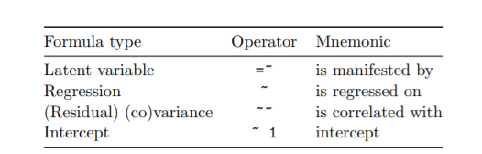
Specifying the Model
After developing hypotheses (path diagrams), we must specify the model.

Slide 28
Specifying the Model
Pedro Lourenco
Bird ~ Canopy + Rainfall
Canopy ~ Rainfall

Slide 29
Specifying the Model
Pedro Lourenco
Bird ~ Canopy + Rainfall

Slide 30
Specifying the Model
Pedro Lourenco
Bird ~ Canopy + Rainfall
Canopy ~~ Rainfall

Slide 31
“Identifying” the model
The maximum number of parameters you can estimate
(coefficients, variances and covariances) for k variables is:
(k²+k/2)
The degrees of freedom (df) is the difference between the number
of parameters to estimate and the max. number of parameters.
- model under-identified if df < 0
- just identified if df = 0
- over-identified if df > 0

Slide 32
“Identifying” the model
The maximum number of parameters you can estimate
(coefficients, variances and covariances) for k variables is:
(k²+k/2)
The degrees of freedom (df) is the difference between the number
of parameters to estimate and the max. number of parameters.
- model under-identified if df < 0
- just identified if df = 0 (no model fit statistics)
- over-identified if df > 0

Slide 33
Goodness of Fit
Rules of thumb from Kline (2012)
Several measures of fit exist for assessing sem/path models
Model Chi-Square with its df and p-value. - prefer p-value greater than 0.05
(2) Root Mean Square Error of Approximation (RMSEA). - prefer value to be < 0.08
(3) Comparative Fit Index (CFI). - prefer value greater than 0.90
(4) Standardized Root Mean Square Residual (SRMR). - prefer value < 0.10

Slide 34
Model Comparison
A key aspect of SEM is the ability to compare models.
AIC/BIC: good for comparing models , the lower the better.
“∆ BIC > 5 is strong evidence, > 10 is conclusive evidence”
Likelihood ratio test (nested models; i.e., is the simpler model better)

Slide 35
SEM with Covariance Matrix
Slide courtesy of Jarret Byrnes

Slide 36
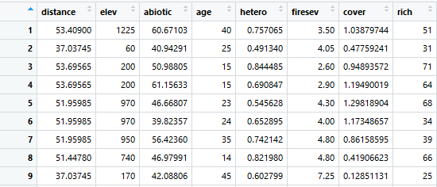
SEM Example – Keely fire data

Slide 37
Path Diagram (Indirect model)
Stand Age
Elevation
Fire Severity
Species Richness
Dist. From coast

Slide 38
Path Diagram (Direct model)
Stand Age
Elevation
Fire Severity
Species Richness
Dist. From coast

Slide 39
Specify Models
indirect<- ' firesev ~ age + elev
rich ~ firesev + distance'

Slide 40
Path Diagram (Indirect model)
Stand Age
Elevation
Fire Severity
Species Richness
Dist. From coast

Slide 41
Specify Models
indirect<- ' firesev ~ age + elev
rich ~ firesev + distance'
direct<-' firesev ~ age + elev
rich ~ firesev + age + elev + distance'

Slide 42
Path Diagram (Direct model)
Stand Age
Elevation
Fire Severity
Species Richness
Dist. From coast

Slide 43
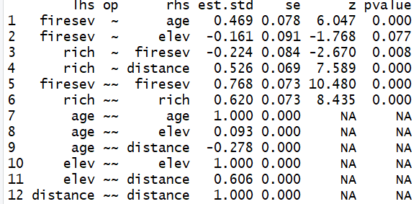
Estimate Coefficients
Indirect model

Slide 44
Estimate Coefficients
Indirect model
Stand Age
0.47
Elevation
Fire Severity
Species Richness
-0.16
-0.22
Dist. From coast
0.53

Slide 45
Estimate Coefficients
Indirect model
Stand Age
0.47
0.47 *-0.22 = -0.10
Elevation
Fire Severity
Species Richness
-0.16
-0.22
Dist. From coast
0.53

Slide 46
Estimate Coefficients
Indirect model
Stand Age
0.47
Elevation
Fire Severity
Species Richness
-0.16
-0.22
R² = 0.23
R² = 0.38
Dist. From coast
0.53

Slide 47
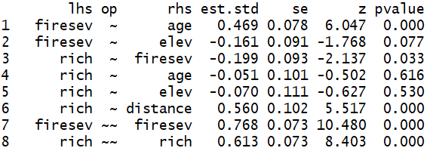
Estimate Coefficients
Direct model
Stand Age
-0.05
0.47
Elevation
Fire Severity
-0.07
Species Richness
-0.16
-0.20
R² = 0.23
R² = 0.39
Dist. From coast
0.56

Slide 48
Goodness of Fit
model | Chisq | df | p-value | cfi | rmsea | srmr
indirect | 1.55 | 3 | 0.67 | 1.00 | 0 | 0.25
direct | 0.562 | 1 | 0.454 | 1.00 | 0 | 0.015

Slide 49
Goodness of Fit
model | Chisq | df | p-value | cfi | rmsea | srmr
indirect | 1.55 | 3 | 0.67 | 1.00 | 0 | 0.025
direct | 0.562 | 1 | 0.454 | 1.00 | 0 | 0.015
Model Chi-Square with its df and p-value. - prefer p-value greater than 0.05
(2) Root Mean Square Error of Approximation (RMSEA). - prefer value to be < 0.08
(3) Comparative Fit Index (CFI). - prefer value greater than 0.90
(4) Standardized Root Mean Square Residual (SRMR). - prefer value < 0.10

Slide 50
Goodness of Fit
model | Chisq | df | p-value | cfi | rmsea | srmr
indirect | 1.55 | 3 | 0.67 | 1.00 | 0 | 0.025
direct | 0.562 | 1 | 0.454 | 1.00 | 0 | 0.015
Model Chi-Square with its df and p-value. - prefer p-value greater than 0.05
(2) Root Mean Square Error of Approximation (RMSEA). - prefer value to be < 0.08
(3) Comparative Fit Index (CFI). - prefer value greater than 0.90
(4) Standardized Root Mean Square Residual (SRMR). - prefer value < 0.10

Slide 51
Goodness of Fit
model | Chisq | df | p-value | cfi | rmsea | srmr
indirect | 1.55 | 3 | 0.67 | 1.00 | 0 | 0.025
direct | 0.562 | 1 | 0.454 | 1.00 | 0 | 0.015
Model Chi-Square with its df and p-value. - prefer p-value greater than 0.05
(2) Root Mean Square Error of Approximation (RMSEA). - prefer value to be < 0.08
(3) Comparative Fit Index (CFI). - prefer value greater than 0.90
(4) Standardized Root Mean Square Residual (SRMR). - prefer value < 0.10

Slide 52
Goodness of Fit
model | Chisq | df | p-value | cfi | rmsea | srmr
indirect | 1.55 | 3 | 0.67 | 1.00 | 0 | 0.025
direct | 0.562 | 1 | 0.454 | 1.00 | 0 | 0.015
Model Chi-Square with its df and p-value. - prefer p-value greater than 0.05
(2) Root Mean Square Error of Approximation (RMSEA). - prefer value to be < 0.08
(3) Comparative Fit Index (CFI). - prefer value greater than 0.90
(4) Standardized Root Mean Square Residual (SRMR). - prefer value < 0.10

Slide 53
Model Comparison
model | AIC | BIC
indirect | 3583 | 3598
direct | 3586 | 3606
AIC/BIC: good for comparing models , the lower the better.
“∆ AIC/BIC > 5 is strong evidence, > 10 is conclusive evidence”

Slide 54
Model Comparison
model | AIC | BIC
indirect | 3583 | 3598
direct | 3586 | 3606
AIC/BIC: good for comparing models , the lower the better.
“∆ AIC/BIC > 5 is strong evidence, > 10 is conclusive evidence”

Slide 55
Model Comparison
model | AIC | BIC
indirect | 3583 | 3598
direct | 3586 | 3606
Likelihood Ratio test
model | Chisq | df | Dif Chisq | Diff Df | P -value
direct | 0.56 | 1
indirect | 1.55 | 3 | 0.99 | 2 | 0.61

Slide 56
Best-fit Model
Indirect model
Stand Age
We can also report and test indirect effects
0.47
Elevation
Fire Severity
Species Richness
-0.16
-0.22
R² = 0.23
R² = 0.38
Dist. From coast
0.53

Slide 57
Best-fit Model
Indirect model
Stand Age
0.47
Elevation
Fire Severity
Species Richness
-0.16
-0.22
R² = 0.23
R² = 0.38
Dist. From coast
0.53

Slide 58
SEM and Path Analysis Wrap-up
SEM and Path models provide a way to test more “realistic”
models about the relationship between variables.
Allows for variables to be both response and explanatory.
Sem and Path are for model testing not building.
Excellent methods for comparing different hypotheses.
Provides cool figures detailing relationships
Local estimation (i.e., piecewiseSEM) incorporates GLMMs in Path Analysis

