Slide 1

The Interaction Between a Basketball and Rim
Joshua Berg, Spencer Ader

Slide 2
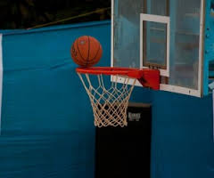
Why?
Rebounds
Field goal percentages
Shooter’s touch
http://www.arabianinsite.com/author/loris81a/

Slide 3
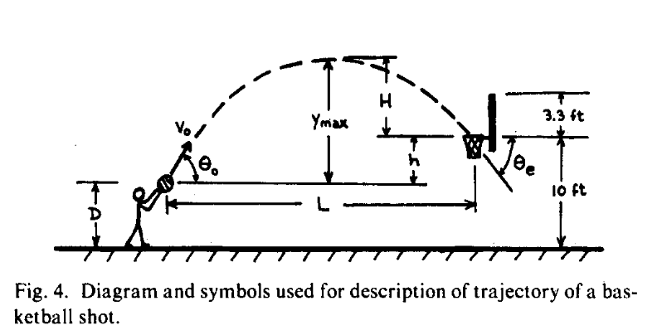
Prior Research – Optimum Shot Angle
49.4 degree angle
Free throw line
(Brancazio et al. 1981)

Slide 4
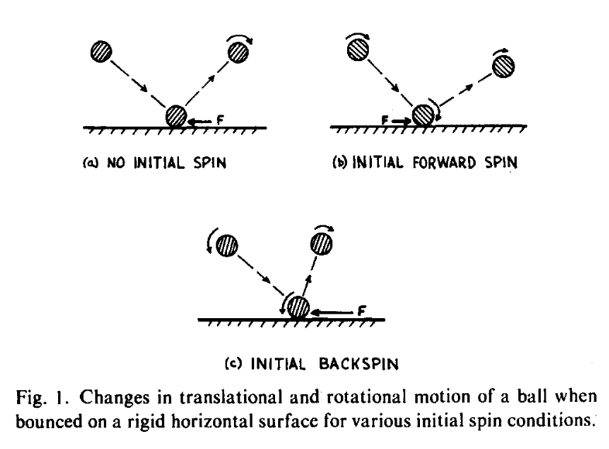
Prior Research – Bounce With Friction
Change in angular frequency
Friction acts in opposite direction
(Brancazio et al. 1981)

Slide 5
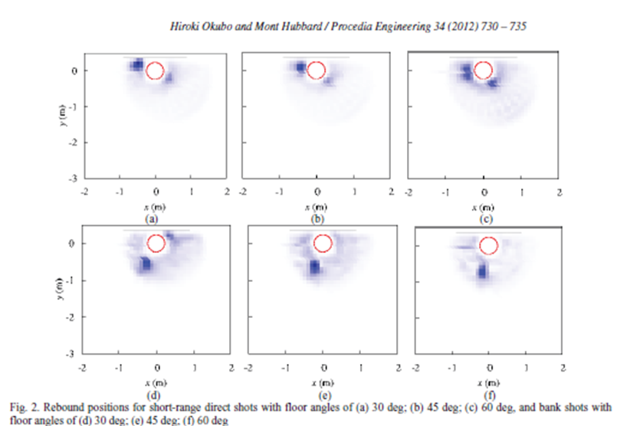
Prior Research – Rebound Position
Rebound from a short-ranged shot
(Okubo et. al. 2012)

Slide 6
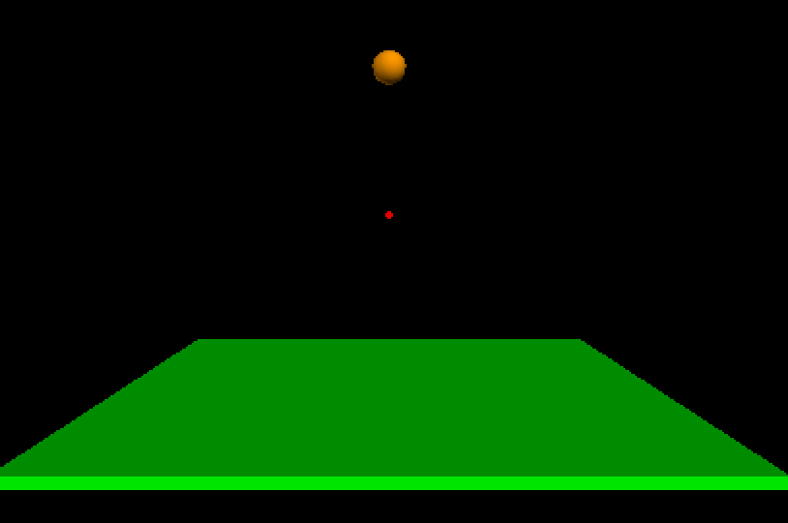
Research Goals
How does a 29.5-inch regulation basketball interact with a rim during a collision?
Final velocity
Angular Frequency
Rebound
Position
Collision point
Angle

Slide 7
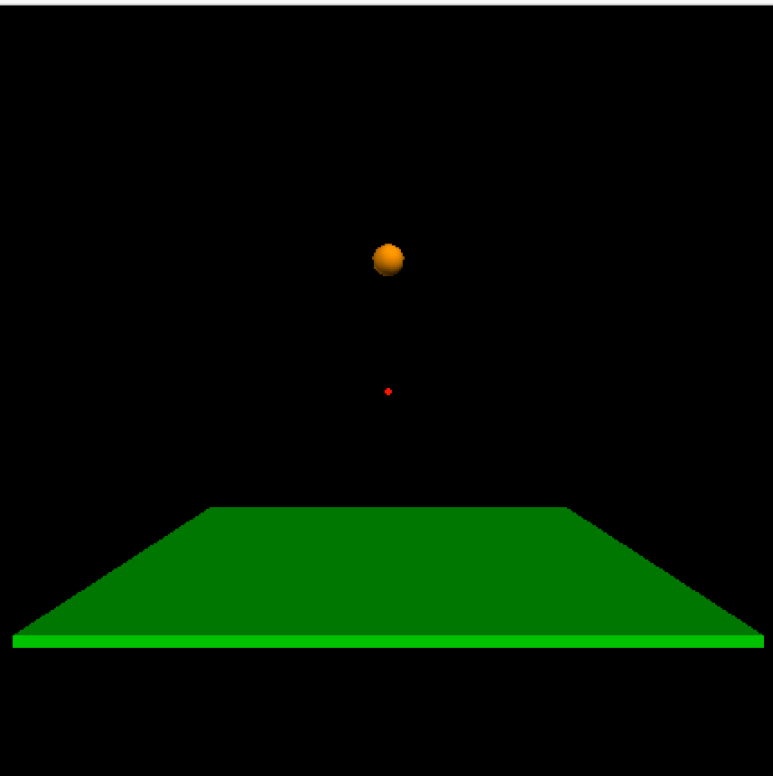

VPython Model Simulation
Drops straight down
Glancing blows
Detects for a collision
Calculates new position and velocity
Prints initial and final momentum

Slide 8
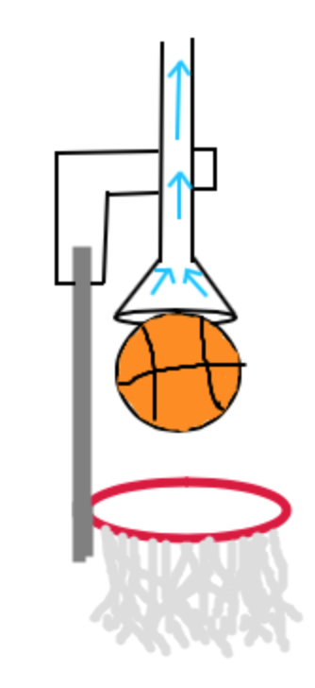
Apparatus
Vacuum
Cut off
Attach to backboard
Directly above rim
Pivot/rotate

Slide 9
Possible Error
Computational data
Gives a perfect situation
Results in a prediction
Experimental data
Gives a range of possibilities
Results in a percent difference
Compiling yields a percent error

Slide 10
Timeline
Nov. 30 VPython modeling
Jan. 20 acquire all materials
Jan. 31 final apparatus constructed
Feb. 17 conduct our experiment
March 18 analyze our data
Experimental and computational

Slide 11
Acknowledgments and Funding
Department of Physics, High Point University
Dr. Aaron Titus
Dr. Martin DeWitt
Dr. Brad Barlow
Dr. Briana Fiser
Department of Physics, High Point University
Dr. Aaron Titus

Slide 12
References
Peter J. Brancazio, "Physics of Basketball," American Journal of Physics 49 (4)(1981).
Okubo, H. and M. Hubbard (2014). “Rebounding Strategies in Basketball.” Procedia Engineering 72: 823-828.

Slide 13
Questions?

