Slide 1
A Physics Model for a Backflip
Joshua Berg, Dr. Aaron Titus and Jon Hatchell

Slide 2

3 Parts of a Backflip
Take Off – $∆$t during the jump while the foot is in contact with the floor
Flight – $∆$t in the air (no contact with the floor)
Landing - $∆$t when contacting the floor after flight, while stopping

Slide 3
Center of Mass Motion
5 Different Center of Masses
Equilibrium
Leaving the floor
In the air
Landing
Equilibrium

Slide 4
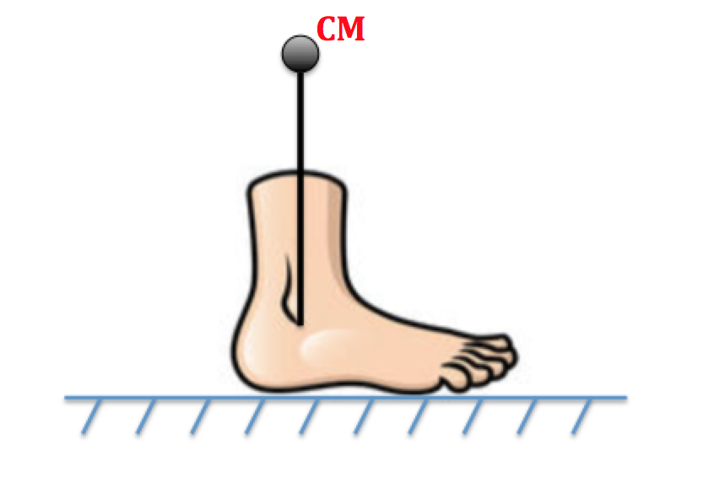
Center of Mass Motion - Equilibrium

Slide 5
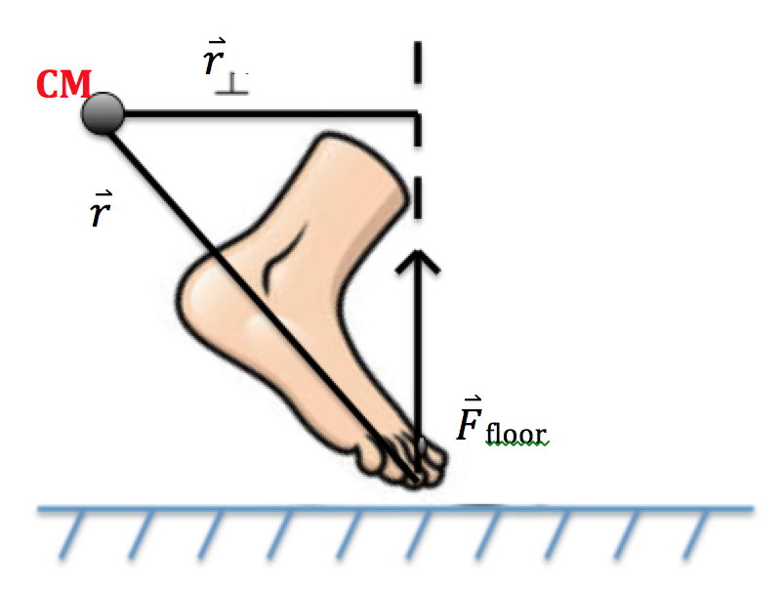
Center of Mass Motion– Take Off

Slide 6
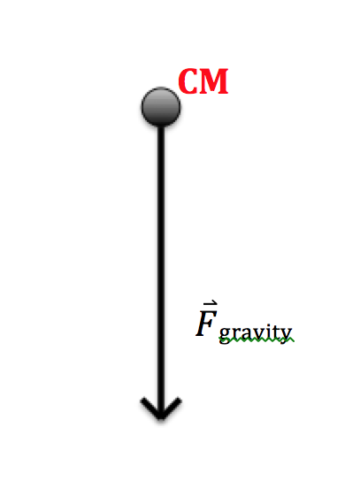
Center of Mass Motion – Flight

Slide 7
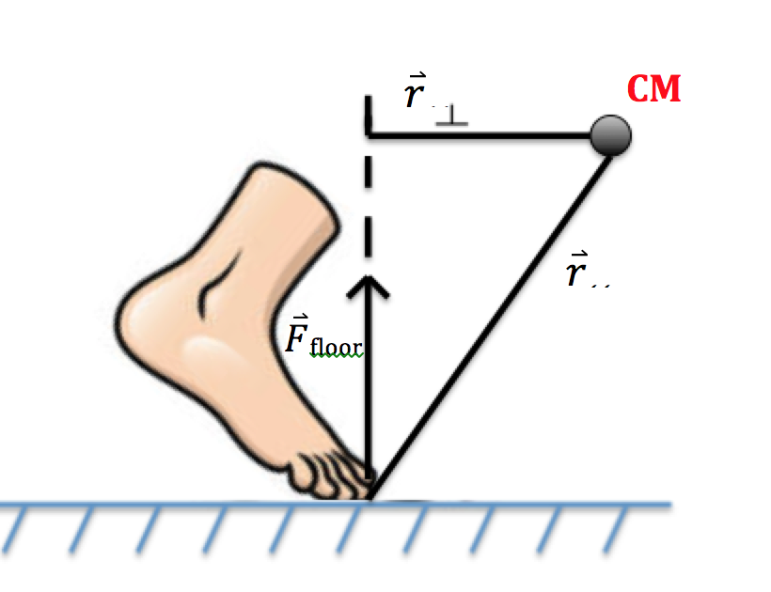
Center of Mass Motion – Landing

Slide 8
Reason take step forward or backward

Slide 9
Dempster’s Body Segment Paramaters
*** Add Scanned Photo(s)

Slide 10
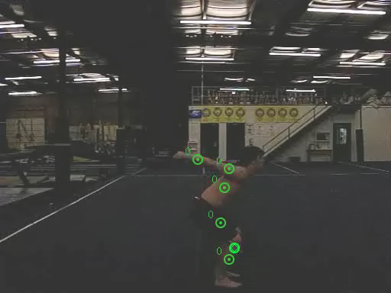

Slide 11
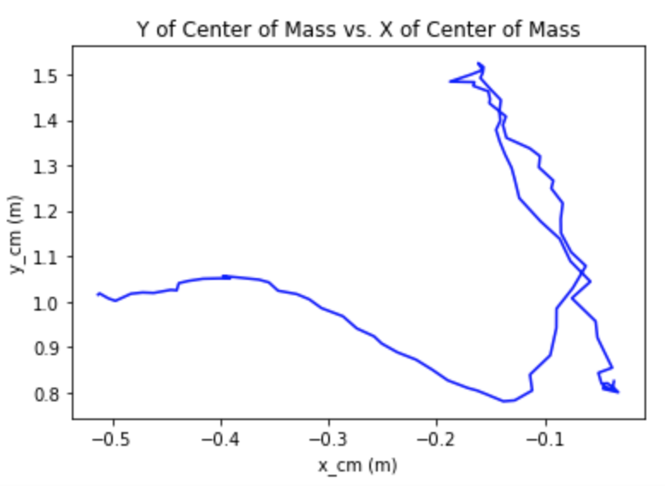
Y(x) of Center of Mass

Slide 12
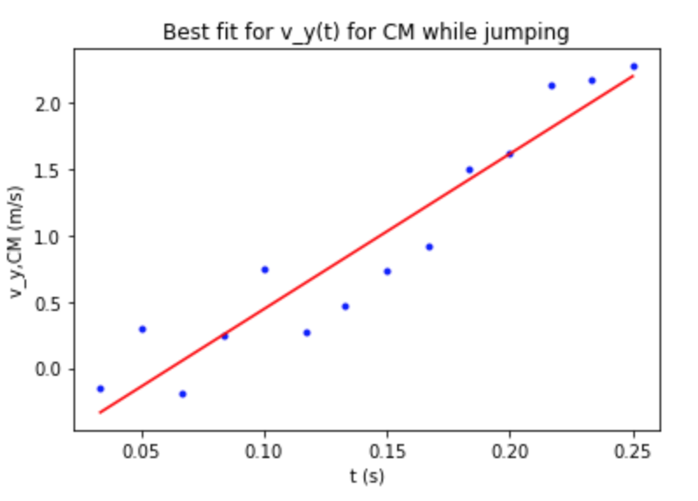
V_{y}(t) During Take Off

Slide 13
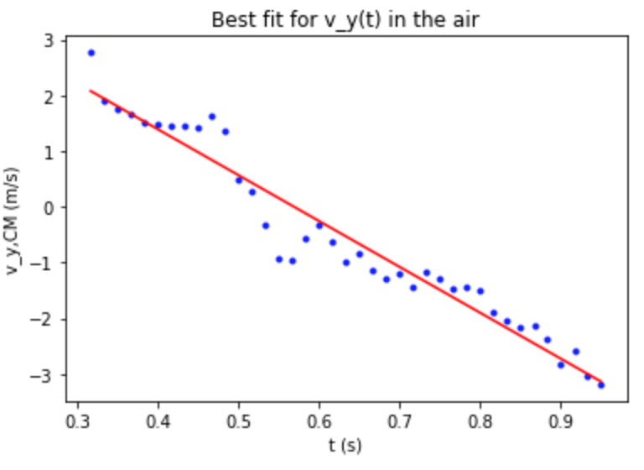
V_{y}(t) During Flight

Slide 14
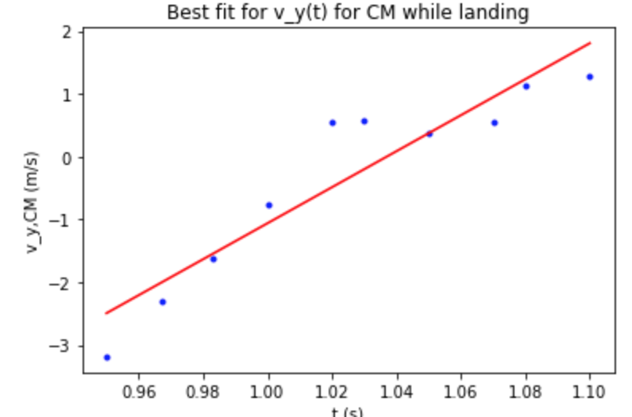
V_{y}(t) During Landing

Slide 15
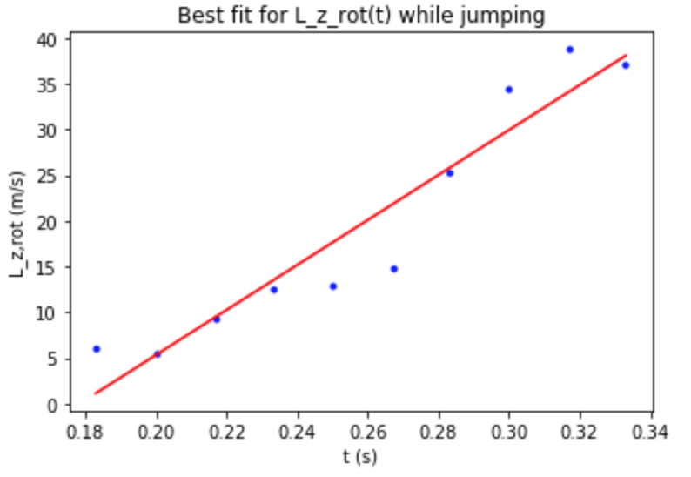
L_{z}(t) During Take Off

Slide 16
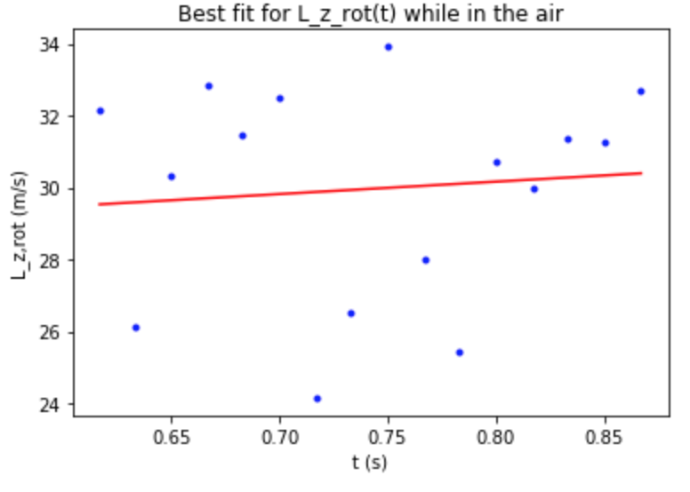
L_{z}(t) During Flight

Slide 18
Acknowledgments
Department of Physics, High Point University
Dr. Aaron Titus

