Slide 1

Quotes Application V.3
Siva R Jasthi
ICS499 Software Engineering and Capstone
Summer 2021
Computer Science and Cyber Security
Metropolitan State University

Slide 2
High Level Goals
To ensure that you all get familiar with the Web Application development, we will be doing minor enhancements and bug fixes to the QUOTES application.
A2, A3 and A4 are all inter-connected.
All assignments depend upon the “quotes” application. (V.2 of the code base is provided to you).
We will be primarily focusing on fixing the issues and making some minor enhancements.
A2, A3 and A4 are all individual assignments.
I will evaluate A2, A3 and A4 together. So, you have the opportunities to catch up.

Slide 3
Sample application (quotes)
Deploy quotes application
Extract the ZIP file and deploy it to htdocs/quotes
Create a db called “quotes_db” and import “quotes/sql/quotes_db.sql” file
2. Launch http://localhost/quotes application
3. If you don’t see the ADMIN option, try http://localhost/quotes/admin.php

Slide 4
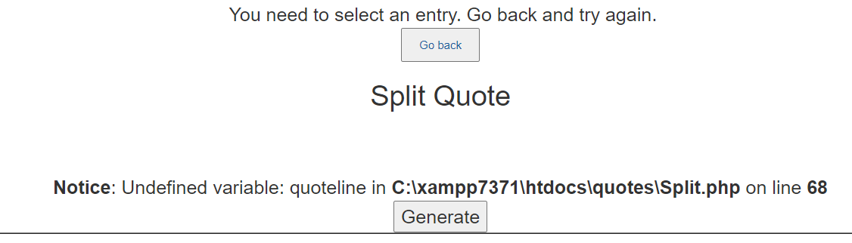
A2, A3 and A4 goals
[Defect #1]
http://localhost/quotes/Split.php
[Defect # 1] When the users try Split quote without selecting an entry, getting a PHP programming message. That shouldn’t be displayed to the users.
This error shall be handled gracefully

Slide 5
A2, A3 and A4 goals
[Defect #2]
http://localhost/quotes/Split.php
[Defect # 2] When the users try Split quote without selecting an entry, users are properly informed that they need to select a quote. And the following message is shown.
However, clicking on “Go back” is giving an error.
That should be fixed. The control shall go back to the List view.
http://localhost/quotes/admin.php

Slide 6
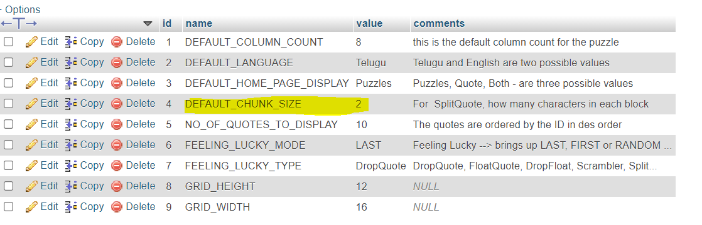
A2, A3 and A4 goals
[Defect #3]
http://localhost/quotes/Split.php
[Defect # 3] DEFAULT_CHUNK_SIZE is a preference which determines how the quote should be split up.
DEFAULT_CHUNK_SIZE should dictate how many characters should be there in each split (box).
But that doesn’t seem to be having any effect.
Ensure that this defect is fixed.
Splitting a quote should honor the DEFAULT_CHUNK_SIZE

Slide 7
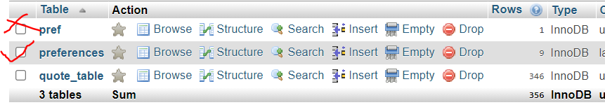
A2, A3 and A4 goals
[Enhancement #4]
http://localhost/quotes/Split.php
[Enhancement #4] Right now, there are two tables dealing with the preferences in the DB schema.
Of these, we should rely only on “preferences”.
“pref” should be deleted completely from the database.
If there are any references to “pref” table in the code, those need to be switched to use “preferences” table.

Slide 8
A2, A3 and A4 goals
[Enhancement #5]
http://localhost/quotes/Split.php
[Enhancement #5] Right now, the split quote preserves all the punctuation marks.
However, the instructor is not sure whether the end-users like it or not.
Do they want the split to happen with the punctuation marks?
OR do they want the split without the punctuation marks?
Perhaps, some users want it with the punctuation marks. And some users want it without the punctuation marks.
To support this variability, we would like to rely on another preference.
KEEP_PUNCTUATION_MARKS = TRUE (will keep the punctuation marks) (default)
KEEP_PUNCTUATION_MARKS = FALSE (will delete the punctuation mark)

Slide 9
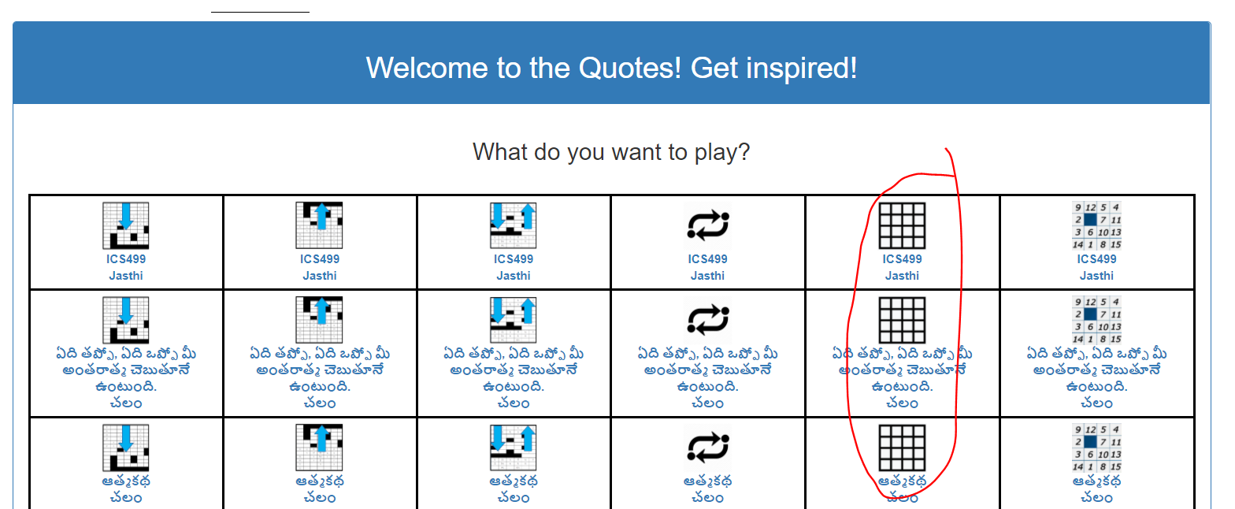
A2, A3 and A4 goals
[Enhancement #6]
http://localhost/quotes/Split.php
[Enhancement #6] Right now, the split quote can not be played.
(Take a look at the DropQuote and ScrambleQuote; They can be played).
Support playing the “SplitQuote”. When the Split quote is clicked on the main home page, the quote is played in the “split” mode.
http://localhost/quotes/feelingLucky/feelingLucky.php?type=splitter&id=403

Slide 10
A2, A3 and A4 Evaluation
 | Requirements | Demo Date Q&A Date | Evaluation
A2 | Defect 1 (PHP Error) Defect 2 (Go Back Button) Defect 3 (CHUNK SIZE) | 5/17/21 | 25 points
A3 | Enhancement 4 (punctuation marks) Enhancement 5 (delete pref table) | 5/24/21 | 25 points
A4 | Enhancement 6 (support play mode) | 6/7/21 | 25 points
Note: [1] The final evaluation will be done after 6/7/21. One month from now! [2] Please ensure that you make incremental progress every week; Show me the demo OR ask me questions if you are stuck. [2] A2, A3 and A4 are solo assignments. You are welcome to discuss the designs the temporary groups / during the in-class working sessions.

Slide 11

Any questions?

Slide 12
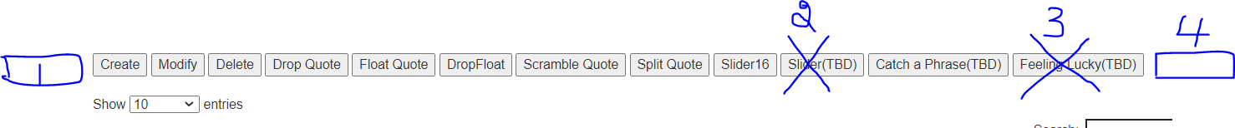
Use Case 1: Admin.php cleanup
1. Add a button called “Import”
2. Remove this button
3. Remove this button.
4. Add a button called “Batch”

Slide 13
Use Case 2: Mass import of quotes
As of now, we can create one quote at a time.
However, we need the ability to do mass import (creating a bunch of quotes) of a CSV file.
Add “Import” button at the beginning of the toolbar.
The “import” button takes a CSV file and imports all the quotes.
If any quote has the same three fields (author, topic, quote), then that quote will be ignored.
Upon successful import, the control comes back to “admin.php” showing the quotes list. And at the top of the page, a success (or failure) message will be shown.

Slide 14
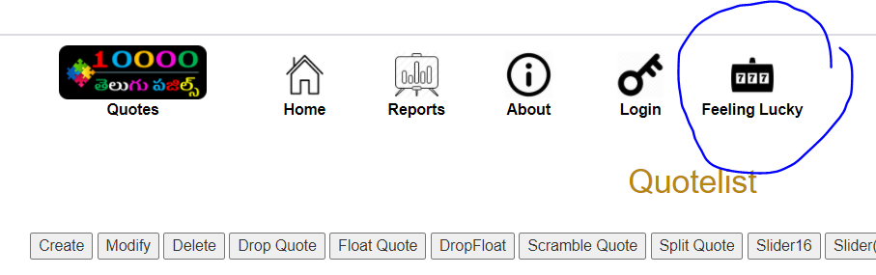
Use Case 3: Feeling Lucky
Feeling Lucky
Works on the last quote added.
Works on predefined preferences

Slide 15
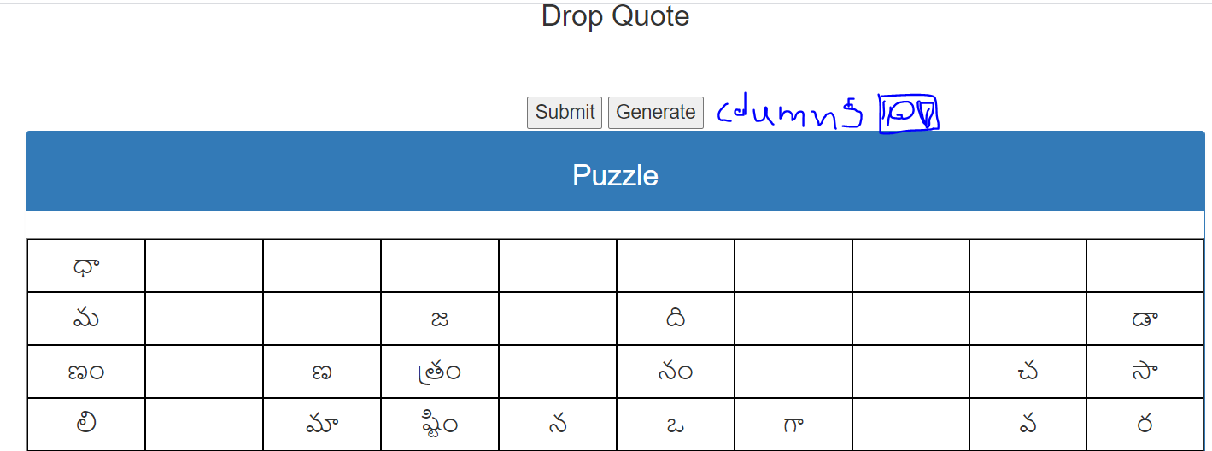
Use Case 4: Drop Quote:
Rely on the preference for default number of columns and empower the admin to change the same on the fly.
Drop Quote when first generated should rely on the preference (length of grid = number of the columns)
However, the admin shall be able to change the length on the fly. And the puzzle will be regenerated. The admin will click “Generate” button to regenerate the puzzle after changing the number of columns

Slide 16
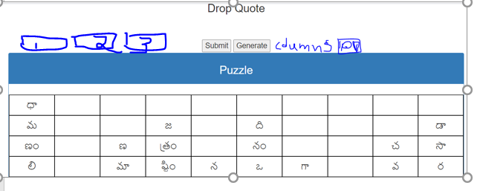
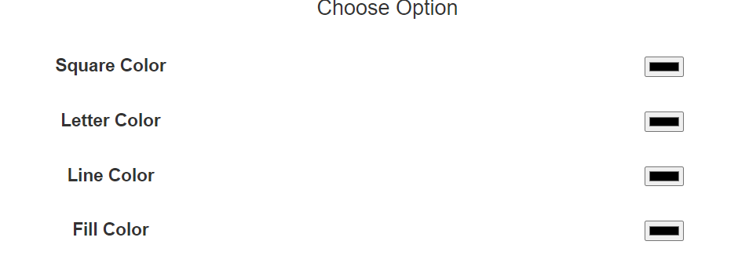
Use Case 5: Drop Quote
Enable the color presents (3 combinations) for each game
Provide some color presets for each of the quotes so that puzzles can be generated with different color backgrounds.
Admin can still change / choose different color options as needed.
(These 3 presets will come preferences)
And the admins can also change the colors on the fly.

Slide 17
Use Case 6: Drop Quote
Preference KEEP_PUNCTUATION_MARKS should come into picture
Whether to honor the punctuation marks or remove those from the quote shall be dictated by the preference
KEEP_PUNCTUATION_MARKS
Drop Quote puzzle generation should rely on KEEP_PUNCTUATION_MARKS preference.

Slide 18
Use Case 7: Drop Quote
It is not required to PLAY the game during the puzzle creation by admin
It is not required to support “PLAY” when admin is creating the puzzles.
The puzzles are PLAYED only from HOME Page or from “FEELING LUCKY” button.
.

Slide 19
Use Case 8: Consistency
The use cases 4 to 7are applicable for all the games.
Use case 4:Rely on the preference for default number of columns and empower the admin to change the same on the fly.
Use case 5:Enable the color presents (3 combinations) for each game
Use Case 6:Preference KEEP_PUNCTUATION_MARKS should come into picture
Use Case 7:It is not required to PLAY the game during the puzzle creation by admin
Make sure that these are supported in each of these games
Drop Quote
Float Quote
Drop N Float
Splitter
Scrambler
Slider16
Catch A Phrase

Slide 20
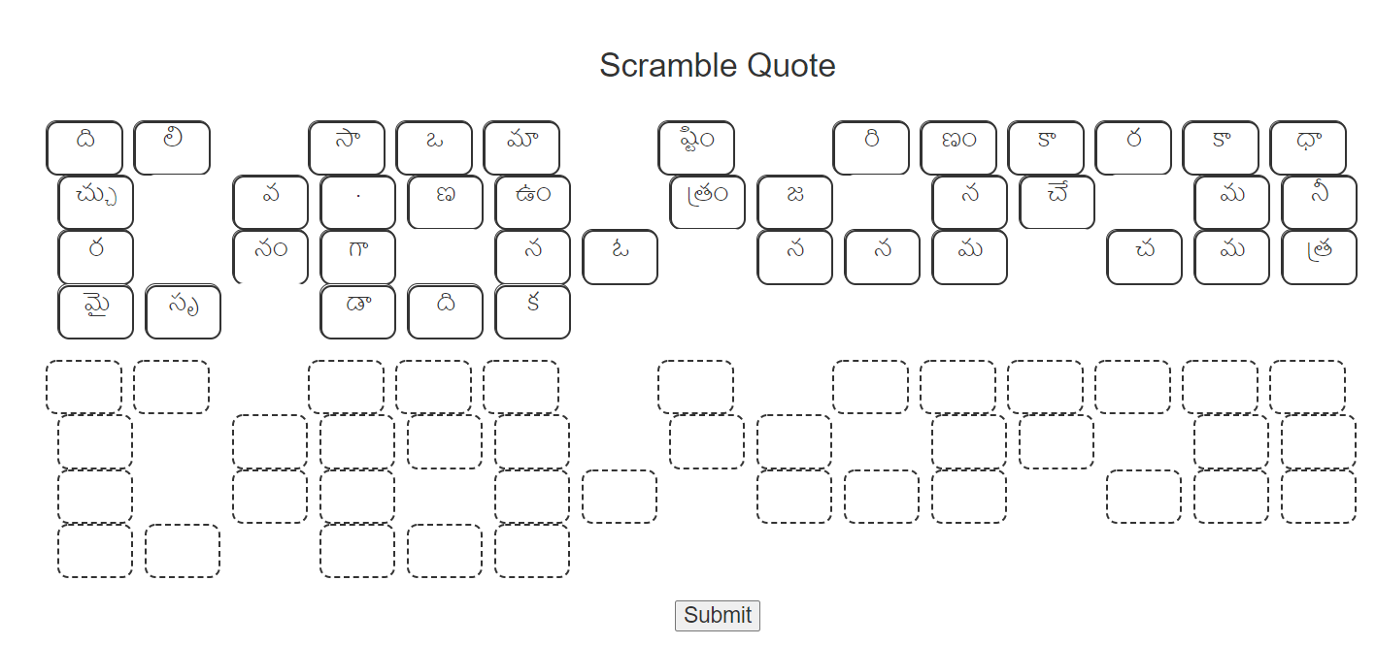
Use Case 9: Scramble Quote
Introduce the color selections, color presets, column length
To this page.

Slide 21
Use Case 10: Scramble Quote
Introduce the color selections, color presets, column length
To this page.

Slide 22
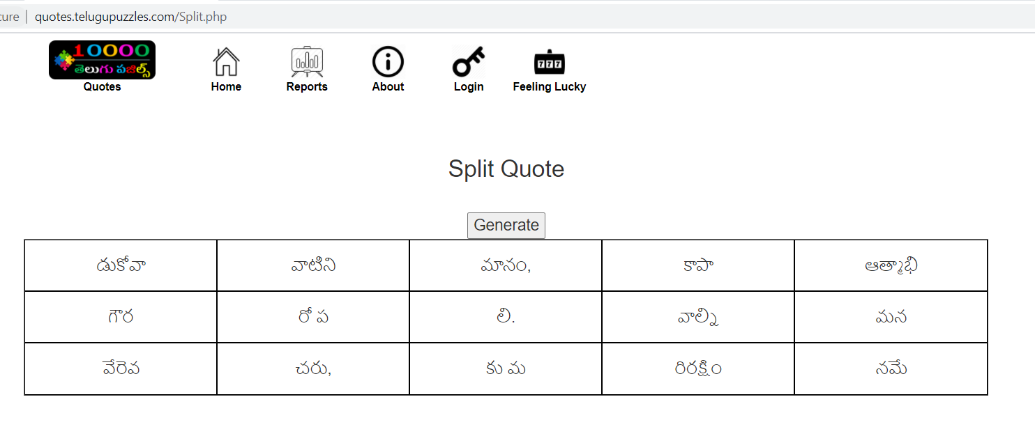
Use Case 10: Split Quote
Introduce the color selections, color presets, column length
To this page.

Slide 23
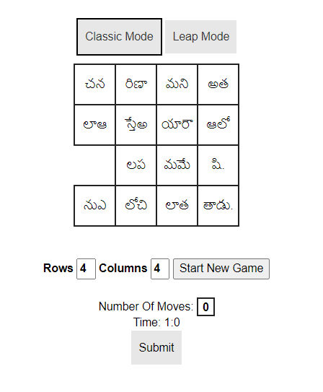
Use Case 11: Slider16
Puzzle generation is good.
Just support the color selections and preset.
And in the play mode (from HOME page), we need to support tracking the time and number of moves.

Slide 24
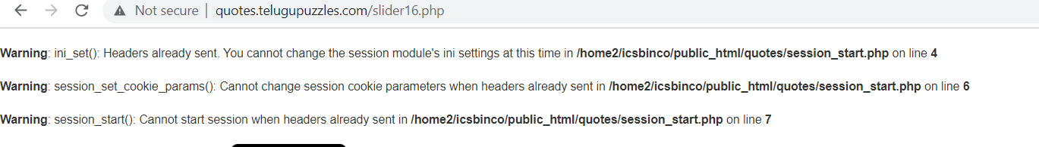
Use Case 12: Slider16
Slider16 is giving these errors. This is a bug

Slide 25
Use Case 13: Catch a Phrase
Puzzle generation is good.
Nothing to do here.

Slide 26
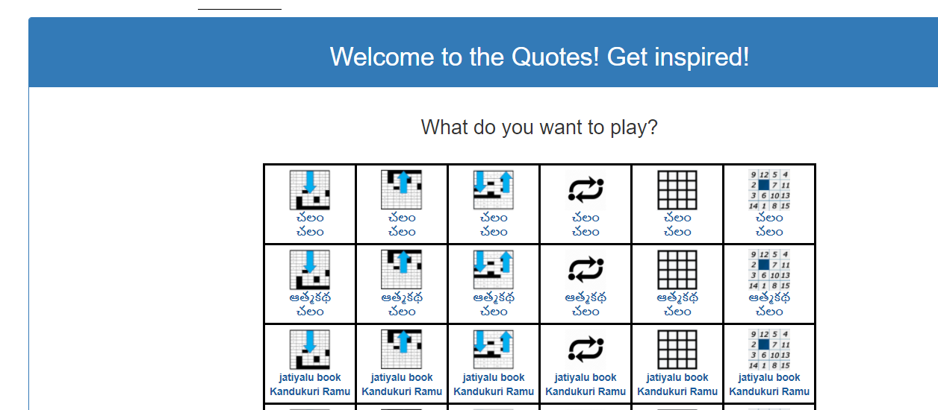
Use Case 14: Home Page
All games are dynamically generated for the users/visitors to play.
Each game relies on a predefined preference

Slide 27
Use Case 15: Support for “Batch” generation
Once the user clicks Batch, the form shows two field.
Which game you want to generate? [ ] (Pulldown list of games)
What is the starting quote ID: [ ]
What is the ending quote ID: [ ]
Then the system generates the selected puzzle for all the quotes in one go. All the puzzles are shown in one single HTML page. This can be printed into PDF using browser print functionality.

Slide 28
Use Case 16: Code Cleanup, Refactoring
Remove any unwanted, unnecessary files.
Refactor the code for readability and maintainability.

Slide 29
Use Case 17-20: TBD

Slide 30
Any questions?

