Slide 1
CIS 612 Final Project
Joe berkheiser

Slide 2
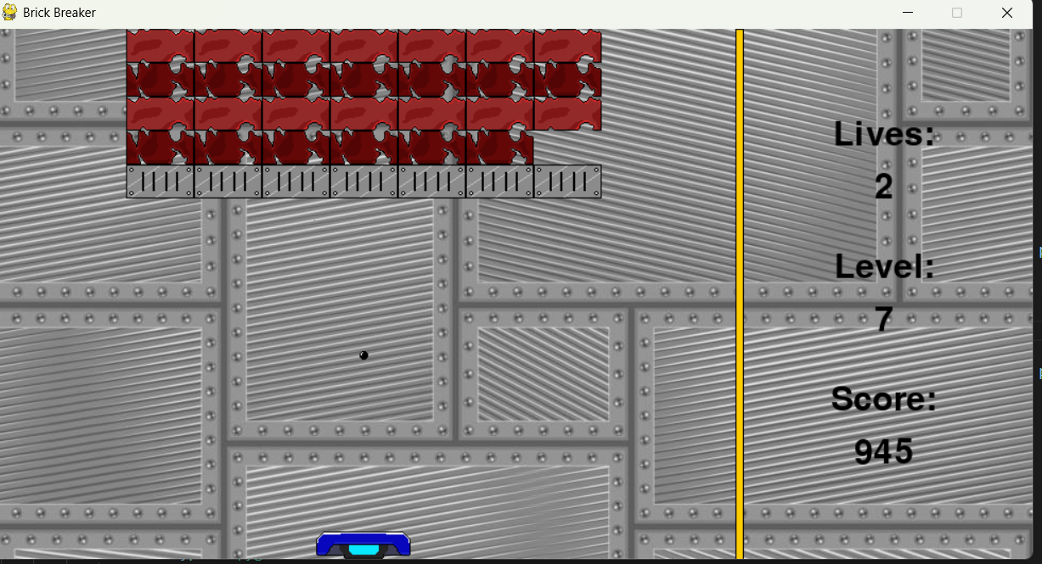
Brick Breaker
Contains:
Real time score, level, and life tracking
10 levels of incrementing difficulty
Controllable platform
Three types of bricks to break
Hand-designed models

Slide 3
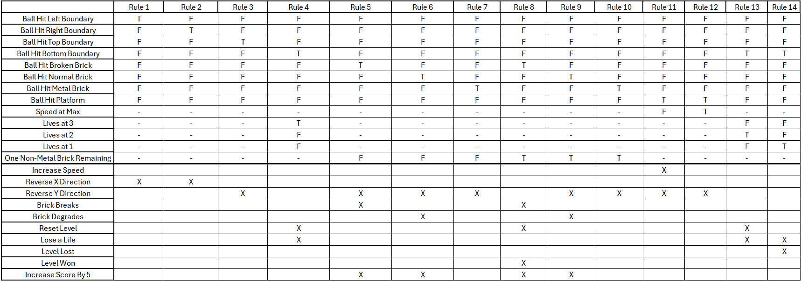
High-level Decision Table

Slide 4
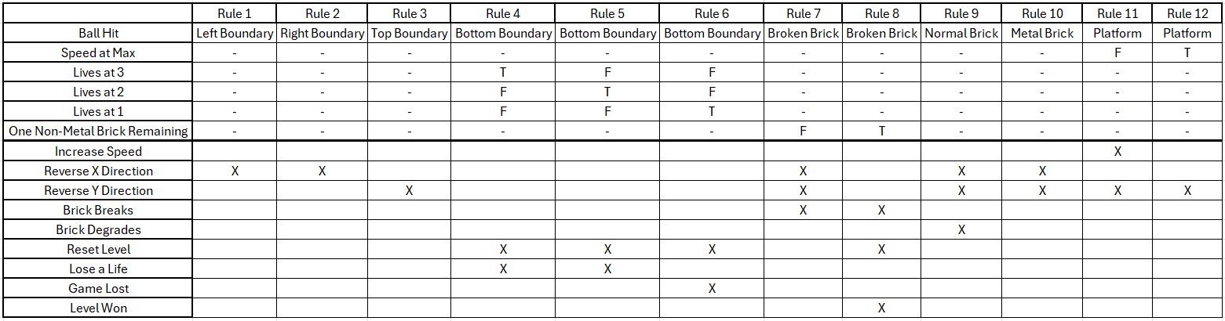
Semi Condensed Decision Table

Slide 5
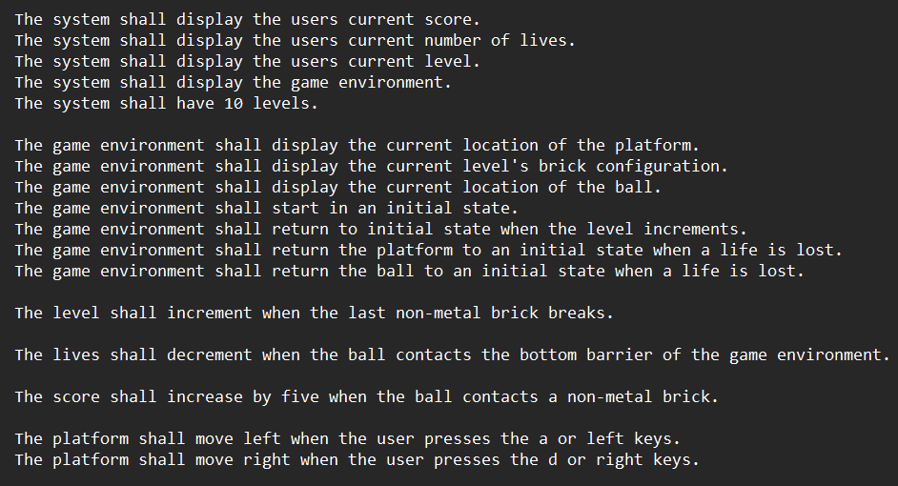
High-Level Natural Language Requirements

Slide 6
Why didn’t I use …
Petri Nets? This would be far too confusing very quickly
all Natural Language Requirements? There would be many with very specific instances
State Charts? There isn’t really any “state” for this project (Game over, won, playing) and what would transitions be?
Finite State Machines? There isn’t really any “state” for this project (Game over, won, playing)
Goal Modeling? The goal is to win the game, that’s on the player not the system. The system has no goal.
Use-Case Diagram? This could be done but would be super high-level and mostly useless

Slide 7
Questions?

