Slide 1


Team 5 Slack + Trello
BY
Lois Grimstead – 16095103
Gerallt hayes – 16095065
Georgio Zeilaa – 17014182
Katie Clark - 15066762

Slide 2
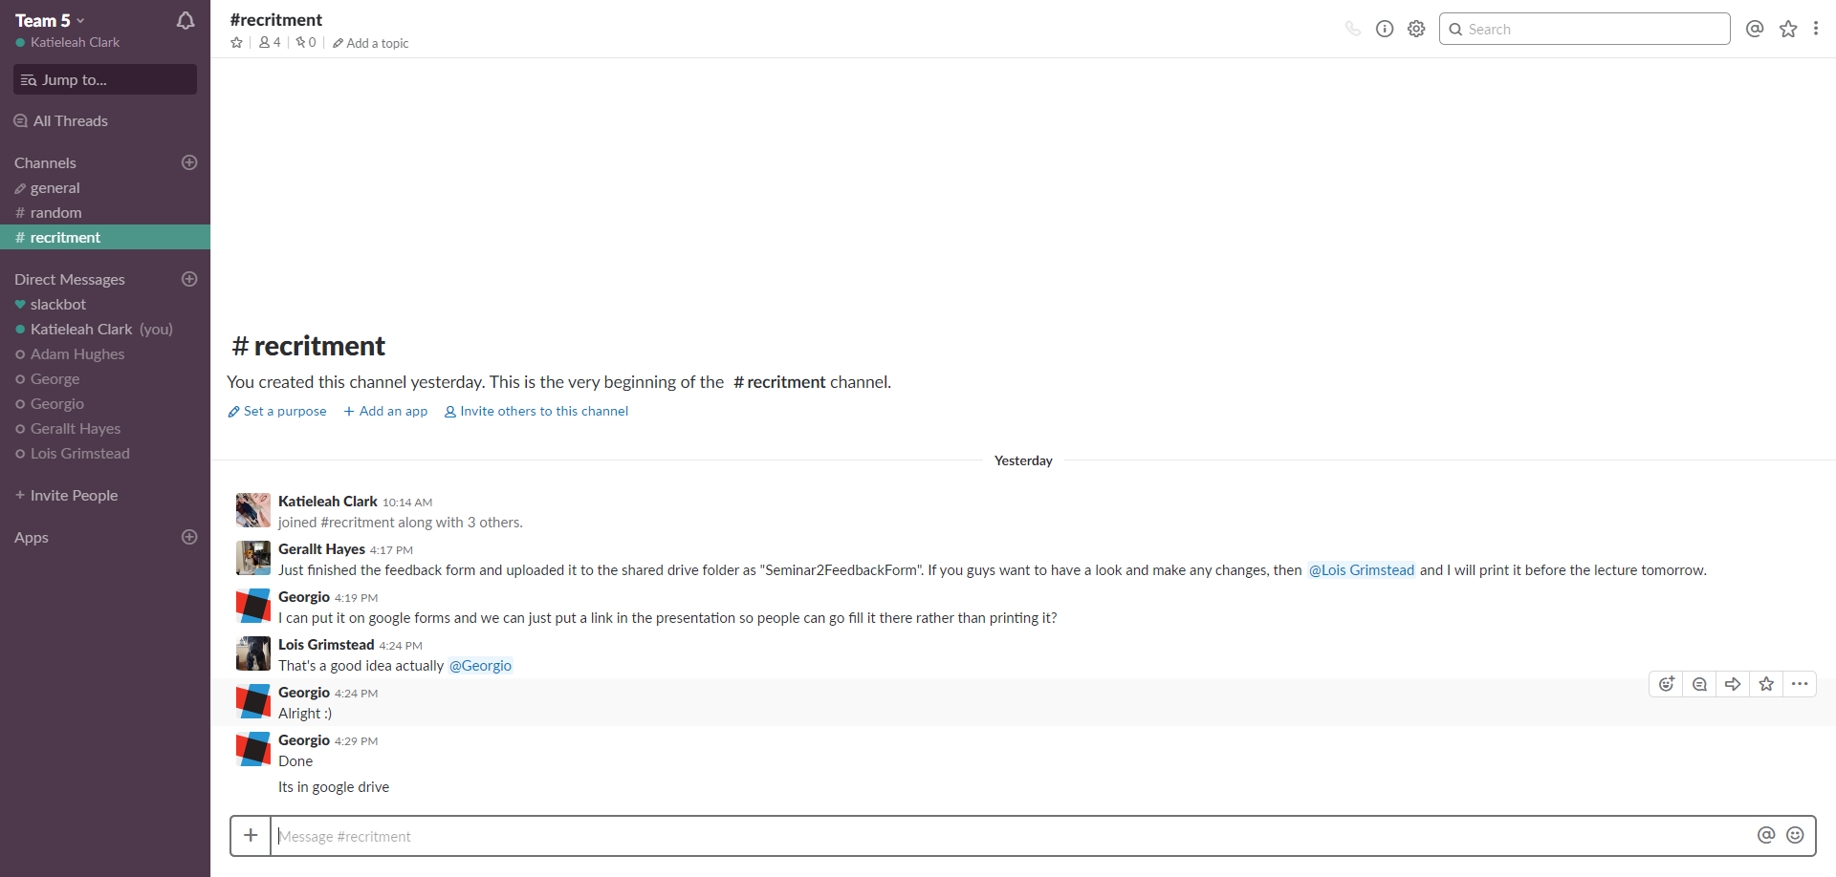
Slack: Functions
Slack is a community open source, chat platform that is popular with developers, where add-ons can be built for more functionality.
There are many uses for slack within a group/team.
We will go over all of these functions on the next slide
Channel Settings
Channel Details
Activity
Starred items
All Channels
More items
All slack members that you can directly message.
Channel Search
This is the message box where many functions can be used.
Attach

Slide 3
Slack: Functions Explanation
All Channels: These are your different chat groups. The general group is created instantly after creating the workspace, and the random group is for chat that isn’t work related.
Direct Message: Where you can see all the team members and choose any of them to direct message.
Message Box: The main function of the workspace. Here you can add, remove, invite or even mute by using backslash.
Attach: Where you can attach code or text, add a file from your computer or post.
Channel Details: Where you can see all the information about your channel such as your attached files, team members and any pinned items.
Channel Settings: Where you can change simple settings such as adding or leaving a chat, mute it or change additional settings.
Activity: Where you can see group mentions and reactions within your channels.
Starred Items: Where you can see all the items you want to keep available and easy to access at all times.
More Items: Where you can find all of your files, channel directory and help if needed.
Channel Search: Where you can search the entire workspace for specific messages or files.

Slide 4

Trello

Slide 5
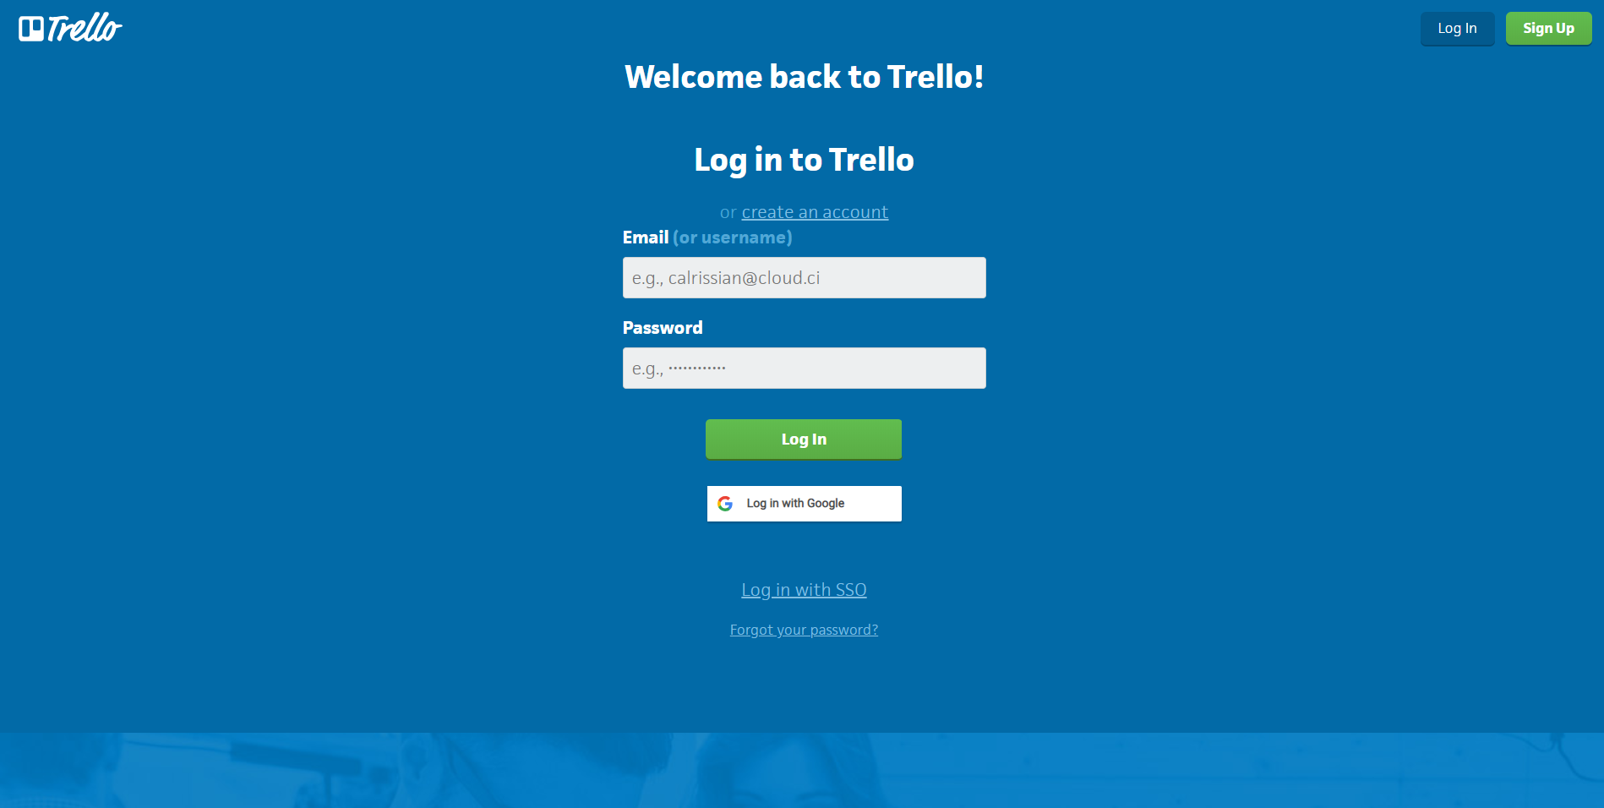
Login Page
First time users, click “Sign Up”, follow the instructions to create your account.
Returning users, input your email and password, then click “Log In”.

Slide 6
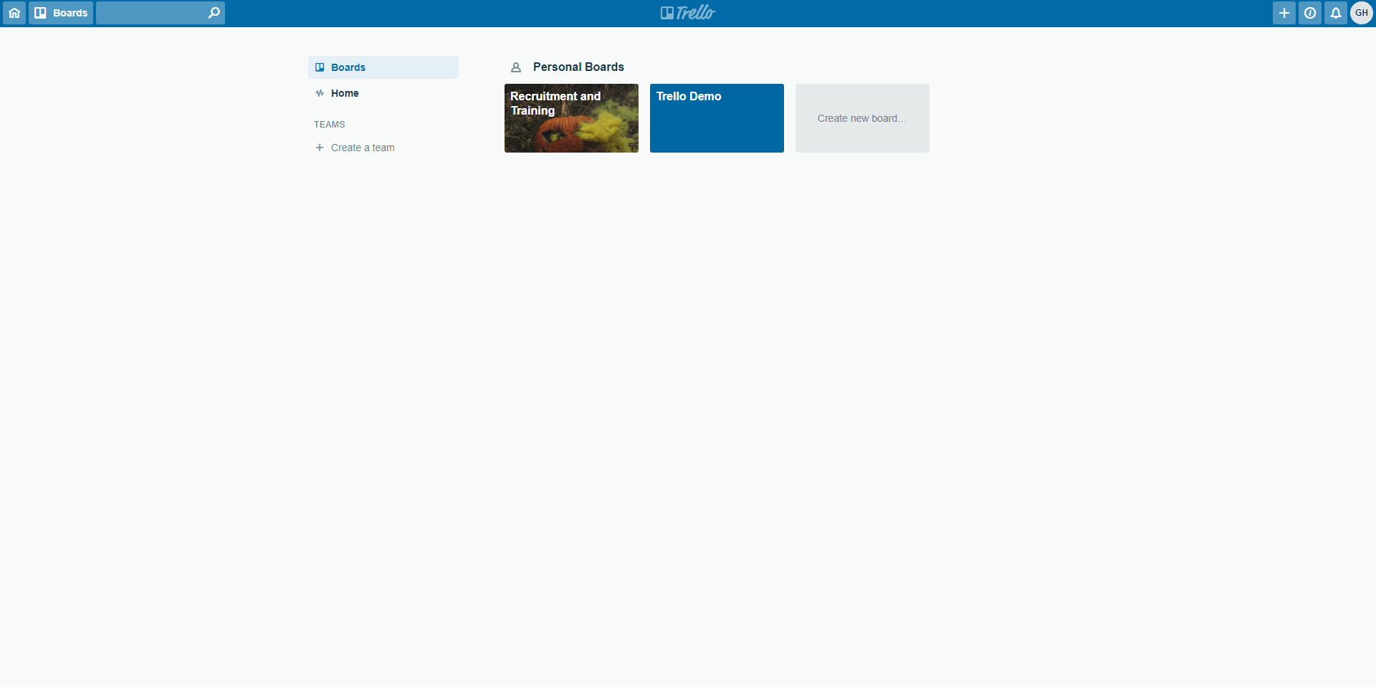
Home Page
Create a new board:
You can create multiple boards and allow different users to work on different boards.
Create a team:
Creating a team allows you to separate users into teams, you can then give teams different permissions (Read, edit, etc.) for boards.

Slide 7
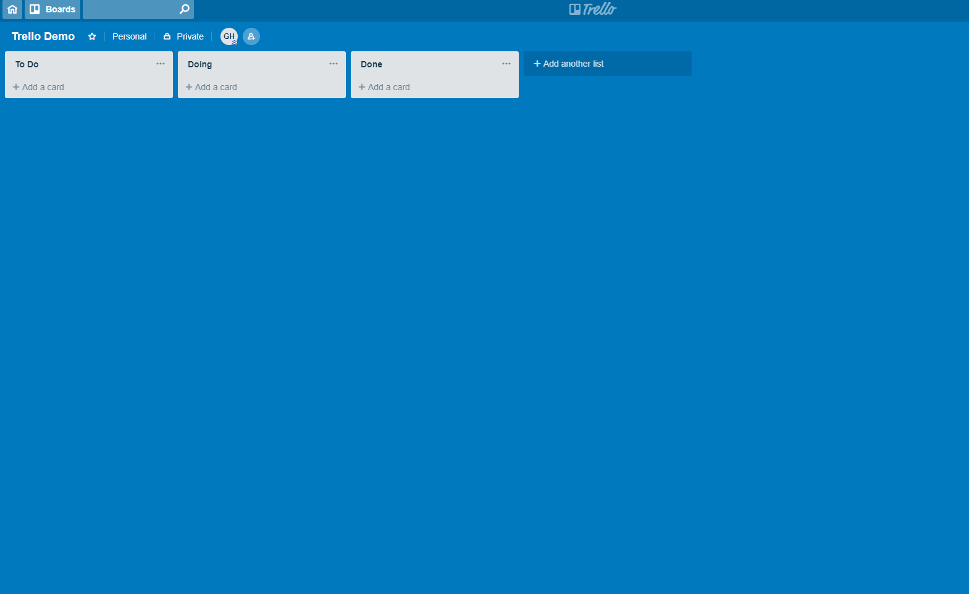
Board Page
Here is the default board page.
From here you can personalise (Background, colours, fonts, etc.)

Slide 8
Adding Users
Click the “Add User” icon

Slide 9
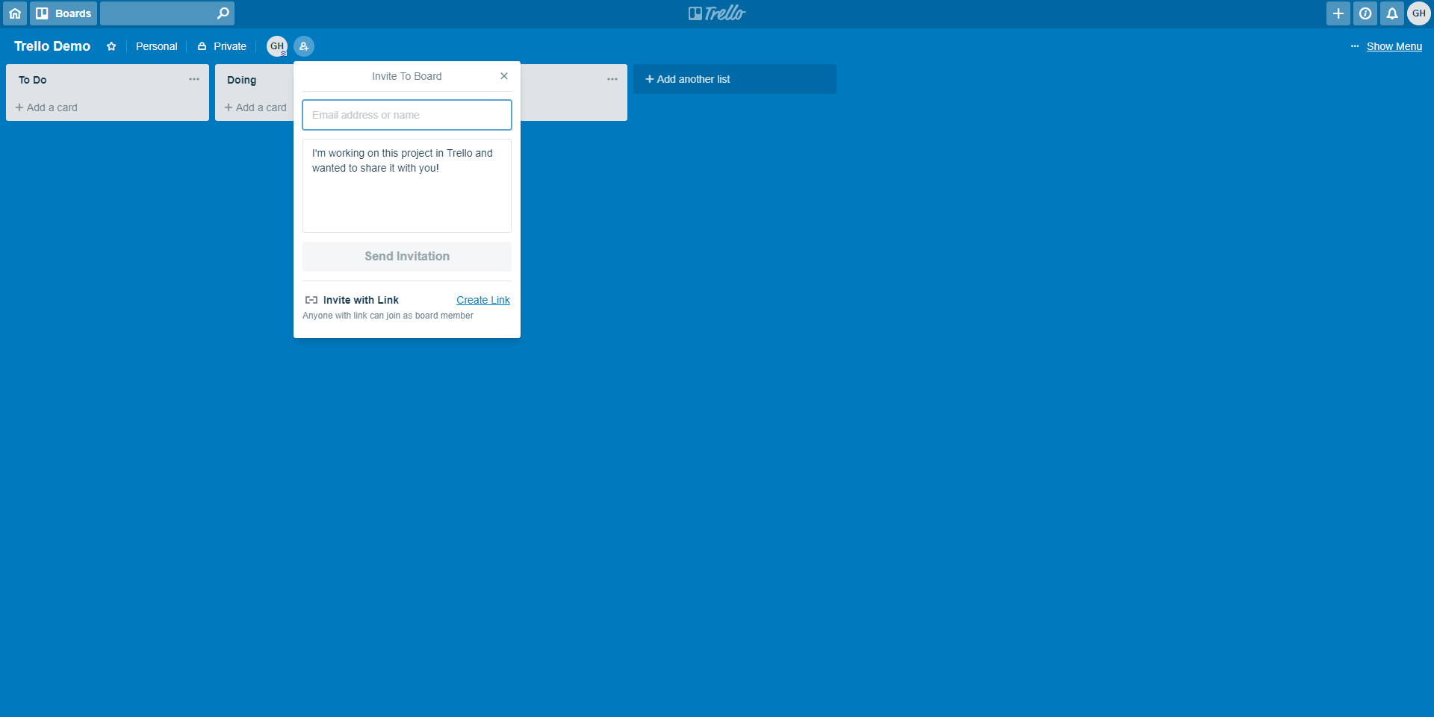
Adding Users
-Input user’s email address
-Personalise the message
-Send Invitation
Alternatively,
Click “Create Link”, copy the link, share on Slack.

Slide 10
Setting Permissions
Set to “Private” by default. Can switch between “Private”, “Team”, or “Public”.

Slide 11
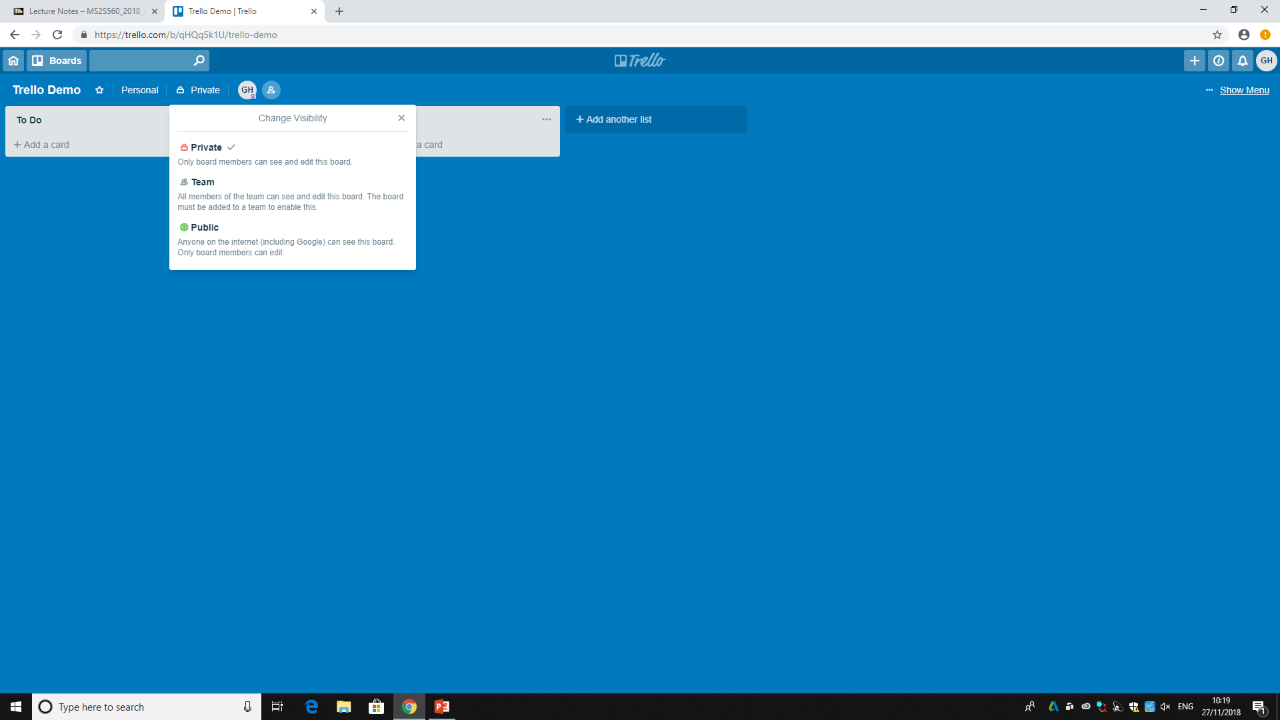
Setting Permissions
-Private: Only added members can see and edit
-Team: Only team members an see and edit
-Public: Anyone can see, only members can edit

Slide 12
Adding Tasks
Click “Add a card” in the appropriate category

Slide 13
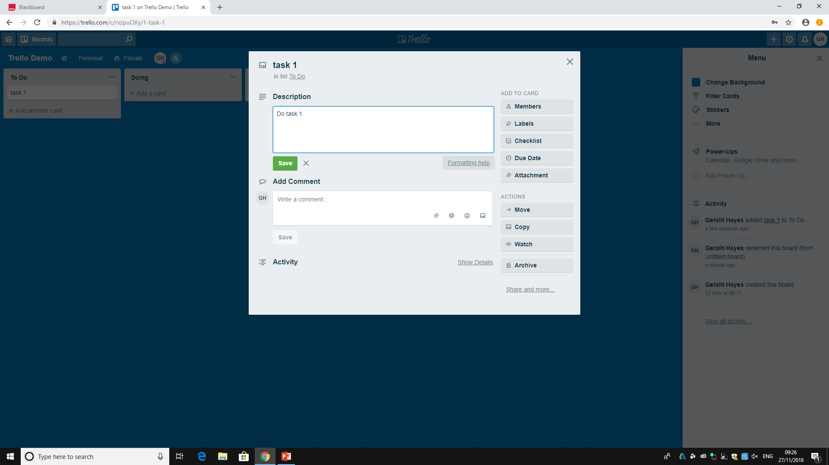
Adding Tasks
To create a task you must choose a name for it.
You can then enter a description so other members can see what must be done.
Here are the useful features we’ll go over in the next slide.

Slide 14
Useful Task Features
Members: You can add members to certain tasks, so you know who is meant to be working on each task.
Checklist: If there are multiple parts to a task, you can add a checklist to ensure that all parts of the task are completed.
Due Date: You can add due dates to tasks to ensure that a schedule is being followed. The tasks are colour coded, and change as the deadline gets closer (Green > Yellow > Red). After the task is complete you can mark it as finished.
Attachment: If there is a guideline or a file required for a task, you can add it as an attachment to the task card so there is no need to locate it elsewhere.

Slide 15


Any Questions?
Feedback Form - https://goo.gl/forms/nlJYiWOCb4Bwjhfm1

