Slide 1
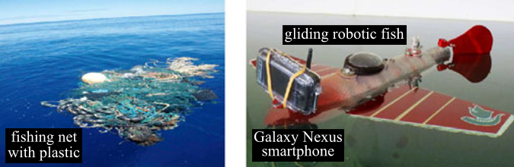
Monitoring Aquatic Debris Using
Smartphone-Based Robots

Slide 2
INDEX:
Introduction
SOAR (SmartphOne-base Aquatic Robot)
Weakness
Improvements
Relation to our Project

Slide 3
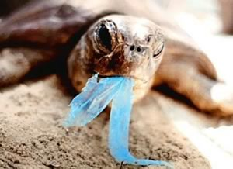
INTRODUCTION
Ecological Problem

Slide 4
Related Work

Slide 5
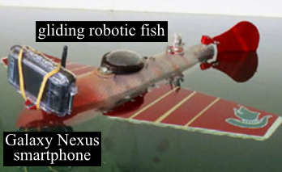
Proposed Solution
low-cost aquatic mobile platform with high maneuverability in rotation and orientation
maintenance

