Slide 1
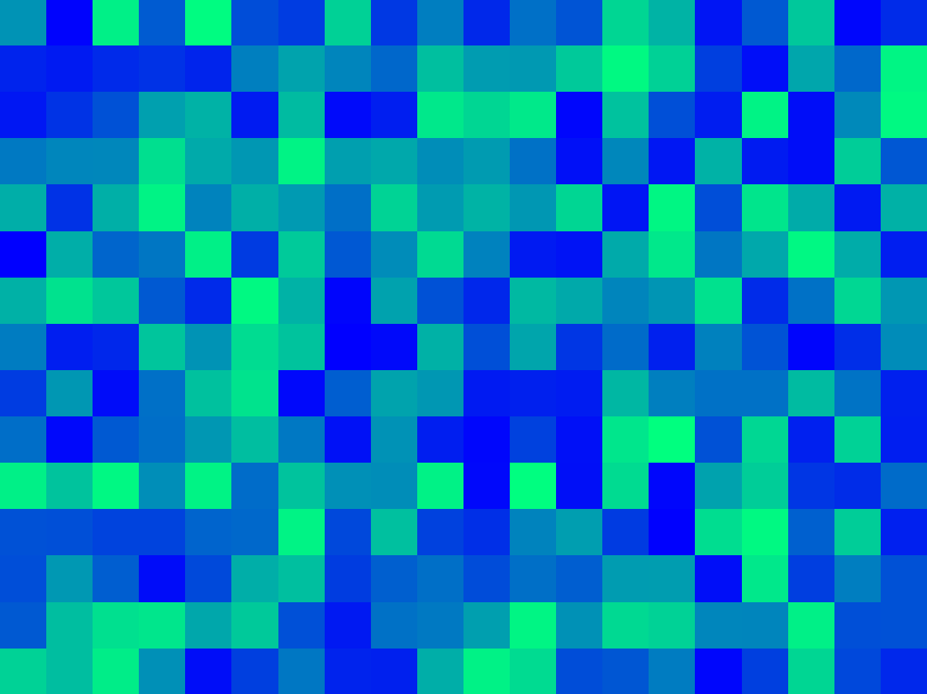

















$$1m$$
variance ($γ$)
z($u_{α1}$)
z($u_{α1}+1m$)
sill ($σ^{2}$)
$$1m$$
$$1m$$
1$m$
nugget ($c_{0}$)
z($u_{α4}$)
z($u_{α4}+1m$)
z($u_{α2}$)
z($u_{α2}+1m$)
$$1m$$
range ($a$)
z($u_{α3}$)
z($u_{α3}+1m$)
lag distance (h)

Slide 2
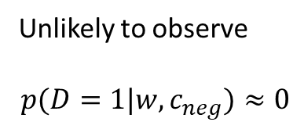
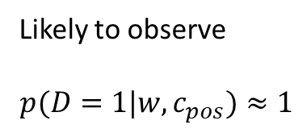
Binomial Classification
(regression, logistic)
(regression, zebra)
(regression, machine)
(regression, pimples)
(regression, sigmoid)
VS
(regression, Gangnam-Style)
(regression, supervised)
(regression, toothpaste)
(regression, neural)
(regression, idiot)
Likely to observe
$$p(D=1|w,c_{pos})≈1$$
Unlikely to observe
$$p(D=1|w,c_{neg})≈0$$

Slide 3
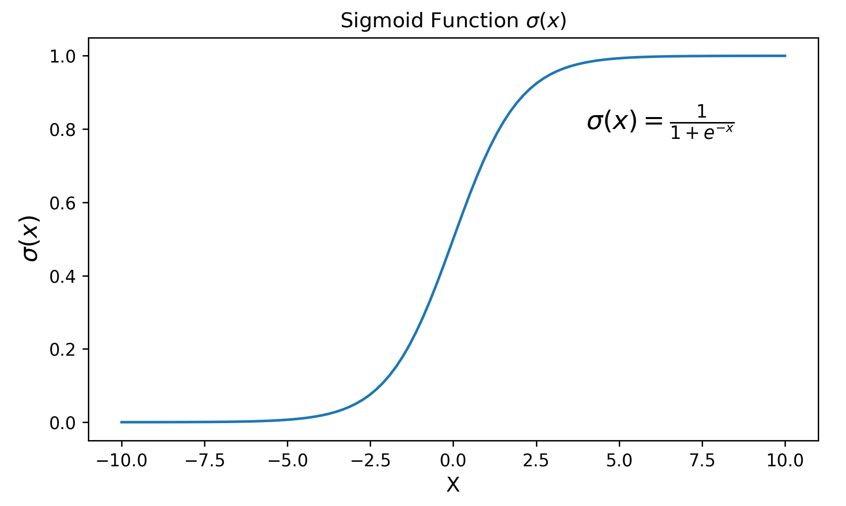
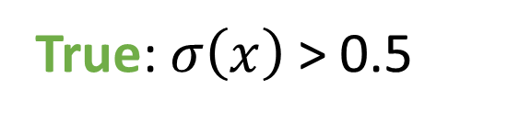
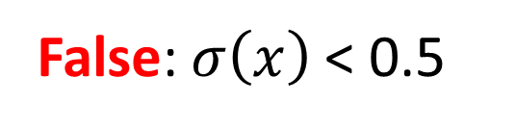
True: $σ\left(x\right)$ > 0.5
False: $σ\left(x\right)$ < 0.5
aegis4048.github.io

Slide 4
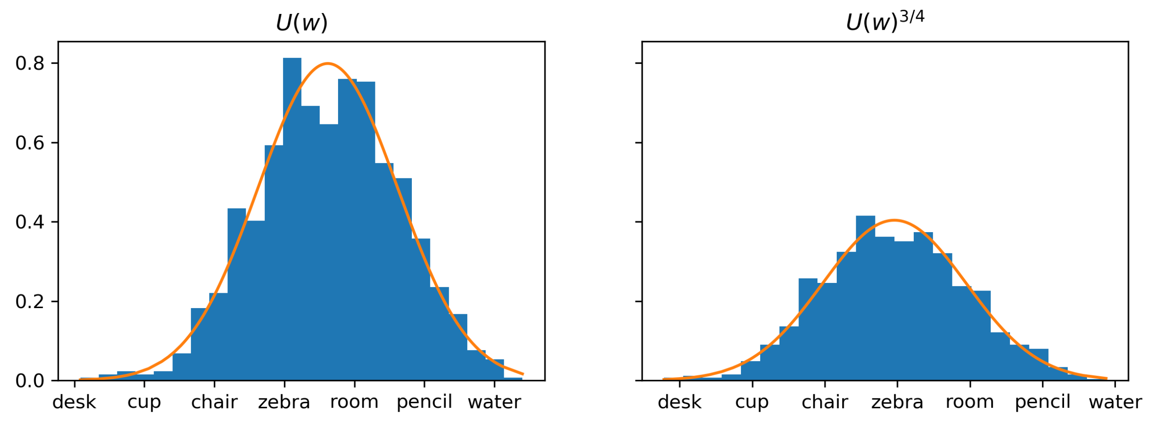
aegis4048.github.io
aegis4048.github.io

Slide 5



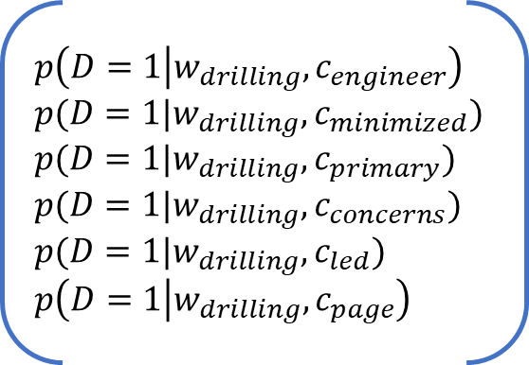






Center word: drilling
$$K=5$$
$$iter=1$$
$$iter=2$$
$$iter=3$$
$$iter=4$$
Current context word: engineer
$$p\left(D=1 | w_{drilling},c_{engineer}\right)$$
$$p(D=1|w_{drilling},c_{minimized})$$
$$p(D=1|w_{drilling},c_{primary})$$
$$p(D=1|w_{drilling},c_{concerns})$$
$$p(D=1|w_{drilling},c_{led})$$
$$p\left(D=1 | w_{drilling},c_{page}\right)$$
0.432
0.312
0.565
0.102
0.853
0.642
0.653
0.169
0.221
0.043
0.532
0.380
0.853
0.042
0.083
0.009
0.115
0.101
0.998
0.000
0.001
0.000
0.001
0.002
engineer
minimized
Update $θ$
Update $θ$
Update $θ$
primary
$$=$$
concerns
led
aegis4048.github.io
aegis4048.github.io
aegis4048.github.io
page

Slide 6
Drilling fluids serve to balance formation pressures while drilling to ensure wellbore stability. They also carry cuttings to the surface and cool the bit. The drilling engineer traditionally designs drilling fluids with two primary goals in mind:
To ensure safe, stable boreholes, which is accomplished by operating within an acceptable mud-weight window
To achieve high rates of penetration so that rig time and well cost can be minimized
These primary considerations do not include well productivity concerns. A growing recognition of the importance of drilling-induced formation damage has led to the use of drill-in fluids (fluids used to drill through the pay zone) that minimize formation damage. This page discusses the formation damage that may be associated with various types of drilling fluids.
current context word
aegis4048.github.io
aegis4048.github.io

Slide 7
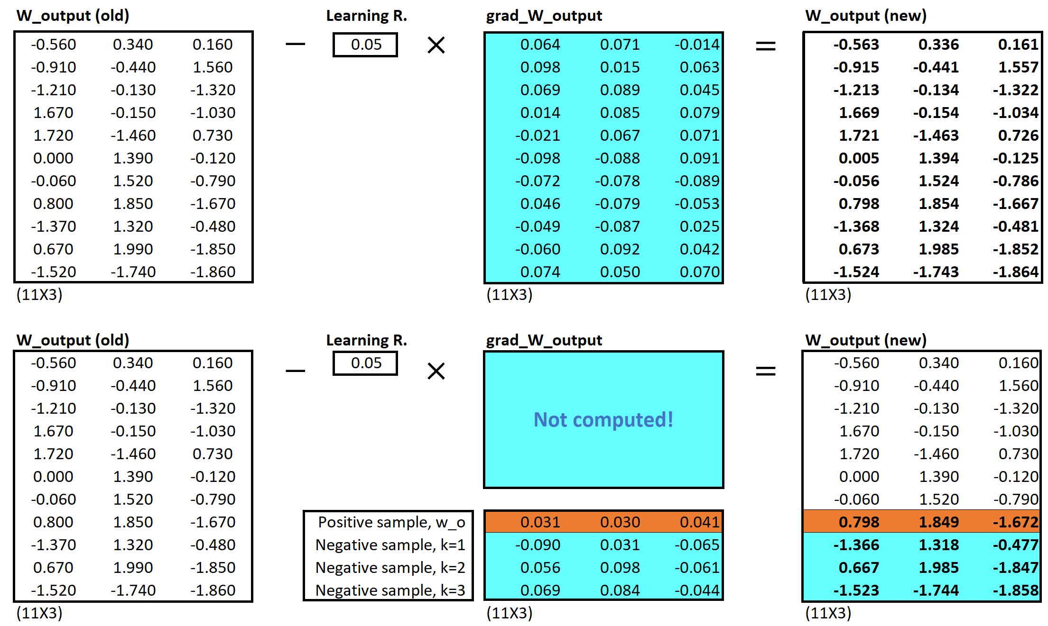
Vanilla Skip-Gram
aegis4048.github.io
aegis4048.github.io
Negative Sampling
aegis4048.github.io
aegis4048.github.io

Slide 8
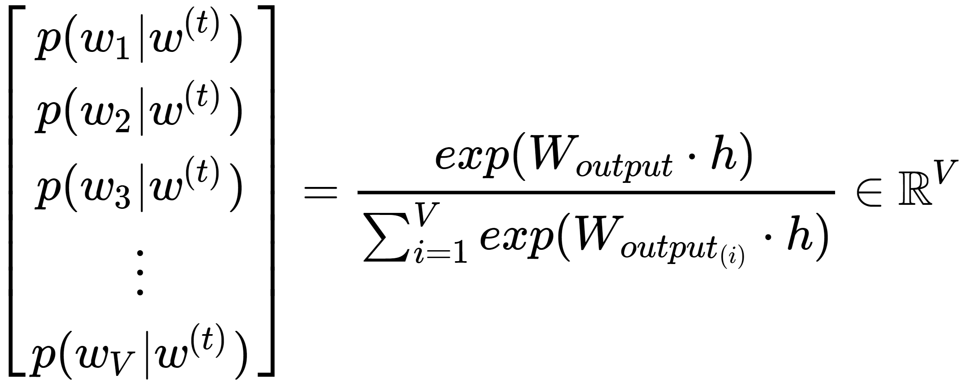
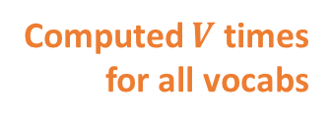
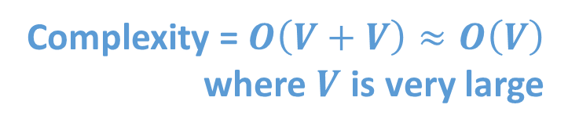
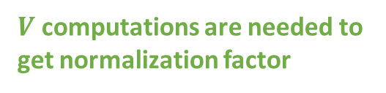
Complexity = $O\left(V+V\right)≈O\left(V\right)$
where $V$ is very large
Computed $V$ times
for all vocabs
aegis4048.github.io
$V$ computations are needed to get normalization factor

Slide 9
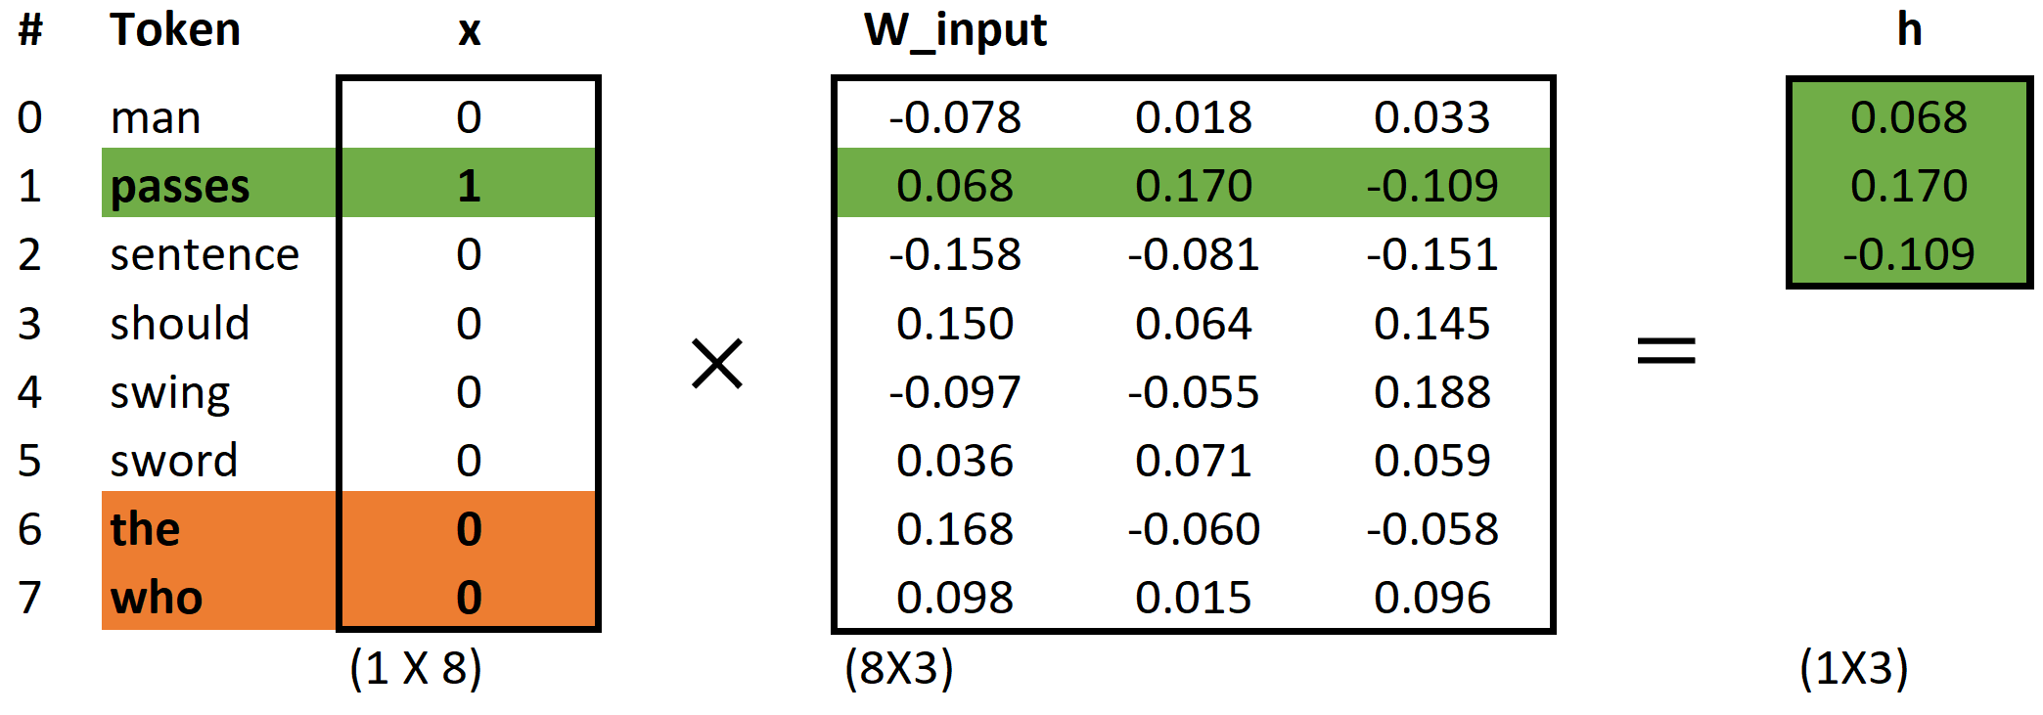
aegis4048.github.io

Slide 10
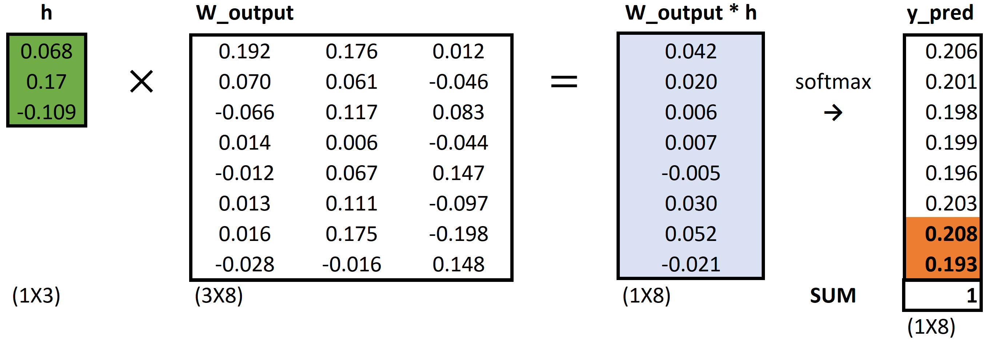
aegis4048.github.io

Slide 11
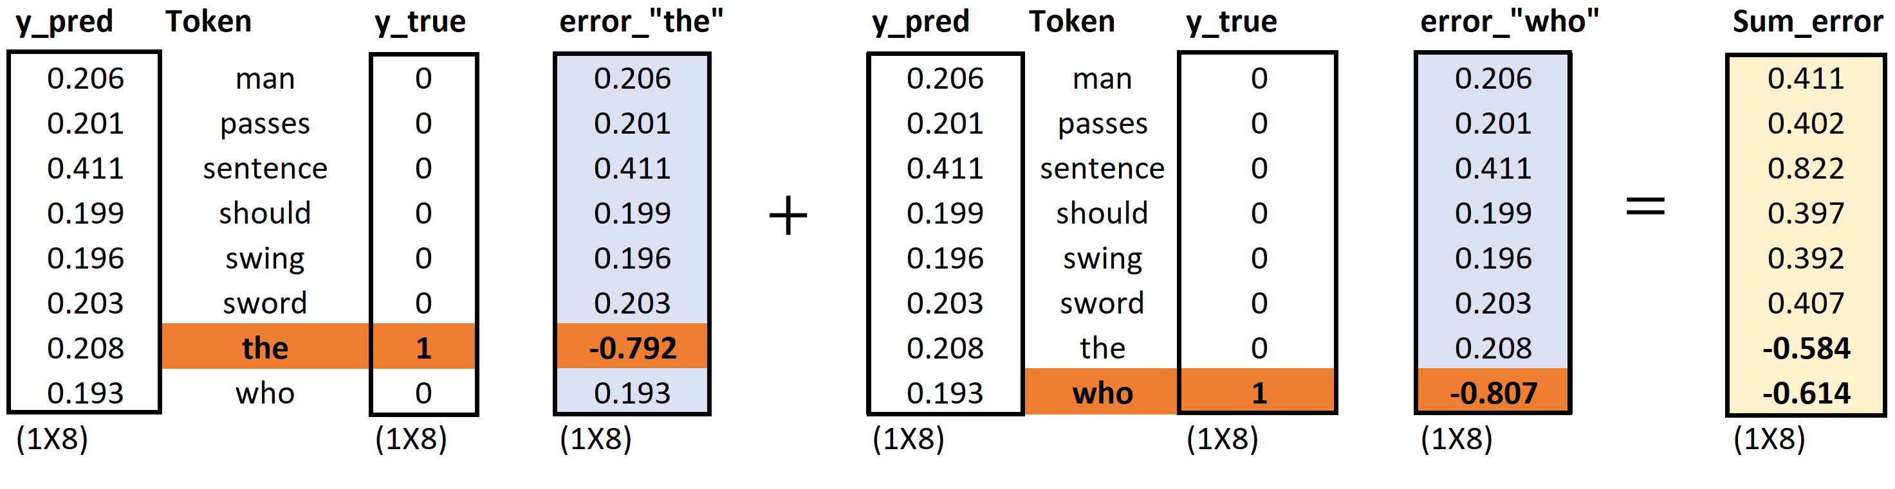
aegis4048.github.io
aegis4048.github.io
aegis4048.github.io

Slide 12
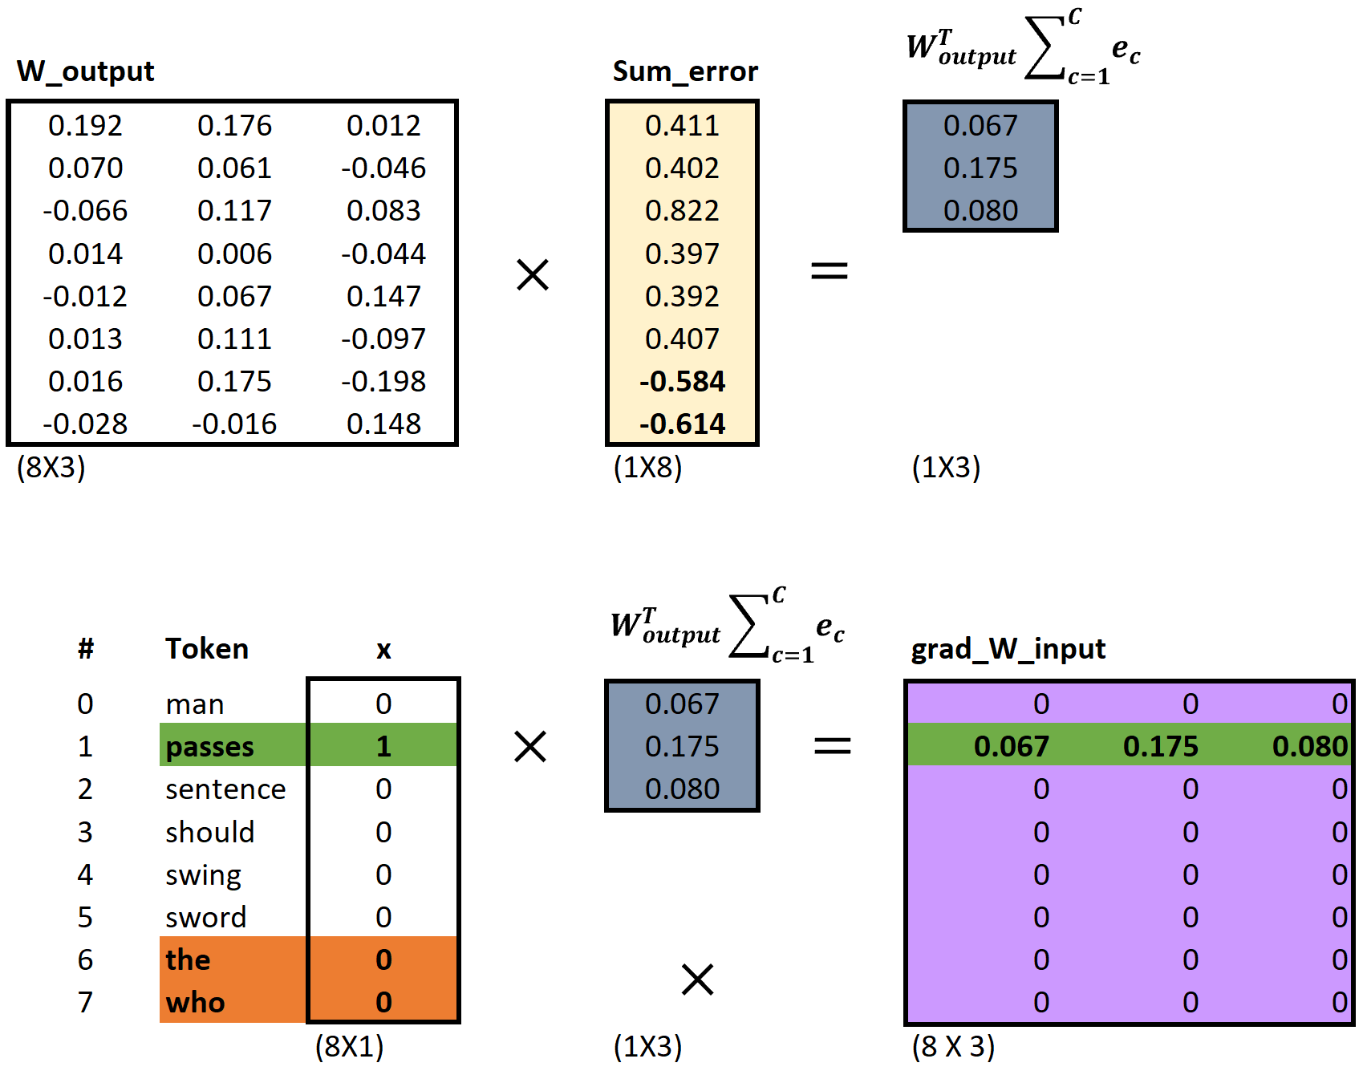
aegis4048.github.io
aegis4048.github.io
aegis4048.github.io

Slide 13
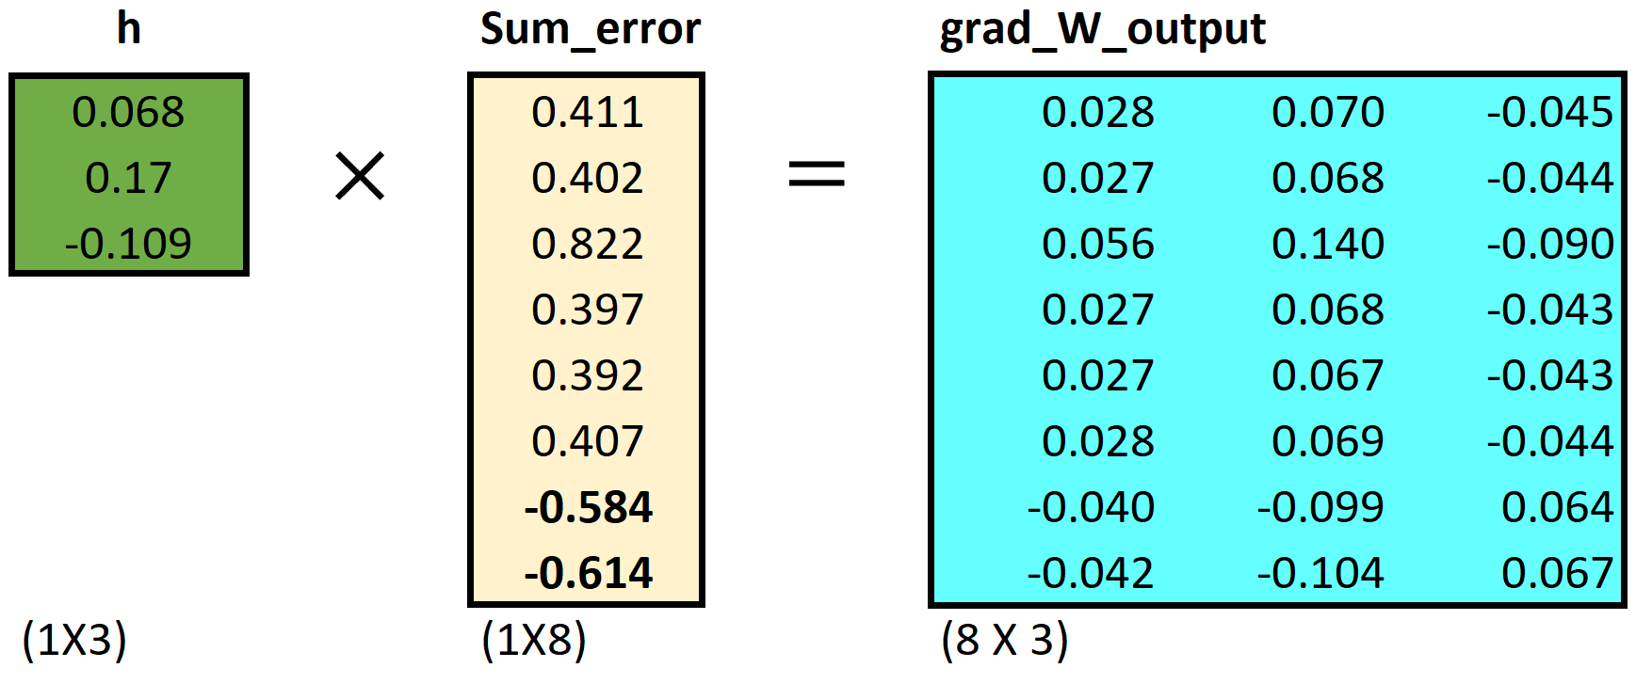
aegis4048.github.io

Slide 14
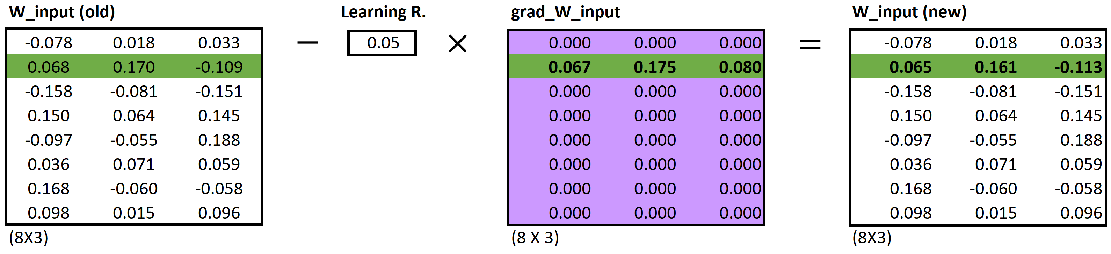
aegis4048.github.io
aegis4048.github.io
aegis4048.github.io

Slide 15
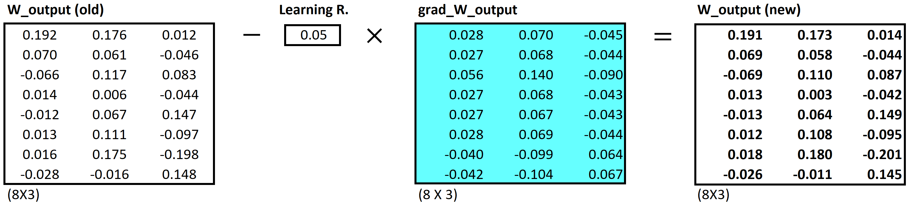
aegis4048.github.io
aegis4048.github.io
aegis4048.github.io

Slide 16


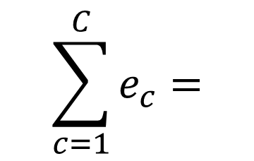



$$c=1$$
$$c=2$$
0.12
0.21
0.10
0.06
-0.87
0.09
0.12
0.21
0.10
0.06
0.13
-0.91
0.24
0.42
0.20
0.12
-0.74
-0.82
man
passes
$$\sum_{c=1}^{C}{e_{c}}=$$
sentence
$$+$$
$$=$$
should
aegis4048.github.io
the
who

Slide 17

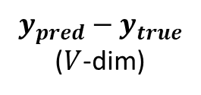
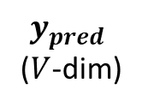
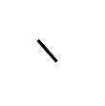
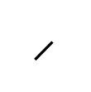
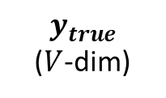
$$y_{true}$$
($V$-dim)
$$y_{pred}−y_{true}$$
($V$-dim)
0
0
0
0
1
0
0.12
0.21
0.10
0.06
-0.87
0.09
man
$$y_{pred}$$
($V$-dim)
passes
sentence
$$=$$
should
0.12
0.21
0.10
0.06
0.13
0.09
$$−$$
c = 1
the
who
aegis4048.github.io
0
0
0
0
0
1
0.12
0.21
0.10
0.06
0.13
-0.91
man
$$−$$
passes
sentence
$$=$$
should
c = 2
the
who

Slide 18
Dimension 3
0.11
0.34
0.54
Achieve
Achieve
Success
0.51
0.91
0.65
Success
Dimension 1
Vector distance
Dimension 2

Slide 19
Training Samples
Source Text
The
man
who
passes
the
sentence
should
swing
the
sword.
(passes, who)
(passes, the)

Slide 20
Dimension 3
should
passes
0.1 0.2 0.7
passes
aegis4048.github.io
should
-2 0.2 0.8
aegis4048.github.io
Dimension 1
Dimension 2

Slide 21





Makes it positive
$$W_{output}∙h$$
Softmax ($W_{output}∙h$)
$$y_{pred}$$
-1.23
0.33
0.18
-5.12
-8.79
-2.01
2.56
4.31
0.12
0.08
0.02
0.13
0.23
0.15
0.11
0.16
$$p\left(y_{i}\right)=\frac{e^{y_{i}^{}}}{\sum_{j}{e^{y_{j}}}}$$
aegis4048.github.io
Normalizes to range [0, 1]
Sum($y_{pred})$ = 1

Slide 22
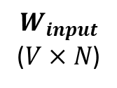
$$W_{input}$$
($V×N$)
man
2 0.5 4
0.1 0.2 0.7
0.3 -2 0.2
-2 0.2 0.8
1 0.7 3
3 5 0.2
passes
sentence
should
aegis4048.github.io
the
who

Slide 23
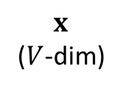
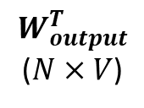
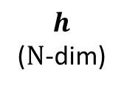
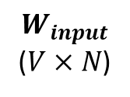
$$y_{true}$$
($V$-dim)
$$y_{pred}−y_{true}$$
($V$-dim)
0
0
0
0
1
0
0.12
0.21
0.10
0.06
-0.87
0.09
man
$$x$$
($V$-dim)
$$W_{input}$$
($V×N$)
$$h$$
($N$-dim)
$$W_{output}^{T}$$
($N×V$)
$$y_{pred}$$
($V$-dim)
passes
sentence
$$=$$
should
man
0
1
0
0
0
0
2 0.5 4
0.1 0.2 0.7
0.3 -2 0.2
-2 0.2 0.8
1 0.7 3
3 5 0.2
0.12
0.21
0.10
0.06
0.13
0.09
$$−$$
c = 1
passes
the
sentence
0.1
0.2
0.7
0.3 0.1 0.4 -0.4
0.1 0.3 -1.1 0.3
0.1 0.2 0.4 0.1
who
should
aegis4048.github.io
aegis4048.github.io
0
0
0
0
0
1
0.12
0.21
0.10
0.06
0.13
-0.91
man
the
$$−$$
passes
who
sentence
$$=$$
should
c = 2
Input Layer one-hot encoded vector
Word-Embedding matrix – a.k.a “Lookup table”
Hidden (Projection)
Layer for center word (passes)
Word-Embedding matrix for context words (the, who)
Softmax Output
Layer of range
[0, 1)
Sum = 1
the
who
Prediction Error – a.k.a function loss

Slide 24
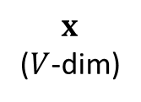


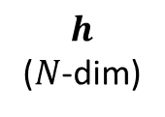
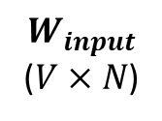
$$x$$
($V$-dim)
$$W_{input}$$
($V×N$)
$$h$$
($N$-dim)
man
0
1
0
0
0
0
2 0.5 4
0.1 0.2 0.7
0.3 -2 0.2
-2 0.2 0.8
1 0.7 3
3 5 0.2
passes
sentence
0.1
0.2
0.7
Projection of word vector for “passes” from the embedding matrix
should
$$×$$
$$=$$
aegis4048.github.io
the
who

Slide 25


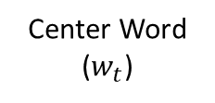

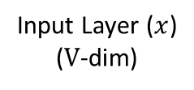


Input Layer ($x$)
($V$-dim)
Assuming Stochastic Gradient Descent…
Center Word
($w_{t}$)
v=0
v=1
v=2
v=3
v=4
v=5
v=6
v=7
man passes sentence should swing sword the who
t=0
The
0 0 0 0 0 0 1 0
t=0
$$θ_{new}=θ_{old}−η∙∇_{θ}J_{0}(θ;w^{(0)})$$
t=1
man
1 0 0 0 0 0 0 0
$$θ_{new}=θ_{old}−η∙∇_{θ}J_{1}(θ;w^{(1)})$$
t=2
who
0 0 0 0 0 0 0 1
$$θ_{new}=θ_{old}−η∙∇_{θ}J_{2}(θ;w^{(2)})$$
aegis4048.github.io
aegis4048.github.io
t=9
sword
0 0 0 0 0 1 0 0
$$θ_{new}=θ_{old}−η∙∇_{θ}J_{9}(θ;w^{(9)})$$

Slide 26
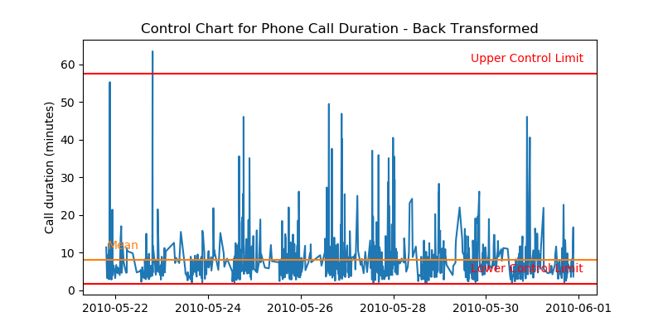
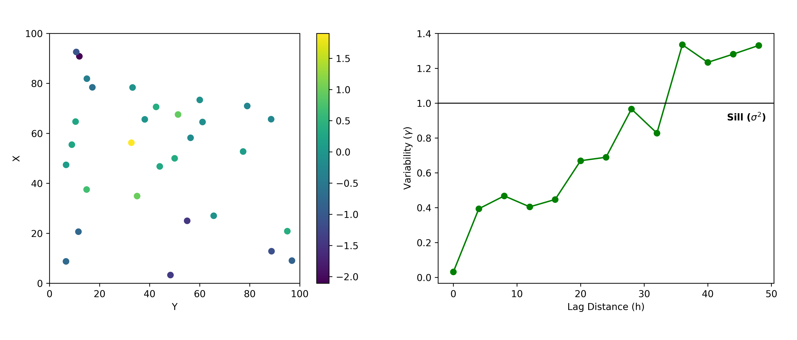

Slide 27
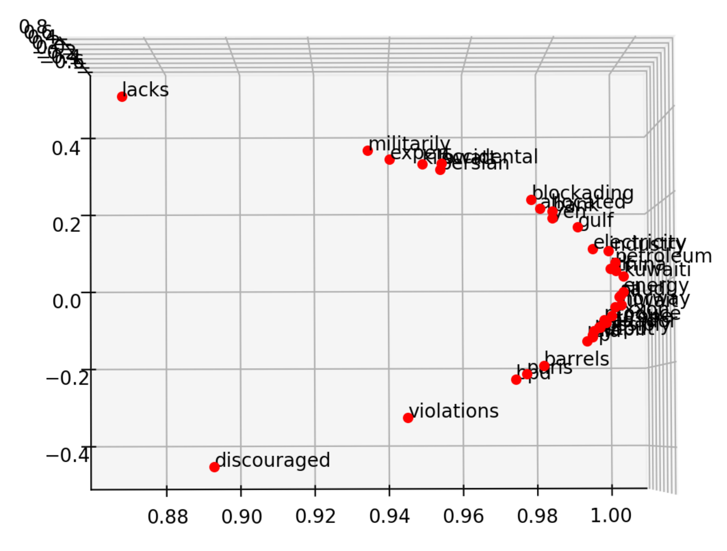
killowatt
electricity
aegis4048.github.io
Oil Producers
Barrels + bpd

Slide 28
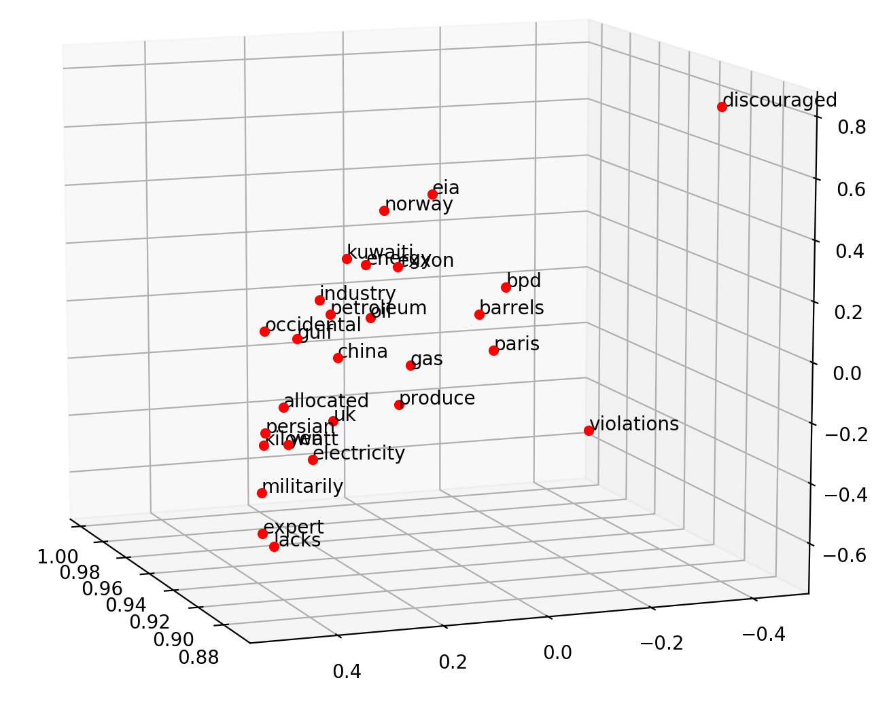
Oil Producers
Barrels + bpd
killowatt
electricity
aegis4048.github.io

Slide 29
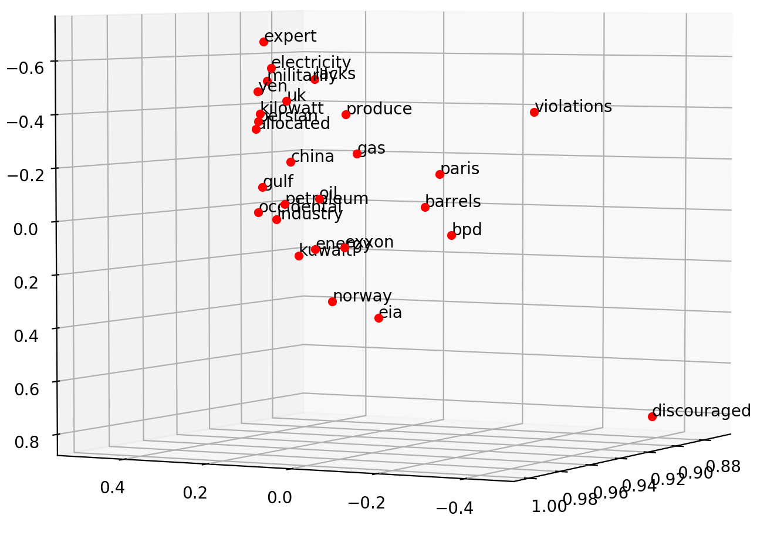
electricity
killowatt
Barrels + bpd
Oil Producers
aegis4048.github.io

Slide 30
0
0
0.32
0.79
0
0.05
0.10
0
0
0.91
Achieve
0
0
0.34
0.75
0
0.10
0
0
0
0.87
Success

Slide 31
Dimension 3
0.11
0.34
0.54
Achieve
Achieve
Success
0.51
0.91
0.65
Success
Dimension 1
Dimension 2

Slide 32
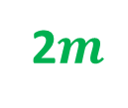












2$m$
variance ($γ$)
sill ($σ^{2}$)
z($u_{α1}$)
z($u_{α1}+2m$)
2$m$
2$m$
2$m$
z($u_{α4}$)
z($u_{α4}+2m$)
nugget ($c_{0}$)
z($u_{α2}$)
z($u_{α2}+2m$)
2$m$
range ($a$)
range
z($u_{α3}$)
z($u_{α3}+2m$)
lag distance (h)

Slide 33





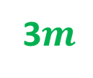



3$m$
variance ($γ$)
sill ($σ^{2}$)
z($u_{α1}$)
z($u_{α1}+3m$)
3$m$
3$m$
z($u_{α3}$)
z($u_{α3}+3m$)
nugget ($c_{0}$)
range ($a$)
3$m$
range
z($u_{α2}$)
z($u_{α2}+3m$)
lag distance (h)

Slide 34
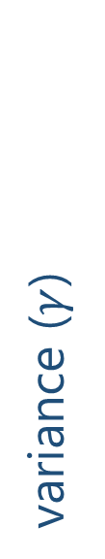



variance ($γ$)
sill ($σ^{2}$)
nugget ($c_{0}$)
range ($a$)
lag distance (h)

Slide 35
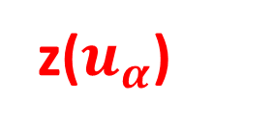
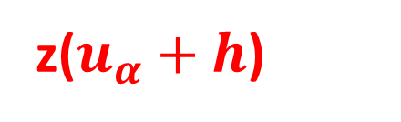
z($u_{α}$)
h
z($u_{α}+h$)

Slide 36
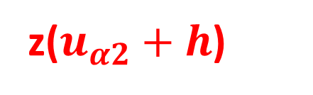
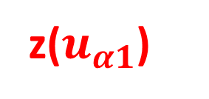
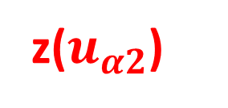





h
z($u_{α1}$)
z($u_{α1}+h$)
h
h
z($u_{α2}$)
z($u_{α2}+h$)
z($u_{α1}$)
z($u_{α}+h$)
h
z($u_{α3}$)
z($u_{α3}+h$)

Slide 38
Y axis (North)
Lag Tolerance
Lag 3
Azimuth
Lag 2
Bandwidth
Lag 1
Azimuth Tolerance
X axis (East)

Slide 39

Z axis (vertical)
Horizontal Major
Horizontal Major
Azimuth
Horizontal Minor
Horizontal Minor
Horizontal Minor
$$θ$$
X axis (East)
Y axis (North)

Slide 40
Y axis (North)
Lag 3
Lag 2
Lag 1
X axis (East)

Slide 41


