Slide 1


variance ($γ$)
sill ($σ^{2}$)
range
lag distance (h)

Slide 2
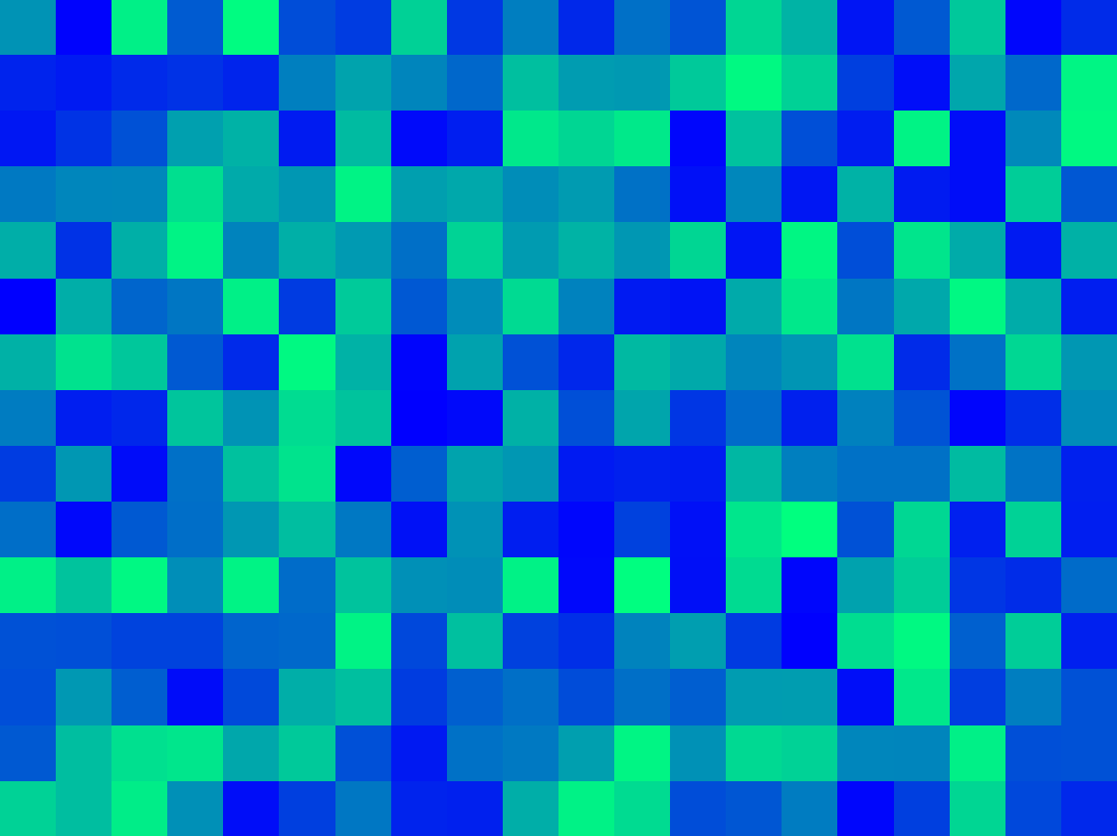















$$1m$$
variance ($γ$)
z($u_{α1}$)
z($u_{α1}+1m$)
sill ($σ^{2}$)
$$1m$$
$$1m$$
1$m$
z($u_{α4}$)
z($u_{α4}+1m$)
z($u_{α2}$)
z($u_{α2}+1m$)
$$1m$$
range
z($u_{α3}$)
z($u_{α3}+1m$)
lag distance (h)

Slide 3
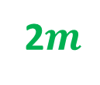












2$m$
variance ($γ$)
sill ($σ^{2}$)
z($u_{α1}$)
z($u_{α1}+2m$)
2$m$
2$m$
2$m$
z($u_{α4}$)
z($u_{α4}+2m$)
z($u_{α2}$)
z($u_{α2}+2m$)
2$m$
range
range
z($u_{α3}$)
z($u_{α3}+2m$)
lag distance (h)

Slide 4





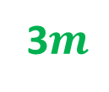



3$m$
variance ($γ$)
sill ($σ^{2}$)
z($u_{α1}$)
z($u_{α1}+3m$)
3$m$
3$m$
z($u_{α3}$)
z($u_{α3}+3m$)
range
3$m$
range
z($u_{α2}$)
z($u_{α2}+3m$)
lag distance (h)

Slide 5
variance ($γ$)
sill ($σ^{2}$)
range
lag distance (h)

Slide 6
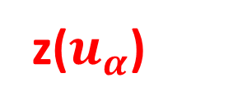

z($u_{α}$)
h
z($u_{α}+h$)

Slide 7

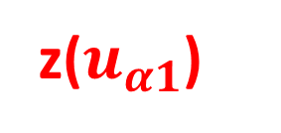
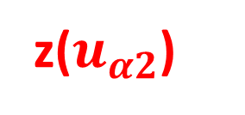





h
z($u_{α1}$)
z($u_{α1}+h$)
h
h
z($u_{α2}$)
z($u_{α2}+h$)
z($u_{α1}$)
z($u_{α}+h$)
h
z($u_{α3}$)
z($u_{α3}+h$)

