Slide 1


















$$1m$$
variance ($γ$)
z($u_{α1}$)
z($u_{α1}+1m$)
sill ($σ^{2}$)
$$1m$$
$$1m$$
1$m$
nugget ($c_{0}$)
z($u_{α4}$)
z($u_{α4}+1m$)
z($u_{α2}$)
z($u_{α2}+1m$)
$$1m$$
range ($a$)
z($u_{α3}$)
z($u_{α3}+1m$)
lag distance (h)

Slide 2
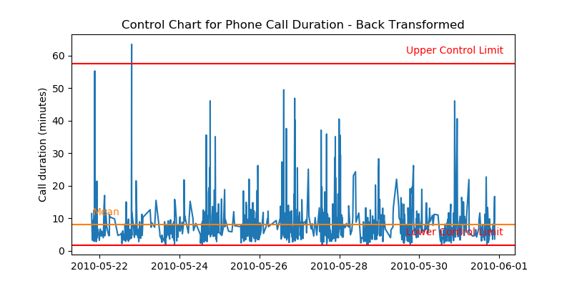
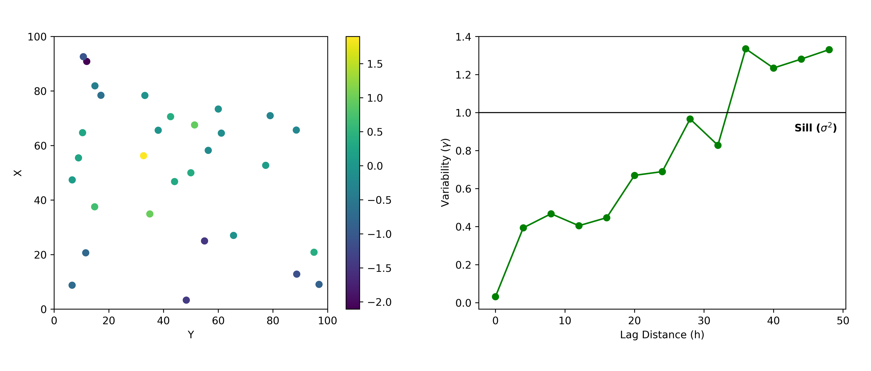

Slide 3
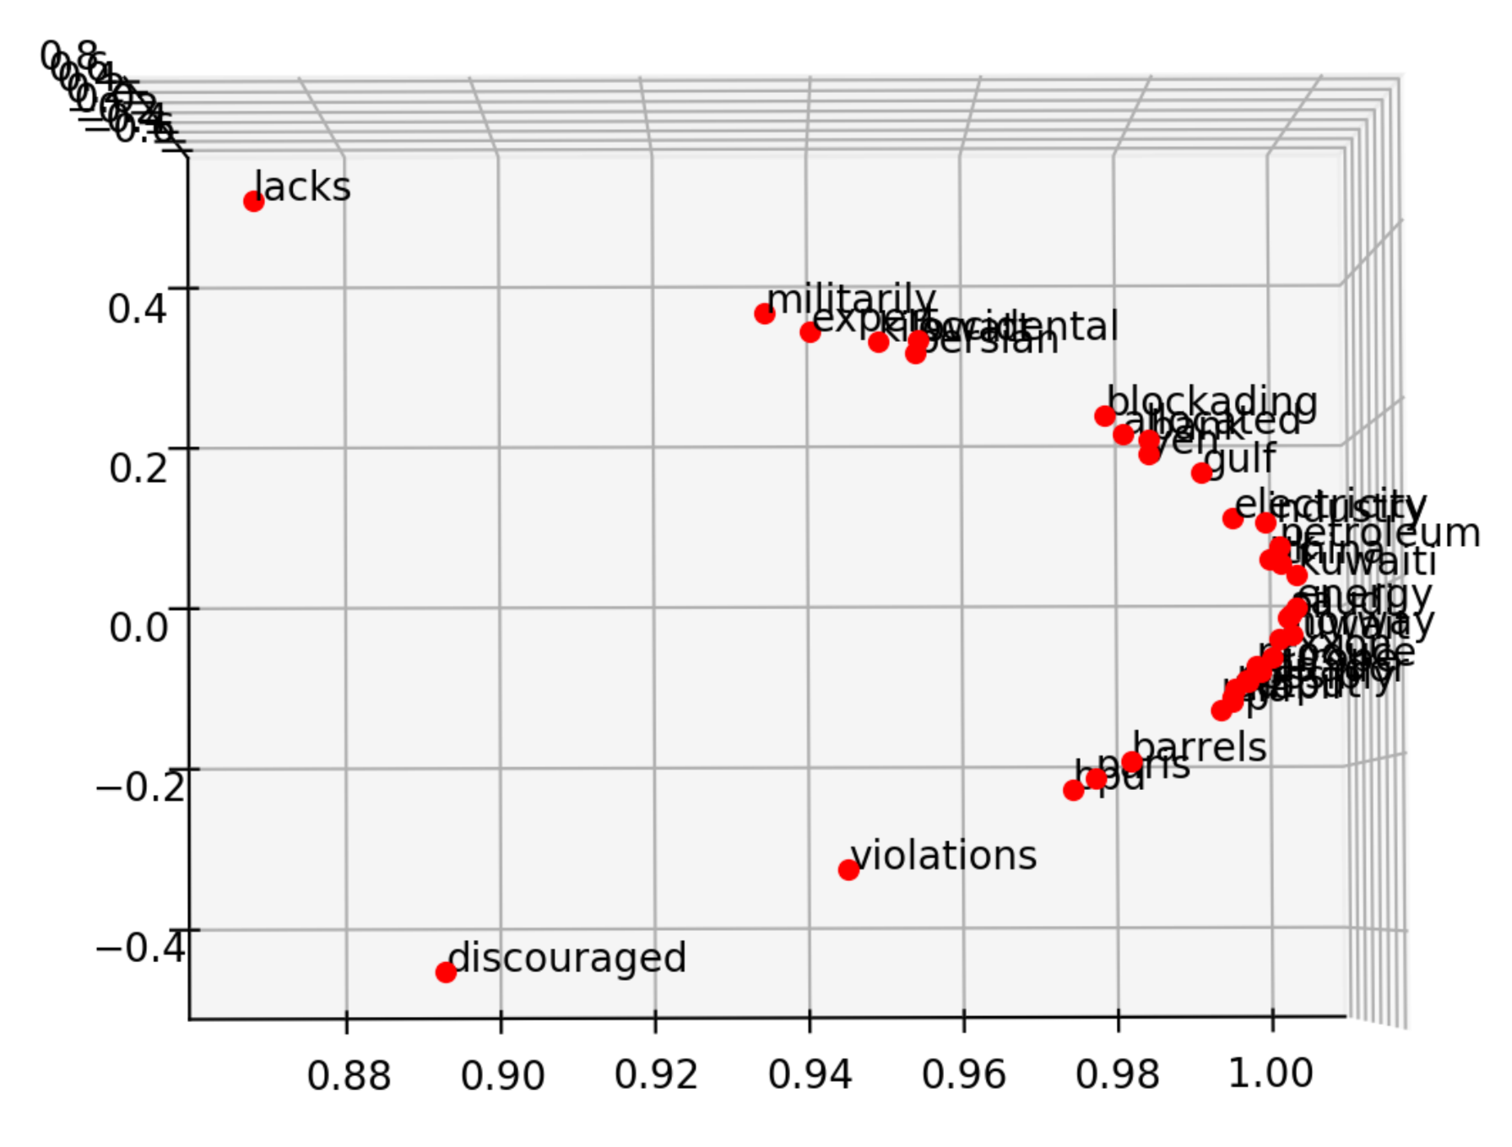
killowatt
electricity
Oil Producers
Barrels + bpd

Slide 4
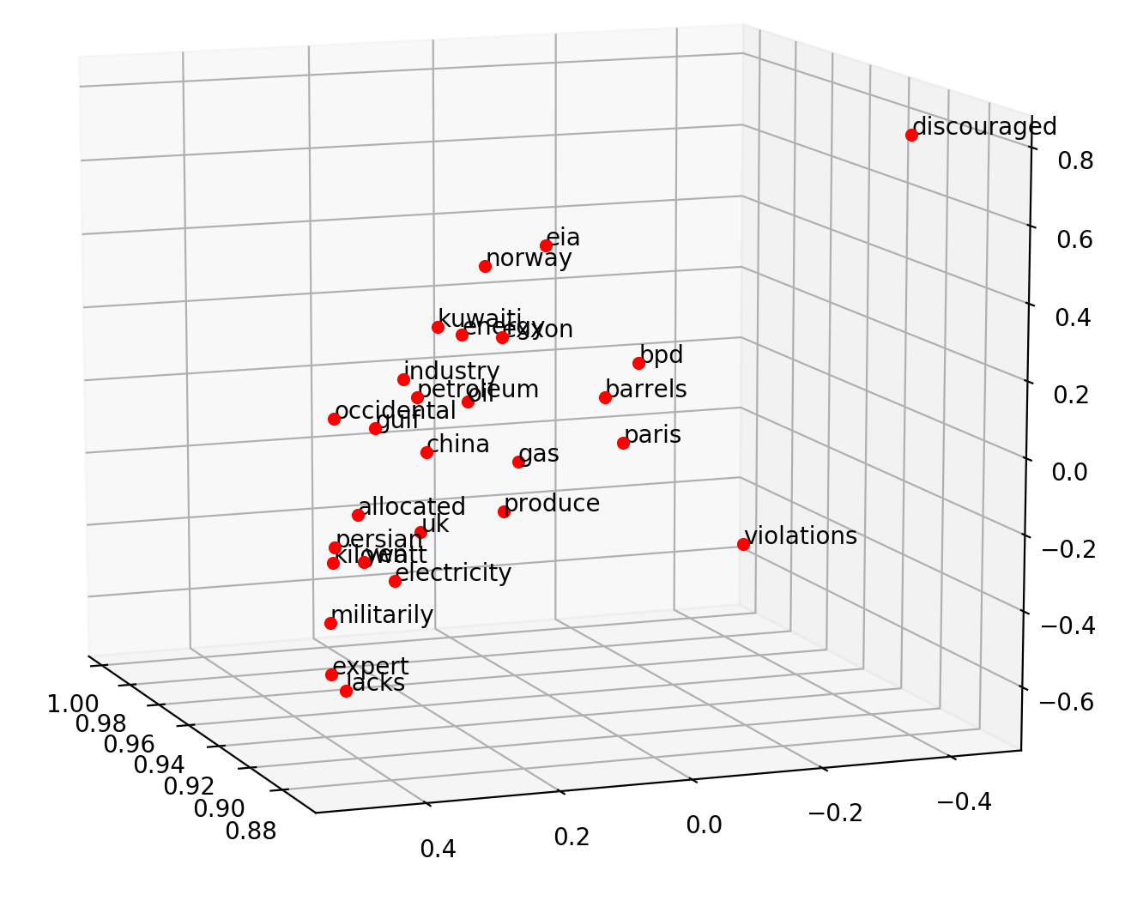
Oil Producers
Barrels + bpd
killowatt
electricity

Slide 5
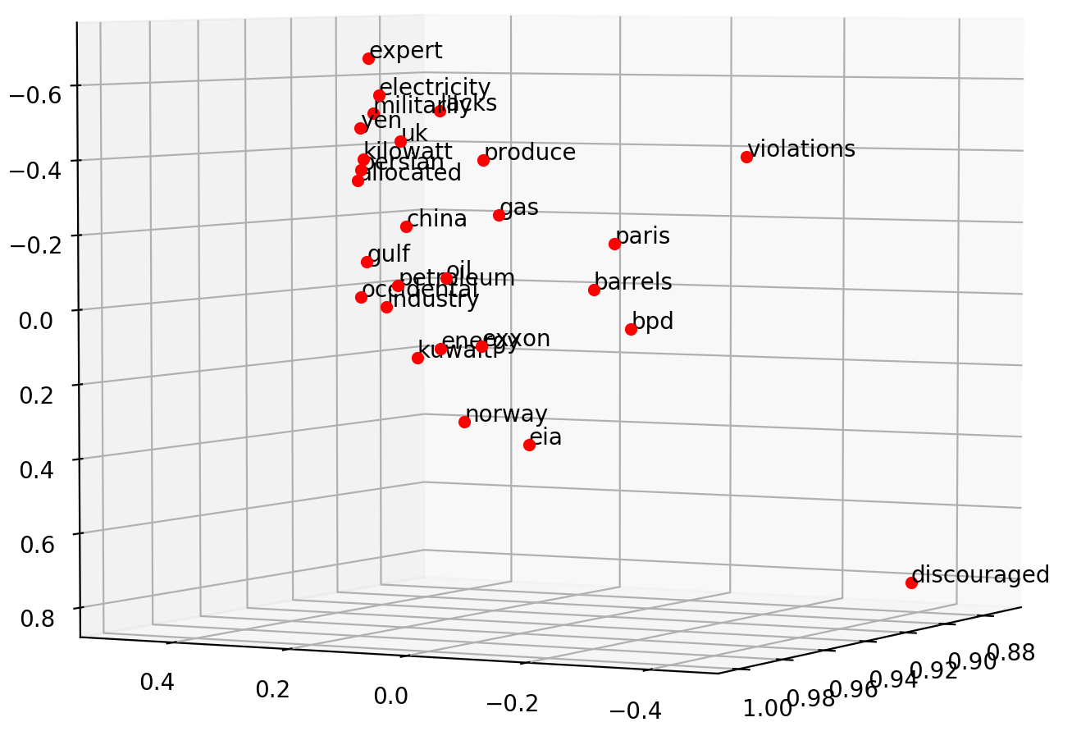
electricity
killowatt
Barrels + bpd
Oil Producers

Slide 6
0
0
0.32
0.79
0
0.05
0.10
0
0
0.91
Achieve
0
0
0.34
0.75
0
0.10
0
0
0
0.87
Success

Slide 7
Dimension 3
0.11
0.34
0.54
Achieve
Achieve
Success
0.51
0.91
0.65
Success
Dimension 1
Dimension 2

Slide 8
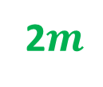












2$m$
variance ($γ$)
sill ($σ^{2}$)
z($u_{α1}$)
z($u_{α1}+2m$)
2$m$
2$m$
2$m$
z($u_{α4}$)
z($u_{α4}+2m$)
nugget ($c_{0}$)
z($u_{α2}$)
z($u_{α2}+2m$)
2$m$
range ($a$)
range
z($u_{α3}$)
z($u_{α3}+2m$)
lag distance (h)

Slide 9





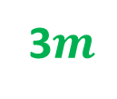



3$m$
variance ($γ$)
sill ($σ^{2}$)
z($u_{α1}$)
z($u_{α1}+3m$)
3$m$
3$m$
z($u_{α3}$)
z($u_{α3}+3m$)
nugget ($c_{0}$)
range ($a$)
3$m$
range
z($u_{α2}$)
z($u_{α2}+3m$)
lag distance (h)

Slide 10




variance ($γ$)
sill ($σ^{2}$)
nugget ($c_{0}$)
range ($a$)
lag distance (h)

Slide 11
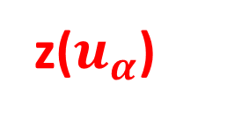
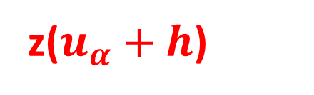
z($u_{α}$)
h
z($u_{α}+h$)

Slide 12
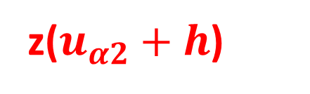
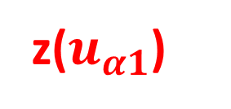
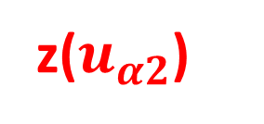
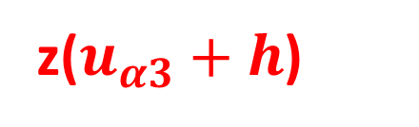

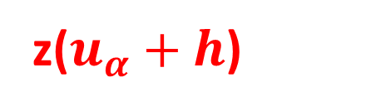
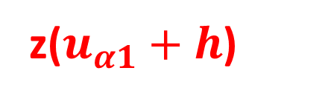

h
z($u_{α1}$)
z($u_{α1}+h$)
h
h
z($u_{α2}$)
z($u_{α2}+h$)
z($u_{α1}$)
z($u_{α}+h$)
h
z($u_{α3}$)
z($u_{α3}+h$)

Slide 14
Y axis (North)
Lag Tolerance
Lag 3
Azimuth
Lag 2
Bandwidth
Lag 1
Azimuth Tolerance
X axis (East)

Slide 15

Z axis (vertical)
Horizontal Major
Horizontal Major
Azimuth
Horizontal Minor
Horizontal Minor
Horizontal Minor
$$θ$$
X axis (East)
Y axis (North)

Slide 16
Y axis (North)
Lag 3
Lag 2
Lag 1
X axis (East)

Slide 17
