Slide 1
Video Game Character Index
An index for video game characters across the gaming universe.

Slide 2
Wireframe
SELECT YOUR CHARACTER
GO

Slide 3
Wireframe
SELECT YOUR CHARACTER
Mario
GO
Mario Marmalade Mee Mii Moo

Slide 4
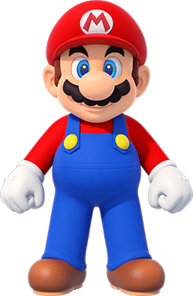
Wireframe
SELECT YOUR CHARACTER
Mario
GO
MARIO
Info1:
Info2:
Info3:
Info4:
Friends: list up to 5 friends
Enemies: list up to 5 enemies

Slide 5
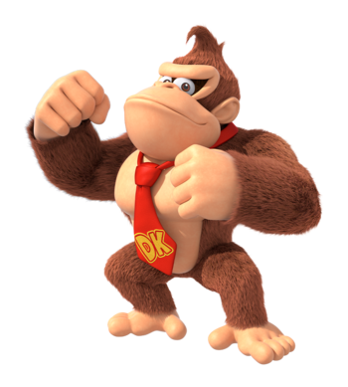
Wireframe
SELECT YOUR CHARACTER
Mario
GO
DONKEY KONG
Info1:
Info2:
Info3:
Info4:
Friends: list up to 5 friends
Enemies: list up to 5 enemies

