Slide 1
An Introduction to the Calibration of Agent-Based Models
James Bristow

Slide 2
Overview
Topics We’ll Be Covering
Predator-Prey Modelling
What is Calibration?
The Challenges of Calibration
Exploring the Parameter Space
Performing a Sensitivity Analysis
Calibration by Optimisation
Applications of Bayesian Calibration
Future Directions

Slide 3
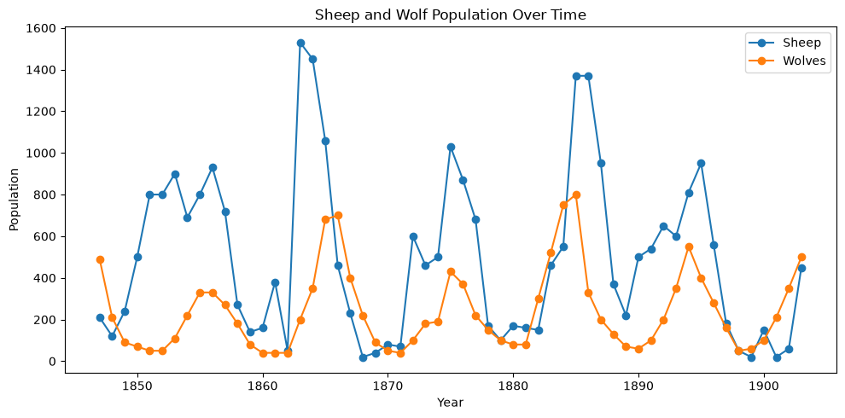
Predator-Prey Modelling
Why Model Predator–Prey Systems?
Cyclic behaviour: More prey → more predators → fewer prey → fewer predators → more prey again
Balance: Models show when predator and prey populations can coexist without either going extinct
Assist with: Conservation, harvesting, and biological control

Slide 4
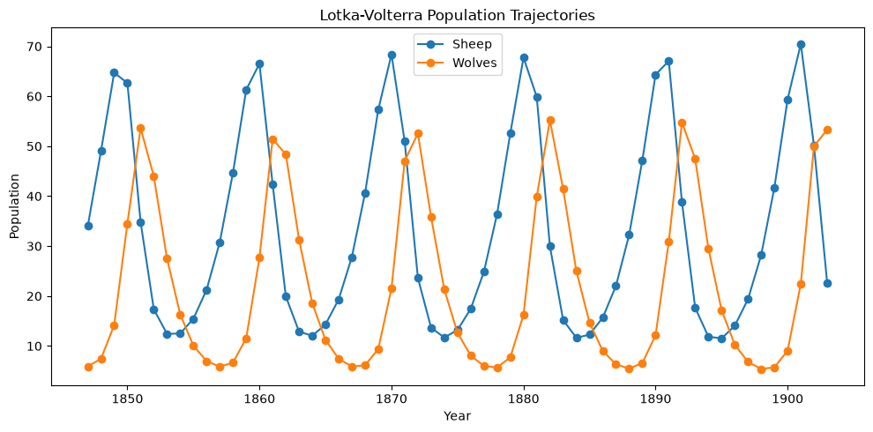
Lotka-Volterra Equations
Population-Level Non-Linear Model
Represents populations, and not individual animals or their behaviour
Describes how the number of sheep and wolves changes over time
Uses equations to represent processes such as reproduction, death, and predation

Slide 5
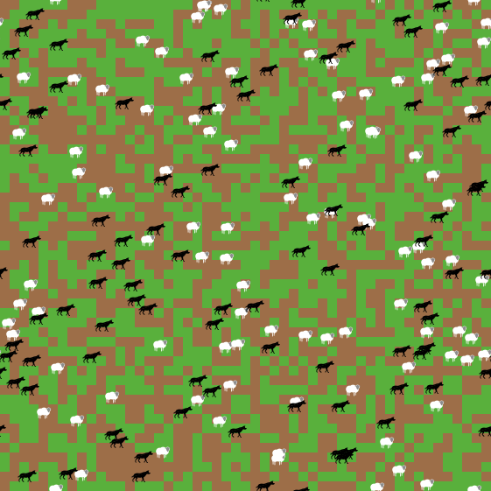
Wolf Sheep Predation Model
Individual-Level Agent-Based Model
Wolves and sheep are represented as individual agents with their own location, energy, and behaviour
Agents move, reproduce, eat, and interact with other agents
Population-level patterns emerge from individual behaviours

Slide 6
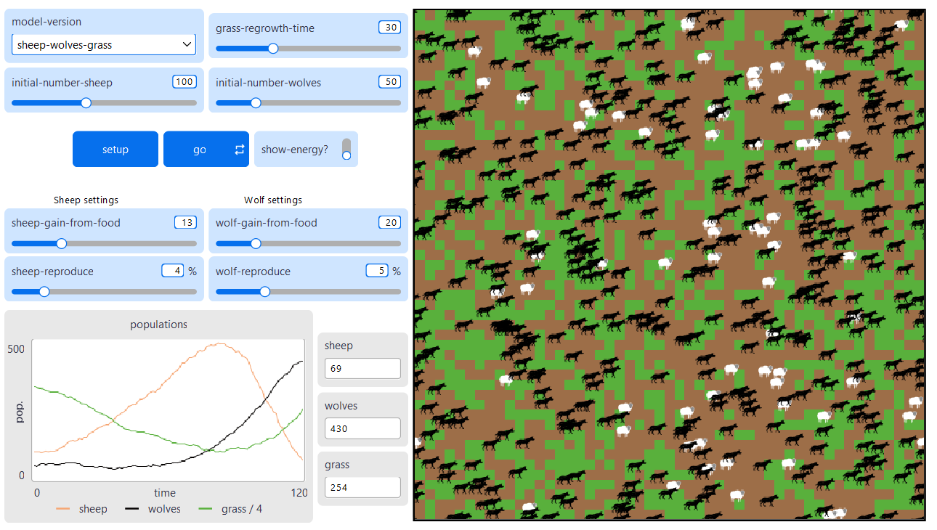
Wolf Sheep Predation Model
Running the Model in NetLogo
File
Models Library
Search for “Wolf Sheep Predation”
Sample Models -> Biology -> Wolf Sheep Predation
model-version = “sheep-wolves-grass”
setup -> go
Can you adjust the model parameters so that the population of sheep is as close as possible to 225 at time 100?

Slide 7
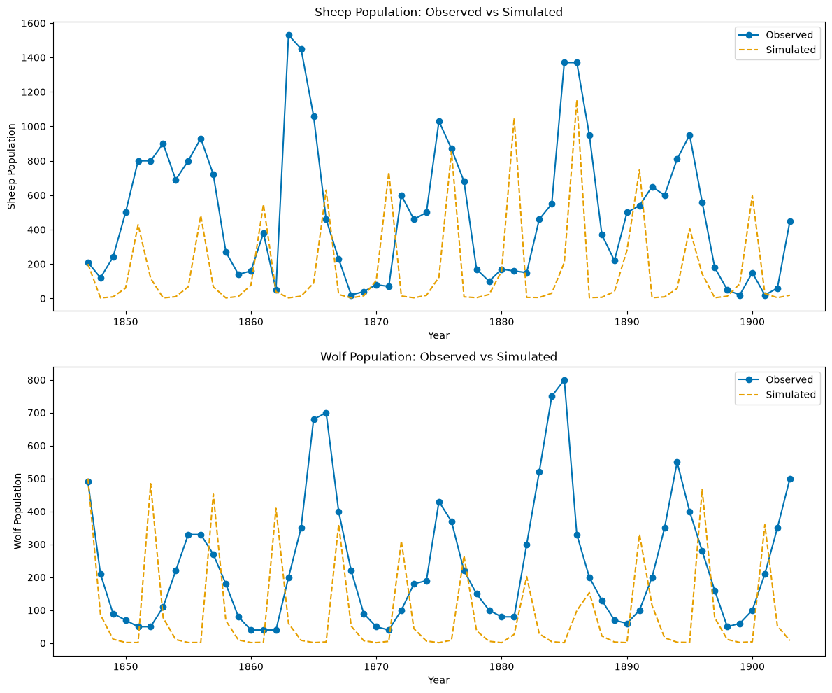
What is Calibration?
From Models to Reality
Adjusting parameters so that simulated outputs most closely match real-world observed data

Slide 8
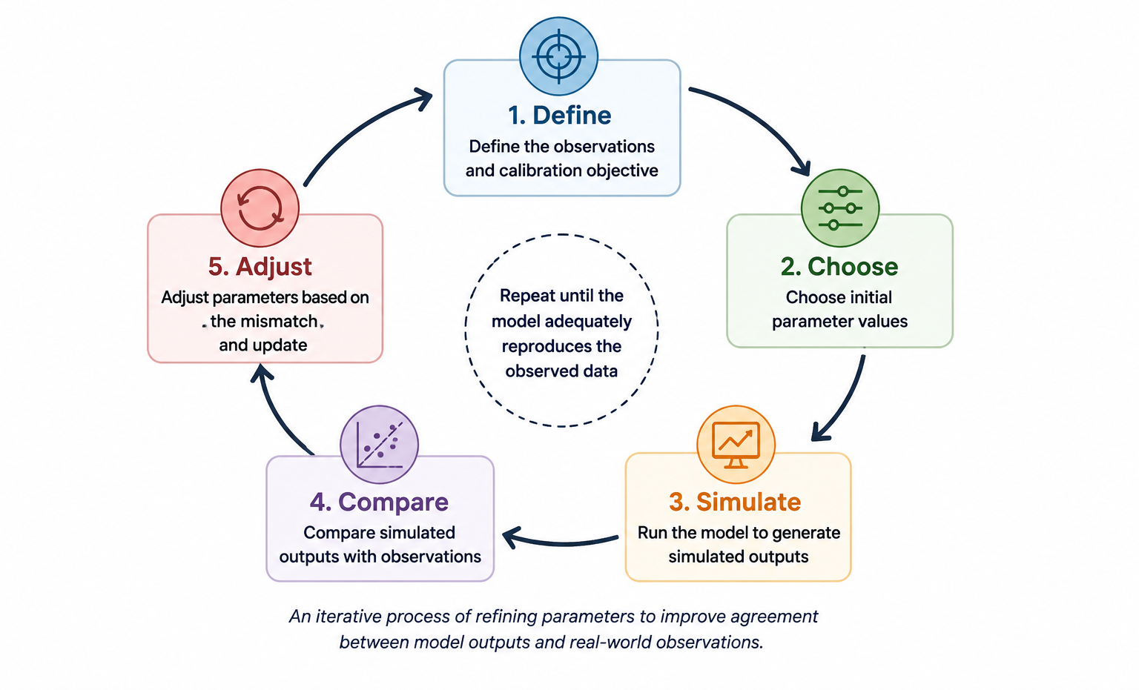
The Calibration Process
Calibration as an Iterative Process

Slide 9
The Challenges of Calibration
Population-Level and Individual-Level Modelling
 | Lotka-Volterra (System-Level) | Wolf Sheep Predation (Individual-Level)
Parameters | Usually fewer | Usually more
Dynamics | Explicit | Often emergent
Stochasticity | Often deterministic | Often stochastic
Computational cost | Usually lower | Usually higher
Observation level | Matches model level | Often aggregated to system level
Calibration | Often easier | Often more difficult

Slide 10
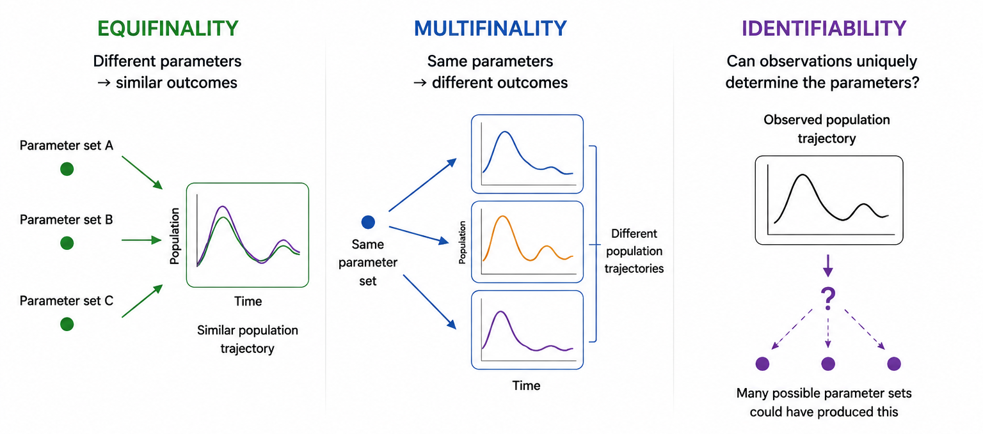
Challenges in Systems Modelling
Calibrating the Model from Observations
Notes:
Stochasticity → Multifinality
More parameters + emergent dynamics → Equifinality
Individual-level model + system-level observations → can contribute to Identifiability problems

Slide 11
Can You Identify the Challenge?
Equifinality, multifinality, or identifiability?
Scenario | Answer
We run the stochastic Wolf–Sheep model five times with identical parameters and obtain five different trajectories
Sheep reproduction and wolf predation parameter values can both be changed while maintaining a good fit to the observation data
Two very different parameter sets produce almost identical wolf–sheep trajectories

Slide 12
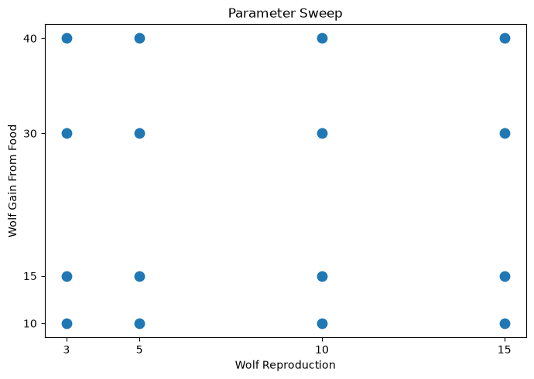
Exploring the Parameter Space
Constructing a Parameter Sweep
Parameter space: Set of possible values for each parameter
Sweep through different parameter combinations. How does model behaviour change?
Combinatorial experiment: Test all possible combinations
2 parameters and 4 values each: 4 x 4 = 16 parameter combinations

Slide 13
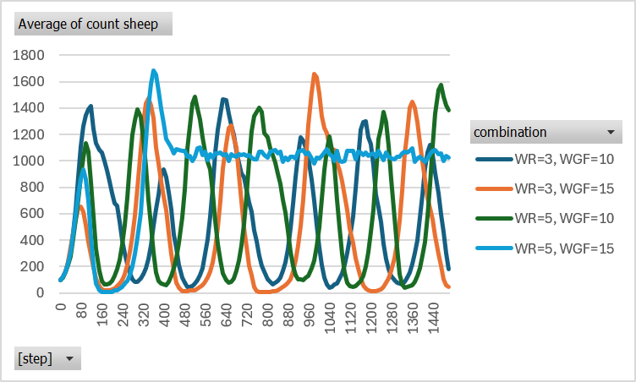
Exploring the Parameter Space
Experiments in BehaviorSpace
Tools
BehaviorSpace
BehaviorSpace combinatorial (16 runs)
Save Table output
Open Excel File
Delete all columns except: wolf-reproduce; wolf-gain-from-food; [step]; count sheep
Create “combination” column with formula: ="WR="&A2&", WGF="&B2
Insert -> Pivot Table
Rows = [step]; Column = combination; Values = count sheep
Sum of count sheep -> Average of count sheep
Insert -> 2D-Line

Slide 14
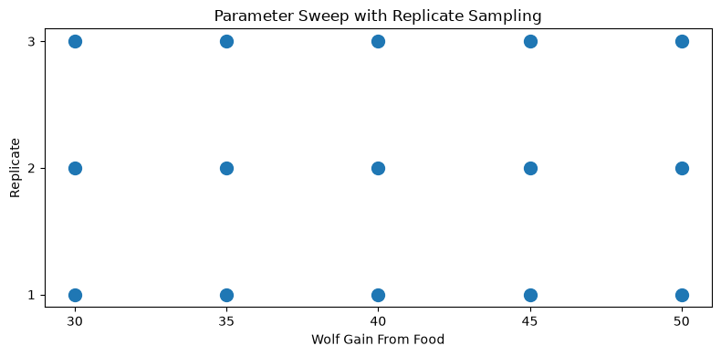
Repeat/Replicate Sampling
Repeating Samples of Parameter Combinations
Stochastic models produce different outcomes with same parameters
Stochasticity: Contributor to multifinality
Repeat simulations to estimate typical behaviour and spread

Slide 15
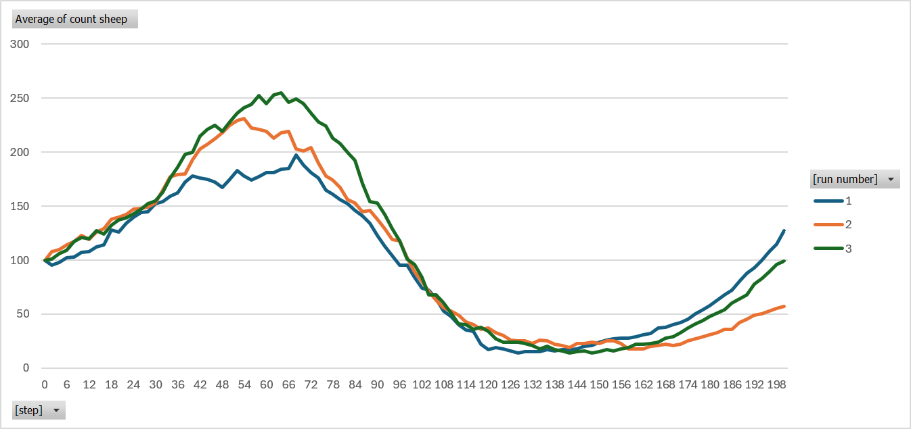
Repeat/Replicate Sampling
Experiments in BehaviorSpace
Tools
BehaviorSpace
New BehaviorSpace Features (15 runs)
Save Table output
Open Excel File
Delete all columns except: [run number]; wolf-gain-from-food; [step]; count sheep
Data -> Filter
wolf-gain-from-food = 30
Insert -> Pivot Table
Rows = [step]; Column = [run number]; Values = count sheep
Sum of count sheep -> Average of count sheep
Insert -> 2D-Line
We have three replicate sheep population trajectories for wolf-gain-from-food = 30. How could we combine them into a single, less noisy trajectory?

Slide 16
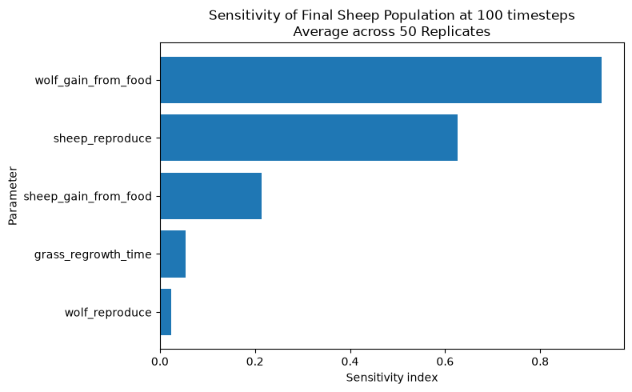
Performing a Sensitivity Analysis
Which parameters most greatly influence model behaviour?
Measures how changes in model parameters affect model outputs
Identifies parameters that have strong or weak influence on model behaviour
Prioritise parameters for calibration
Sensitivity indices from 44,800 simulations (not in NetLogo)
128 * (5+2) * 50 = 44,800 simulation runs

Slide 17
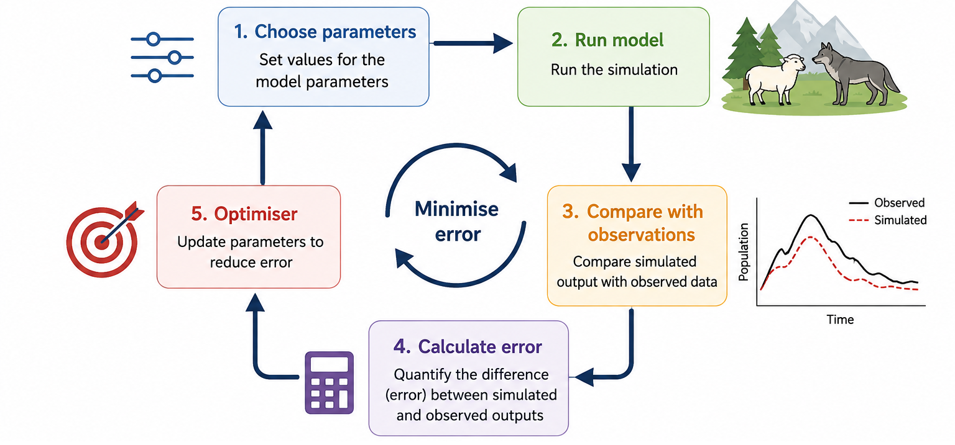
Calibration by Optimisation
What is Calibration by Optimisation?

Slide 18
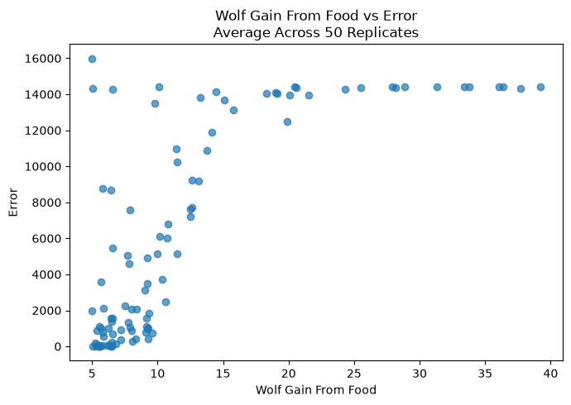
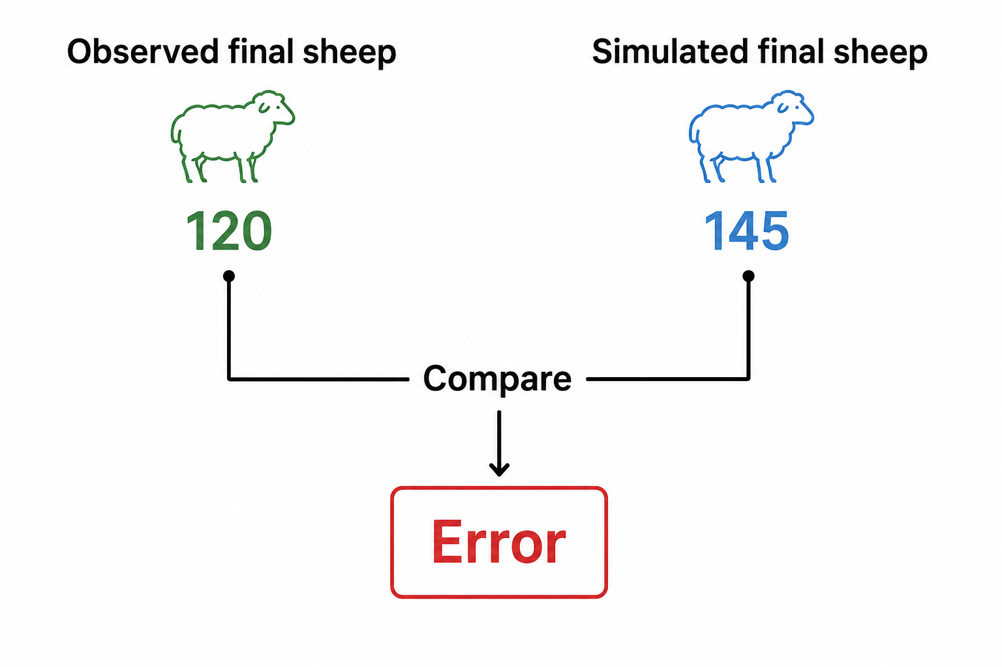
Finding the Best Fit
Parameter Values that Produces the Smallest Error
Calculate error: (Simulated−Observed)^2

Slide 19
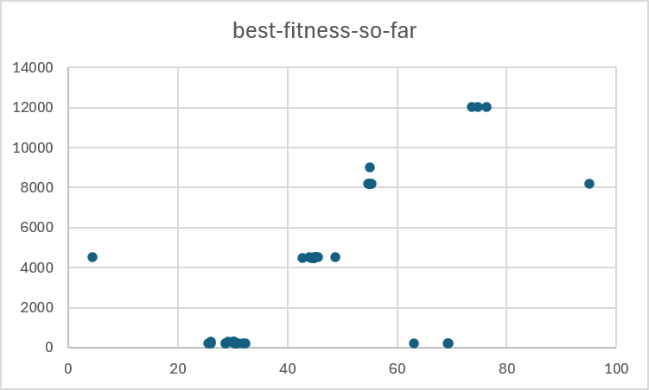
Finding the Best Fit
Optimisation in BehaviorSearch
Visit C:\Program Files\NetLogo 7.0.4
Open BehaviorSearch.exe
Browse for model = C:\Program Files\NetLogo 7.0.4\models\Sample Models\Biology\Wolf Sheep Predation.nlogox
Load parameter ranges from model interface
["wolf-gain-from-food" [0 "C" 100]]
["model-version" "sheep-wolves-grass"]
Measure = (count sheep - 120) ^ 2
Search Objective -> Minimize Fitness
Output file stem (sic)
Open *.objectiveFunctionHistory.csv
Select wolf-gain-from-food* and best-fitness-so-far
Insert -> Scatter

Slide 20
Beyond One Best Fit
Why Might a Single Best Fit Not Be Enough?
Challenge | What it means for optimisation
Multifinality & Stochasticity | Noisy errors: The same parameters can produce different errors
Equifinality | Multiple good fits: Different parameter combinations can produce similarly good fits
Identifiability | Limited information: Observations may not contain enough information to identify a unique best fit
A single best fit does not capture the spread in the parameters of the model

Slide 21
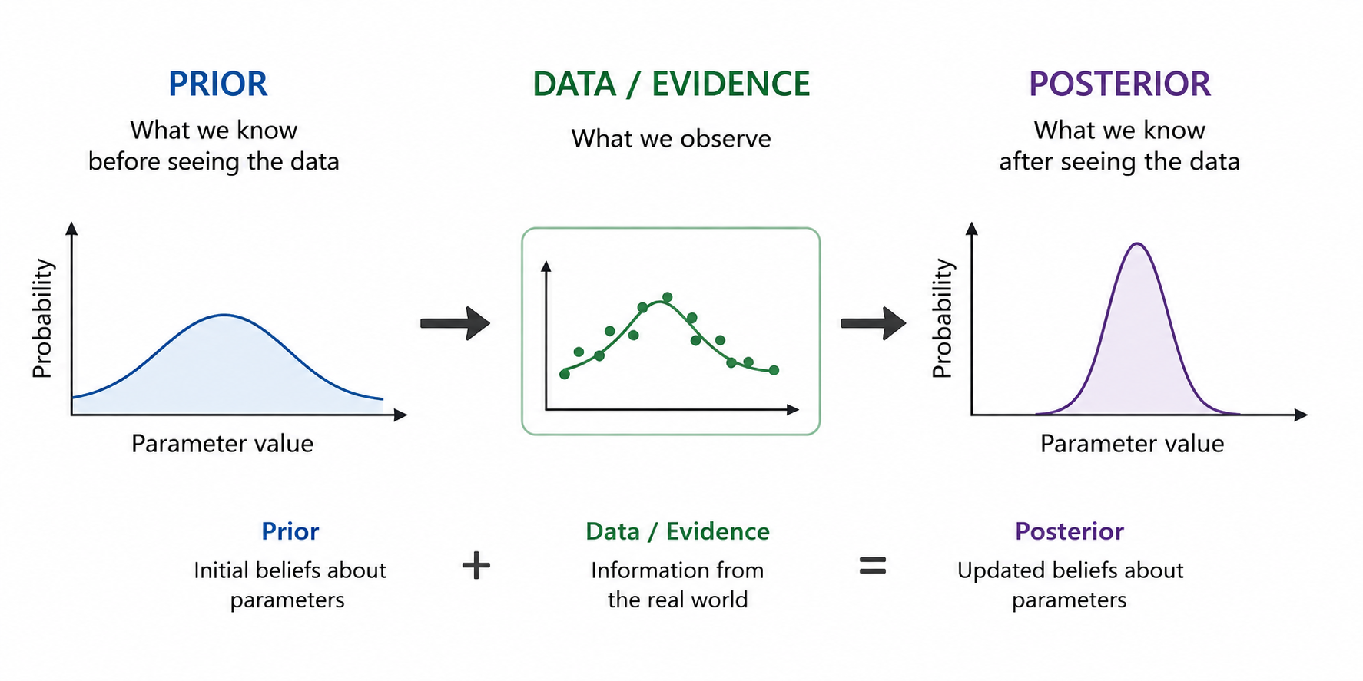
Applications of Bayesian Calibration
Which Parameter Values are Plausible Given the Evidence?

Slide 22
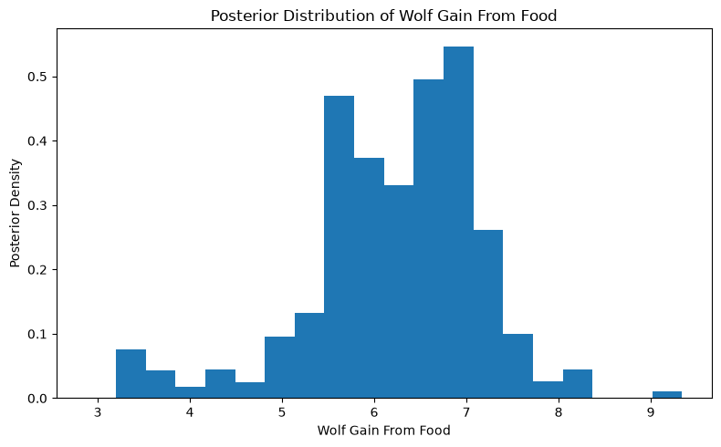
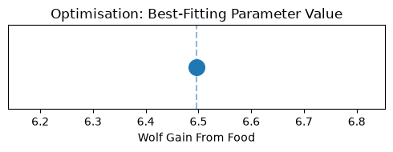
From a Best Fit to a Distribution
What do we Gain from Bayesian Calibration?

Slide 23
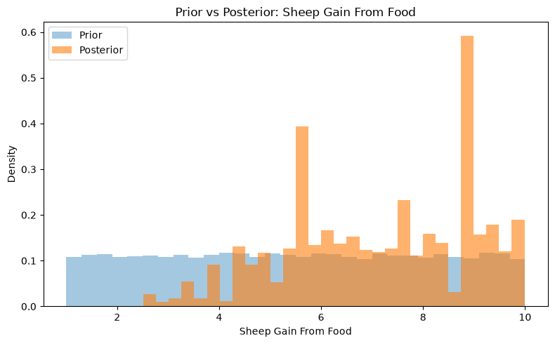
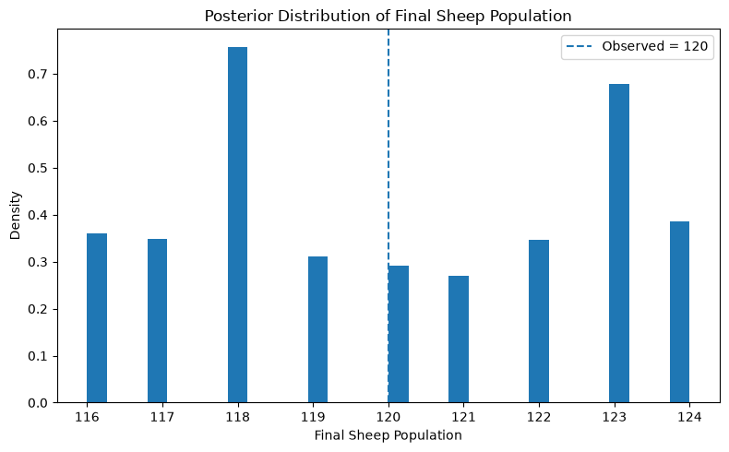
What Does the Posterior Tell Us?
Equifinality, multifinality, and identifiability
Match the systems modelling challenge to the image

Slide 24
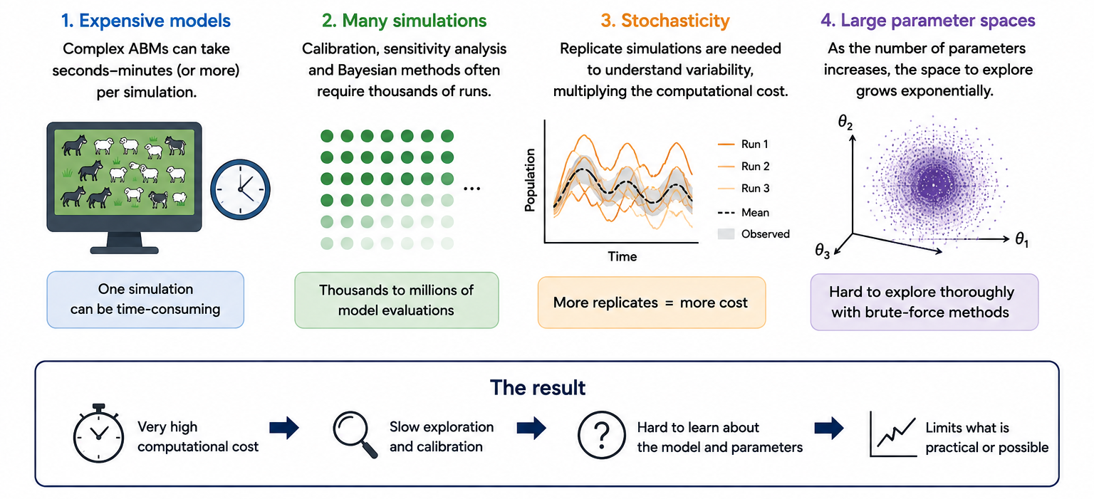
Future Directions
Why Do We Need New Approaches?

Slide 25
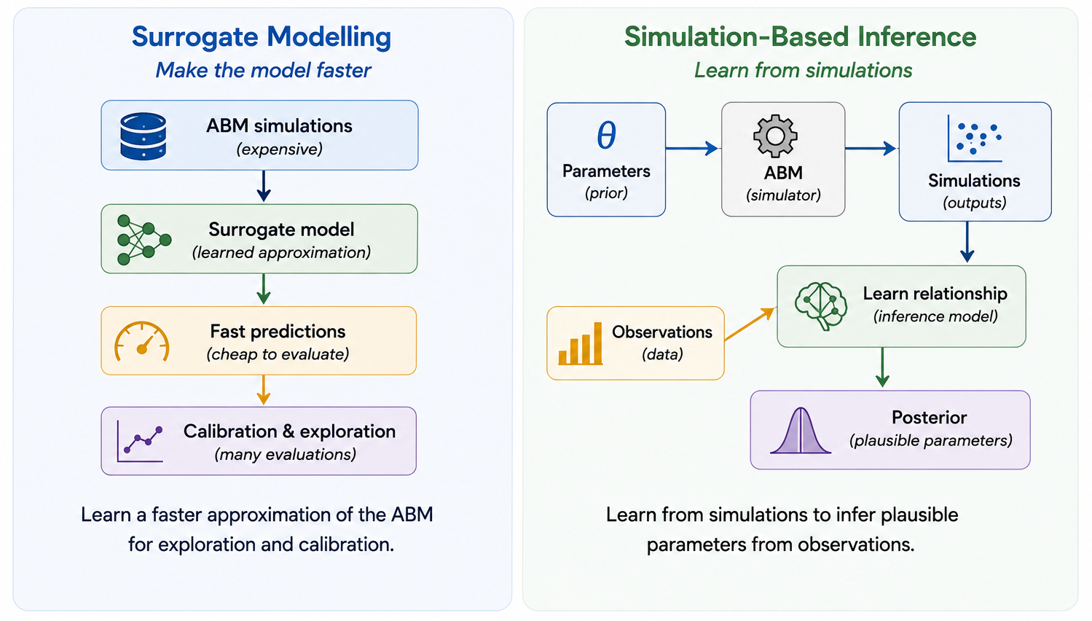
Future Directions
Can We Make Better Use of Our Simulations?

Slide 26
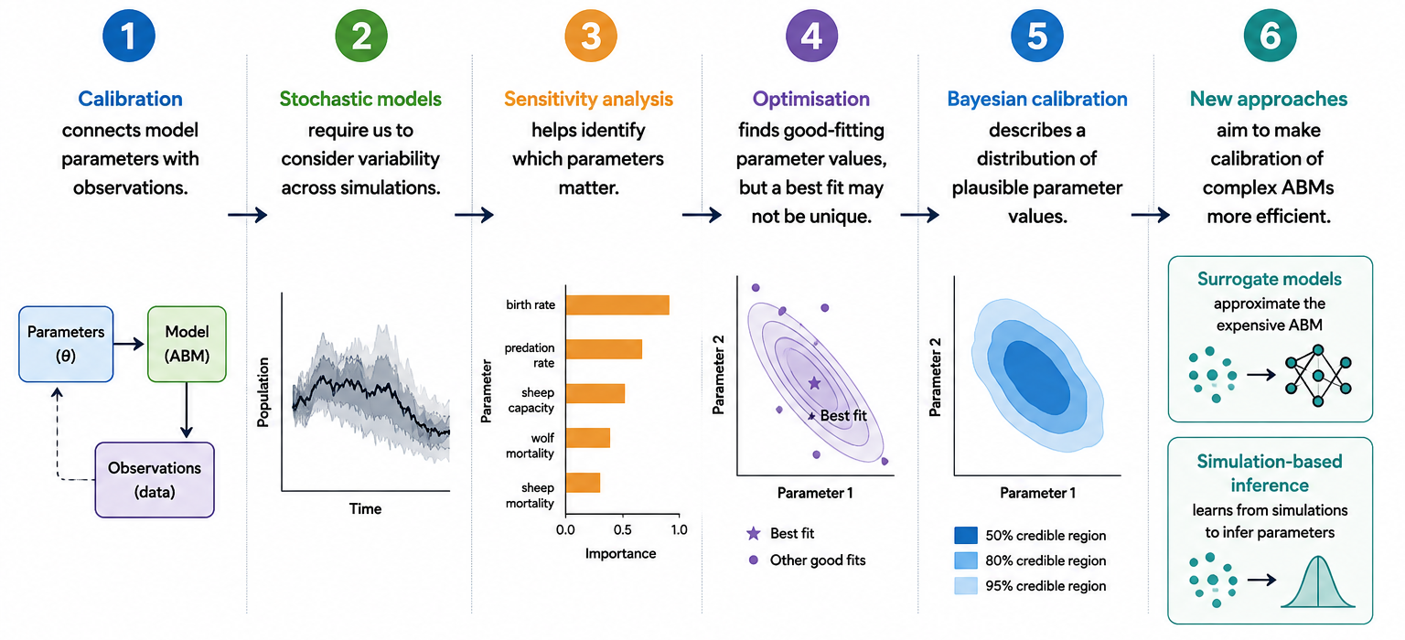
Key Takeaways
A Summary of this Session

Slide 27
Next Steps
The Following 45 Minutes
Code Demonstration of:
Exploration via Space-Filling Designs
Global Sensitivity Analysis
Black-Box Optimisation
Likelihood-Free Bayesian Calibration
Future Directions: SBI and Surrogates
Group Idea Development:
Develop your own ABM
Rotate into New Groups

Slide 28
Closing

