Slide 1

An Introduction to the Calibration of Agent-Based Models
James Bristow
TPM Agent Based Modelling Wānanga

Slide 2
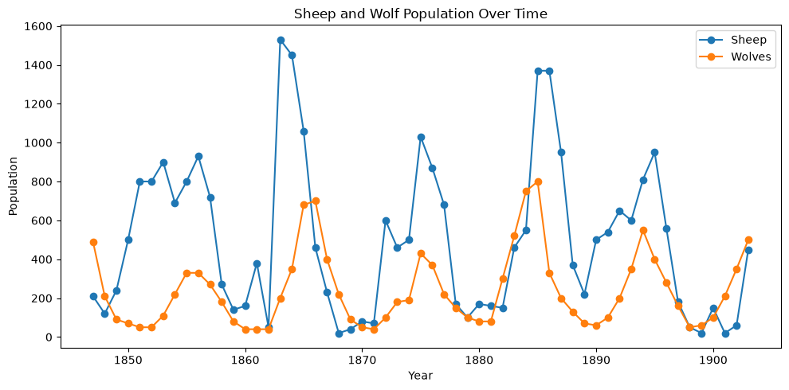
Predator-Prey Modelling
Why Model Predator–Prey Systems?
Cyclic behaviour: More prey → more predators → fewer prey → fewer predators → more prey again
Balance: Models show when predator and prey populations can coexist without either going extinct

Slide 3
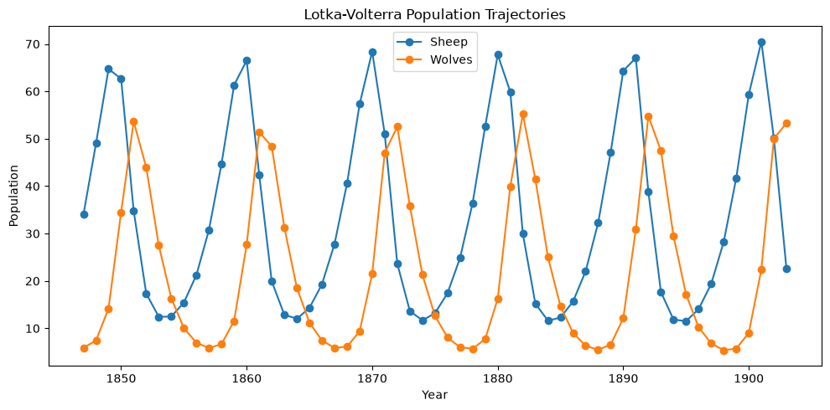
Lotka-Volterra Equations
Population-Level Ordinary Differential Equations
Represents populations, and not individual animals or their behaviour
Describes how the number of sheep and wolves changes over time
Uses equations to represent processes such as reproduction, death, and predation

Slide 4
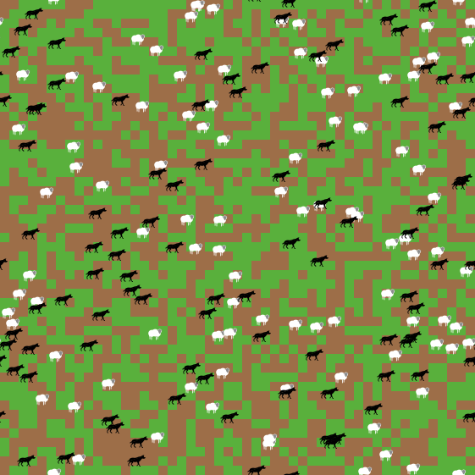
Wolf Sheep Predation Model
Individual-Level Agent-Based Model
Wolves and sheep are represented as individual agents with their own location, energy, and behaviour
Agents move, reproduce, eat, and interact with other agents
Population-level patterns emerge from individual behaviours

Slide 5
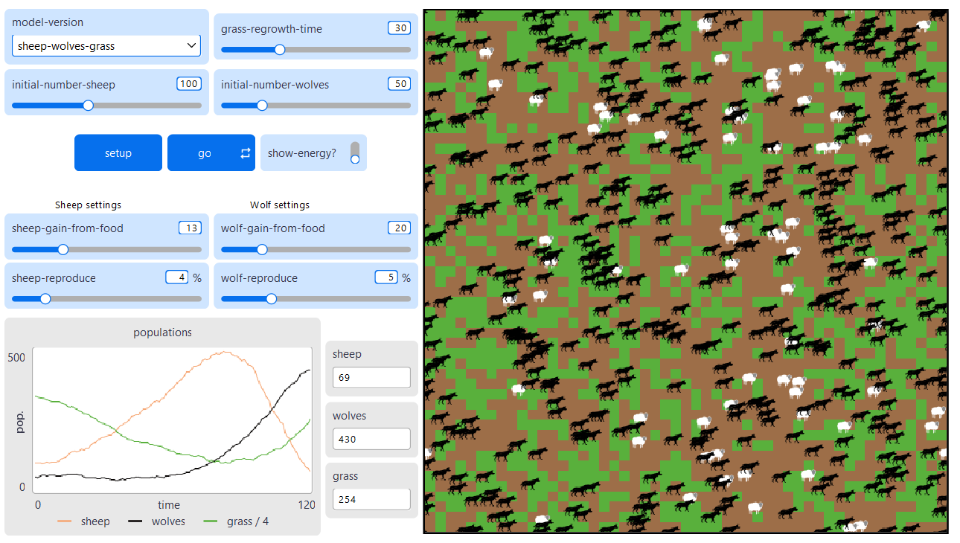
Wolf Sheep Predation Model
Running the Model in NetLogo
File
Models Library
Search for “Wolf Sheep Predation”
Sample Models -> Biology -> Wolf Sheep Predation
model-version = “sheep-wolves-grass”
setup -> go
Can you adjust the model parameters so that the population of sheep is as close as possible to 120 at time 100?
Notes:
Adjust the parameters of the model until the sheep population is as close to 120 as possible at 100 timesteps

Slide 6
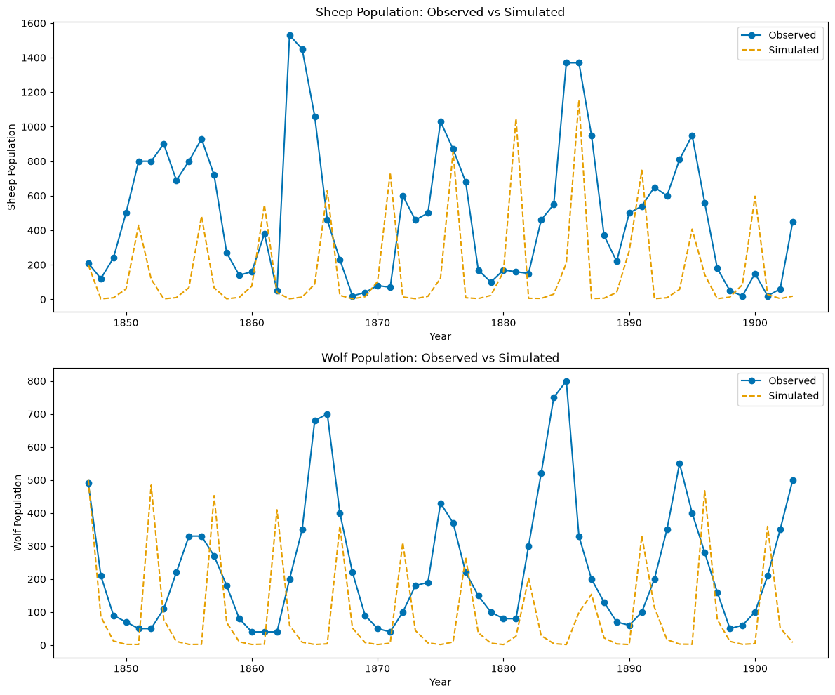
What is Calibration?
From Models to Reality
Systematically adjusting model parameters so that simulated outputs are consistent with observed data

Slide 7
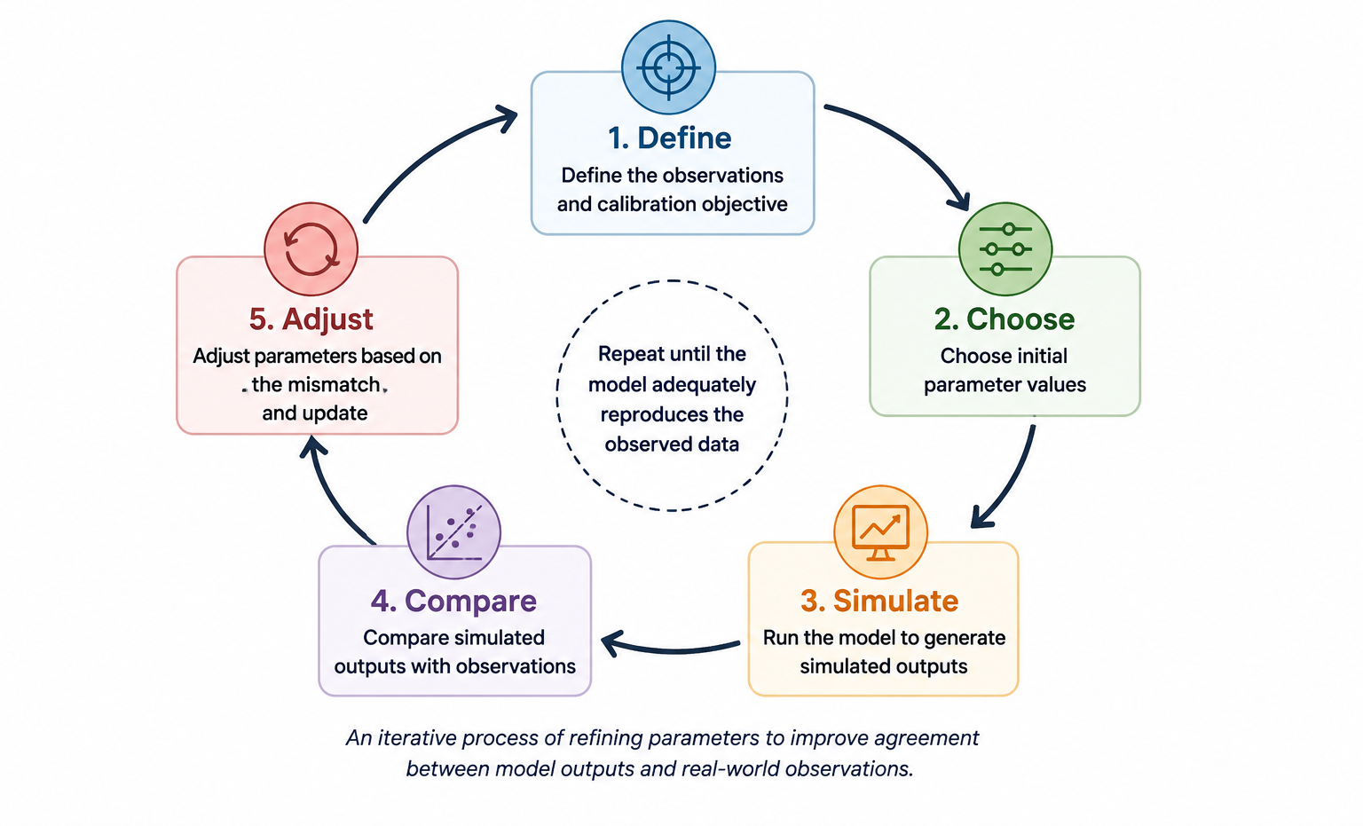
The Calibration Process
Calibration as an Iterative Process

Slide 8
The Challenges of Calibration
Population-Level and Individual-Level Modelling
 | Lotka-Volterra (Population-Level) | Wolf Sheep Predation (Individual-Level)
Parameters | Usually fewer | Usually more
Population- Level Dynamics | Explicit | Often emergent
Stochasticity | Often deterministic | Often stochastic
Computational cost | Usually lower | Usually higher
Observation level | Matches model level | Often aggregated to system level - mismatch
Calibration | Often easier | Often more difficult

Slide 9
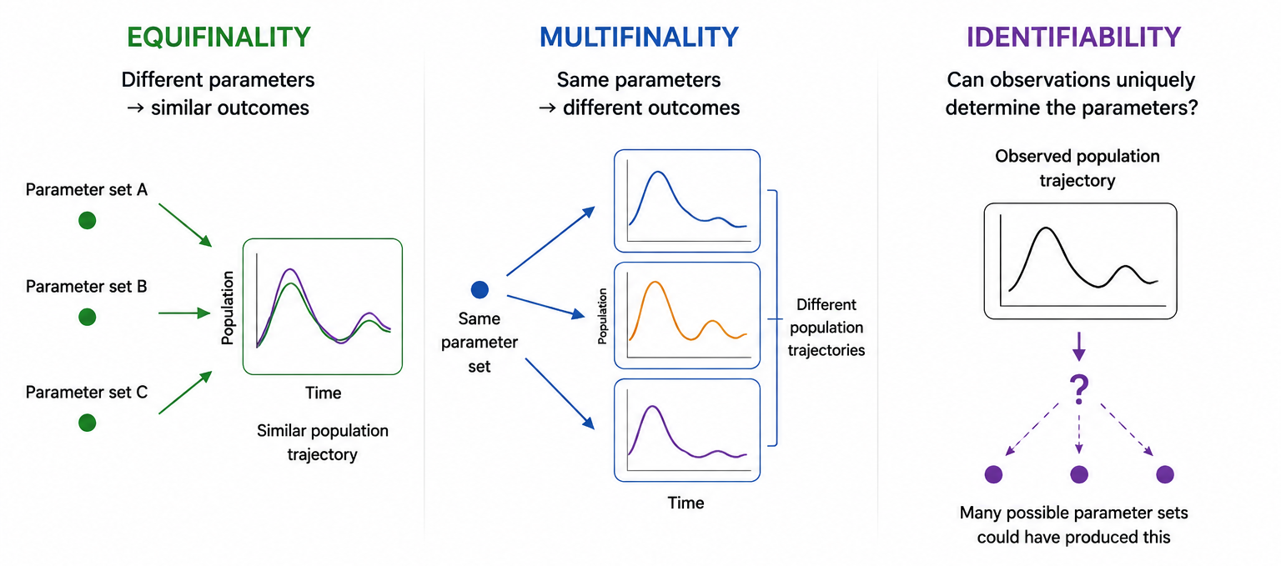
The Challenges of Calibration
Calibrating the Model from Observations
Notes:
Stochasticity → Multifinality
More parameters + emergent dynamics → Equifinality
Individual-level model + population-level observations → can contribute to Identifiability problems
What is the difference between equifinality and identifiability?

Slide 10
Can You Identify the Challenge?
Equifinality, multifinality, or identifiability?
Scenario | Answer
We run the stochastic Wolf–Sheep model five times with identical parameters and obtain five different sheep population trajectories
We try five different parameter combinations of sheep reproduction and wolf predation. All five fit the observations equally well
Two very different parameter sets produce almost identical sheep population trajectories

Slide 11
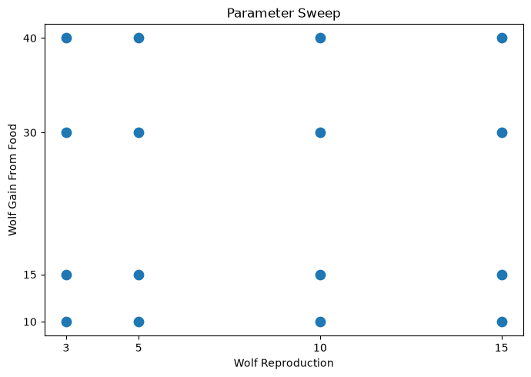
Exploring the Parameter Space
Constructing a Parameter Sweep
Parameter space: Set of possible values for each parameter
Sweep through different parameter combinations. How does model behaviour change?
Combinatorial experiment: Test all possible combinations. 2 parameters and 4 values each: 4 x 4 = 16 combinations
Other experimental designs possible

Slide 12
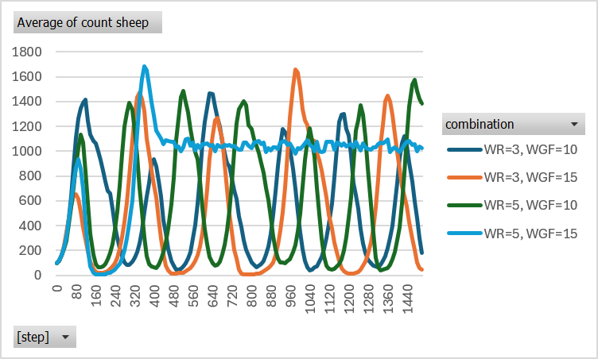
Exploring the Parameter Space
Experiments in BehaviorSpace
Tools
BehaviorSpace
BehaviorSpace combinatorial (16 runs)
Save Table output
Open Excel File
Delete all columns except: wolf-reproduce; wolf-gain-from-food; [step]; count sheep
Create “combination” column with formula: ="WR="&A2&", WGF="&B2
Insert -> Pivot Table
Rows = [step]; Column = combination; Values = count sheep
Sum of count sheep -> Average of count sheep
Insert -> 2D-Line
Notes:
Do you have any observations regarding the four sheep population trajectories?
Wolf reproduction=5 and wolf energy gain=15; what would you do?

Slide 13
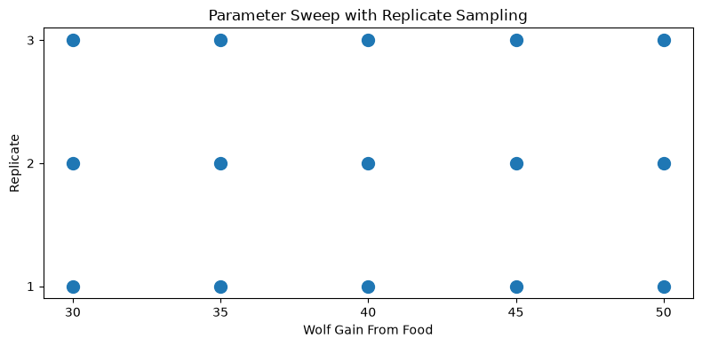
Repeat/Replicate Sampling
Repeating Samples of Parameter Combinations
Due to randomness, stochastic models produce different outcomes with same parameters
Repeat simulations to characterise typical behaviour and spread

Slide 14
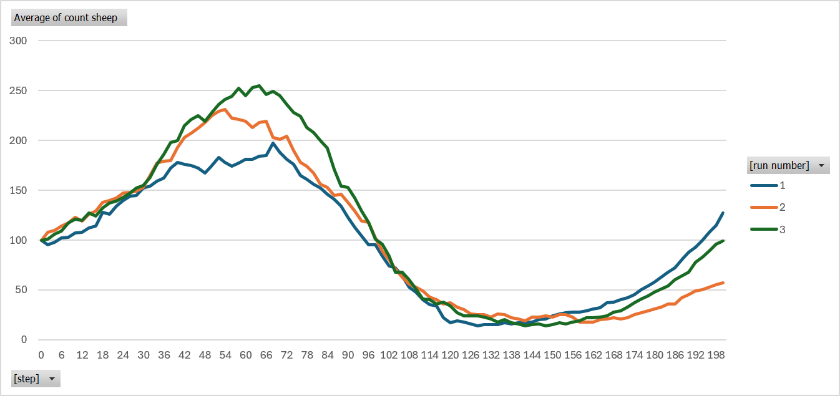
Repeat/Replicate Sampling
Experiments in BehaviorSpace
Tools
BehaviorSpace
New BehaviorSpace Features (15 runs)
Save Table output
Open Excel File
Delete all columns except: [run number]; wolf-gain-from-food; [step]; count sheep
Data -> Filter
wolf-gain-from-food = 30
Insert -> Pivot Table
Rows = [step]; Column = [run number]; Values = count sheep
Sum of count sheep -> Average of count sheep
Insert -> 2D-Line

Slide 15
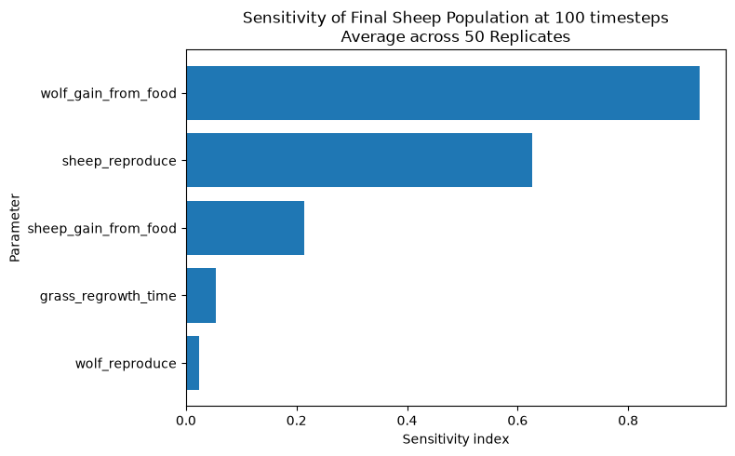
Performing a Sensitivity Analysis
Which parameters most greatly influence model behaviour?
Measures how changes in model parameters affect model outputs
Identifies parameters that have strong or weak influence on model behaviour
Prioritise parameters for calibration
Sensitivity indices from 358,400 simulations (not in NetLogo)
1024 * (5+2) * 50 = 358,400 simulation runs
Notes:
Based of the sensitivity indices, which parameters might we prioritise for calibration?
Add dummy parameter to NetLogo without changing model? If I vary the dummy parameter, would I expect that to contribute to the variation in the outputs

Slide 16
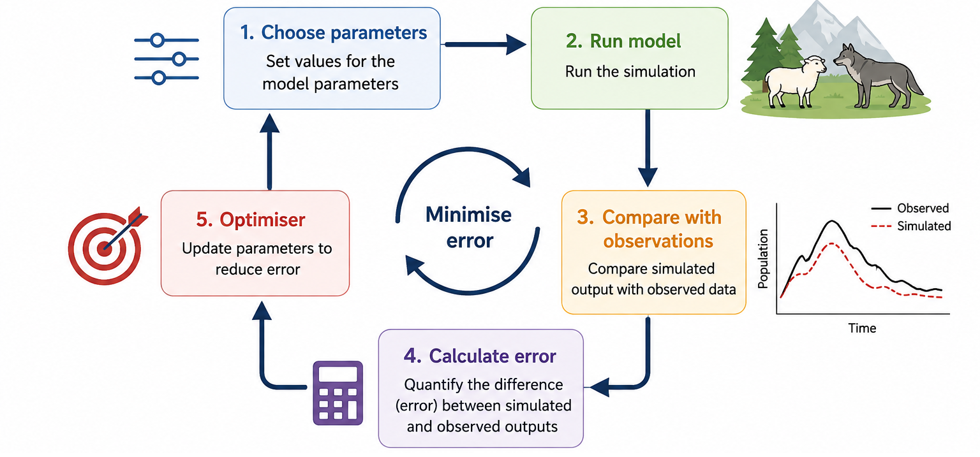
Calibration by Optimisation
What is Calibration by Optimisation?
Notes:
Process of selecting parameter is semi-automated by an optimisation algorithm
Optimisation problems have objectives that we want to achieve
Our objective is to minimise the error between observed and simulated data

Slide 17
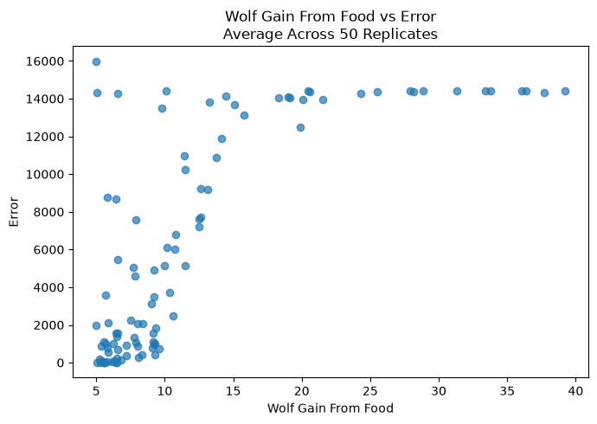
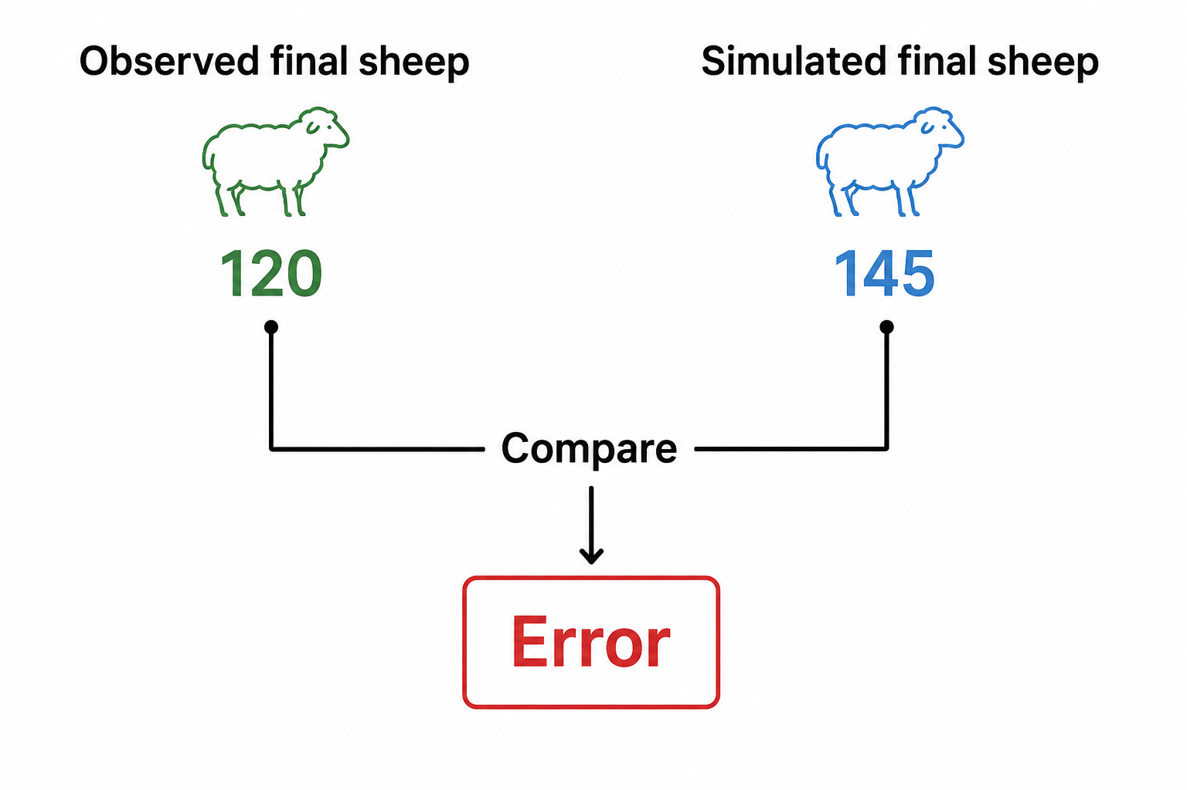
Finding the Best Fit
Parameter Values that Produces the Smallest Error
Calculate error: (Simulated−Observed)^2

Slide 18
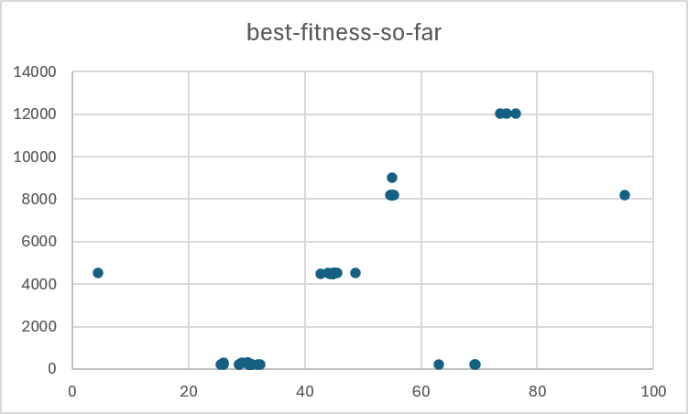
Finding the Best Fit
Optimisation in BehaviorSearch
Visit C:\Program Files\NetLogo 7.0.4
Open BehaviorSearch.exe
Browse for model = C:\Program Files\NetLogo 7.0.4\models\Sample Models\Biology\Wolf Sheep Predation.nlogox
Load parameter ranges from model interface
["wolf-gain-from-food" [0 "C" 100]]
["model-version" "sheep-wolves-grass"]
Measure = (count sheep - 120) ^ 2
Search Objective -> Minimize Fitness
Output file stem (sic)
Open *.objectiveFunctionHistory.csv
Select wolf-gain-from-food* and best-fitness-so-far
Insert -> Scatter

Slide 19
Beyond One Best Fit
Why Might a Single Best Fit Not Be Enough?
Challenge | What it means for optimisation
Multifinality | Noisy errors: The same parameters can produce different errors
Equifinality | Multiple good fits: Different parameter combinations can produce similarly good fits
Identifiability | Limited information: Observations may not contain enough information to identify a unique best fit
A single best fit does not capture the uncertainty in the parameters of the model

Slide 20
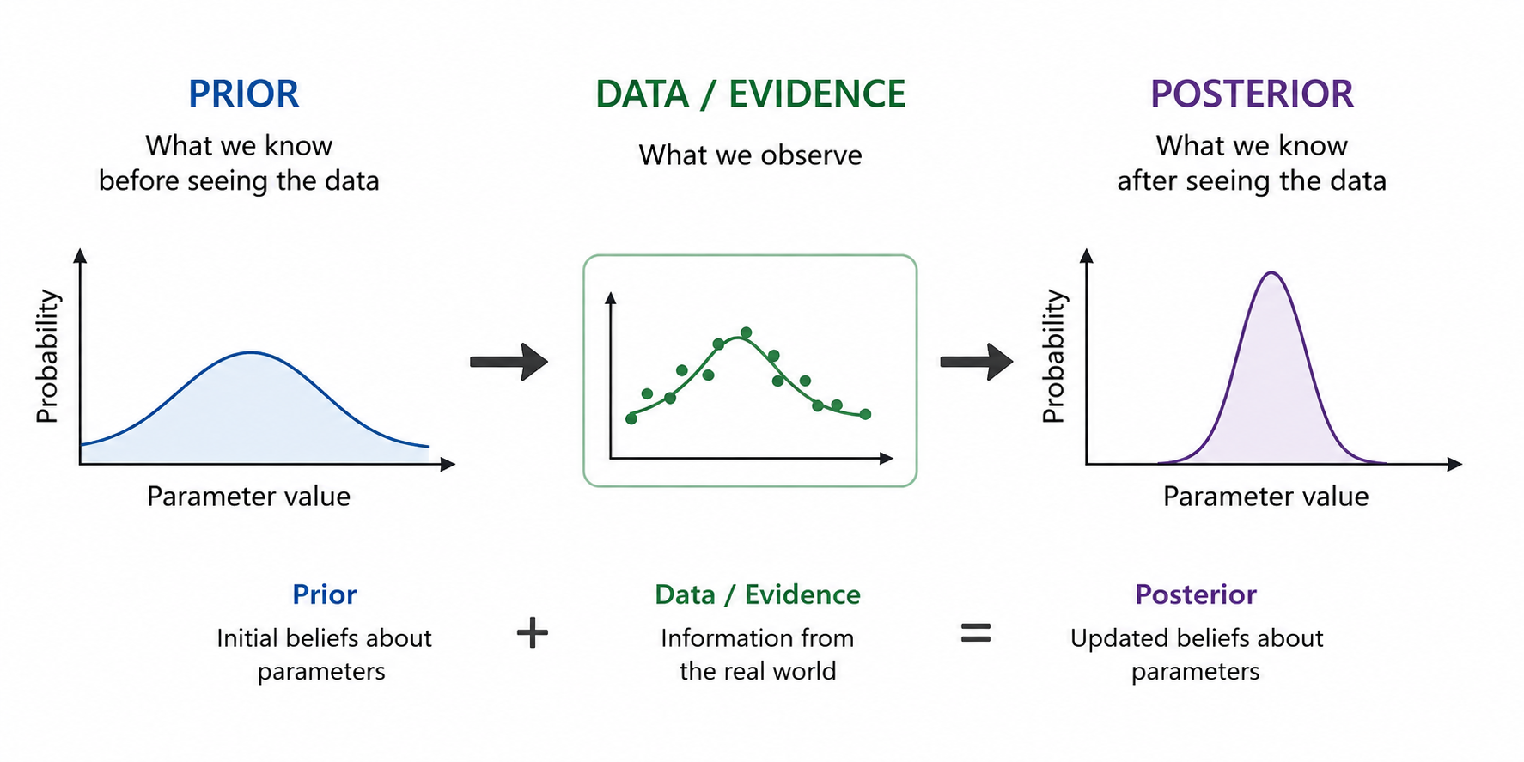
Applications of Bayesian Calibration
Which Parameter Values are Plausible Given the Evidence?

Slide 21
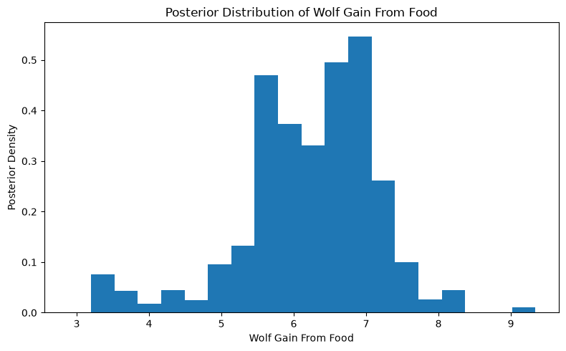
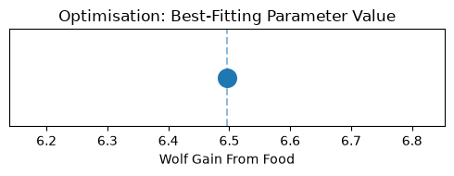
From a Best Fit to a Distribution
What do we Gain from Bayesian Calibration?

Slide 22
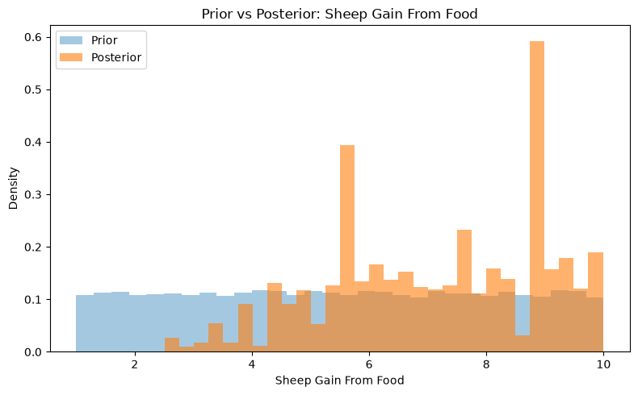
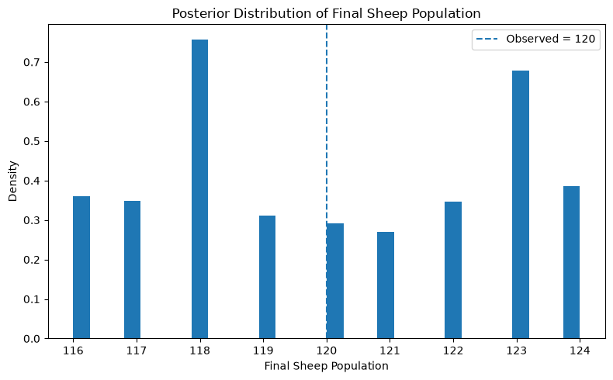
What Does the Posterior Tell Us?
Equifinality, multifinality, and identifiability
Match the challenge to the image

Slide 23
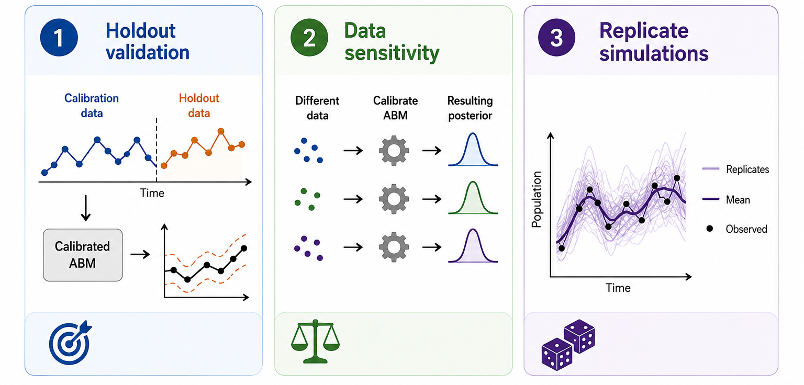
Evaluating the Calibration
Does the calibration hold up?

Slide 24
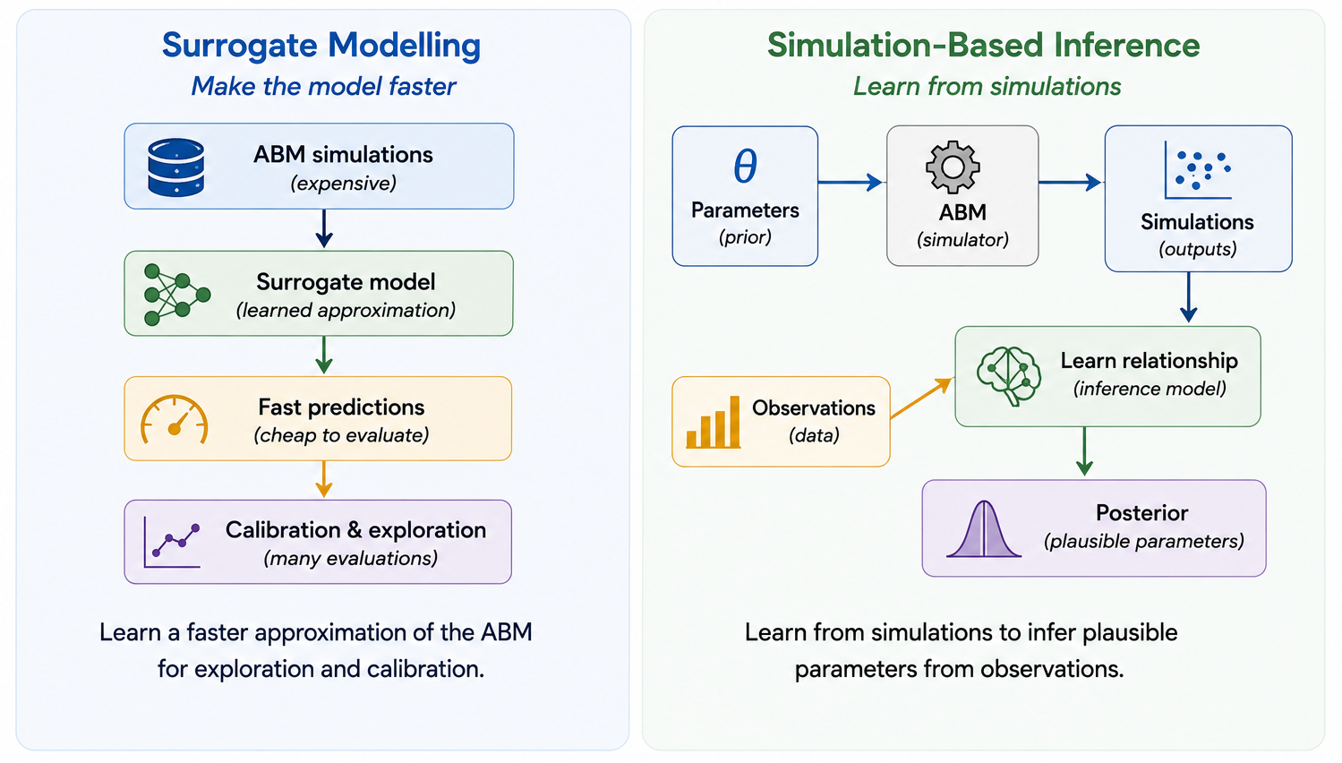
Future Directions
Can We Make Better Use of Our Simulations?
Notes:
Even though there are some benefits to using Bayesian calibration over optimisation, these are all theoretical concepts
From a more applied modelling standpoint
Bayesian methods may run 1 or 2 orders of magnitude more simulations during the calibration process. There are also typically more hyperparameters, and more components.
So when I began working with systems modelling a few years ago, a good piece of advice a supervisor was that a simpler model can often outperform a complicated model - there are fewer assumptions, fewer components, fewer things that go wrong. That also applies to the algorithm you use to perform you use to perform calibration

Slide 25
Next Steps
The Following 45 Minutes
Python Code Examples of:
Exploration via Space-Filling Designs
Global Sensitivity Analysis
Black-Box Optimisation
Likelihood-Free Bayesian Calibration
Future Directions: SBI and Surrogates
Group Idea Development:
Develop your own ABM
Rotate into New Groups

Slide 26
Thank You
https://github.com/JBris/calibrating-abms-workshop

