Slide 1

158755 Data Science – Making Sense of Data
Dolphin Fin Segmentation and Identification
Martin Brenner - 20022611
James Bristow - 11189075

Slide 2
Introduction
Process of identifying individual dolphins is:
Time consuming
Prone to error
Tedious
Automation via machine learning:
Detect and crop dolphin fins
Identify individuals
Deploy using a web app
Notes:
Requires involvement by experts

Slide 3
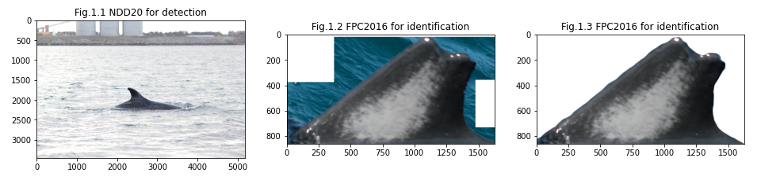
Exploratory Data Analysis
For the project two public datasets were used:
NDD20: For object detection https://arxiv.org/abs/2005.13359
About 2200 images
NIWA marine researchers: Provided images of fins for the identification process https://niwa.co.nz/news/know-your-dolphin-by-the-fin-says-niwa-scientist
About 3700 images
186 individual dolphins

Slide 4
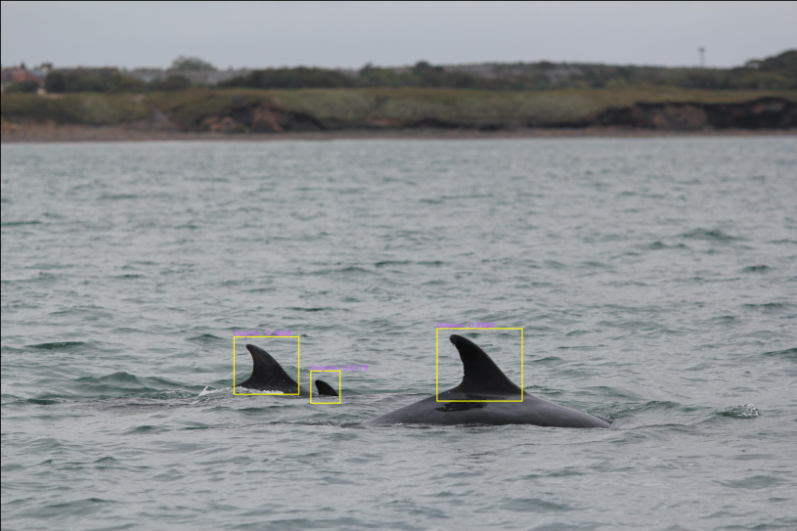
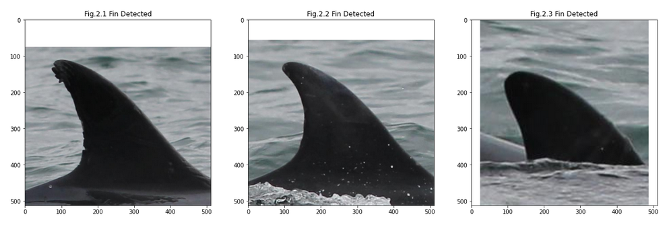
Object Detection
YOLOv4 was used for object detection
About 3170 fins in the 2200 images
OpenCV darknet detector used
Automatic cropping/resizing
Model trained with 4000 epochs
98% accuracy
12 hours training time

Slide 5
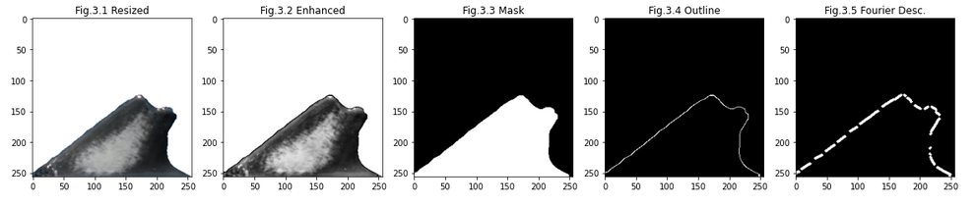
Feature Analysis
Distinction of individuals based on contour and pigmentation
Pigmentation does not change in a dolphin's lifetime
Colours are not important / variations based on lighting and cameras
Shape and pigmentation enhancement in pre-processing
Pre-processing of all images
Filter application on detected/cropped fins for identification input

Slide 6
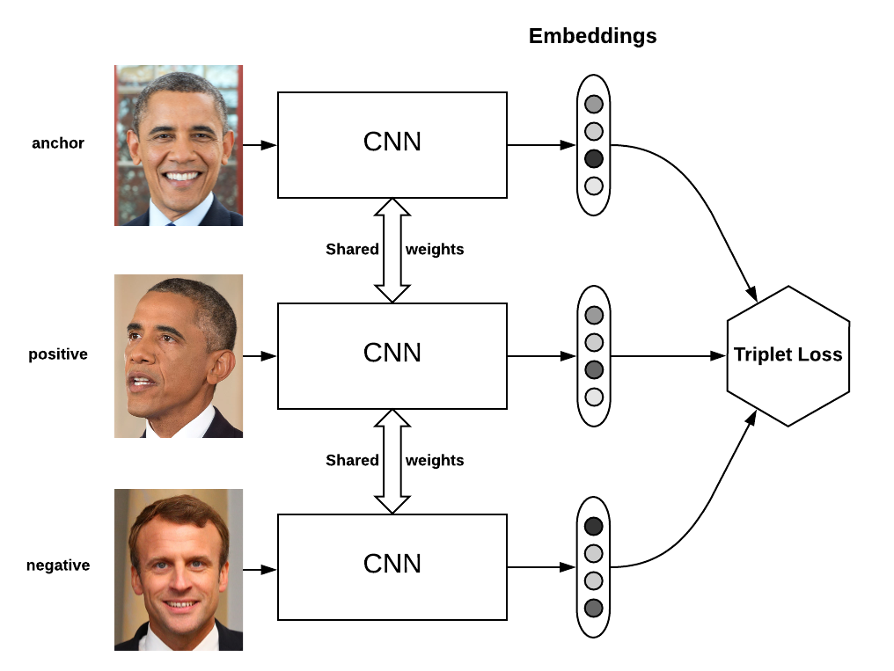
Individual Identification
Convolutional Neural Network
Triplet Loss
Anchor
Positive Input
Negative Input
Goal:
Minimise Euclidean distance between anchor and positive input
Maximise Euclidean distance between anchor and negative input
Source: https://omoindrot.github.io/triplet-loss​

Slide 7
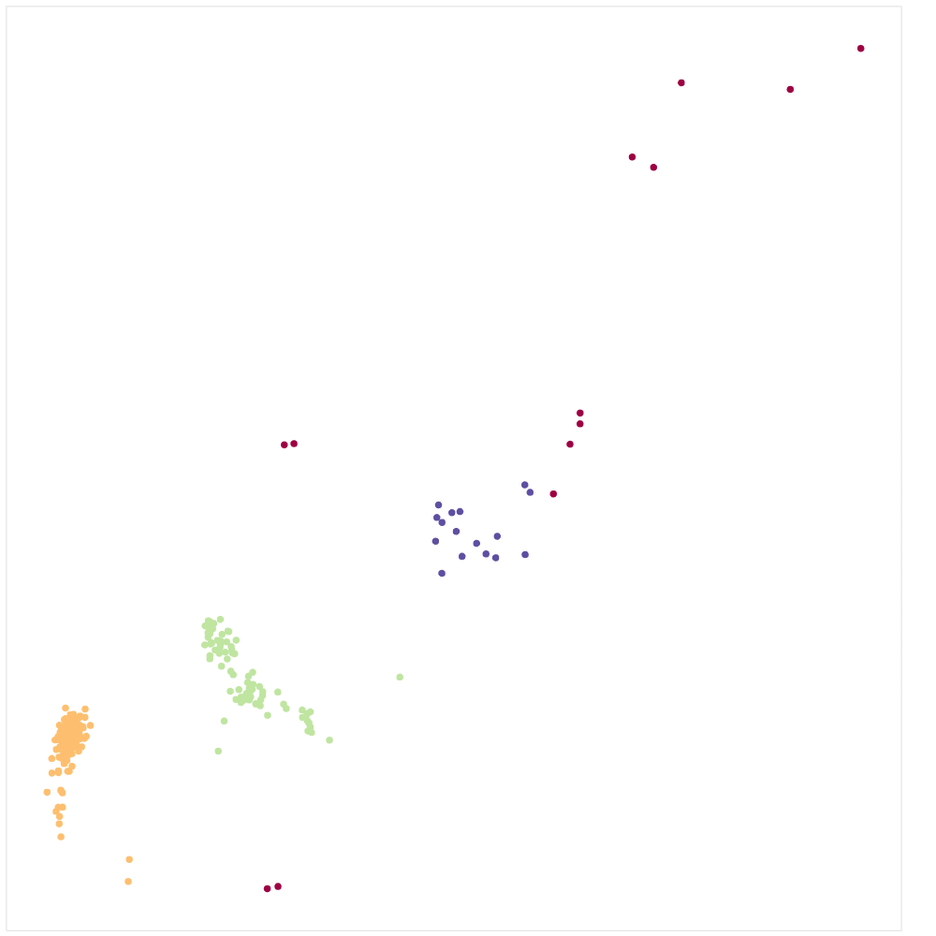
Visualisation
UMAP on the neural network embeddings
Non-linear dimensionality reduction
Visualise data in 2D
HDBSCAN for identifying clusters and outliers
Clusters are well-formed on bottom left
Outliers on top right

Slide 8
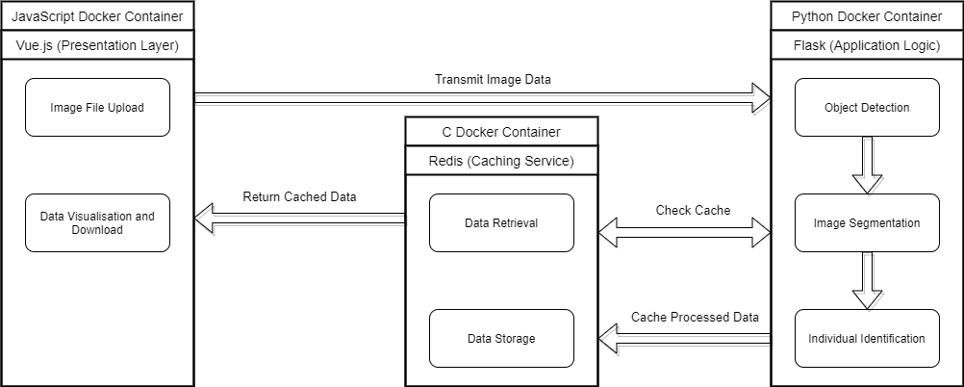
Application Architecture
https://github.com/JBris/dolphin_segmentation

Slide 9
Results
Object Detection and segmentation
Trivial – solved task
Individual Identification
Very difficult
Small datasets of dolphins
Triplet loss network is very sensitive

Slide 10
Application Demonstration

