Slide 1
A Machine Learning Framework for Fruit Sizing
James Bristow
Andrew Gilman
Henry Kirkwood
Notes:
Hi everyone, I’m James and I’m here to talk a little about what I’ve been up to during my summer internship at PlantTech., which is developing a machine learning framework for fruit sizing
During which, I’ve been principally working with Andrew, but also lately with Henry

Slide 2
Introduction
Fruit sizing using Approximate Bayesian Computation
Challenges and considerations
Machine learning tools
DVC
MLFlow
PyCaret
Ray
Optuna
A machine learning framework
Gold and Hayward kiwifruit datasets
Notes:
So, this talk is really divided into two sections. Firstly, I’ll provide a bit of background on the PlantTech Bayesian fruit sizing project that I’ve been working on for over six months now using Approximate Bayesian Computation or ABC.
I’ll identify some challenges and considerations for this project. There’s five machine learning tools that can help to solve these challenges. DVC, MLFlow, PyCaret, Ray, and Optuna.
But many of these challenges are not specific to the Bayesian sizing project. They are things that many PlantTech researchers have to deal with.
So the core question is whether it’s possible to develop a flexible and generalisable machine learning framework applicable to a variety of projects using these five tools. To prove this, I’ll demonstrate the use of this framework on a dataset of Gold and Hayward kiwifruits.
And this framework is really what I’ll be discussing

Slide 3
Bayesian Kiwifruit Sizing
Infer the size and weight distribution within an orchard
Varying consumer demand within domestic and overseas markets
Features are extracted from images collected from the orchard
Notes:
The idea behind Bayesian sizing is that we want to infer the size and weight distribution of kiwifruits within an orchard. This is because overseas and domestic consumers have different expectations about the size and shape of their kiwifruits. So it’s all about market segmentation.
Kiwifruit growers need to be able to estimate this sizing information to ensure that they are matching the supply of kiwifruits with consumer demand within different segments
Currently, we use orchard images captured from autonomous vehicles. Kiwifruits are segmented from images, and informative features are extracted. These features, when combined with the actual fruit weights, allows us to perform Bayesian inference.

Slide 4
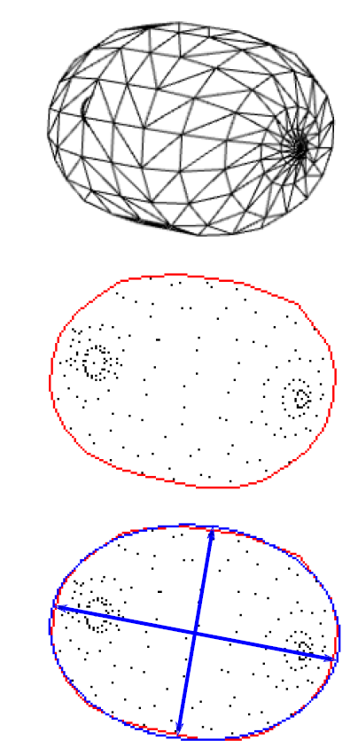
Approximate Bayesian Computation
Parameter estimation using the likelihood
A simulation-based approach
Synthetic kiwifruits evaluated against real data
Ranjard, L., Bristow, J., Hossain, Z., Orsi, A., Kirkwood, H. J., & Gilman, A. (2021, December). Likelihood-free Bayesian inference framework for sizing kiwifruit from orchard imaging surveys. In 2021 36th International Conference on Image and Vision Computing New Zealand (IVCNZ) (pp. 1-6). IEEE.
Notes:
Why use ABC?
The majority of statistical models that you’ll run into use a likelihood function to estimate the model parameters. For the sort of complex models that PlantTech will be working with, it may not be possible to calculate the likelihood, or it may take too long.
We can use a simulation-based approach to approximate this likelihood instead. The Bayesian model uses a simulation function to produce synthetic data leading to creation of simulated images of kiwifruits, which you can see on the left. These synthetic kiwifruits will have their own simulated features, such as the major and minor axes that you can see at the bottom.
These are compared with real kiwifruit data to ensure that the simulated numbers are sensible. Parameter values estimated from synthetic data allow use to infer the distribution of parameter values within the model..

Slide 5
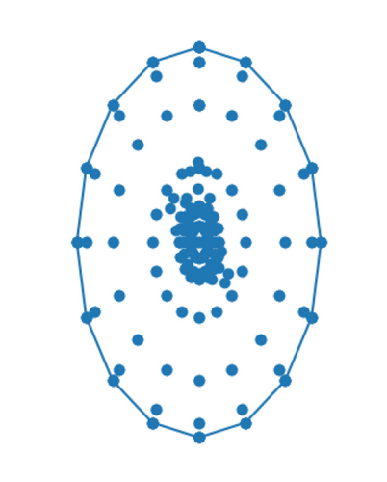
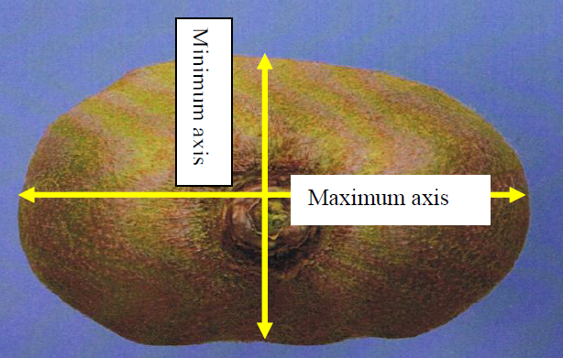
Considerations
Data and model versioning
Harmandeep, J. (2010). Factors affecting the replacement of wooden harvesting bins with plastic equivalents for the New Zealand kiwifruit industry (Doctoral dissertation, University of Waikato).
Notes:
There’s some considerations with respect to this ABC model.
To give you an example, I’d like to be able to impacts of flat kiwifruits, which have a width greater than their length, on model performance.
A synthetic dataset and model with zero flat kiwifruits is going to be quite different from a dataset and model with only flat kiwifruits.
Ideally, it should be possible to version both the synthetic datasets and the model itself, so I can reproduce and experiment with different versions.

Slide 6
Considerations
Experiment tracking, metrics logging, and visualisations
Harmandeep, J. (2010). Factors affecting the replacement of wooden harvesting bins with plastic equivalents for the New Zealand kiwifruit industry (Doctoral dissertation, University of Waikato).
Notes:
In order to reproduce my results, I’d need to track my experiments and see all the parameter values I’ve used to achieve these results.
To understand how flat kiwifruits effect my ABC model’s performance, I need to be able to log and compare metrics and view data visualisation to really understand what’s going on.
And because we’re a team, I’d like to be able to easily share all this information with others.

Slide 7
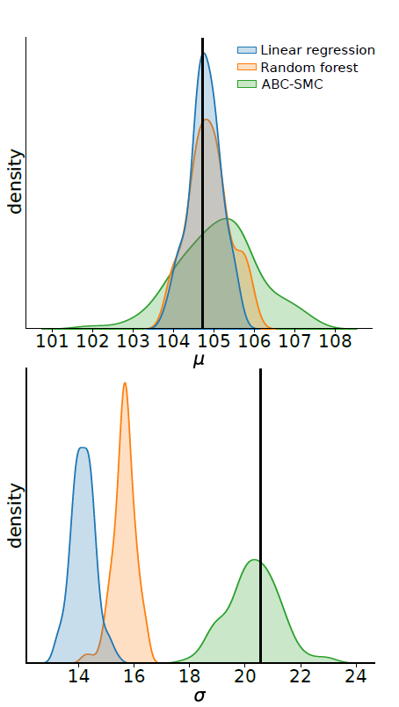
Considerations
Comparisons with non-Bayesian models
Many types of models
Model optimisation
Ranjard, L., Bristow, J., Hossain, Z., Orsi, A., Kirkwood, H. J., & Gilman, A. (2021, December). Likelihood-free Bayesian inference framework for sizing kiwifruit from orchard imaging surveys. In 2021 36th International Conference on Image and Vision Computing New Zealand (IVCNZ) (pp. 1-6). IEEE.
Notes:
Moreover, PlantTech’s current approach to performing fruit sizing doesn’t really make use of Bayesian models.
So, to determine the value of this ABC model, we need to compare it with non-Bayesian models. To perform this comparison, we want to train and evaluate a broad variety of models.
But this comparison process can be quite time consuming and repetitive. Now, I’m a pretty lazy guy, so it would be nice automate a lot of this tedious work and minimise a the amount of coding that we need to do.
We also need to optimise these non-Bayesian models using a scalable approach that is appropriate for complex models and big data.

Slide 8
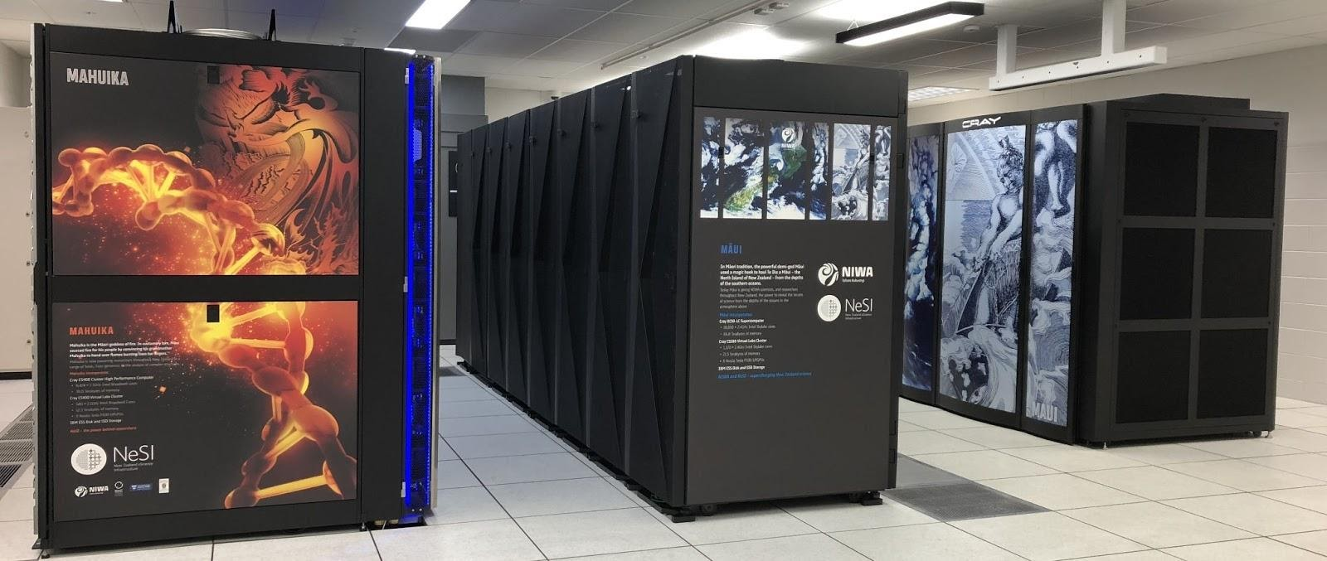
Considerations
Integration with High Performance Computing environments
New Zealand eScience Infrastructure (NeSI)
New Zealand eScience Infrastructure. (n.d.). High performance computing and analytics. https://www.nesi.org.nz/services/high-performance-computing-and-data-analytics
Notes:
Finally, a lot of this work is computationally expensive. Running thousands of simulations and optimising thousands of models requires a lot of computing power and takes a lot of time.
So integration with high-performance computing environments is key, and we need a way to facilitate parallel and distributed computing.
This might be PlantTech’s own computing cluster or NeSI, where a lot of this ABC modelling work was performed.

Slide 9
Machine Learning Tools
Name | Usage
DVC | Data versioning
MLFlow | Model versioning, experiment tracking, metrics logging, and data visualisations
PyCaret | Low-code pipeline construction
Ray | Parallel and distributed computing
Optuna | Model optimisation
Notes:
So, I’ll discuss the use of five machine learning tools to help overcome these challenges.
We can use DVC for data versioning.
MLFlow which is a web app for model versioning, experiment tracking, metrics logging, and visualisations.
PyCaret to automate these tedious work and build complex pipelines with only a little code.
Ray for parallel and distributed computing.
And Optuna for model optimisation using scalable algorithms for complex models, such as successive halving.
And these tools work. They’ve made the process of ABC modelling easier. But the challenges I’ve discussed are not unique to this Bayesian sizing project.
They’re challenges that PlantTech researchers have to deal with within their own projects.

Slide 10
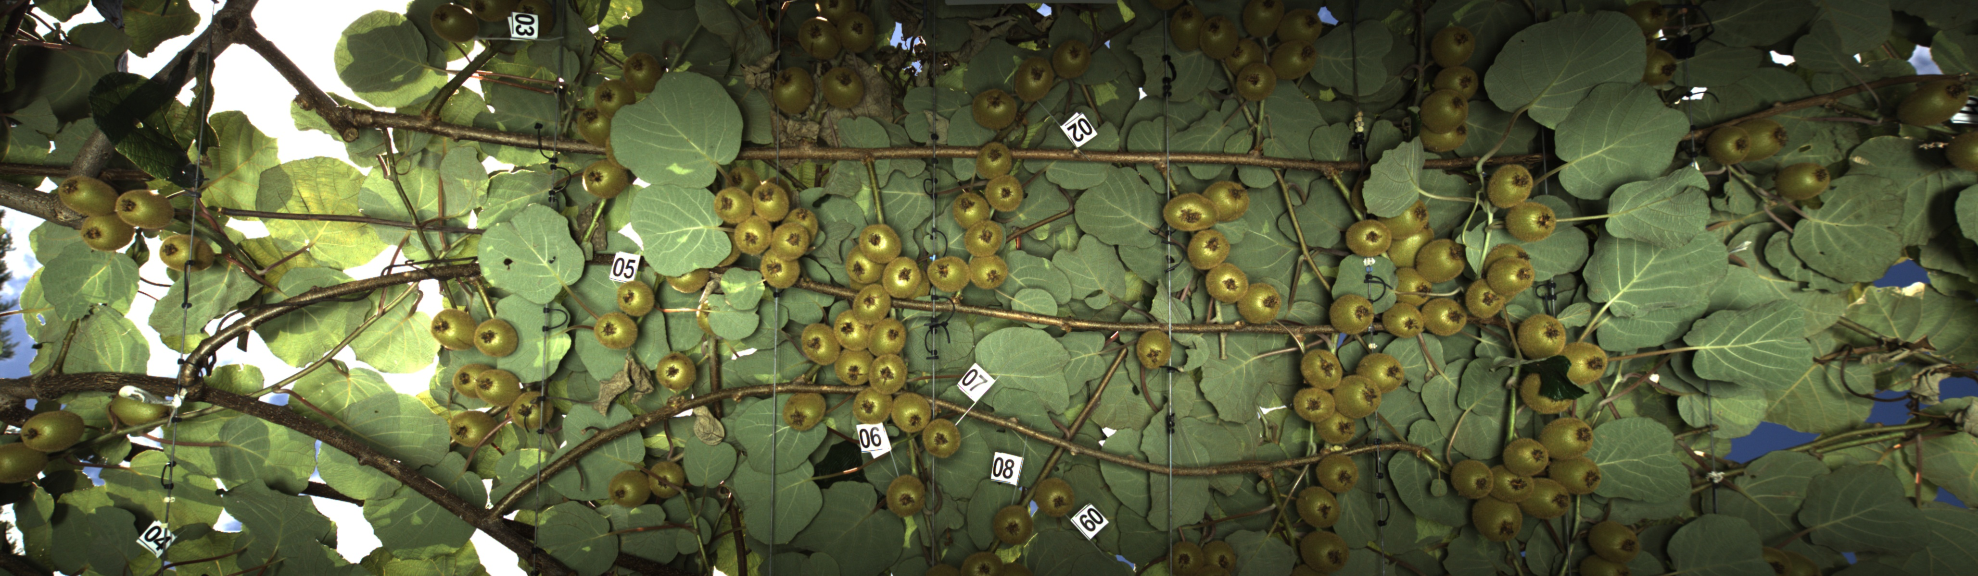
Kiwifruit Dataset
Two varieties
Golden
Hayward
Two KPINS
4217
7154
Notes:
So, Andrew and Henry have provided me with a dataset for both Golden and Hayward kiwifruits which were gathered from orchard images from two KPINS: 4217 and 7154
The question is: If these five tools are combined together, is it possible to create a generalisable machine learning framework for use outside of the Bayesian sizing project, and can this framework more broadly benefit PlantTech’s researchers in their own workflows?

Slide 11
Kiwifruit Dataset
Data preprocessing
Weight estimation using regression models
Clustering
Anomaly detection
Notes:
I’ll cover four different use cases:
Data pre-processing
Weight estimation using regression models
Clustering
And anomaly detection

Slide 12
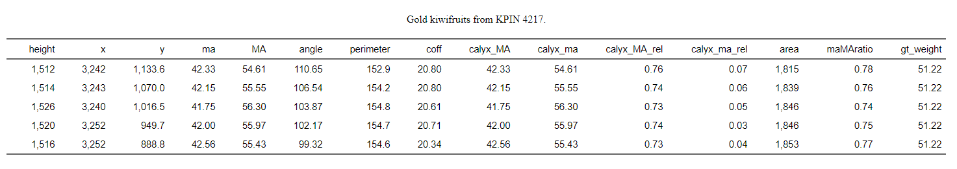
Data Processing
Notes:
The process of actually constructing this dataset is non-trivial.
The dataset was gathered from various sources. All this data needs to be manipulated, cleaned and combined together before it can be used.
This is where DVC is beneficial. We can declare all of our data pre-processing steps, document all the parameter values needed to produce this kiwifruit data, version it, and reproduce it.

Slide 13
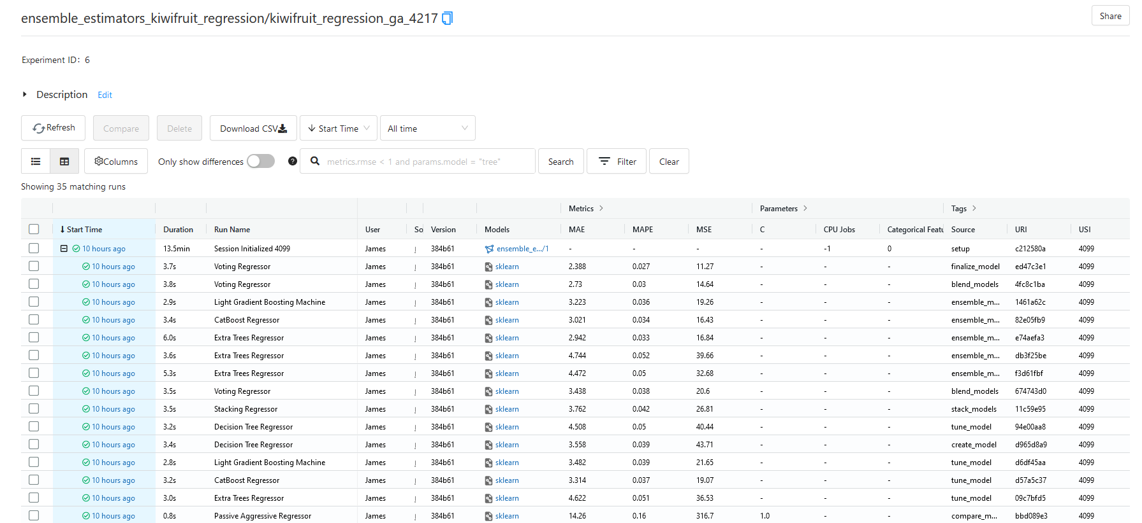
Regression Models
Notes:
Here I’m using the MLFlow dashboard to visualise all these tracked experiments, where I’ve used PyCaret to train a set of 25 different types of regression models on golden kiwifruit data from 4217 . You can see the model types under run name, and you can compare these models using these three metrics.
So what I can do is view one of these experiments.

Slide 14
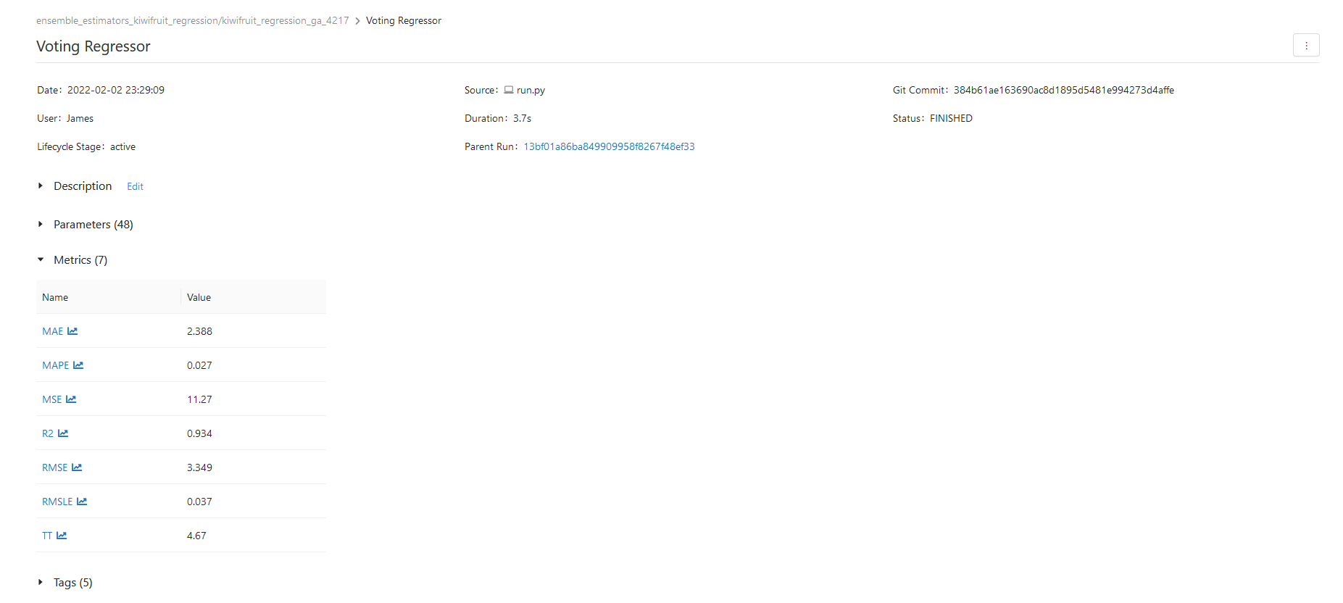
Regression Models
Notes:
This voting regressor is the top performing model. There’s all sorts of metadata. The date, the duration, the git commit and so on. Various metrics are logged at the bottom.
Each experiment run can also contain various artifacts

Slide 15
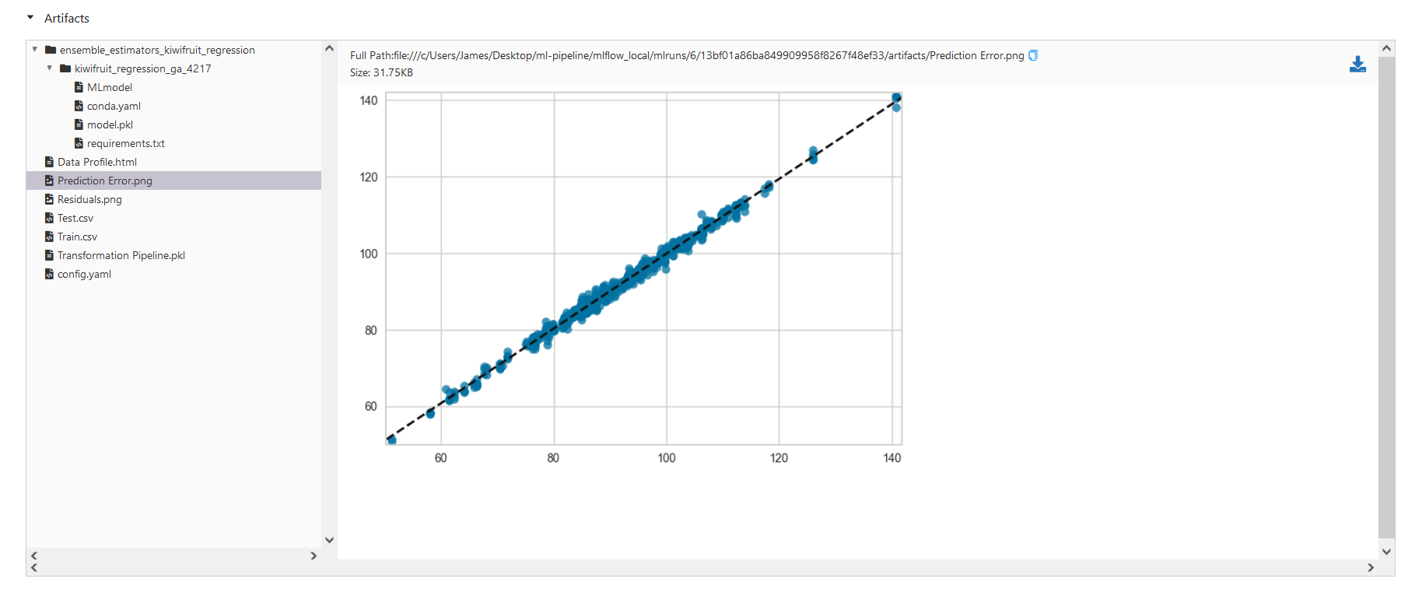
Regression Models
Notes:
One artifact is this visualisation of the prediction error of the model. You can see that the model performance is pretty outstanding.
You can save all sorts of visualisations as artifacts and download them later

Slide 16
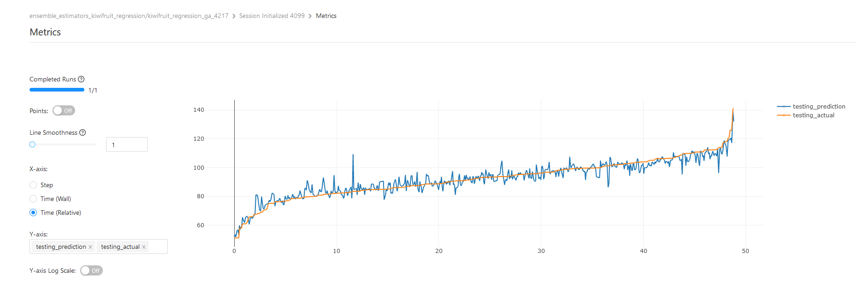
Regression Models
Notes:
It’s also possible to create and view interactive visualisations. If you look on the left, there’s all sorts of customisation tools.
So the model performance on testing data is not actually that great; there’s a lot of variation here. We can do more experimentation to improve model performance.

Slide 17
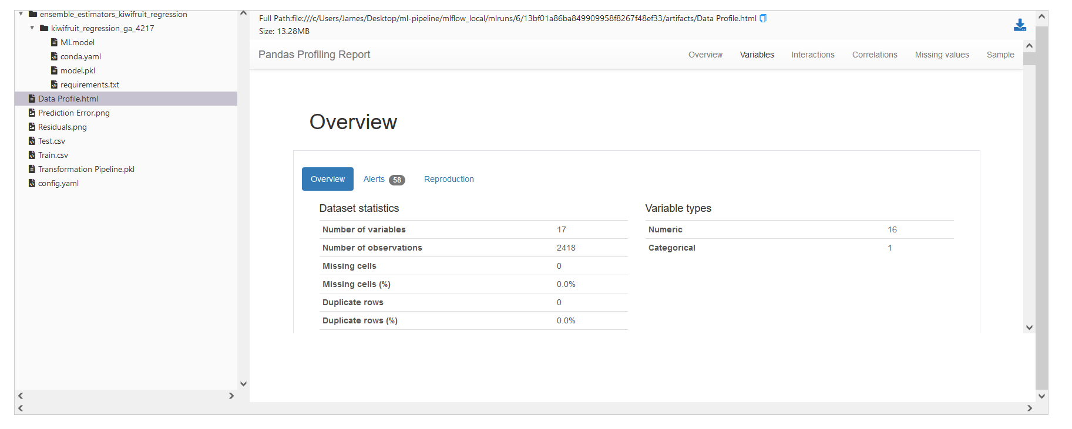
Regression Models
Notes:
Finally, a report containing an exploratory data analysis and feature analysis is automatically generated by PyCaret.
There’s useful information here like the number of observations and variables, any missing data, and variable types.

Slide 18
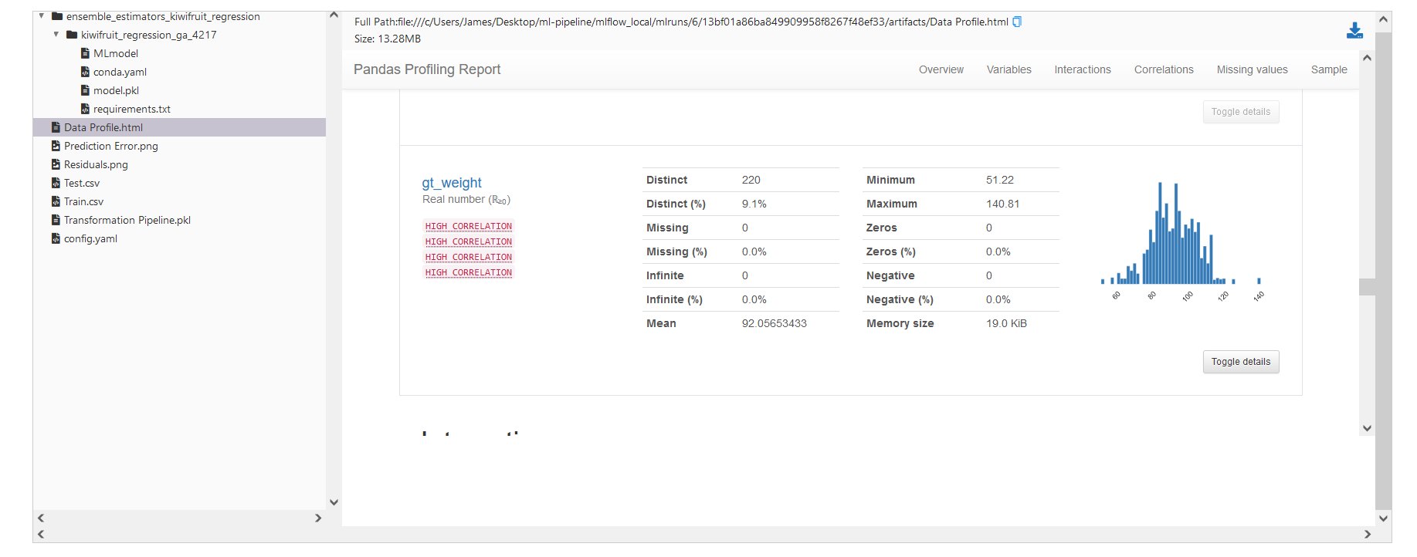
Regression Models
Notes:
So we have the ground truth kiwifruit weights. You can see that it’s approximately normally distributed with a mean of 92 grams, no missing values, a minimum of 51 and a maximum of 141

Slide 19
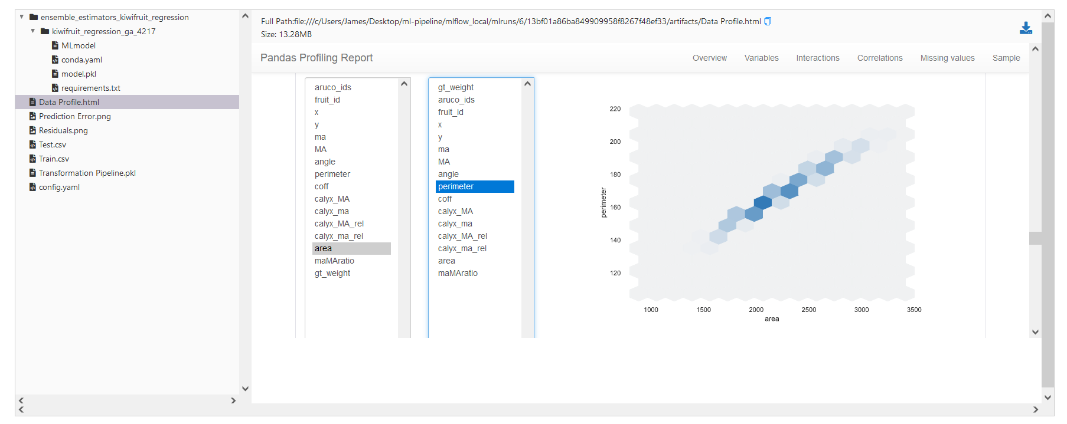
Regression Models
Notes:
Here’s a plot of feature interactions. There’s a prominent interaction between kiwifruit area and perimeter just around the middle here.
We can use this information to account for interactions and construct new features.

Slide 20
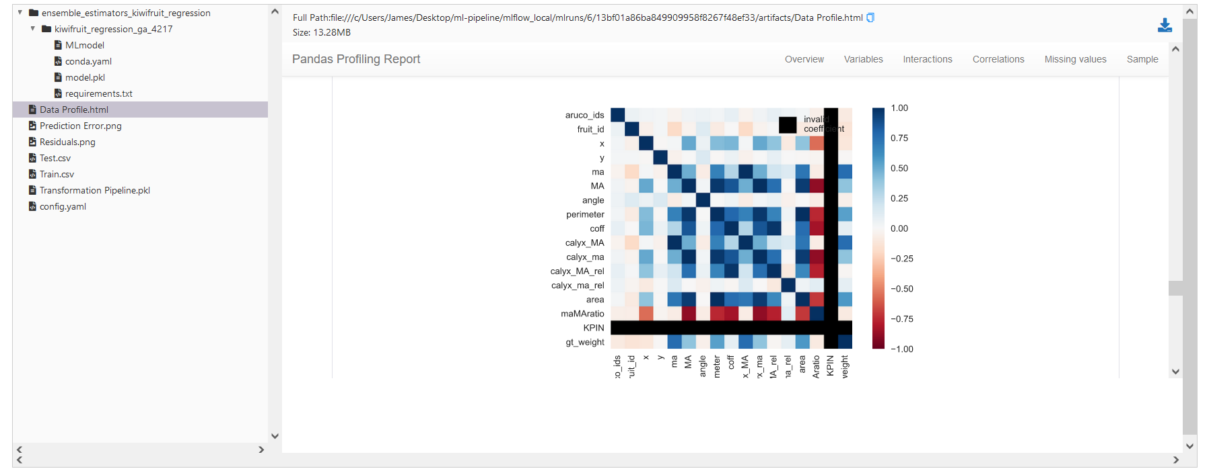
Regression Models
Notes:
This is a correlation plot. You can see that there’s a strong linear correlation between the major and minor axes, and the calyx major and minor axes.
These visualisation can be used to identify multicollinearity in the data.

Slide 21
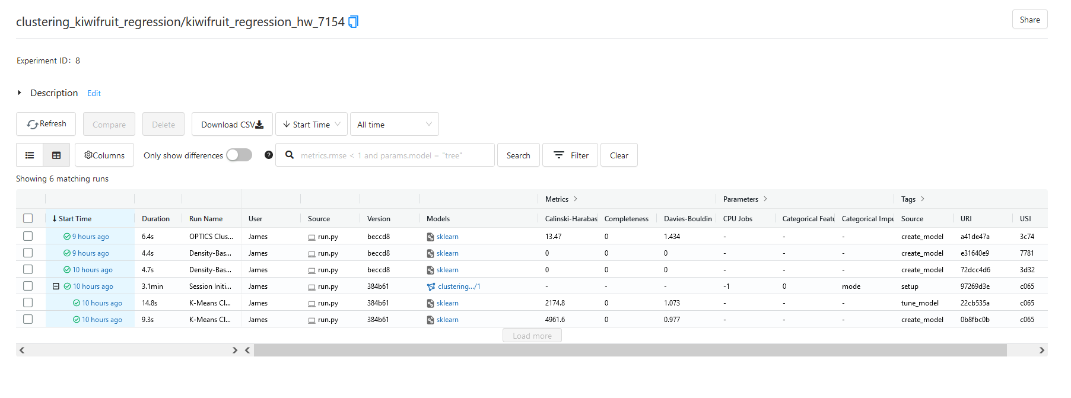
Clustering
Notes:
That was regression modelling. But we can also perform clustering on the data.
Here I’ve used several clustering algorithms on the Hayward kiwifruits from 7154 to do some data analysis and maybe identify different groups.

Slide 22
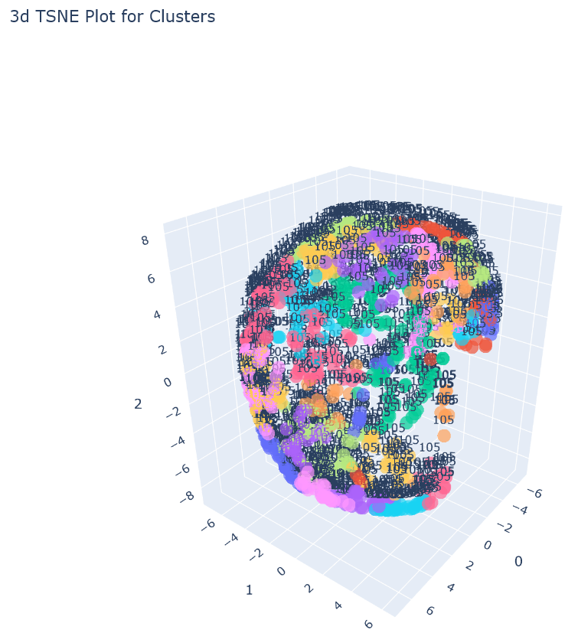
Clustering
Notes:
This is a 3D interactive plot of all the clusters. There’s 14 different kiwifruit clusters here, and you can hover your mouse over these points to identify all these groupings.
So this is where MLFlow really shines. Being able to produce all of these informative interactive plots without having to code them yourself.

Slide 23
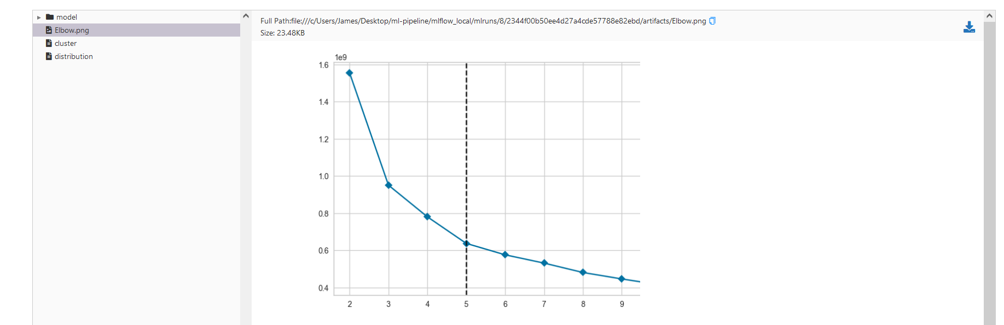
Clustering
Notes:
And this is an elbow plot. According to this, the optimal number of clusters for the Hayward dataset is 5. So there’s five different groups.

Slide 24
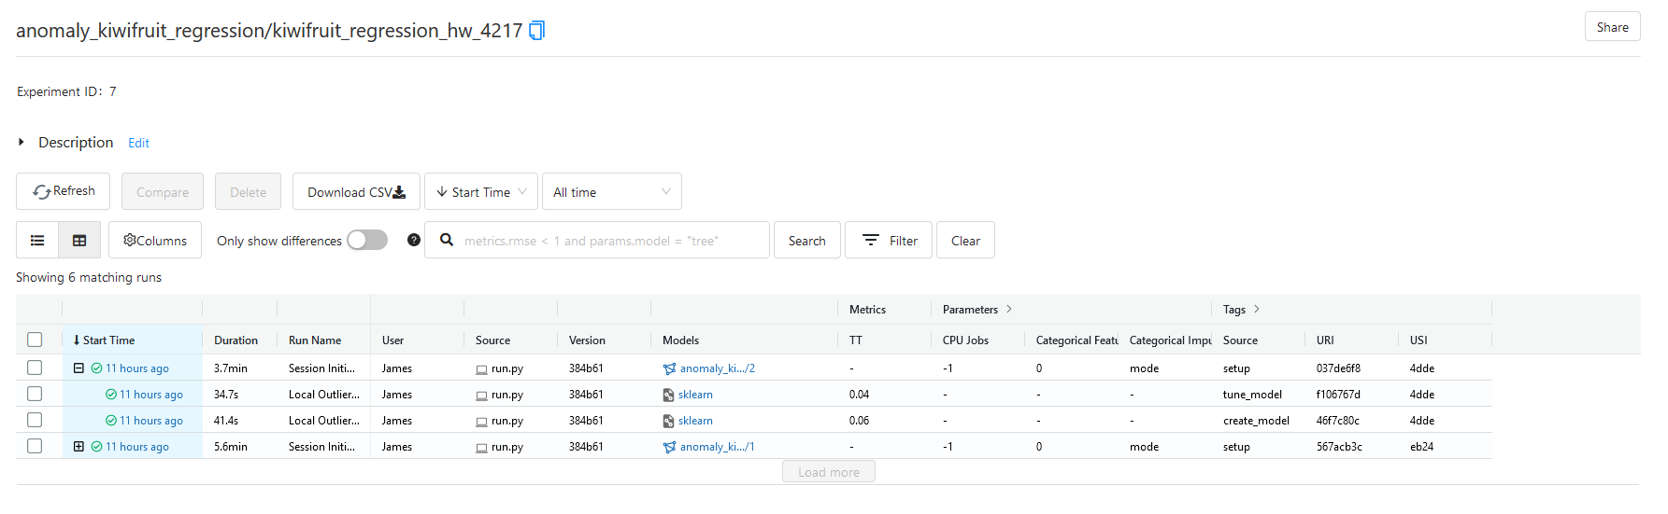
Anomaly Detection
Notes:
Finally, PyCaret supports various anomaly detection algorithms. So what I’m going to do is do some exploration and look for outlying Hayward kiwifruits from 4217.

Slide 25
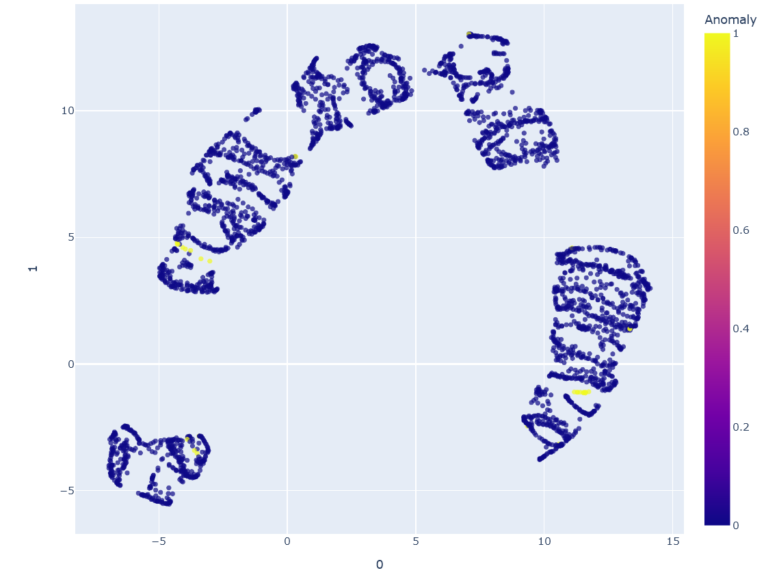
Anomaly Detection
Notes:
So this a 2D visualisation of the data. There’s 3 groups of anomalies here in yellow.
Again, this is interactive. You can hover your mouse over the anomalies and find their kiwifruit IDs.
So this can be used for data validation. Has something gone wrong in the pipeline to cause this anomaly, or it just an unusual looking kiwifruit?

Slide 26
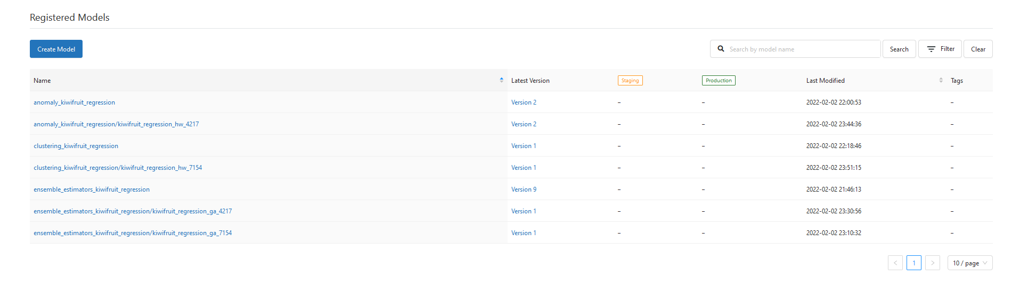
Model Versioning
Notes:
So I've covered regression, clustering and anomaly detection.
Performing these three tasks is going result in the creation of several different models.
What you can do using MLFlow is version them. It’s actually pretty easy to switch between and deploy different versions of these models
And the process of actually producing each model is all tracked.

Slide 27
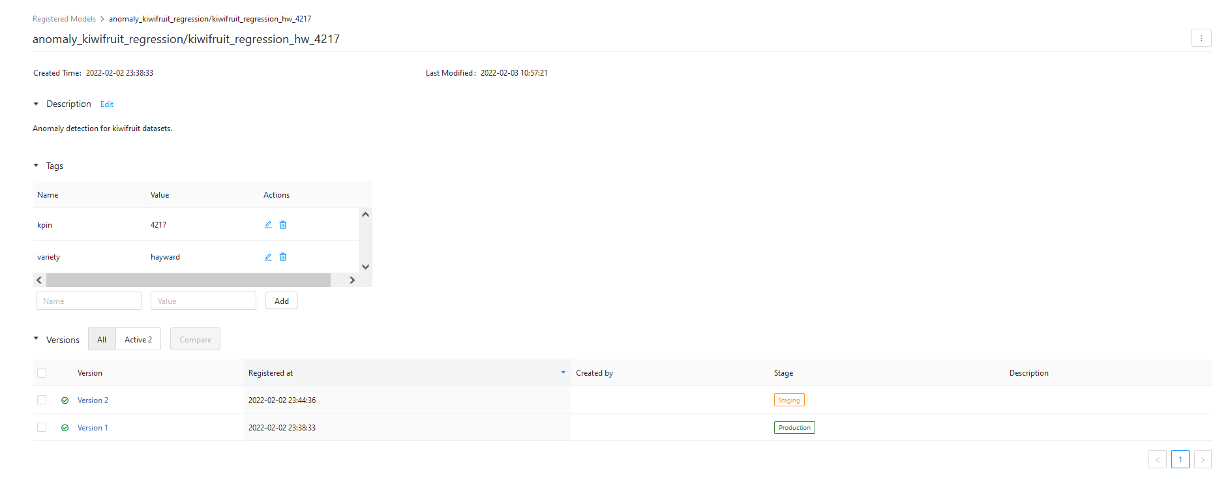
Model Versioning
Notes:
This is an anomaly detection model here that contains metadata tags. You can see at the bottom that there are two versions, one in staging and the other in production.
And the date that they were saved to the model registry

Slide 28
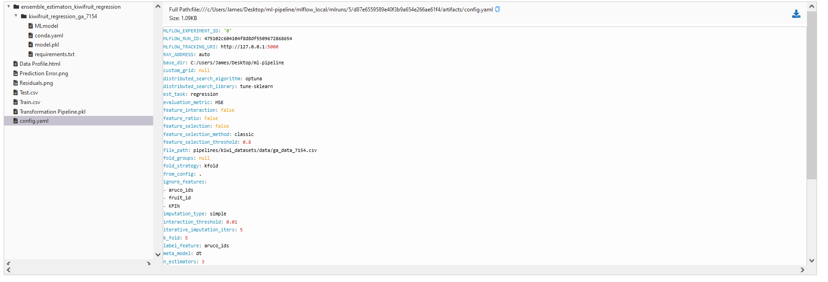
Pipeline Reproducibility
Notes:
Finally, all of these experiments need to be reproducible
This configuration file contains all of the metadata and information required to replicate the experiment results
It’s as simple as downloading the file and supplying it to the machine learning framework. The framework will run the experiment according to this configuration

Slide 29
Future Exploration
High-performance computing
Ray
Optuna
Metrics storage and visualisation
Prometheus and Grafana
Real-time streaming and stress testing
Kafka
Continuous Integration and delivery
Jenkins
BATS
Workflow automation
Airflow
Notes:
So, the next steps are to improve model performance with further hyperparameter tuning. The tuning process can be quite time consuming, so we might want to perform this process on NeSI or on PlantTech’s cluster.
This is where Ray and Optuna are going to be very useful in enabling parallel and distributed model optimisation

Slide 30


Acknowledgments
Notes:
Thank you for listening. I’d like to thank PlantTech and NeSI for making the project possible. Do you have any questions?

