Slide 1
A Machine Learning Framework for Fruit Sizing
James Bristow
Andrew Gilman
Henry Kirkwood

Slide 2
Introduction
Fruit sizing using Approximate Bayesian Computation
Challenges and considerations
Machine learning tools
DVC
MLFlow
PyCaret
Ray
Optuna
A flexible and generalizable machine learning framework
Gold and Hayward kiwifruit datasets

Slide 3
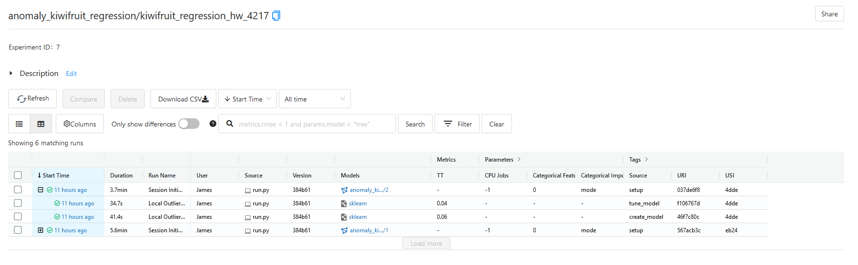
Anomaly Detection

Slide 4
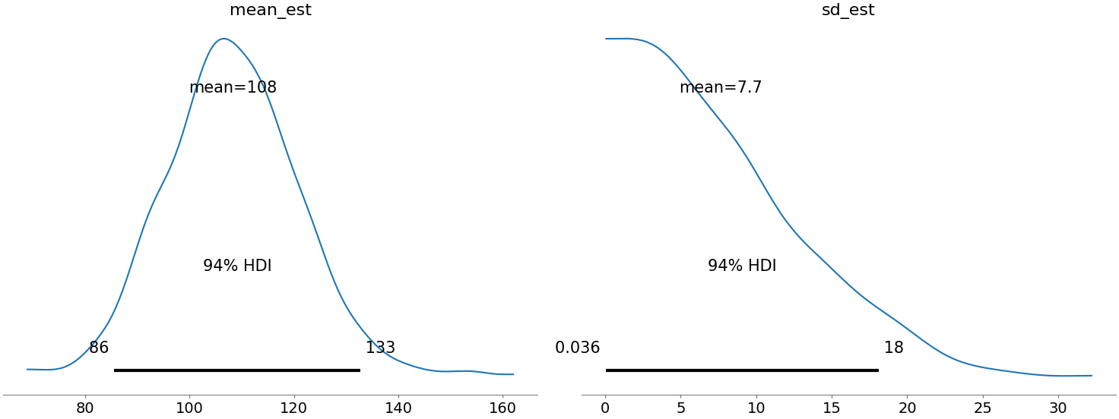
Bayesian Kiwifruit Sizing
Infer the size and weight distribution within an orchard
Varying consumer demand within domestic and overseas markets

Slide 5
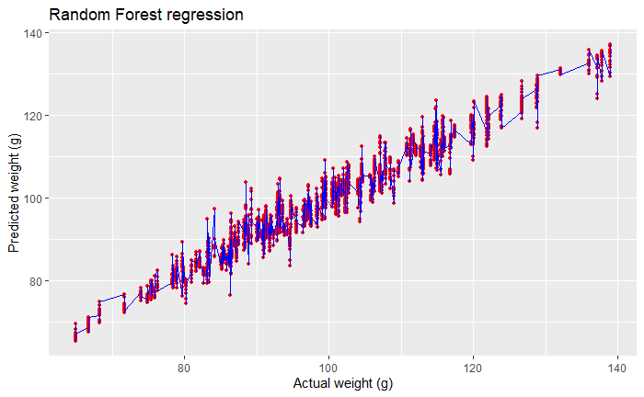
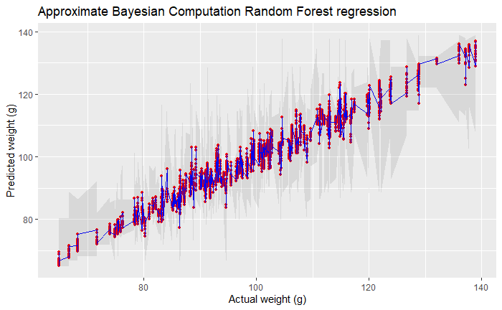
Why Bayesian Models?
Incorporate prior knowledge
Quantify uncertainty
Generate simulated observations

Slide 6
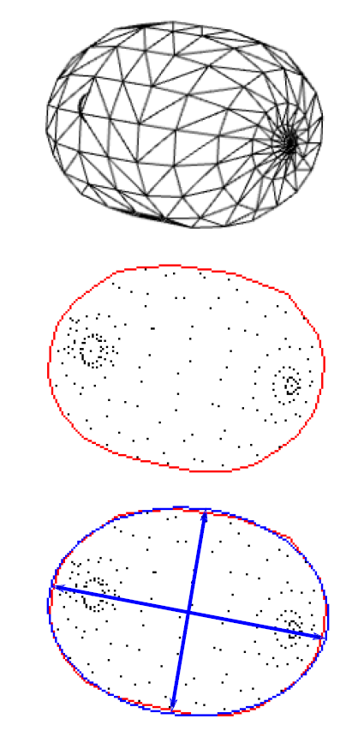
Approximate Bayesian Computation
Parameter estimation using the likelihood
A simulation-based approach
Synthetic kiwifruits evaluated against real data
Ranjard, L., Bristow, J., Hossain, Z., Orsi, A., Kirkwood, H. J., & Gilman, A. (2021, December). Likelihood-free Bayesian inference framework for sizing kiwifruit from orchard imaging surveys. In 2021 36th International Conference on Image and Vision Computing New Zealand (IVCNZ) (pp. 1-6). IEEE.

Slide 7
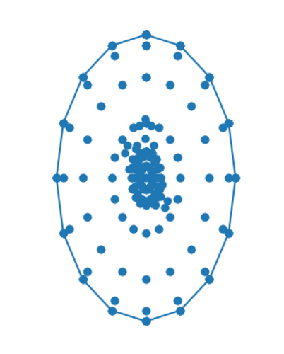
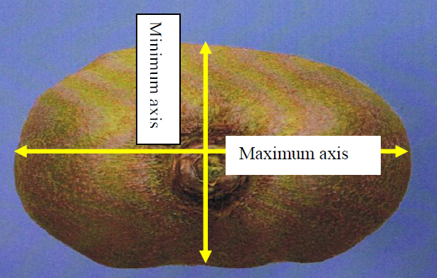
Considerations
Data and model versioning
Harmandeep, J. (2010). Factors affecting the replacement of wooden harvesting bins with plastic equivalents for the New Zealand kiwifruit industry (Doctoral dissertation, University of Waikato).

Slide 8
Considerations
Experiment tracking, metrics logging, and visualisations
Harmandeep, J. (2010). Factors affecting the replacement of wooden harvesting bins with plastic equivalents for the New Zealand kiwifruit industry (Doctoral dissertation, University of Waikato).

Slide 9
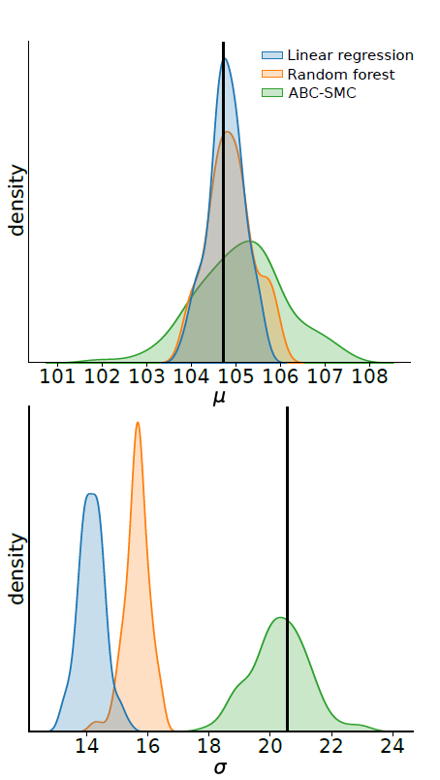
Considerations
Comparisons with non-Bayesian models
Train and evaluate many types of models
Model optimisation
Ranjard, L., Bristow, J., Hossain, Z., Orsi, A., Kirkwood, H. J., & Gilman, A. (2021, December). Likelihood-free Bayesian inference framework for sizing kiwifruit from orchard imaging surveys. In 2021 36th International Conference on Image and Vision Computing New Zealand (IVCNZ) (pp. 1-6). IEEE.

Slide 10
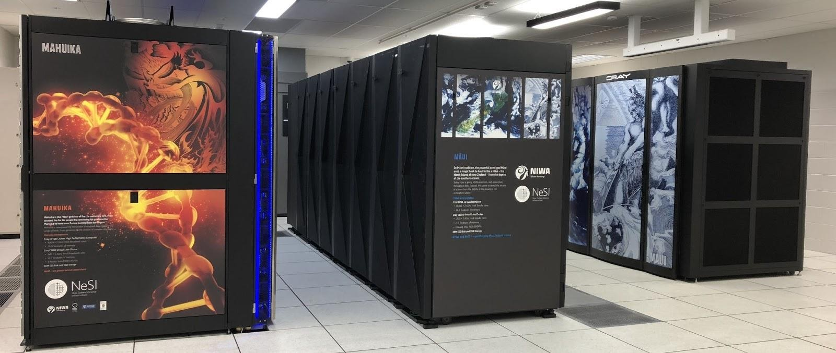
Considerations
Integration with High Performance Computing environments
New Zealand eScience Infrastructure (NeSI)
New Zealand eScience Infrastructure. (n.d.). High performance computing and analytics. https://www.nesi.org.nz/services/high-performance-computing-and-data-analytics

Slide 11
Machine Learning Tools
Name | Usage
DVC | Data versioning
MLFlow | Model versioning, experiment tracking, metrics logging, and data visualisations
PyCaret | Low-code pipeline construction
Ray | Parallel and distributed computing
Optuna | Model optimisation

Slide 12
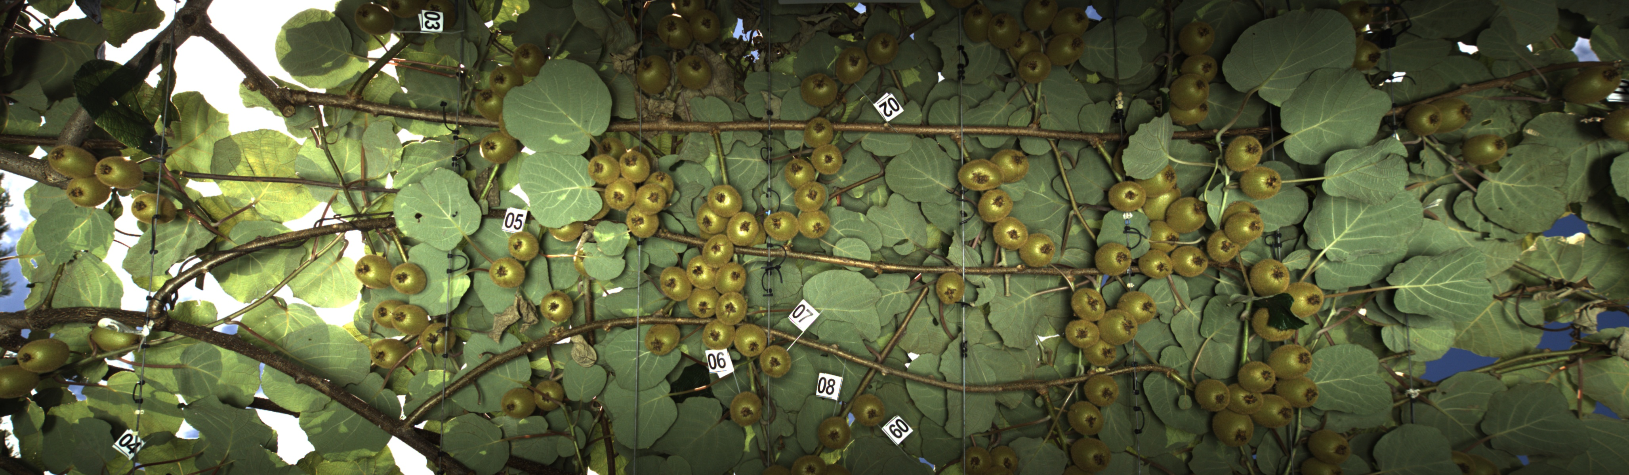
Kiwifruit Dataset
Two varieties
Golden
Hayward
Two KPINS
4217
7154

Slide 13
Kiwifruit Dataset
Data preprocessing
Weight estimation using regression models
Clustering
Anomaly detection

Slide 14
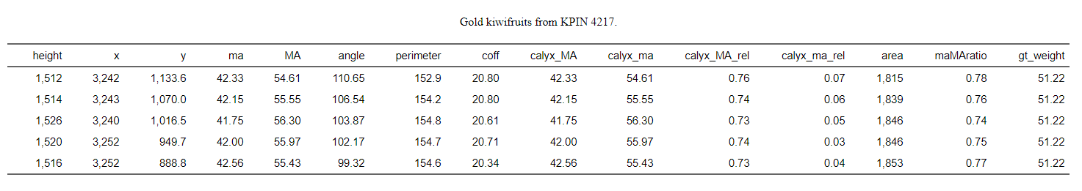
Data Processing

Slide 15
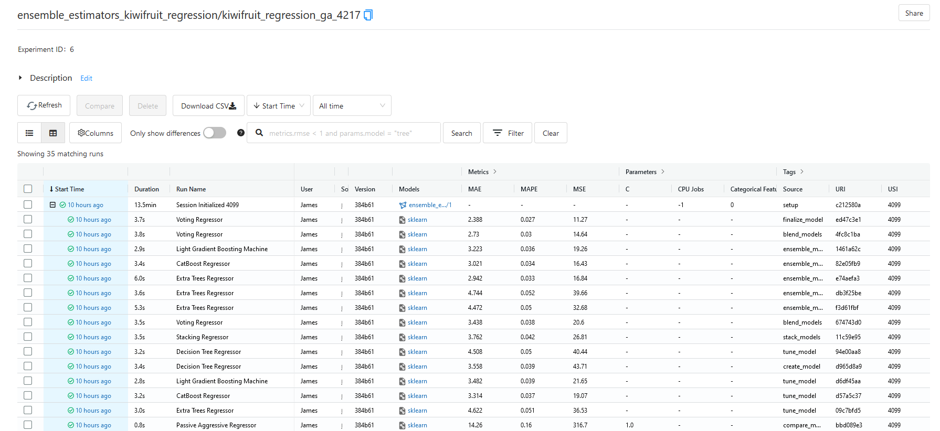
Regression Models

Slide 16
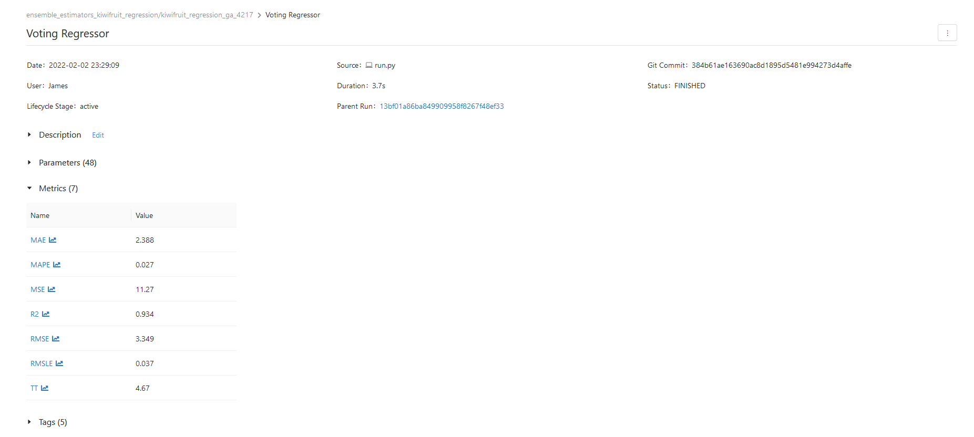
Regression Models

Slide 17
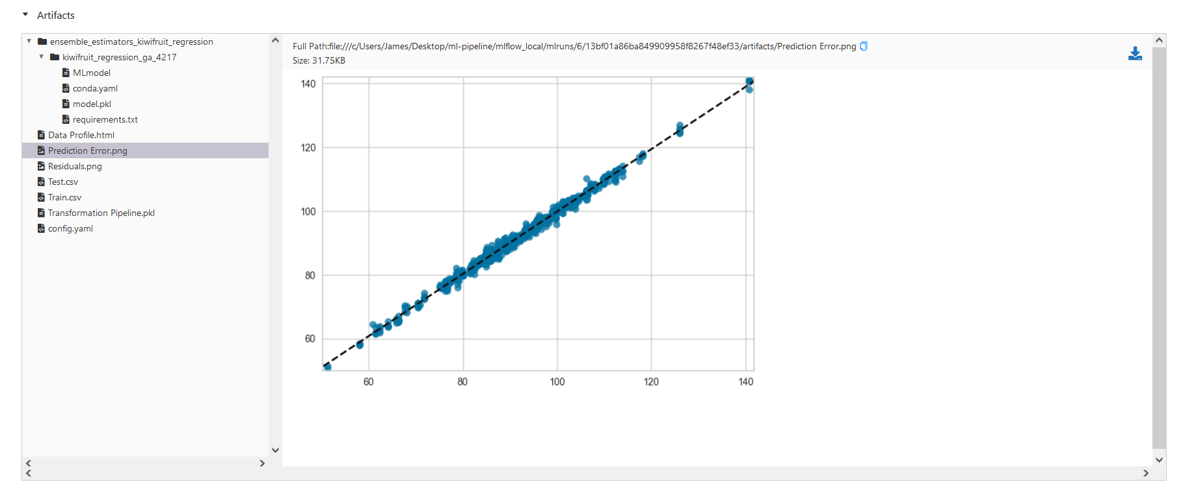
Regression Models

Slide 18
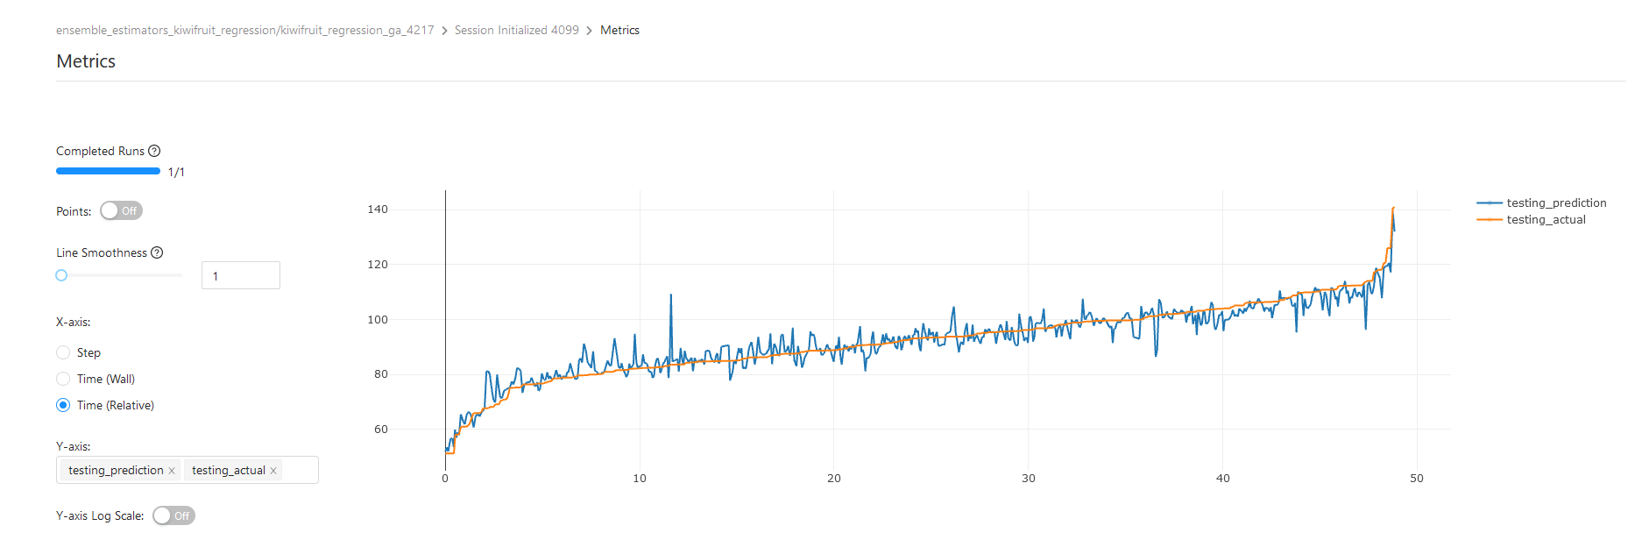
Regression Models

Slide 19
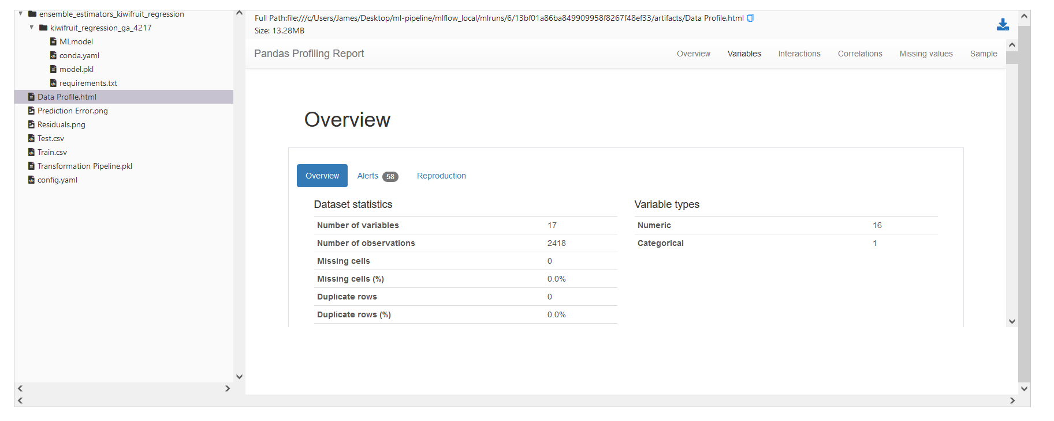
Regression Models

Slide 20
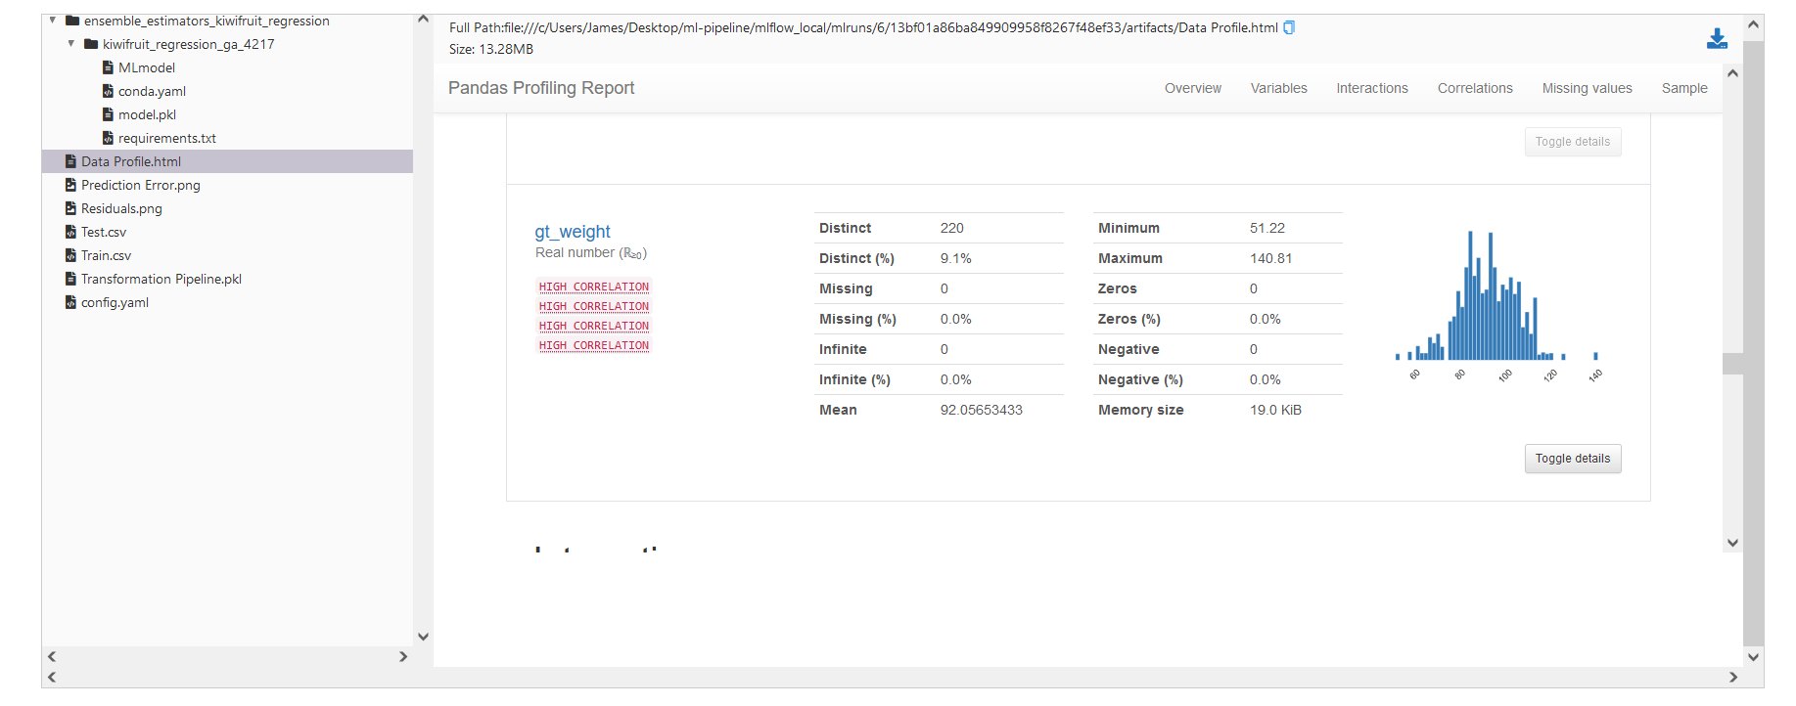
Regression Models

Slide 21
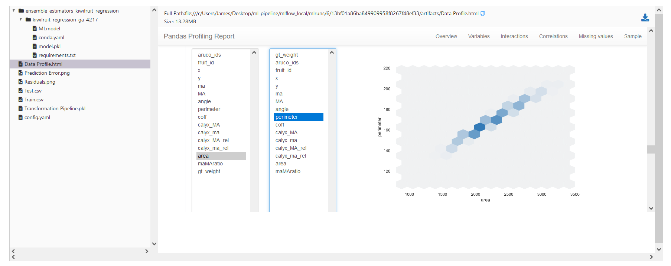
Regression Models

Slide 22
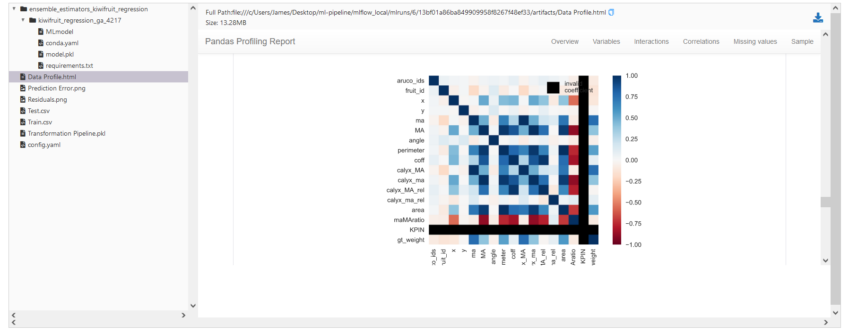
Regression Models

Slide 23
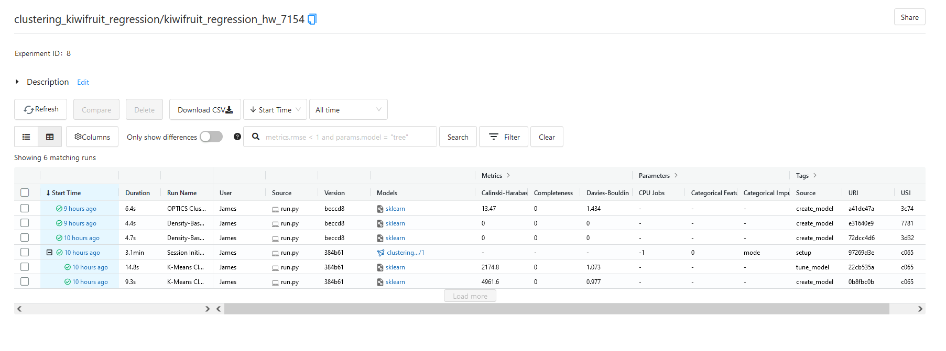
Clustering

Slide 24
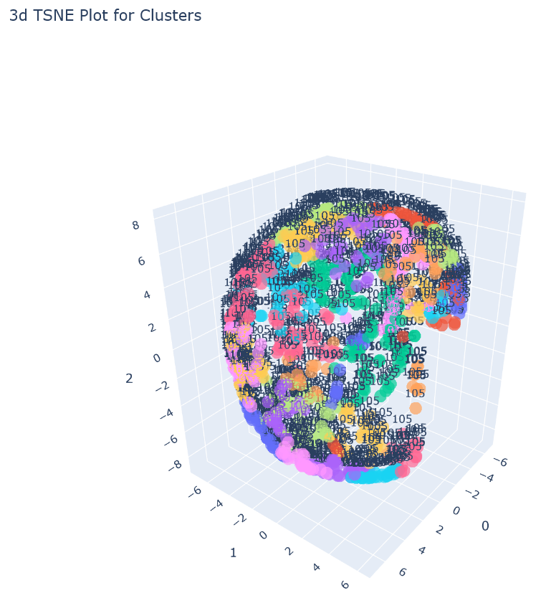
Clustering

Slide 25
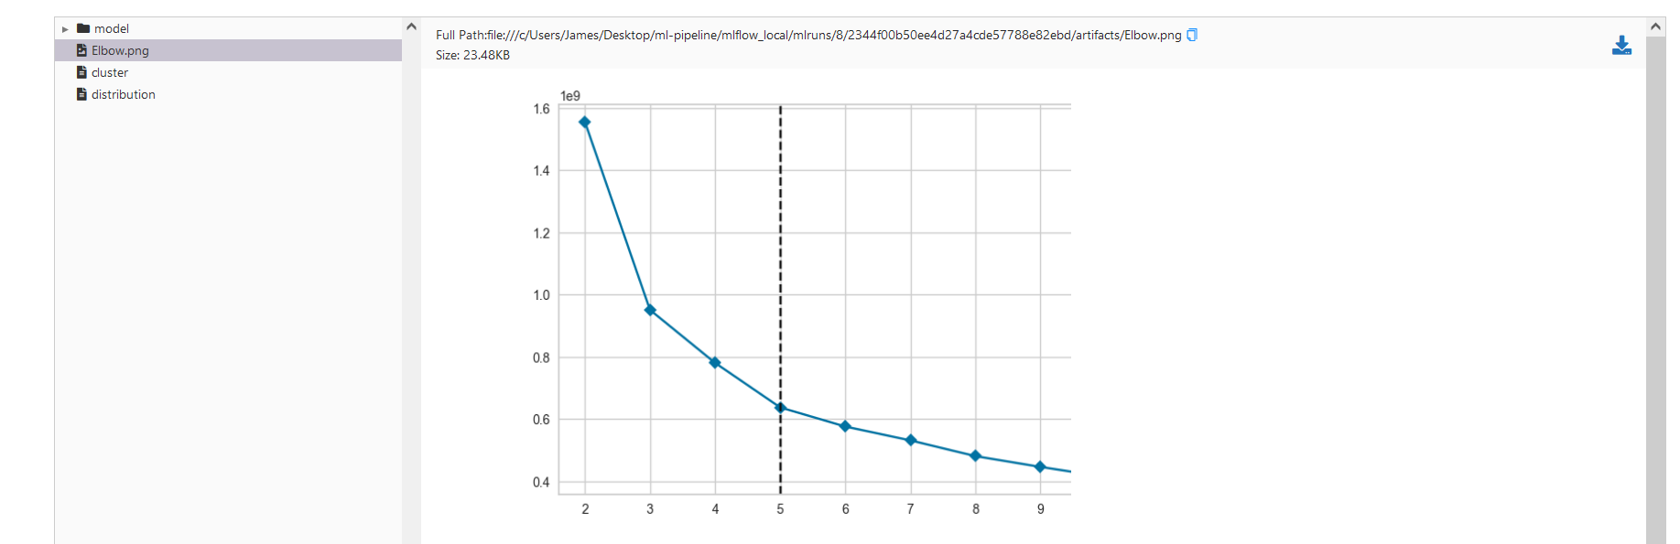
Clustering

Slide 26
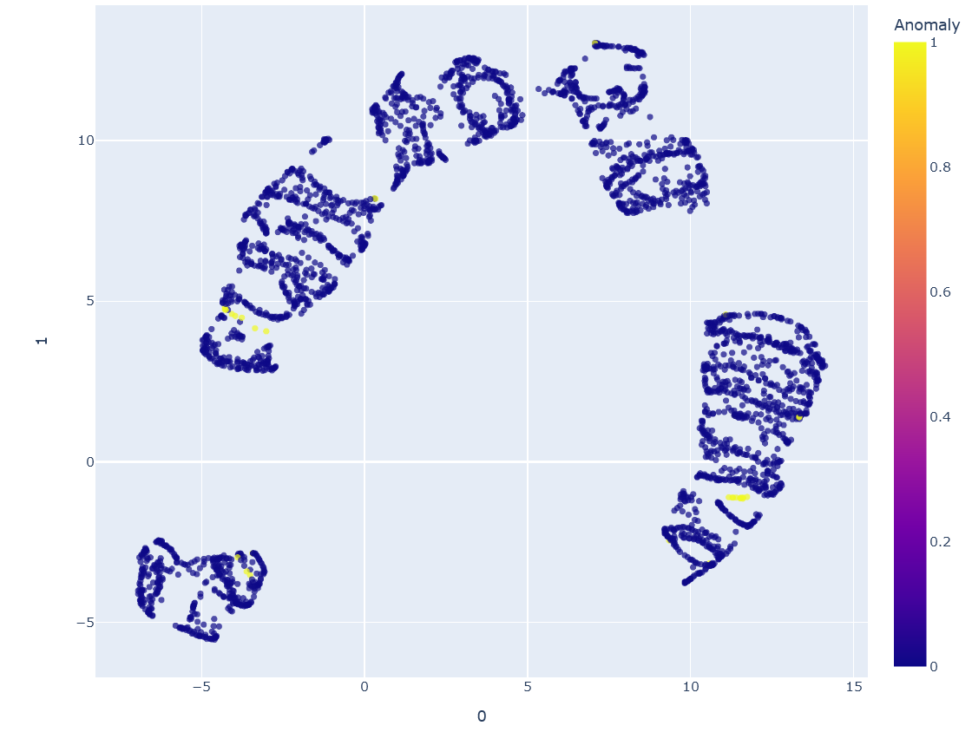
Anomaly Detection

Slide 27
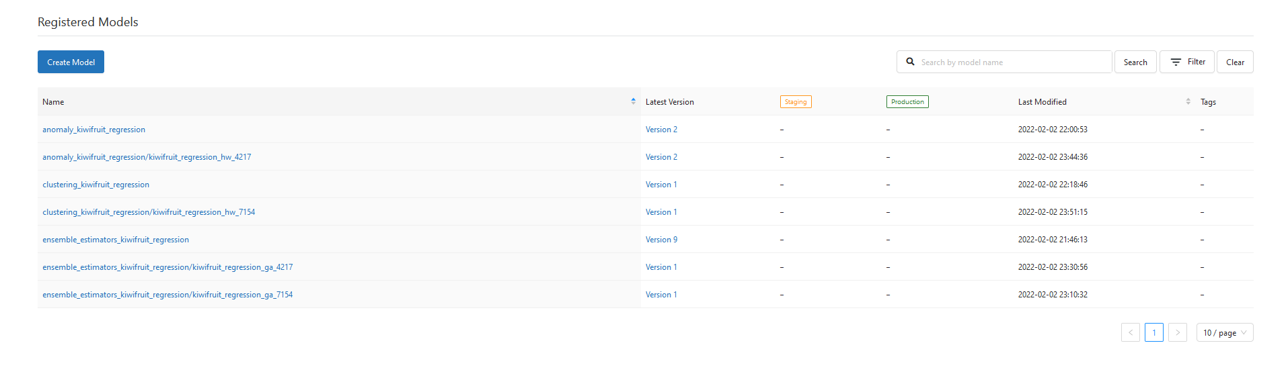
Model Versioning

Slide 28
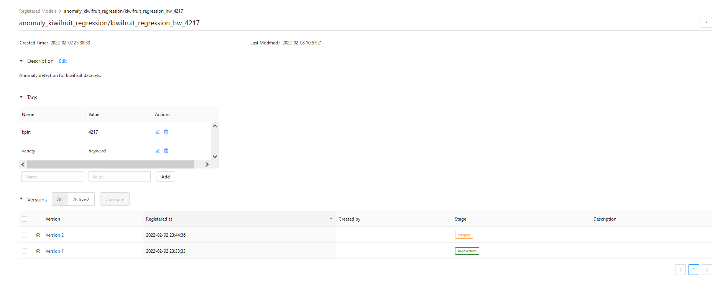
Model Versioning

Slide 29
Future Exploration
High-performance computing
Ray
Optuna
Metrics storage and visualisation
Prometheus and Grafana
Real-time streaming and stress testing
Kafka
Continuous Integration and delivery
Jenkins
BATS
Workflow automation
Airflow

Slide 30


Acknowledgments

