Slide 1
A Machine Learning Framework for Fruit Sizing
James Bristow
Andrew Gilman
Henry Kirkwood

Slide 2
Introduction
Fruit sizing using Approximate Bayesian Computation
Challenges and considerations
Machine learning tools
DVC
MLFlow
PyCaret
Ray
Optuna
A flexible and generalizable machine learning framework
Gold and Hayward kiwifruit datasets

Slide 3
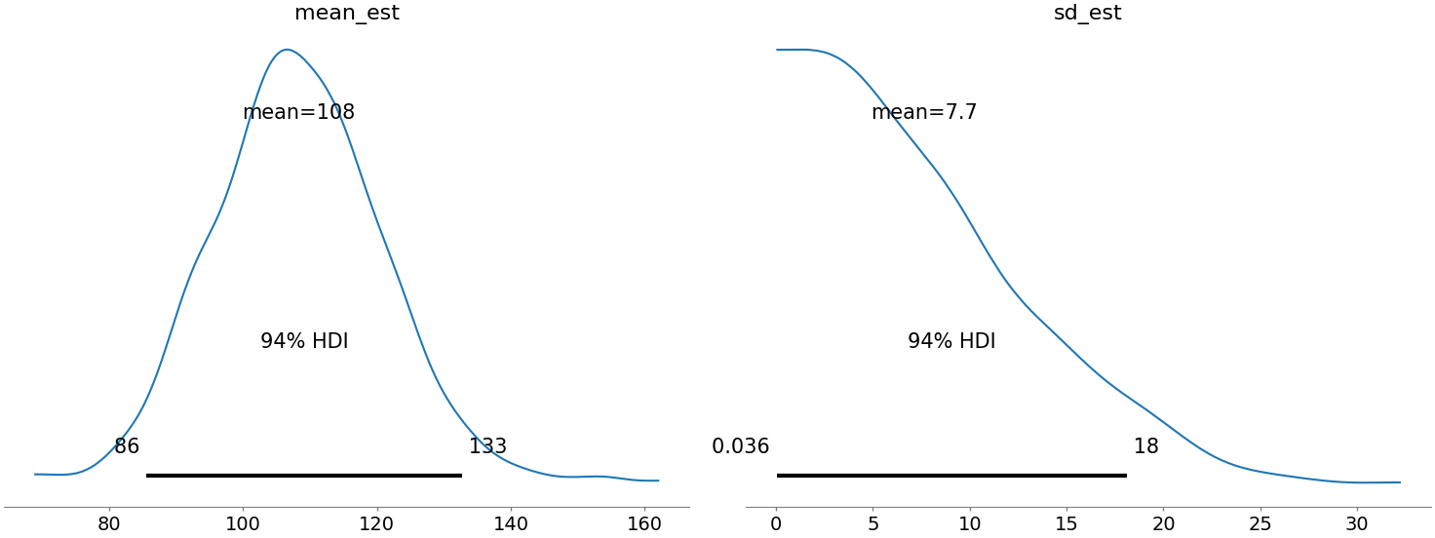
Bayesian Kiwifruit Sizing
Infer the size and weight distribution within an orchard
Varying consumer demand within domestic and overseas markets

Slide 4
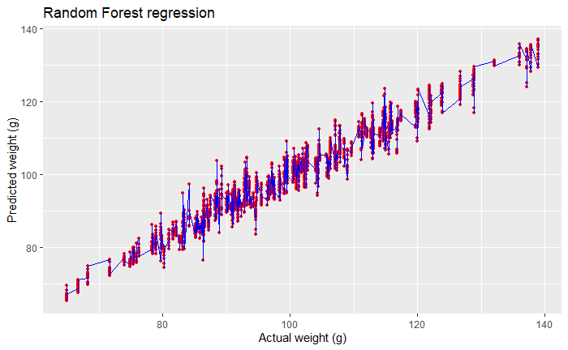
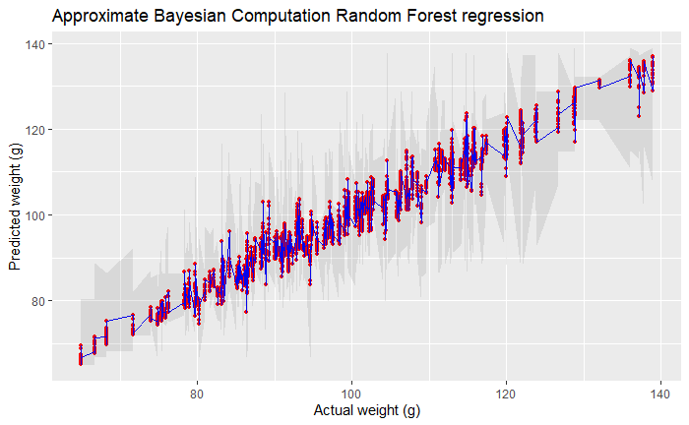
Why Bayesian Models?
Incorporate prior knowledge
Quantify uncertainty
Generate simulated observations

Slide 5
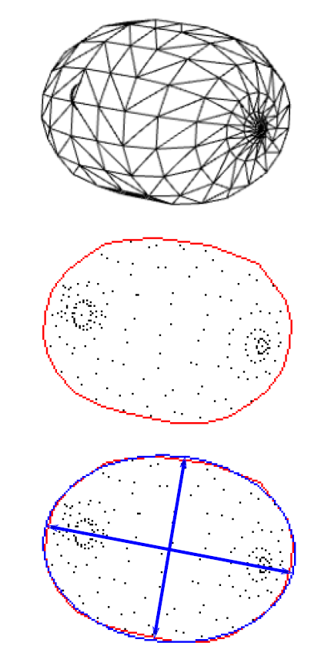
Approximate Bayesian Computation
Parameter estimation using the likelihood
A simulation-based approach
Synthetic kiwifruits evaluated against real data
Ranjard, L., Bristow, J., Hossain, Z., Orsi, A., Kirkwood, H. J., & Gilman, A. (2021, December). Likelihood-free Bayesian inference framework for sizing kiwifruit from orchard imaging surveys. In 2021 36th International Conference on Image and Vision Computing New Zealand (IVCNZ) (pp. 1-6). IEEE.

Slide 6
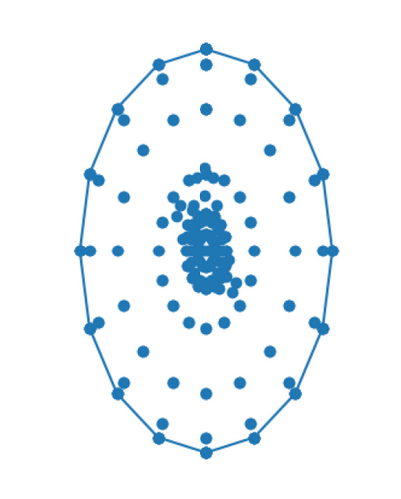
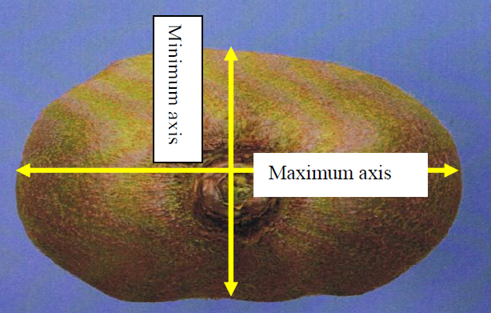
Considerations
Data and model versioning
Harmandeep, J. (2010). Factors affecting the replacement of wooden harvesting bins with plastic equivalents for the New Zealand kiwifruit industry (Doctoral dissertation, University of Waikato).

Slide 7
Considerations
Experiment tracking, metrics logging, and visualisations
Harmandeep, J. (2010). Factors affecting the replacement of wooden harvesting bins with plastic equivalents for the New Zealand kiwifruit industry (Doctoral dissertation, University of Waikato).

Slide 8
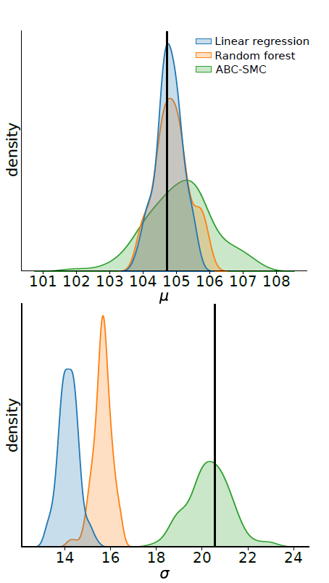
Considerations
Comparisons with non-Bayesian models
Train and evaluate many types of models
Model optimisation
Ranjard, L., Bristow, J., Hossain, Z., Orsi, A., Kirkwood, H. J., & Gilman, A. (2021, December). Likelihood-free Bayesian inference framework for sizing kiwifruit from orchard imaging surveys. In 2021 36th International Conference on Image and Vision Computing New Zealand (IVCNZ) (pp. 1-6). IEEE.

Slide 9
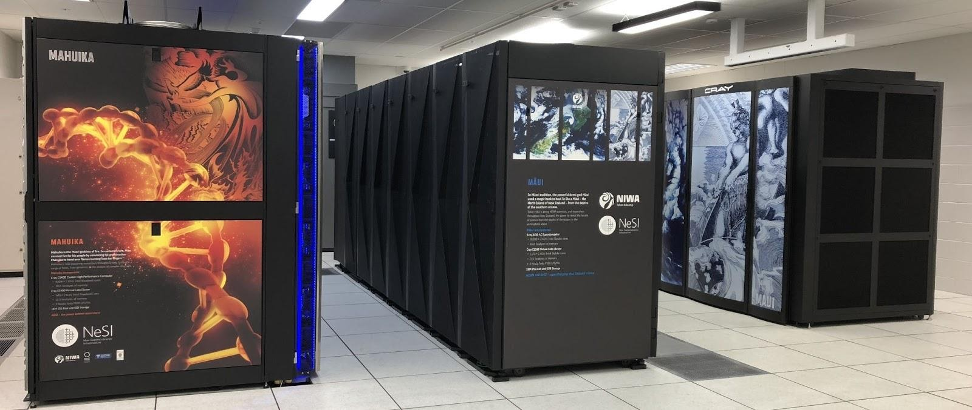
Considerations
Integration with High Performance Computing environments
New Zealand eScience Infrastructure (NeSI)
New Zealand eScience Infrastructure. (n.d.). High performance computing and analytics. https://www.nesi.org.nz/services/high-performance-computing-and-data-analytics

Slide 10
Machine Learning Tools
Name | Usage
DVC | Data versioning
MLFlow | Model versioning, experiment tracking, metrics logging, and data visualisations
PyCaret | Low-code pipeline construction
Ray | Parallel and distributed computing
Optuna | Model optimisation

Slide 11
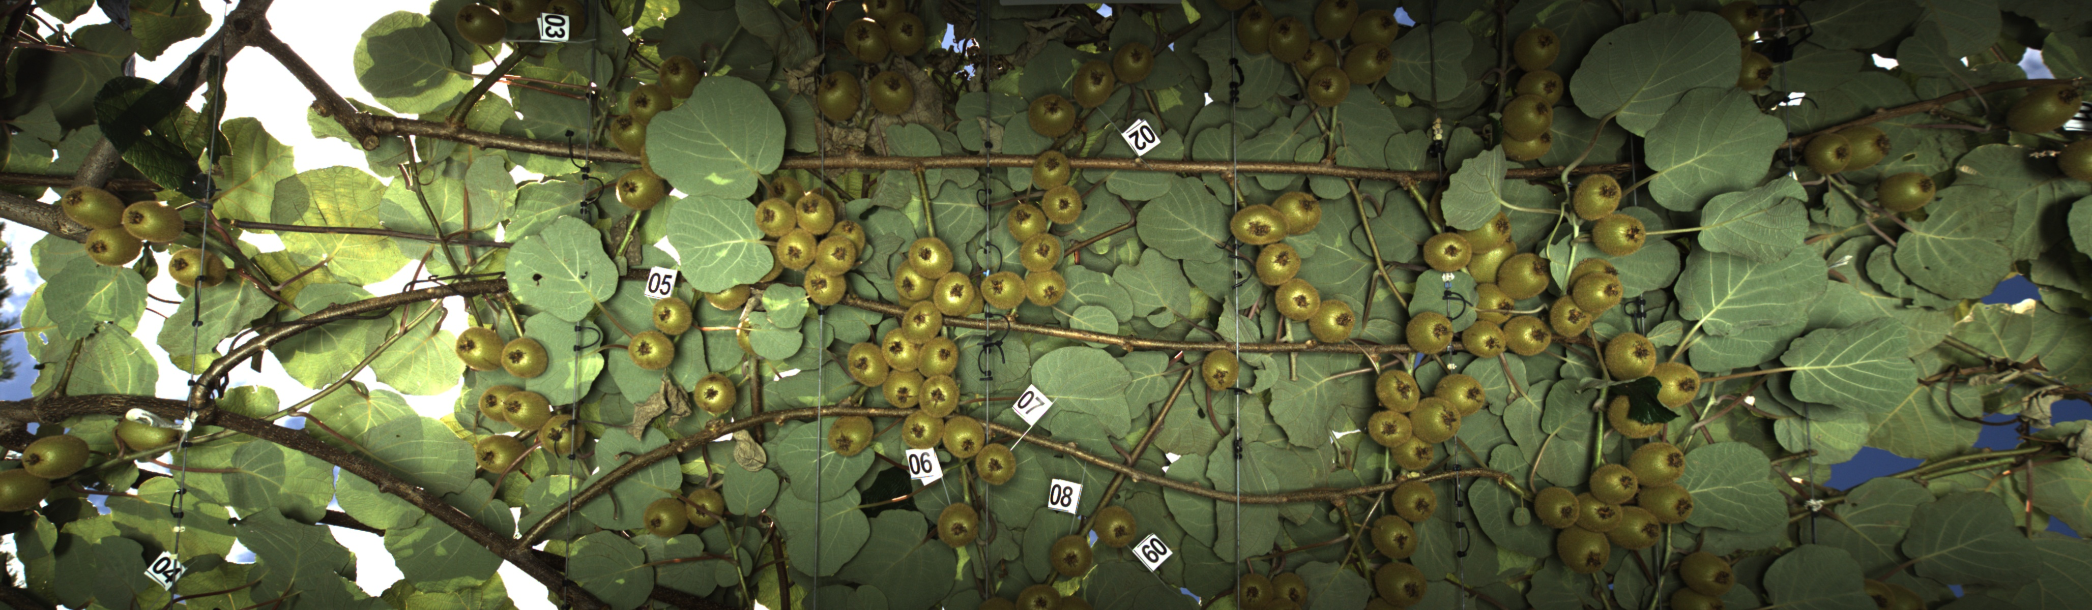
Kiwifruit Dataset
Two varieties
Golden
Hayward
Two KPINS
4217
7154

Slide 12
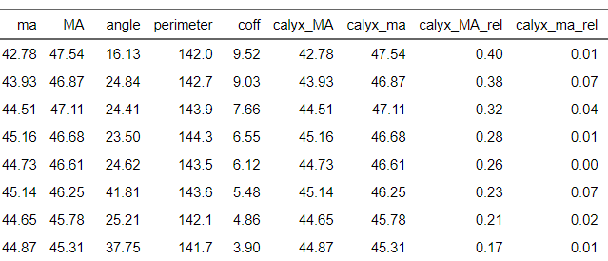
DVC – Data processing

Slide 13
PyCaret

Slide 14
Ray

Slide 15
Optuna

Slide 16
Future exploration

Slide 17


Acknowledgments

