Slide 1
Deeper differential expression analysis with shrinkage correction
Jared Brown
Postdoctoral research fellow
Lab of Rafael Irizarry · DFCI Data Science
16 July 2025

Slide 2
Follow-along preliminaries
Software:
R: https://cran.r-project.org/
Rstudio: https://posit.co/download/rstudio-desktop/
R packages:
install.packages("BiocManager")
BiocManager::install(c("DESeq2”, “pasilla”,…))
DESeq2, pasilla, ggplot2, matrixStats, apeglm, ashr, TENxPBMCData, Matrix,
irlba, scran, scater, sparseMatrixStats
Analysis scripts:
https://github.com/JBrownBiostat/DifferentialExpressionTraining_July2025

Slide 3
Other resources
From the original developers, Michael Love, Simon Anders, Wolfgang Huber: https://bioconductor.org/packages/release/bioc/vignettes/DESeq2/inst/doc/DESeq2.html
General (single-cell RNA) pipelines from some greats in the field:
https://bioconductor.org/books/3.17/OSCA/
Carpentry workshop from Bioconductor:
https://carpentries-incubator.github.io/bioc-rnaseq/

Slide 4
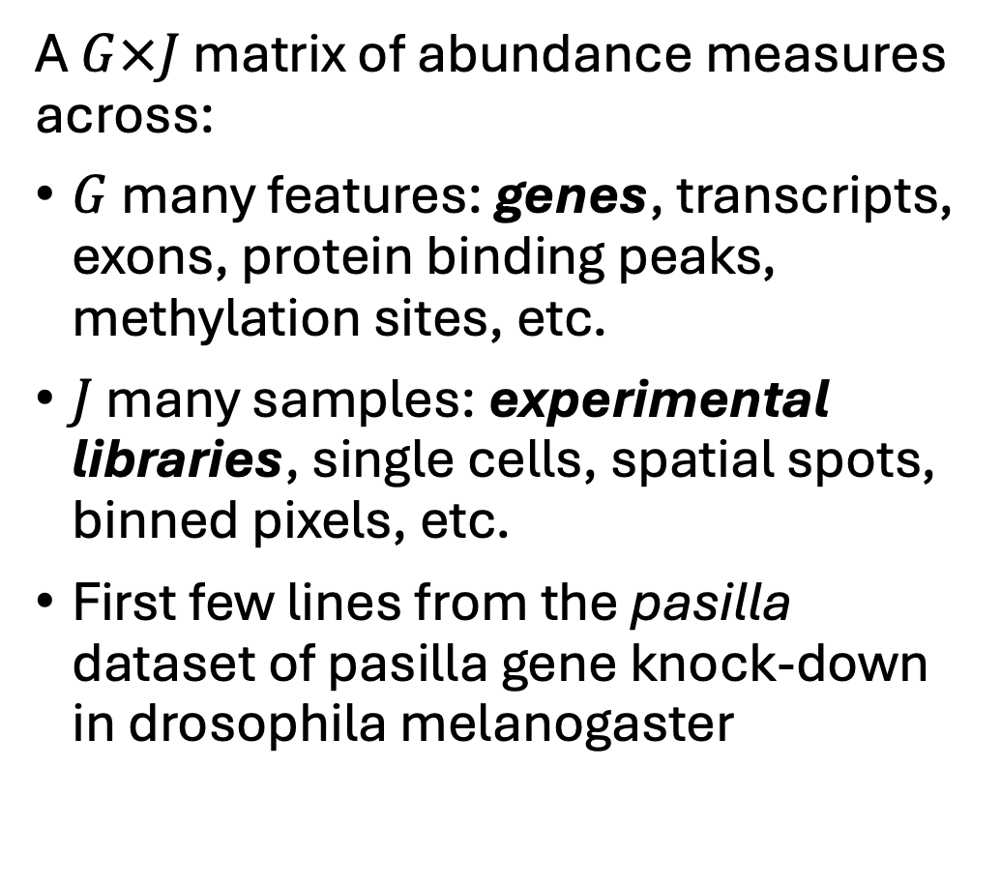
DE definitions: data structure
A $G×J$ matrix of abundance measures across:
$G$ many features: genes, transcripts, exons, protein binding peaks, methylation sites, etc.
$J$ many samples: experimental libraries, single cells, spatial spots, binned pixels, etc.
First few lines from the pasilla dataset of pasilla gene knock-down in drosophila melanogaster
 | Samp1 | Samp2 | Samp3 | Samp4 | Samp5 | Samp6 | Samp7
FBgn0000003 | 0 | 0 | 0 | 0 | 0 | 0 | 1
FBgn0000008 | 92 | 161 | 76 | 70 | 140 | 88 | 70
FBgn0000014 | 5 | 1 | 0 | 0 | 4 | 0 | 0
FBgn0000015 | 0 | 2 | 1 | 2 | 1 | 0 | 0
FBgn0000017 | 4664 | 8714 | 3564 | 3150 | 6205 | 3072 | 3334
FBgn0000018 | 583 | 761 | 245 | 310 | 722 | 299 | 308
FBgn0000022 | 0 | 1 | 0 | 0 | 0 | 0 | 0
FBgn0000024 | 10 | 11 | 3 | 3 | 10 | 7 | 5
FBgn0000028 | 0 | 1 | 0 | 0 | 0 | 1 | 1
FBgn0000032 | 1446 | 1713 | 615 | 672 | 1698 | 696 | 767

Slide 5
DESeq2 quick-start analysis
Switch over to bulkRNA_AnalysisScript.R

Slide 6
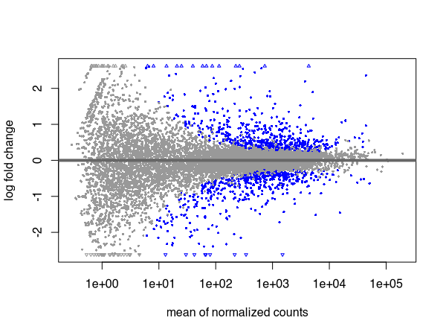
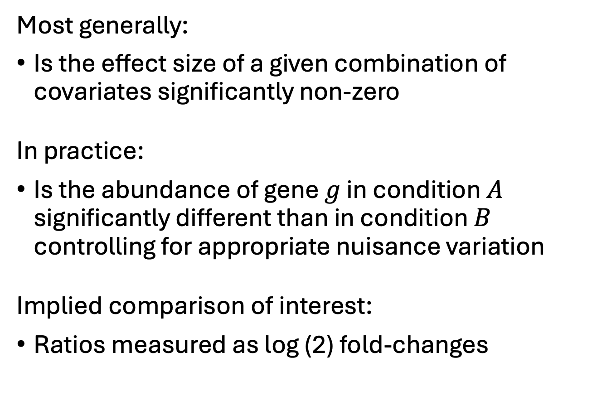
DE definitions: what are we testing
Most generally:
Is the effect size of a given combination of covariates significantly non-zero
In practice:
Is the abundance of gene $g$ in condition $A$ significantly different than in condition $B$ controlling for appropriate nuisance variation
Implied comparison of interest:
Ratios measured as log (2) fold-changes

Slide 7
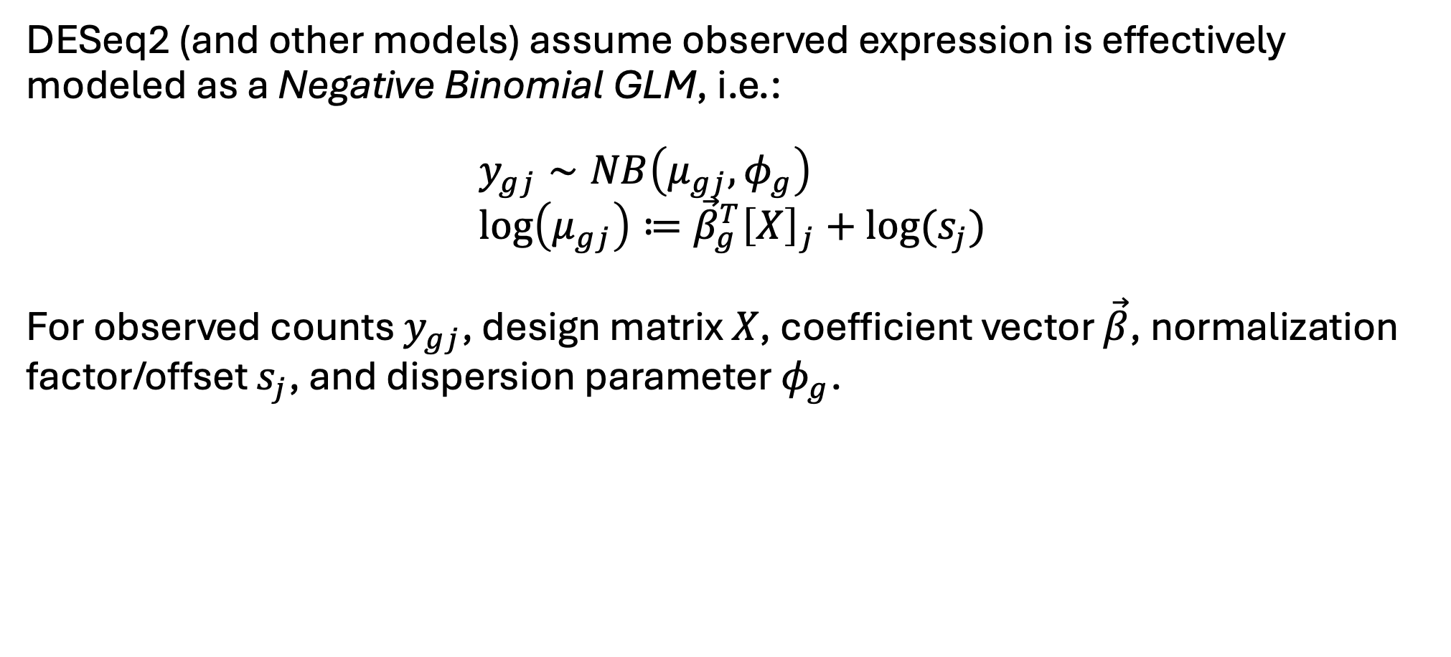
DE definitions: typical model spec.
DESeq2 (and other models) assume observed expression is effectively modeled as a Negative Binomial GLM, i.e.:
$$y_{gj}∼NB\left(μ_{gj},φ_{g}\right) \\ \log\left(μ_{gj}\right)≔{\vec{β}}_{g}^{T}{\left[X\right]}_{j}+log⁡(s_{j})$$
For observed counts $y_{gj}$, design matrix $X$, coefficient vector $\vec{β}$, normalization factor/offset $s_{j}$, and dispersion parameter $φ_{g}$.

Slide 8
DE definitions: typical model spec.
DESeq2 (and other models) assume observed expression is effectively modeled as a Negative Binomial GLM, i.e.:
$$y_{gj}∼NB\left(μ_{gj},φ_{g}\right) \\ \log\left(μ_{gj}\right)≔{\vec{β}}_{g}^{T}{\left[X\right]}_{j}+log⁡(s_{j})$$
For observed counts $y_{gj}$, design matrix $X$, coefficient vector $\vec{β}$, normalization factor/offset $s_{j}$, and dispersion parameter $φ_{g}$.

Slide 9
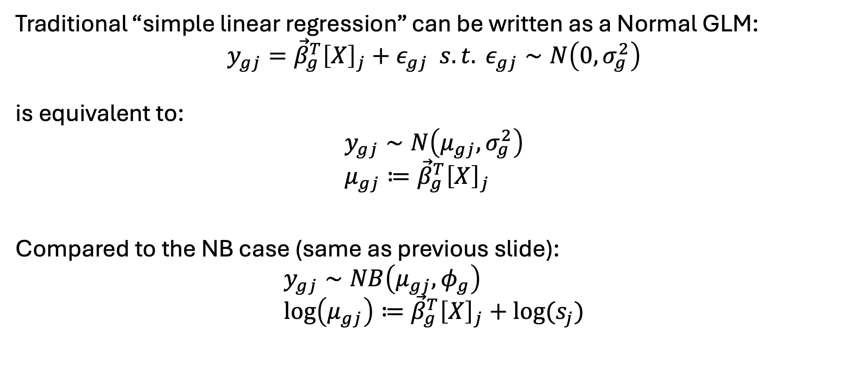
NB GLM: Comp. to linear regression
Traditional “simple linear regression” can be written as a Normal GLM:
$$y_{gj}={\vec{β}}_{g}^{T}{\left[X\right]}_{j}+ε_{gj} s.t. ε_{gj}∼N\left(0,σ_{g}^{2}\right)$$
is equivalent to:
$$y_{gj}∼N\left(μ_{gj}, σ_{g}^{2}\right) \\ μ_{gj}≔{\vec{β}}_{g}^{T}{\left[X\right]}_{j}$$
Compared to the NB case (same as previous slide): $$y_{gj}∼NB\left(μ_{gj},φ_{g}\right) \\ \log\left(μ_{gj}\right)≔{\vec{β}}_{g}^{T}{\left[X\right]}_{j}+log⁡(s_{j})$$

Slide 10
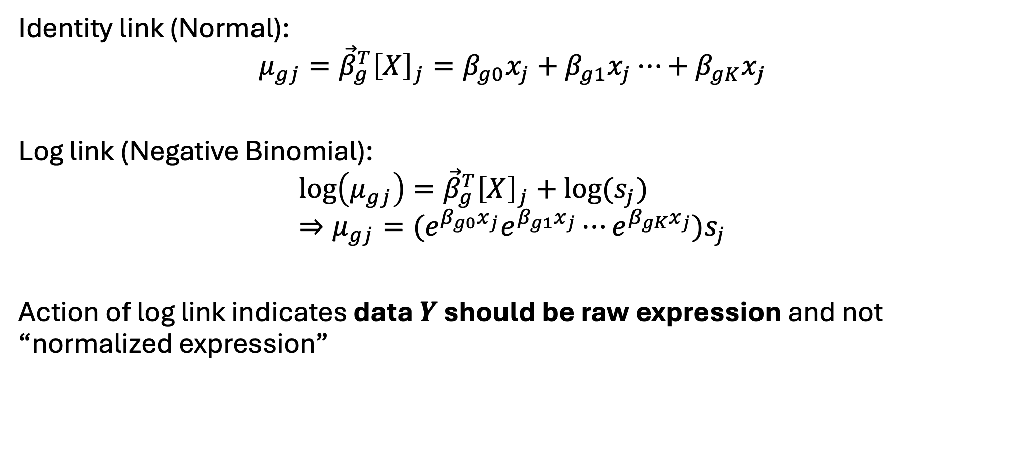
NB GLM: Link function
Identity link (Normal):
$$μ_{gj}={\vec{β}}_{g}^{T}{\left[X\right]}_{j}=β_{g0}x_{j}+β_{g1}x_{j}⋯+β_{gK}x_{j}$$
Log link (Negative Binomial):
$$\log\left(μ_{gj}\right)={\vec{β}}_{g}^{T}{\left[X\right]}_{j}+log⁡(s_{j}) \\ ⇒μ_{gj}={(e}^{β_{g0}x_{j}}e^{β_{g1}x_{j}}⋯e^{β_{gK}x_{j}})s_{j}$$
Action of log link indicates data $Y$ should be raw expression and not “normalized expression”

Slide 11
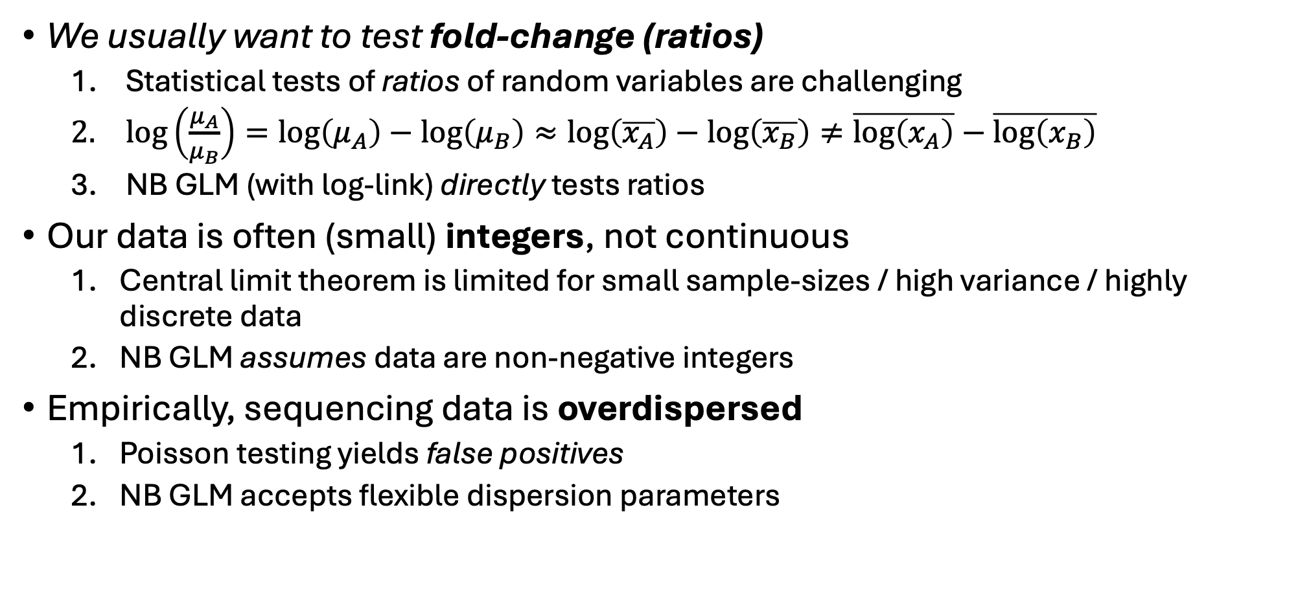
Why NB GLM (summary)
We usually want to test fold-change (ratios)
Statistical tests of ratios of random variables are challenging
$log\left(\frac{μ_{A}}{μ_{B}}\right)=\log\left(μ_{A}\right)−\log\left(μ_{B}\right)≈\log\left(\overline{x_{A}}\right)−\log\left(\overline{x_{B}}\right)≠\overline{\log\left(x_{A}\right)}−\overline{\log\left(x_{B}\right)}$
NB GLM (with log-link) directly tests ratios
Our data is often (small) integers, not continuous
Central limit theorem is limited for small sample-sizes / high variance / highly discrete data
NB GLM assumes data are non-negative integers
Empirically, sequencing data is overdispersed
Poisson testing yields false positives
NB GLM accepts flexible dispersion parameters

Slide 12
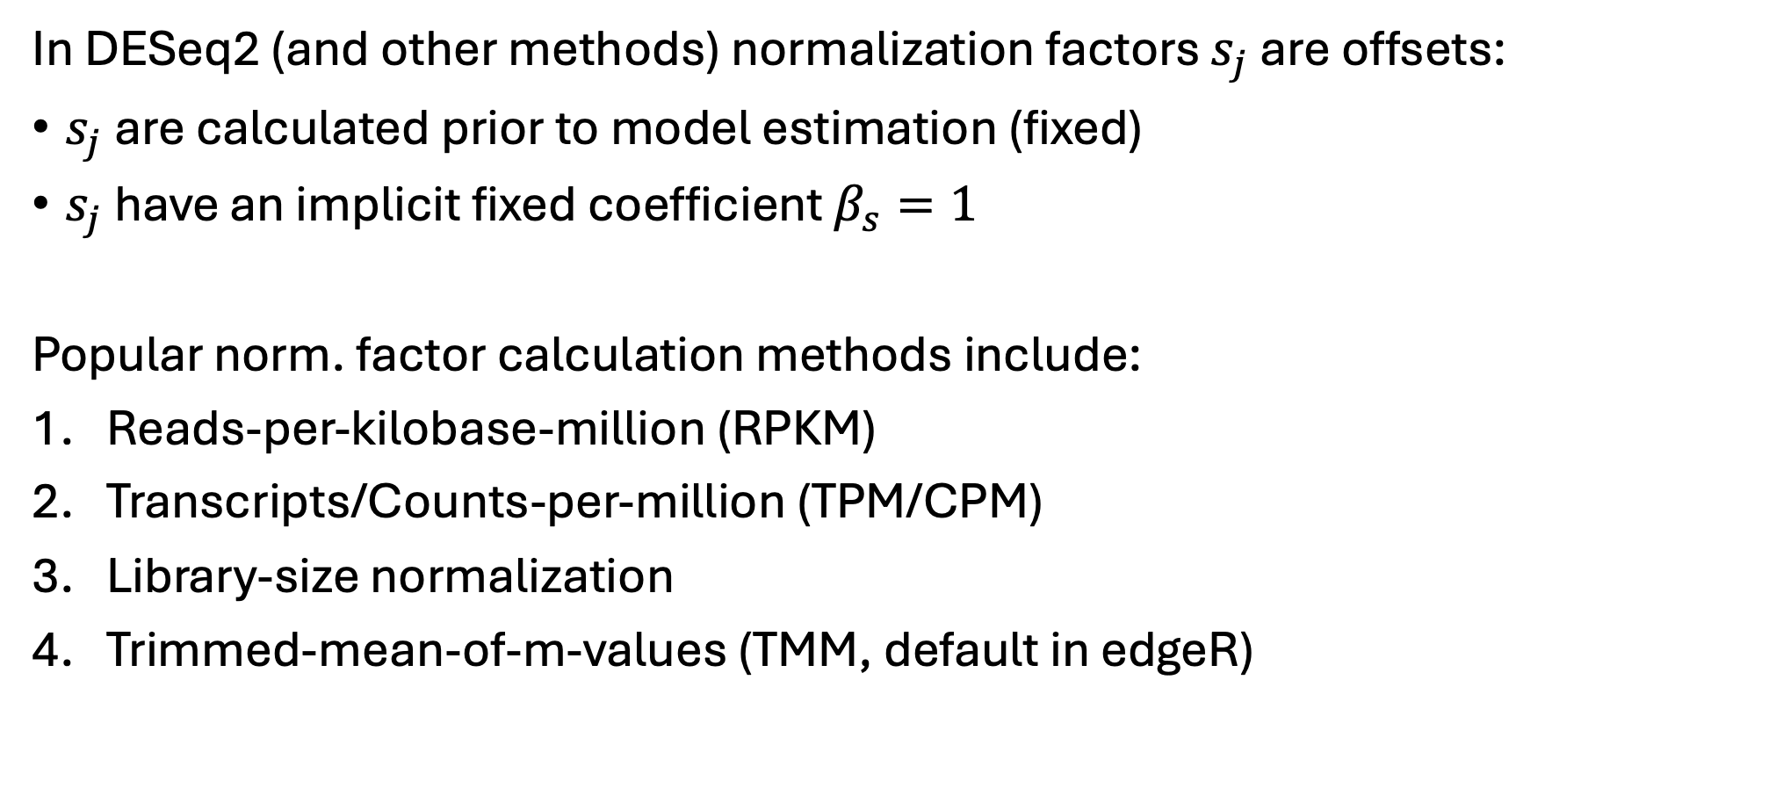
(Pre) Calculation of normalization offset
In DESeq2 (and other methods) normalization factors $s_{j}$ are offsets:
$s_{j}$ are calculated prior to model estimation (fixed)
$s_{j}$ have an implicit fixed coefficient $β_{s}=1$
Popular norm. factor calculation methods include:
Reads-per-kilobase-million (RPKM)
Transcripts/Counts-per-million (TPM/CPM)
Library-size normalization
Trimmed-mean-of-m-values (TMM, default in edgeR)

Slide 13
Poor normalization (example)
Fig. Ref: Robinson and Oshlack, Genome Biology, 2010

Slide 14
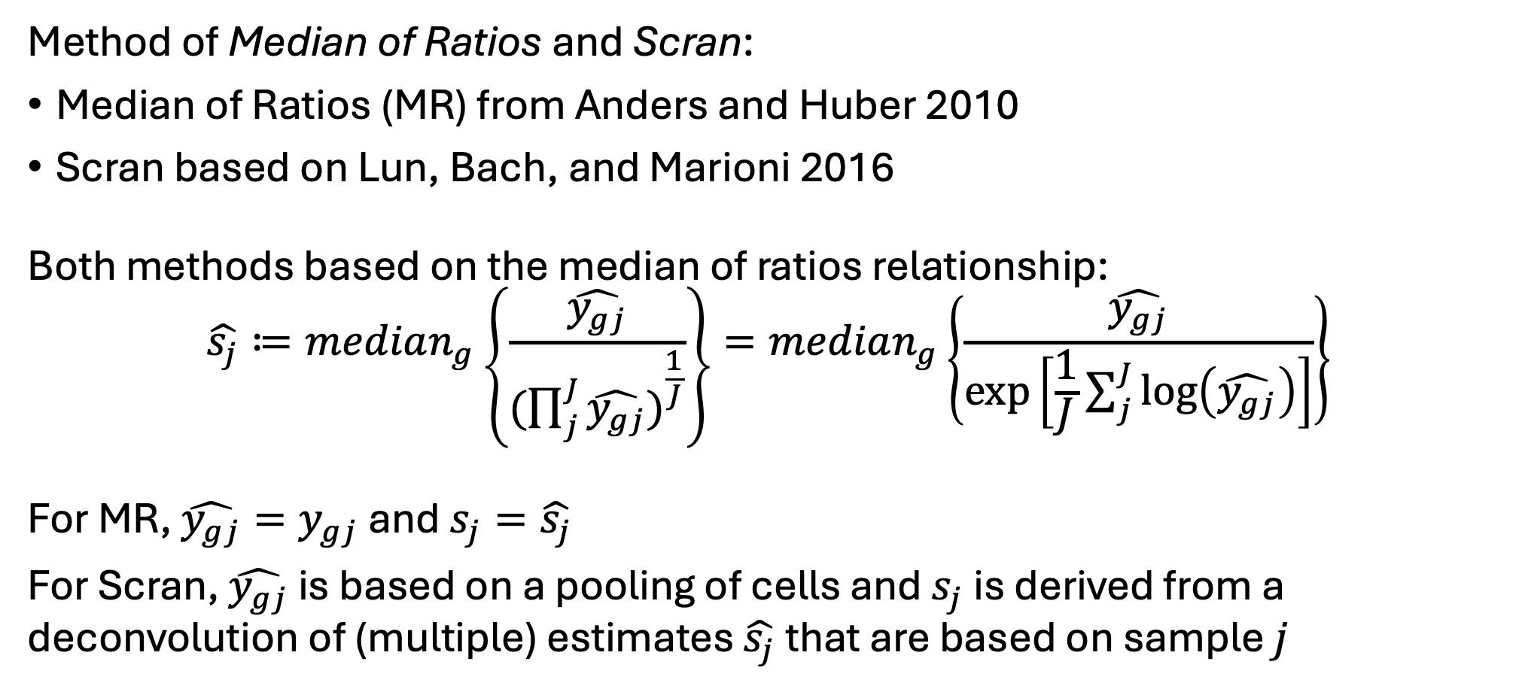
DESeq2 normalization default
Method of Median of Ratios and Scran:
Median of Ratios (MR) from Anders and Huber 2010
Scran based on Lun, Bach, and Marioni 2016
Both methods based on the median of ratios relationship:
$$\hat{s_{j}}≔median_{g}\left\{\frac{\hat{y_{gj}}}{({\prod_{j}^{J}{\hat{y_{gj}})}}^{\frac{1}{J}}}\right\}=median_{g}\left\{\frac{\hat{y_{gj}}}{\exp\left[\frac{1}{J}\sum_{j}^{J}{\log\left(\hat{y_{gj}}\right)}\right]}\right\}$$
For MR, $\hat{y_{gj}}=y_{gj}$ and $s_{j}=\hat{s_{j}}$
For Scran, $\hat{y_{gj}}$ is based on a pooling of cells and $s_{j}$ is derived from a deconvolution of (multiple) estimates $\hat{s_{j}}$ that are based on sample $j$

Slide 15
DESeq2 bulk custom size factors
Switch over to bulkRNA_AnalysisScript.R

Slide 16
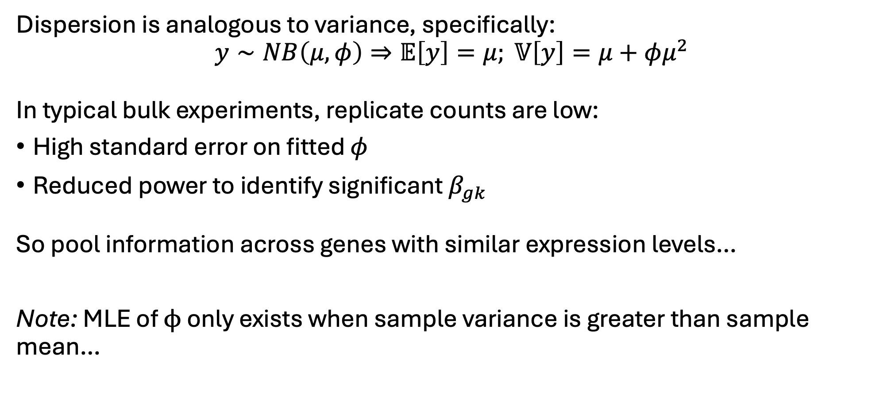
NB GLM: Dispersion estimates
Dispersion is analogous to variance, specifically:
$$y∼NB\left(μ,φ\right)⇒𝔼\left[y\right]=μ; 𝕍\left[y\right]=μ+φμ^{2}$$
In typical bulk experiments, replicate counts are low:
High standard error on fitted $φ$
Reduced power to identify significant $β_{gk}$
So pool information across genes with similar expression levels…
Note: MLE of $ϕ$ only exists when sample variance is greater than sample mean…

Slide 17
DESeq2 dispersion visualization
Switch over to bulkRNA_AnalysisScript.R

Slide 18
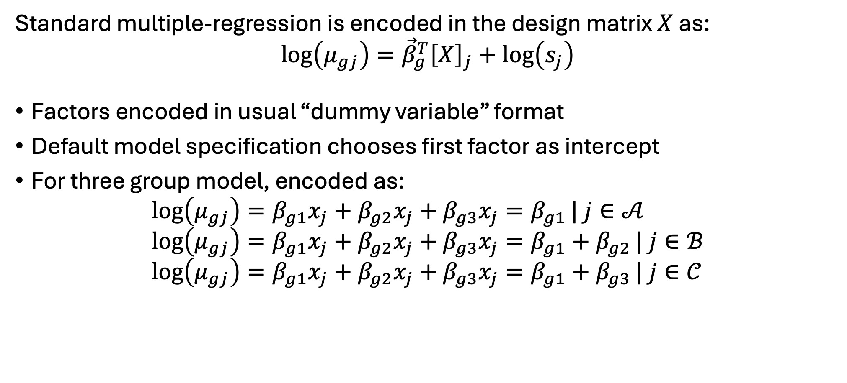
Multiple covariates
Standard multiple-regression is encoded in the design matrix $X$ as:
$$\log\left(μ_{gj}\right)={\vec{β}}_{g}^{T}{\left[X\right]}_{j}+\log\left(s_{j}\right)$$
Factors encoded in usual “dummy variable” format
Default model specification chooses first factor as intercept
For three group model, encoded as:
$$\log\left(μ_{gj}\right)=β_{g1}x_{j}+β_{g2}x_{j}+β_{g3}x_{j}=β_{g1}| j∈𝒜 \\ \log\left(μ_{gj}\right)=β_{g1}x_{j}+β_{g2}x_{j}+β_{g3}x_{j}=β_{g1}+β_{g2}| j∈ℬ \\ \log\left(μ_{gj}\right)=β_{g1}x_{j}+β_{g2}x_{j}+β_{g3}x_{j}=β_{g1}+β_{g3}| j∈𝒞$$

Slide 19
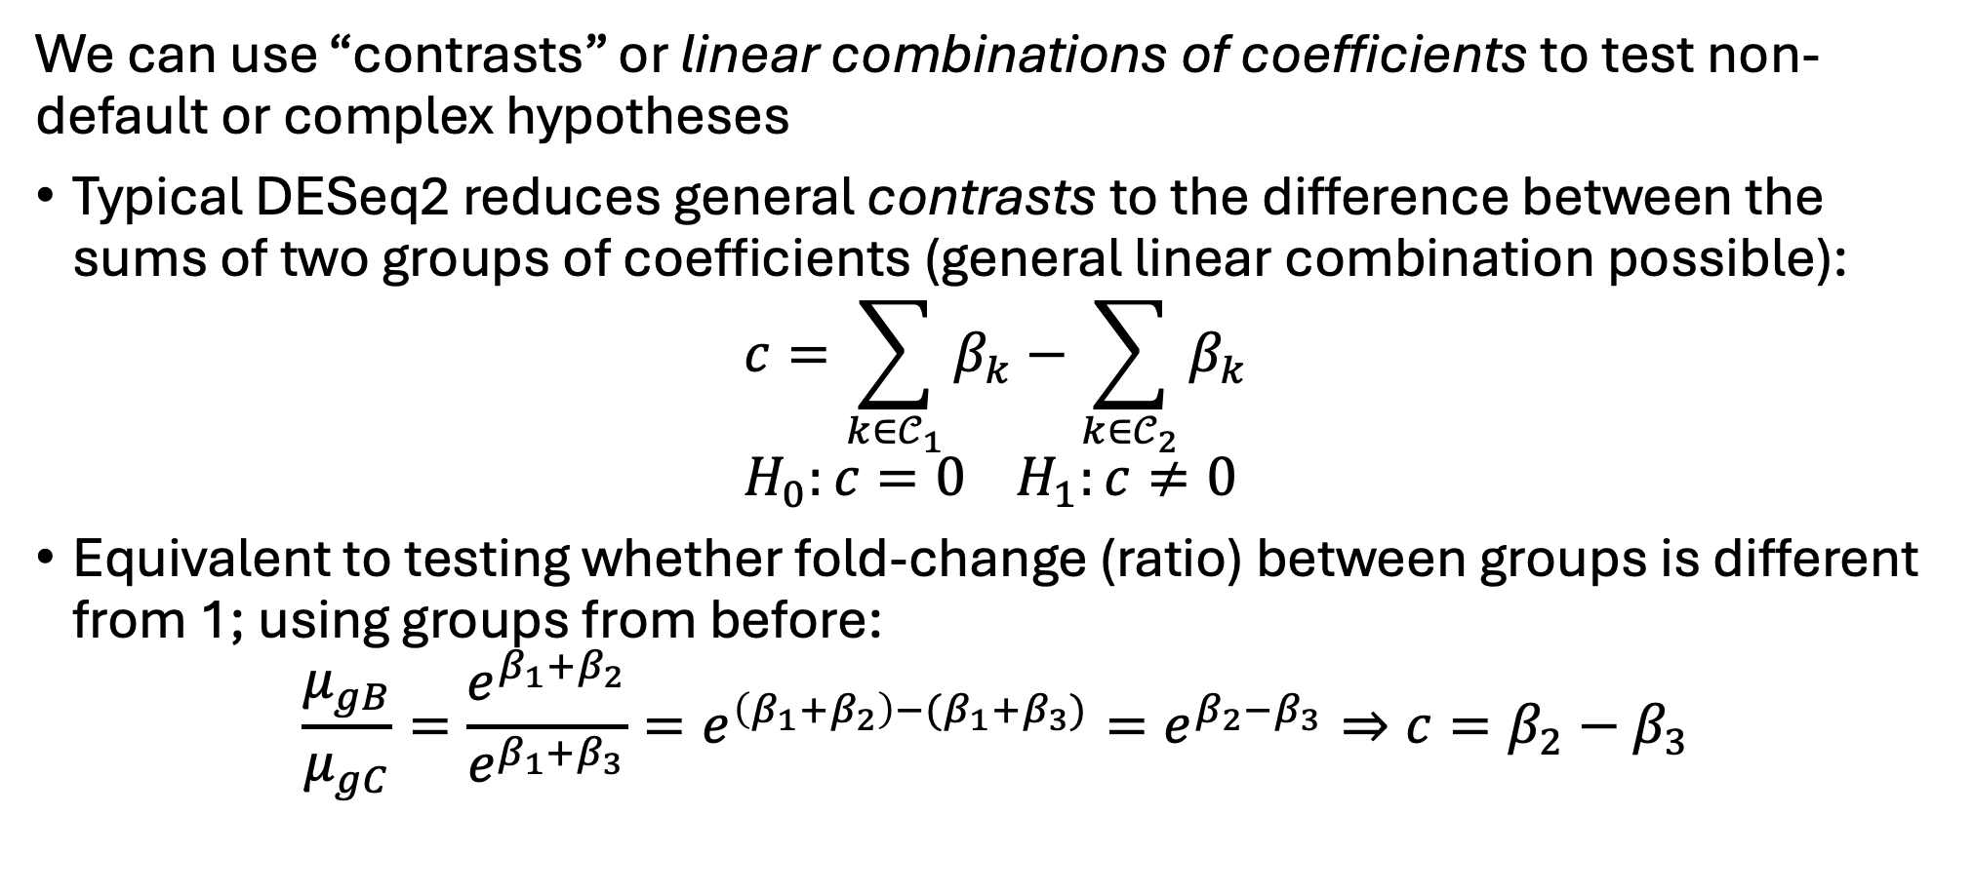
Contrasts and complex comparisons
We can use “contrasts” or linear combinations of coefficients to test non-default or complex hypotheses
Typical DESeq2 reduces general contrasts to the difference between the sums of two groups of coefficients (general linear combination possible):
$$c=\sum_{k∈𝒞_{1}}{β_{k}}−\sum_{k∈𝒞_{2}}{β_{k}} \\ H_{0}:c=0 H_{1}:c≠0$$
Equivalent to testing whether fold-change (ratio) between groups is different from 1; using groups from before:
$$\frac{μ_{gB}}{μ_{gC}}=\frac{e^{β_{1}+β_{2}}}{e^{β_{1}+β_{3}}}=e^{\left(β_{1}+β_{2}\right)−(β_{1}+β_{3})}=e^{β_{2}−β_{3}}⇒c=β_{2}−β_{3}$$

Slide 20
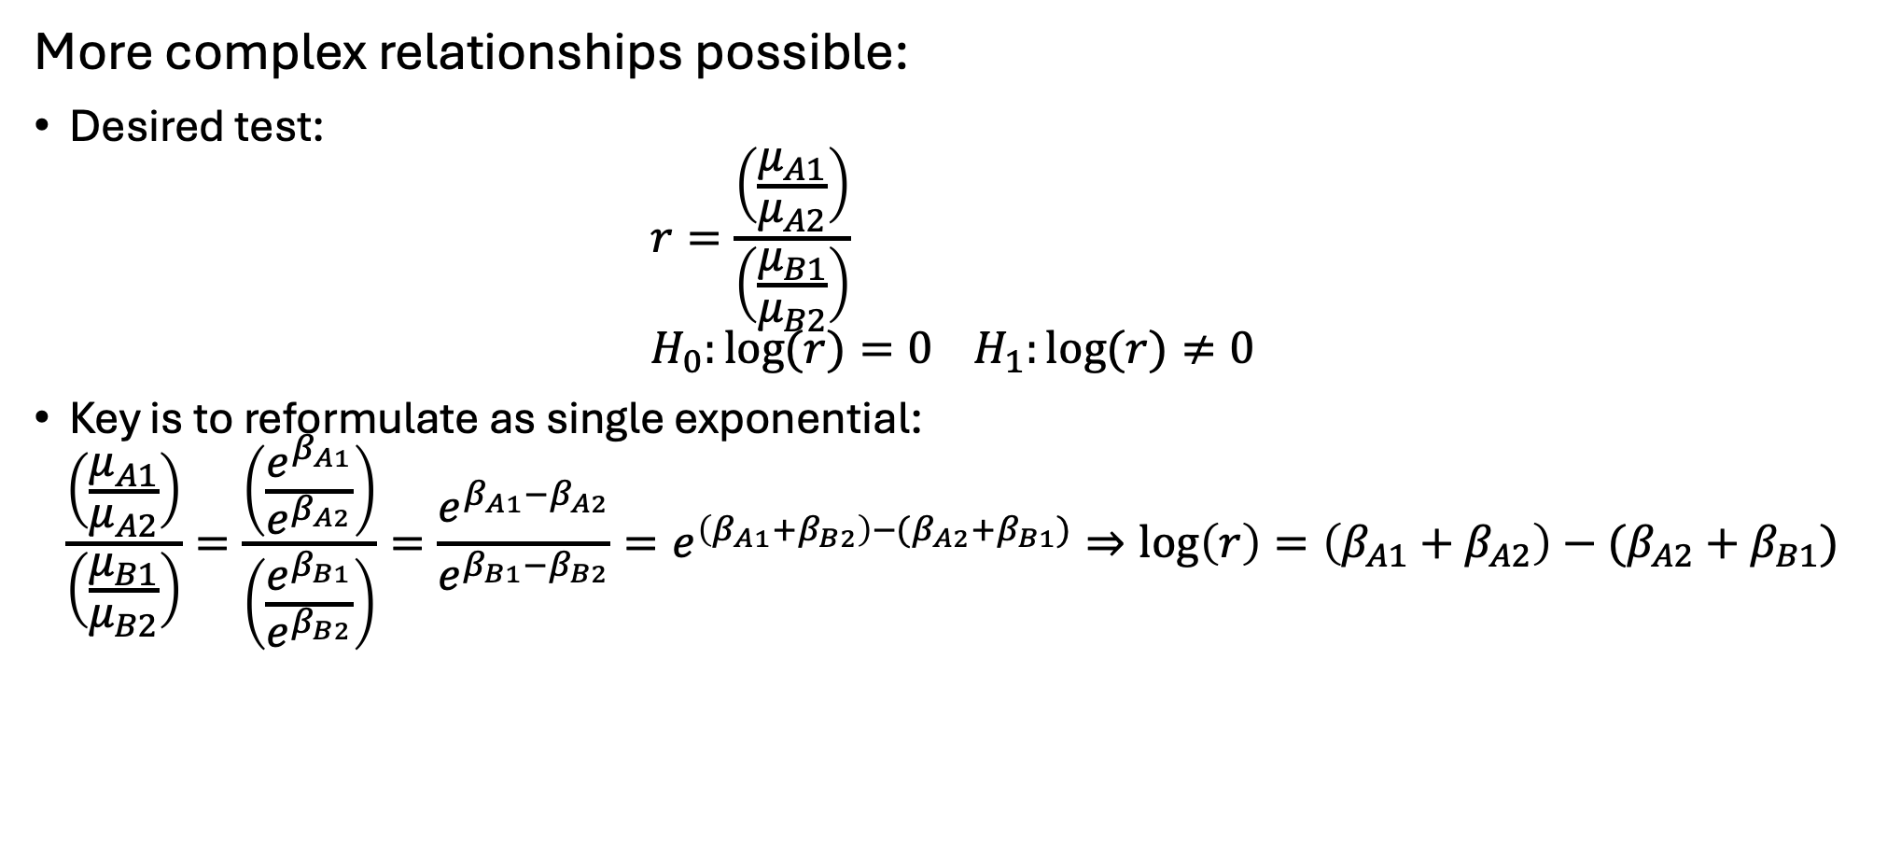
Example 2 – ratio of ratios
More complex relationships possible:
Desired test:
$$r=\frac{\left(\frac{μ_{A1}}{μ_{A2}}\right)}{\left(\frac{μ_{B1}}{μ_{B2}}\right)} \\ H_{0}:log⁡(r)=0 H_{1}:log⁡(r)≠0$$
Key is to reformulate as single exponential:
$$\frac{\left(\frac{μ_{A1}}{μ_{A2}}\right)}{\left(\frac{μ_{B1}}{μ_{B2}}\right)}=\frac{\left(\frac{e^{β_{A1}}}{e^{β_{A2}}}\right)}{\left(\frac{e^{β_{B1}}}{e^{β_{B2}}}\right)}=\frac{e^{β_{A1}−β_{A2}}}{e^{β_{B1}−β_{B2}}}=e^{\left(β_{A1}+β_{B2}\right)−(β_{A2}+β_{B1})}⇒\log\left(r\right)=\left(β_{A1}+β_{A2}\right)−(β_{A2}+β_{B1})$$

Slide 21
DESeq2 design matrix and contrasts
Switch over to bulkRNA_AnalysisScript.R

Slide 22
Shrinkage and calling sig. features
Goals:
Maximize power
Maintain control on FDR (or something like it…)
Improve interpretability/reliability
Note 1: traditional methods for controlling FDR tend to be under-powered
Note 2: leveraging extra information can boost power

Slide 23
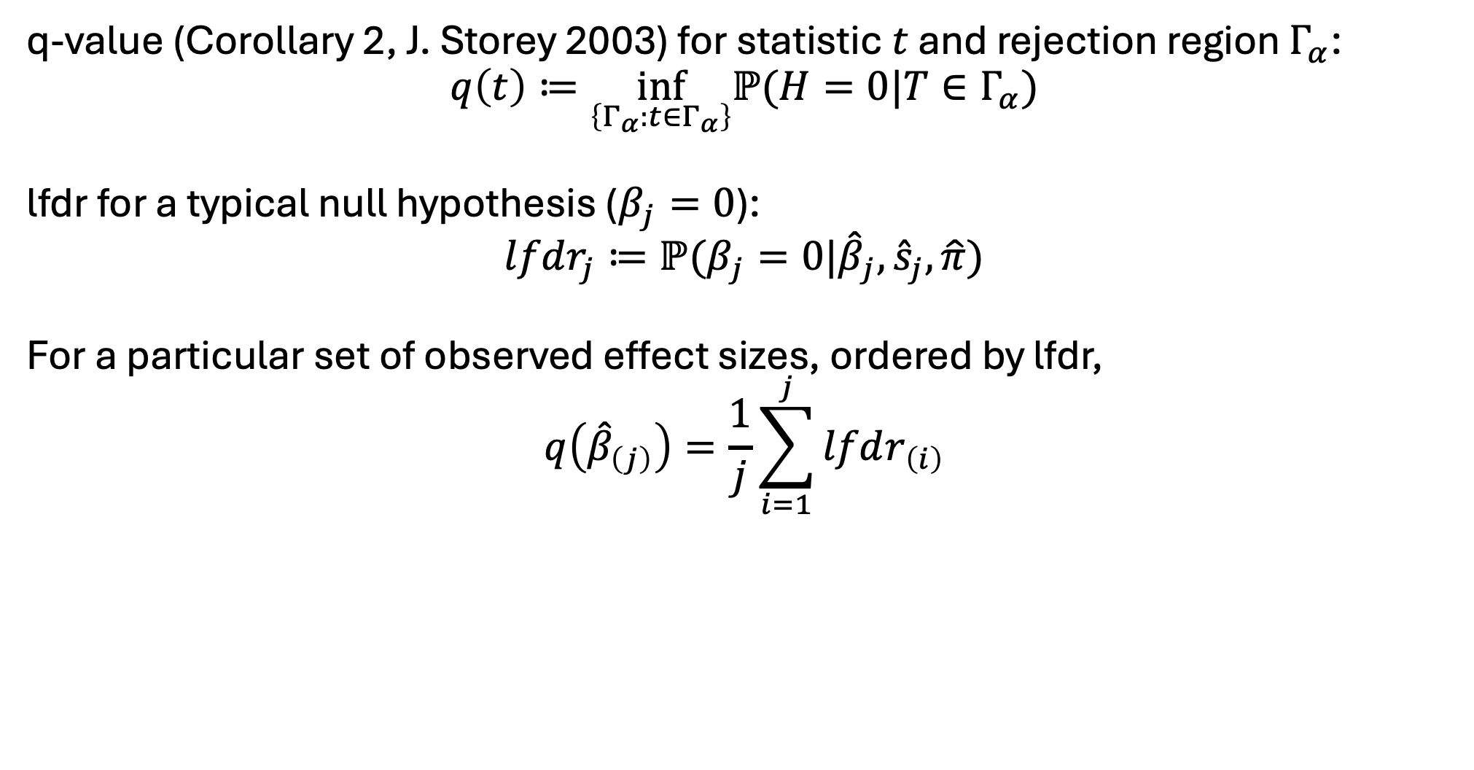
q-value and local false discovery rate
q-value (Corollary 2, J. Storey 2003) for statistic $t$ and rejection region $Γ_{α}$:
$$q\left(t\right)≔\inf_{\left\{Γ_{α}:t∈Γ_{α}\right\}}ℙ(H=0|T∈Γ_{α})$$
lfdr for a typical null hypothesis ($β_{j}=0$):
$$lfdr_{j}≔ℙ(β_{j}=0|{\hat{β}}_{j},{\hat{s}}_{j},\hat{π})$$
For a particular set of observed effect sizes, ordered by lfdr,
$$q\left({\hat{β}}_{\left(j\right)}\right)=\frac{1}{j}\sum_{i=1}^{j}{lfdr_{\left(i\right)}}$$

Slide 24
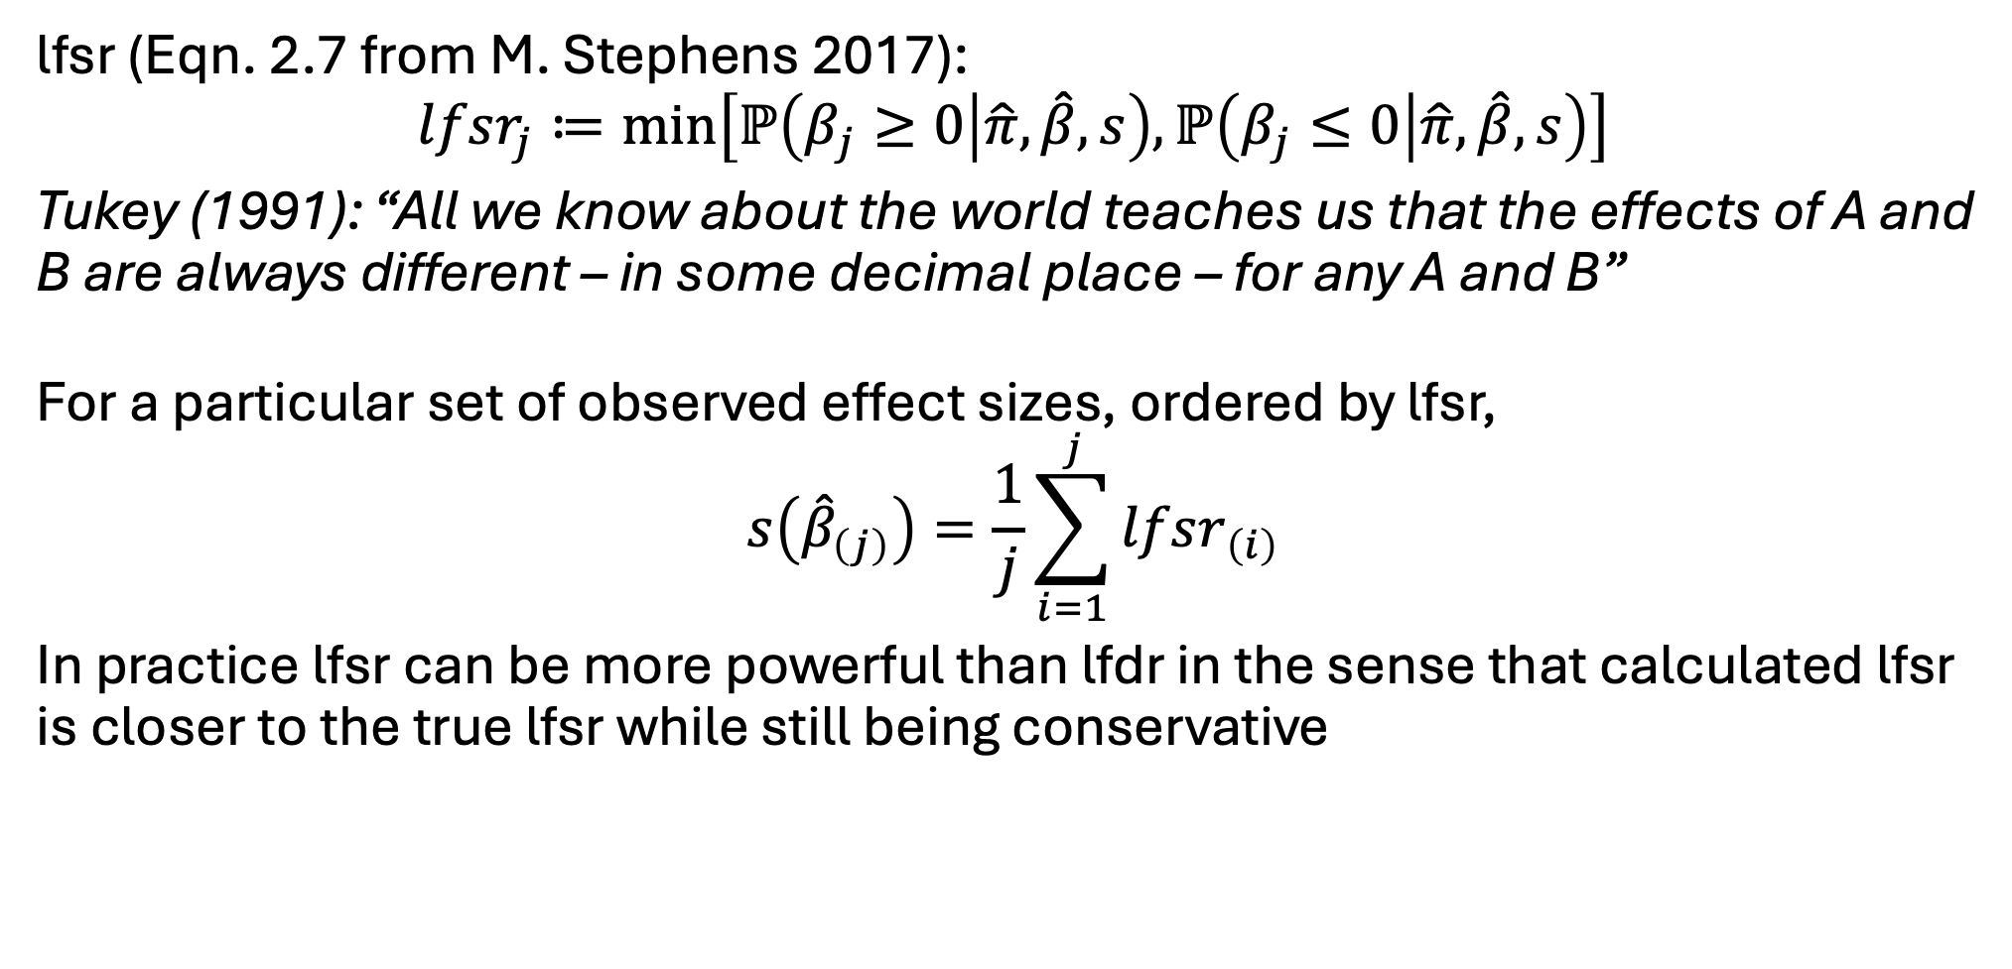
Local false sign rate and s-value
lfsr (Eqn. 2.7 from M. Stephens 2017):
$$lfsr_{j}≔\min\left[ℙ\left(β_{j}≥0 | \hat{π},\hat{β},s\right),ℙ\left(β_{j}≤0 | \hat{π},\hat{β},s\right)\right]$$
Tukey (1991): “All we know about the world teaches us that the effects of A and B are always different – in some decimal place – for any A and B”
For a particular set of observed effect sizes, ordered by lfsr,
$$s\left({\hat{β}}_{\left(j\right)}\right)=\frac{1}{j}\sum_{i=1}^{j}{lfsr_{\left(i\right)}}$$
In practice lfsr can be more powerful than lfdr in the sense that calculated lfsr is closer to the true lfsr while still being conservative

Slide 25
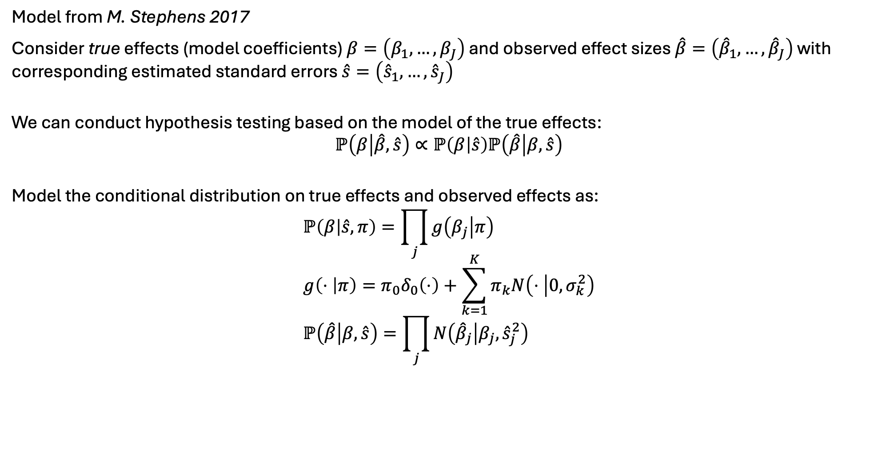
Adapative SHrinkage (ASH) model
Model from M. Stephens 2017
Consider true effects (model coefficients) $β=\left(β_{1},…,β_{J}\right)$ and observed effect sizes $\hat{β}=\left({\hat{β}}_{1},…,{\hat{β}}_{J}\right)$ with corresponding estimated standard errors $\hat{s}=\left({\hat{s}}_{1},…,{\hat{s}}_{J}\right)$
We can conduct hypothesis testing based on the model of the true effects:
$$ℙ\left(β | \hat{β},\hat{s}\right)∝ℙ\left(β | \hat{s}\right)ℙ\left(\hat{β} | β,\hat{s}\right)$$
Model the conditional distribution on true effects and observed effects as:
$$ℙ\left(β | \hat{s},π\right)=\prod_{j}{g\left(β_{j} | π\right)} \\ g\left(⋅ | π\right)=π_{0}δ_{0}\left(⋅\right)+\sum_{k=1}^{K}{π_{k}N\left(⋅ | 0,σ_{k}^{2}\right)} \\ ℙ\left(\hat{β} | β,\hat{s}\right)=\prod_{j}{N\left({\hat{β}}_{j} | β_{j},{\hat{s}}_{j}^{2}\right)}$$

Slide 26
Shrinkage/FDR control examples
Switch over to bulkRNA_AnalysisScript.R

Slide 27
Some considerations for single cell
Data sparsity causes normalization problems
Use scran
Data sparsity also affects lower bound on fitted dispersion parameters
Set minmu = 1e-6
High sample (cell) counts trigger outlier correction
Set minReplicatesForReplace = Inf
Higher variance (sparsity, heterogeneity, etc.) slow convergence to standard normal
Set useT = TRUE

Slide 28
Shrinkage/FDR control examples
Switch over to scRNA_AnalysisScript.R

