Slide 1
Deeper differential expression analysis with shrinkage correction
Jared Brown
Postdoctoral research fellow
Lab of Rafael Irizarry · DFCI Data Science
20 May 2024

Slide 2
Follow-along preliminaries
Software:
R: https://cran.r-project.org/
Rstudio: https://posit.co/download/rstudio-desktop/
R packages:
install.packages("BiocManager")
BiocManager::install(c("DESeq2”, “pasilla”, “ggplot2”))
Analysis scripts:
https://github.com/JBrownBiostat/DifferentialExpressionTraining_May2024

Slide 3
Other resources
From the original developers, Michael Love, Simon Anders, Wolfgang Huber: https://bioconductor.org/packages/release/bioc/vignettes/DESeq2/inst/doc/DESeq2.html
General (single-cell RNA) pipelines from some greats in the field:
https://bioconductor.org/books/3.17/OSCA/
Carpentry workshop from Bioconductor:
https://carpentries-incubator.github.io/bioc-rnaseq/

Slide 4
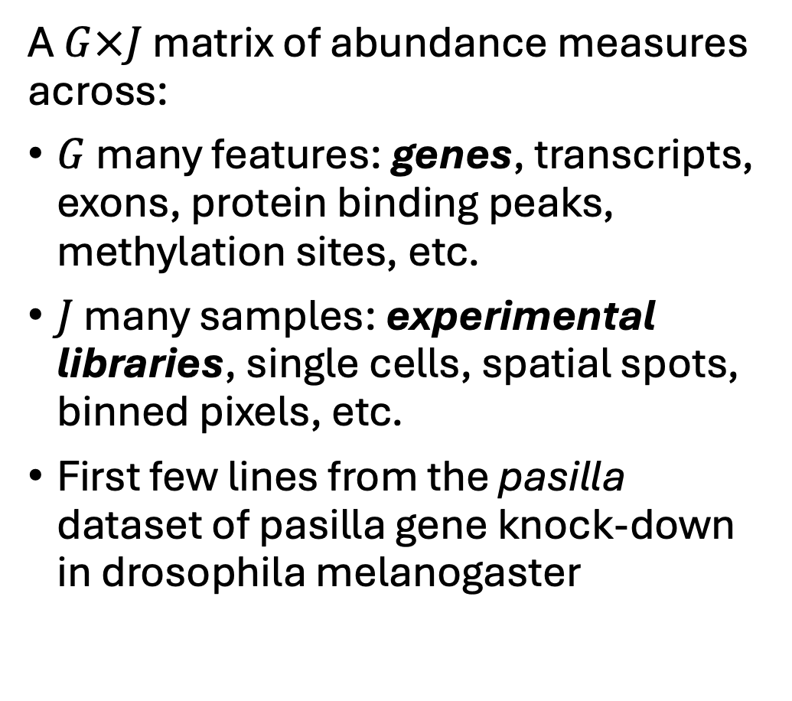
DE definitions: data structure
A $G×J$ matrix of abundance measures across:
$G$ many features: genes, transcripts, exons, protein binding peaks, methylation sites, etc.
$J$ many samples: experimental libraries, single cells, spatial spots, binned pixels, etc.
First few lines from the pasilla dataset of pasilla gene knock-down in drosophila melanogaster
 | Samp1 | Samp2 | Samp3 | Samp4 | Samp5 | Samp6 | Samp7
FBgn0000003 | 0 | 0 | 0 | 0 | 0 | 0 | 1
FBgn0000008 | 92 | 161 | 76 | 70 | 140 | 88 | 70
FBgn0000014 | 5 | 1 | 0 | 0 | 4 | 0 | 0
FBgn0000015 | 0 | 2 | 1 | 2 | 1 | 0 | 0
FBgn0000017 | 4664 | 8714 | 3564 | 3150 | 6205 | 3072 | 3334
FBgn0000018 | 583 | 761 | 245 | 310 | 722 | 299 | 308
FBgn0000022 | 0 | 1 | 0 | 0 | 0 | 0 | 0
FBgn0000024 | 10 | 11 | 3 | 3 | 10 | 7 | 5
FBgn0000028 | 0 | 1 | 0 | 0 | 0 | 1 | 1
FBgn0000032 | 1446 | 1713 | 615 | 672 | 1698 | 696 | 767

Slide 5
DESeq2 quick-start analysis
Switch over to bulkRNA_AnalysisScript.R

Slide 6
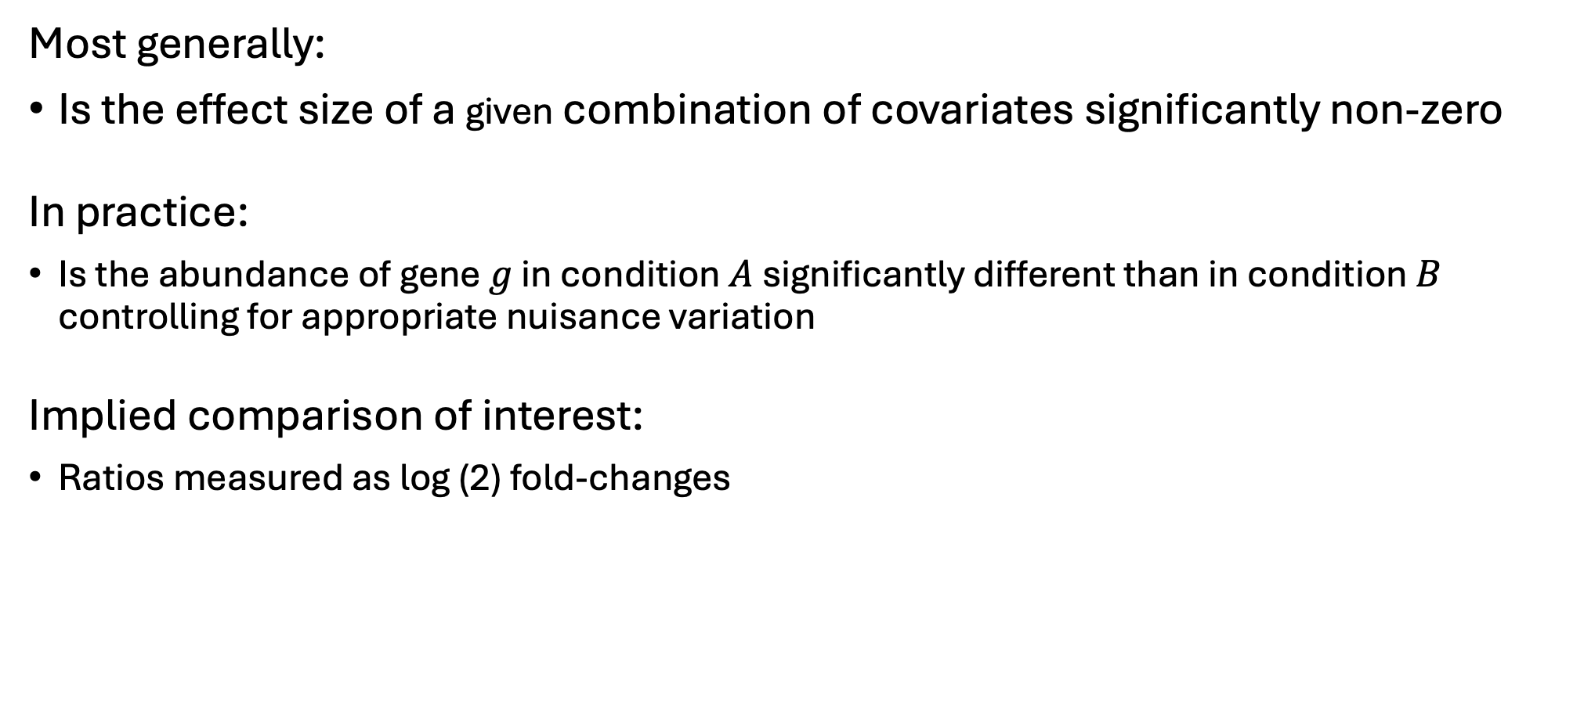
DE definitions: what are we testing
Most generally:
Is the effect size of a given combination of covariates significantly non-zero
In practice:
Is the abundance of gene $g$ in condition $A$ significantly different than in condition $B$ controlling for appropriate nuisance variation
Implied comparison of interest:
Ratios measured as log (2) fold-changes

Slide 7
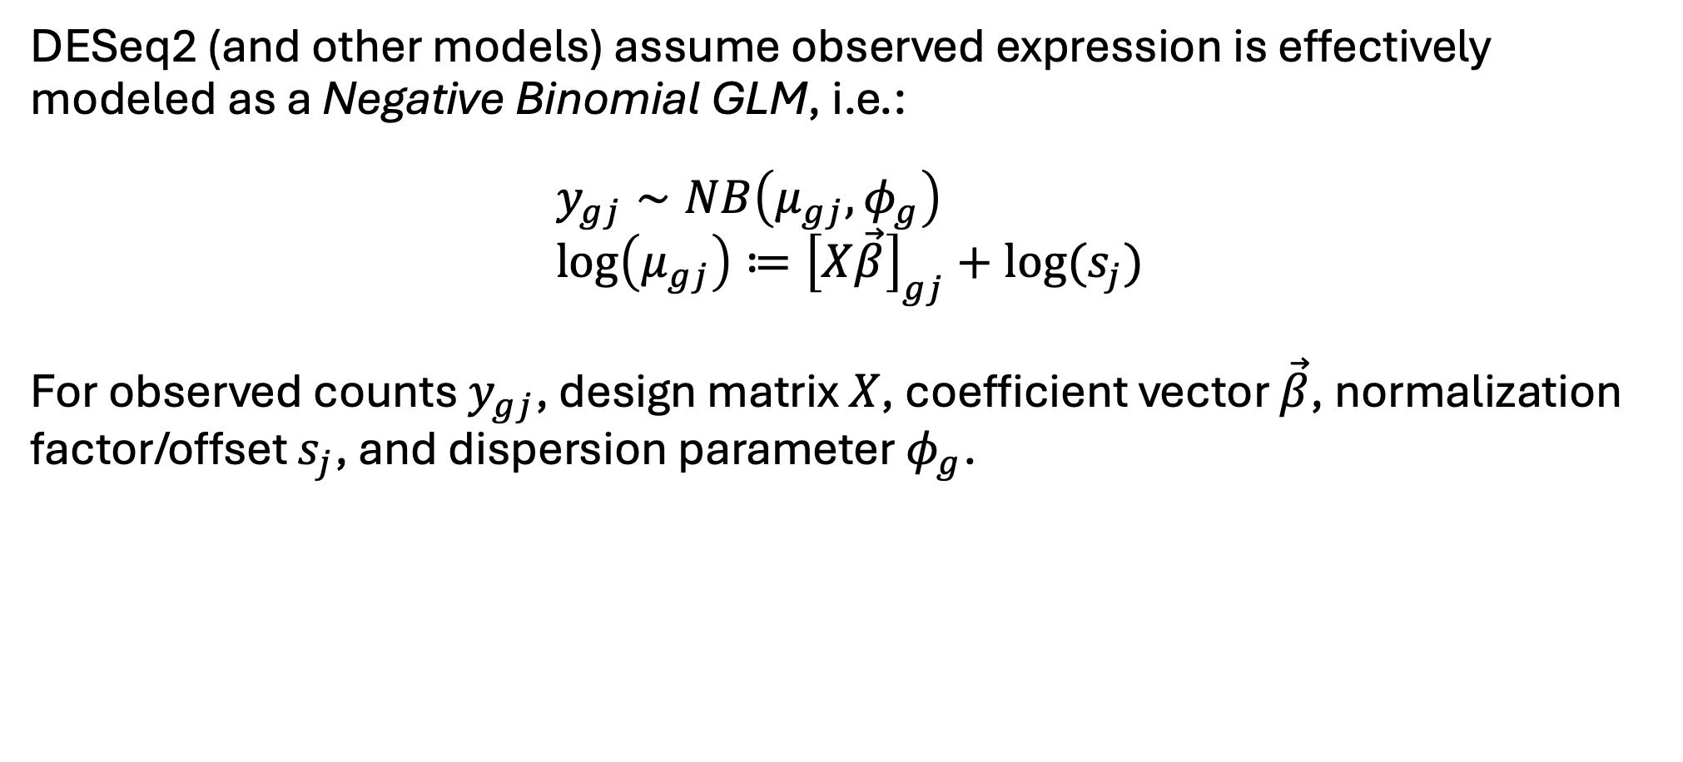
DE definitions: typical model spec.
DESeq2 (and other models) assume observed expression is effectively modeled as a Negative Binomial GLM, i.e.:
$$y_{gj}∼NB\left(μ_{gj},φ_{g}\right) \\ \log\left(μ_{gj}\right)≔{\left[X\vec{β}\right]}_{gj}+log⁡(s_{j})$$
For observed counts $y_{gj}$, design matrix $X$, coefficient vector $\vec{β}$, normalization factor/offset $s_{j}$, and dispersion parameter $φ_{g}$.

Slide 8

NB GLM: Comp. to linear regression
Traditional “simple linear regression” can be written as a Normal GLM:
$$y_{gj}={\left[X\vec{β}\right]}_{gj}+ε_{gj} s.t. ε_{gj}∼N\left(0,σ_{g}^{2}\right)$$
is equivalent to:
$$y_{gj}∼N\left(μ_{gj}, σ_{g}^{2}\right) \\ μ_{gj}≔{\left[X\vec{β}\right]}_{gj}$$

Slide 9
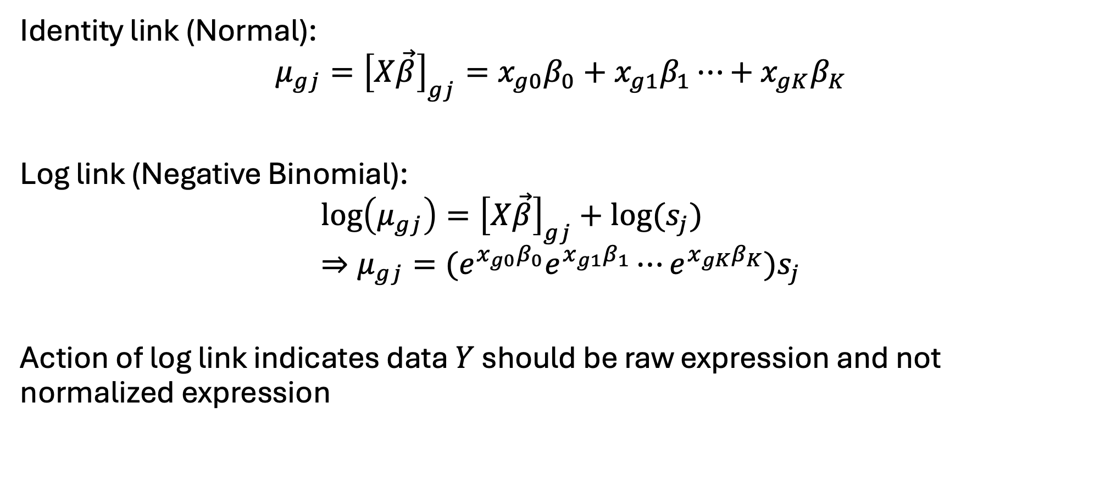
NB GLM: Link function
Identity link (Normal):
$$μ_{gj}={\left[X\vec{β}\right]}_{gj}=x_{g0}β_{0}+x_{g1}β_{1}⋯+x_{gK}β_{K}$$
Log link (Negative Binomial):
$$\log\left(μ_{gj}\right)={\left[X\vec{β}\right]}_{gj}+log⁡(s_{j}) \\ ⇒μ_{gj}={(e}^{x_{g0}β_{0}}e^{x_{g1}β_{1}}⋯e^{x_{gK}β_{K}})s_{j}$$
Action of log link indicates data $Y$ should be raw expression and not normalized expression

Slide 10
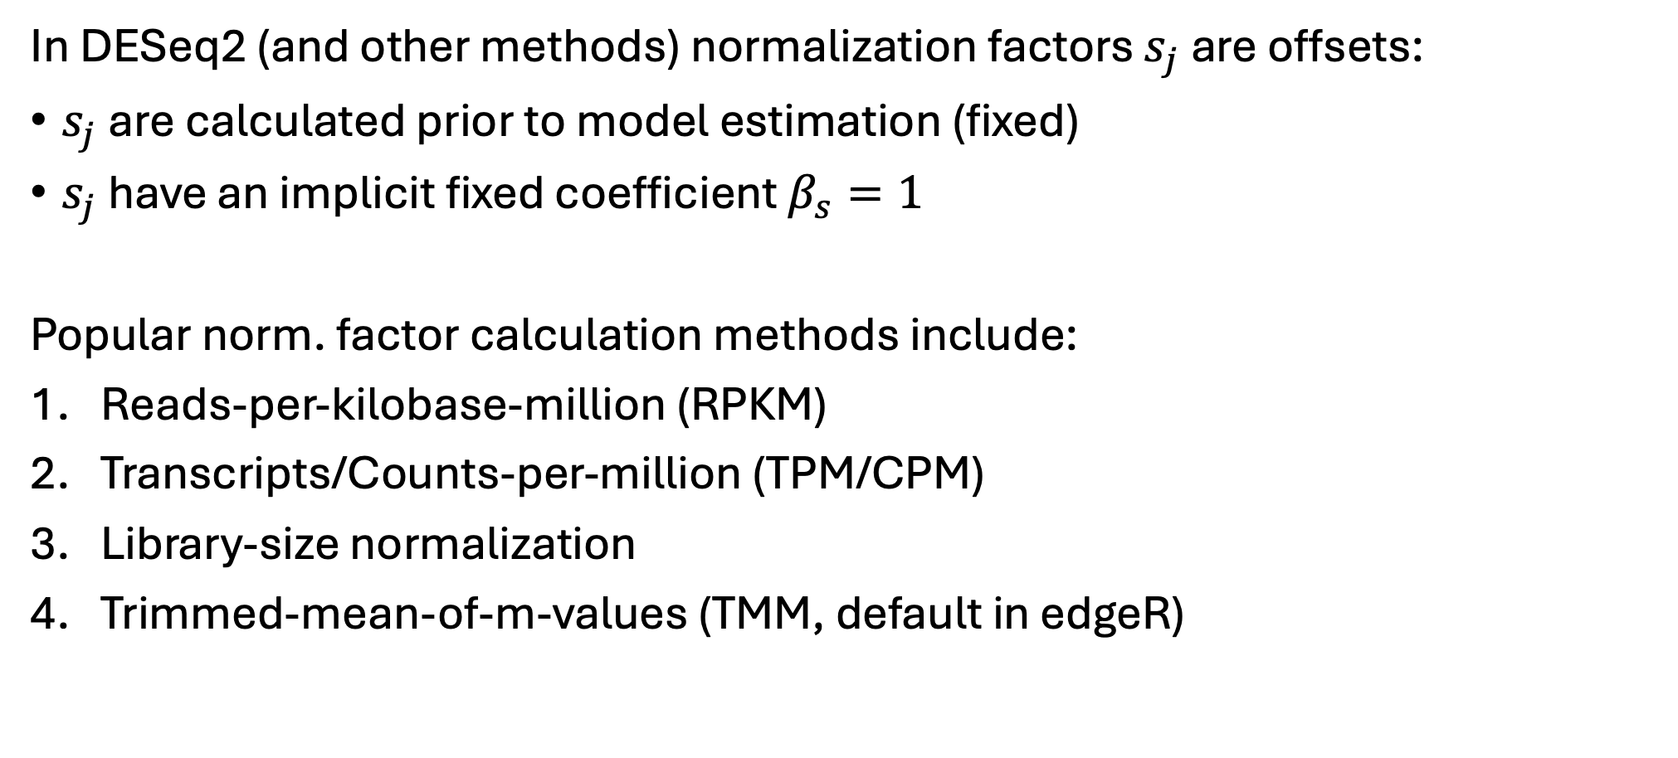
(Pre) Calculation of normalization offset
In DESeq2 (and other methods) normalization factors $s_{j}$ are offsets:
$s_{j}$ are calculated prior to model estimation (fixed)
$s_{j}$ have an implicit fixed coefficient $β_{s}=1$
Popular norm. factor calculation methods include:
Reads-per-kilobase-million (RPKM)
Transcripts/Counts-per-million (TPM/CPM)
Library-size normalization
Trimmed-mean-of-m-values (TMM, default in edgeR)

Slide 11
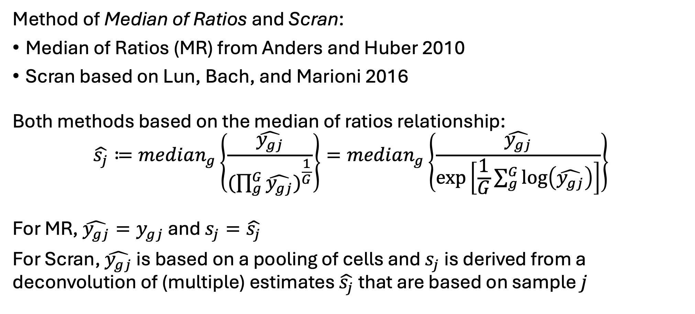
DESeq2 normalization default
Method of Median of Ratios and Scran:
Median of Ratios (MR) from Anders and Huber 2010
Scran based on Lun, Bach, and Marioni 2016
Both methods based on the median of ratios relationship:
$$\hat{s_{j}}≔median_{g}\left\{\frac{\hat{y_{gj}}}{({\prod_{g}^{G}{\hat{y_{gj}})}}^{\frac{1}{G}}}\right\}=median_{g}\left\{\frac{\hat{y_{gj}}}{\exp\left[\frac{1}{G}\sum_{g}^{G}{\log\left(\hat{y_{gj}}\right)}\right]}\right\}$$
For MR, $\hat{y_{gj}}=y_{gj}$ and $s_{j}=\hat{s_{j}}$
For Scran, $\hat{y_{gj}}$ is based on a pooling of cells and $s_{j}$ is derived from a deconvolution of (multiple) estimates $\hat{s_{j}}$ that are based on sample $j$

Slide 12
DESeq2 bulk custom size factors
Switch over to bulkRNA_AnalysisScript.R

Slide 13
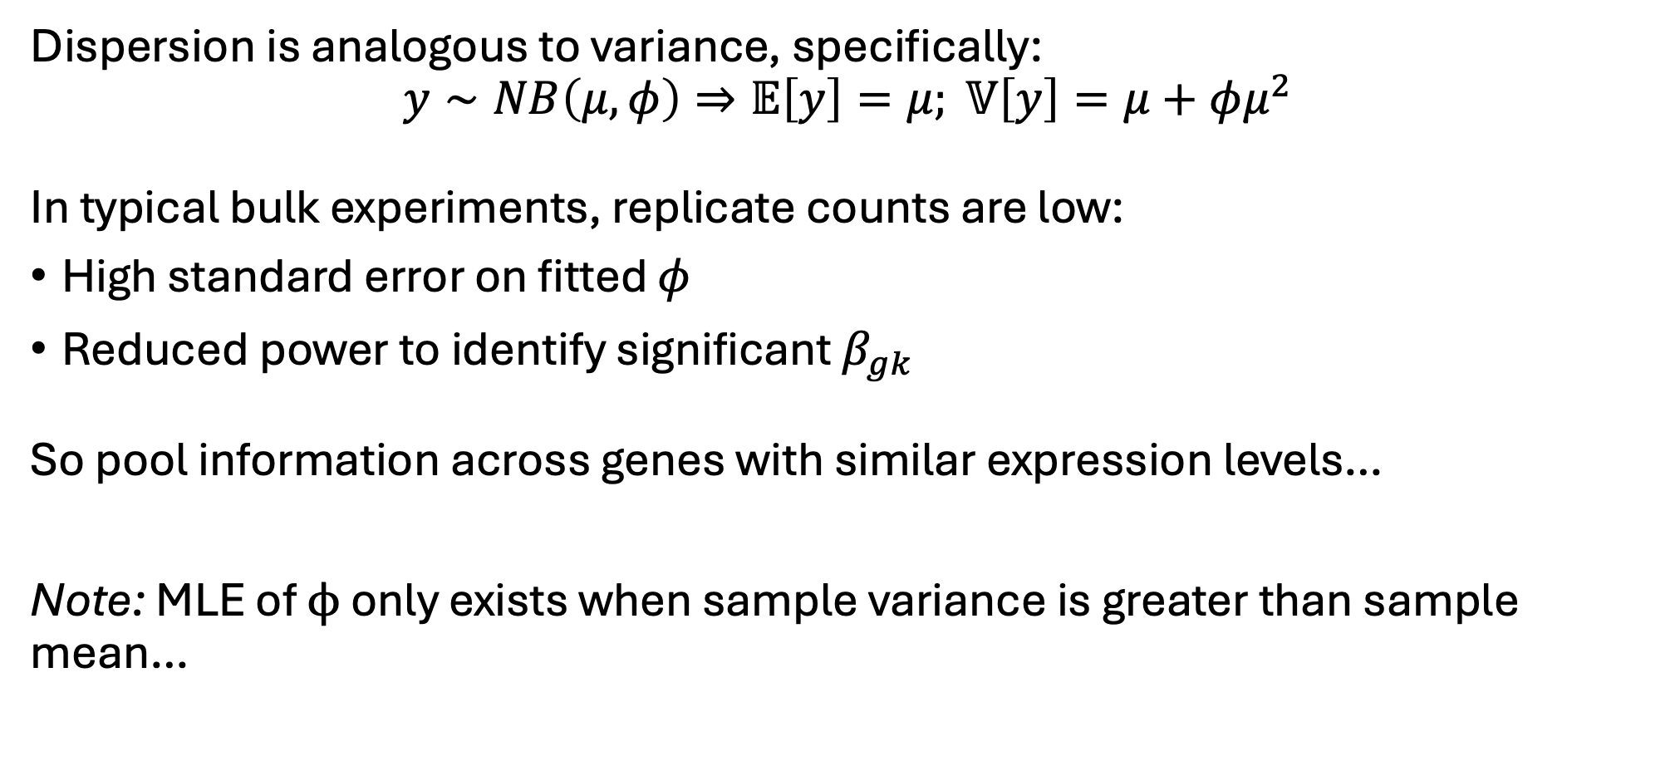
NB GLM: Dispersion estimates
Dispersion is analogous to variance, specifically:
$$y∼NB\left(μ,φ\right)⇒𝔼\left[y\right]=μ; 𝕍\left[y\right]=μ+φμ^{2}$$
In typical bulk experiments, replicate counts are low:
High standard error on fitted $φ$
Reduced power to identify significant $β_{gk}$
So pool information across genes with similar expression levels…
Note: MLE of $ϕ$ only exists when sample variance is greater than sample mean…

Slide 14
DESeq2 dispersion visualization
Switch over to bulkRNA_AnalysisScript.R

