Slide 1
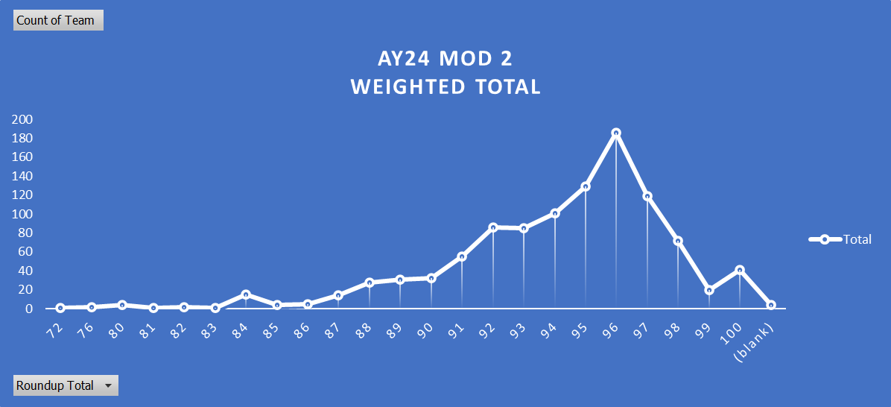
Assessment (TRI) QUAD
Meets standard = 1060 >= 80% below the past AY (trends) performance
99.9%
0.1%
Does not meet standard = 1 < 80% which is above the past AY (trends) performance
Block Author Analysis:
AY23 C300 Analytics
Quantitative data | Weighted Total | M200P1 MOD CTGL | M299A1 - Div Mvmnt- | M200B1 U.S. Officers | M200B1 IMS Officers | BB exam rollup
Max | 100.00 | 100.00 | 100.00 | 100.00 | 100.00 | 100.00
Min | 72.00 | 0.00 | 80.00 | 64.00 | 52.00 | 52.00
Mean (Average) | 93.73 | 81.76 | 94.96 | 92.47 | 91.63 | 92.37
Median | 94.40 | 94.00 | 95.00 | 92.00 | 92.00 | 92.00
SD of score | 3.62 | 32.73 | 2.56 | 6.54 | 7.50 | 6.66
Upper Quartile | 96.00 | 95.99 | 96.00 | 96.00 | 96.00 | 96.00
Lower Quartile | 92.00 | 92.00 | 94.00 | 88.00 | 88.00 | 88.00
Interquartile Range(IQR) | 4.00 | 3.99 | 2.00 | 8.00 | 8.00 | 8.00
Mode | 96.00 | 0.00 | 95.00 | 96.00 | 96.00 | 96.00
Range | 28.00 | 100.00 | 20.00 | 36.00 | 48.00 | 48.00
Analytics: Jasona.a.ballard6.civ@army.mil

