Slide 1
Trends in US Manufacturing
For Data Vis By Jonathan Budnick

Slide 2
Problem Statement
This is a study examining regional trends in USA manufacturing employment and potential correlations with robotics adoption.

Slide 3
Motivation
US Manufacturing Sector employs ~13 million
Industry Trends have far-reaching implications on communities
Robotics has the potential for massive change
Policymakers request more data in this area

Slide 4
Data Sources
BLS.gov
Employment data in manufacturing by state
Census.gov
Population Data
Surveys on Robotics Capital Expenditure

Slide 5
Data Processing
Employment data was adjusted using population data for per capita
Employment data was used to calculate percent change over 1-year and 5-year increments
Robotics Expenditure data from 2018-2022 were combined into a dataset

Slide 6
Visualizations and Analysis
Manufacturing and Robotics in The United States

Slide 7
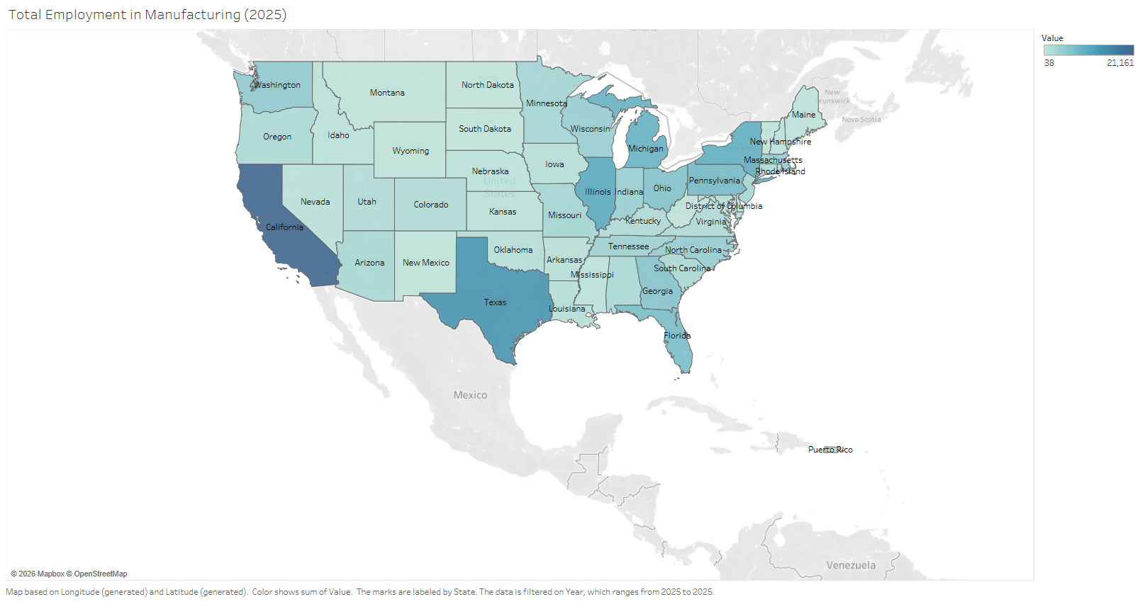
Overview: Total Employment in Manufacturing (2025)

Slide 8
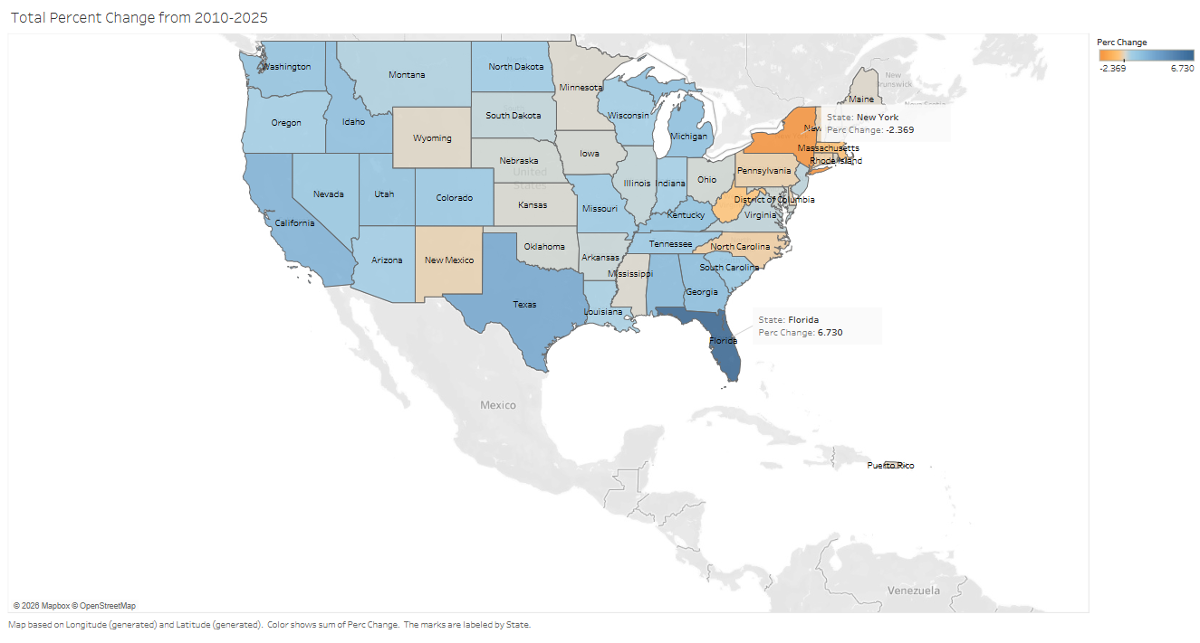
Overview: Total Change In Employment (2010-2025)

Slide 9
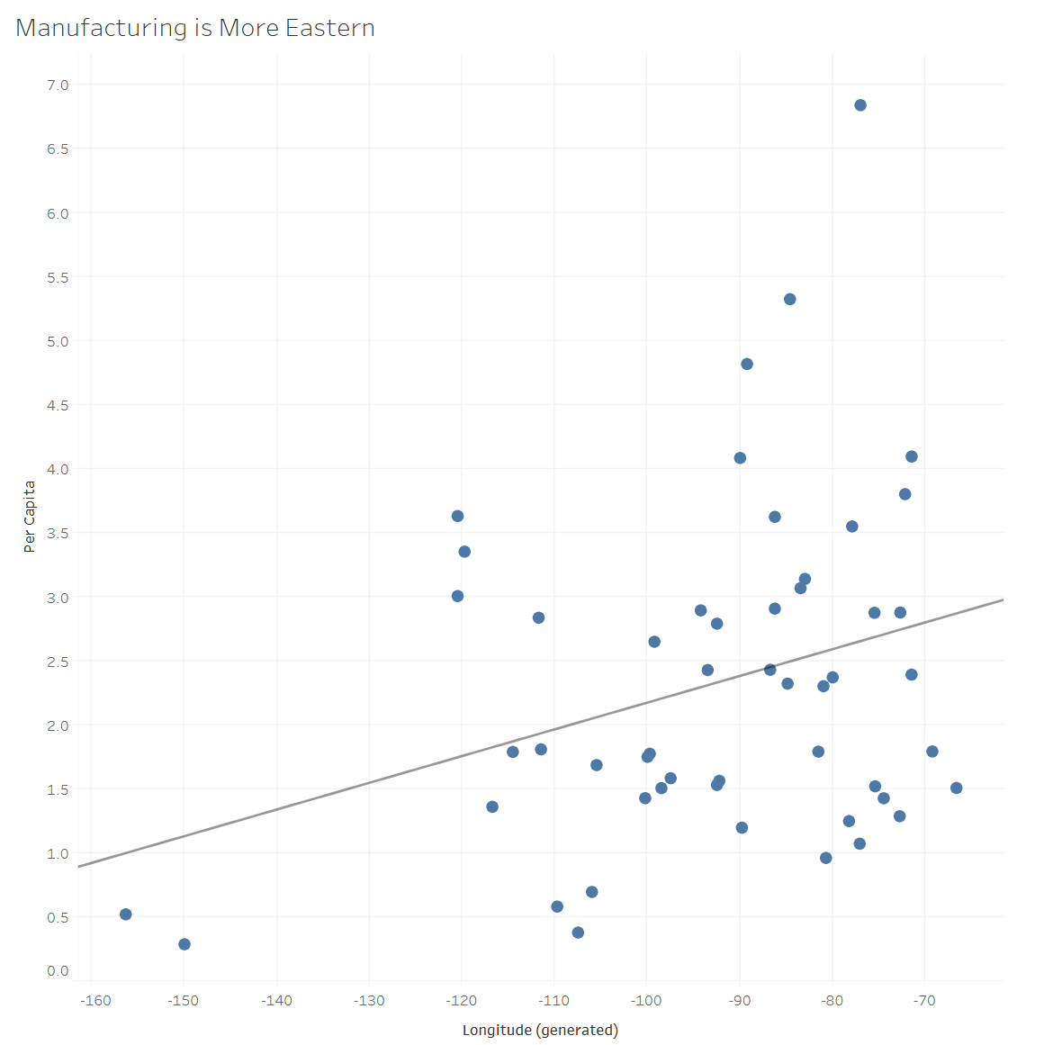
Employment Density Trends Eastward (2025)

Slide 10
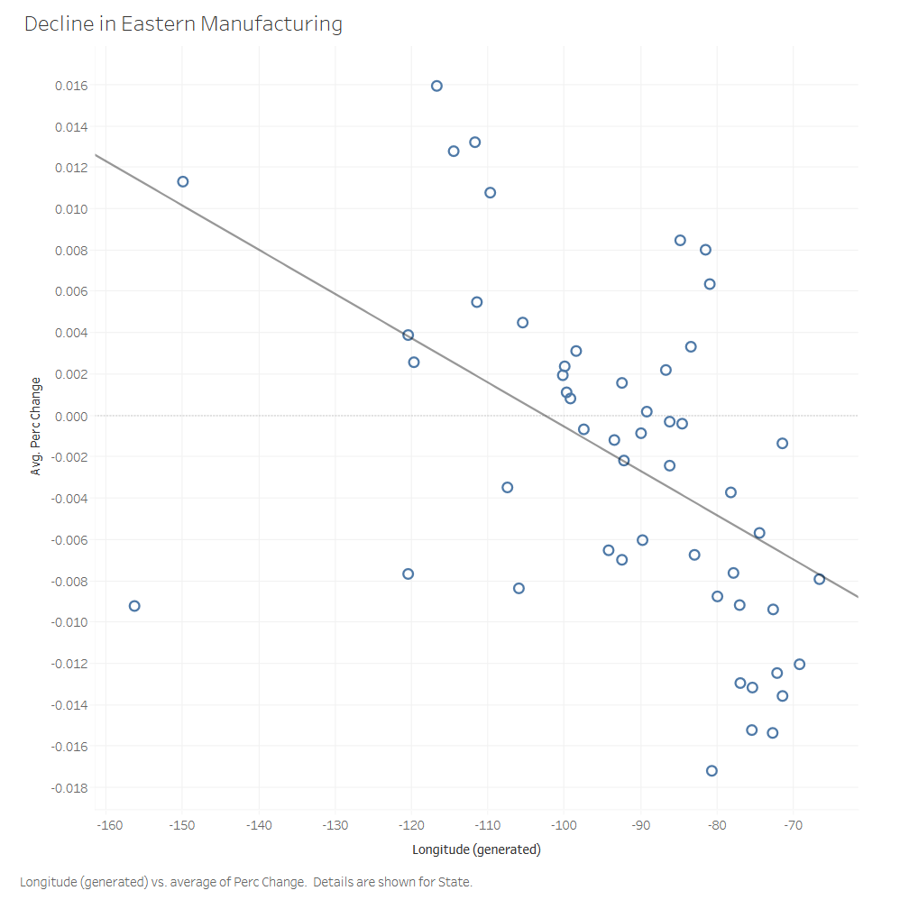
However, the Decline in Employment Most Effects The East

Slide 11
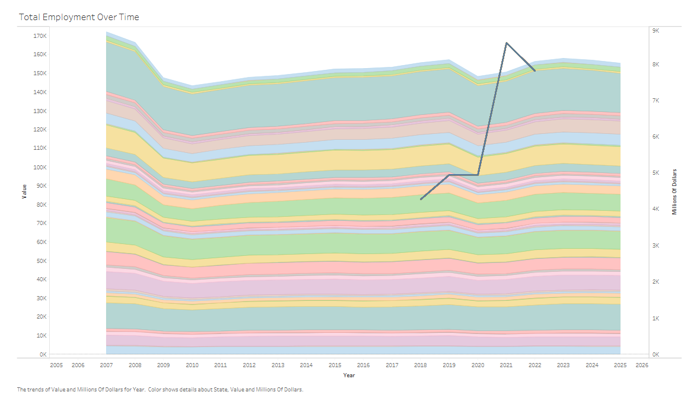
Covid Time Robotics Investment Spiked During Decline in Employment & Lack of Growth Since 2008 Economic Crisis

Slide 12
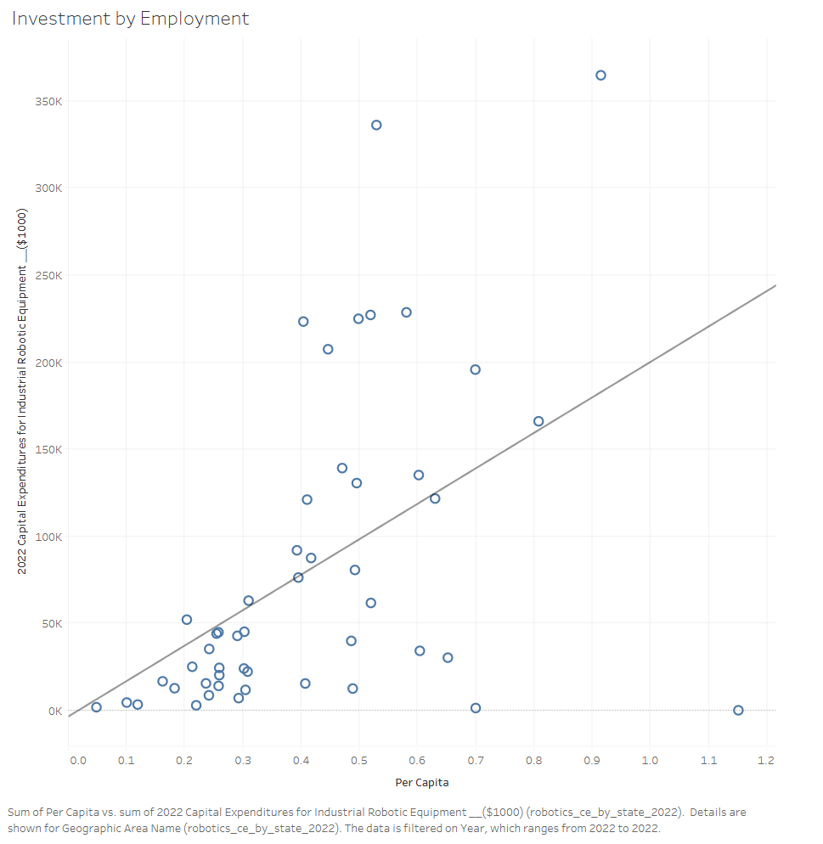
States With More Workers Invested More in Robotics (2022)

Slide 13
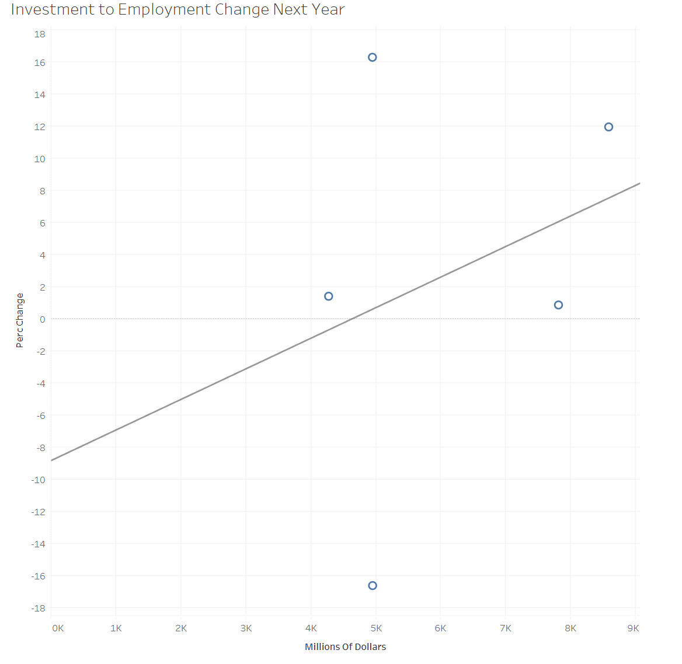
Robotics Investment Might Correlate with Job Creation (But There is Too Little Data)

Slide 14
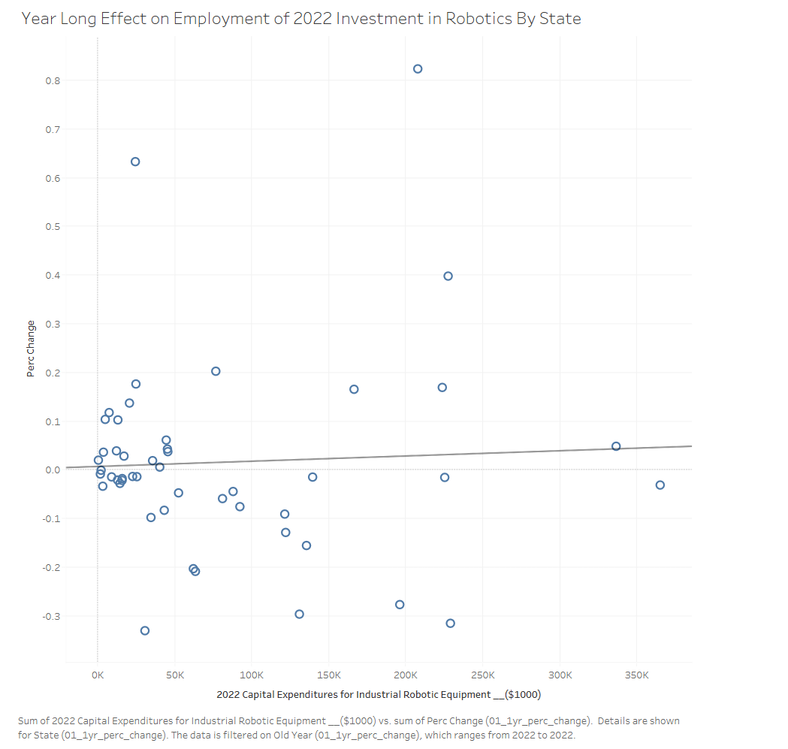
Analysis of Change After 2022 Investment For Each State Shows Weak Positive Correlation

Slide 15
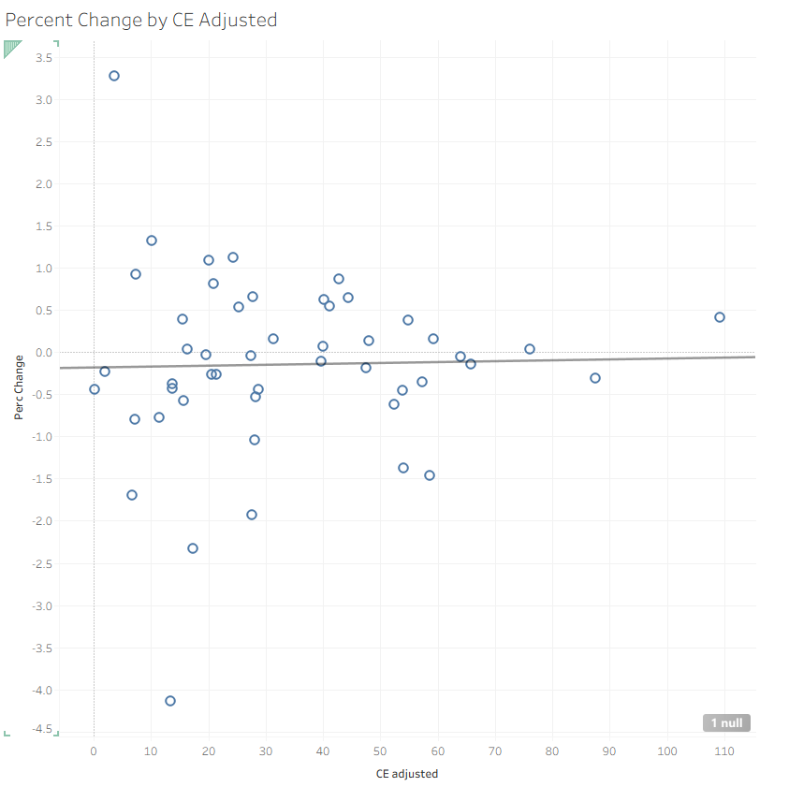
The Same Weak Correlation Is Found When CE is Adjusted Per Worker

Slide 16
Closing Findings
Manufacturing Declined Overall From 2008 Financial Crisis, and during 2020 Covid
Declined most in the East (NY, MA, WV, NC, but FL grew)
Investment in Robotics appeared to rise in an attempt by businesses to offset this decline
Manufacturing Employment returned to normal after Covid but still less than before 2008
A weak positive correlation suggests robotics investment may support job growth in the short term, but data is limited

