Slide 1
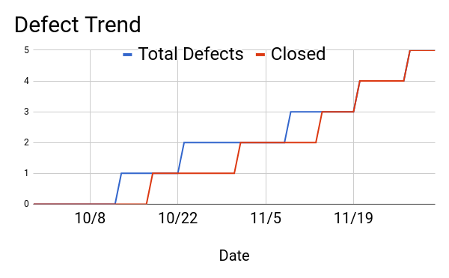

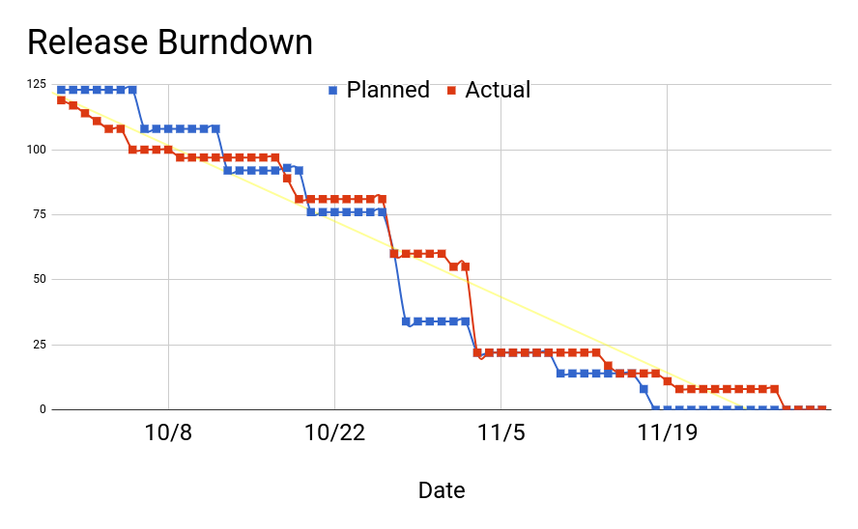

Flairdocs Workflow Designer Tool
By Joe Burkhart, Alex Cabello, Fan Chen, Mason Koch
Sponsored by Flairsoft
Objective:
Create a design tool help speed up creating customizable, automated workflows. By creating this product￼, system administrators will be able to make configurable workflows without the need of a software developer.
Usable
Configurable
Functional
Accessible
Product Backlog:
Tools Used:
SweetAlerts 2: pretty confirmation boxes
DOJO: border panel and live splitter
Select2: JQuery search bar framework
Microsoft C# Unit Test: controller testing
JQuery UI: Drag and drop
Challenges:
New languages as developers
Visual Studio caching and builds
Legacy, reference code was mostly unusable
Mid-project switch from component driven development to thin-thread
Representation of a workflow as a piece of data
Stakeholder | Priority | Feature | Use Case | Points
Admin | 1 | Workflow Processing | Create a workflow | 21
Admin | 2 | Workflow Processing | Save a workflow | 13
Admin | 3 | Workflow Processing | Search for a workflow | 5
Admin | 4 | Workflow Processing | Open a workflow | 8
Admin | 5 | Workflow Designer Tool | Add a step to workflow | 21
Admin | 6 | Workflow Designer Tool | Add reviewer to step | 5
Admin | 7 | Workflow Designer Tool | Remove reviewer from step | 3
Admin | 8 | Workflow Designer Tool | Add step in between steps | 3
Admin | 9 | Workflow Designer Tool | Delete step | 3
Admin | 10 | Reviewer configurations | Set person as reviewer | 8
Admin | 11 | Reviewer configurations | Create actions for user role | 8
Admin | 12 | Reviewer configurations | Attach XML | 3
Admin | 13 | Reviewer configurations | Set prerequisites for reviewers | 5
Future Steps
Set reviewer roles such as PM, admin etc
Set special authorization prerequisites
Set custom rules for steps
Guided by Al Cline
Notes:
https://www.njsbjc.org/cms/lib/NJ02226125/Centricity/Domain/43/Using%20Google%20Slides%20to%20Design%20a%20poster.pdf

