Slide 1
Raft Consensus Algorithm
Fidan Ahmadova
Principles of Distributed Systems

Slide 2
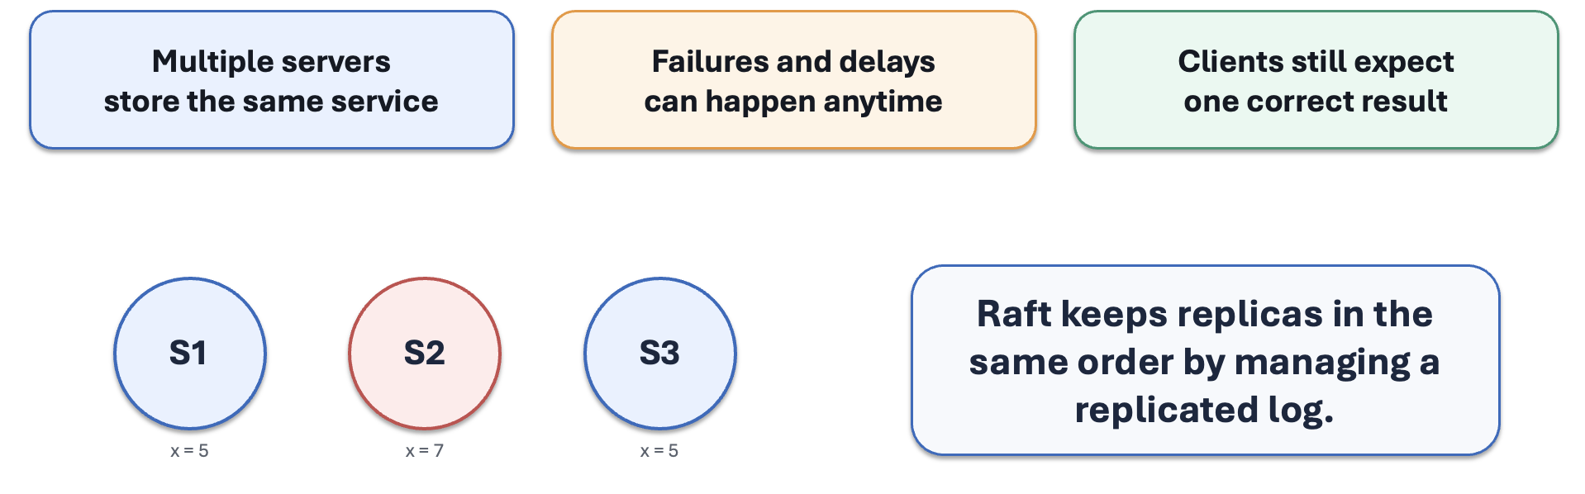
What Problem Does Raft Solve?
Problem: Distributed systems need multiple servers to agree.
Why it matters:
Servers may crash
Messages may be delayed
Data must stay consistent

Slide 3
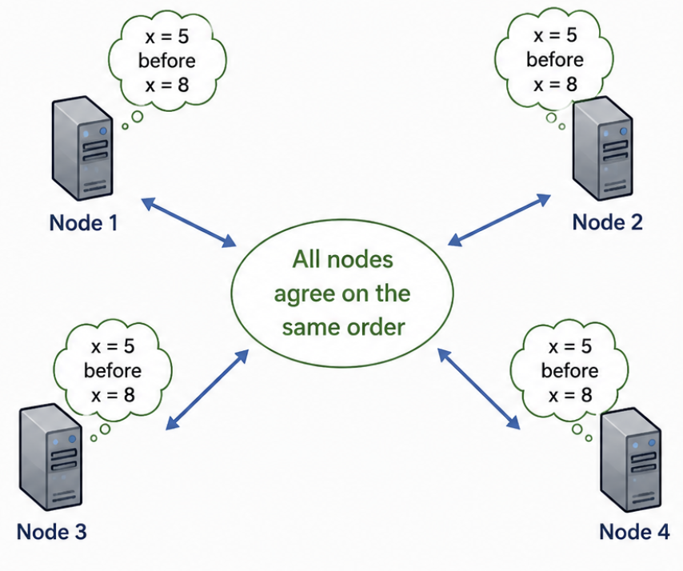
What Is Distributed Consensus?
Distributed consensus means: Multiple nodes agree on one value or one
sequence of actions.
Example: All servers agree that: X=5 happens before X=8

Slide 4
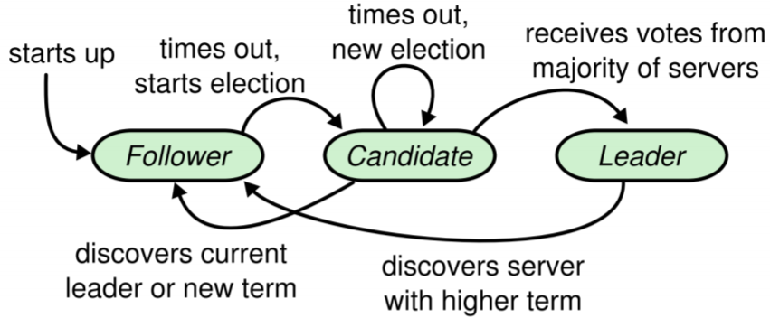
Main Roles in Raft
Leader Handles client requests and sends heartbeats
Follower Listens to the leader and stores log entries
Candidate Starts an election when no leader is detected

Slide 5
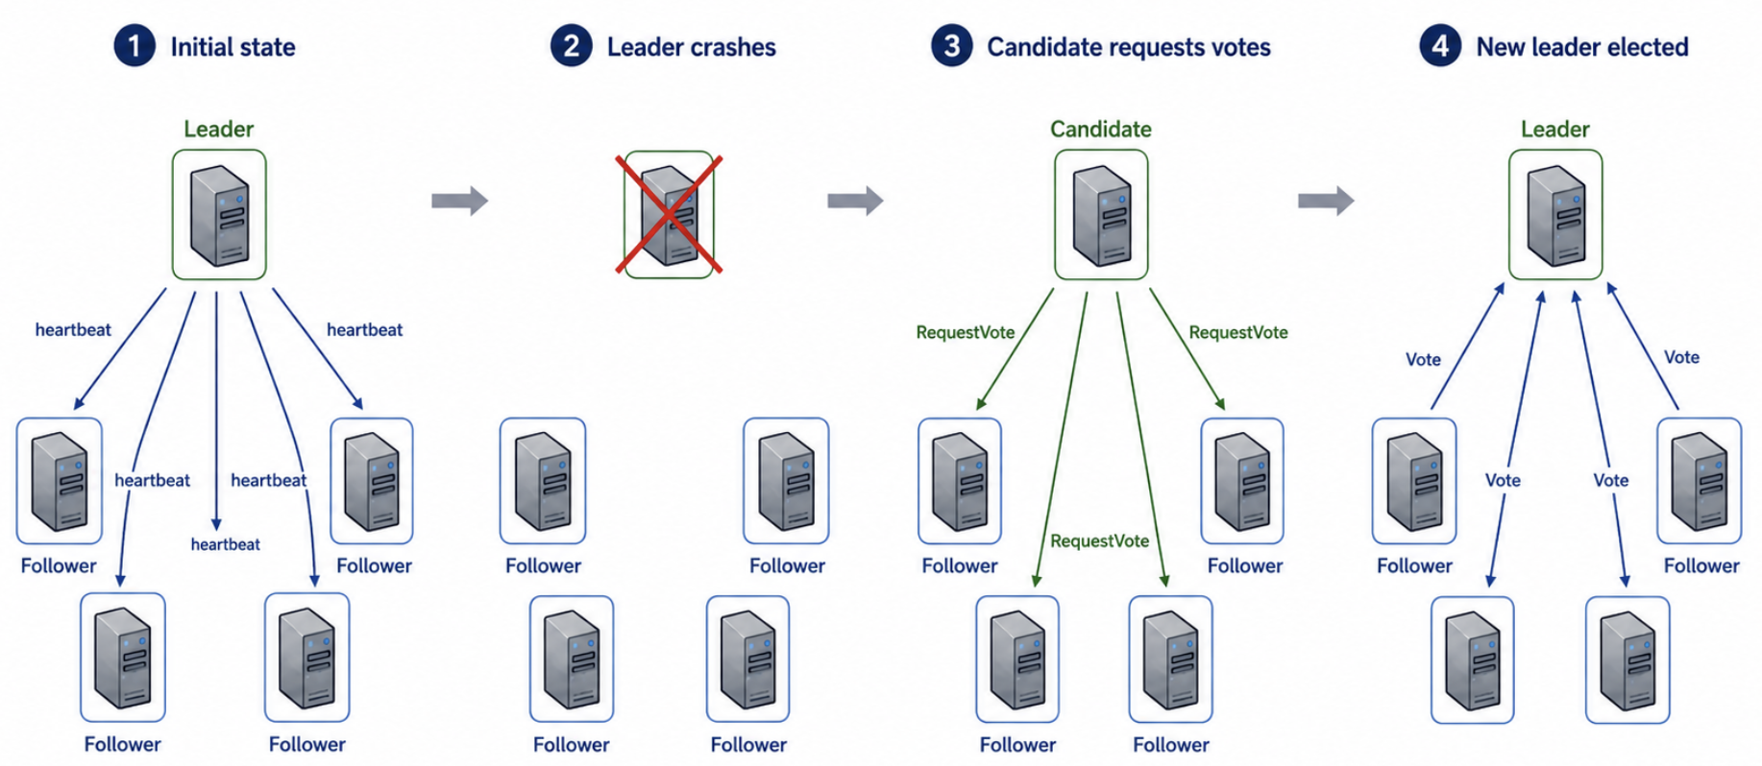
Leader Election
Leader Election Steps:
Followers wait for heartbeat
If heartbeat stops, timeout happens
Follower becomes candidate
Candidate asks for votes
Majority vote = new leader

Slide 6
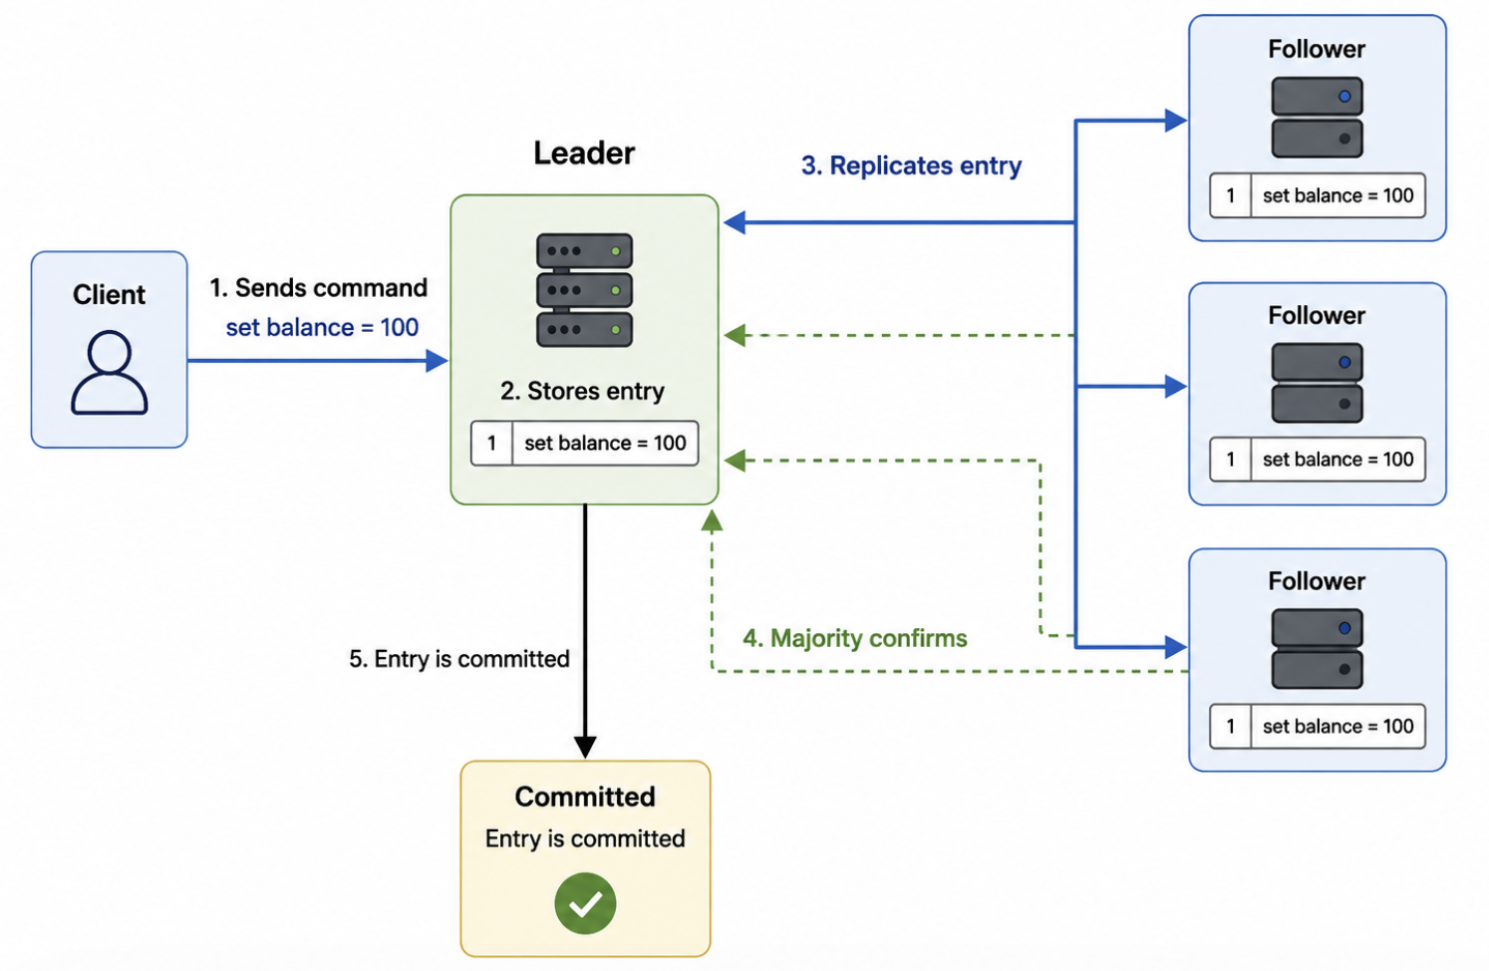
Log Replication
Log replication: The leader copies client commands to followers.
Example command: set balance = 100
Flow: Client sends command → Leader stores it → Followers copy it → Majority confirms → Entry is committed

Slide 7
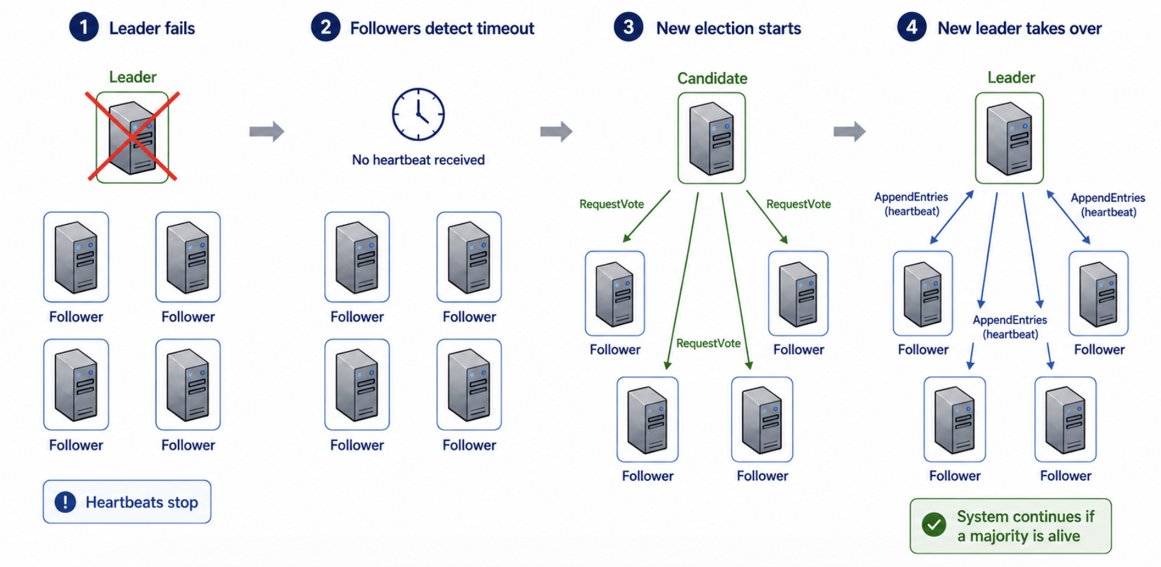
What Happens If the Leader Crashes?
Leader crash scenario:
Leader stops sending heartbeats
Followers detect timeout
New election starts
New leader continues the system
Key idea: Raft can continue if a majority of nodes are alive.

Slide 8
Recap / Conclusion
Raft in one sentence: Raft helps distributed servers agree by using a leader.
Main ideas:
Consensus keeps data consistent
One leader manages updates
Followers replicate logs
Elections recover from failures
Final question: What would happen if no majority is available?

