Slide 1
ROBOT GRASPS …..WITH CNNs OR IS IT REALLY
DSCI6005 gu5 Jc WAY-IN-OVER-MYHEAD

Slide 2

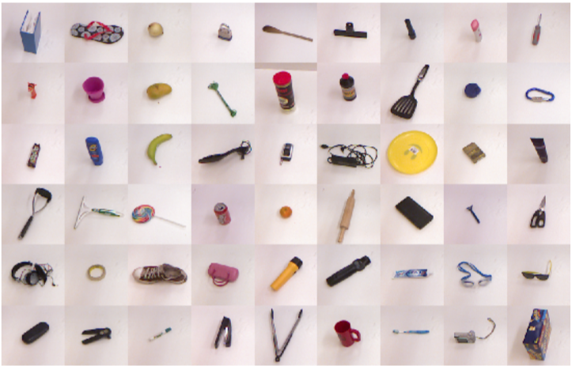
DATASET
885 IMAGES
(3 * 128 * 128) IMAGE DIMENSIONALITY
Images captured by baxter robot’s MAIN CAMERA in point cloud format (PCD)
GRASP POINTS (THAT WILL MAKE THE bounding box) captured by ROBOT ARM CAMERAS : X, Y
GRASP POINTS CLASSIFIED AS -1 AND +1
BONUS - 1901 FEATURES IDENTIFIED FOR BOUNDING BOXES FOR A OBJECT TYPE AS BASELINE MODEL
Notes:
Dataset statistics: # of objects: 244 # of object categories: 93 # of images: 885 # of labeled grasps: 8019 positive: 5110 (0.64) negative: 2909 (0.36)

Slide 3
INITIAL SCOPE
PHASE 1 :
GIVEN AN IMAGE AND ITS BOUNDING BOX FEATURES, CLASSIFY THE GRASPS AS +1 or -1
PHASE 2 :
PREDICT GRASP POINTS FOR ANY IMAGE OF THE TRAINED OBJECT TYPE
NOT IN SCOPE : PHASE 3 :
IDENTIFY THE OBJECT AN ANY BACKGROUND

Slide 4
CLASS IMBALANCE CHECK : +1 AND -1 GRASPS

Slide 5
PHASE 1 – MACHINE LEARNING MODEL AS BASELINE
BASELIENE PROCESSED DATA :
Support Vector Classification
APPROX 80% ACCURACY
75-25 TEST-TRAIn SPLIT
3 FOLD CROSS VALIDATION

Slide 6
PHASE 1 – NEURAL NETS
USING NEURAL NETS - MOOT POINT
BOUNDING BOX’S FEATURES ALREADY PROVIDED
SVC PERFORMS WELL
MOVE TO PHASE 2 FOR NEURAL NETS : IDENTIFY GRASP POINTS FOR ANY IMAGE OF THE TRAINED OBJECT

Slide 7
PHASE 2 – NEURAL NETS
ANYTHING THAT CAN GO WRONG WILL GO WRONG…
RECREATE IMAGE MATRIX TO PLOT / IDENTIFY THE GRASP POINTS FOR +1 AND -1
Image matrix is patent to baxter camera
REVERSE ENGINEER USING baxter SDK and OPENCV. WeLL, that’s gotta be easy NOT !
THE SHOW HAS JUST BEGUN.
DATA is from old baxter. Cannot be recreated. GOOD job !

Slide 8
Phase 2 Scope modified
Maybe not any image of trained object types
But how About image of the trained objects in different orientation
And recreate the ‘bonus’ data set identify the grasp rectangle features using neural nets
Not in scope : Phase 3
Bimodal and quicker Identification of other objects in the given data set
potential grasp identification step 1 : recognise grasp shapes already seen
For example uses coffee mug handle and a scissor handle

Slide 9
Phase 2 – preprocessing
Convert pcd to numpy matrix
for +1 and -1 grasps
center the image to the bounding box
SHIFT the gripper axis to the NEW x-axis and Y-AXIS
Crop the image to a fixed size around the bounding boX
Rotate images at various angles (ALSO RECREATE PNG FOR THESE)
ROATET bounding boxes at various angles
Depth scale factoring (GRASP POINT CAPTURE HAPPENS WITH THE ARM)
ORIGINAL # of objects : 244
NEW # OF IMAGES : 885
LABELLED GRASPS : 8019
LABELLED +1 GRASPS : 5110 (0.64)
LABELLED -1 GRASPS : 2909 (0.36)
CLASSIFY OBJECT TYPES MANUALLY (ID, NAME)
# of object categories: 93

Slide 10
TRAIN TEST SPLIT
80 – 20 TRAIN TEST SPLIT
LOOK AT ALL OBJECTS (NO SPLIT. FOUND THIS AFTER TERRIBLE METRICS ON INITIAL MODEL)
PERMUTATED SPLITS ON GRASPS FOR ALL OBJECTS
GRASPS
Train : 6415 (VALIDATION: 0.1)
TEST : 1604

Slide 11
MODEL ARCHITECTURE
Conv2D
Conv2D
Conv2D
Conv2D
FullyConnected
MaxPool
MaxPool
MaxPool
Sigmoid
Loss
Categorical Cross Entropy

Slide 12
HYPER PARAMETERS ….LeT’s STRESS THE MODEL !
Name | Run1 | Run2 | Run3
Batch Size Hyper parameter | 500 | 250 | 50
Epochs Hyper parameter | 40 | 100 | 1000
Validation Accuracy Metric | 0.7 | 0.8 | 0 OR 1
Test Accuracy Metric | 0.64 | 0.7 | 0.37
Hyper parameter | Value
global_step | 0
initial_learning_rate | 0.01
decay_steps | 64
decay_rate | 0.9
learning_rate | Exponentional decay function of above parameters

Slide 13
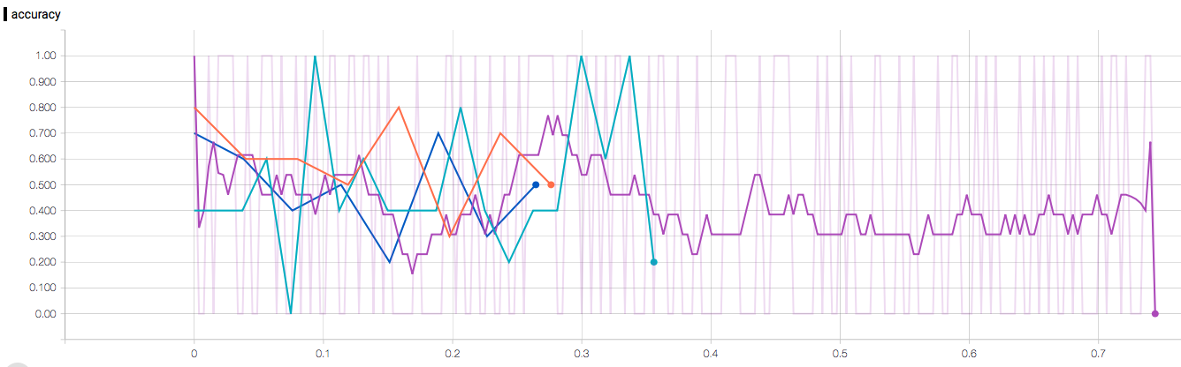
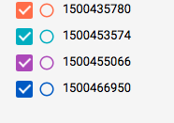
TENSORBOARD SO I DON’T PLOT TO KILL !

Slide 14
When do I get to meet this ‘GRASP’ you talk about..?
WELL, LETS CHECK if GCLOUD COPY-FILES DID ITS VODOO THING…

Slide 15
GO BACK TO THE MANUAL OBJECT TYPE LABELLING
Conv2D - Object type
282 labels – fairly balanced
Conv2D
Conv2D
Conv2D
Conv2D
FullyConnected
MaxPool
MaxPool
MaxPool
Sigmoid
Input
Loss
Categorical Cross Entropy

Slide 16
NEURAL NET FOR OBJECT TYPE CLASSIFICATION
MODELS TRIED | VALIDATION ACCURACY
CNN – 8 LAYERS | 0.009
VG16 | 0.07
RESIDUAL NET

Slide 17
Residual NET (RESNET)
‘Plain’ Net
X
H(x)
relu
Weight Layer
relu
Weight Layer
relu
‘Residual’ Net
I(x) = x
X
Weight Layer
Weight Layer
+
-
relu
relu
relu
relu
Borrowed Algorithm and code for 50 layer RESNET – Modified it to 19

Slide 18
Yo FANCY, HOWDYA DO ?
EPOCH | TRAIN ACCURACY | VALIDATION ACCURACY | TEST ACCURACY
12/200 | 0.89 | 0.61 | To be revealed in 8 hours

Slide 19
I WONDER ?
Keras – Check
TENSORFLOW – check
Tensorboard – check
Google cloud – CHECk and CASH
OPENCV – OMG !
Lua – WHAT !
CHALLENGE ? DEEP LEARNING
GENERALIZABLE ? NOT REALLY IN ITS STRUCTURE
SCALABLE ? HA HA
ACCURACY ? NOT REALLY. BUT, WHAT ELSE ?...False positives or false negatives !
TWO MORE WEEK WHAT WOULD I DO ? AT THIS POINT, SLEEP….
FUTURE – BABY STEPS:
HYPER PARAMETER SEARCH, FINE TUNE, visualize intermediate tensor outputs

Slide 20
COnclusion
In progress…....just getting started actually !

