Slide 1
Litex Experiments
Jean-Christophe Le Lann
October 2019

Slide 2
Litex ?
Library of IP written in Migen
Migen ?
  A Python DSL for Hardware Description
  Replacement of Verilog
  IPs in Verilog are wrapped in Migen

Slide 3
My own install
Follow Enjoy-digital tutorial
  In My case everything is in
    ~/EXPERIMENTS/LITEX/
I am testing on
  NexysA7 (ex Nexys4DDR) Digilent board
I want to run a RISC-V processor
  Picorv32 choosen
  Vexriscv is also cool (can run Linux !)

Slide 4
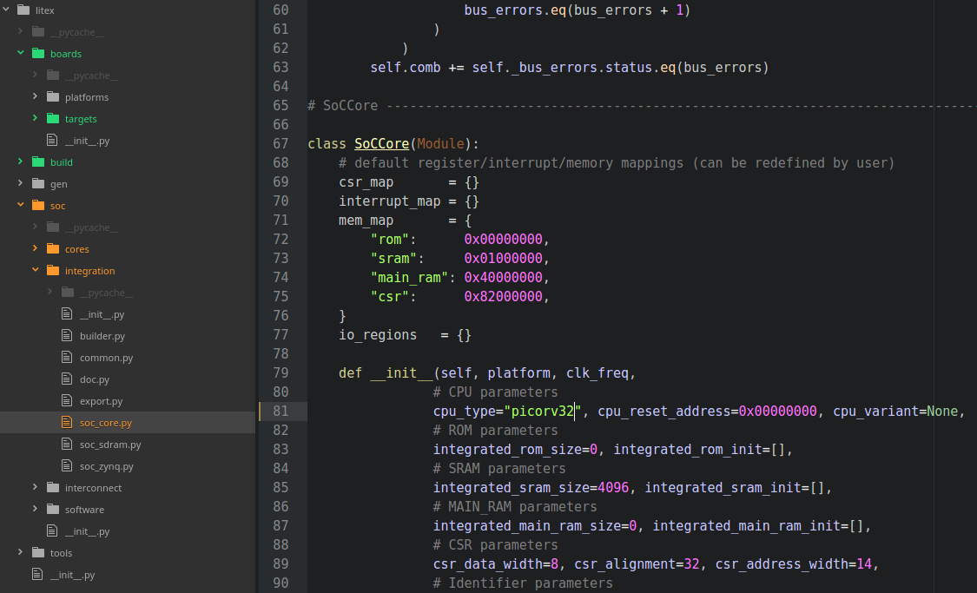
Where to indicate
“I want a Picorv32 ?”

Slide 5
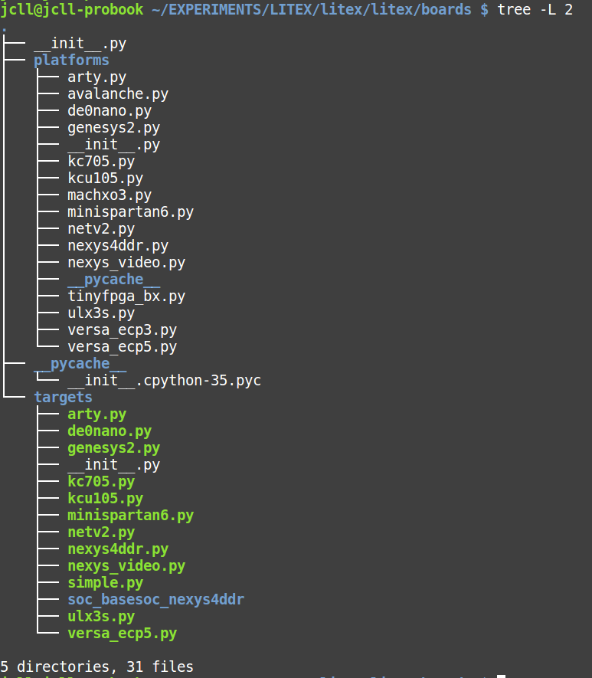
“Build the target of your board”
litex-boards/litex_boards/**/targets
Platforms ~ board pinout
Targets ~ soc
cd targets
Python3 nexys4ddr.py

Slide 6
Build & Synthesis
cd targets
Python3 nexys4ddr.py
Litex generates (thru Migen) the verilog files
Litex calls the appropriate Synthesis tool
  Vivado,ISE, Quartus or Yosys
A bitstream is generated

Slide 7
Program the board

Slide 8
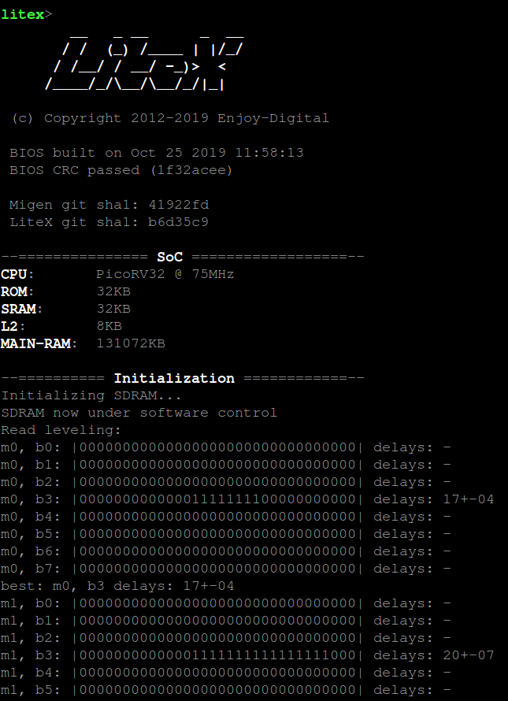
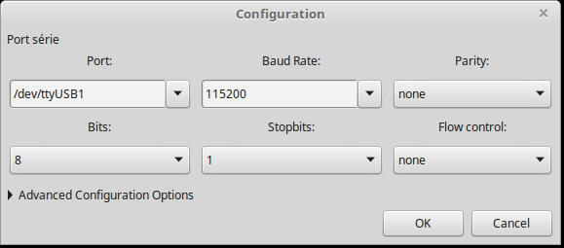
Connect a serial terminal
I am using Gtkterm
Reset button is “CPU reset” on NexysA7

Slide 9
Complete new SoC description ?

