Slide 1

Exploring Size-Speed Trade-Offs in Static Index Pruning
Juan Rodriguez Torsten Suel Tandon School of Engineering
New York University Brooklyn, NY
Supported by NSF Grant IIS-1718680 and by Amazon.
Juan Rodriguez
IEEE Big Data 2018 - Seattle, WA

Slide 2
Paper, slides and code:
https://github.com/JC-R/BD2018

Slide 3
Static Index Pruning
Motivation
Suppose a search engine indexes 4 trillion documents
250 index entries per document → 10^15 entries
5B queries per day, with 3.4 terms on average
< 170 billion index entries lead to top-10 in a month
Actually, far less ...
Can we find and remove useless entries from the index?

Slide 4
Introduction
Inverted Index
term
posting (inverted) list
posting
Notes:
Our work deals with the problem of too much data, a lot of it useless
So in essence, this work is about what data NOT to keep, specifically in the field of text search.
The main data structure used in search engines is the inverted index.
For each word or term in the corpus, we store where it is used
Inverted list for term t contains index entries (postings)
Postings have form (did, f) where did is the ID of a document containing t and f is the number of occ.

Slide 5
Problem Definition
+
Query processing in a nutshell:
Traverse inverted lists for query terms
Apply a ranking function to docs in union or intersection
E.g., cosine, BM25, or more complex ranker
Then return the top-k results to the user
Notes:
Query processing:
For example, cat and mouse
Look at intersection of documents in the two terms, or the union of the lists, depending on whether we use conjunctive or disjunctive queries

Slide 6
Problem Definition
+
Many inverted lists are very long, millions of entries long…
We cannot afford to traverse and rank all candidates
Search engines use shortcuts: “early termination techniques”: - Index tiering, impact ordering, maxscore/wand etc. - Index pruning is one early such termination (ET) techn.
Notes:
This is a processing performance challenge.
Posting Lists can be very long, in the millions
Search engines have strict time constraint!! They need to identify candidates and rank them in a fraction of a second in order to satisfy some SLA.

Slide 7
Index Pruning
“would anybody search for doc 454 using this term?”
“will this posting ever lead to a top-k result for a likely query?”
If “no”, remove this posting from the index
Notes:
So, how do we identify these unlikely postings?

Slide 8
Goal: Remove postings that are (fairly) useless, while keeping quality “almost” the same; make query processing as fast as possible.
Why? Shorter lists lead to faster query processing
Smaller indexes need less RAM or disk accesses
Smaller indexes: move search to devices at the edge
Index pruning is a non-safe ET technique (lossy)
Not the same as spam detection/removal
Notes:
Performance: shorter lists: less traversal
→ results after pruning are not exactly the same

Slide 9
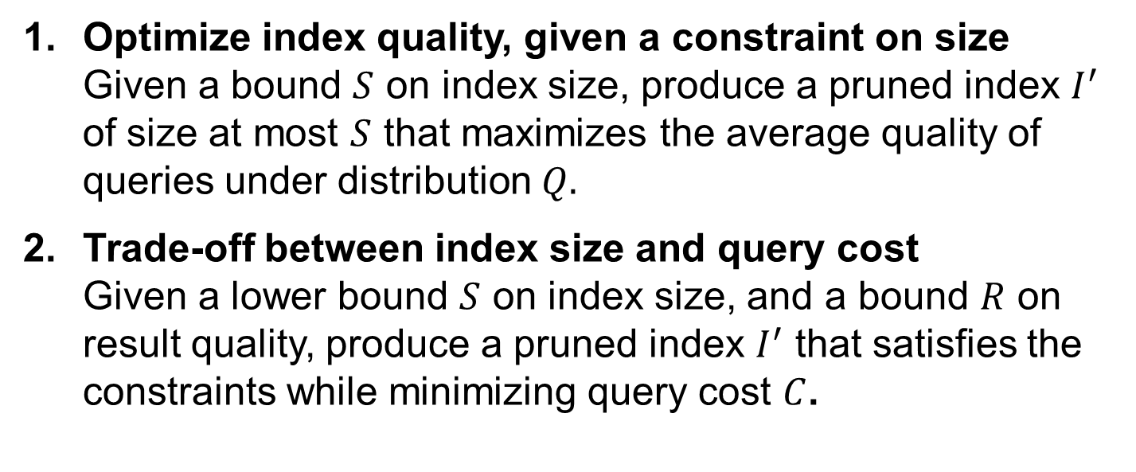
Static Index Pruning
Our Objectives
Optimize index quality, given a constraint on size Given a bound $S$ on index size, produce a pruned index $I^{′}$ of size at most $S$ that maximizes the average quality of queries under distribution $Q.$
Trade-off between index size and query cost Given a lower bound $S$ on index size, and a bound $R$ on result quality, produce a pruned index $I^{′}$ that satisfies the constraints while minimizing query cost $C$.
Notes:
This is what normal Static Index Pruning work
This is speed optimization of a statically pruned index

Slide 10
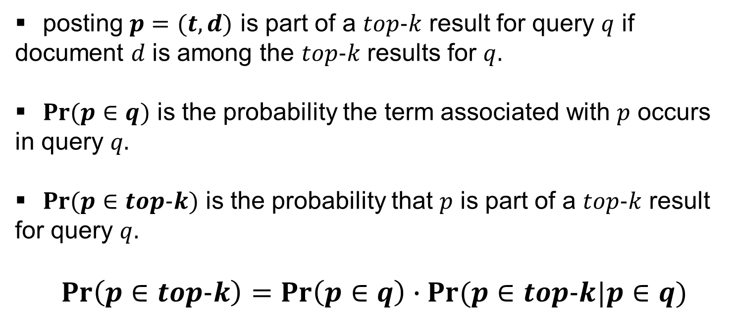
Definitions used in this paper
posting $p=(t,d)$ is part of a $top-k$ result for query $q$ if document $d$ is among the $top-k$ results for $q.$
$Pr⁡(p∈q)$ is the probability the term associated with $p$ occurs in query $q.$
$Pr⁡(p∈top-k)$ is the probability that $p$ is part of a $top-k$ result for query $q.$
$$\operatorname{Pr}\left(p∈top-k\right)=\operatorname{Pr}\left(p∈q\right)∙Pr⁡(p∈top-k|p∈q)$$
Notes:
Definitions used in this paper:
Note that Pr p will be in a topK result can be computed

Slide 11
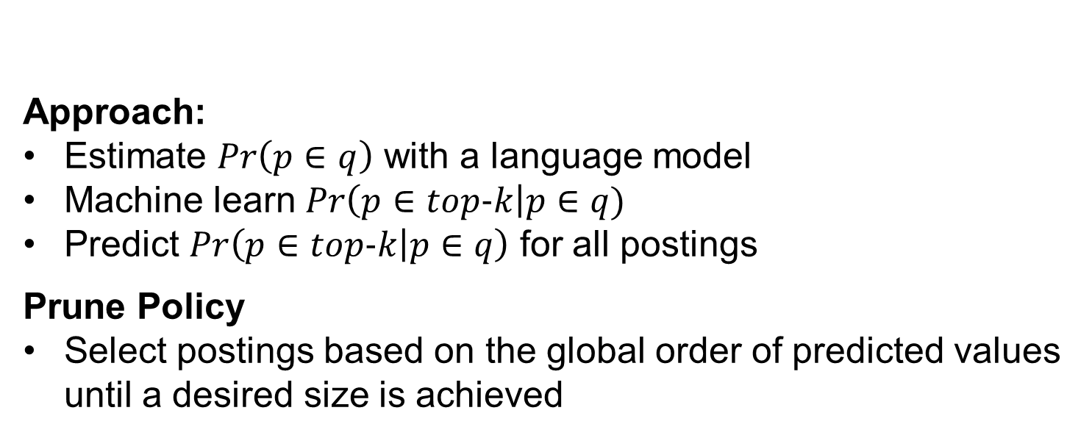
Objective 1. Optimize index quality, given a constraint on size
Approach:
Estimate $Pr\left(p∈q\right)$ with a language model
Machine learn $Pr\left(p∈top-k\right|p∈q)$
Predict $Pr\left(p∈top-k | p∈q\right)$ for all postings
Prune Policy
Select postings based on the global order of predicted values until a desired size is achieved
Notes:
Objective #1: classical static index pruning as a size optimization problem
Our approach is as follows:

Slide 12
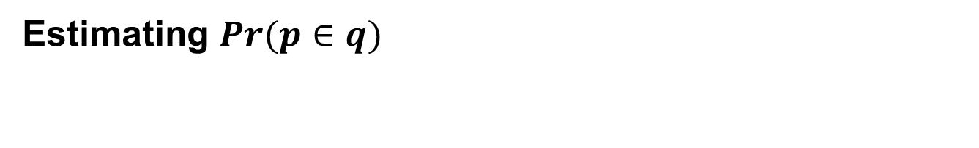
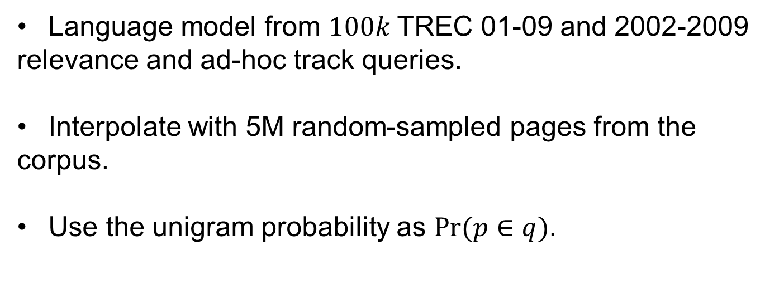
Estimating $Pr⁡(p∈q)$
Language model from $100k$TREC 01-09 and 2002-2009 relevance and ad-hoc track queries.
Interpolate with 5M random-sampled pages from the corpus.
Use the unigram probability as $Pr⁡(p∈q)$.

Slide 13
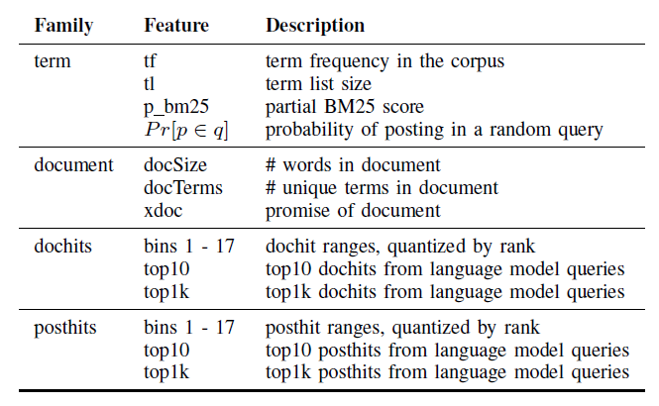
Random Forest
Training size: 2M
Predict on entire index 16 billion postings
Spark cluster on Hadoop
1024 Vcores
3Tb RAM
200 Tb HD

Slide 14
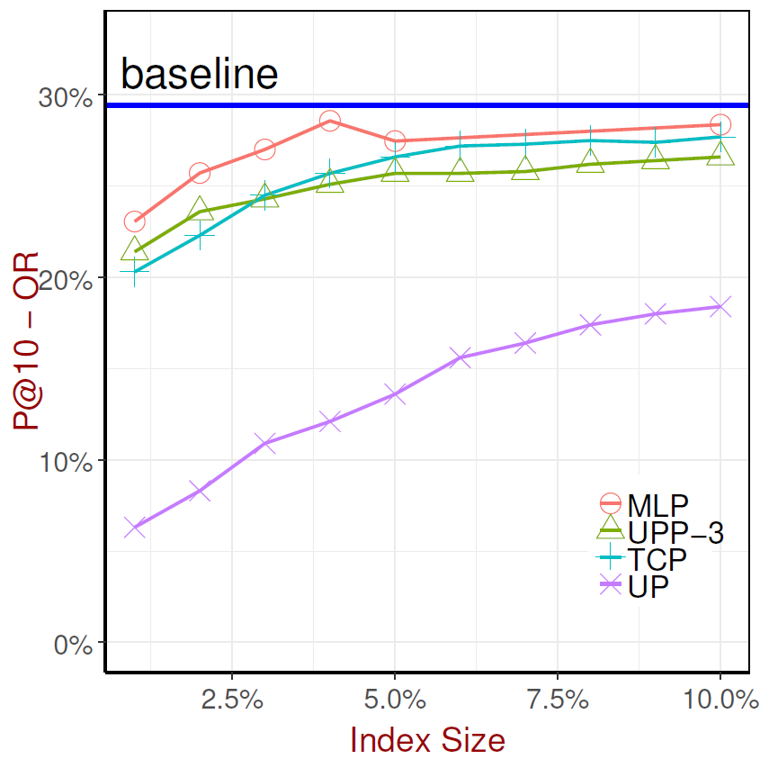
Experimental Results
Machine Learned Pruning
Very high pruning ratios
Quality metrics P@10 Postings Kept* Results Kept*
Notes:
Note in this work, we work at very high pruning ratios
While we optimize for precision, we use other metrics of quality in our work.
Specifically, results and postings kept, defined as percentages of

Slide 15
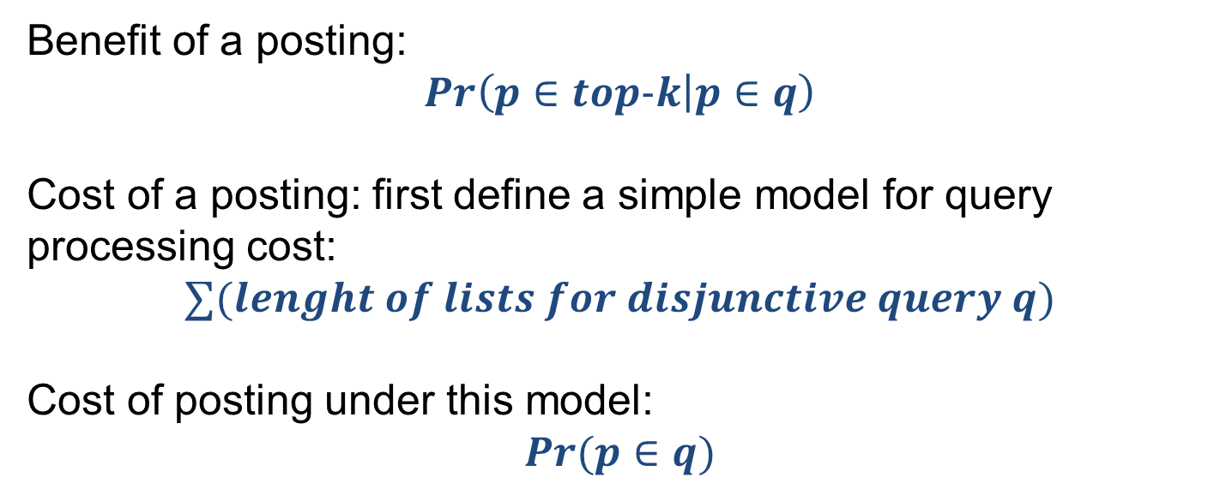
Objective 2. Trade-Off between Index Size and Query Cost
Benefit of a posting:
$$Pr\left(p∈top-k | p∈q\right)$$
Cost of a posting: first define a simple model for query processing cost:
$$∑(lenght of lists for disjunctive query q)$$
Cost of posting under this model:
$$Pr(p∈q)$$
Notes:
Why only size in previous work.
→ challenge the decision to optimize for size only, by previous work
Each choice can be reasonable, depending on system setup and requirements.
Sometimes it is size, sometime speed only. But mostly it is in the middle, like best speed given limits on size, and this is where we can show real speed improvements with little increase in size.
First, we need to define what benefit and cost are as applied to postings:
We define benefit as the prob learned in the previous machine learned model:
To define cost of a posting, we use use a simple model of list length, Under this cost model, each posting has an expected cost as prob p in a random query.

Slide 16
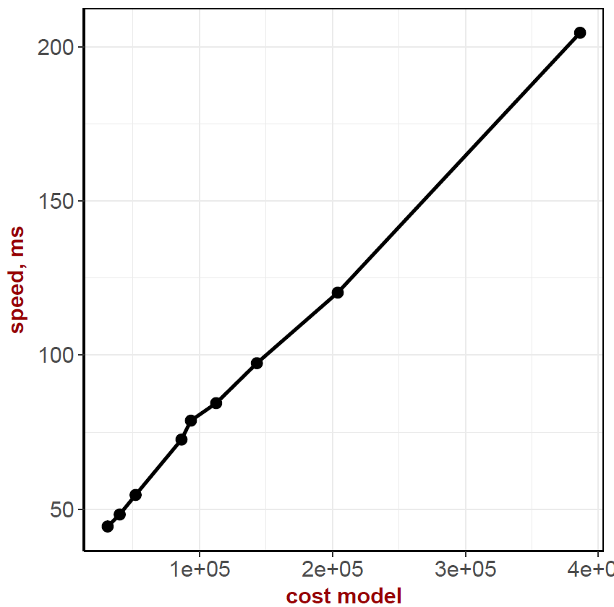
Cost Model Validation
Actual query speed measurements show near linear relationship to our cost model
(Exhaustive OR evaluation)
Notes:
We evaluated actual query processing speeds against our expected cost model.
The results show a near linear relationship between our cost model and actual cost.

Slide 17
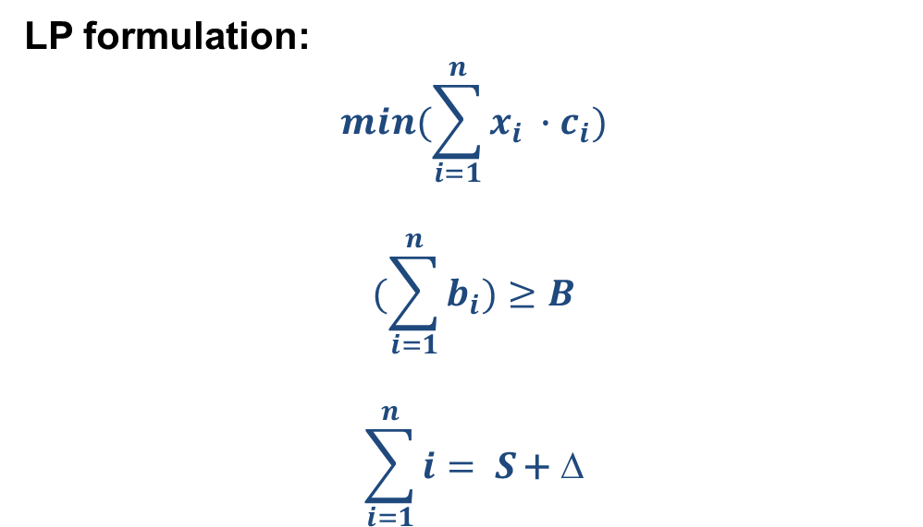
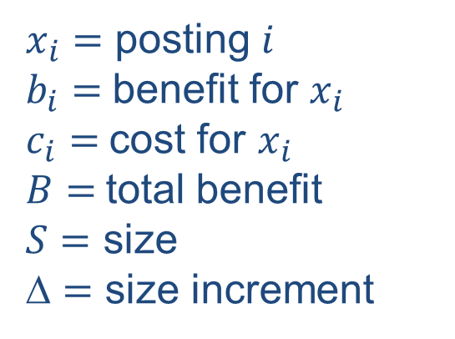
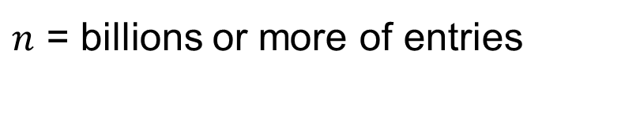
Size Cost Trade-Off
$n$ = billions or more of entries
Notes:
Having models for benefit and cost, we can formulate our objective as a linear programming problem.
where the objective is minimizing cost, given the benefit, cost and size constraints
Problem with this, we cannot formulate a linear program woith billions of entries,
So we quantize each posting into one of 1000x1000 using simple logarithmic quantization

Slide 18
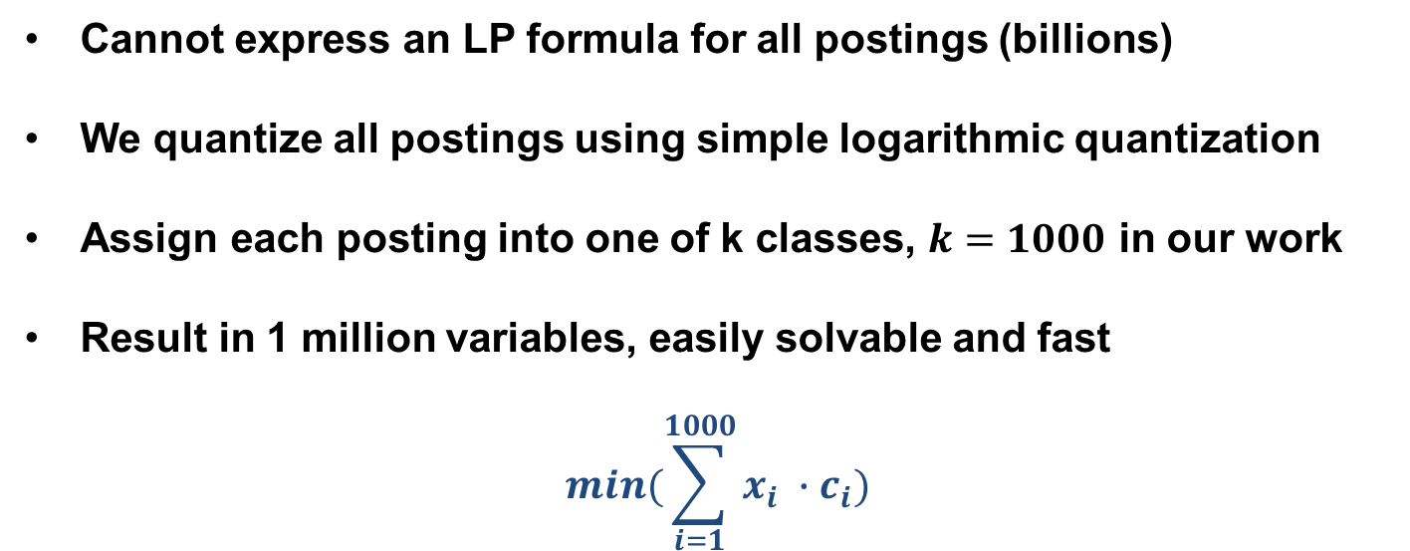
Size Cost Trade-Off

Slide 19
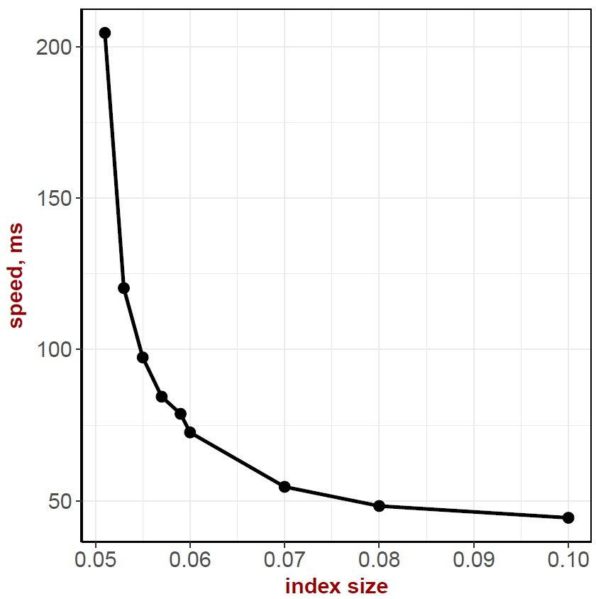
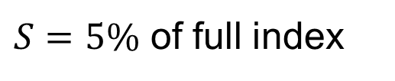
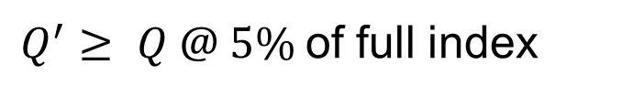
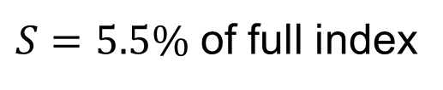
Size Cost Trade-Off
Results
$S=5\%$ of full index
S = 5%
$S=5.5\%$ of full index
$Q^{′}≥ Q @ 5\%$of full index
Notes:
This graph shows speed optimization if we allow the index size to increase by a half percent,

Slide 20
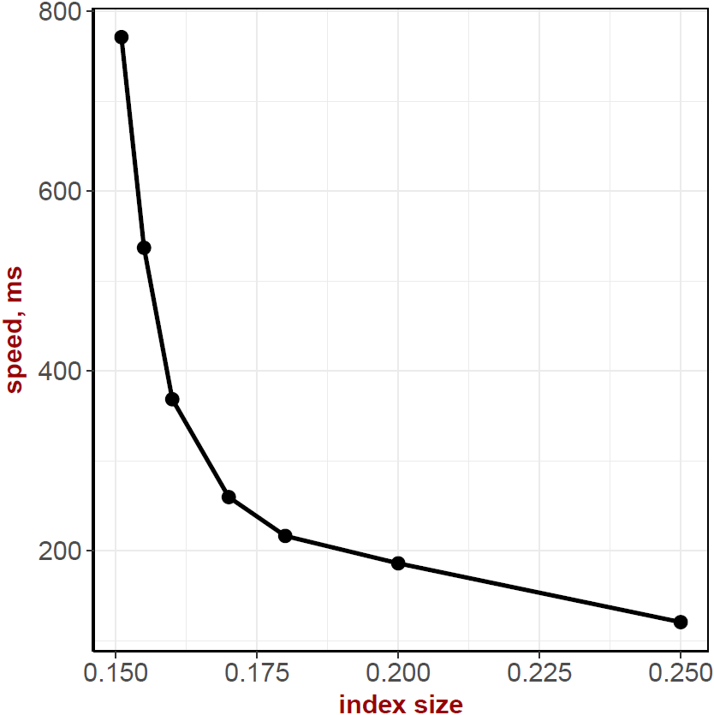
S = 5%
S = 15%
Notes:
Side by side results for size-cost trade-off with a starting point of 5% on the left and 15% pruned index on the right.
show the same general behavior for trade-off;
As prune ration decreases, this curve would flatten out….

Slide 21
Summary
1. Learning to prune: optimize for size.
2. Significantly increase query processing speed if we allow a very small increment in index size: optimize for speed
1 + 2 = optimal size/cost at any index pruning size
Notes:
In summary, we demonstrate a two step process:

Slide 22



Thanks!
Questions?
Acknowledgements

