Slide 1
Make & command line argument

Slide 2

Make in linux
Very easy, just type make

Slide 3
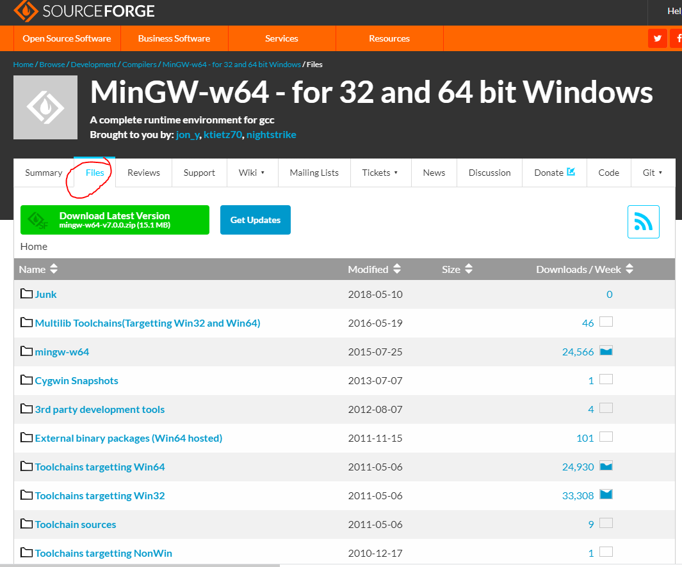
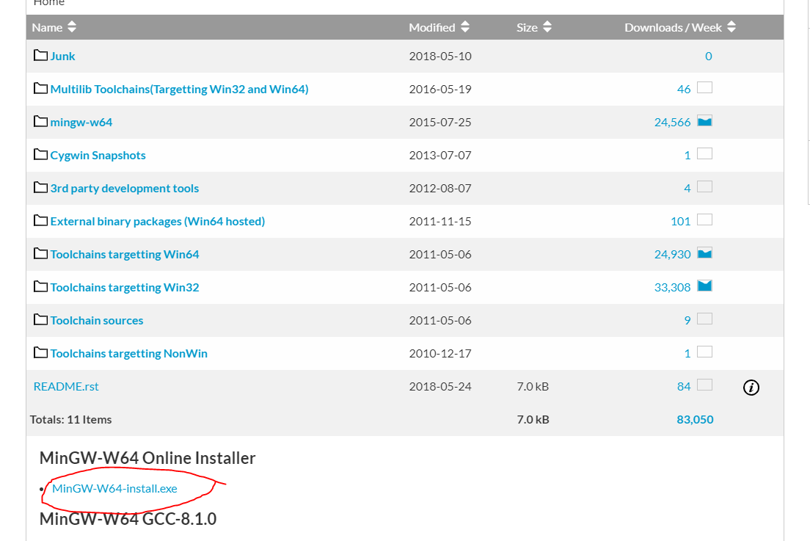
In Windows (Step 1)
Download the compiler installer
https://sourceforge.net/projects/mingw-w64/

Slide 4
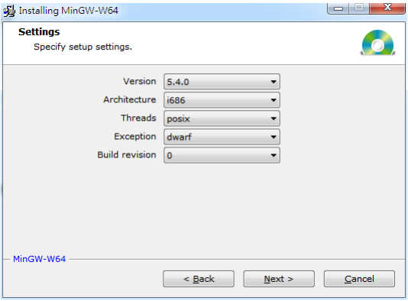
In Windows (Step 2)
Select gcc version 5.4.0 and i686 architecture

Slide 5
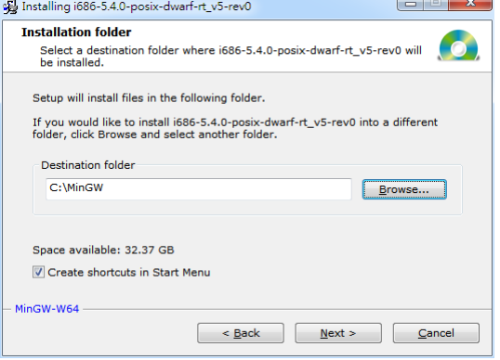
In Windows (Step 3)
Install the compiler to C:\MinGW

Slide 6
In Windows (Step 4)
Computer [right button]->Properties
- >Advanced system settings- >Advanced->Environment Variables
-> System Variables->Path->add the instruction C:\MinGW\mingw32\bin;
Now you can use g++ in cmd

Slide 7
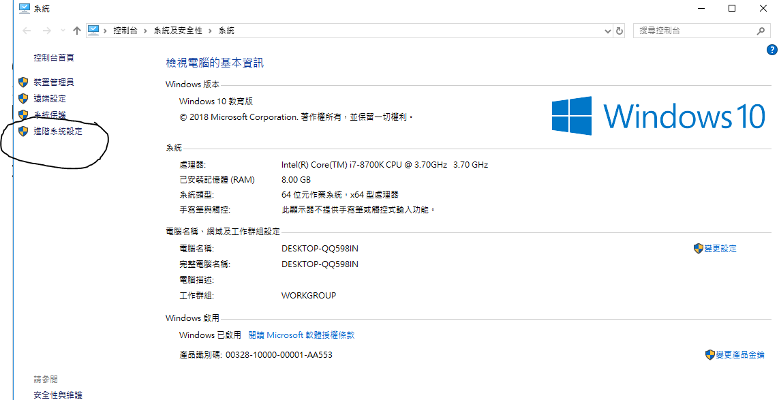
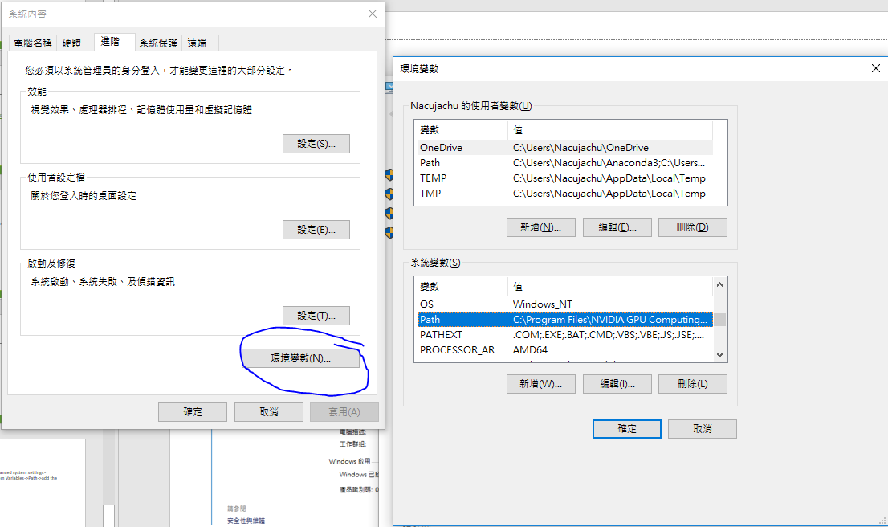

Slide 8
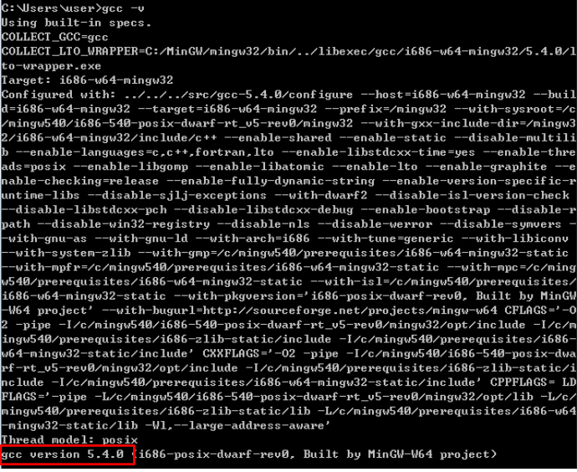

Slide 9
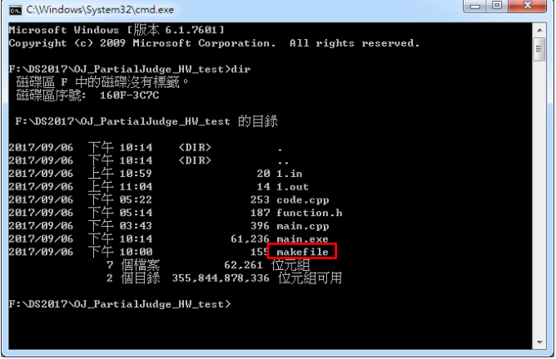
In Windows (makefile)

Slide 10
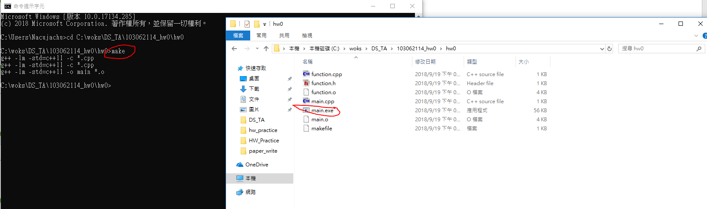
In Windows
Enter “make (-f makefile) or mingw32-make” and it will create a executable file of main.cpp.

Slide 11
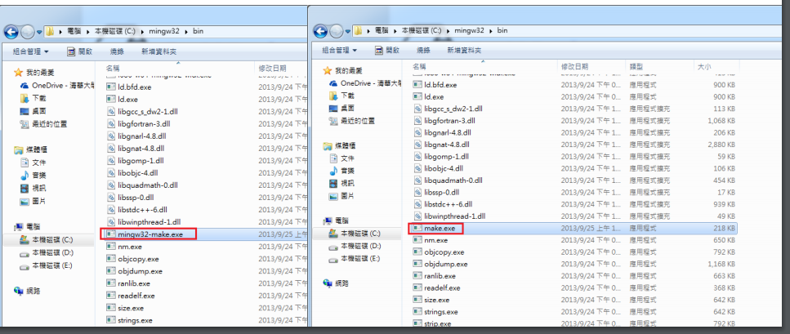
You can change the filename “mingw32-make.exe” into “make.exe” and use shorter “make”

Slide 12
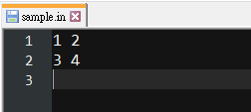

In Windows

Slide 13
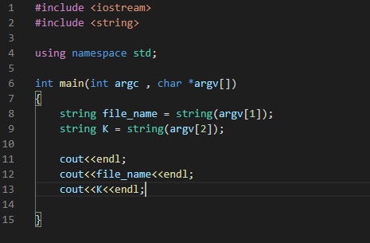
Command line argument
Declare main as
int main(int argc, char *argv[] )
argc: number of arguments
*argv[]: arguments, store as strings (char array)

Slide 14
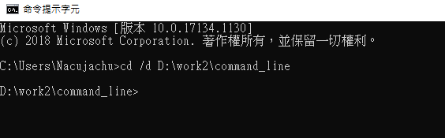
Command line argument
In windows, use cmd (命令提示字元)
cd to the directory with your code and makefile

Slide 15
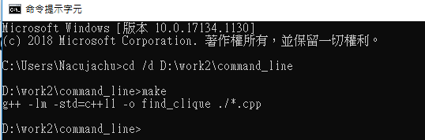

Command line argument
Type “make”, then your code will be compiled
Test your code with [exe_name] [argv1] [argv2] …

Slide 16
Note
Access array ( char *argv[] ) from index 1
argv[0] is executable file name

