Slide 1
How to test timeout in windows
This is a tutorial for “how to test timeout in windows”

Slide 2
Download git
Download git and install it, we need to use git bash
https://gitforwindows.org/

Slide 3
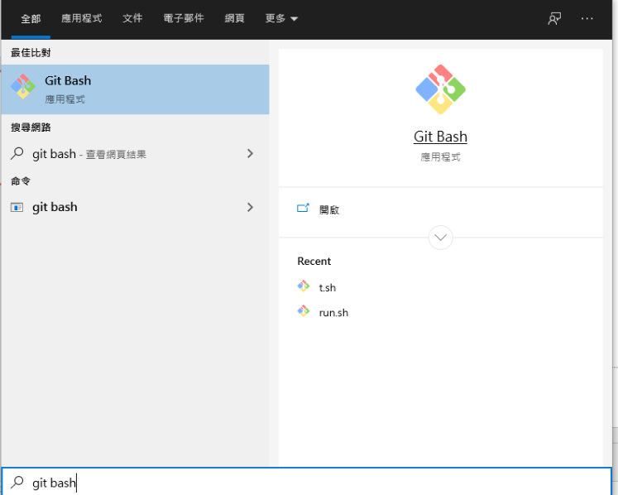
1. Open Git bash
Open git bash

Slide 4
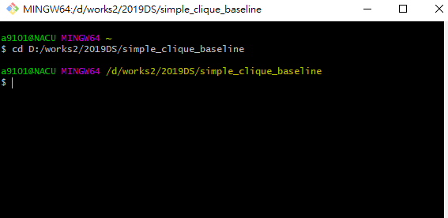
2. Cd to the directory with your code

Slide 5
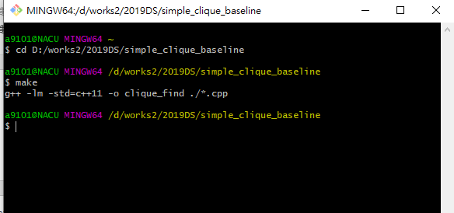
3. Compile your code

Slide 6
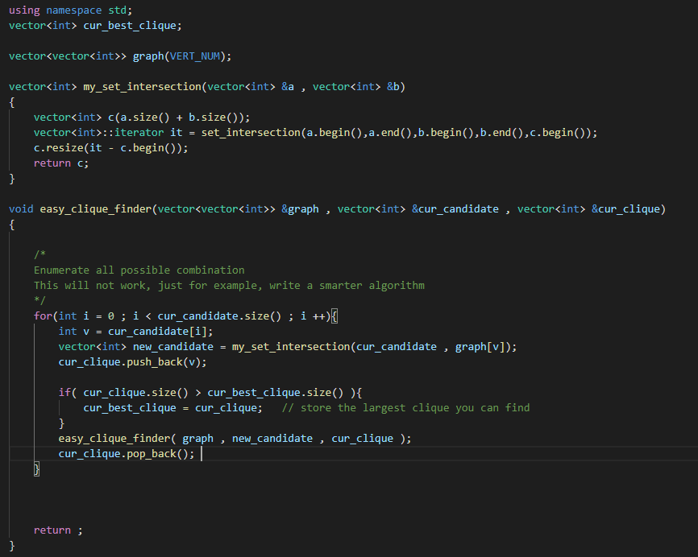
Sample code
Enumerate all possible combinations
Store in a global vector

Slide 7
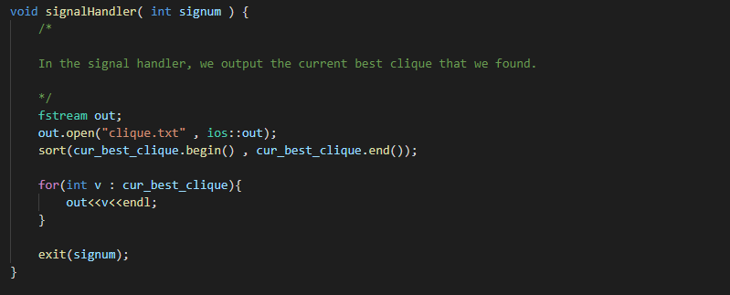
Sample code
In signal handler, output it

Slide 8
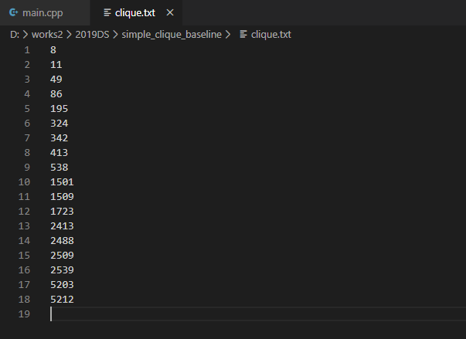
4. Execute with timeout
timeout -s SIGINT 180 ./clique_find.exe open_testcase_ds.txt 50
50 is K, just for example
Output

Slide 9
Sample code
Download here
https://github.com/Nacujachu/DS_project_sample/blob/master/main.cpp
Don’t forget to output at the end of main function, your program may terminated before SIGINT is received

