Slide 1
Introduction to Programming (II)
Mini project 1 - Package 解說
楊舜仁

Slide 2
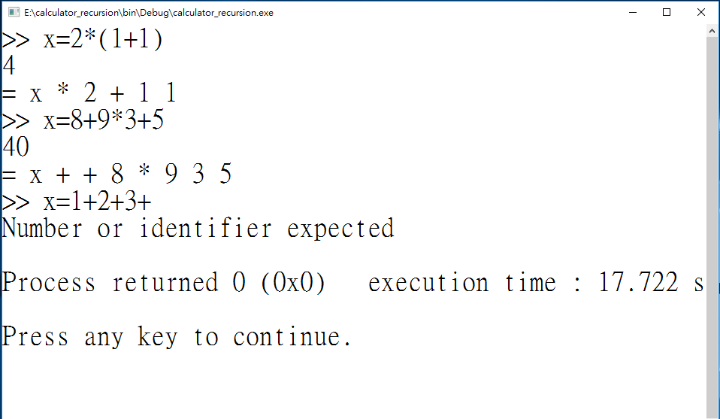
A Simple Calculator: Interpreter Version
同
一
組
這只是在這裡show出prefix而已，實際上不用design
同
一
組
同
一
組

Slide 3

The compilation process
.c file
.o file
HWs: 10966
10968
10972
HWs: 11359
11360
11362

Slide 4
The lexical analyzer (lex.h/lex.c)
The lexical (語彙的) analysis: the process of
recognizing which strings of symbols from the source program represent a single entity called token
identifying whether they are numeric values, words, arithmetic operators, and so on.

Slide 5
Lexical analysis: tokens
Tokenizer “getToken()”: a function that
extracts the next token from the input string;
stores the token in “char lexeme[MAXLEN]”;
identifies the token’s type
typedef enum {UNKNOWN, END, ENDFILE, INT, ID, ADDSUB, MULDIV, LOGICAL, INCDEC, ASSIGN, LPAREN, RPAREN} TokenSet;

Slide 6
The parser (parser.h/parser.c)
The parsing (從語法上分析) process:
group tokens into statements based on a set of rules, collectively called a grammar.
The grammars:
statement := ENDFILE | END | expr END
expr := term expr_tail
expr_tail := ADDSUB term expr_tail | NiL
term := factor term_tail
term_tail := MULDIV factor term_tail| NiL
factor := INT | ADDSUB INT |
ID | ADDSUB ID |
ID ASSIGN expr |
LPAREN expr RPAREN |
ADDSUB LPAREN expr RPAREN

Slide 7
Tail Recursion -> Loop (1/2)
Recursion Version
Loop Version
BTNode* expr(void)
{
BTNode *node;
node = term();
return expr_tail(node);
}
BTNode* expr_tail(BTNode *left)
{
BTNode *node;
if (match(ADDSUB)) {
node = makeNode(ADDSUB, getLexeme());
advance();
node->left = left;
node->right = term();
return expr_tail(node);
}
else
return left;
}
BTNode* expr(void)
{
BTNode *retp, *left;
//int retval;
retp = left = term();
while (match(ADDSUB)) {
retp = makeNode(ADDSUB, getLexeme());
advance();
retp->right = term();
retp->left = left;
left = retp;
}
return retp;
}

Slide 8
Tail Recursion -> Loop (2/2)
Recursion Version
Loop Version
BTNode* term(void)
{
BTNode *node;
node = factor();
return term_tail(node);
}
BTNode* term_tail(BTNode *left)
{
BTNode *node;
if (match(MULDIV)) {
node = makeNode(MULDIV, getLexeme());
advance();
node->left = left;
node->right = factor();
return term_tail(node);
}
else
return left;
}
BTNode* term(void)
{
BTNode *retp, *left;
retp = left = factor();
while (match(MULDIV)) {
retp = makeNode(MULDIV, getLexeme());
advance();
retp->right = factor();
retp->left = left;
left = retp;
}
return retp;
}

Slide 9
The syntax trees based on the grammars
10+2*5+(1+1)*(1+1)
+
+
*
10
*
+
+
2
5
1
1
1
1

Slide 10
The syntax trees based on the grammars
-5*10-100
-
*
100
-
10
0
5

Slide 11
The syntax trees based on the grammars
y=2*10-7
=
y
-
*
7
2
10

Slide 12
The code generator (codeGen.h/codeGen.c)
The code generation process:
constructing the machine-language instructions to implement the statements recognized by the parser and represented as syntax trees
In codeGen.h/codeGen.c, we provide a function: evaluateTree(BTNode *root)
that calculates the answer by pre-order traversal of the syntax tree (refer to HWs 11359, 11360 and 11362)

Slide 13
Symbol table
Note that, to deal with expressions including variables such as
>> x=3
>> 4*x+(y=((10-2)/4))
we use a symbol table to record variables’ current values
we use getval() and setval() to manipulate the symbol table
The symbol table are used both in the parser and the code generator.

Slide 14
Symbol table
#define TBLSIZE 65535
typedef struct {
char name[MAXLEN];
int val;
} Symbol;
Symbol table[TBLSIZE];

Slide 15
What you need to do in this mini-project?
Trace all the code if you like to
understand each detail and
review what you have learnt during the courses.
Modify the grammar and parser.c to accept new operators, including &, |, ^, ++, --.
Replace the current evaluateTree () in codeGen.c to generate assembly code during the pre-order tree traversal.
Check the error handling in the parser.c to print “EXIT 1” when encountering errors.
Optimize your assembly code to get extra credits!

