Slide 1
How to manage an SD card on STM32F7 discovery board
we present here in detail how to configure a STM32F746G Discovery Board using cubeMX in order to drive an SD card.

Slide 2
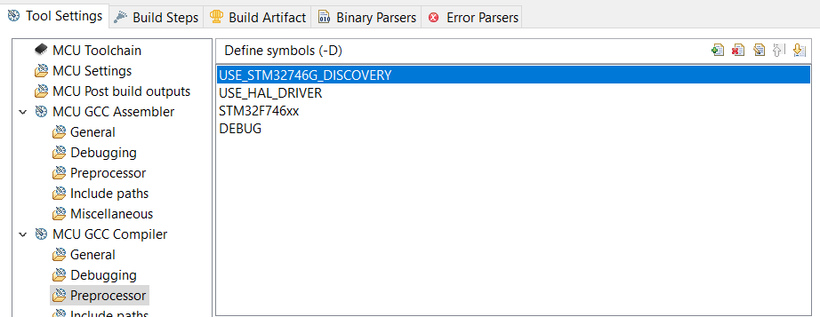
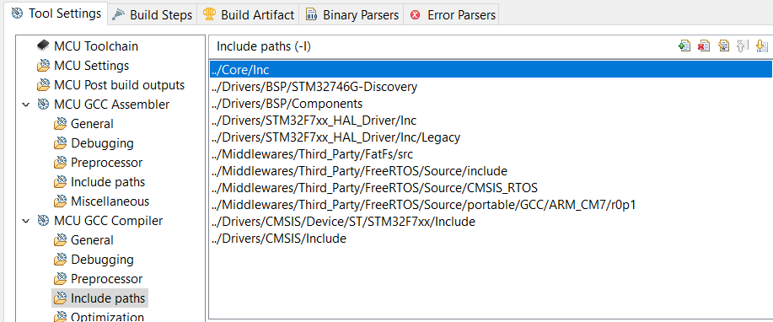
Defines and Include Paths

Slide 3
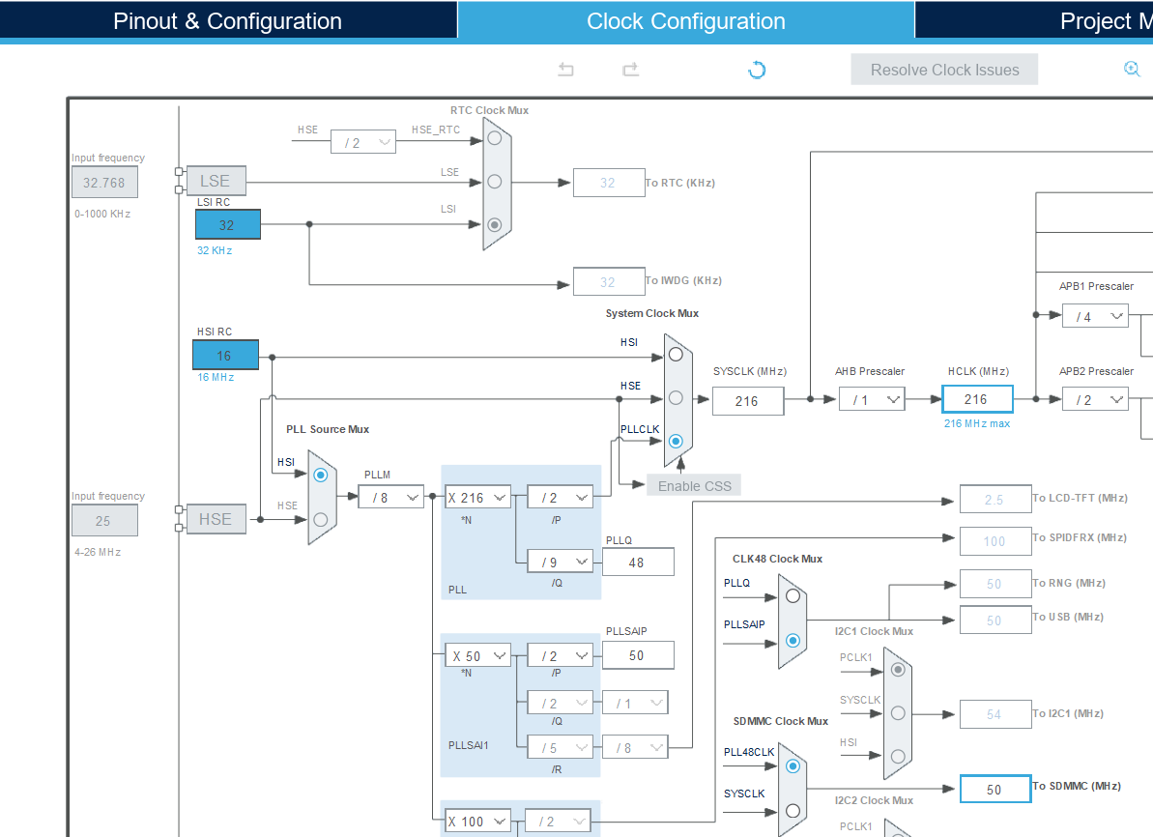
Clock configuration
HSI Clock is used here, the clock of SDMMC1 is 50MHz

Slide 4
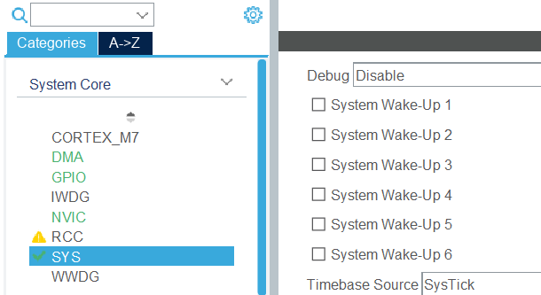
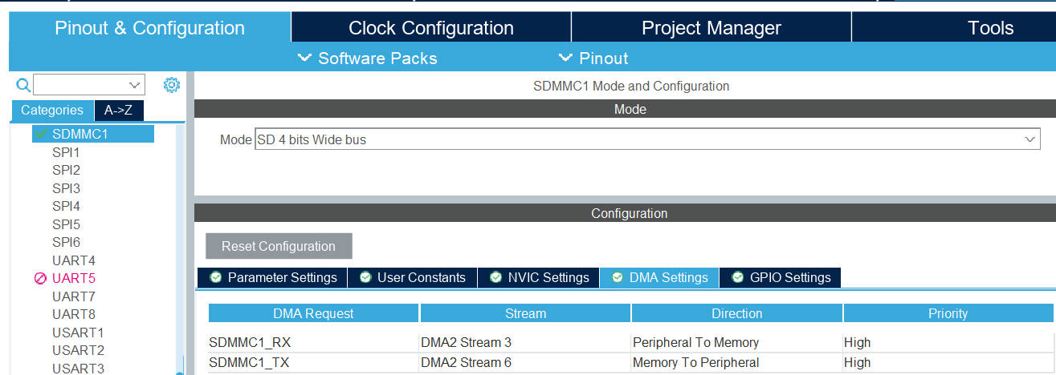
STM32Cube configuration

Slide 5
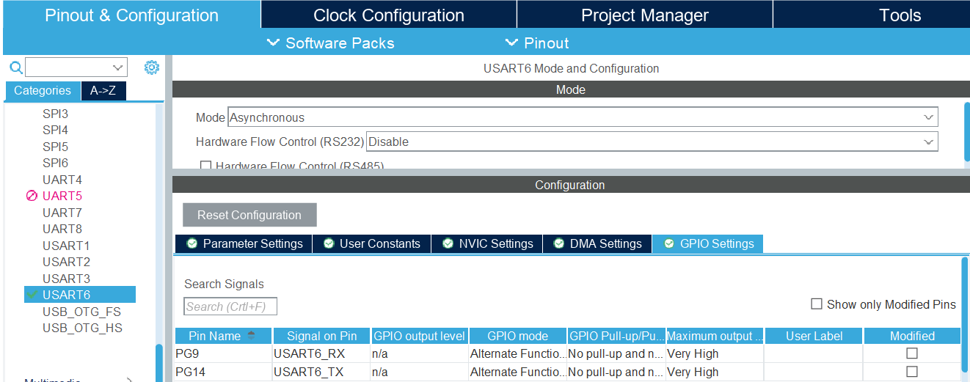

Slide 6
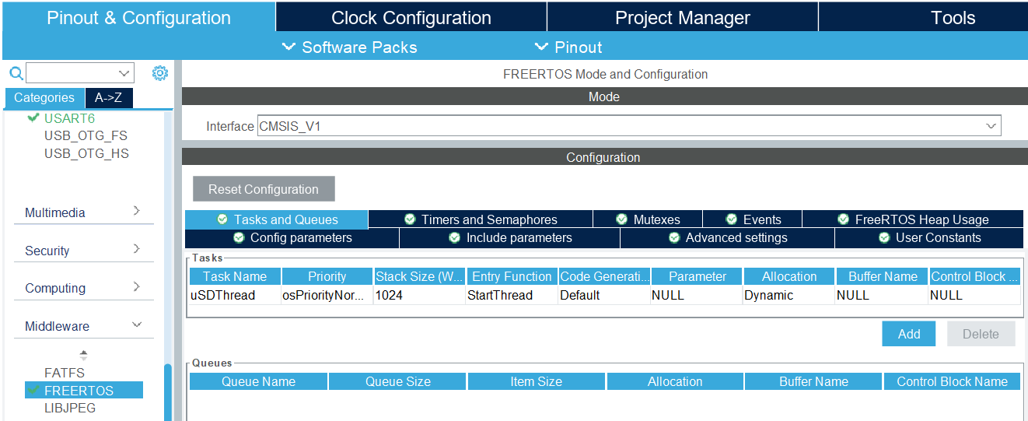
Freertos configuration
The Heap size is increased here, and the memory management method of heap_4 is used.

Slide 7
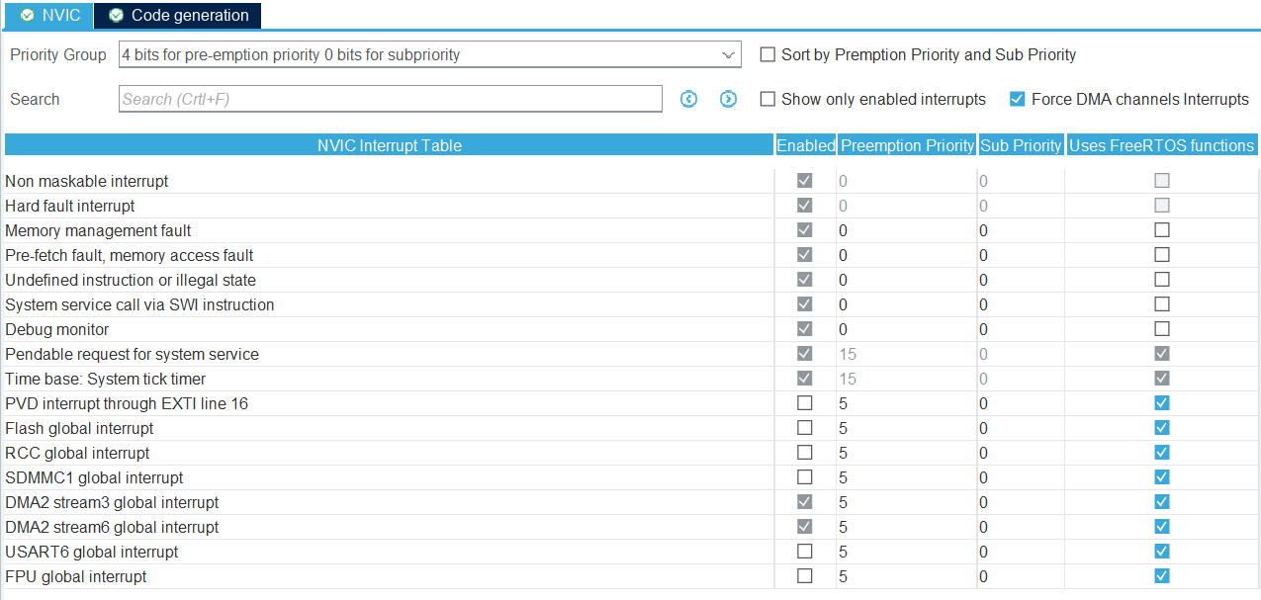
NVIC configuration

Slide 8
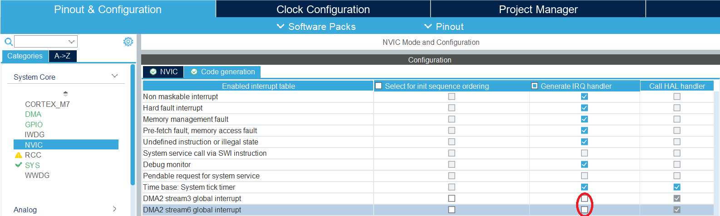
Code generation
Exclude DMA interrupt code generation

Slide 9
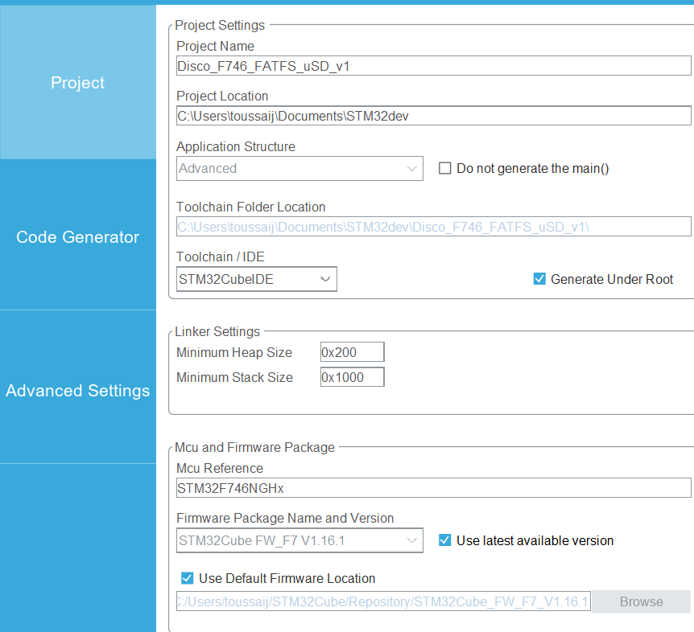
Stack size

Slide 10
Files to copy from FatFs_uSD_RTOS example
Copy sd_diskio_dma_rtos.c into Src project folder
Copy ffconf.h into Inc folder
Copy sd_diskio_dma_rtos.h into Inc folder

Slide 11
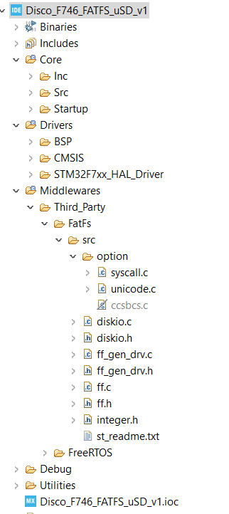
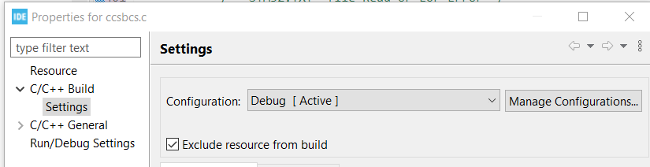
File ccsbcs.c to exclude from build
Right click on ccsbcs.c in the tree structure
Select properties and check the box « Exclude resource from build »

Slide 12
STM32f7xx_it.c
/* Private variables ---------------------------------------------------------*/
/* USER CODE BEGIN PV */
/* SD handler declared in "stm32746g_discovery_sd.c" file */
extern SD_HandleTypeDef uSdHandle;
/* USER CODE END PV */
/* USER CODE BEGIN 1 */
/**
* @brief This function handles SDMMC1 global interrupt request.
* @param None
* @retval None
*/
void BSP_SDMMC_IRQHandler(void)
{
HAL_SD_IRQHandler(&uSdHandle);
}

Slide 13
/**
* @brief This function handles DMA2 Stream 6 interrupt request.
* @param None
* @retval None
*/
void BSP_SDMMC_DMA_Tx_IRQHandler(void)
{
HAL_DMA_IRQHandler(uSdHandle.hdmatx);
}
/**
* @brief This function handles DMA2 Stream 3 interrupt request.
* @param None
* @retval None
*/
void BSP_SDMMC_DMA_Rx_IRQHandler(void)
{
HAL_DMA_IRQHandler(uSdHandle.hdmarx);
}
/* USER CODE END 1 */

Slide 14
main.c
/**
* @brief Start task
* @param pvParameters not used
* @retval None
*/
static void StartThread(void const *argument)
{
FRESULT res; /* FatFs function common result code */
uint32_t byteswritten, bytesread; /* File write/read counts */
uint8_t wtext[] = "This is STM32 working with FatFs"; /* File write buffer */
uint8_t rtext[100]; /* File read buffer */
/*##-1- Link the micro SD disk I/O driver ##################################*/
if(FATFS_LinkDriver(&SD_Driver, SDPath) == 0)
{
...
/*##-11- Unlink the micro SD disk I/O driver ###############################*/
FATFS_UnLinkDriver(SDPath);
}
/* Infinite Loop */
for( ;; )
{
}
/* USER CODE END 5 */
}

