Slide 1
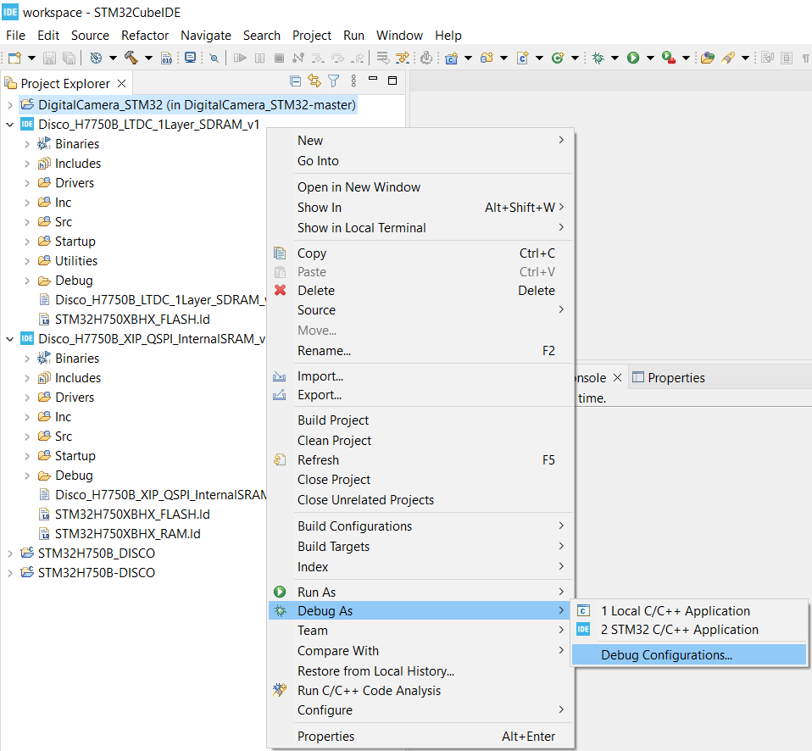
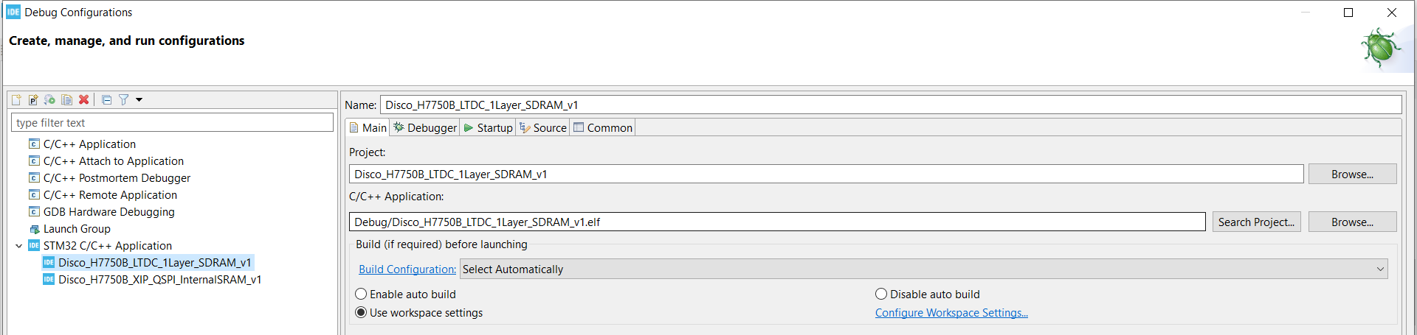
STM32H750B-dk : How to debug program located in external flash memory ?
The STM32H750B-dk comes with only 128KB internal flash and is intended for code execution from external memories.
The project Disco_H750B_XIP_QSPI_InternalSRAM_v1 shows how to boot from internal flash, configure external memories
then jump to the application Disco_H750B_LTDC_1Layer_SDRAM_v1 located on external memory.

Slide 3
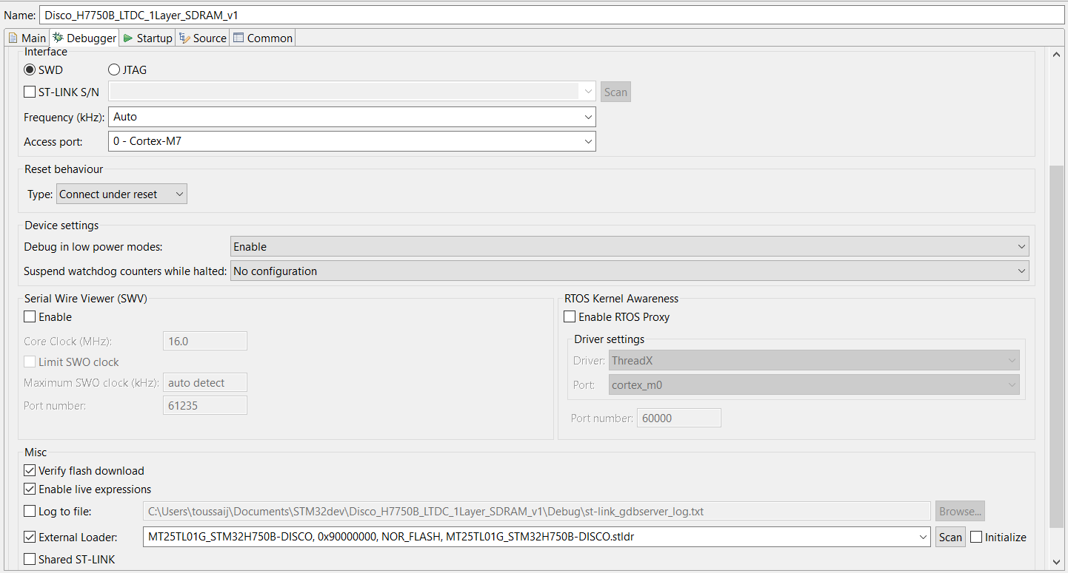

Slide 4
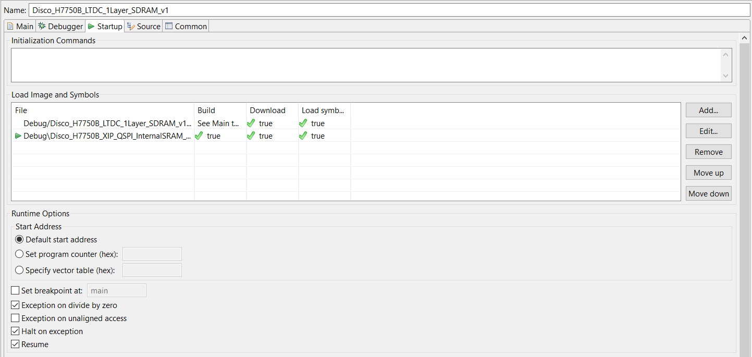
To be added

