Slide 1
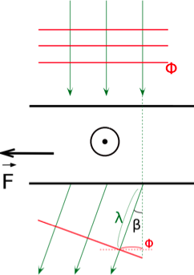

Electron Holography
Wave approach to Aharonov-Bohm
The electric action of the sample is taken into account
through the mean inner potential of the studied material.
The constant CE depends on the electron energy
and therefore on the microscope used.
Takeshi Kasama, Rafal E. Dunin-Borkowski and Marco Beleggia (2011). Electron Holography of Magnetic Materials,
Holography - Different Fields of Application, Dr. Freddy Monroy (Ed.), ISBN: 978-953-307-635-5, InTech, DOI: 10.5772/22366.
Available from: http://www.intechopen.com/books/holography-different-fields-of-application/electron-holography-of-magnetic-materials
Rafal E. Dunin-Borkowski, Takeshi Kasama, Marco Beleggia, Giulio Pozzi, Ch.6: Lorentz Microscopy and Electron Holography of Magnetic
Materials, in Handbook of Nanoscopy, Vol.1, Gustaaf Van Tendeloo, Dirk Van Dyck, Stephen J. Pennycook, Eds, Wiley-VCH (2012)
DOI: 10.1002/9783527641864.ch6
Print ISBN: 9783527317066 Online ISBN: 9783527641864

Slide 2
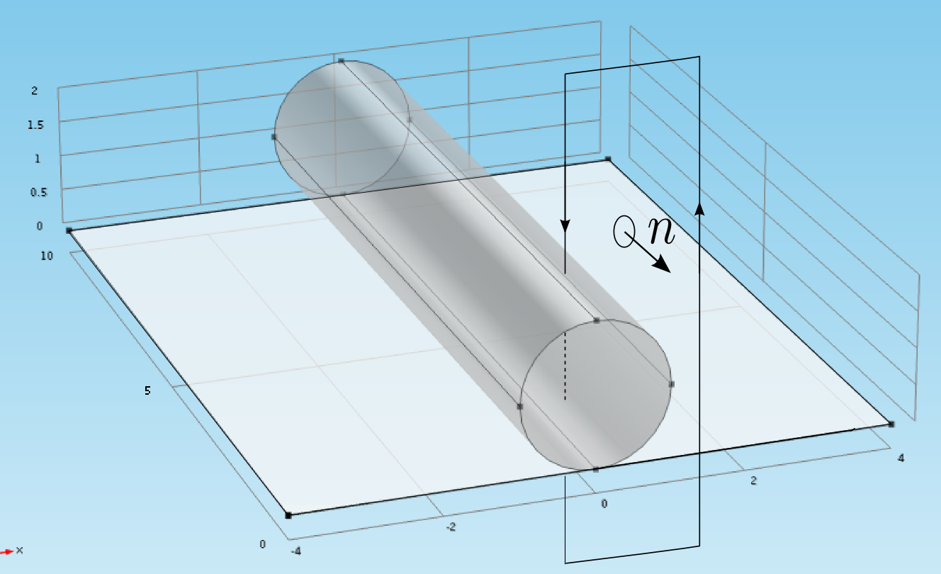
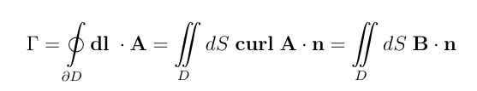
First approach to calculate the magnetic phase
Pure 3D calculations,
Biziere et al, Nano Lett. 2013, 13, 2053−2057
One must compute the flux through the vertical surface for each point
of the horizontal plane. These calculations are highly time-consuming
The support D must be large enough to limit finite-size effects.

Slide 3
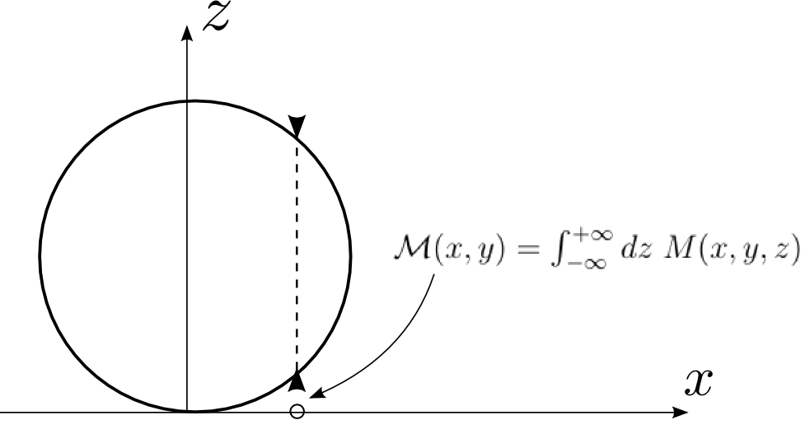
Second approach to calculate the magnetic phase
Reducing the problem from 3D to 2D yields
a significant reduction in computational cost.
The size effects are not due to the phase calculation
but rather to the finite size of the micromagnetic system.
One implements a 2D integral method that requires
computing an integral of the magnetization along the beam path.

Slide 4
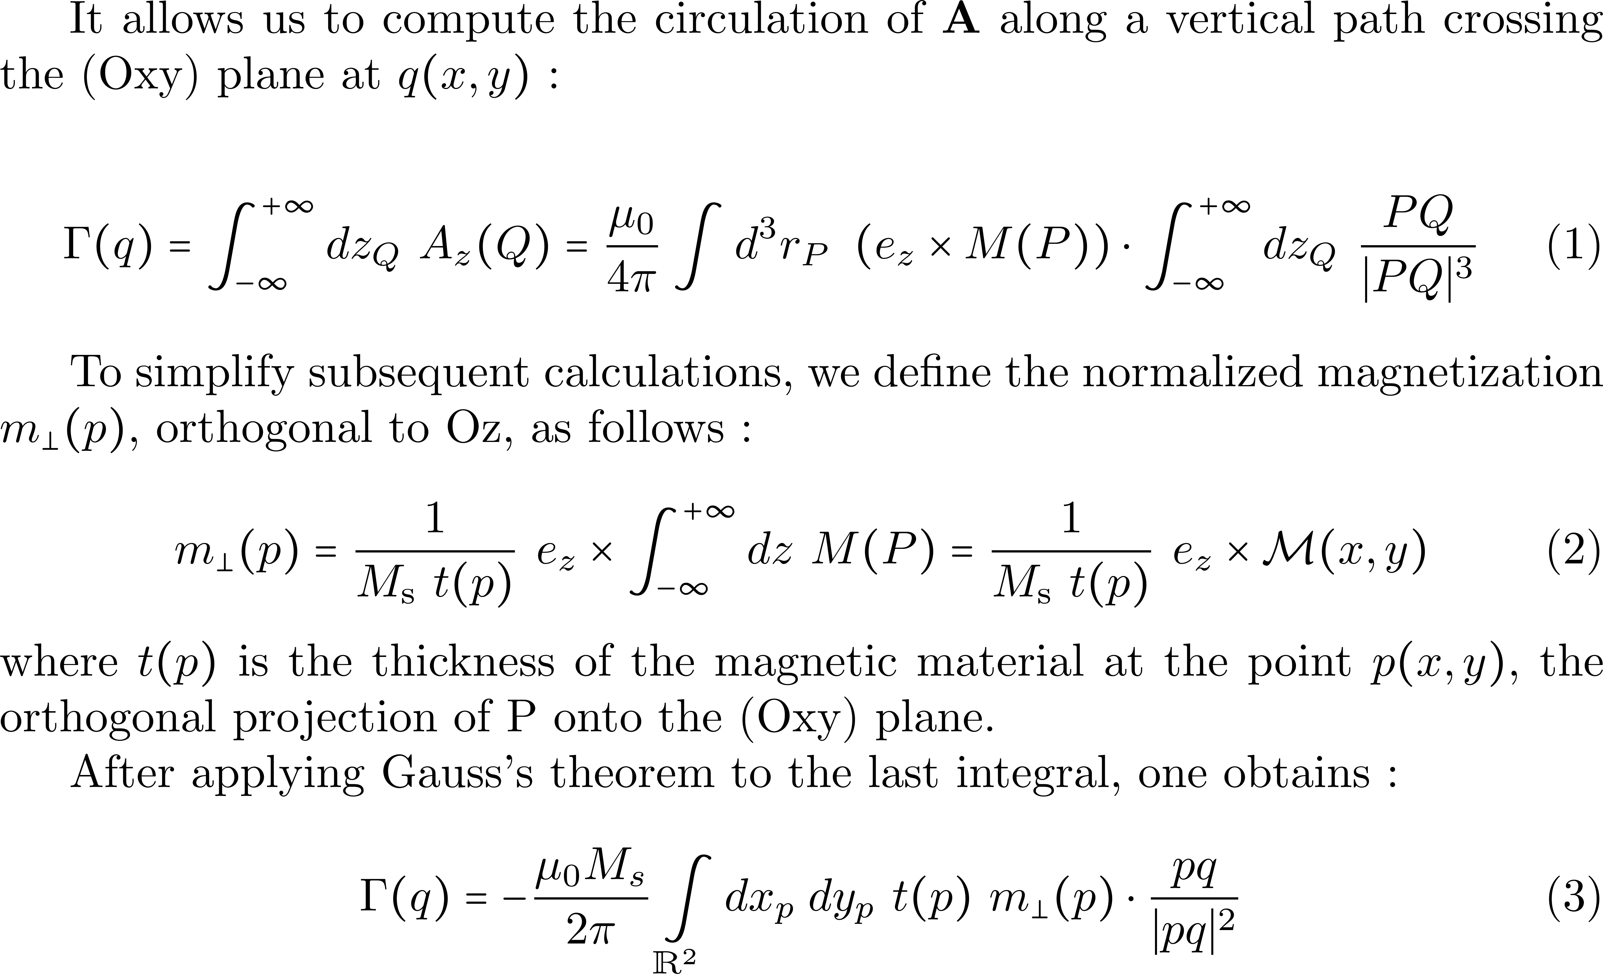

Slide 5
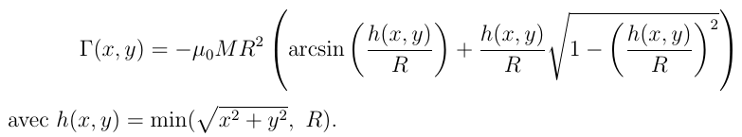
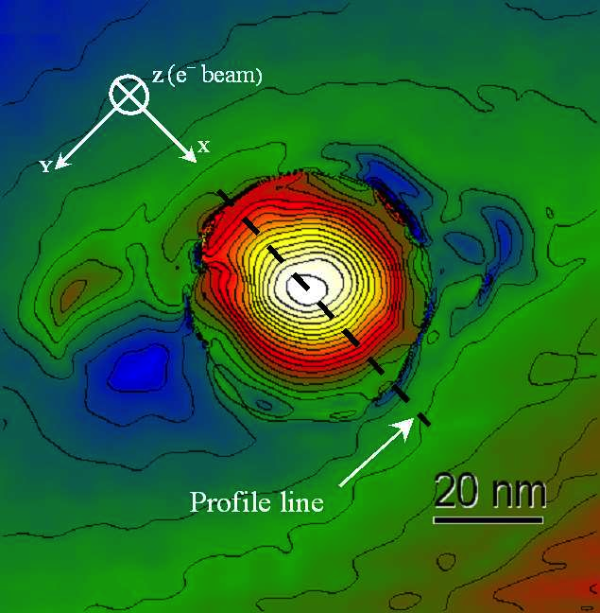
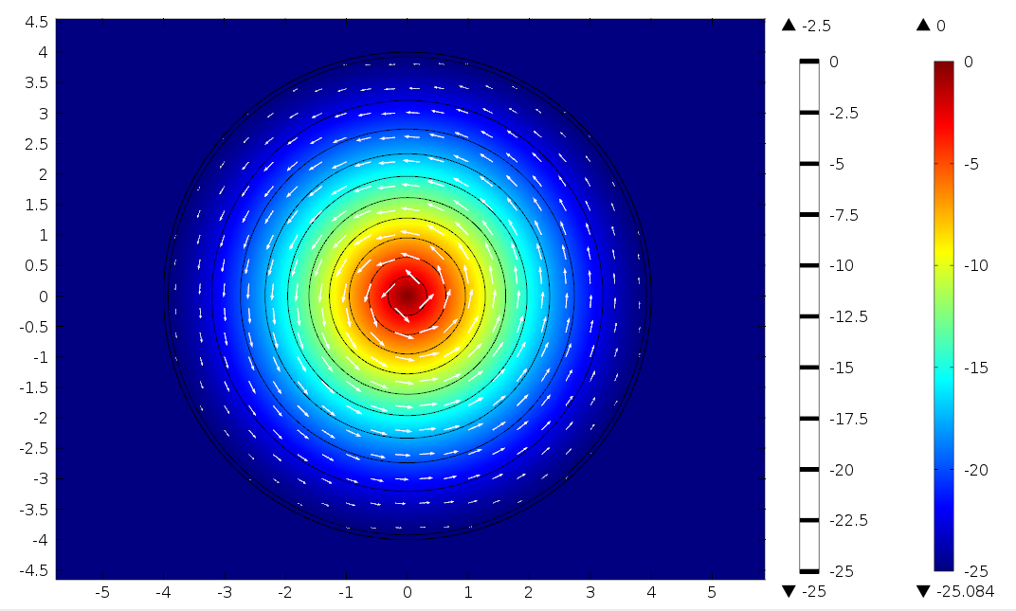
Cas test : sphère à aimantation de type curling dans le plan

Slide 6
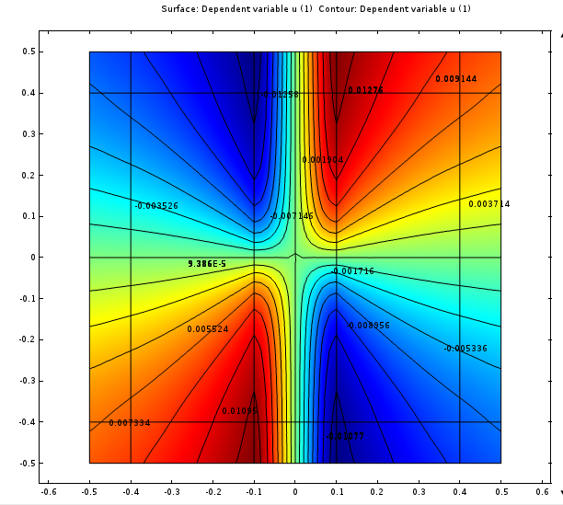
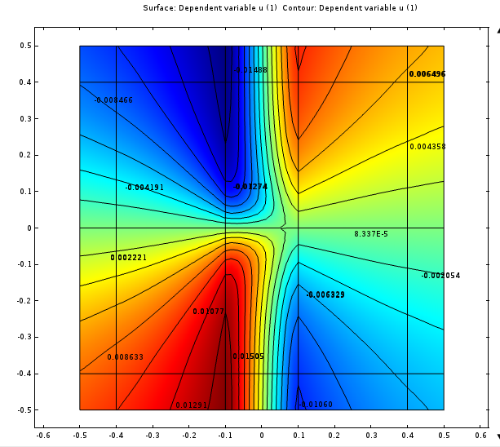
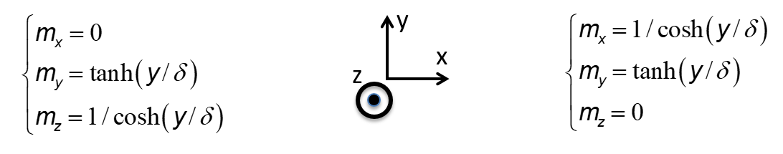
With an ansatz for the TW magnetization distribution
e⁻

