Slide 1
Méthode des volumes finis
J.-C. TOUSSAINT, G. GHIGLIOTTI

Slide 2
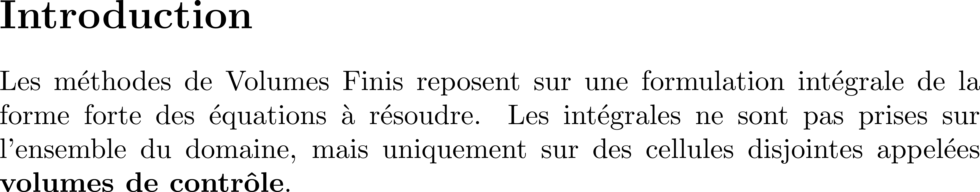
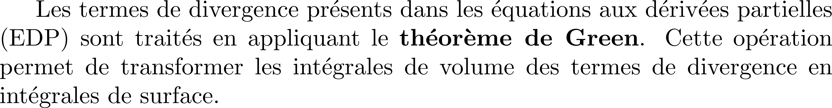
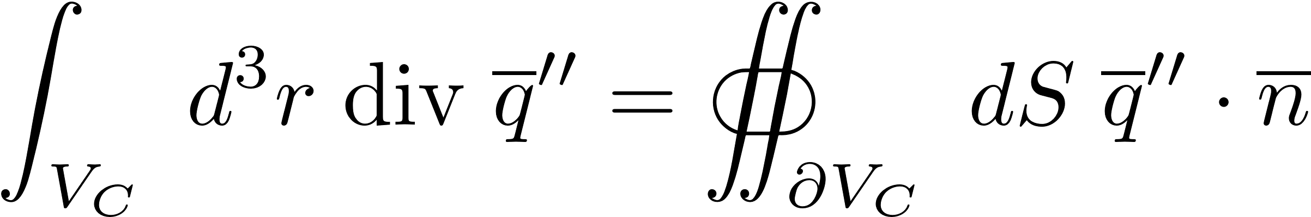
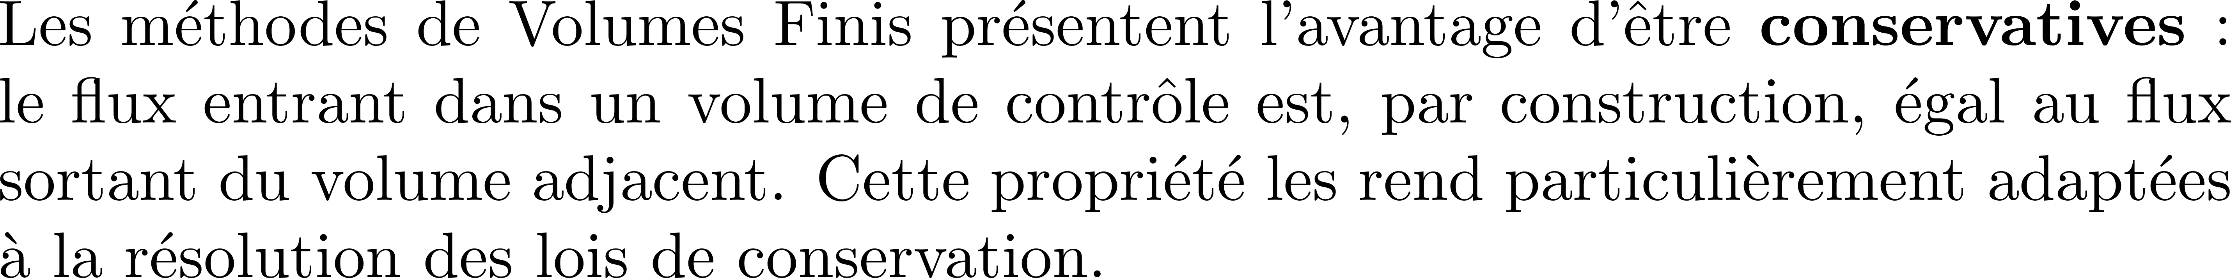

Slide 4
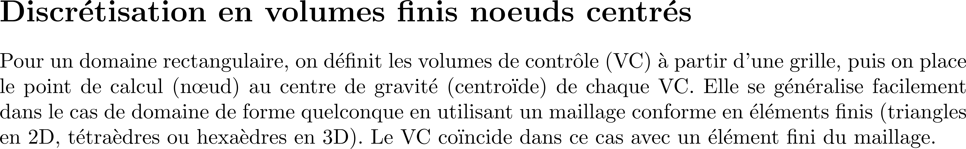
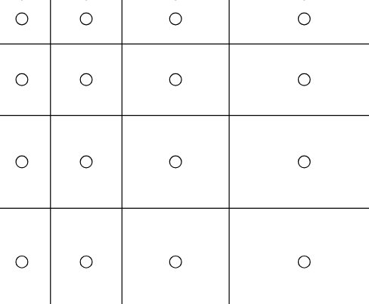
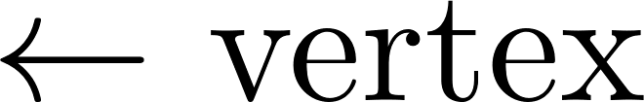
VC
VC
La discrétisation en volumes finis nœuds centrés permet de mieux représenter la moyenne
de la quantité dans le VC (précision d’ordre 2), car le nœud est au centre du volume fini.
Cette méthode est plus couramment utilisée dans les logiciels de volumes finis comme Fluent
et OpenFoam. C’est celle qui est adoptée dans le livre de référence de Ferziger
Ferziger, J. H., & Perić, M. (2002). Computational Methods for Fluid Dynamics (4th ed.). Springer.

Slide 5
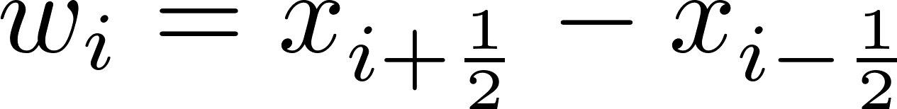
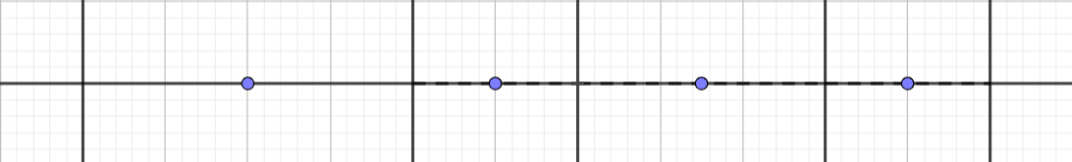

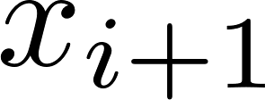

Slide 7
- +

Slide 8
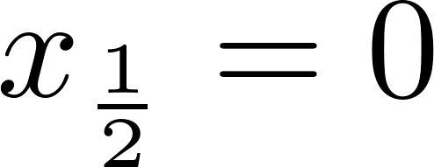

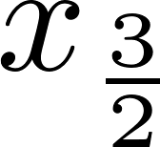

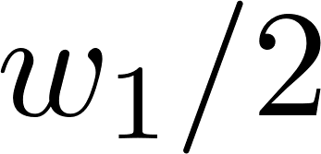

Slide 9
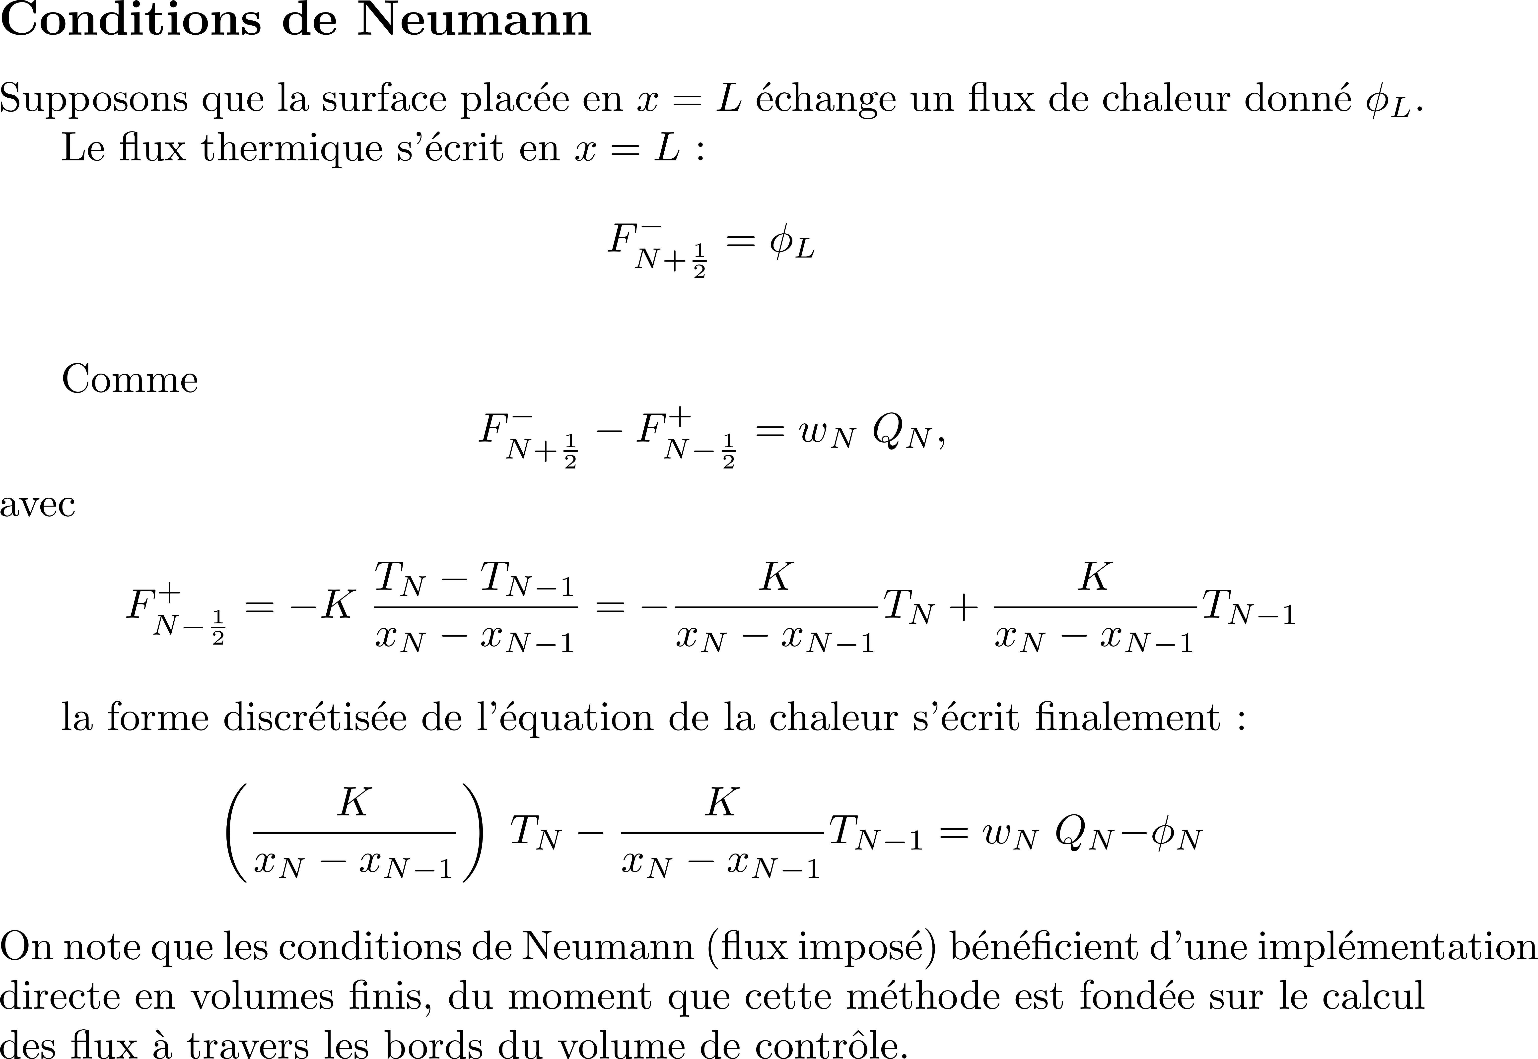
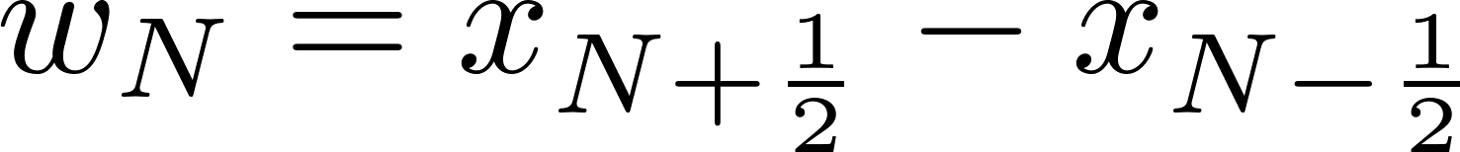

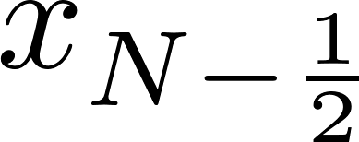
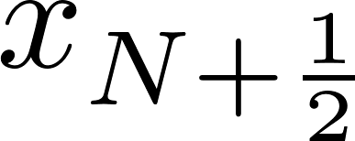
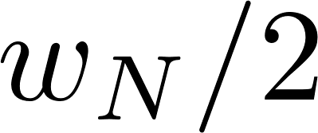

Slide 10
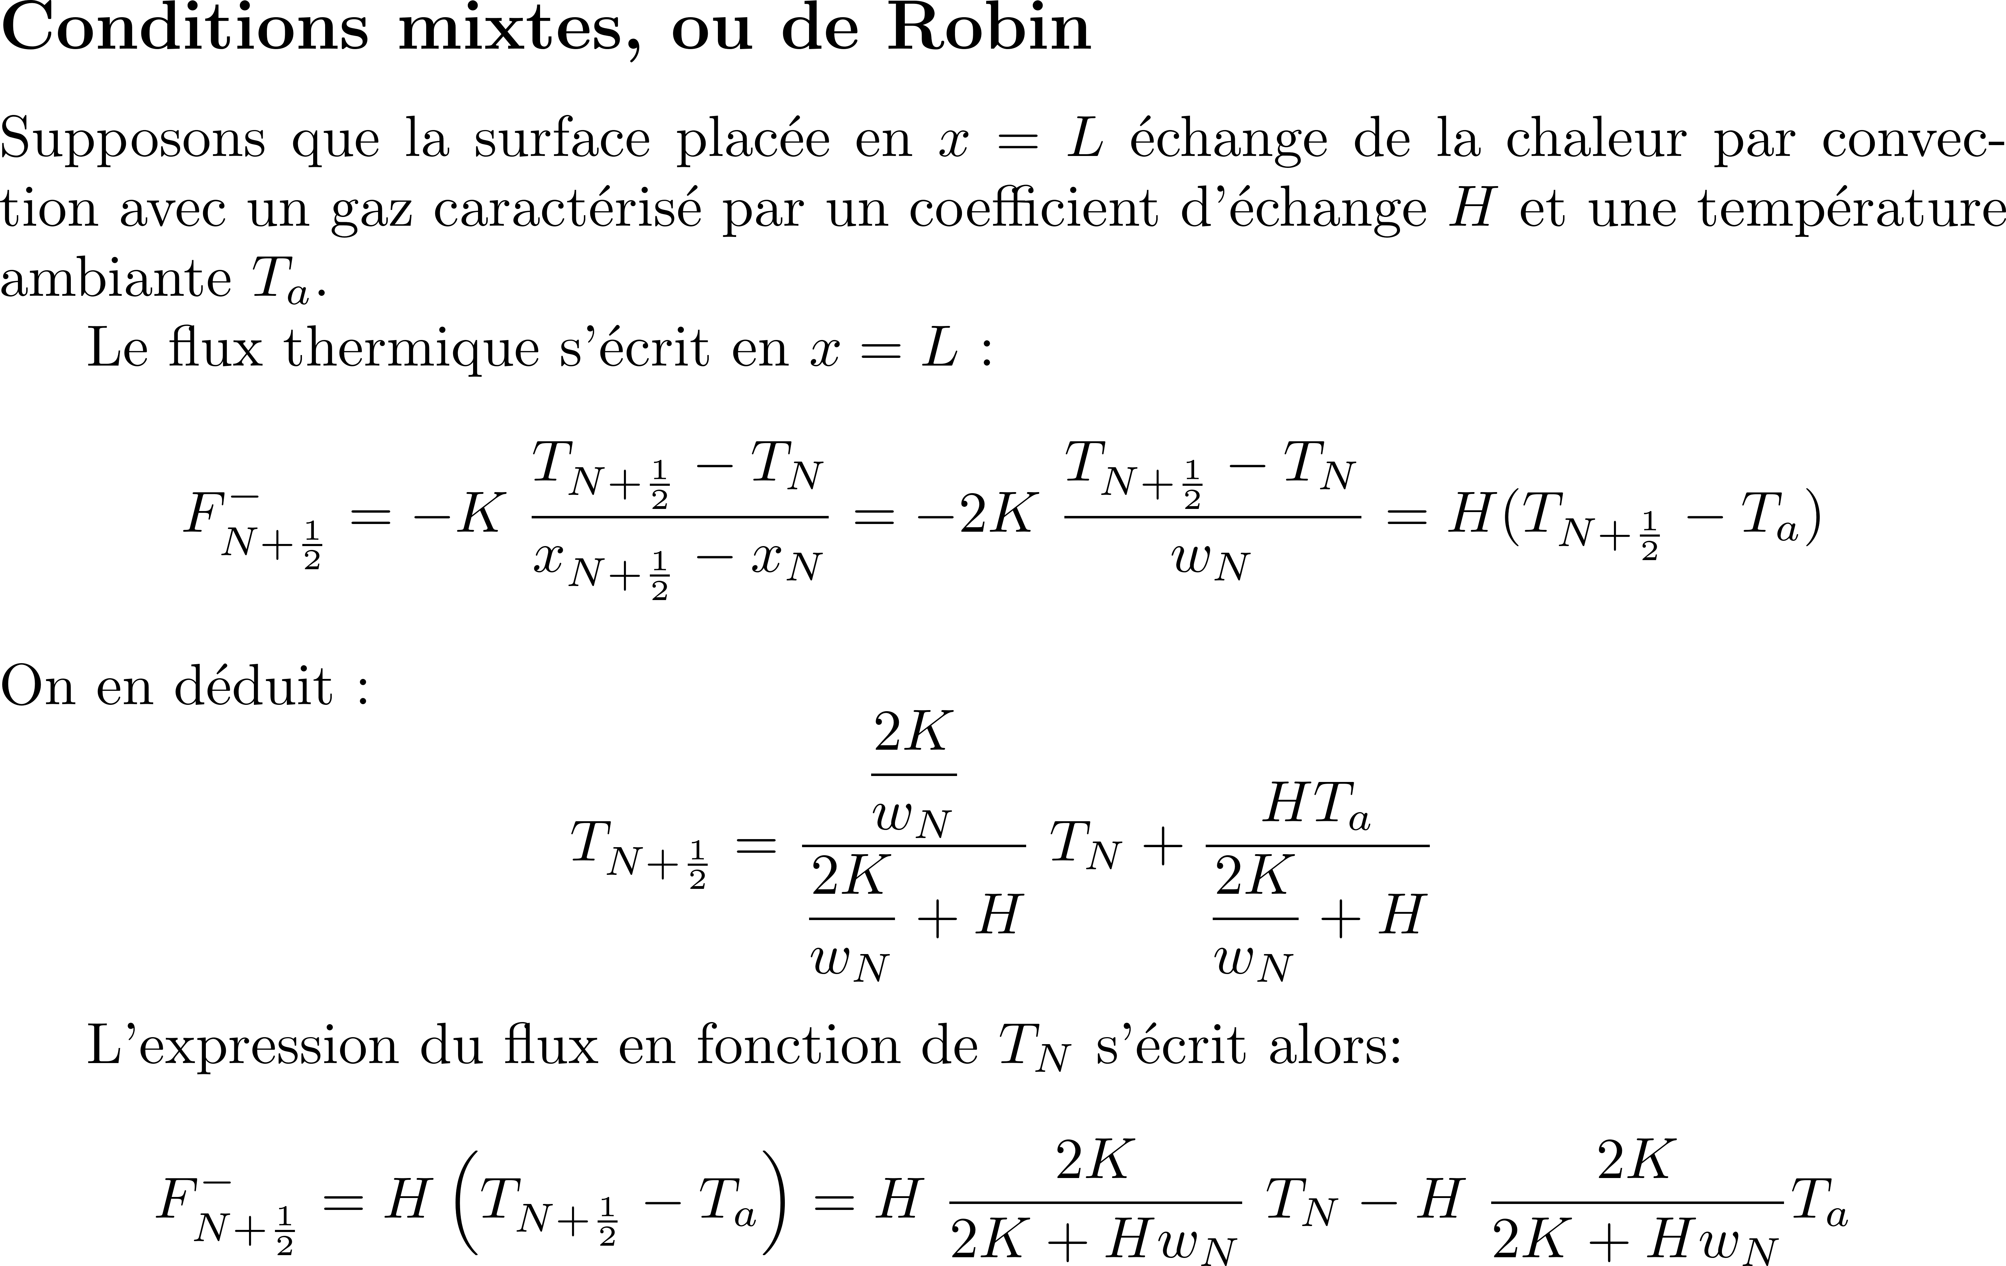

Slide 11
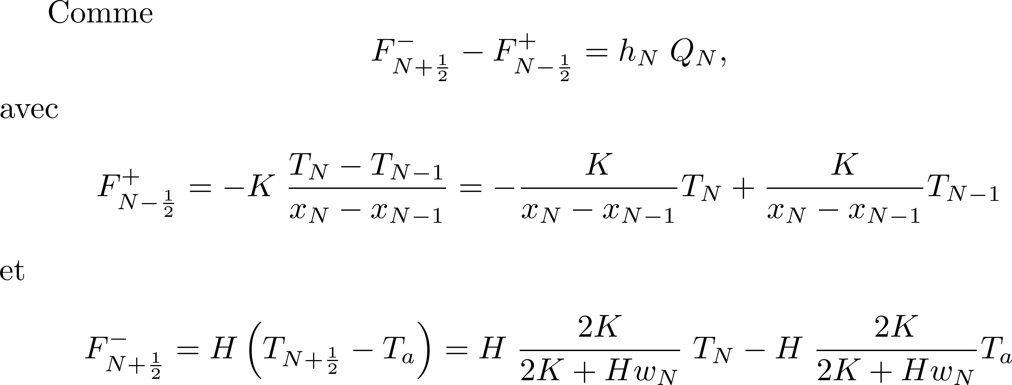

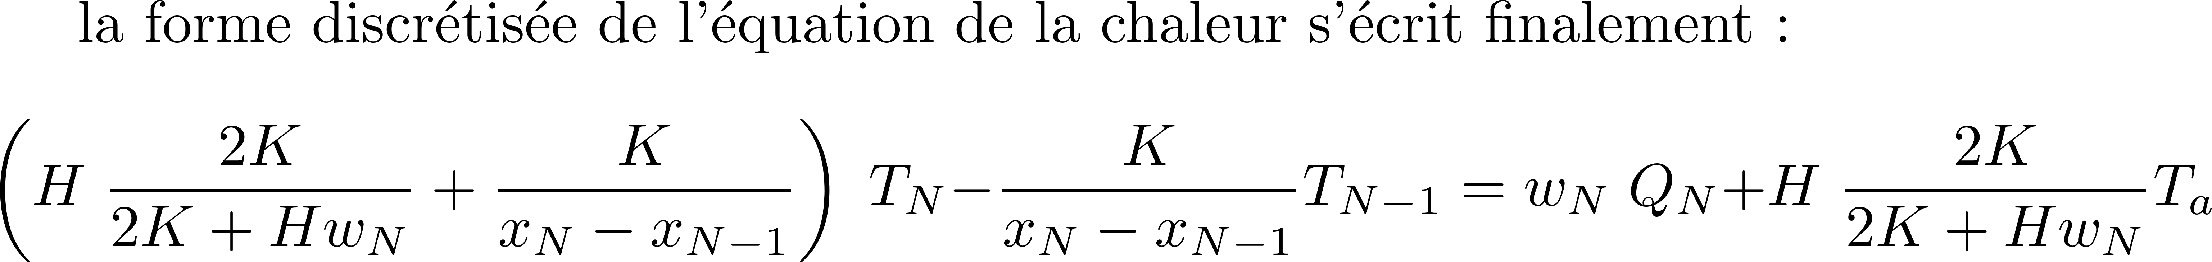

Slide 12
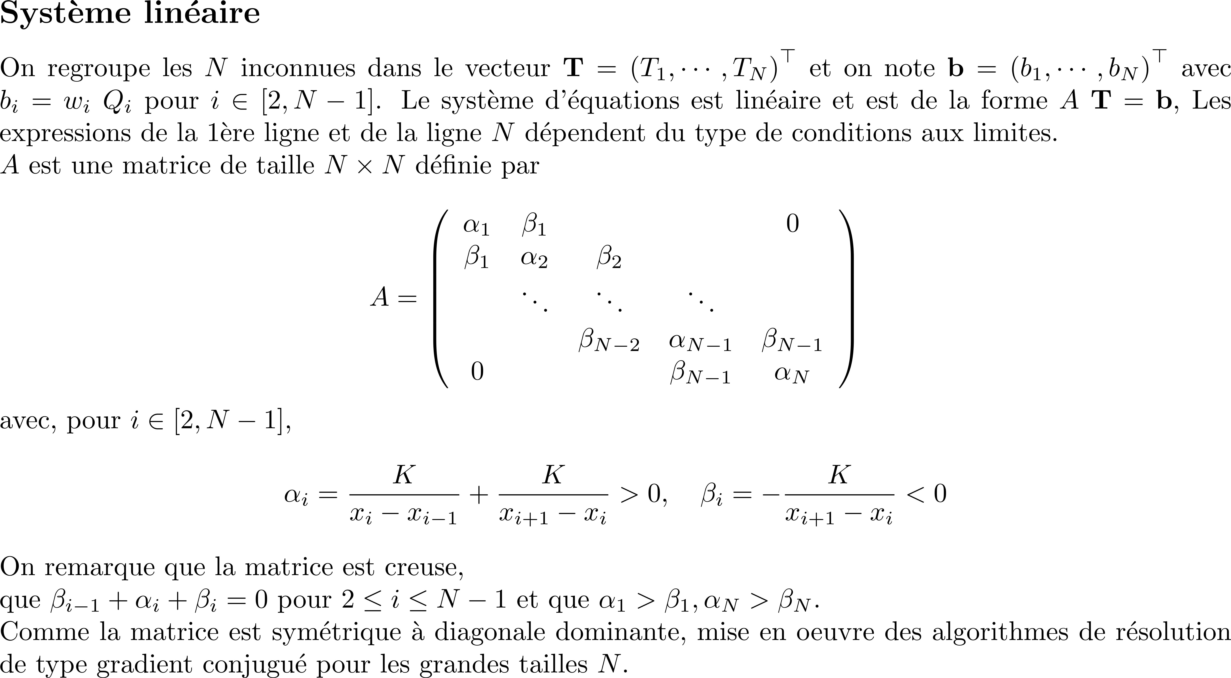

Slide 13
# Initialisation de la matrice A et du vecteur b
A = np.zeros((N, N))
b = np.zeros(N)
# Remplissage de la matrice pour les cellules
# intérieures (i = 1 à N-2)
for i in range(1, N-1):
A[i, i-1] = -K / (x[i] - x[i-1])
A[i, i ] = +K / (x[i] - x[i-1]) + K / (x[i+1] - x[i])
A[i, i+1] = -K / (x[i+1] - x[i])
# Condition aux limites sur le bord gauche
A[0, 0] = 2*K/w[0] + K/(x[1] - x[0])
A[0, 1] = -K/(x[1] - x[0])
b[0] = 2*K/w[0] * Tdg
# Condition aux limites sur le bord droit
A[N-1, N-1] = H*2*K/(2*K + H*w[N-1]) + K/(x[N-1] - x[N-2])
A[N-1, N-2] = -K/(x[N-1] - x[N-2])
b[N-1] = H*2*K/(2*K + H*w[N-1]) * Tad
# Résolution du système linéaire
T = np.linalg.solve(A, b)
# Affichage
plt.plot(x, T, 'r.-', linewidth=2, markersize=8)
import numpy as np
import matplotlib.pyplot as plt
from scipy.sparse import csr_matrix
from scipy.sparse.linalg import spsolve
# Paramètres
L = 1
N = 10
K = 200
H = 10
Tdg = 0
Tad = 100
# Largeurs des cellules (uniformes)
w = np.ones(N) * L/N
# Centres des cellules
x = np.zeros(N)
width = w[0]
x[0] = w[0]/2
for i in range(1, N):
x[i] = x[i-1] + w[i]

Slide 14
clc
clear all
close all
L = 1;
N = 10;
K = 200;
H = 10;
Tdg = 0;
Tad = 100;
w = L/N*ones(1, N);
% centres des cellules
x = zeros(1, N);
width = w(1);
x(1)=w(1)/2;
for i=2:N
x(i) = x(i-1)+w(i);
end
A = sparse(N, N);
b = zeros(N, 1);
for i=2:N-1
A(i, i-1) = -K/(x(i)-x(i-1));
A(i, i ) = +K/(x(i)-x(i-1))+K/(x(i+1)-x(i));
A(i, i+1) = -K/(x(i+1)-x(i));
end
A(1, 1) = 2*K/w(1)+K/(x(2)-x(1));
A(1, 2) = -K/(x(2)-x(1));
b(1) = 2*K/w(1)*Tdg;
A(N, N ) = H*2*K/(2*K+H*w(N))+K/(x(N)-x(N-1));
A(N, N-1) = -K/(x(N)-x(N-1));
b(N) = H*2*K/(2*K+H*w(N))*Tad;
T = A\b;
plot(x, T, 'r.-')
grid on

Slide 15
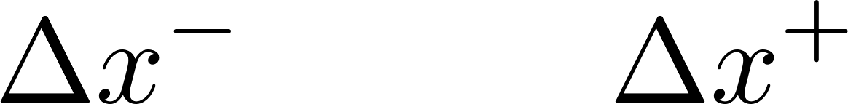
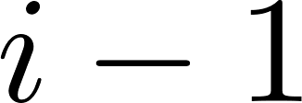

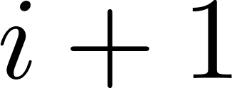
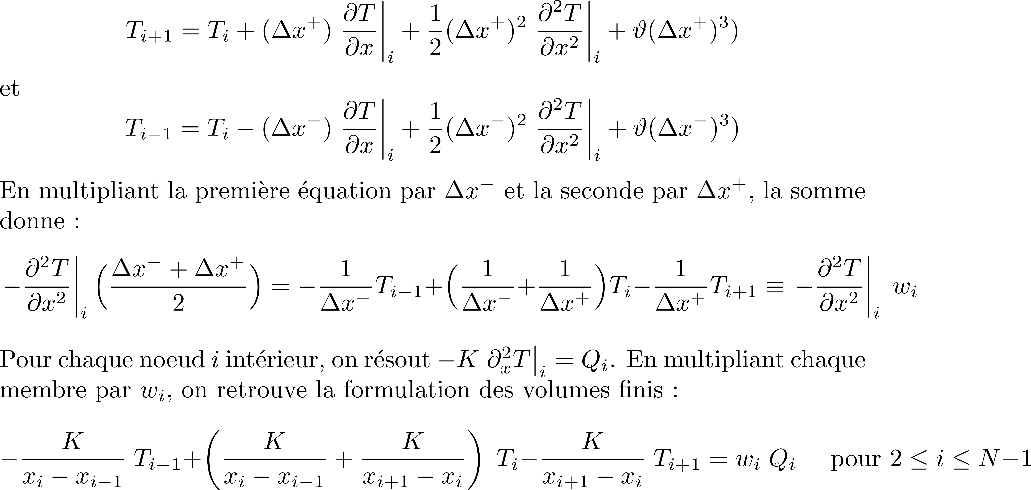
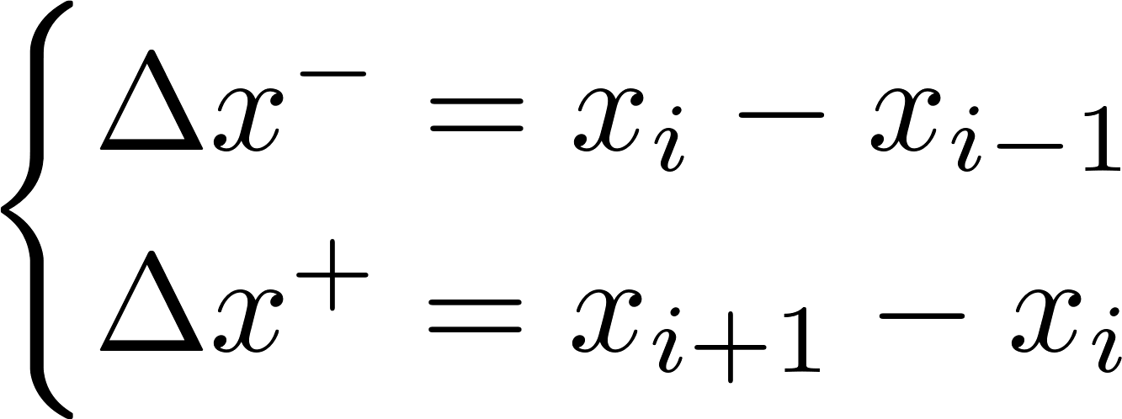

Slide 16
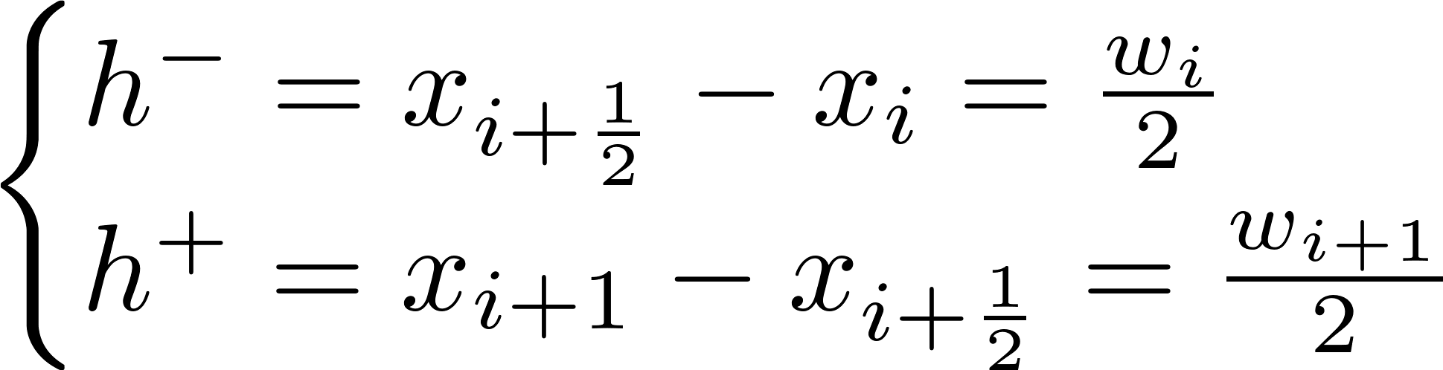
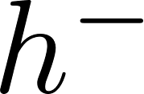
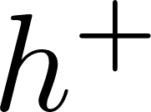


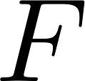
- +

Slide 17
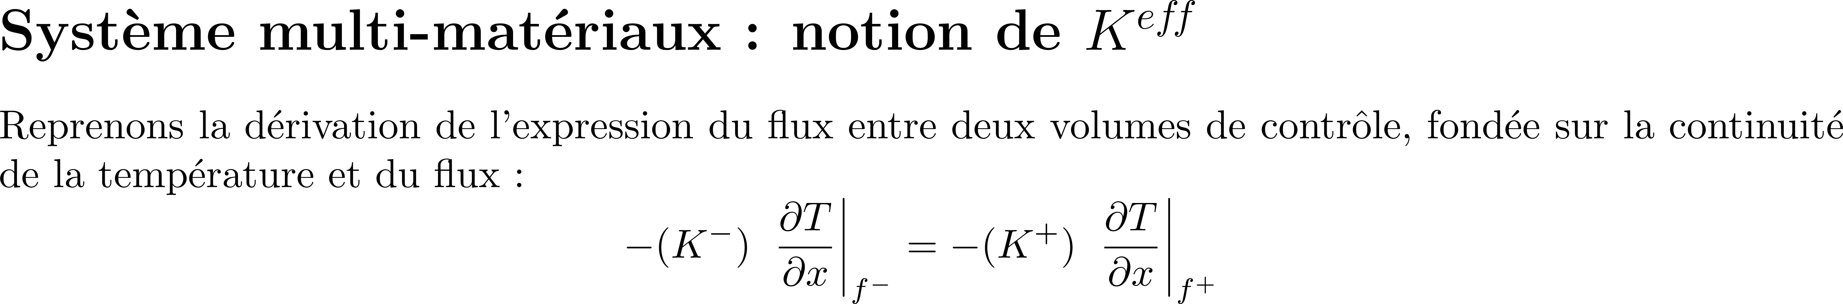
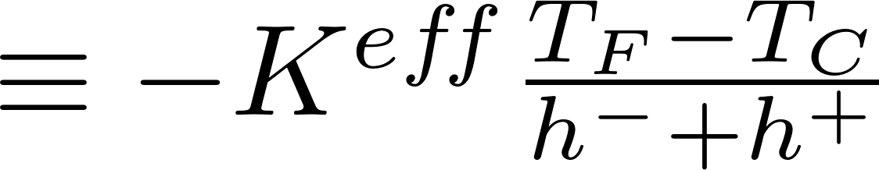
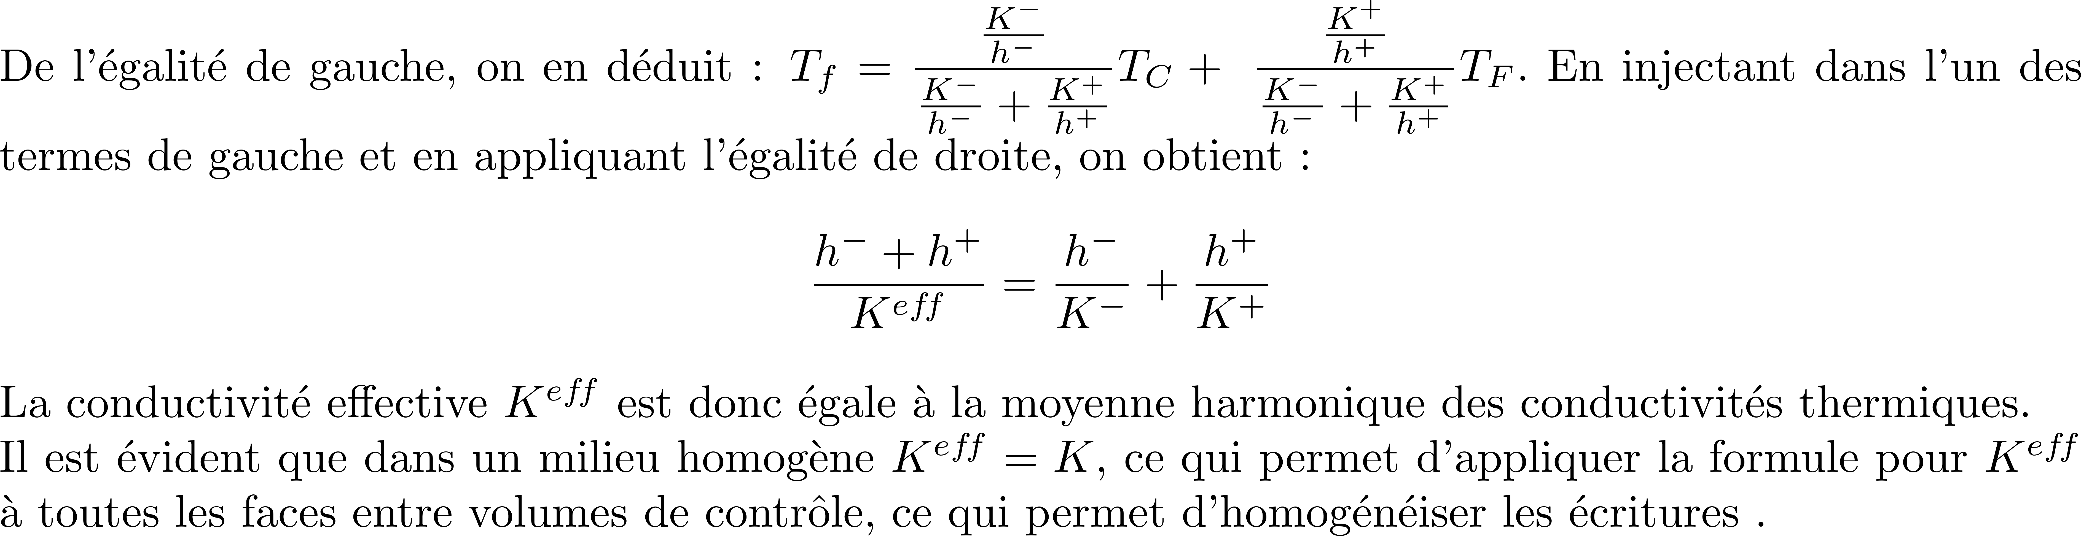
- +

Slide 18
# Condition aux limites Dirichlet sur le bord gauche
Km = K[0]
A[0, 0] = 2*Km/w[0]
b[0] = 2*Km/w[0]*Tdg
# Contribution de l'interface (1 | 2)
hm, hp = w[0]/2, w[1]/2
Km, Kp = K[0], K[1]
Keff = (hm + hp) / (hm/Km + hp/Kp)
A[0, 0] += +Keff / (x[1] - x[0])
A[0, 1] = -Keff / (x[1] - x[0])
# Condition aux limites Neumann sur le bord droit
Kp = K[N-1]
A[N-1, N-1] = H*2*Kp / (2*Kp + H*w[N-1])
b[N-1] = H*2*Kp / (2*Kp + H*w[N-1]) * Tad
# Contribution de l'interface (N-1 | N)
hm, hp = w[N-2]/2, w[N-1]/2
Km, Kp = K[N-2], K[N-1]
Keff = (hm + hp) / (hm/Km + hp/Kp)
A[N-1, N-1] = A[N-1, N-1] + Keff / (x[N-1] - x[N-2])
A[N-1, N-2] = -Keff / (x[N-1] - x[N-2])
# Conductivité (K1 pour x < L/2, K2 pour x >= L/2)
K = np.where(x < L/2, K1, K2)
assert len(K) == N
# Initialisation de la matrice A et du vecteur b
A = np.zeros((N, N))
b = np.zeros(N)
# Pour les cellules intérieures (i = 1 à N-2)
for i in range(1, N-1):
# Contribution de l'interface (i-1 | i)
hm, hp = w[i-1]/2, w[i]/2
Km, Kp = K[i-1] , K[i]
Keff = (hm + hp) / (hm/Km + hp/Kp)
A[i, i-1] = -Keff / (x[i] - x[i-1])
A[i, i ] = +Keff / (x[i] - x[i-1])
# Contribution de l'interface (i | i+1)
hm, hp = w[i]/2, w[i+1]/2
Km, Kp = K[i], K[i+1]
Keff = (hm + hp) / (hm/Km + hp/Kp)
A[i, i+1] = -Keff / (x[i+1] - x[i])
A[i, i] += +Keff / (x[i+1] - x[i])

Slide 19
…
K1 = 200;
K2 = 400;
K = K1*(x < L/2) + K2*(x >= L/2);
assert(length(K) == N);
A = sparse(N, N);
b = zeros(N, 1);
for i=2:N-1
% contribution de l'interface (i-1 | i)
hm = w(i-1)/2; Km = K(i-1);
hp = w(i )/2; Kp = K(i);
Keff = (hm+hp)/(hm/Km + hp/Kp);
A(i, i-1) = -Keff/(x(i)-x(i-1));
A(i, i ) = +Keff/(x(i)-x(i-1));
% contribution de l'interface (i | i+1)
hm = w(i )/2; Km = K(i );
hp = w(i+1)/2; Kp = K(i+1);
Keff = (hm+hp)/(hm/Km + hp/Kp);
A(i, i+1) = -Keff/(x(i+1)-x(i));
A(i, i ) = A(i, i) + Keff/(x(i+1)-x(i));
end
% CL Dirichlet sur le bord gauche
A(1, 1) = 2*Km/w(1);
b(1) = 2*Km/w(1)*Tdg;
% contribution de l'interface (1 | 2)
hm = w(1)/2; Km = K(1);
hp = w(2)/2; Kp = K(2);
Keff = (hm+hp)/(hm/Km + hp/Kp);
A(1, 1) = A(1, 1) +Keff/(x(2)-x(1));
A(1, 2) = -Keff/(x(2)-x(1));
% CL Neumann sur le bord droit
A(N, N) = H*2*Kp/(2*Kp+H*w(N));
b(N) = H*2*Kp/(2*Kp+H*w(N))*Tad;
% contribution de l'interface (N-1 | N)
hm = w(N-1)/2; Km = K(N-1);
hp = w(N )/2; Kp = K(N );
Keff = (hm+hp)/(hm/Km + hp/Kp);
A(N, N ) = A(N, N) +Keff/(x(N)-x(N-1));
A(N, N-1) = -Keff/(x(N)-x(N-1));
…

