Slide 1
Exercice : cœur du réacteur de Super-Phénix
Image CEA

Slide 2



CORRECTION

Slide 3
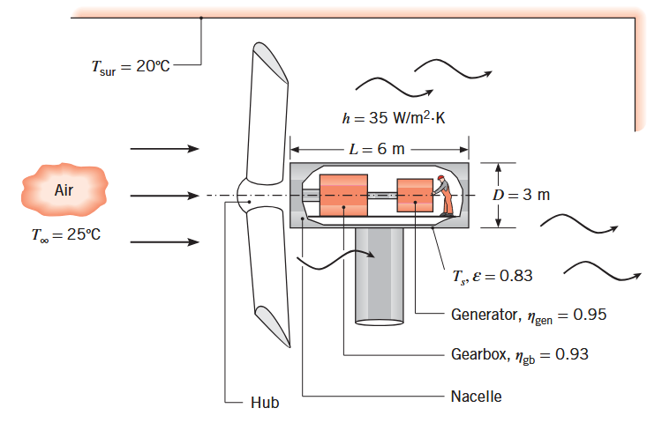

Slide 4
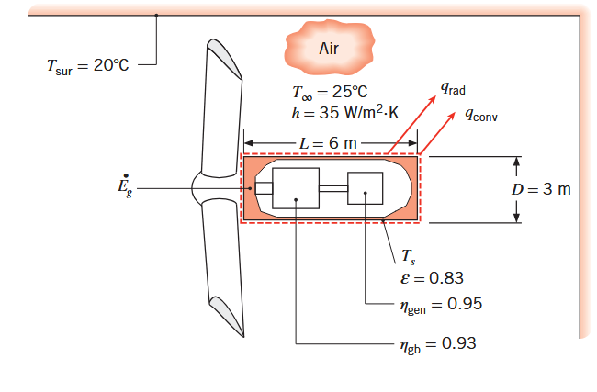
CORRECTION

Slide 5
CORRECTION

Slide 6

CORRECTION

Slide 8
CORRECTION

Slide 9
CORRECTION

Slide 10

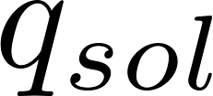

Slide 11
CORRECTION
Metal

Slide 12
Incropera
Example 1.4

Slide 13
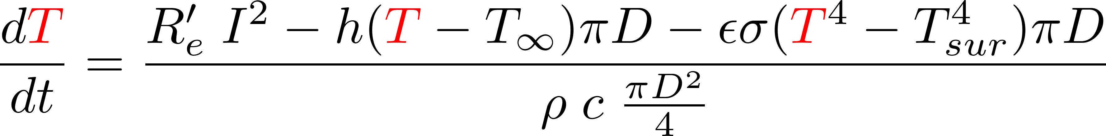
CORRECTION

Slide 14
CORRECTION
import numpy as np
import matplotlib.pyplot as plt
from scipy.integrate import solve_ivp
# Paramètres physiques pour le cuivre
rho = 8960 # kg/m³
c = 385 # J/(kg·K)
# Paramètres du problème
D = 1e-3 # m
Re = 0.4 # Ω/m
Tsur = 300 # K
Tinf = 300 # K
h = 100 # W/(m²·K)
epsilon = 0.8
sigma = 5.67e-8 # W/(m²·K⁴)
# Courant électrique
I = 10 # A
def dT_dt(t, T):
Tval = T[0]
terme_joule = Re * I**2
terme_convection = h * (Tval - Tinf) * np.pi * D
terme_rayonnement = epsilon * sigma * (Tval**4 - Tsur**4) * np.pi * D
capacite_thermique = rho * c * (np.pi * D**2) / 4
dTdt = (terme_joule - terme_convection - terme_rayonnement) / capacite_thermique
return [dTdt]
# Conditions initiales et temps
T0 = [300] # K
t_span = (0, 100) # intervalle de temps
t_eval = np.linspace(t_span[0], t_span[1], 1000) # points d'évaluation
# Résolution avec RK45
solution_rk45 = solve_ivp(dT_dt, t_span, T0, t_eval=t_eval,
method='RK45', rtol=1e-8, atol=1e-10)
# Tracé de l'évolution de la température avec le temps
plt.figure(figsize=(10, 6))
plt.plot(solution_rk45.t, solution_rk45.y[0]-273, 'b-',
linewidth=2, label='RK45')
plt.xlabel('Temps (s)')
plt.ylabel('Température (C)')
plt.title(f'Évolution de la température avec le temps I={I:.2f} A')
plt.grid(True, alpha=0.3)

Slide 15
CORRECTION
Sans rayonnement

Slide 16
Incropera
Example 1.7

Slide 17
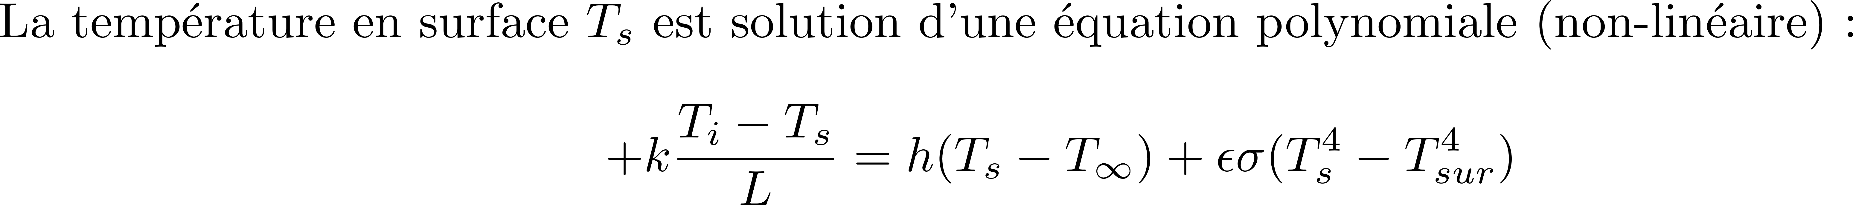
CORRECTION
1
2
x

Slide 18
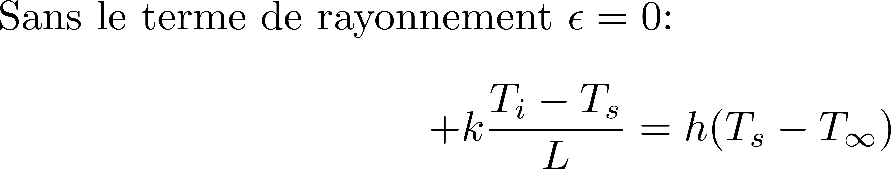
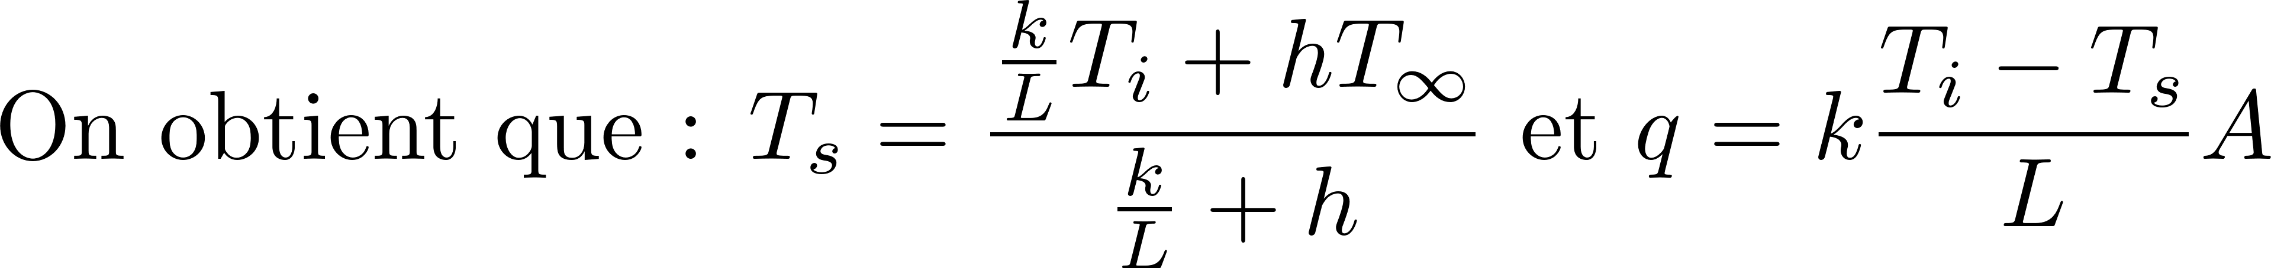
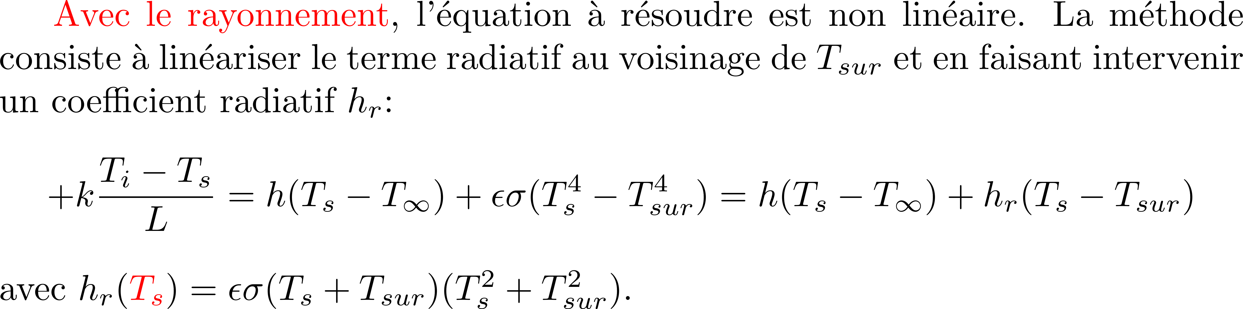
CORRECTION
h (W m-2 K-1 ) | Ts (K) | q(W)
2 | 307.78 | 39
200 | 300.67 | 1320

Slide 19
CORRECTION
h=2
epsilon = 0.95
sigma = 5.670374419e-8
Ti, Tinf, Tsur = 308, 297, 297
k = 0.3
L, A = 3e-3, 1.8
def hr(Ts):
return epsilon*sigma*(Ts+Tsur)*(Ts**2+Tsur**2)
# guess value for Ts
Ts = Tinf
# boucle de convergence (point fixe)
for n in range(50):
Ts = (k/L*Ti + h*Tinf + hr(Ts)*Tsur)/(k/L+ h + hr(Ts))
print(n, Ts)
q = k*(Ti-Ts)/L*A
print(f'Ts = {Ts:.2f} K et q = {q:.2f} W')
h (W m-2 K-1 ) | Ts (K) | q(W) avec rayonnement
2 | 307.19 | 146
200 | 300.60 | 1332
h (W m-2 K-1 ) | Ts (K) | q(W) sans rayonnement
2 | 307.78 | 39
200 | 300.67 | 1320

Slide 20
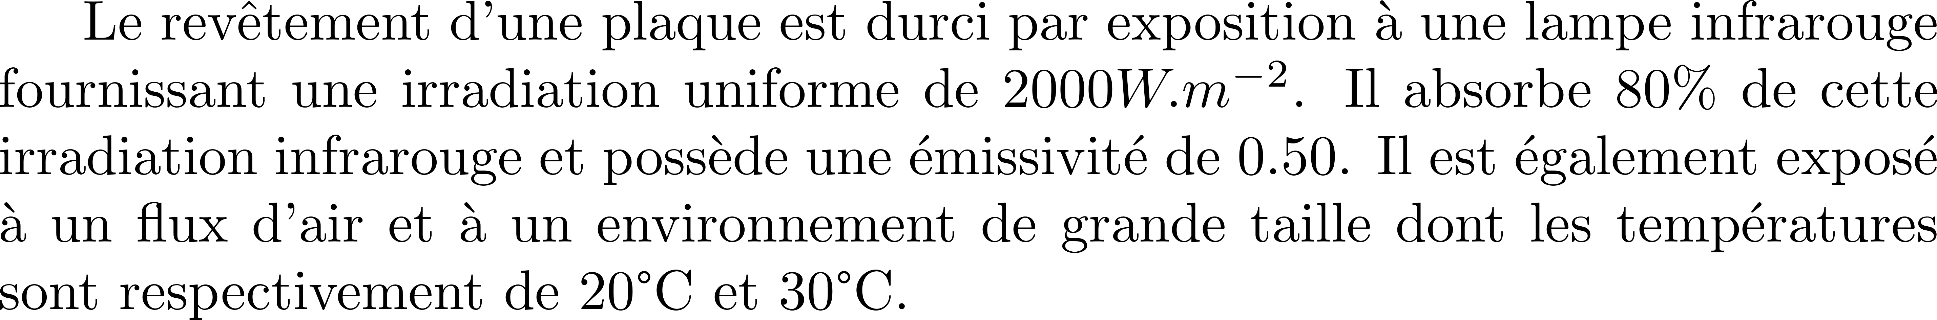
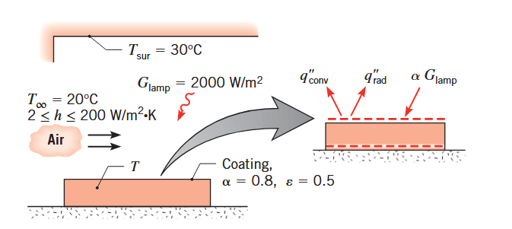
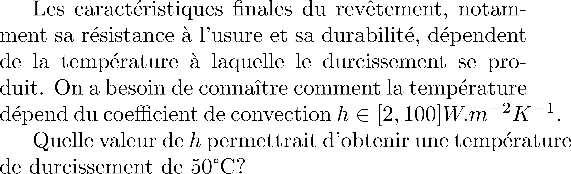
Incropera
Example 1.9

Slide 21
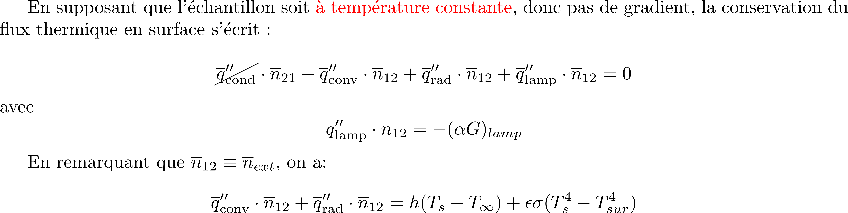
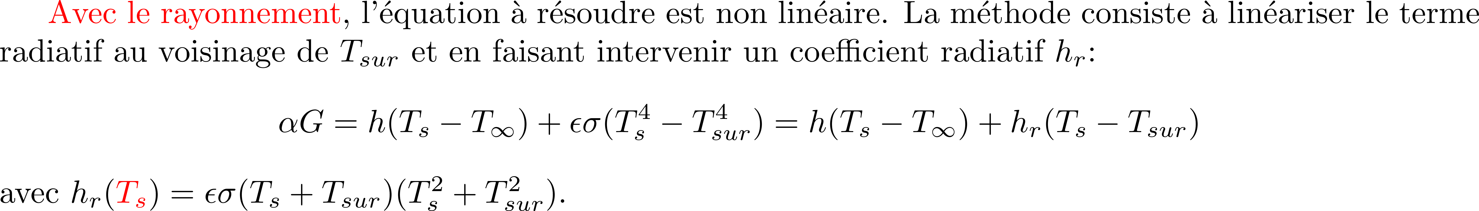
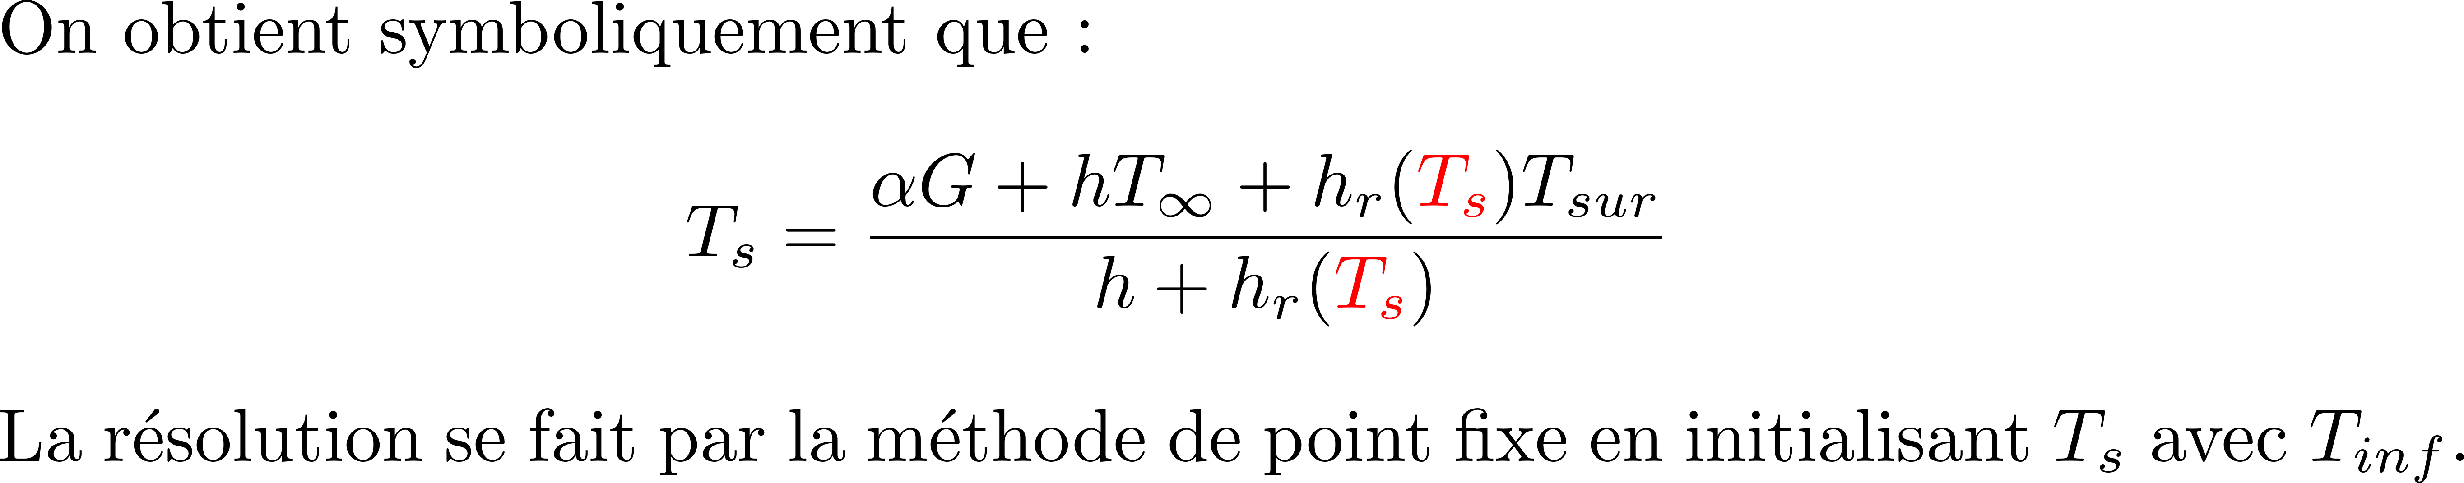
CORRECTION
1
2
x

Slide 22
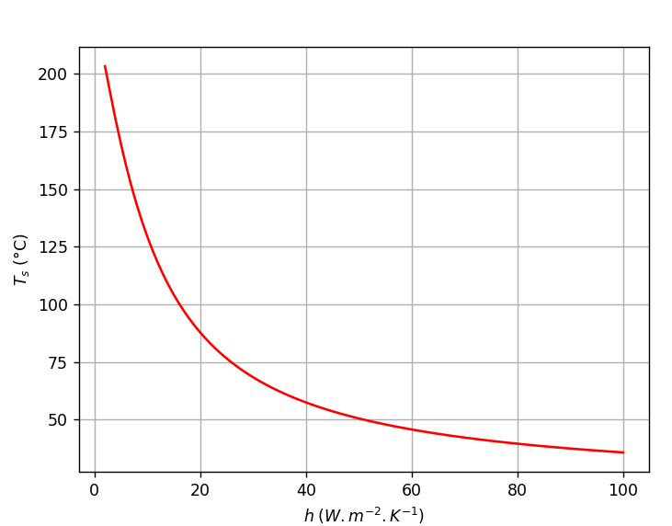
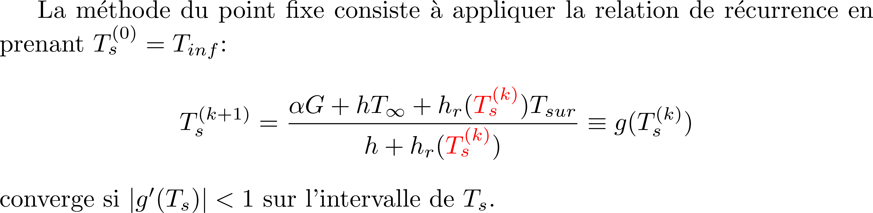
CORRECTION
import matplotlib.pyplot as plt
import numpy as np
epsilon = 0.5
sigma = 5.670374419e-8
Tinf, Tsur = 293, 303
G= 2000
alpha = 0.8
def hr(Ts):
return epsilon*sigma*(Ts+Tsur)*(Ts**2+Tsur**2)
def solve(hvec):
Tvec =[]
for h in hvec:
# guess value for Ts
Ts = Tinf
# boucle de convergence (point fixe)
for n in range(50):
Ts = (alpha*G + h*Tinf + hr(Ts)*Tsur)/(h + hr(Ts))
Tvec.append(Ts)
return np.array(Tvec)
hvec = np.linspace(2, 100, 100)
Tvec = solve(hvec)
plt.plot(hvec, Tvec-273, 'r')
plt.xlabel('$h (W.m^{-2}.K^{-1})$')
plt.ylabel('$T_s$ (°C)')
plt.grid()
plt.show()

Slide 23
CORRECTION
Convergence de la méthode du point fixe
h = 2 iter = 0 Ts = 618.885
h = 2 iter = 1 Ts = 412.647
h = 2 iter = 2 Ts = 518.924
h = 2 iter = 3 Ts = 454.719
h = 2 iter = 4 Ts = 490.785
h = 2 iter = 5 Ts = 469.552
h = 2 iter = 6 Ts = 481.740
h = 2 iter = 7 Ts = 474.636
h = 2 iter = 8 Ts = 478.741
h = 2 iter = 9 Ts = 476.357
h = 2 iter = 10 Ts = 477.737
h = 2 iter = 11 Ts = 476.937
h = 2 iter = 12 Ts = 477.400
h = 2 iter = 13 Ts = 477.131
h = 2 iter = 14 Ts = 477.287
h = 2 iter = 15 Ts = 477.197
h = 2 iter = 16 Ts = 477.249
h = 2 iter = 17 Ts = 477.219
h = 2 iter = 18 Ts = 477.237
h = 2 iter = 19 Ts = 477.226
h = 2 iter = 20 Ts = 477.232
h = 2 iter = 21 Ts = 477.229
h = 2 iter = 22 Ts = 477.231
h = 2 iter = 23 Ts = 477.230
h = 2 iter = 24 Ts = 477.230
h = 2 iter = 25 Ts = 477.230

Slide 24
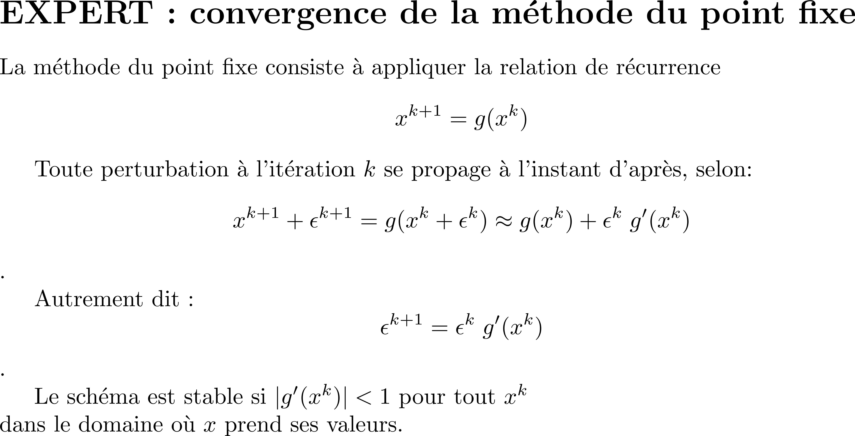
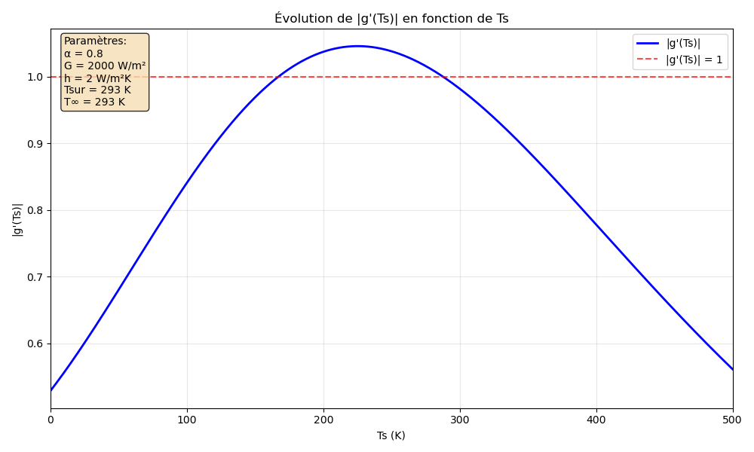
CORRECTION

Slide 25
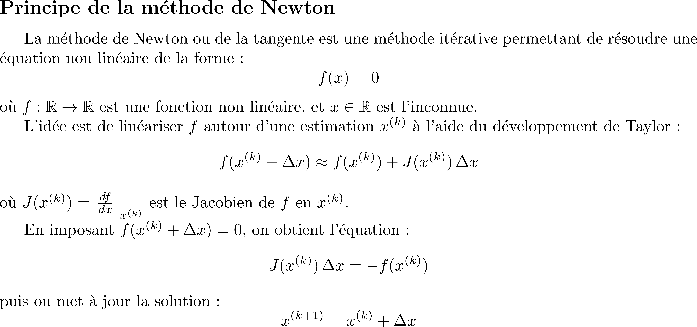
CORRECTION

Slide 26
CORRECTION
import matplotlib.pyplot as plt
import numpy as np
from scipy.optimize import root
# Paramètres
epsilon = 0.5
sigma = 5.67e-8
Tinf, Tsur = 293, 303
G = 2000
alpha = 0.8
def f(Ts, h):
"""Fonction scalaire à annuler"""
return h * (Ts - Tinf) + epsilon * sigma * (Ts**4 - Tsur**4) - alpha * G
def jac(Ts, h):
"""Dérivée de f par rapport à Ts (jacobien)"""
return h + 4 * epsilon * sigma * Ts**3
def solve_with_root(hvec):
Tvec = []
for h in hvec:
Tguess = Tinf
sol = root(fun=f, x0=Tguess, args=(h,), jac=jac, method='hybr')
Tvec.append(sol.x[0] if sol.success else np.nan)
return np.array(Tvec)
# Étude pour h ∈ [2, 100]
hvec = np.linspace(2, 100, 100)
# Méthode : root avec jacobien
Tvec = solve_with_root(hvec)

Slide 27
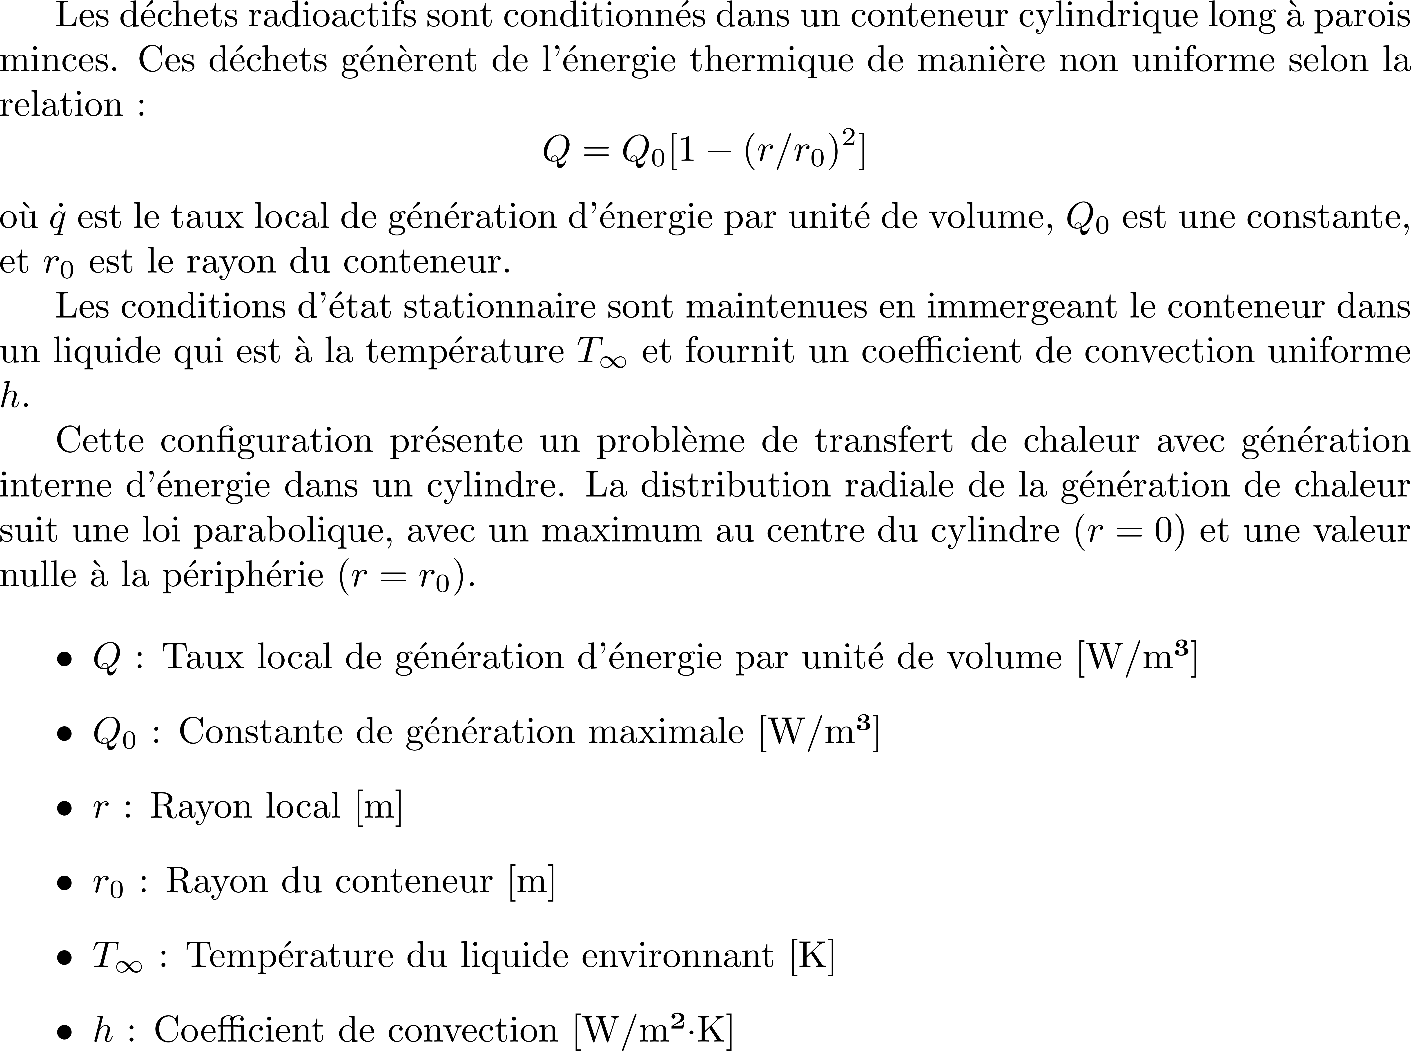
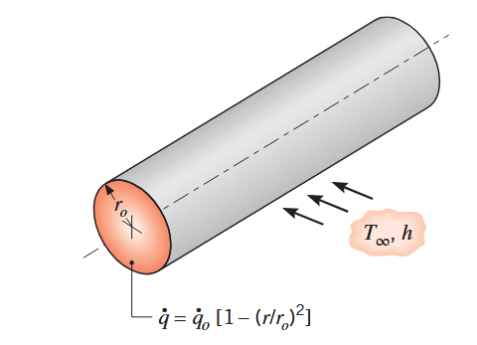
Incropera
Example 1.39

Slide 28
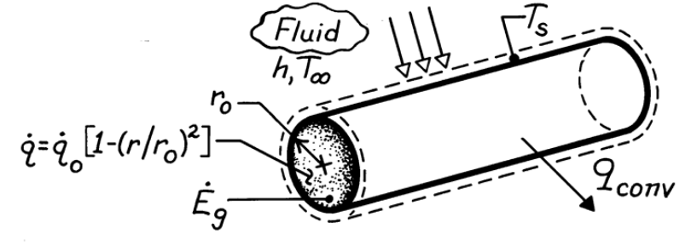
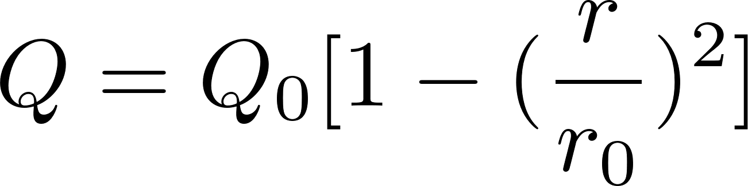
CORRECTION

Slide 31
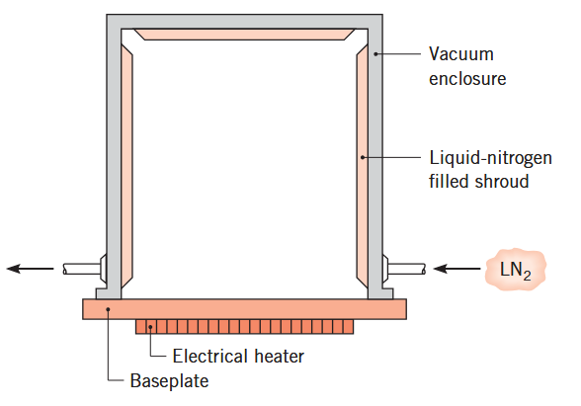
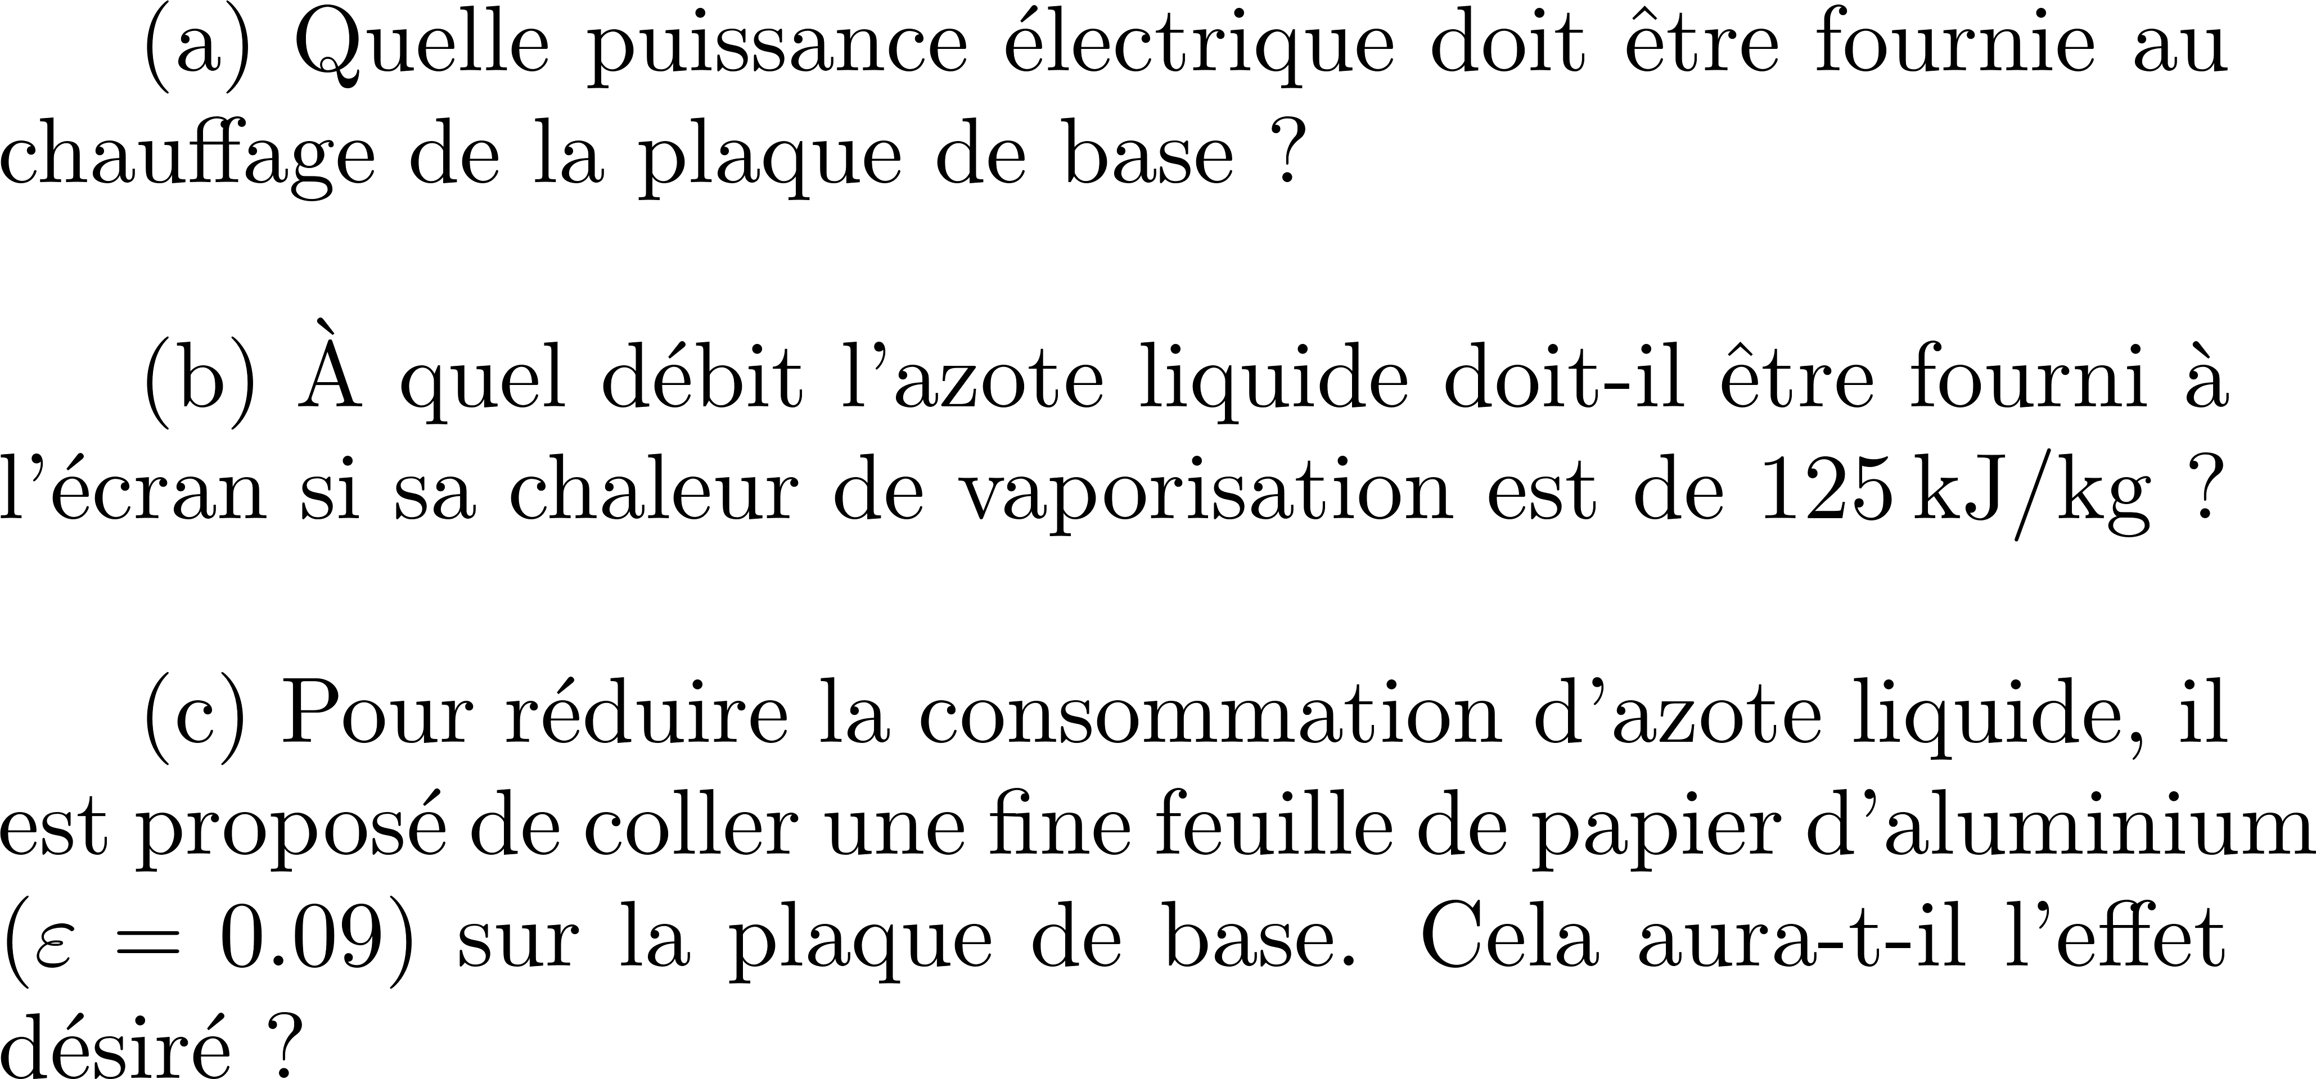

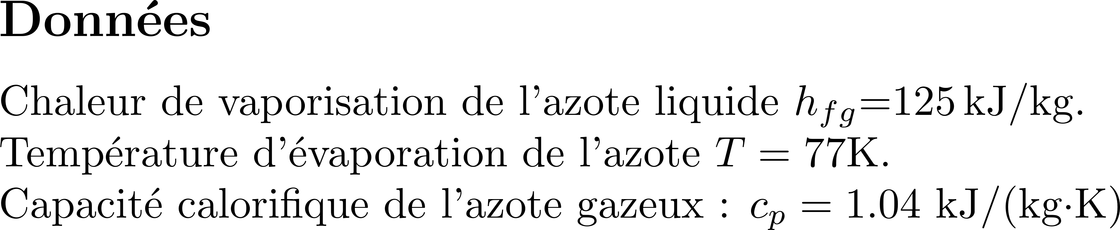
Incropera
Example 1.27
Version 1.5

Slide 32
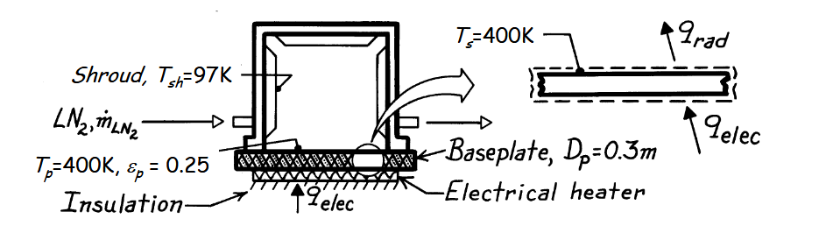
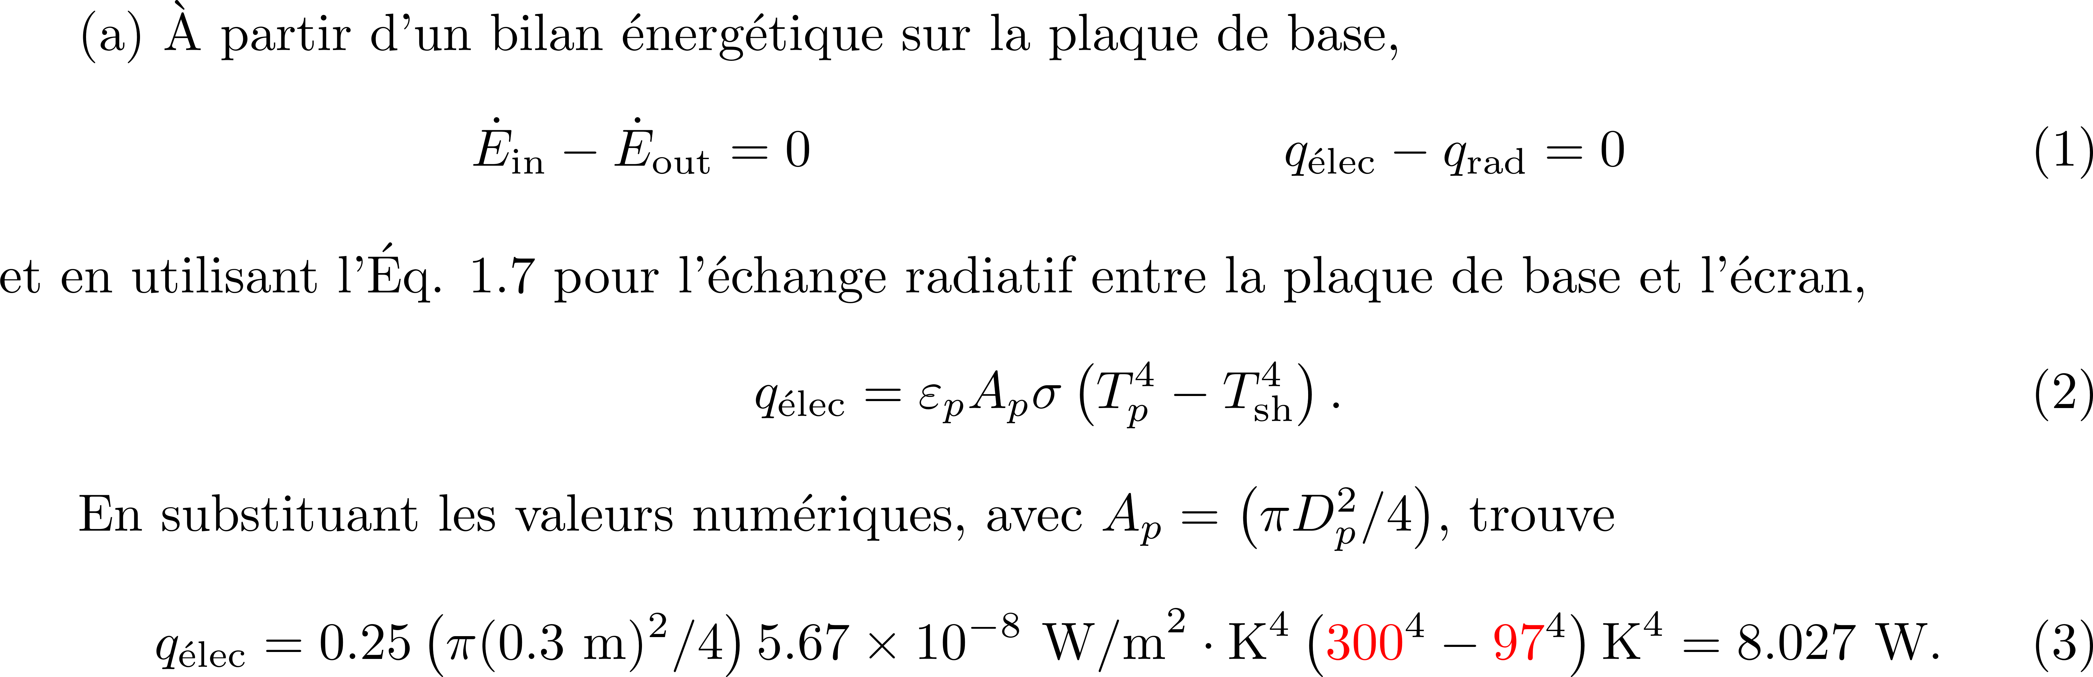
CORRECTION
3OOK
3OOK

Slide 33
CORRECTION

