Slide 1
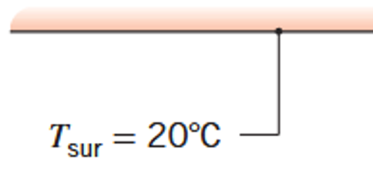
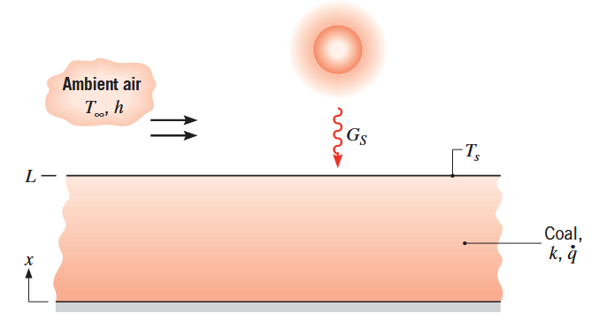

k, Q

Slide 2
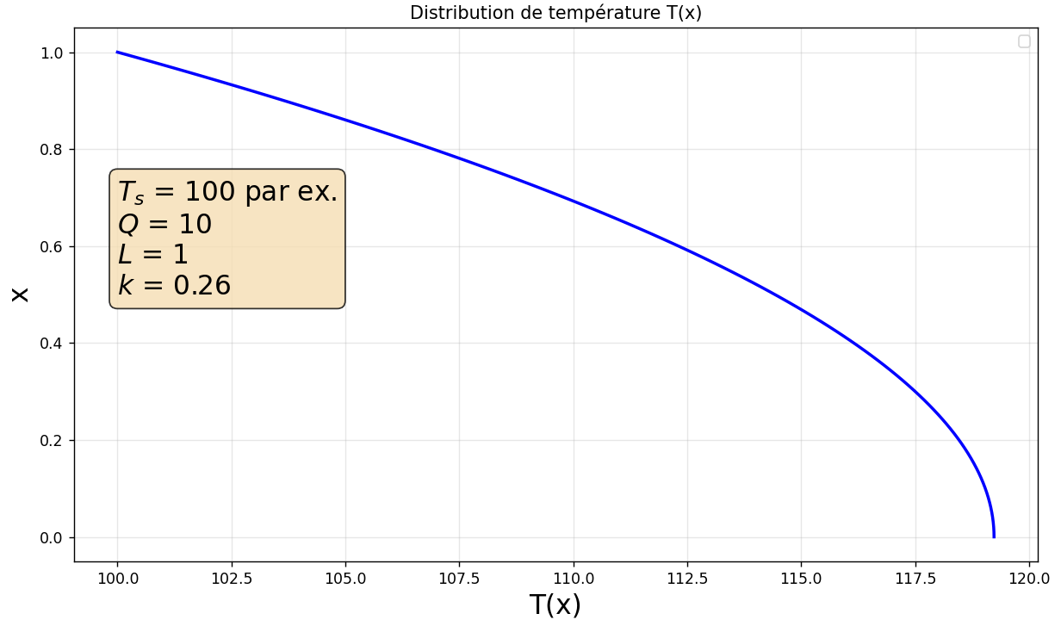
CORRECTION

Slide 3






CORRECTION
x
1
2

Slide 4
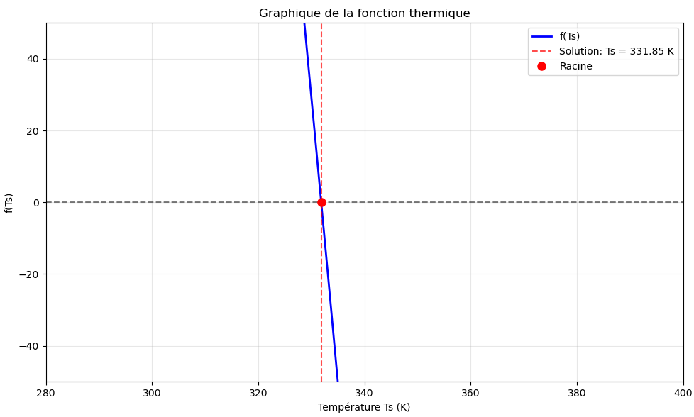
CORRECTION

Slide 5
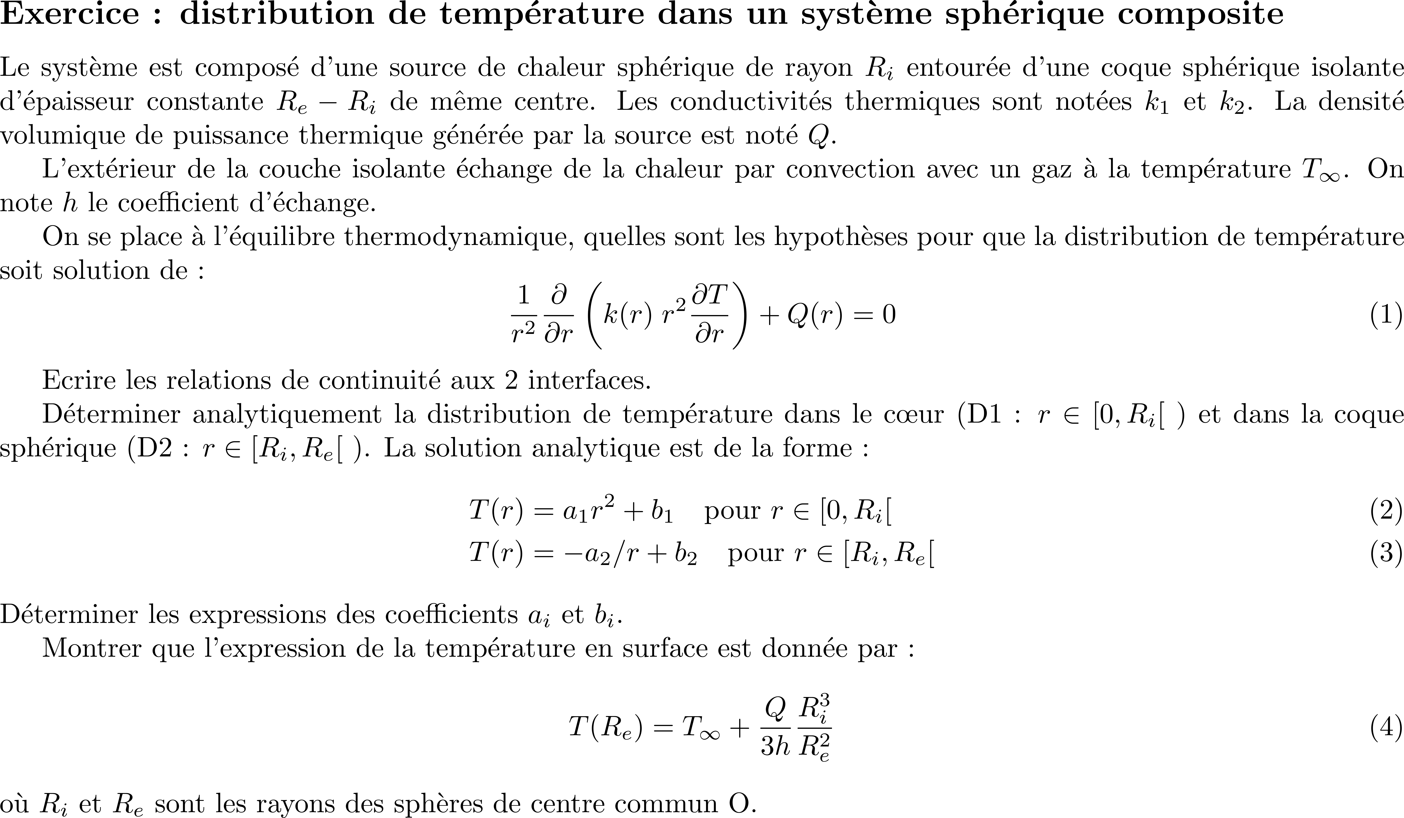

Slide 6
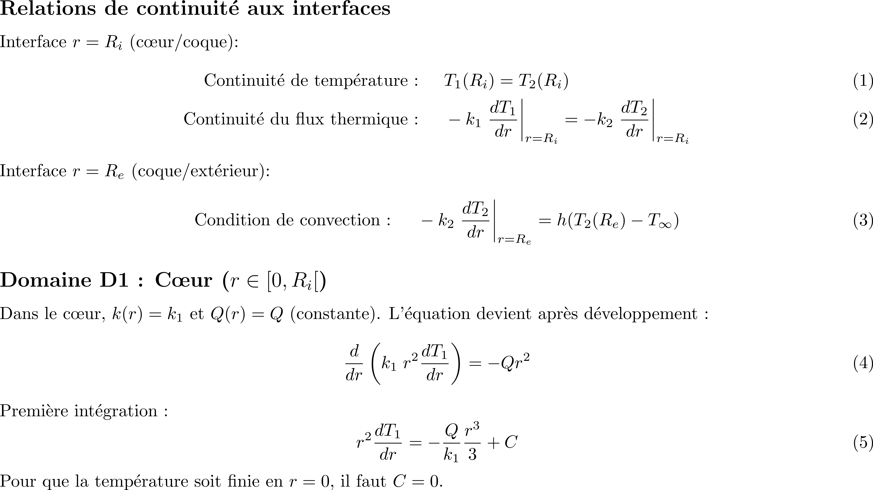
CORRECTION

Slide 7
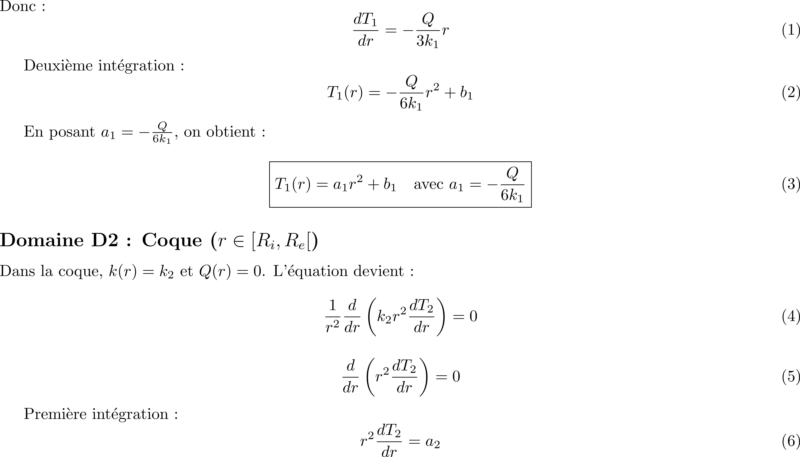
CORRECTION

Slide 8
CORRECTION

Slide 9
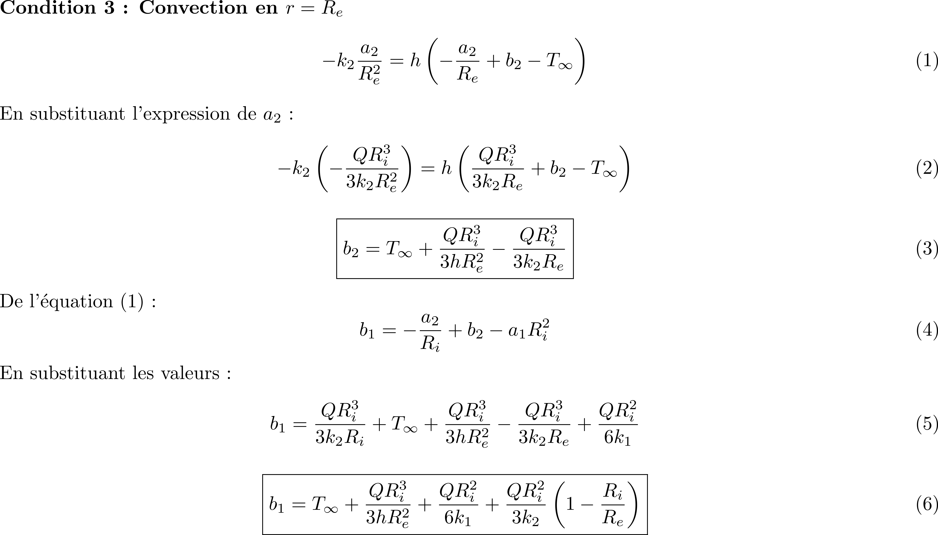
CORRECTION

Slide 10
CORRECTION

Slide 11
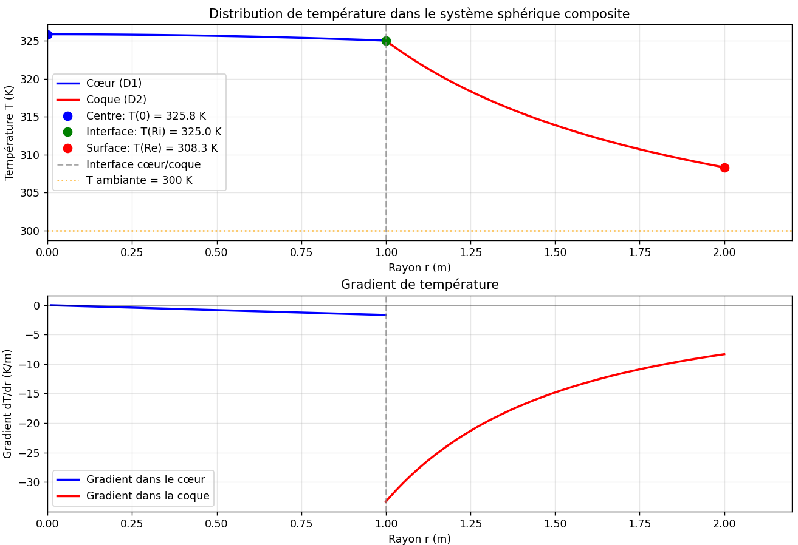


CORRECTION

