Slide 1


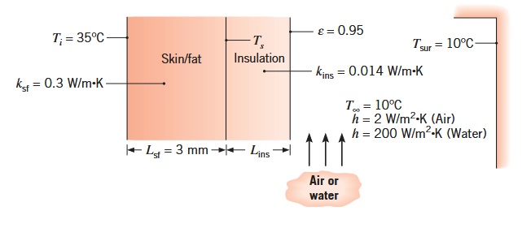
Incropera
Example 3.1
T

Slide 2
CORRECTION

Slide 3
plt.plot(hvec, Tvec-273, 'r')
plt.xlabel('$h (W.m^{-2}.K^{-1})$')
plt.ylabel('$T$ (°C)')
plt.grid()
plt.show()
plt.figure()
plt.plot(Tvec, hr(Tvec), 'r')
plt.grid()
plt.show()
ksf = 0.3
Lsf = 3e-3
Ti = 308
kins = 0.014
Rsf = Lsf/(ksf*A)
Ts = Ti-q*Rsf
print('Ts = ', Ts-273)
Lins = kins * A* (Ts-Tvec)/q
plt.plot(hvec, Lins, 'b')
plt.xlabel('$h (W.m^{-2}.K^{-1})$')
plt.ylabel('$Lins$ (m)')
plt.grid()
plt.show()
CORRECTION
import matplotlib.pyplot as plt
import numpy as np
epsilon = 0.95
sigma = 5.67e-8
Tinf, Tsur = 283, 283
q = 100
A = 1.8
def hr(Ts):
return epsilon*sigma*(Ts+Tsur)*(Ts**2+Tsur**2)
def solve(hvec):
Tvec =[]
for h in hvec:
# guess value for T
T = Tinf
# boucle de convergence (point fixe)
for n in range(10):
T = (q/A + h*Tinf + hr(T)*Tsur)/(h + hr(T))
Tvec.append(T)
return np.array(Tvec)
hvec = np.linspace(2, 200, 100)
Tvec = solve(hvec)
h = 2.0000 iteration 0 T = 18.0709 °C
h = 2.0000 iteration 1 T = 17.8288 °C
h = 2.0000 iteration 2 T = 17.8359 °C
h = 2.0000 iteration 3 T = 17.8357 °C
h = 2.0000 iteration 4 T = 17.8357 °C
h = 200.0000 iteration 0 T = 10.2712 °C
h = 200.0000 iteration 1 T = 10.2711 °C
h = 200.0000 iteration 2 T = 10.2711 °C

Slide 4
CORRECTION

Slide 5
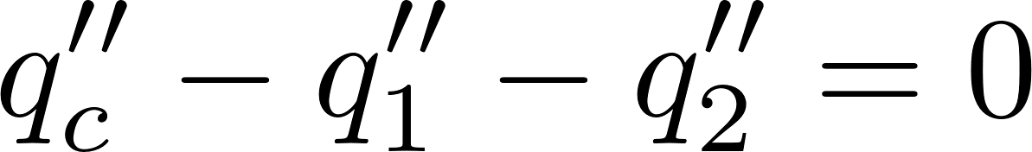
Incropera
Example 3.2

Slide 6
CORRECTION
import matplotlib.pyplot as plt
import numpy as np
Tinf = 298
qc_pp = 1e4
h =100
L = 8e-3
k = 239
def solve(Rtc_pp_vec):
Tc_vec =[]
for Rtc_pp in Rtc_pp_vec:
Tc = Tinf + qc_pp/(h+ 1/(Rtc_pp + L/k +1/h))
Tc_vec.append(Tc)
return np.array(Tc_vec)
Rtc_pp_vec = np.linspace(0.2e-4, 0.9e-4, 100)
Tc_vec = solve(Rtc_pp_vec)
plt.plot(Rtc_pp_vec, Tc_vec-273, 'r')
plt.xlabel('$R_{tc}'' (m^{2}.K.W^{-1})$')
plt.ylabel('$Tc$ (°C)')
plt.grid()
plt.show()

Slide 7
Incropera
Example 3.3

Slide 9

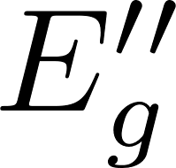

CORRECTION
1
2
x

Slide 10
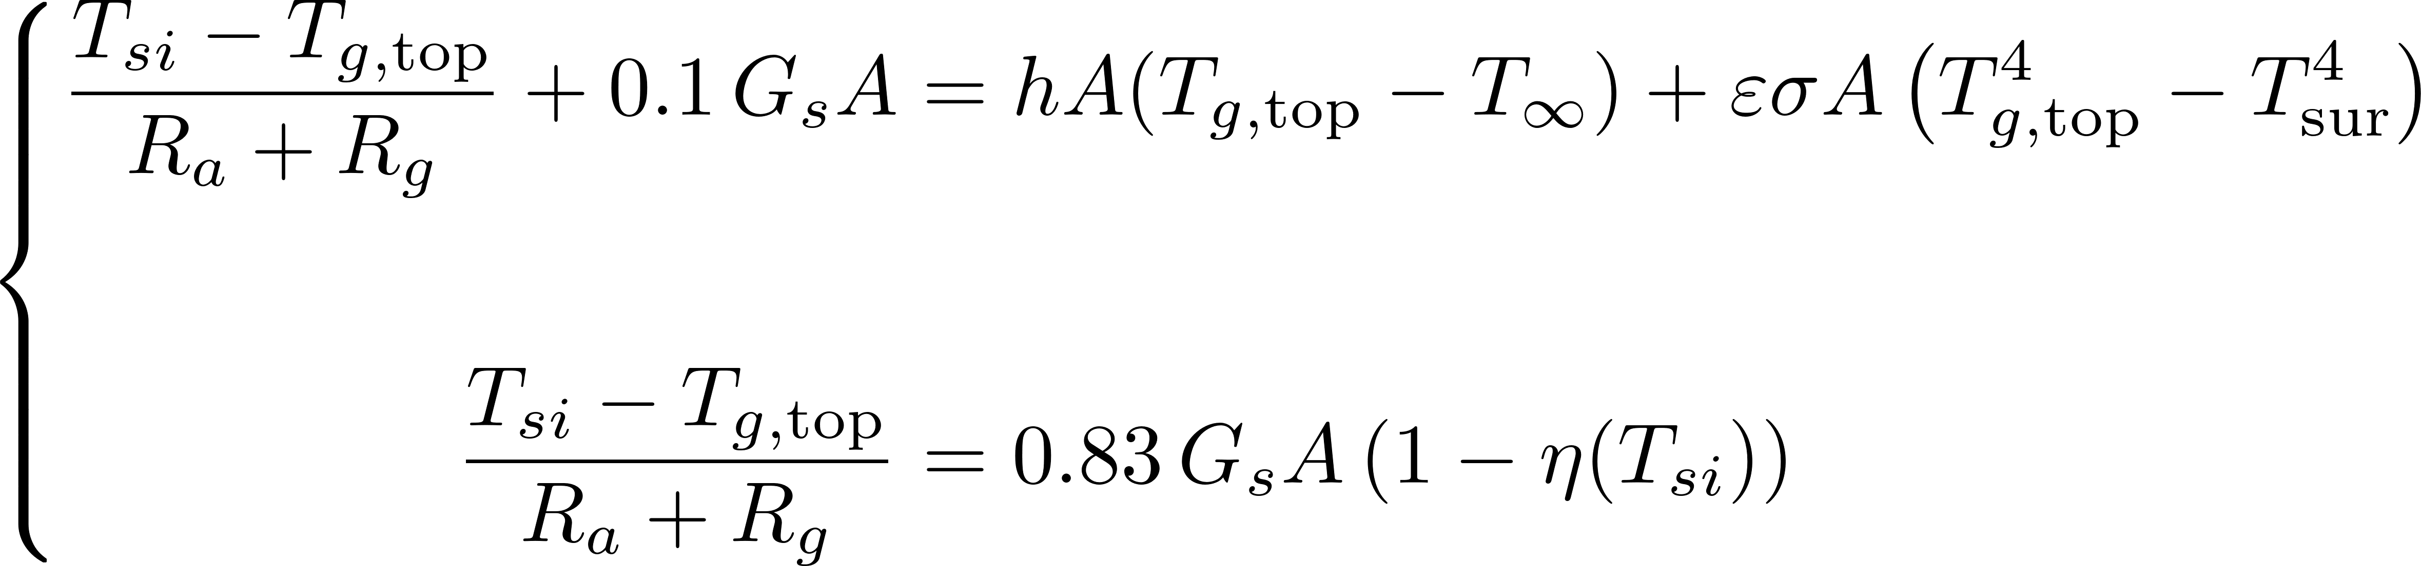
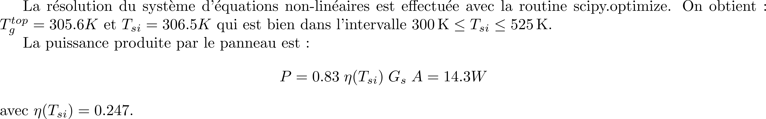
CORRECTION

Slide 11
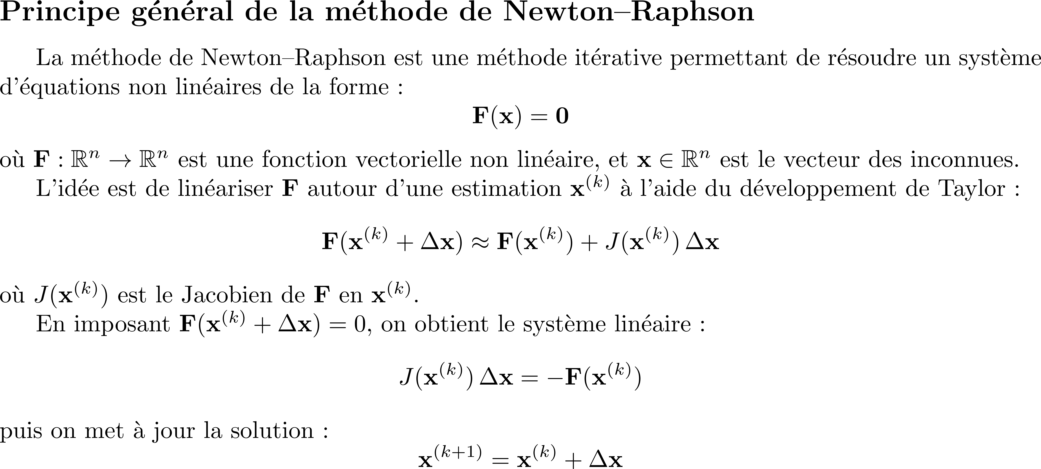
CORRECTION

Slide 12
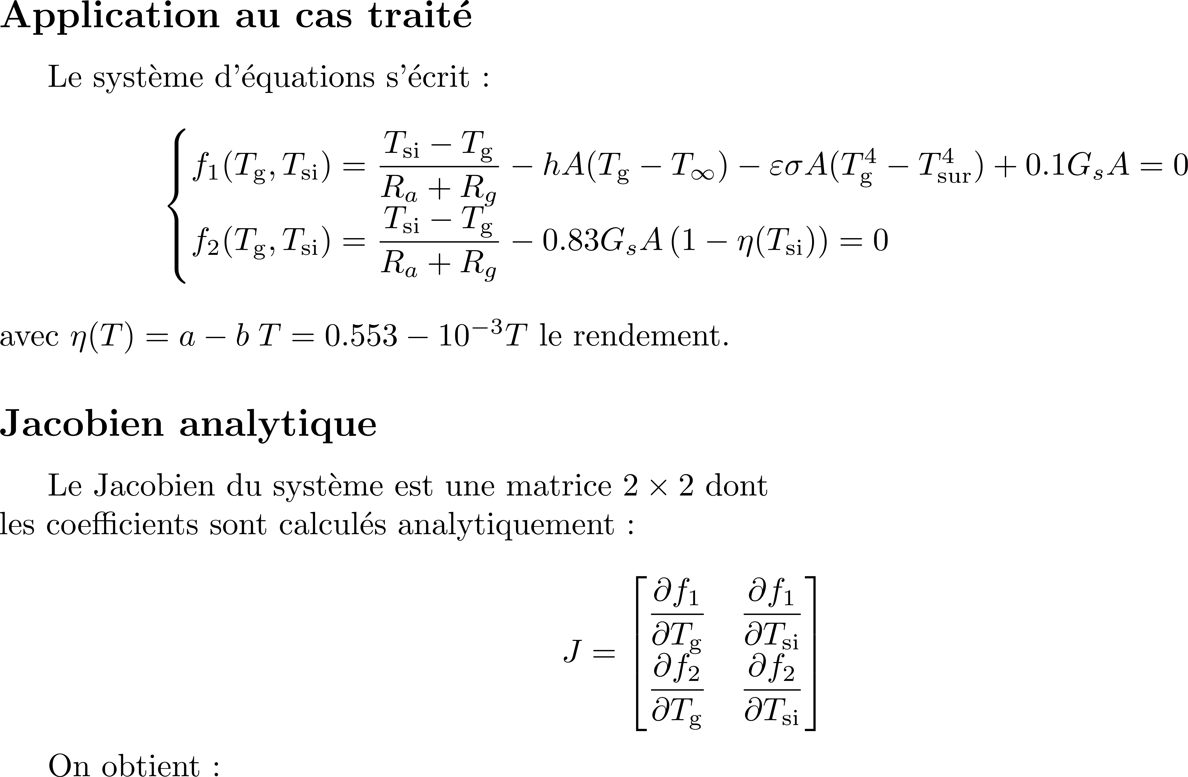
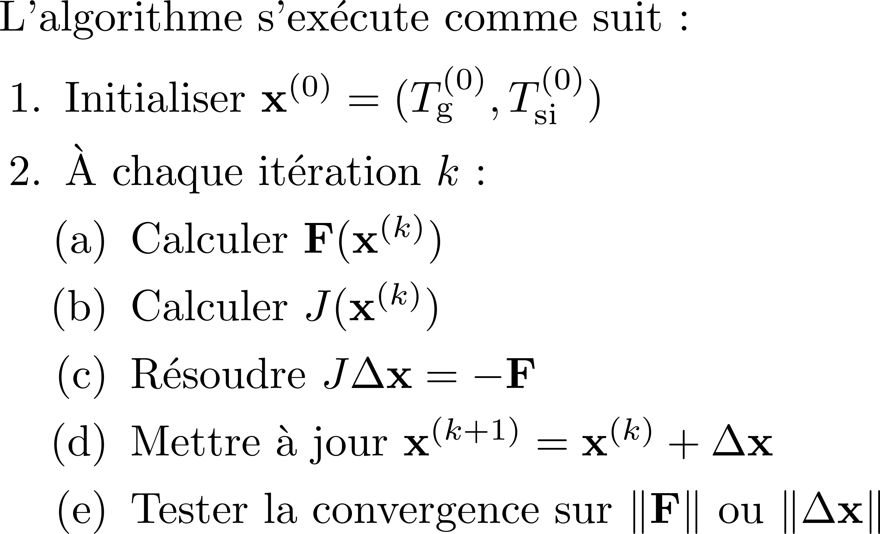
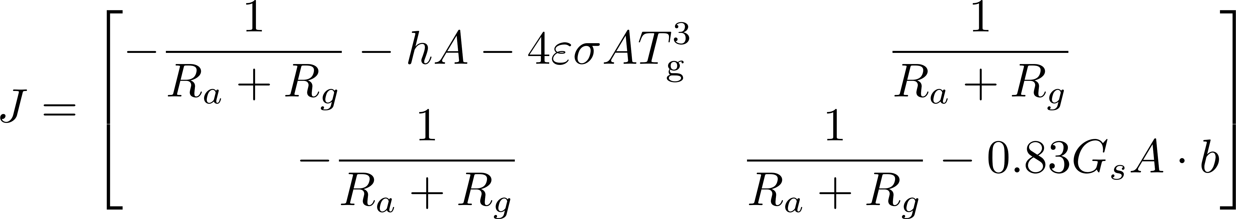
CORRECTION

Slide 13
from scipy.optimize import root
from scipy.optimize import approx_fprime
import numpy as np
epsilon = 0.9
sigma = 5.67e-8
Tinf, Tsur = 293, 293
h = 35
A = 0.1
Gs = 700
Lg, La = 3.0e-3, 0.1e-3
kg, ka = 1.4, 145
Ra, Rg = La/(ka*A), Lg/(kg*A)
def eta(T):
a, b = 0.553, 1e-3
return a-b*T
def equations(vars):
Tg_top, Tsi = vars
RHS = (h*A*(Tg_top-Tinf)+
epsilon*sigma*A*(Tg_top**4-Tsur**4)-0.1*Gs*A)
f1 = (Tsi-Tg_top)/(Ra+Rg) -RHS
RHS = 0.83*Gs*A*(1-eta(Tsi))
f2 = (Tsi-Tg_top)/(Ra+Rg) -RHS
return np.array([f1, f2])
CORRECTION
# Valeurs initiales
initial_guess = [Tsur, Tsur]
# Appel à root
# hybr est l'abréviation de Hybrid Powell method.
# méthode par défaut dans scipy.optimize.root
# Elle combine :
# 1. la méthode de Newton modifiée si le Jacobien est fourni
# ou approché,
# 2. des techniques de moindres carrés pour la robustesse
# (similaire à Levenberg–Marquardt),
# 3. une mise à l’échelle adaptative des variables.
sol = root(equations, initial_guess)
# Affichage
if sol.success:
Tg_top_sol, Tsi_sol = sol.x
print(f"Solution trouvée : Tg_top = {Tg_top_sol:.4f}, \
Tsi = {Tsi_sol:.4f}")
print(f"Residu : {equations(sol.x)}")
else:
print("Échec de la résolution :", sol.message)

Slide 14
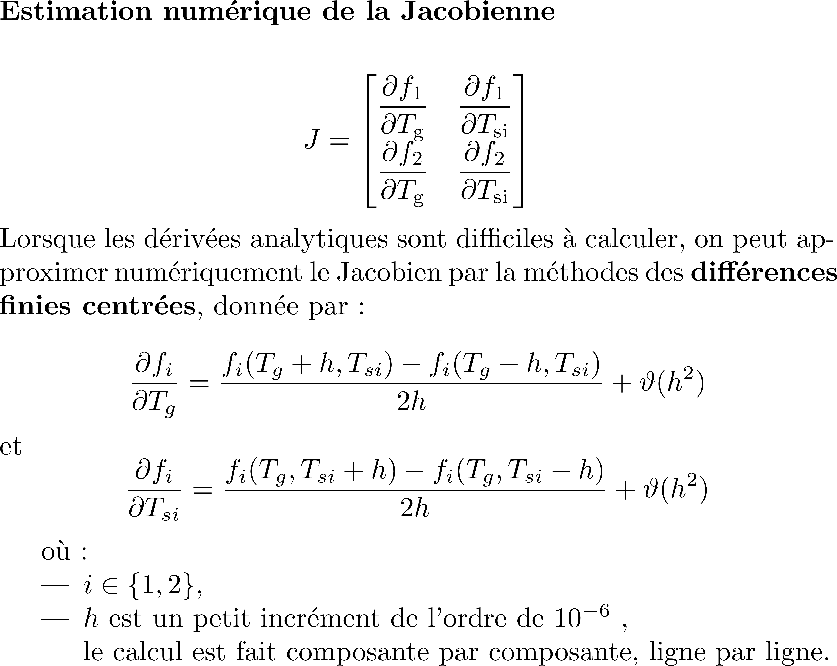
CORRECTION
# Valeurs initiales
initial_guess = [Tsur, Tsur]
# Utilisation de scipy.optimize.root
sol = root(equations, initial_guess)
# Affichage
if sol.success:
Tg_top_sol, Tsi_sol = sol.x
print(f"Solution trouvée : Tg_top = {Tg_top_sol:.4f}, \
Tsi = {Tsi_sol:.4f}")
print(f"Residu : {equations(sol.x)}")
J = np.zeros((2, 2))
for i in range(2):
def fi(x):
return equations(x)[i]
J[i, :] = approx_fprime(sol.x, fi, epsilon= 1e-6)
# estimer la variance résiduelle
res = np.array(equations(sol.x))
sigma2 = np.sum(res**2) / (len(sol.x) - 1)
# covariance (si J bien conditionnée)
cov = sigma2 * np.linalg.inv(J.T @ J)
# erreur standard (barres d'erreur)
errors = np.sqrt(np.diag(cov))
print(f"Tg_top = {sol.x[0]:.4f} ± {errors[0]:.4g}")
print(f"Tsi = {sol.x[1]:.4f} ± {errors[1]:.4g}")
else:
print("Échec de la résolution :", sol.message)
Tg_top = 305.5458 ± 2.318e-13
Tsi = 306.4842 ± 2.423e-13

Slide 15
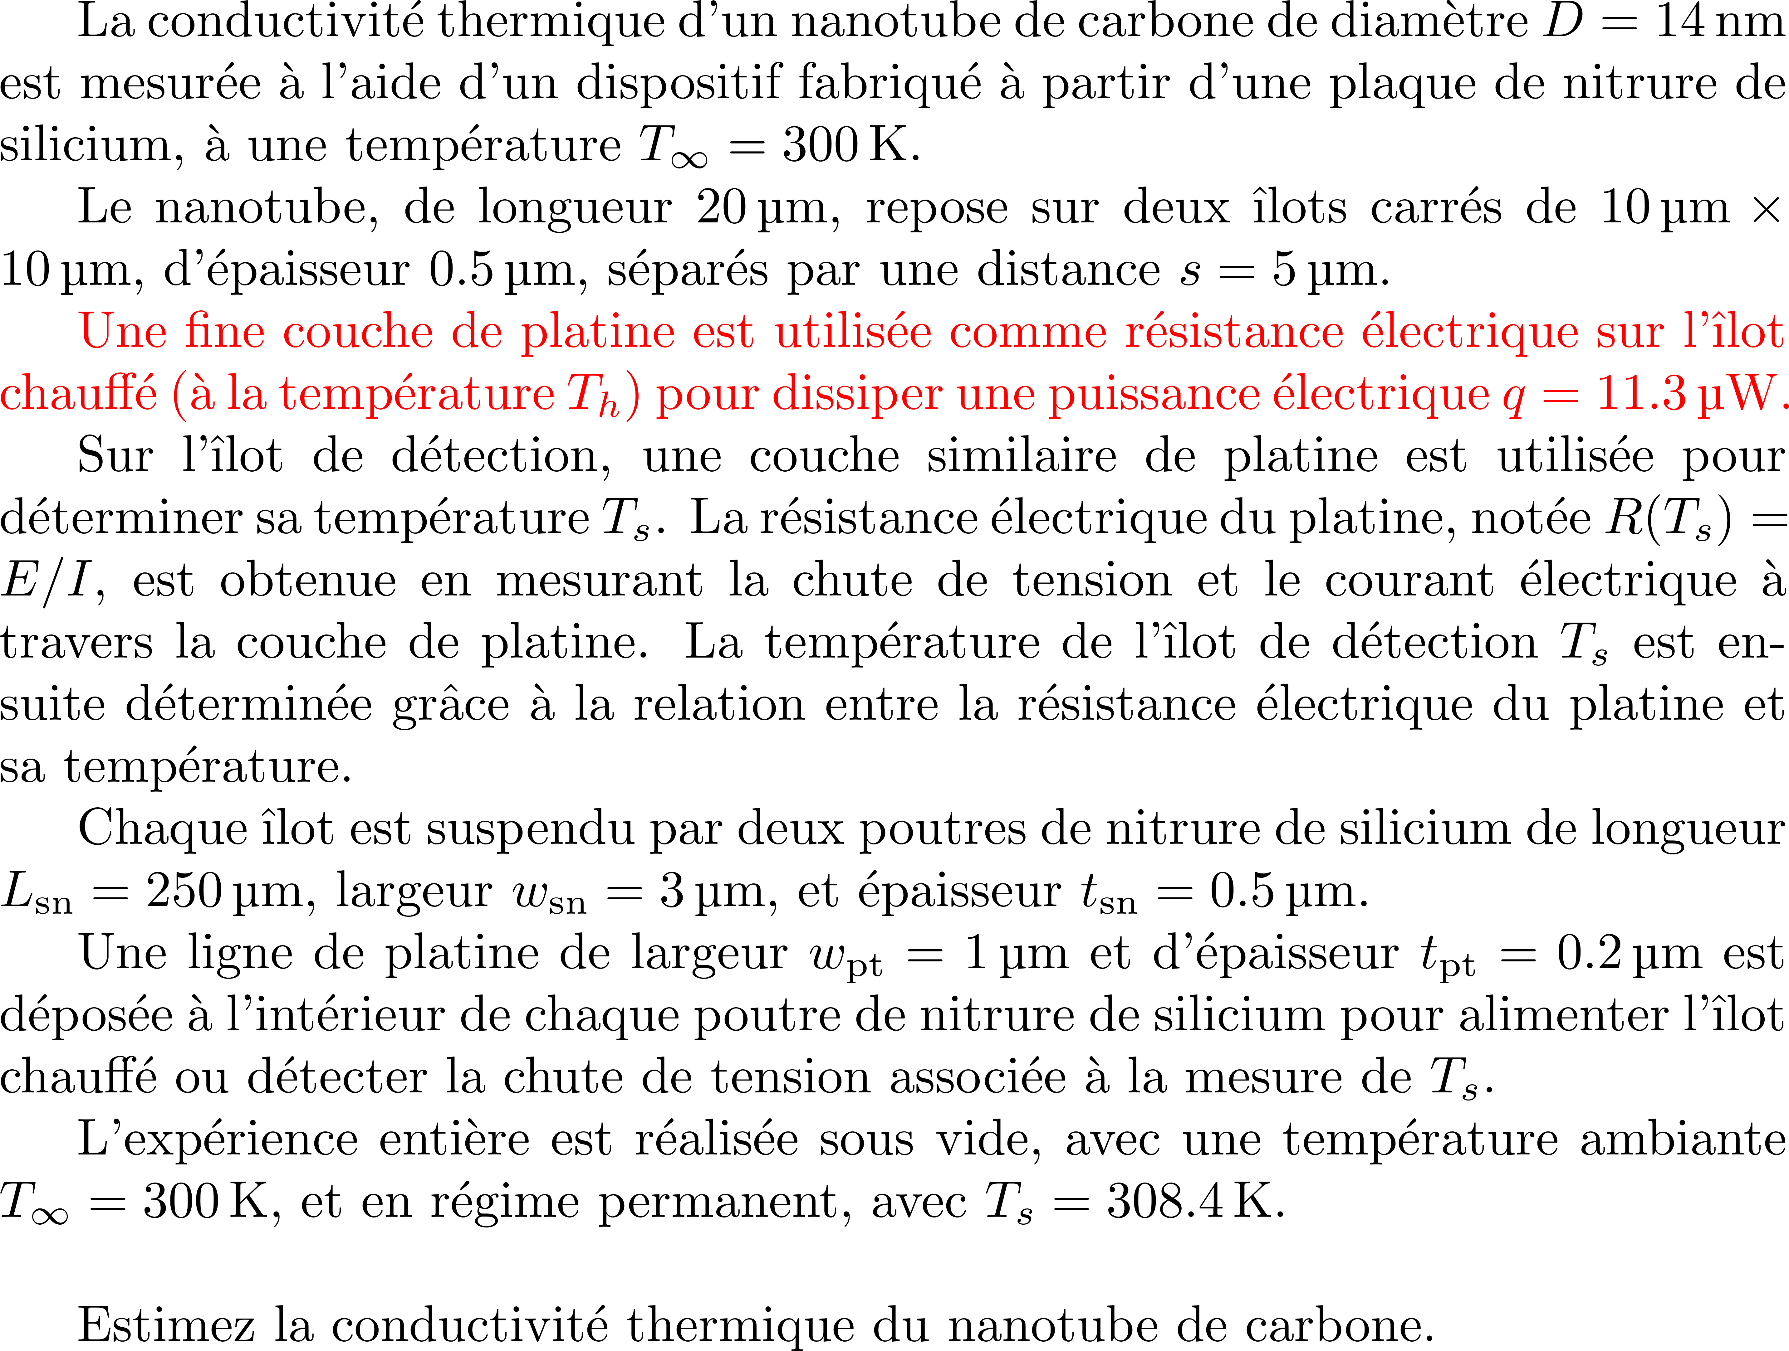
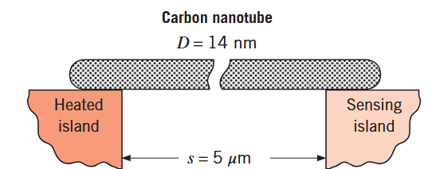
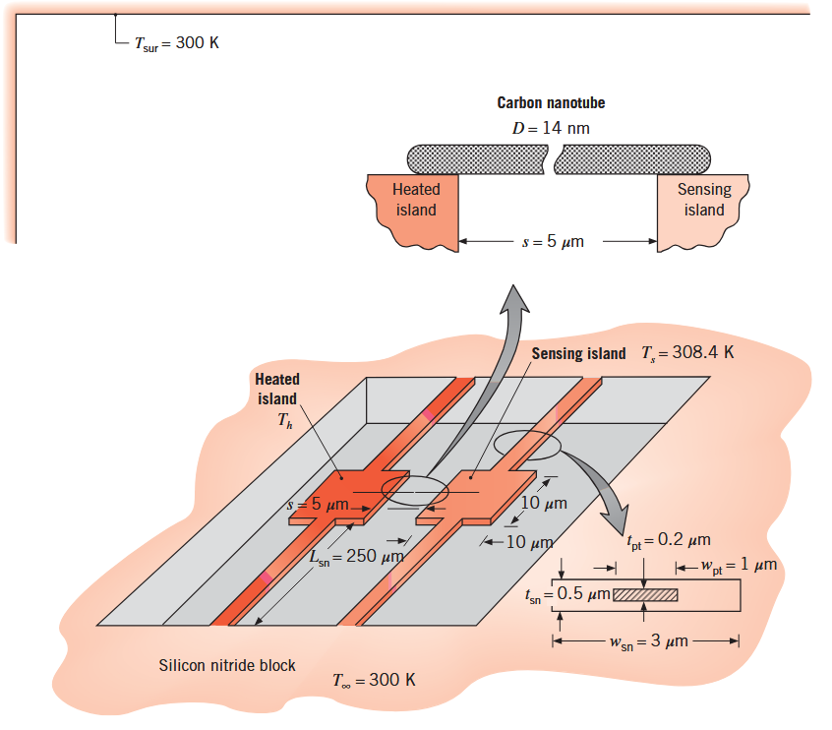
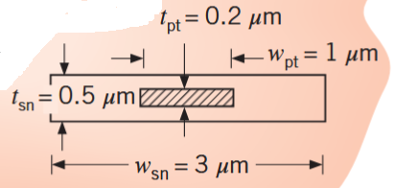
Incropera
Example 3.4

Slide 16
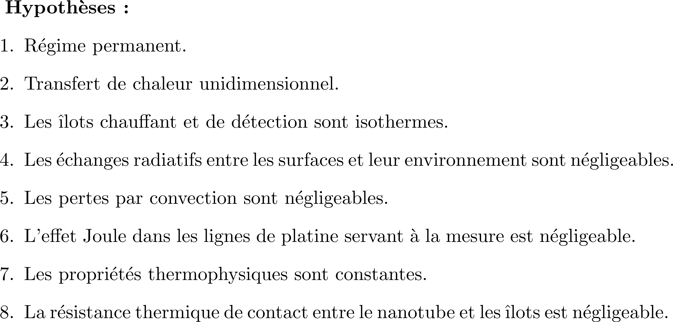
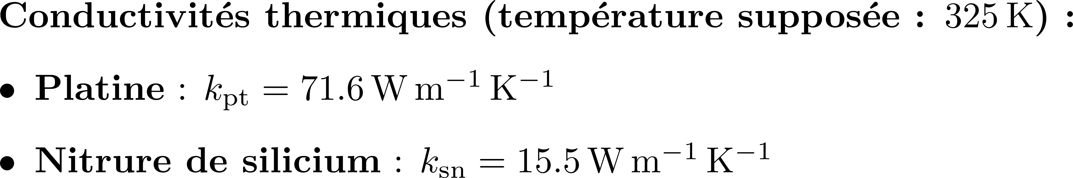

Slide 17
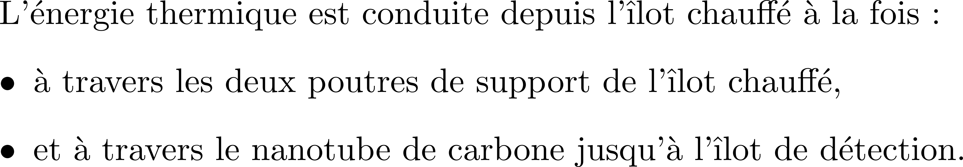
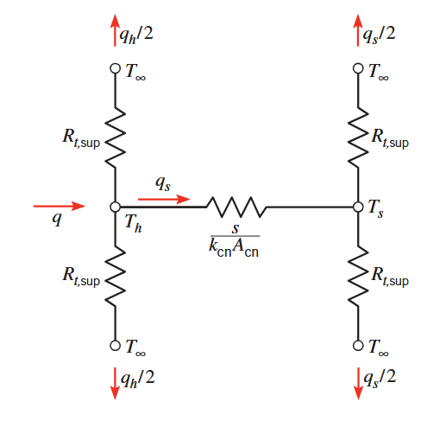

Slide 18
CORRECTION

Slide 19
CORRECTION

Slide 20
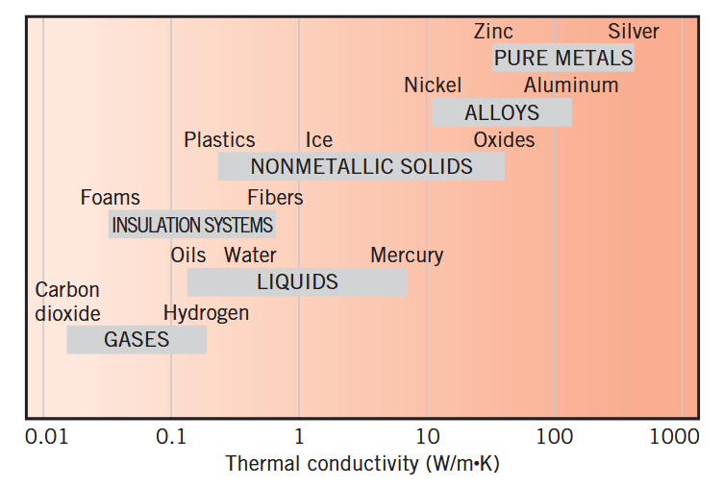
CORRECTION

Slide 21
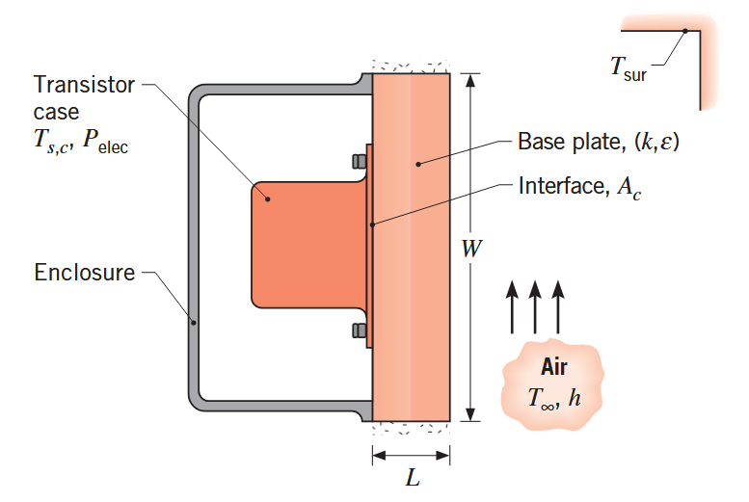
Incropera
Example 3.26

Slide 22
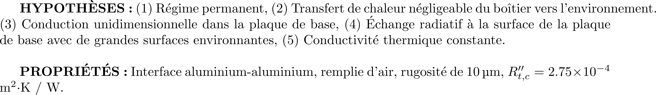
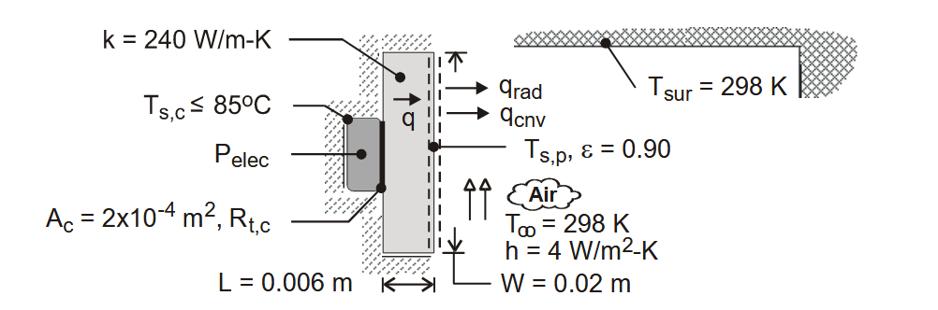
CORRECTION

Slide 23
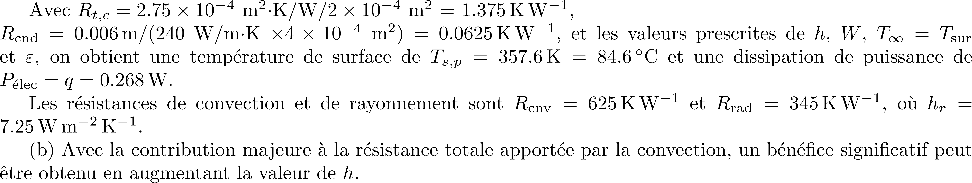
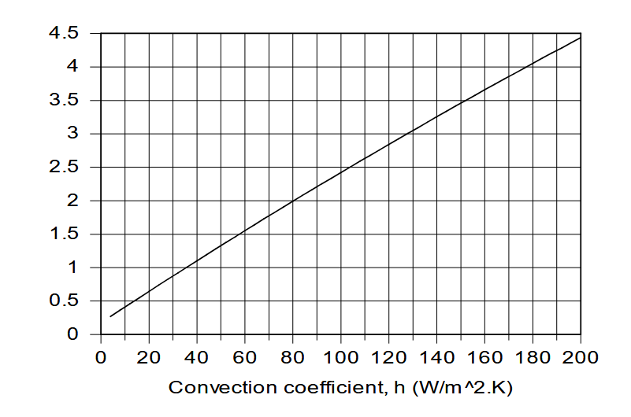
CORRECTION

