Slide 1
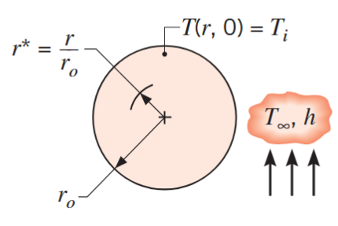

Slide 4
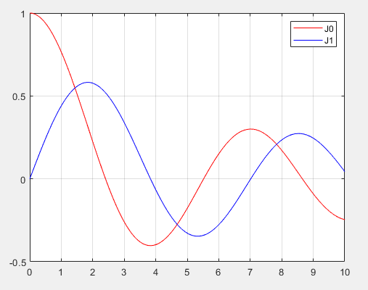

Slide 5
CORRECTION

Slide 6
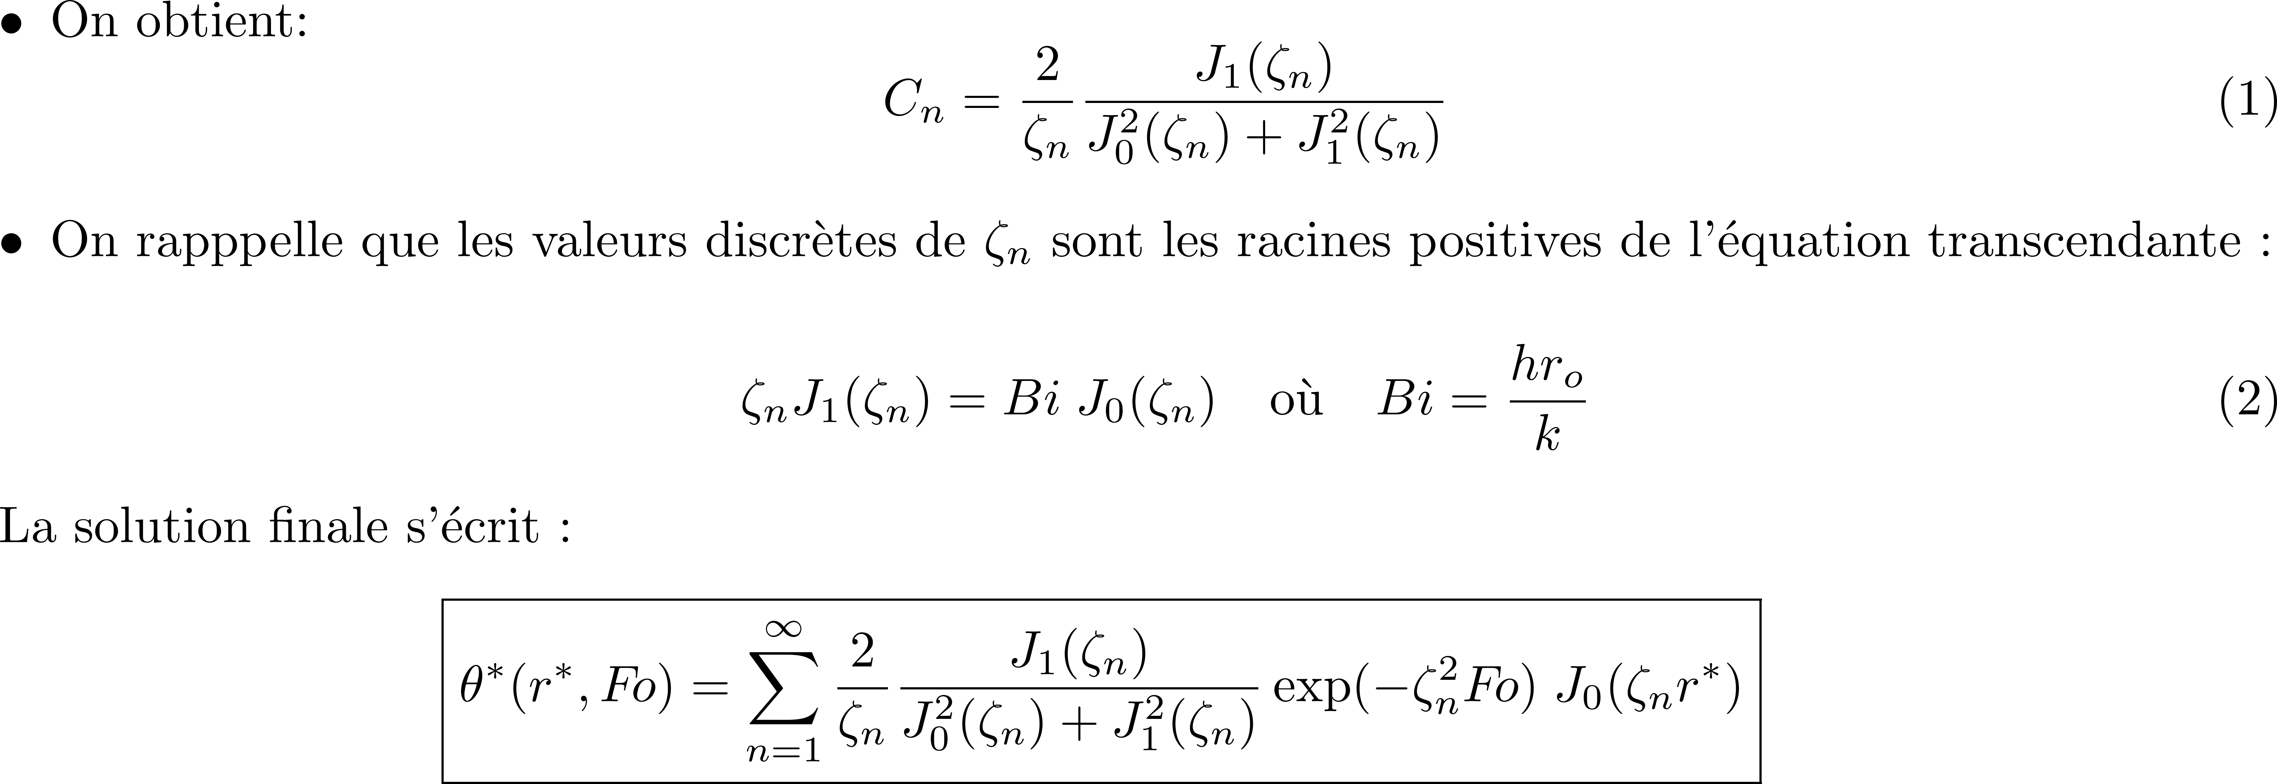

CORRECTION

Slide 7
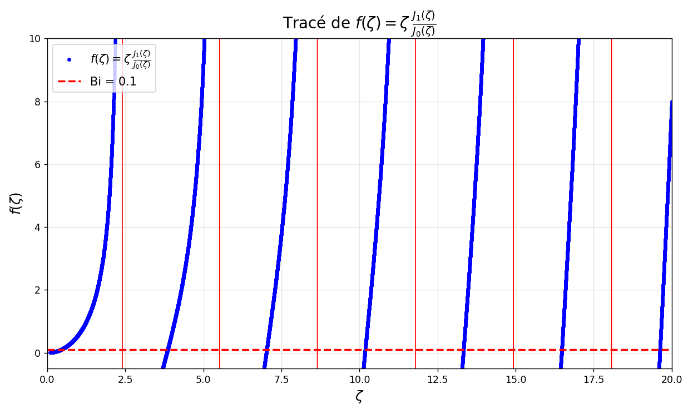
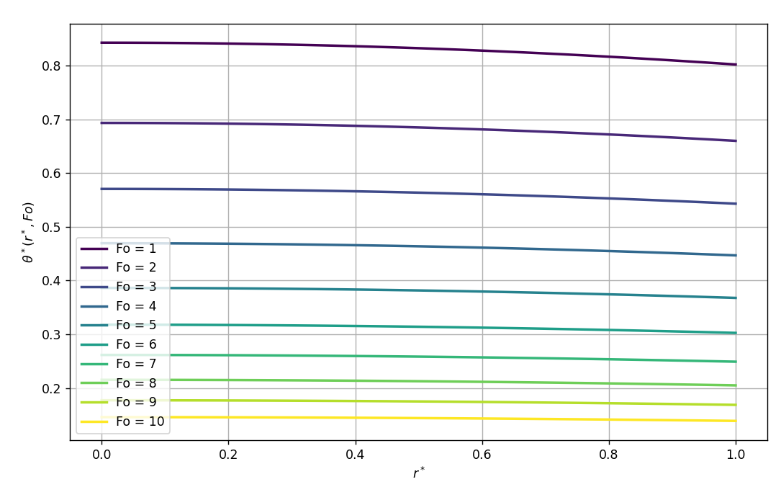
CORRECTION
Intersections approximatives avec Bi = 0.1:
ζ_1 ≈ 0.4417
ζ_2 ≈ 3.8577
ζ_3 ≈ 7.0298
ζ_4 ≈ 10.1833
ζ_5 ≈ 13.3312
ζ_6 ≈ 16.4767
ζ_7 ≈ 19.6210

Slide 13
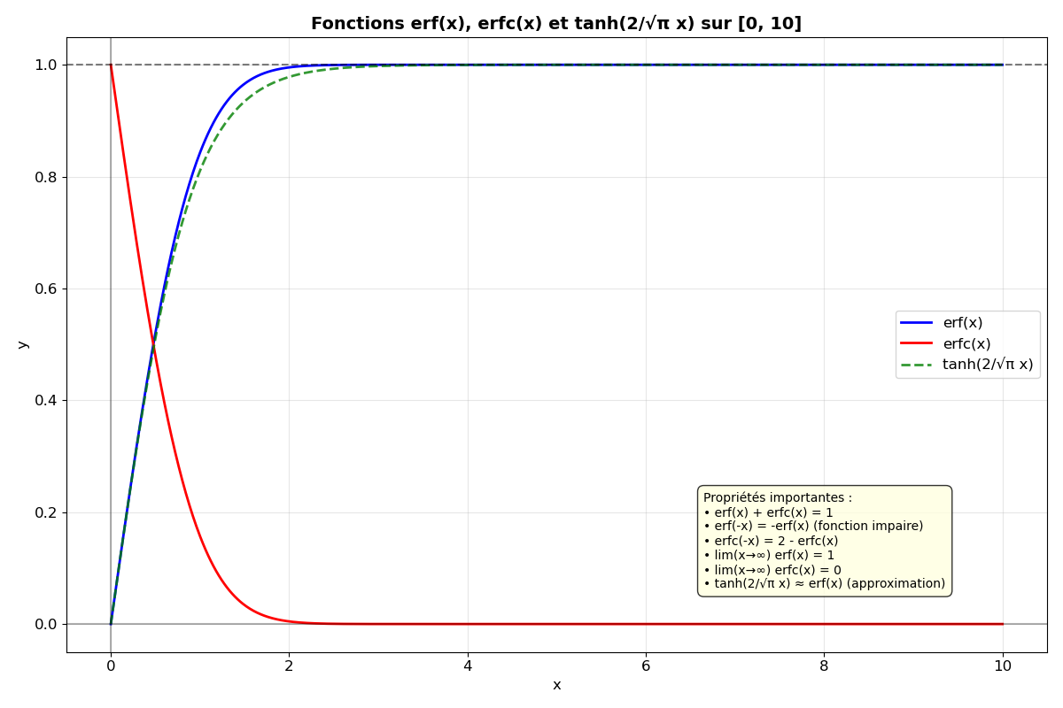

Slide 15
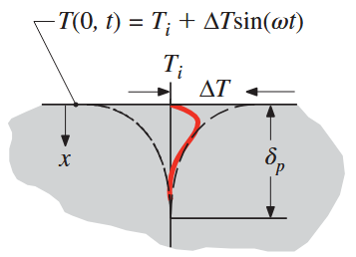

Slide 16
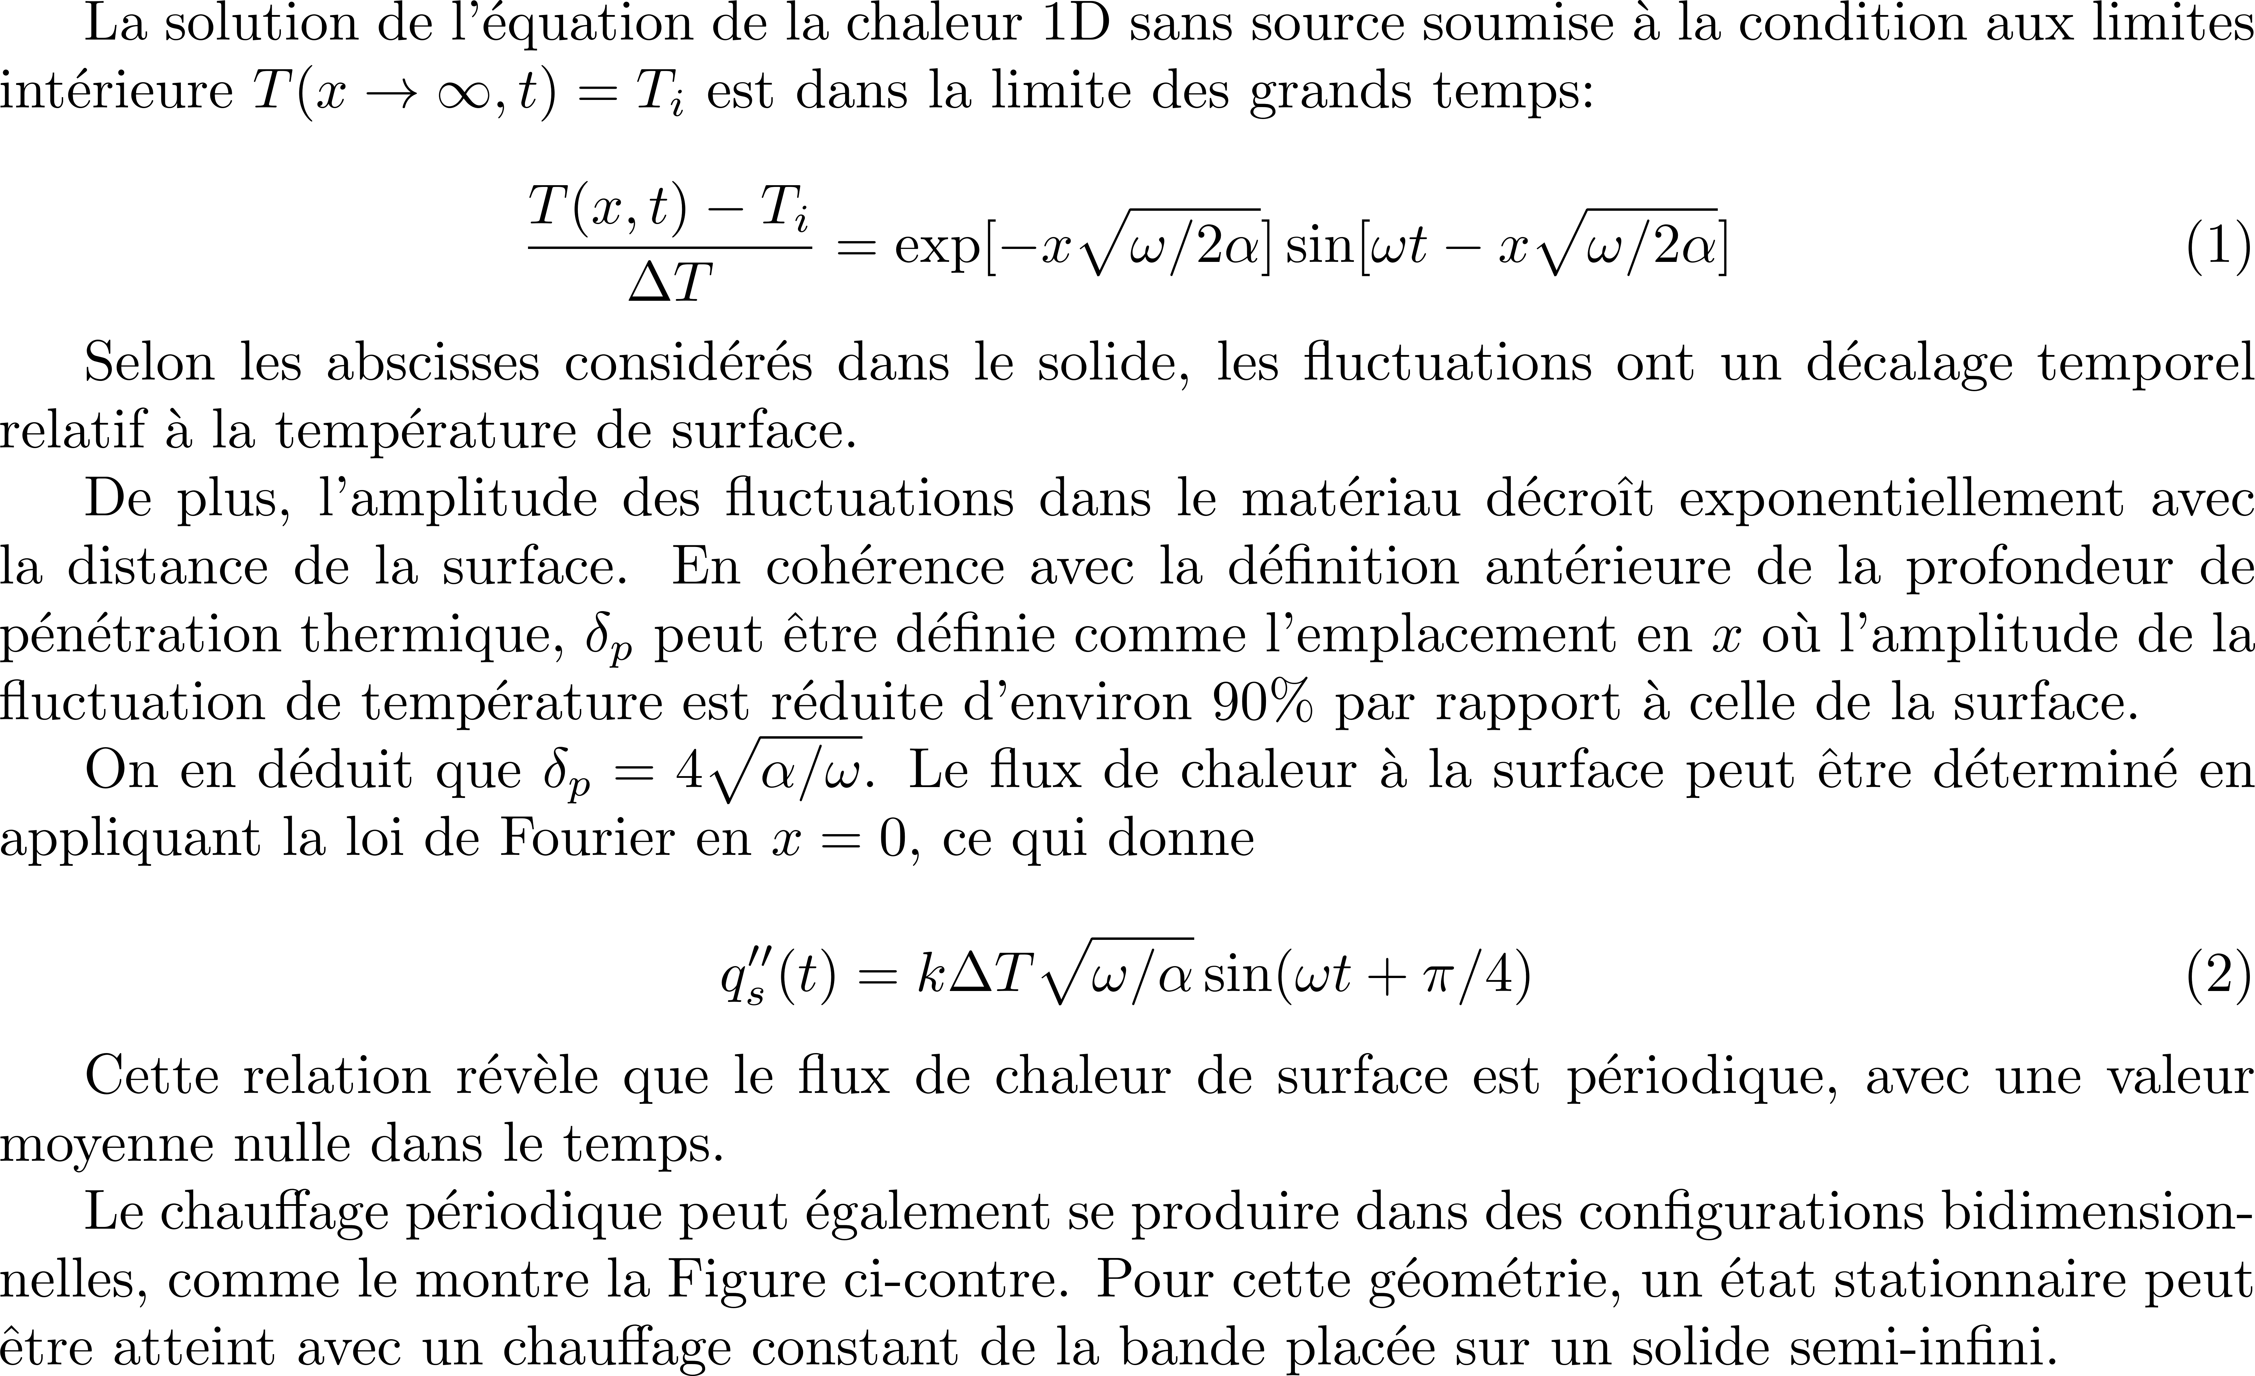
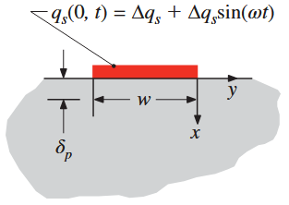


Slide 18
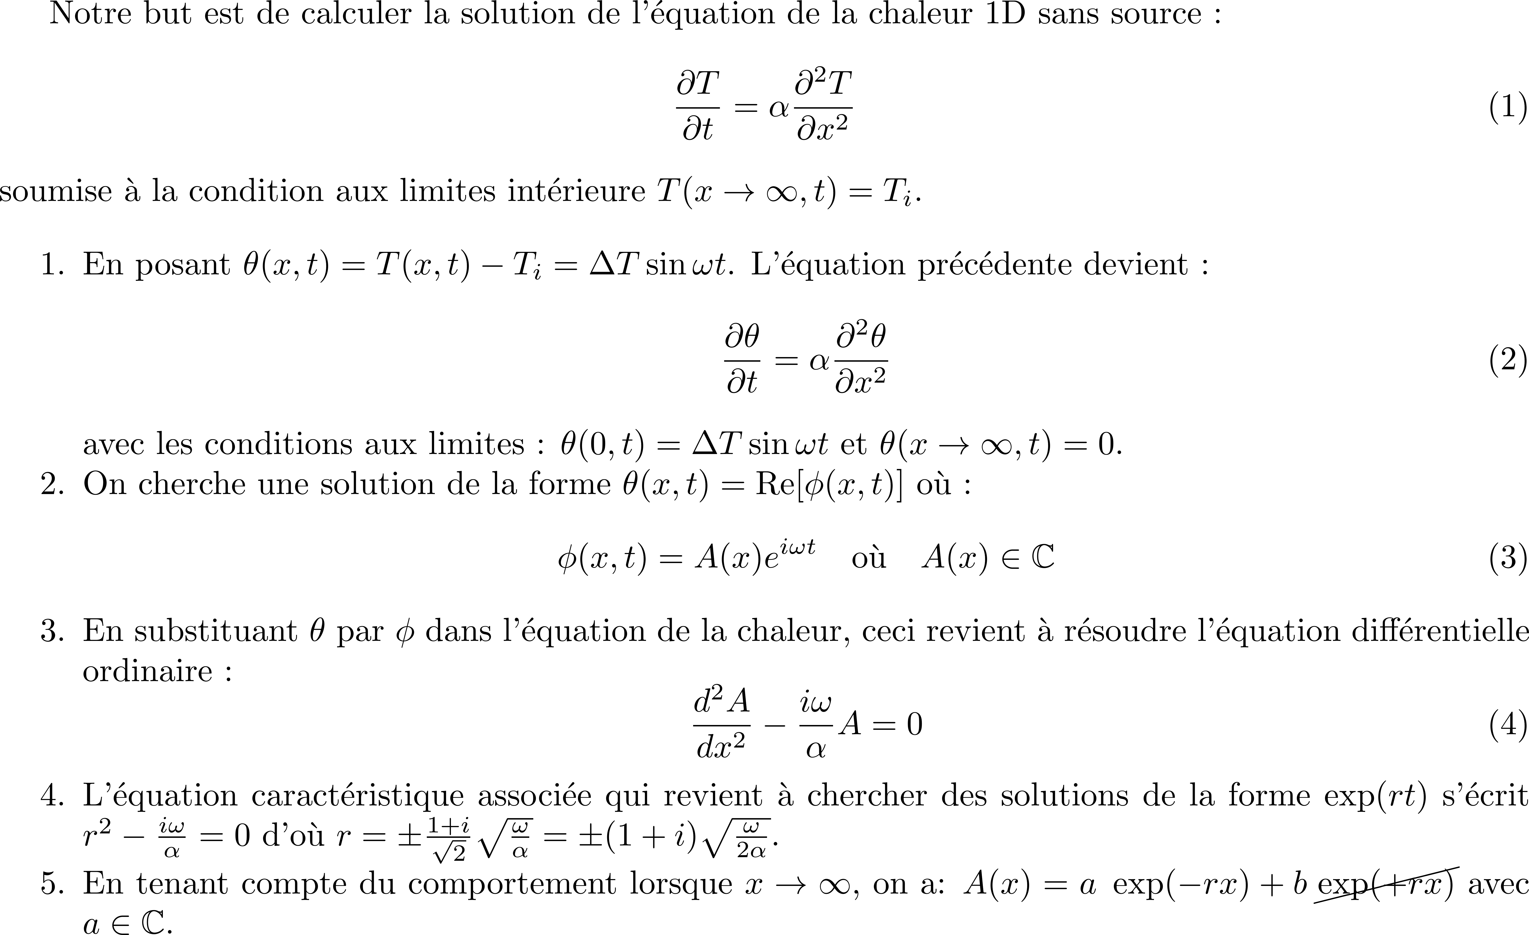
CORRECTION

Slide 19
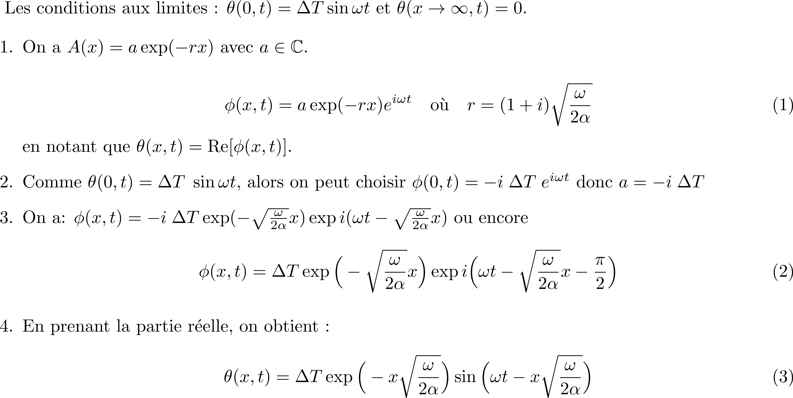
CORRECTION

Slide 20





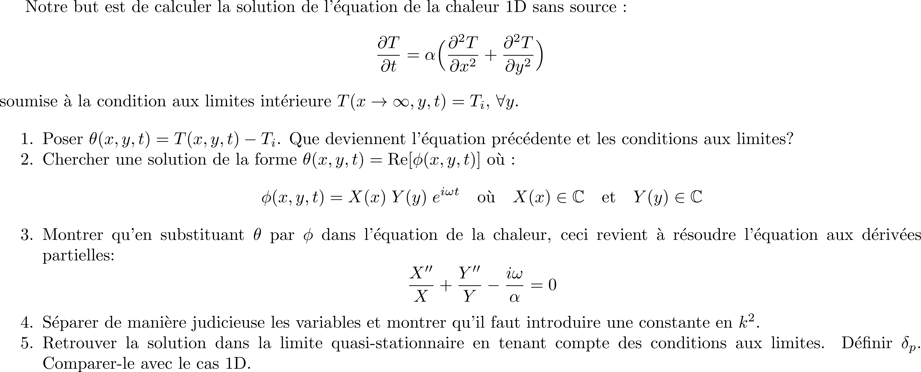

Slide 21
