Slide 1
RTC Project on STM32L476RG
Most of the STM32 devices have RTC (Real Time Clock) built in which can keep the track of the current time and date.
RTC can be used for chronometers, alarm clocks, watches, small electronic agendas, and many other devices and today we are going to learn HOW to access internal RTC in STM32.
The aim of this small project is to toggle a LED every 10s.
The MCU is placed in sleep mode when the core is not working

Slide 2
The majority of STM32 microcontrollers provide an additional memory region called backup
memory (or RTC backup data memory). This memory is powered-on by VBAT when VDD is
switched off, if the VBAT pin is connected to a backup power source, so that its content is not lost
upon a system reset. Content of the backup memory remains valid even when the device operates
in low-power mode. Instead, backup registers are reset when a tamper detection event occurs.
By default, after a system reset, the access in write mode to the so called backup domain (which
includes the backup memory and the RTC registers) is disabled to protected it from possible and
unwanted write accesses due to unstable power source. In order to modify the whole domain, and
hence the backup memory, we need to explicitly follow this procedure:
• enable the power interface clock by using the macro __HAL_RCC_PWR_CLK_ENABLE();
• call the HAL_PWR_EnableBkUpAccess() function to enable the access to the backup domain (RTC
registers, RTC backup data memory).
• Use the functions HAL_RTCEx_BKUPWrite() and HAL_RTCEx_BKUPRead() function to write/read
inside the available backup registers (the number of registers differs among the several STM32
MCUs)
https://embedded-lab.com/blog/stm32s-internal-rtc/

Slide 3
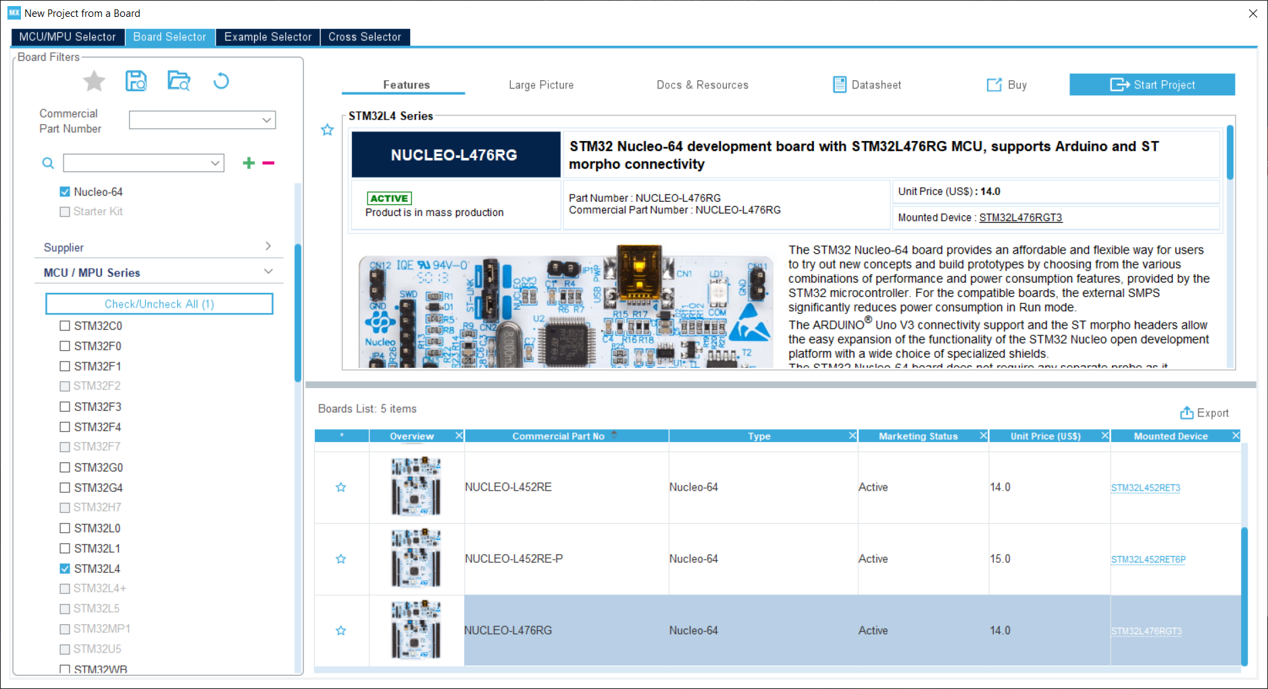
Select Nucleo L476RG board

Slide 4
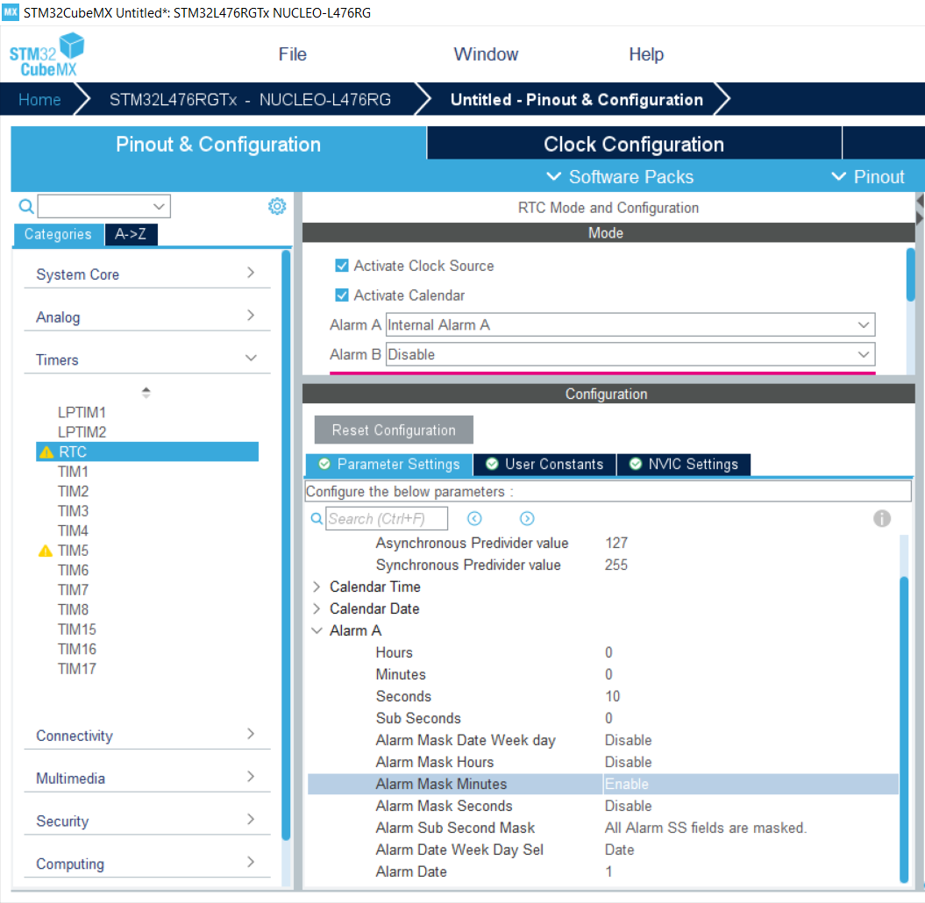
Set RTC parameters.
Alarm is emitted every 10s

Slide 5
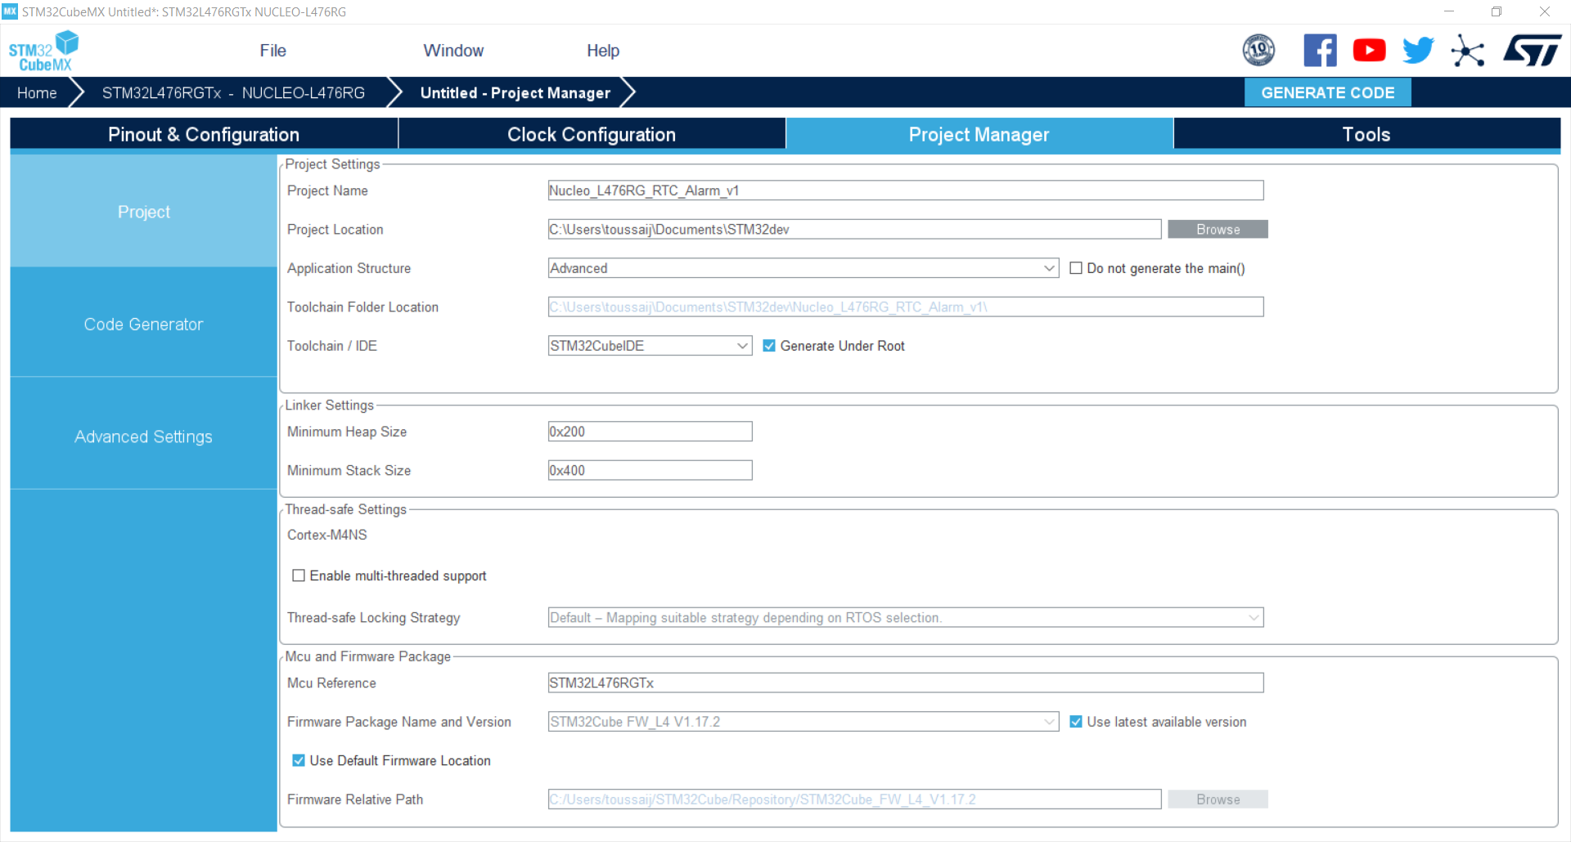
Set Project location and name

Slide 6
Code à ajouter dans le main.c
/* USER CODE BEGIN Includes */
#include <stdio.h>
/* USER CODE END Includes */
/* USER CODE BEGIN 0 */
// WARNING UART2 is connected to st-link
// OPTIONAL Properties -> Settings -> MCU_Settings ->
// select use float with printf
/*
* USART2, BaudRate = 115200, WordLength = UART_WORDLENGTH_8B,
StopBits = UART_STOPBITS_1;
* */
int _write(int file, char *ptr, int len)
{
HAL_UART_Transmit(&huart2,(uint8_t *)ptr, len, 10);
return len;
}
/* USER CODE END 0 */

Slide 7
/* USER CODE BEGIN WHILE */
while (1)
{
/* USER CODE END WHILE */
/* USER CODE BEGIN 3 */
printf("Enter sleep mode\n");
HAL_SuspendTick();
HAL_PWR_EnterSLEEPMode(PWR_LOWPOWERREGULATOR_ON,PWR_SLEEPENTRY_WFI);
HAL_ResumeTick();
printf("Enter run mode\n");
}
/* USER CODE END 3 */

Slide 8
/* USER CODE BEGIN SysInit */
/* The backup registers can be written/read and protected
and have the option of being preserved in VBAT mode when
the VDD domain is powered off */
HAL_PWR_EnableBkUpAccess();
//enable PWR backup domain access (RTC,BKReg)
__HAL_RCC_RTC_ENABLE();
//Enable RTC. not created by cube because the RTC can run.
/* USER CODE END SysInit */
/* USER CODE BEGIN WHILE */
while (1)
{
/* USER CODE END WHILE */
/* USER CODE BEGIN 3 */
printf("Enter sleep mode\n");
HAL_SuspendTick();
HAL_PWR_EnterSLEEPMode(PWR_LOWPOWERREGULATOR_ON,PWR_SLEEPENTRY_WFI);
HAL_ResumeTick();
printf("Enter run mode\n");
}
/* USER CODE END 3 */

Slide 9
/* USER CODE BEGIN 4 */
void HAL_RTC_AlarmAEventCallback(RTC_HandleTypeDef *hrtc){
RTC_AlarmTypeDef sAlarm;
HAL_RTC_GetAlarm(hrtc,&sAlarm,RTC_ALARM_A,FORMAT_BIN);
printf("%d\n", sAlarm.AlarmTime.Seconds);
uint8_t every=10;
if(sAlarm.AlarmTime.Seconds>=60-every){
sAlarm.AlarmTime.Seconds=0;
printf("Seconds overflow\n");
}else{
sAlarm.AlarmTime.Seconds=sAlarm.AlarmTime.Seconds+every;
}
while(HAL_RTC_SetAlarm_IT(hrtc, &sAlarm, FORMAT_BIN)!=HAL_OK){}
HAL_GPIO_TogglePin(LD2_GPIO_Port, LD2_Pin);
}
/* USER CODE END 4 */

Slide 10
Compiler et édition de liens
Télécharger le binaire vers le MCU
Reset du MCU par appui sur bouton noir

Slide 11

Nucleo-STM32L476 en mode basse consommation : mode SLEEP
GPIO’s
Core
CM4
FLASH
Core is stopped
Peripherals are running
RTC/backup reg.
RAM
IWDG
DMA
Clock
GP timers
SPI
USB
USART
DAC
I2C
Reset
ADC
Power regulator

Slide 12
Use SLEEP mode with RTC_Alarm
HAL Library work flow summary
4. create edge
1. init NVIC
Peripheral Initializations
including peripheral interrupt NVIC initializations
2. init RTC
Configure the RTC to generate alarm interrupt
5. RTC interrupt handler
3. Use WFI
HAL_RTC_AlarmIRQHandler
RTC_AlarmIRQHandler
Enter into SLEEP mode(WFI)
6. HAL RTC interrupt handler
Edge detection callback
HAL_RTC_AlarmAEventCallback
HAL files clearing flags, check errors, …
7. HAL RTC callback

Slide 13
When exiting the Low-power sleep mode by issuing an interrupt or a wakeup event,
the MCU is in Low-power Run mode.
/* USER CODE BEGIN WHILE */
while (1)
{
/* USER CODE END WHILE */
/* USER CODE BEGIN 3 */
printf("Enter sleep mode\n");
HAL_SuspendTick();
HAL_PWR_EnterSLEEPMode(PWR_LOWPOWERREGULATOR_ON,PWR_SLEEPENTRY_WFI);
HAL_ResumeTick();
printf("Enter run mode\n");
}
/* USER CODE END 3 */

Slide 14


Nucleo-STM32L476 en mode basse consommation : mode STOP
GPIO’s
Core
CM4
FLASH
RTC/backup reg.
RAM
Core is stopped
HSE, MSI clocks are OFF
SRAM and registers content is preserved
Peripherals with HSI, LSI, LSE clock option can be ON
GPIO’s keep their setup
IWDG
DMA
Clock
GP timers
HSE
SPI
HSI
USB
LSI
USART
DAC
LSE
I2C
ADC
Reset
Power regulator
Notes:
The Stop mode is based on the Cortex™-M0+ deepsleep mode combined with peripheral clock gating.
HSI ON/OFF is optional

Slide 15
/* USER CODE BEGIN WHILE */
while (1) {
printf("Enter stop mode\n");// not working USART disabled
HAL_PWR_EnterSTOPMode(PWR_LOWPOWERREGULATOR_ON,PWR_STOPENTRY_WFI);
SystemClock_Config();
printf("Enter run mode\n"); // not working USART disabled
}
/* USER CODE END WHILE */

