Slide 1


MTH5000 · MASTERS RESEARCH PROJECT
Forecasting Hazardous
Air Quality Days
Ten specifications at a Delhi monitor, one to three days ahead — and the alarm budget that outweighs every one of them.
Jaykumar Vinodbhai Chauhan · 34710280
Supervisor: Dr Tianhai Tian · School of Mathematics, Monash University
Peak daily PM2.5 per ~18-day window, 2016–2026 · 3,093 usable days · square-root scale
121 µg/m³ · HEALTH THRESHOLD

Slide 2
AGENDA
What we'll cover
01
02
03
Introduction
Literature Review
Methodology
Why this matters, and what three questions it answers
Classical, ML and deep learning methods, and the gap this fills
Data, two real defects, twelve models, one evaluation harness
04
05
06
Results
Discussion
Conclusion
Accuracy, weather, the two arms, and the decision threshold
What the numbers mean, how large a difference is, and the limits
What was found, and what comes next
Results is where the central finding lands — the alarm budget, not the model.

Slide 3

01
CHAPTER 01 OF 06
Introduction
Why a forecast only helps if it arrives before the hazardous day — and the three questions that follow.

Slide 4
INTRODUCTION
Motivation
PM2.5 in Indian cities regularly reaches hazardous levels; sustained exposure raises cardiopulmonary and all-cause mortality
A forecast only helps if it arrives before the hazardous day — same-day warnings are of limited use
Daily PM2.5 has exploitable structure: day-to-day persistence, a strong annual cycle, dependence on recent conditions
My own motivation: growing up in India, seasonal smog was ordinary life, not an abstract statistic
THE EVENT BEING FORECAST
920 days
above the 121 µg/m³ health threshold — 29.7% of the usable record.
RECORD LENGTH
3,093
usable daily means, 2016–2026
A forecast issued on the morning of a hazardous day cannot change anyone's behaviour — the lead time is the point.

Slide 5
INTRODUCTION
Research problem and significance
THE GAP IN THE LITERATURE
WHY AVERAGE ERROR MISLEADS
Existing ML studies of Indian air quality report average error only — not decomposed by the operating point a warning actually uses.
Good average error can still mean a poor warning system — and the reverse also holds.
AN ASSUMPTION WORTH TESTING
SIGNIFICANCE
The approved proposal assumed a weekly cycle alongside the annual one. It is tested directly here, not carried over.
If the decision threshold dominates the model, then the alarm budget is the more consequential design choice.

Slide 6
INTRODUCTION
Objectives and research questions
OBJECTIVES
RESEARCH QUESTIONS
1
Evaluate classical, ML and deep learning models 1–3 days ahead, under a leakage-tested protocol
Q1
How accurately can PM2.5 be forecast 1–3 days ahead?
2
Compare forecast-then-threshold against direct classification
Q2
Threshold a forecast, or classify the exceedance directly?
3
Quantify skill as a warning system under a varying threshold
Q3
What hit rate / false alarm rate trade-off does each give?
Q3's answer turns out to dominate Q1 and Q2 — and the report is organised around that.

Slide 7
02
CHAPTER 02 OF 06
Literature Review
Where these methods come from — and the one thing the Delhi literature never does.

Slide 8
LITERATURE REVIEW
Classical and machine learning methods
ARIMA (BOX–JENKINS)
Differenced series, own past values and errors; order chosen by an AIC grid (Hyndman & Khandakar, 2008); Fourier terms carry complex seasonality (De Livera et al., 2011).
TAKEAWAY
The deciding factor is exploitable structure, not “ML vs. classical” in the abstract — and this project's single series sits closer to M4 than M5.
THE MACHINE LEARNING LINEAGE
Ridge (Hoerl & Kennard, 1970); random forest = bagging (Breiman, 1996) + trees (Breiman et al., 2017) + decorrelation (Breiman, 2001); gradient boosting, additive and stagewise (Friedman, 2001).
COMPETITION EVIDENCE
AND HOW IT IS TESTED
Flexible learners need not beat ARIMA on short series (M3/M4: Makridakis et al., 2018/2020); an LSTM lost to ARIMA head-to-head (Siami-Namini et al., 2018) — but gradient boosting won M5, where genuine exogenous structure existed (Makridakis et al., 2022).
A single train-test split understates variability (Tashman, 2000; Hewamalage et al., 2023) — the motivation for rolling-origin evaluation.

Slide 9
LITERATURE REVIEW
Deep learning: narrowing to a GRU
Each ruled out a priori for a stated reason — then the two closest were fitted in full, and both beat the GRU.
MLP
No sense of sequence order — needs the same hand-built lag table the regression and tree models already use (Hornik et al., 1989)
✕
CNN
Fixed receptive field, ill-suited to an annual cycle already handed to every model as Fourier terms (LeCun et al., 1998)
✕
Transformer / TFT
Large parameter counts, tuned for datasets orders of magnitude bigger than ~3,000 observations (Lim et al., 2021) — fitted in full after Dr Tian challenged that premise, and it beats the GRU
→
Plain RNN
Vanishing and exploding gradients over long sequences (Bengio et al., 1994)
✕
LSTM
Fixes that with 3 gates and a memory cell — more parameters than this dataset needs (Hochreiter & Schmidhuber, 1997) — fitted in full on Dr Tian's advice, and it wins too
→
GRU
2 gates, no memory cell, same gradient-flow property, smaller parameter count (Cho et al., 2014). Chapter 4 tests both size arguments directly — and supports neither.
✓

Slide 10
LITERATURE REVIEW
Delhi air quality, and the research gap
WHERE DELHI'S POLLUTION COMES FROM
PRIOR DELHI PM2.5 ML STUDIES
Traffic, industry and seasonal stubble burning (Guttikunda et al., 2014; Cusworth et al., 2018; Jethva et al., 2019).
Masood & Ahmad (2020) and Singh & Srivastava (2025) score accuracy only — none evaluates forecasts as a warning system with an explicit alarm budget.
FORECAST VERIFICATION
DATA QUALITY
Match measures to the decision (Jolliffe & Stephenson, 2012); CSI (Schaefer, 1990); plain accuracy misleads on imbalanced events (He & Garcia, 2009; Saito & Rehmsmeier, 2015).
The literature on negative readings (Jiang et al., 2023) and on missingness mirrors the two defects found in this project's own source data.
THE GAP
Evaluate the comparison against an explicit alarm budget — Chapter 4 shows it changes which model wins.

Slide 11
03
CHAPTER 03 OF 06
Methodology
The data and two real defects in it, twelve models, and one leakage-tested harness.

Slide 12
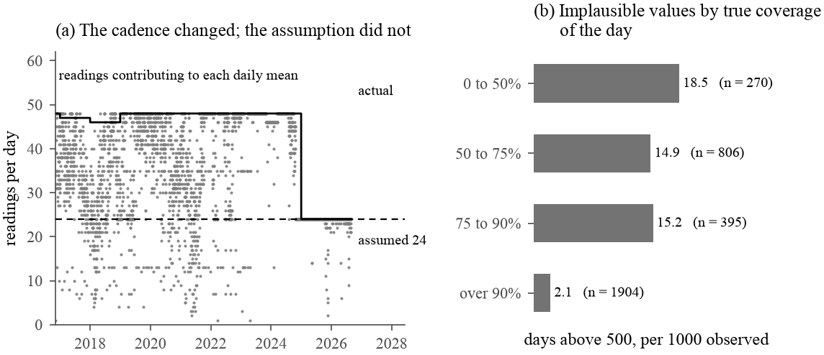
METHODOLOGY
The data — and two defects in it
PERIOD
USABLE DAYS
LONGEST GAP
ABOVE THRESHOLD
2016–2026
3,093 (86.4%)
34 days
920 (29.7%)
OpenAQ. Every CPCB station returns only ~18 months; only location 8118 (AirNow, a US diplomatic post) has the full decade — selected, with that limitation stated plainly.
01
Clipped instrument ceiling
THE COVERAGE DEFECT, DIAGNOSED
1990 µg/m³ repeats identically on three unrelated dates — an instrument ceiling, not a reading.
02
Wrong coverage denominator
It assumed 24 hourly readings; the sensor was half-hourly 2016–2024. Recomputed: 1,085 of 3,467 days fall below 75% true coverage, against 268 with no value at all.
Cadence taken from the data each year (solid) against the assumed 24 (dashed), and implausible values by true coverage.

Slide 13
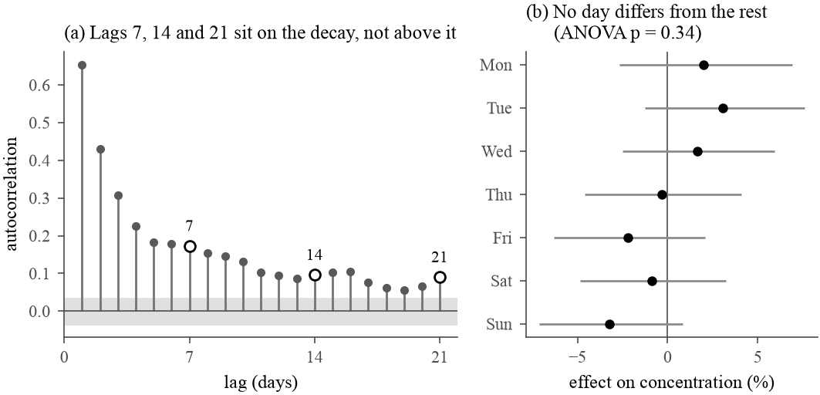
METHODOLOGY
Seasonality: tested, not assumed
The approved proposal assumed a weekly cycle alongside the annual one. It was tested directly, three independent ways.
PERIODOGRAM
LAGS 7, 14 AND 21 SIT ON THE DECAY
Dominant periods near 358, 179 and 61 days — the annual cycle and its harmonics. Nothing near 7.
AUTOCORRELATION
Lag 7 is 0.173 and lag 6 is 0.179 — sitting on the decay curve, not above it.
DAY OF WEEK
ANOVA p = 0.34; Kruskal-Wallis p = 0.77. No day differs from the rest.
No weekly cycle at this station — consistent with a diplomatic enclave rather than a roadside site. ARIMA therefore carries annual Fourier terms only.

Slide 14
METHODOLOGY
Features and weather covariates
ONE ROW PER FORECAST ORIGIN t — USING ONLY DATA UP TO DAY t
WEATHER (METEOSTAT)
Lags 0, 1, 2, 3, 7
First differences
Rolling mean / SD / max
Temperature, wind speed, pressure, precipitation
Each at its own value, a one-day lag, and a 3-day rolling mean
Only observations up to day t — never a forecast
Windows 3, 7, 14, 30 d
Anomaly vs 30-day norm
Exceedance frequency
Days since last exceedance
Calendar terms
4 annual Fourier pairs
3 missingness flags
Missing values are never imputed — the two recurrent networks are the only exception.
03
A third data defect — in the weather record itself
The archive ends 202 days before the PM2.5 series does: a hard cutoff, not scattered gaps. Precipitation is only 54% complete and is excluded from the recurrent network for that reason. The comparison is therefore checked twice — over every origin, and restricted to origins inside the fully observed window.

Slide 15
METHODOLOGY
Classical benchmark and ML regressors
ARIMA(1,1,1) WITH FOUR ANNUAL FOURIER PAIRS — ORDER CHOSEN BY AIC (1892.5)
Fitted on log(PM2.5) — φ₁ = 0.581, θ₁ = −0.987, both inside the stationarity and invertibility boundaries.
THREE MACHINE LEARNING REGRESSORS — EACH FITTED TO LEVEL AND TO CHANGE FROM ORIGIN
Ridge
Random forest
Gradient boosting
β = (XᵀX + λI)⁻¹Xᵀy
bagging + random features
additive, stagewise
A closed-form solution — the penalty keeps it stable when lagged and rolling features are collinear, as they necessarily are.
Bagged trees plus a random feature subset at each split, which decorrelates the trees and lowers the variance floor averaging alone cannot reach.
Each round's tree corrects the ensemble's residual. The histogram implementation accepts missing values natively — no imputation step.

Slide 16
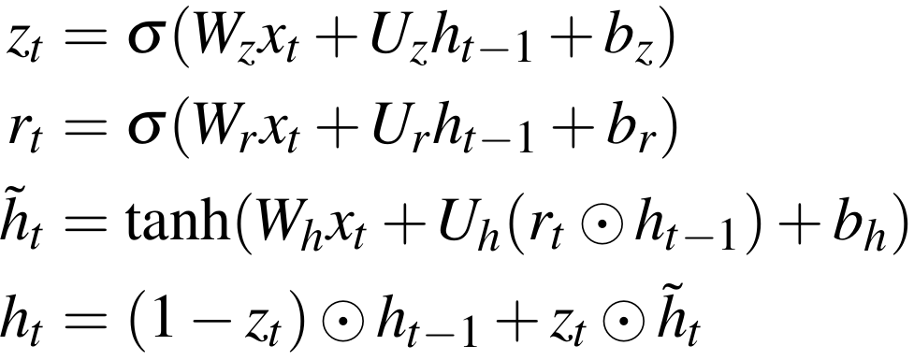
METHODOLOGY
The three deep learning models
TWO GATES, NO SEPARATE MEMORY CELL
THREE ARCHITECTURES, ONE PROTOCOL
GRU
2 gates, no separate memory cell — 2,329 parameters
LSTM
3 gates and an explicit cell state — 3,097 parameters
Transformer
Self-attention in place of recurrence: d_model = 16, 2 heads, 1 encoder layer — 3,409, the largest of the three
hₜ is a convex combination, not a product of nonlinear transforms — so gradients survive many timesteps.
Same 6 channels, same 30-day window, same target, same optimiser, same ten seeds. Only the architecture differs.
10
The three models whose results depend on a random initialisation. Every number for them is reported as a range across ten runs, never a single favourable one — and the GRU's training is not even bit-reproducible at a fixed seed.
RANDOM SEEDS

Slide 17
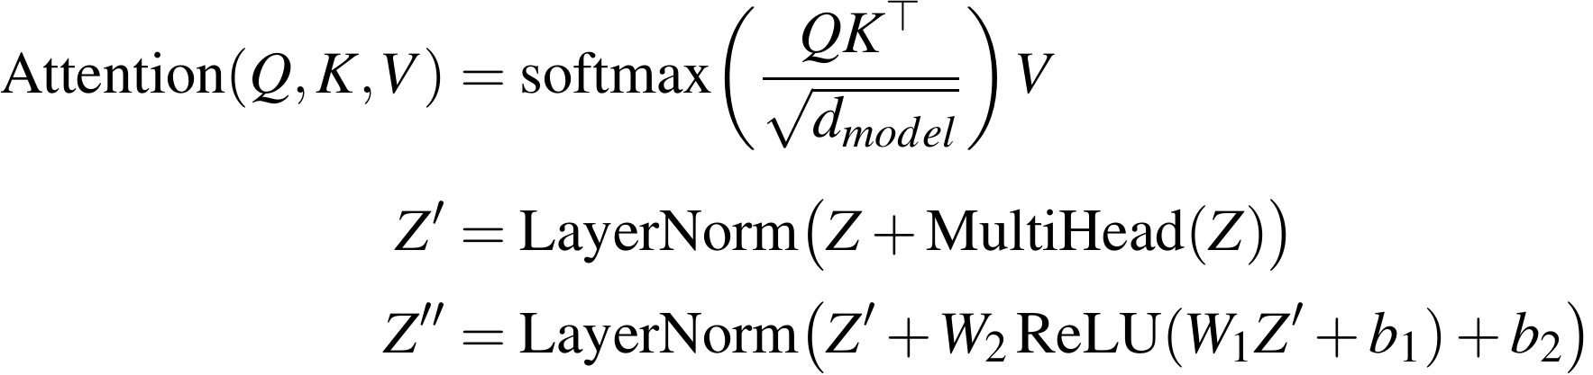
METHODOLOGY
Self-attention in place of recurrence
SCALED DOT-PRODUCT ATTENTION, AND THE ENCODER LAYER
WHAT HAS TO BE ADDED BACK
A sinusoidal positional encoding, added before the first layer — attention alone cannot tell position
Two heads on separate subspaces of Q, K and V, so more than one relationship between positions survives
A linear layer on the final position, predicting the change in log concentration
Every timestep in the 30-day window attends directly to every other one. There is no hidden state propagated step by step — and so no inherent sense of order.
4
d_model = 16, two heads, one encoder layer, and Adam at 0.001 rather than the 0.01 the GRU and LSTM use — all inherited unchanged from the bounded check. The GRU has three bounded sensitivity checks behind it; the transformer has none yet.
UNTUNED SETTINGS

Slide 18
METHODOLOGY
Rolling-origin evaluation and measures
FORECAST ORIGINS
SPAN
REFIT CADENCE
NETWORK REFIT
2,303
6.8 years
90 days
180 days
THE GOVERNING INVARIANT
At origin t a model may use observations up to and including day t and nothing else — enforced by construction, and verified by corrupting the series from a chosen date and requiring that no earlier forecast changes.
ACCURACY
AS A WARNING SYSTEM
SIGNIFICANCE
rMAE against persistence
Hit rate and false alarm rate
Diebold-Mariano test
1.000 is persistence; below one beats it. MASE reported alongside, and never averaged across horizons — skill decays with horizon and concealing that would defeat the purpose.
With precision, the critical success index, and alarms raised per year. Plain accuracy is never reported: on a minority class it rewards never raising an alarm at all.
With the Harvey-Leybourne-Newbold small-sample correction. Run each network against ARIMA once per seed, and ARIMA against every machine learning regressor.

Slide 19
04
CHAPTER 04 OF 06
Results
Three research questions answered — and the one that turns out to dominate the other two.

Slide 20
RESULTS · RQ1
Forecast accuracy
RELATIVE MAE AT ONE DAY AHEAD — LOWER IS BETTER
Transformer, 10 seeds
LSTM, 10 seeds
GRU, 10 seeds
ARIMA + Fourier
Random forest (change)
Gradient boosting (change)
Random forest (level)
Ridge regression
Persistence
Gradient boosting (level)
0.85
0.90
0.95
1.00
1.05
persistence
Model | h = 1 | h = 2 | h = 3
Transformer, range over 10 seeds | 0.914–0.925 | 0.870–0.893 | 0.825–0.842
LSTM, range over 10 seeds | 0.913–0.932 | 0.874–0.892 | 0.824–0.847
GRU, range over 10 seeds | 0.910–0.939 | 0.878–0.906 | 0.831–0.879
ARIMA(1,1,1) + Fourier | 0.940 | 0.883 | 0.832
Best ML regressor (GBM, change) | 0.983 | 0.937 | 0.878
Persistence | 1.000 | 1.000 | 1.000
15 / 15
Diebold-Mariano pairings favour ARIMA over every machine learning regressor, at every horizon. Fourteen reach p < 0.05. The three networks are the exception, and only at one day ahead.

Slide 21
RESULTS
Does weather change the answer?
CHANGE IN rMAE FROM ADDING WEATHER — NEGATIVE IS AN IMPROVEMENT
THE GRU WITH WEATHER, VS ARIMA
h = 1
Wins clearly — 7 of 10 seeds now significant, up from 4 of 10.
h = 2
A genuine three-way split: 3 clear wins, 6 ties, 1 loss.
h = 3
More often a loss than a win — 5 of 10.
WHAT SURFACED IT
CARRIED THROUGH THE THRESHOLD
Doubling the seed count from five to ten. Under the first five seeds alone, h = 2 and h = 3 had both looked like wins for the network.
At most 1.2 points of extra hit rate at any budget — a materially more accurate forecaster still does not escape the alarm-budget ceiling.

Slide 22
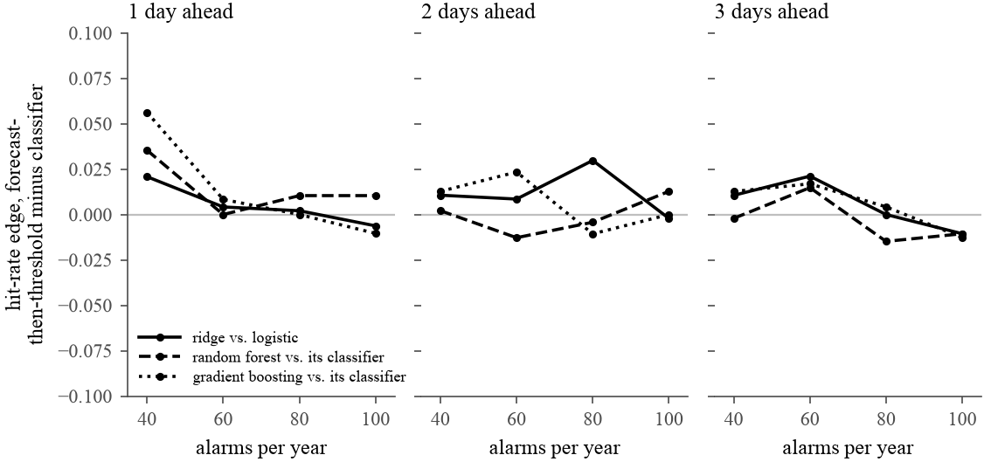
RESULTS · RQ2
Two arms of the same question
Forecast-then-threshold against direct classification, matched by base algorithm — 36 comparisons across 3 pairs, 3 horizons and 4 alarm budgets.
21 forecast-then-threshold
11 classifier
4 ties
A REAL BUT MODEST EDGE
HIT-RATE EDGE BY ALARM BUDGET
Median gap of 0.011 in hit rate, largest 0.056 — real, but modest
The edge narrows as the budget loosens: 8 of 9 at a budget of 40, but the classifier overtakes it, 6 of 9, at 100
Preferred anyway: a forecast can be rethresholded for any future health policy, while a classifier is welded to the threshold it was trained on
Above zero, forecast-then-threshold wins; below it, the classifier does.

Slide 23
RESULTS · RQ3 · THE CENTRAL RESULT
The decision threshold
BEST ACHIEVABLE HIT RATE, BY ALARM BUDGET
MOVE THE BUDGET, 40 → 100
50 pts
of hit rate at one day ahead — 0.379 to 0.881.
SWITCH THE MODEL INSTEAD
~5 pts
across all ten specifications, at a fixed budget.
alarms permitted per year
At three days ahead and a budget of 40 alarms a year, plain persistence — carrying today's reading forward unchanged — is the single best model in the entire study, at 0.359.

Slide 24
05
CHAPTER 05 OF 06
Discussion
What the numbers mean, how large a difference really is, and where the limits sit.

Slide 25
DISCUSSION
The operational question dominates
THREE DAYS AHEAD, AT THE LOOSEST BUDGET
BUT NOT AN ARGUMENT AGAINST MODELLING
Climatology — uses no recent information at all
ARIMA and the GRU both earn real gains over persistence
A better point forecast still narrows the range of thresholds worth considering
The argument is about where the leverage sits, not whether to model at all
0.816
The best fitted model in the study
0.827
A forecast using nothing but the calendar lands within roughly a hundredth of the best model fitted here.
THE RECOMMENDATION
The alarm budget is the policy instrument; the forecasting model only supplies its input. Fix the budget with the health authority first — and treat the choice of model as a secondary refinement of a curve whose shape is already mostly set.

Slide 26
DISCUSSION
How large is a difference between models?
MEASURED IN rMAE — ON THE SAME SCALE
THE FORMAL TEST IS STRICTER STILL
Gap between two models in the table (0.878 vs 0.879 at h = 3)
GRU seeds reaching p < 0.05 against ARIMA
0.001
4/10
at h = 1 — the noise floor credits 8 of 10
Same pipeline, same seeds, two different machines
0.004
0/10
at h = 2
The GRU, across ten random seeds
0.028 – 0.048
1/10
at h = 3 — and that one favours ARIMA
Rerunning the identical command with the same seed moves it almost as much.
AND THOSE COUNTS ARE THEMSELVES SMALL SAMPLES
A 95% Wilson interval on “4 of 10” at one day ahead runs from 0.17 to 0.69. A different batch of ten seeds could plausibly have produced a noticeably different count without the underlying comparison having changed at all.

Slide 27
DISCUSSION
Limitations I — scope and sensitivity
ONE STATION
ONE CITY
HYPERPARAMETERS
An AirNow diplomatic-post monitor, not the CPCB network. It was chosen because it is the only nearby monitor with a full decade of record — history bought at the cost of representativeness.
Delhi only. Nothing here should be read as a claim about any other station or city — sources, meteorology and the strength of the annual cycle all vary by region.
Tree models were tuned from a small explicit grid at every refit, not an exhaustive search — so their results are a lower bound on what those model classes could reach.
CLEANING THRESHOLD, CHECKED DIRECTLY — rMAE WITH AND WITHOUT THE 1000 µg/m³ CAP
Model | Reported (capped) | Uncapped
ARIMA, h = 1 | 0.940 | 0.935
Ridge, h = 1 | 0.997 | 1.118
Gradient boosting (level), h = 3 | 0.883 | 1.006
WHAT THAT MEANS
The central finding does not merely survive removing the threshold — it strengthens. The models ARIMA beat most narrowly are precisely the ones most exposed to the uncleaned tail.

Slide 28
DISCUSSION
Limitations II — the GRU and reproducibility
ARCHITECTURE FIXED BY INSPECTION
THE FOURIER ABLATION
H = 24 and a 30-day window were set by inspection, with no search equivalent to the tree models' grid. A bounded check found a 45-day window scored 2.2 points better at h = 3 — untested at the full ten-seed scale, and nothing in the reported table was changed on the strength of it.
Giving the network ARIMA's K = 4 harmonics instead of its own K = 2 helps at every horizon — substantially at h = 3, by 3.96 points. The network was already handed a seasonal signal; just a coarser one than assumed.
NOT BIT-REPRODUCIBLE
THE WEATHER EXTENSION IS NARROW
Rerunning the identical command with the same seed moved the network's score by nearly as much as switching to a genuinely different one. That is why the seed count was doubled from five to ten — and why even ten should be read as a reduction in the problem, not a solution to it.
Only observed weather enters the table, never a forecast — a real early-warning system would use a numerical weather prediction, which is a materially stronger claim. Boundary layer height, the variable most directly tied to the physical mechanism, is unavailable without a reanalysis product.

Slide 29
DISCUSSION
Limitations III — what the supervisor reviews added
OPTIMISER AND LEARNING RATE — BOUNDED CHECK
THE LSTM AND TRANSFORMER SCOPE, STATED PLAINLY
Adam at 0.01 is at or near the best setting tried at one and two days. At three days SGD with momentum beats it by about two points, 0.839 against 0.858, with a tighter seed spread. Three separate bounded checks now agree that the three-day configuration is the one this project would least defend.
Both were held to the same ten-seed rolling-origin evaluation as the GRU for accuracy, and no further: no weather channels, no threshold sweep for either. Both appear in the accuracy and significance tables and nowhere in the warning-system tables. Not tested because the marginal evidence did not justify the compute, not because a result was avoided.
THE TRANSFORMER, PROMOTED OUT OF THIS LIST
A KAN-LSTM HYBRID — THE ONE CHECK STILL BOUNDED
It began here as a bounded check. Dr Tian challenged the small-data premise directly — some four thousand days clears the threshold he had seen cited — so it was given the full ten-seed treatment. It beats the GRU in 8 of 10 matched seeds at every horizon and carries the strongest formal result against ARIMA at one day ahead, 7 of 10 seeds.
Dr Tian named this combination directly. No maintained library exists, so the layer was built from the published construction and unit-tested alone first, recovering sin(3x) to 1e-4. All three seeds trained stably. Competitive with the other three: worst at one day, best at two.

Slide 30
06
CHAPTER 06 OF 06
Conclusion
What was found, what it recommends, and what should be done next.

Slide 31
CONCLUSION
Three questions, three answers
Hazardous PM2.5 forecast one to three days ahead at one Delhi monitor; two real data defects corrected first; the proposal's weekly-cycle assumption tested and rejected.
Q1
Q2
Q3
Machine learning earns a narrow place
Threshold the forecast
The budget beats the model
ARIMA beats every ML regressor at every horizon, DM-backed. The three that win are the networks — GRU, LSTM and transformer — each clearly only at one day ahead, reported as a range over ten seeds. Both of the two added on review beat the GRU originally chosen.
Forecast-then-threshold beats direct classification in 21 of 36 matched comparisons to 11, with 4 ties — real but modest. It is preferred anyway, because a forecast can be rethresholded for any future policy without refitting.
Across ten specifications at a fixed alarm budget, the spread in hit rate is about five points. Moving the budget instead moves it about fifty. The decision maker's choice outweighs the modeller's.
ON THE METHOD ITSELF
Trying several methods rather than defaulting to ARIMA is what surfaced the one-day-ahead network win — and what makes the negative result at two and three days credible. Two rounds of supervisor review then added two more architectures, and both beat the one originally chosen.

Slide 32
CONCLUSION
Future work
1
A genuine weather forecast
2
Boundary layer height
3
Refit the GRU with K = 4
A numerical weather prediction for the days ahead, rather than the conditions already observed at the origin — the stronger claim for an operational system, and the one this project deliberately did not make.
Unavailable from meteostat; it would need a reanalysis product such as ERA5. It is the variable most directly tied to the physical mechanism of an episode rather than a correlate of it.
Four Fourier harmonics under the full ten-seed evaluation, not the single validation split used so far — to settle how much of the gap to ARIMA that one difference explains.
4
A second station
5
Finish the LSTM and the transformer
6
Evaluate the KAN-LSTM hybrid in full
Ideally one inside the CPCB network once its record lengthens — to test whether these findings are a property of Delhi air quality, or of this one diplomatic-enclave monitor.
Fit each with the weather channels and carry each through the threshold sweep — the two steps taken for neither. The honest expectation is that this refines the central finding rather than overturning it.
Ten seeds and rolling origins for the one architecture still on a bounded check — the same promotion the transformer was just given, after its own bounded check proved to be understating it.

Slide 33
THE RECOMMENDATION
Design the warning system around the alarm budget it can justify — and treat the forecasting model as a secondary refinement.
Questions?
Jaykumar Vinodbhai Chauhan · 34710280
Supervisor: Dr Tianhai Tian · School of Mathematics, Monash University

