Slide 1

BUILDING CRYPTOCURRENCY TRADING SYSTEM
---- Using Python
Jasmine Jiang | Chu Wang | Qingyi Wang

Slide 2
Technology
HTML
Python
Pandas
Numpy
Cbpro
json
---- (Flask)----
Other software: VS Code, Github, Jupyter Notebook

Slide 3
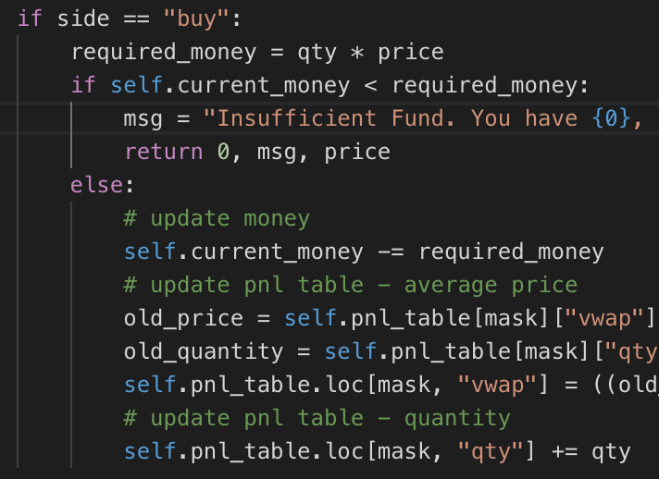
Design & Solution
Get live cryptocurrency price from Coindesk API
Create tables in Pandas dataframes (symbol, transaction, P&L)
Define ‘TRADE’ function: if ‘BUY’ else ‘SELL’
Define ‘PnL’ calculation
Define ’TRANSACTION’ functions that updates table
6. @app.route, method = GET, POST

Slide 4
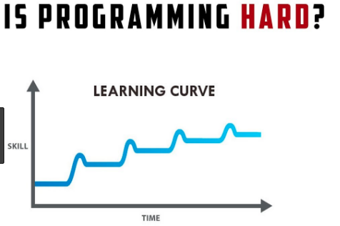

Challenges
Writing the code!!!!!!
Scraping data from various sources: API, url, txt, etc.
Using new libraries – look at documentation.
Data relation
Connection to MySQL

Slide 5
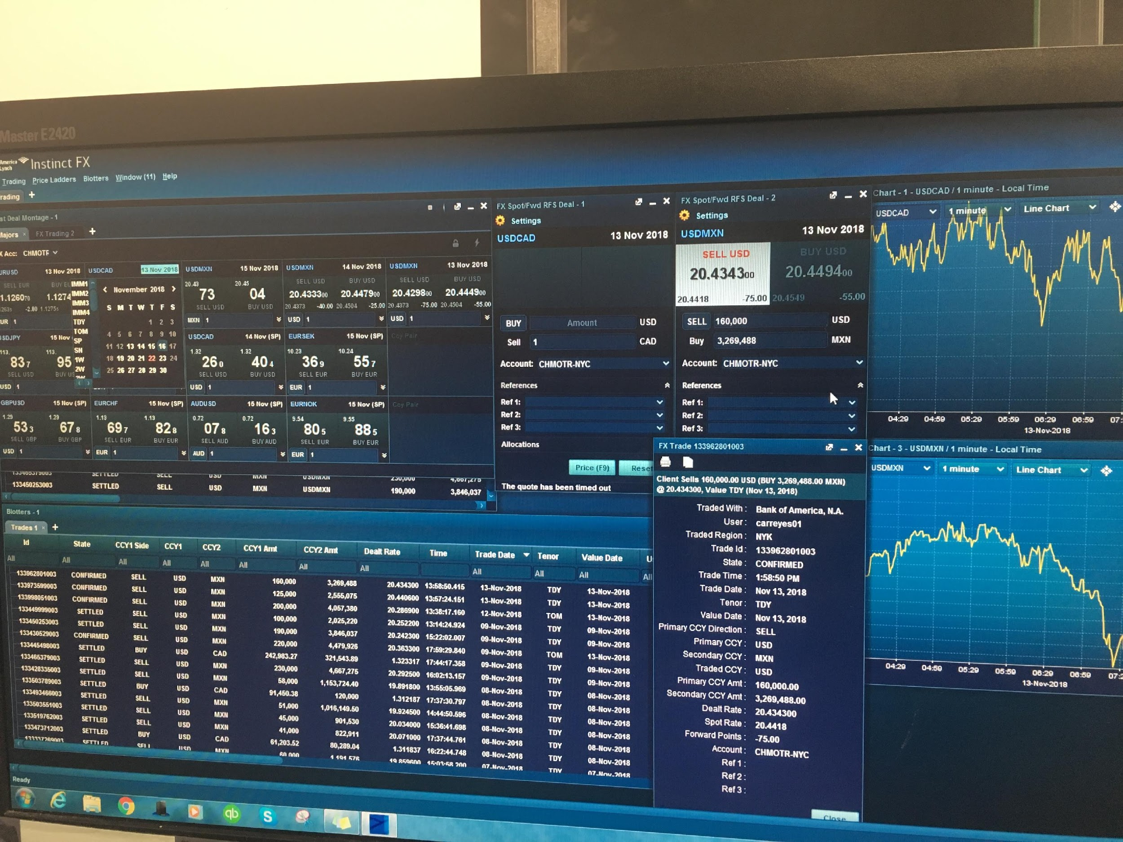
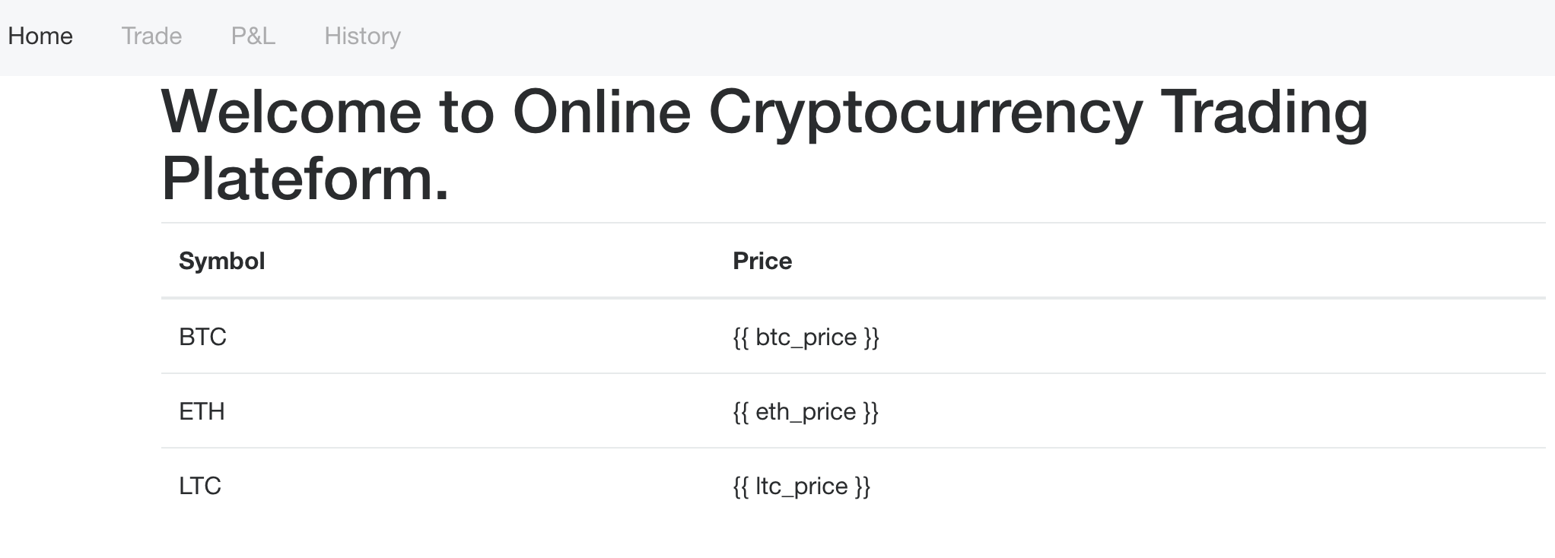
Innovation
Dream vs.
Reality
For building a trading app:
Retrieve more live data
MySQL connection
Data visualization
For future programming:
HTML - better looking layout & connections
Python - Better streamlined coding process
Team Collaboration

Slide 6
THANK YOU QUESTIONS?

