Slide 1
Chapter 2
Operating System Overview
Notes:
“Operating Systems: Internal and Design Principles”, 8/e, by William Stallings, Chapter 2 “Operating System Overview”.

Slide 2
Overview
Operating system objectives and functions
  User/computer interface
  Resource manager
    Evolution of operating systems
  Serial processing
  Simple/multiprogrammed/time-sharing batch systems
    Major achievements
    Developments leading to modern operating systems
    OS design considerations for multiprocessor and multicore
Traditional Unix systems
  History/description
Modern Unix systems
  System V Release 4 (SVR4), BSD, Solaris 10
Linux
  History
  Modular structure
  Kernel components
Notes:
Summary of Chapter 2.

Slide 3
Operating System
A program that controls the execution of application programs
An interface between applications and hardware
Main objectives of an OS:
convenience
efficiency
ability to evolve
Notes:
An OS is a program that controls the execution of application programs and acts as
an interface between applications and the computer hardware. It can be thought of
as having three objectives:
• Convenience: An OS makes a computer more convenient to use.
• Efficiency: An OS allows the computer system resources to be used in an efficient
manner.
• Ability to evolve: An OS should be constructed in such a way as to permit the
effective development, testing, and introduction of new system functions without
interfering with service.

Slide 4
Notes:
The hardware and software used in providing applications to a user can be viewed
in a layered or hierarchical fashion, as depicted in Figure 2.1 . The user of those
applications, the end user, generally is not concerned with the details of computer
hardware. Thus, the end user views a computer system in terms of a set of applications.
An application can be expressed in a programming language and is developed
by an application programmer. If one were to develop an application program as a
set of machine instructions that is completely responsible for controlling the computer
hardware, one would be faced with an overwhelmingly complex undertaking.
To ease this chore, a set of system programs is provided. Some of these programs
are referred to as utilities, or library programs. These implement frequently used
functions that assist in program creation, the management of files, and the control of
I/O devices. A programmer will make use of these facilities in developing an application,
and the application, while it is running, will invoke the utilities to perform
certain functions. The most important collection of system programs comprises the
OS. The OS masks the details of the hardware from the programmer and provides
the programmer with a convenient interface for using the system. It acts as mediator,
making it easier for the programmer and for application programs to access and
use those facilities and services.

Slide 5
Operating System Services
Program execution
User management/permissions
Access I/O devices
Controlled access to files
System access
Error detection and response
Accounting
Notes:
Briefly, the OS typically provides services in the following areas:
• Program development: The OS provides a variety of facilities and services,
such as editors and debuggers, to assist the programmer in creating programs.
Typically, these services are in the form of utility programs that, while not
strictly part of the core of the OS, are supplied with the OS and are referred to
as application program development tools.
• Program execution: A number of steps need to be performed to execute a
program. Instructions and data must be loaded into main memory, I/O devices
and files must be initialized, and other resources must be prepared. The OS
handles these scheduling duties for the user.
• Access to I/O devices: Each I/O device requires its own peculiar set of instructions
or control signals for operation. The OS provides a uniform interface
that hides these details so that programmers can access such devices using simple
reads and writes.
• Controlled access to files: For file access, the OS must reflect a detailed understanding
of not only the nature of the I/O device (disk drive, tape drive) but
also the structure of the data contained in the files on the storage medium.
In the case of a system with multiple users, the OS may provide protection
mechanisms to control access to the files.
• System access: For shared or public systems, the OS controls access to the
system as a whole and to specific system resources. The access function must
provide protection of resources and data from unauthorized users and must
resolve conflicts for resource contention.
• Error detection and response: A variety of errors can occur while a computer
system is running. These include internal and external hardware errors, such
as a memory error, or a device failure or malfunction; and various software
errors, such as division by zero, attempt to access forbidden memory location,
and inability of the OS to grant the request of an application. In each case,
the OS must provide a response that clears the error condition with the least
impact on running applications. The response may range from ending the program
that caused the error, to retrying the operation, to simply reporting the
error to the application.
• Accounting: A good OS will collect usage statistics for various resources and
monitor performance parameters such as response time. On any system, this
information is useful in anticipating the need for future enhancements and in
tuning the system to improve performance. On a multiuser system, the information
can be used for billing purposes.

Slide 6
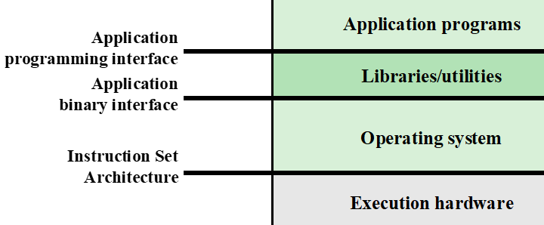
Key Interfaces
Application programming interface (API)
The API gives a program access to the hardware resources and services available in a system through user ISA supplemented with high-level language (HLL) library calls
Application binary interface (ABI)
The ABI defines the system call interface to the operating system and the hardware resources and services available in a system through the user ISA.
Instruction set architecture (ISA)
The ISA defines machine language instructions that a computer can follow
Notes:
Figure 2.1 also indicates three key interfaces in a typical computer system:
• Instruction set architecture (ISA) : The ISA defines the repertoire of machine
language instructions that a computer can follow. This interface is the boundary
between hardware and software. Note that both application programs
and utilities may access the ISA directly. For these programs, a subset of the
instruction repertoire is available (user ISA). The OS has access to additional
machine language instructions that deal with managing system resources
(system ISA).
• Application binary interface (ABI) : The ABI defines a standard for binary
portability across programs. The ABI defines the system call interface to
the operating system and the hardware resources and services available in a
system through the user ISA.
• Application programming interface (API) : The API gives a program access
to the hardware resources and services available in a system through the user
ISA supplemented with high-level language (HLL) library calls. Any system
calls are usually performed through libraries. Using an API enables application
software to be ported easily, through recompilation, to other systems that
support the same API.
API: Application Program Interface
This is the set of public types/variables/functions that you expose from your application/library.
In C/C++ this is what you expose in the header files that you ship with the application.
ABI: Application Binary Interface
This is how the compiler builds an application.
It defines things (but is not limited to):
How parameters are passed to functions (registers/stack).
Who cleans parameters from the stack (caller/callee).
Where the return value is placed for return.
How exceptions propagate.

Slide 7
The Role of an OS
A computer is a set of resources for the movement, storage, and processing of data
The OS is responsible for managing these resources
Notes:
A computer is a set of resources for the movement, storage, and processing of data
and for the control of these functions. The OS is responsible for managing these
resources.

Slide 8
Operating System as Software
Functions in the same way as ordinary computer software
Program, or suite of programs, executed by the processor
Frequently relinquishes control and must depend on the processor to allow it to regain control
Notes:
The OS, as a control mechanism is unusual in two respects:
• The OS functions in the same way as ordinary computer software; that is, it is
a program or suite of programs executed by the processor.
• The OS frequently relinquishes control and must depend on the processor to
allow it to regain control.
Like other computer programs, the OS provides instructions for the processor.
The key difference is in the intent of the program. The OS directs the processor
in the use of the other system resources and in the timing of its execution of other
programs. But in order for the processor to do any of these things, it must cease
executing the OS program and execute other programs. Thus, the OS relinquishes
control for the processor to do some “useful” work and then resumes control long
enough to prepare the processor to do the next piece of work. The mechanisms
involved in all this should become clear as the chapter proceeds.

Slide 9
Where is OS allocated?
Notes:
Figure 2.2 suggests the main resources that are managed by the OS. A portion
of the OS is in main memory. This includes the kernel , or nucleus , which contains
the most frequently used functions in the OS and, at a given time, other portions
of the OS currently in use. The remainder of main memory contains user programs
and data. The memory management hardware in the processor and the OS jointly
control the allocation of main memory, as we shall see. The OS decides when an I/O
device can be used by a program in execution and controls access to and use of files.
The processor itself is a resource, and the OS must determine how much processor
time is to be devoted to the execution of a particular user program. In the case of a
multiple-processor system, this decision must span all of the processors.

Slide 10
Evolution of Operating Systems
A major OS will evolve over time for a number of reasons:
hardware upgrades
new types of hardware
new services
Fixes
Notes:
A major OS will evolve over time for a number of reasons:
• Hardware upgrades plus new types of hardware: For example, early versions
of UNIX and the Macintosh OS did not employ a paging mechanism because
they were run on processors without paging hardware. Subsequent versions
of these operating systems were modified to exploit paging capabilities. Also,
the use of graphics terminals and page-mode terminals instead of line-at-a time
scroll mode terminals affects OS design. For example, a graphics terminal
typically allows the user to view several applications at the same time through
“windows” on the screen. This requires more sophisticated support in the OS.
• New services: In response to user demand or in response to the needs of system
managers, the OS expands to offer new services. For example, if it is found
to be difficult to maintain good performance for users with existing tools, new
measurement and control tools may be added to the OS.
• Fixes: Any OS has faults. These are discovered over the course of time and
fixes are made. Of course, the fix may introduce new faults.
The need to change an OS regularly places certain requirements on its design.
An obvious statement is that the system should be modular in construction, with
clearly defined interfaces between the modules, and that it should be well documented.
For large programs, such as the typical contemporary OS, what might be
referred to as straightforward modularization is inadequate [DENN80a]. That is,
much more must be done than simply partitioning a program into modules. We
return to this topic later in this chapter.

Slide 11
Evolution of Operating Systems
Serial Processing
Simple Batch Systems
Multiprogrammed Batch Systems
Time Sharing Systems
Notes:
eh·vuh·loo·shn
In attempting to understand the key requirements for an OS and the significance of the major features of a contemporary OS, it is useful to consider how operating systems have evolved over the years.

Slide 12
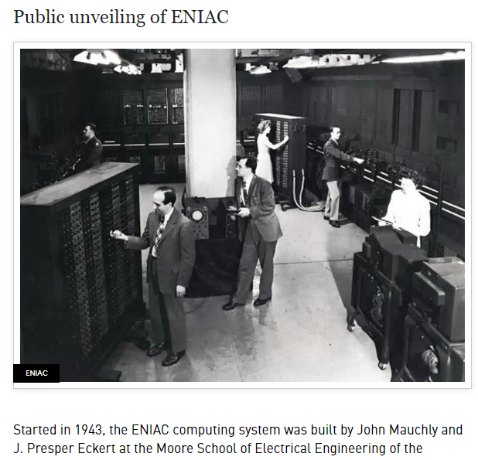
Serial Processing
Earliest Computers:
No operating system
    programmers interacted directly with the computer hardware
    Yes, we can use computer without OS
Computers ran from a console with display lights, toggle switches, some form of input device, and a printer
Users have access to the computer in “series”
Problems:
Scheduling:
  most installations used a hardcopy sign-up sheet to reserve computer time
      time allocations could run short or long, resulting in wasted computer time
      Setup time
  a considerable amount of time was spent just on setting up the program to run
https://www.youtube.com/watch?v=bGk9W65vXNA&t=328s
Notes:
With the earliest computers, from the late 1940s to the mid-1950s, the programmer
interacted directly with the computer hardware; there was no OS. These computers
were run from a console consisting of display lights, toggle switches, some form of
input device, and a printer. Programs in machine code were loaded via the input
device (e.g., a card reader). If an error halted the program, the error condition was
indicated by the lights. If the program proceeded to a normal completion, the output
appeared on the printer.
https://www.youtube.com/watch?v=bGk9W65vXNA
These early systems presented two main problems:
• Scheduling : Most installations used a hardcopy sign-up sheet to reserve computer
time. Typically, a user could sign up for a block of time in multiples of a
half hour or so. A user might sign up for an hour and finish in 45 minutes; this
would result in wasted computer processing time. On the other hand, the user
might run into problems, not finish in the allotted time, and be forced to stop
before resolving the problem.
• Setup time: A single program, called a job , could involve loading the compiler
plus the high-level language program (source program) into memory,
saving the compiled program (object program) and then loading and linking
together the object program and common functions. Each of these steps could
involve mounting or dismounting tapes or setting up card decks. If an error
occurred, the hapless user typically had to go back to the beginning of the
setup sequence. Thus, a considerable amount of time was spent just in setting
up the program to run.
This mode of operation could be termed serial processing , reflecting the fact
that users have access to the computer in series. Over time, various system software
tools were developed to attempt to make serial processing more efficient. These
include libraries of common functions, linkers, loaders, debuggers, and I/O driver
routines that were available as common software for all users.

Slide 13
Evolution of Operating Systems
Serial Processing
Simple Batch Systems
Multiprogrammed Batch Systems
Time Sharing Systems
Notes:
In attempting to understand the key requirements for an OS and the significance of the major features of a contemporary OS, it is useful to consider how operating systems have evolved over the years.

Slide 14
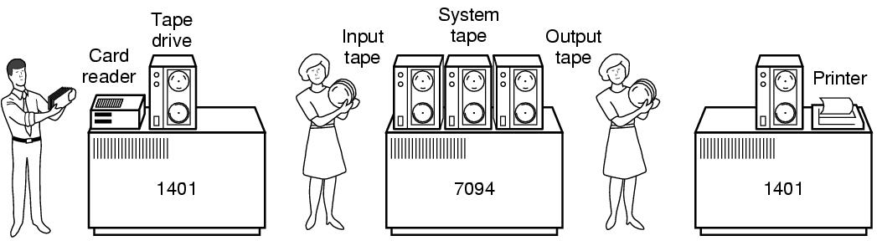
Simple Batch Systems
Early computers were very expensive
    important to maximize processor utilization
Monitor (<<OS, not true OS)
    user no longer has direct access to processor
    job is submitted to computer operator who batches them together and places them on an input device
    program branches back to the monitor when finished
    Users can go and come back to pick up results.
Notes:
Early computers were very expensive, and therefore it was important to maximize
processor utilization. The wasted time due to scheduling and setup time was
unacceptable.
To improve utilization, the concept of a batch OS was developed. It appears
that the first batch OS (and the first OS of any kind) was developed in the mid-1950s
by General Motors for use on an IBM 701 [WEIZ81]. The concept was subsequently
refined and implemented on the IBM 704 by a number of IBM customers. By the
early 1960s, a number of vendors had developed batch operating systems for their
computer systems. IBSYS, the IBM OS for the 7090/7094 computers, is particularly
notable because of its widespread influence on other systems.
The central idea behind the simple batch-processing scheme is the use of a
piece of software known as the monitor . With this type of OS, the user no longer has
direct access to the processor. Instead, the user submits the job on cards or tape to a
computer operator, who batches the jobs together sequentially and places the entire
batch on an input device, for use by the monitor. Each program is constructed to
branch back to the monitor when it completes processing, at which point the monitor
automatically begins loading the next program.

Slide 15
Monitor Point of View
Monitor controls the sequence of events
Resident Monitor is software always in memory
Monitor reads in job and gives control
Job returns control to monitor
Notes:
Monitor point of view: The monitor controls the sequence of events. For this
to be so, much of the monitor must always be in main memory and available
for execution ( Figure 2.3 ). That portion is referred to as the resident monitor .
The rest of the monitor consists of utilities and common functions that are
loaded as subroutines to the user program at the beginning of any job that
requires them. The monitor reads in jobs one at a time from the input device
(typically a card reader or magnetic tape drive). As it is read in, the current job
is placed in the user program area, and control is passed to this job. When the
job is completed, it returns control to the monitor, which immediately reads
in the next job. The results of each job are sent to an output device, such as a
printer, for delivery to the user.

Slide 16
Processor Point of View
Processor executes instruction from the memory containing the monitor
Executes the instructions in the user program until it encounters an ending or error condition
“control is passed to a job” means processor is fetching and executing instructions in a user program
“control is returned to the monitor” means that the processor is fetching and executing instructions from the monitor program
[User-space]
[Kernel-space]
Notes:
Processor point of view: At a certain point, the processor is executing instructions
from the portion of main memory containing the monitor. These
instructions cause the next job to be read into another portion of main
memory. Once a job has been read in, the processor will encounter a branch
instruction in the monitor that instructs the processor to continue execution
at the start of the user program. The processor will then execute the instructions
in the user program until it encounters an ending or error condition.
Either event causes the processor to fetch its next instruction from the monitor
program. Thus the phrase “control is passed to a job” simply means that
the processor is now fetching and executing instructions in a user program,
and “control is returned to the monitor” means that the processor is now
fetching and executing instructions from the monitor program.

Slide 17
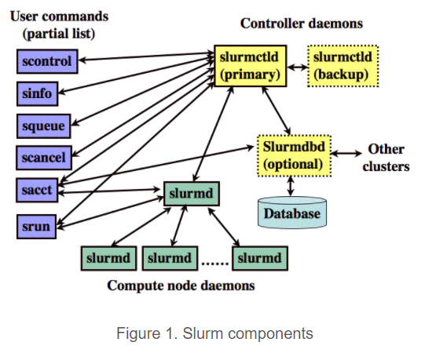

Job Control Language (JCL)
Special type of programming language used to provide instructions to the monitor
what compiler to use
what data to use
JCL is part of the monitor.
Notes:
The monitor performs a scheduling function: A batch of jobs is queued up,
and jobs are executed as rapidly as possible, with no intervening idle time. The monitor
improves job setup time as well. With each job, instructions are included in a
primitive form of job control language (JCL) . This is a special type of programming
language used to provide instructions to the monitor. A simple example is that of a
user submitting a program written in the programming language FORTRAN plus
some data to be used by the program. All FORTRAN instructions and data are on a
separate punched card or a separate record on tape. In addition to FORTRAN and
data lines, the job includes job control instructions, which are denoted by the beginning
$.

Slide 18

Desirable Hardware Features
Monitor = Batch OS
Memory protection for monitor
while the user program is executing, it must not alter the memory area containing the monitor
Timer
prevents a job from monopolizing the system
Privileged instructions
can only be executed by the monitor
Interrupts
gives monitor more flexibility in controlling user programs
Notes:
mo·nop·o·lize
/məˈnäpəˌlīz
The monitor, or batch OS, is simply a computer program. It relies on the ability
of the processor to fetch instructions from various portions of main memory to
alternately seize and relinquish control. Certain other hardware features are also
desirable:
• Memory protection: While the user program is executing, it must not alter the
memory area containing the monitor. If such an attempt is made, the processor
hardware should detect an error and transfer control to the monitor. The
monitor would then abort the job, print out an error message, and load in the
next job.
• Timer: A timer is used to prevent a single job from monopolizing the system.
The timer is set at the beginning of each job. If the timer expires, the user program
is stopped, and control returns to the monitor.
• Privileged instructions : Certain machine level instructions are designated privileged
and can be executed only by the monitor. If the processor encounters
such an instruction while executing a user program, an error occurs causing
control to be transferred to the monitor. Among the privileged instructions
are I/O instructions, so that the monitor retains control of all I/O devices. This
prevents, for example, a user program from accidentally reading job control
instructions from the next job. If a user program wishes to perform I/O, it must
request that the monitor perform the operation for it.
Interrupts : Early computer models did not have this capability. This feature
gives the OS more flexibility in relinquishing control to and regaining control
from user programs.

Slide 19
Modes of Operation
User Mode
user program executes in user mode
certain areas of memory are protected from user access
certain instructions may not be executed
Kernel Mode
monitor executes in kernel mode
privileged instructions may be executed
protected areas of memory may be accessed
Notes:
Considerations of memory protection and privileged instructions lead to the
concept of modes of operation. A user program executes in a user mode , in which
certain areas of memory are protected from the user’s use and in which certain
instructions may not be executed. The monitor executes in a system mode, or what
has come to be called kernel mode , in which privileged instructions may be executed
and in which protected areas of memory may be accessed.
Of course, an OS can be built without these features. But computer vendors
quickly learned that the results were chaos, and so even relatively primitive batch
operating systems were provided with these hardware features.

Slide 20
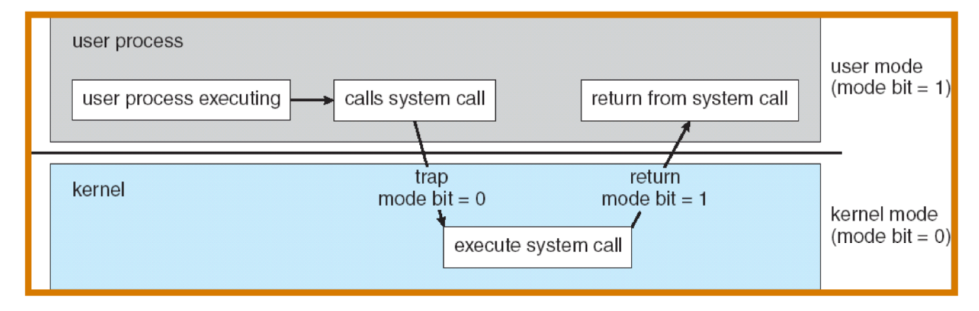
Crossing Protection Boundaries
System call: OS procedure that executes privileged instructions (e.g., I/O) ;
  Causes a trap, which vectors (jumps) to the trap handler in the OS kernel.
  The trap handler uses the parameter to the system call to jump to the appropriate handler (I/O, Terminal, etc.).
  The handler saves caller's state (PC, mode bit) so it can restore control to the user process.
  The architecture must permit the OS to verify the caller's parameters.
  The architecture must also provide a way to return to user mode when finished

Slide 21
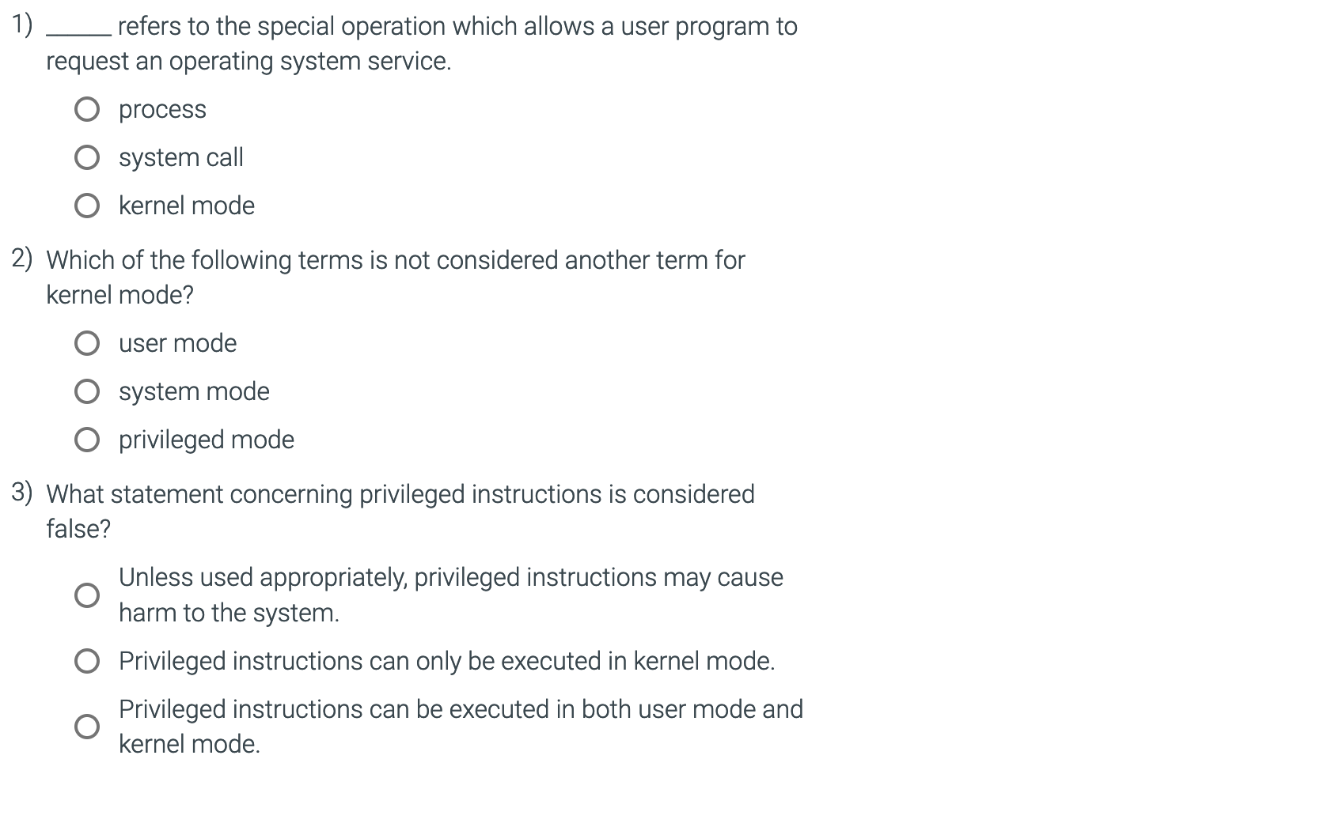
Question time

Slide 22
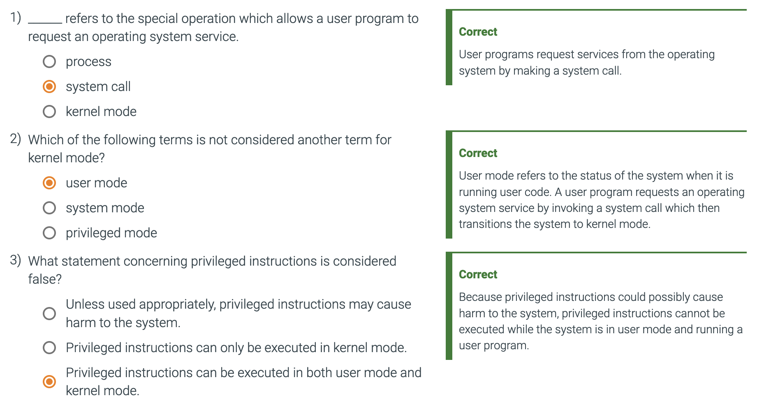
Question time

Slide 23
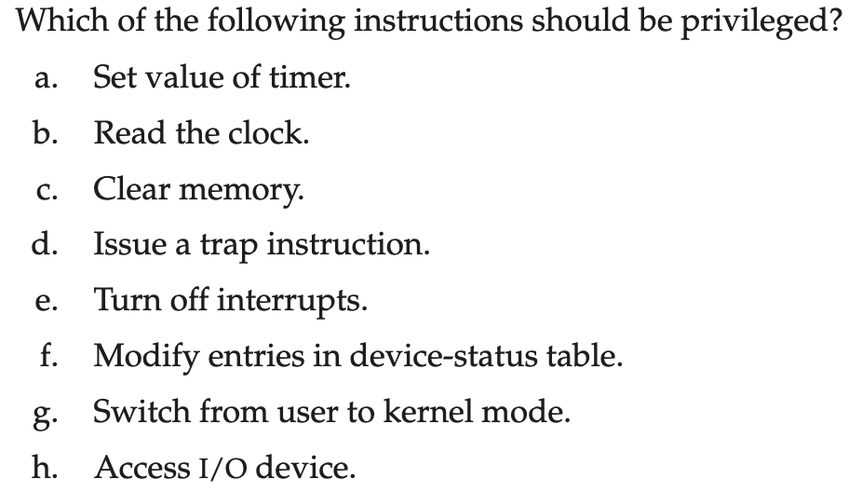
Kernel Mode Instructions
Notes:
The following operations need to be privileged: Set value of timer, clear
memory, turn off interrupts, modify entries in device-status table, access
I/O device (directly). The rest can be performed in user mode.

Slide 24
Simple Batch Systems Overhead
Processor time alternates between execution of user programs and execution of the monitor
Sacrifices:
    some main memory is now given over to the monitor
    some processor time is consumed by the monitor
  Despite overhead, the simple batch system improves utilization of the computer, when compared to serial processing.
      STILL: HIGHLY INEFFICIENT
Notes:
With a batch OS, processor time alternates between execution of user programs
and execution of the monitor. There have been two sacrifices: Some main
memory is now given over to the monitor and some processor time is consumed by
the monitor. Both of these are forms of overhead. Despite this overhead, the simple
batch system improves utilization of the computer.

Slide 25
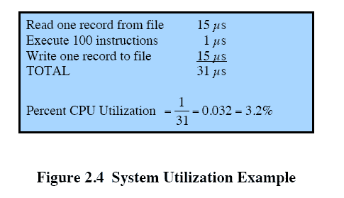
Single Batch Systems Underutilization
Processor is often idle
    even with automatic job sequencing
    I/O devices are slow compared to processor
CPU
The computer spends over 96% of its time waiting for I/O devices to finish transferring data to and from the file.
Notes:
Even with the automatic job sequencing provided by a simple batch OS, the processor
is often idle. The problem is that I/O devices are slow compared to the processor.
Figure 2.4 details a representative calculation. The calculation concerns a program
that processes a file of records and performs, on average, 100 machine instructions
per record. In this example, the computer spends over 96% of its time waiting for
I/O devices to finish transferring data to and from the file.

Slide 26
Uniprogramming
The processor spends a certain amount of time executing, until it reaches an I/O instruction; it must then wait until that I/O instruction concludes before proceeding
Notes:
Figure 2.5a illustrates this situation, where we have a single program, referred to as uniprogramming.
The processor spends a certain amount of time executing, until it reaches an I/O instruction.
It must then wait until that I/O instruction concludes before proceeding.

Slide 27
Evolution of Operating Systems
Serial Processing
Simple Batch Systems
Multiprogrammed Batch Systems
Time Sharing Systems
Multi-programming
Uni-programming
Notes:
In attempting to understand the key requirements for an OS and the significance of the major features of a contemporary OS, it is useful to consider how operating systems have evolved over the years.

Slide 28
Multiprogramming
There are enough memory to hold the OS (resident monitor) and two user programs
When one job needs to wait for I/O, the processor can switch to the other job, which is likely not waiting for I/O
I/O
I/O
Notes:
This inefficiency is not necessary. We know that there must be enough
memory to hold the OS (resident monitor) and one user program. Suppose that
there is room for the OS and two user programs. When one job needs to wait for
I/O, the processor can switch to the other job, which is likely not waiting for I/O
( Figure 2.5b ).

Slide 29
Multiprogramming
There are enough memory to hold the OS (resident monitor) and two user programs
When one job needs to wait for I/O, the processor can switch to the other job, which is likely not waiting for I/O
How many CPU/cores do we have in this example?
Notes:
This inefficiency is not necessary. We know that there must be enough
memory to hold the OS (resident monitor) and one user program. Suppose that
there is room for the OS and two user programs. When one job needs to wait for
I/O, the processor can switch to the other job, which is likely not waiting for I/O
( Figure 2.5b ).

Slide 30
Multiprogramming
Multiprogramming/multitasking
    memory is expanded to hold three, four, or more programs and switch among all of them
Notes:
Furthermore, we might expand memory to hold three, four, or more
programs and switch among all of them ( Figure 2.5c ). The approach is known as
multiprogramming , or multitasking . It is the central theme of modern operating
systems.

Slide 31
Multiprogramming Example
Given the following 3 jobs, we will show Uniprogramming VS Multiprogramming
CPU Bound
I/O Bound
I/O Bound
CPU Bursts
I/O
I/O
I/O
Table 2.1 Sample Program Execution Attributes
Notes:
To illustrate the benefit of multiprogramming, we give a simple example. Consider a computer with 250 Mbytes of available memory (not used by the OS), a disk, a terminal, and a printer. Three programs, JOB1, JOB2, and JOB3, are submitted for execution at the same time, with the attributes listed in Table 2.1 . We assume minimal processor requirements for JOB2 and JOB3 and continuous disk and printer use by JOB3.
For a simple batch environment, these jobs will be executed in sequence. Thus, JOB1 completes in 5 minutes. JOB2 must wait until the 5 minutes are over and then completes 15 minutes after that. JOB3 begins after 20 minutes and completes at 30 minutes from the time it was initially submitted.

Slide 32
the jobs are running concurrently under a multiprogramming OS
Notes:
Device-by-device utilization is illustrated in
Figure 2.6a . It is evident that there is gross underutilization for all resources when
averaged over the required 30-minute time period.
Now suppose that the jobs are run concurrently under a multiprogramming
OS. Because there is little resource contention between the jobs, all three can run
in nearly minimum time while coexisting with the others in the computer (assuming
that JOB2 and JOB3 are allotted enough processor time to keep their input
and output operations active). JOB1 will still require 5 minutes to complete, but at
the end of that time, JOB2 will be one-third finished and JOB3 half finished. All
three jobs will have finished within 15 minutes. The improvement is evident when
examining the multiprogramming column of Table 2.2 , obtained from the histogram
shown in Figure 2.6b .

Slide 33
Multiprogramming Example
Given the following 3 jobs, we will show Uniprogramming VS Multiprogramming
CPU Bound
I/O Bound
I/O Bound
CPU Bursts
I/O
Yes
I/O
I/O
Table 2.1 Sample Program Execution Attributes
What happen if both Job 2 and Job 3 need disk I/O?
Notes:
To illustrate the benefit of multiprogramming, we give a simple example. Consider a computer with 250 Mbytes of available memory (not used by the OS), a disk, a terminal, and a printer. Three programs, JOB1, JOB2, and JOB3, are submitted for execution at the same time, with the attributes listed in Table 2.1 . We assume minimal processor requirements for JOB2 and JOB3 and continuous disk and printer use by JOB3.
For a simple batch environment, these jobs will be executed in sequence. Thus, JOB1 completes in 5 minutes. JOB2 must wait until the 5 minutes are over and then completes 15 minutes after that. JOB3 begins after 20 minutes and completes at 30 minutes from the time it was initially submitted.

Slide 34
Effects on Resource Utilization
Table 2.2 Effects of Multiprogramming on Resource Utilization
Notes:
The average resource utilization, throughput, and response times are shown in the
uniprogramming column of Table 2.2 .

Slide 35
Problem Time
A multiprocessor with eight processors has 20 attached tape drives. There is a large number of jobs submitted to the system that each require a maximum of five tape drives to complete execution.
Assume that each job starts running with only three tape drives for a long period before requiring the fourth and fifth tape drives for a short period towards the end of its operation. Also assume an endless supply of such jobs.
a) Assume the scheduler in the OS will not start a job unless there are five tape drives available. When a job is started, five drives are assigned immediately and are not released until the job finishes. What is the maximum number of jobs that can be in progress at once? What are the maximum and minimum number of tape drives that may be left idle as a result of this policy?
b) Suggest an alternative policy to improve tape drive utilization and at the same time avoid system deadlock. What is the maximum number of jobs that can be in progress at once? What are the bounds on the number of idling tape drives?

Slide 36
Evolution of Operating Systems
Serial Processing
Simple Batch Systems
Multiprogrammed Batch Systems
Time Sharing Systems
Notes:
In attempting to understand the key requirements for an OS and the significance of the major features of a contemporary OS, it is useful to consider how operating systems have evolved over the years.

Slide 37
Time-Sharing Systems
Can be used to handle multiple interactive jobs
Processor time is shared among multiple users
Multiple users simultaneously access the system through terminals
The OS interleaves the execution of each user program in a short burst or quantum of computation
Notes:
Just as multiprogramming allows the processor to handle multiple batch jobs
at a time, multiprogramming can also be used to handle multiple interactive jobs. In
this latter case, the technique is referred to as time sharing , because processor time is
shared among multiple users. In a time-sharing system, multiple users simultaneously
access the system through terminals, with the OS interleaving the execution of each
user program in a short burst or quantum of computation. Thus, if there are n users
actively requesting service at one time, each user will only see on the average 1/ n
of the effective computer capacity, not counting OS overhead. However, given the
relatively slow human reaction time, the response time on a properly designed system
should be similar to that on a dedicated computer.

Slide 38
Batch Multiprogramming vs. Time Sharing
Table 2.3 Batch Multiprogramming versus Time Sharing
Notes:
Both batch processing and time sharing use multiprogramming. The key
differences are listed in Table 2.3 .

Slide 39
Compatible Time-Sharing Systems (CTSS)
What is CTSS?
How was time slicing implemented?
One of the first time-sharing operating systems
  Developed at MIT by a group known as Project MAC in 1961
  Ran on a computer with 32,000, 36-bit words of main memory, with the resident monitor consuming 5,000 of that.
  To simplify both the monitor and memory management a program was always loaded to start at the location of the 5000th word
  System clock generates interrupts at a rate of approximately one every 0.2 seconds
  At each interrupt OS regained control and could assign processor to another user
  At regular time intervals the current user would be preempted, and another user loaded in
  Old user programs and data were written out to disk
  Old user program code and data were restored in main memory when that program was next given a turn
https://www.youtube.com/watch?v=Q07PhW5sCEk&list=PLT8Ms9NT2xpb6yBvtVpBXzUoIMAhDu0G9
The system was first developed for the IBM 709 in 1961 and later transferred to an IBM 7094.
Notes:
One of the first time-sharing operating systems to be developed was the
Compatible Time-Sharing System (CTSS) [CORB62], developed at MIT by a
group known as Project MAC (Machine-Aided Cognition, or Multiple-Access
Computers). The system was first developed for the IBM 709 in 1961 and later
transferred to an IBM 7094.
Compared to later systems, CTSS is primitive. The system ran on a computer
with 32,000 36-bit words of main memory, with the resident monitor consuming 5000
of that. When control was to be assigned to an interactive user, the user’s program
and data were loaded into the remaining 27,000 words of main memory. A program
was always loaded to start at the location of the 5000th word; this simplified
both the monitor and memory management. A system clock generated interrupts
at a rate of approximately one every 0.2 seconds. At each clock interrupt, the OS
regained control and could assign the processor to another user. This technique is
known as time slicing . Thus, at regular time intervals, the current user would be
preempted and another user loaded in. To preserve the old user program status for
later resumption, the old user programs and data were written out to disk before the
new user programs and data were read in. Subsequently, the old user program code
and data were restored in main memory when that program was next given a turn.

Slide 40
Will we lose data of Job 1 when Job1 is suspended and overwritten by Job 2?
Notes:
To minimize disk traffic, user memory was only written out when the incoming program would overwrite it. This principle is illustrated in Figure 2.7 . Assume that there are four interactive users with the following memory requirements, in words:
JOB1: 15,000
JOB2: 20,000
JOB3: 5000
JOB4: 10,000
Initially, the monitor loads JOB1 and transfers control to it (a). Later, the
monitor decides to transfer control to JOB2. Because JOB2 requires more memory
than JOB1, JOB1 must be written out first, and then JOB2 can be loaded (b).
Next, JOB3 is loaded in to be run. However, because JOB3 is smaller than JOB2,
a portion of JOB2 can remain in memory, reducing disk write time (c). Later, the
monitor decides to transfer control back to JOB1. An additional portion of JOB2
must be written out when JOB1 is loaded back into memory (d). When JOB4 is
loaded, part of JOB1 and the portion of JOB2 remaining in memory are retained
(e). At this point, if either JOB1 or JOB2 is activated, only a partial load will be
required. In this example, it is JOB2 that runs next. This requires that JOB4 and the
remaining resident portion of JOB1 be written out and that the missing portion of
JOB2 be read in (f).

Slide 41
Modern O/S
Operating Systems are among the most complex pieces of software ever developed
Major advances in development include:
memory management
information protection and security
scheduling and resource management
processes
Notes:
Operating systems are among the most complex pieces of software ever developed.
This reflects the challenge of trying to meet the difficult and in some cases
competing objectives of convenience, efficiency, and ability to evolve. [DENN80a]
proposes that there have been four major theoretical advances in the development
of operating systems:
• Processes
• Memory management
• Information protection and security
• Scheduling and resource management
Each advance is characterized by principles, or abstractions, developed to
meet difficult practical problems. Taken together, these five areas span many of
the key design and implementation issues of modern operating systems. The brief
review of these five areas in this section serves as an overview of much of the rest
of the text.

Slide 42
Process
Fundamental to the structure of operating systems
A process can be defined as:
a program in execution
an instance of a running program
the entity that can be assigned to, and executed on, a processor
a unit of activity characterized by a single sequential thread of execution, a current state, and an associated set of system resources
Notes:
Central to the design of operating systems is the concept of process. This term was
first used by the designers of Multics in the 1960s [DALE68]. It is a somewhat
more general term than job. Many definitions have been given for the term process ,
including
• A program in execution
• An instance of a program running on a computer
• The entity that can be assigned to and executed on a processor
• A unit of activity characterized by a single sequential thread of execution, a current state, and an associated set of system resources

Slide 43
The need for “Process”
Three major lines of computer system development created
problems in timing and synchronization that contributed to
the development:
utilization (e.g. multiprogramming batch operation)
processor is switched among the various programs residing in main memory
responsiveness (e.g. time sharing)
be responsive to the individual user but be able to support many users simultaneously
priority (e.g. real-time transaction systems)
a number of users are entering queries or updates against a database
Notes:
Three major lines of computer system development created problems in timing
and synchronization that contributed to the development of the concept of the
process: multiprogramming batch operation, time sharing, and real-time transaction
systems. As we have seen, multiprogramming was designed to keep the processor
and I/O devices, including storage devices, simultaneously busy to achieve maximum
efficiency. The key mechanism is this: In response to signals indicating the
completion of I/O transactions, the processor is switched among the various programs
residing in main memory.
A second line of development was general-purpose time sharing. Here, the
key design objective is to be responsive to the needs of the individual user and yet,
for cost reasons, be able to support many users simultaneously. These goals are
compatible because of the relatively slow reaction time of the user. For example,
if a typical user needs an average of 2 seconds of processing time per minute, then
close to 30 such users should be able to share the same system without noticeable
interference. Of course, OS overhead must be factored into such calculations.
A third important line of development has been real-time transaction processing
systems. In this case, a number of users are entering queries or updates against a
database. An example is an airline reservation system. The key difference between
the transaction processing system and the time-sharing system is that the former
is limited to one or a few applications, whereas users of a time-sharing system can
engage in program development, job execution, and the use of various applications.
In both cases, system response time is paramount.

Slide 44
Components of a Process
  The execution context is essential:
  it is the internal data by which the OS is able to supervise and control the process
  includes the contents of the various process registers
  includes information such as the priority of the process and whether the process is waiting for the completion of a particular I/O event
A process contains three components:
  an executable program
  the associated data needed by the program (variables, work space, buffers, etc.)
  the execution context (or “process state”) of the program
Notes:
We can think of a process as consisting of three components:
• An executable program
• The associated data needed by the program (variables, work space, buffers, etc.)
• The execution context of the program
This last element is essential.
The execution context, or process state, is the internal data by which the OS is able to supervise and control the process.
This internal information is separated from the process, because the OS has information not permitted to the process.
The context includes all of the information that the OS needs to manage the process and that the processor needs to execute the process properly including:
contents of the various processor registers, such as the program counter and data registers
And information of use to the OS, such as the priority of the process and whether the process is waiting for the completion of a particular I/O event.

Slide 45
Process Management
The entire state of the process at any instant is contained in its context
The process index register indicates that process B is executing. Process A was previously executing but has been temporarily interrupted.
Notes:
Figure 2.8 indicates a way in which processes may be managed. Two processes,
A and B, exist in portions of main memory. That is, a block of memory is
allocated to each process that contains the program, data, and context information.
Each process is recorded in a process list built and maintained by the OS. The
process list contains one entry for each process, which includes a pointer to the
location of the block of memory that contains the process. The entry may also
include part or all of the execution context of the process. The remainder of the
execution context is stored elsewhere, perhaps with the process itself (as indicated
in Figure 2.8 ) or frequently in a separate region of memory. The process index
register contains the index into the process list of the process currently controlling
the processor. The program counter points to the next instruction in that process
to be executed. The base and limit registers define the region in memory occupied
by the process: The base register is the starting address of the region of memory
and the limit is the size of the region (in bytes or words). The program counter and
all data references are interpreted relative to the base register and must not exceed
the value in the limit register. This prevents interprocess interference.
In Figure 2.8 , the process index register indicates that process B is executing.
Process A was previously executing but has been temporarily interrupted. The
contents of all the registers at the moment of A’s interruption were recorded in its
execution context. Later, the OS can perform a process switch and resume execution
of process A. The process switch consists of storing the context of B and restoring
the context of A. When the program counter is loaded with a value pointing into A’s
program area, process A will automatically resume execution.

Slide 46
Memory Management
The OS has five principal storage management responsibilities:
• Process isolation: The OS must prevent independent processes from interfering
with each other’s memory, both data and instructions.
process isolation
long-term storage
protection and access control
support of modular programming
automatic allocation and management
Notes:
The needs of users can be met best by a computing environment that supports modular programming and the flexible use of data. System managers need efficient and orderly control of storage allocation. The OS, to satisfy these requirements, has five principal storage management responsibilities:
• Process isolation: The OS must prevent independent processes from interfering with each other’s memory, both data and instructions.
• Automatic allocation and management: Programs should be dynamically allocated across the memory hierarchy as required. Allocation should be transparent to the programmer. Thus, the programmer is relieved of concerns relating to memory limitations, and the OS can achieve efficiency by assigning memory to jobs only as needed.
• Support of modular programming: Programmers should be able to define program modules, and to create, destroy, and alter the size of modules dynamically.
• Protection and access control: Sharing of memory, at any level of the memory hierarchy, creates the potential for one program to address the memory space of another. This is desirable when sharing is needed by particular applications. At other times, it threatens the integrity of programs and even of the OS itself. The OS must allow portions of memory to be accessible in various ways by various users.
• Long-term storage: Many application programs require means for storing information for extended periods of time, after the computer has been powered down.

Slide 47
Memory Management
The OS has five principal storage management responsibilities:
Programs should be dynamically allocated across the memory hierarchy as required.
Allocation should be transparent to the programmer.
process isolation
long-term storage
protection and access control
support of modular programming
automatic allocation and management
Notes:
The needs of users can be met best by a computing environment that supports modular programming and the flexible use of data. System managers need efficient and orderly control of storage allocation. The OS, to satisfy these requirements, has five principal storage management responsibilities:
• Process isolation: The OS must prevent independent processes from interfering with each other’s memory, both data and instructions.
• Automatic allocation and management: Programs should be dynamically allocated across the memory hierarchy as required. Allocation should be transparent to the programmer. Thus, the programmer is relieved of concerns relating to memory limitations, and the OS can achieve efficiency by assigning memory to jobs only as needed.
• Support of modular programming: Programmers should be able to define program modules, and to create, destroy, and alter the size of modules dynamically.
• Protection and access control: Sharing of memory, at any level of the memory hierarchy, creates the potential for one program to address the memory space of another. This is desirable when sharing is needed by particular applications. At other times, it threatens the integrity of programs and even of the OS itself. The OS must allow portions of memory to be accessible in various ways by various users.
• Long-term storage: Many application programs require means for storing information for extended periods of time, after the computer has been powered down.

Slide 48
Memory Management
The OS has five principal storage management responsibilities:
Programmers should be able to define program modules, and to create, destroy,
and alter the size of modules dynamically.
process isolation
long-term storage
protection and access control
support of modular programming
automatic allocation and management
Notes:
The needs of users can be met best by a computing environment that supports modular programming and the flexible use of data. System managers need efficient and orderly control of storage allocation. The OS, to satisfy these requirements, has five principal storage management responsibilities:
• Process isolation: The OS must prevent independent processes from interfering with each other’s memory, both data and instructions.
• Automatic allocation and management: Programs should be dynamically allocated across the memory hierarchy as required. Allocation should be transparent to the programmer. Thus, the programmer is relieved of concerns relating to memory limitations, and the OS can achieve efficiency by assigning memory to jobs only as needed.
• Support of modular programming: Programmers should be able to define program modules, and to create, destroy, and alter the size of modules dynamically.
• Protection and access control: Sharing of memory, at any level of the memory hierarchy, creates the potential for one program to address the memory space of another. This is desirable when sharing is needed by particular applications. At other times, it threatens the integrity of programs and even of the OS itself. The OS must allow portions of memory to be accessible in various ways by various users.
• Long-term storage: Many application programs require means for storing information for extended periods of time, after the computer has been powered down.

Slide 49
Memory Management
The OS has five principal storage management responsibilities:
Sharing of memory, at any level of the memory hierarchy, creates the potential for
one program to address the memory space of another. At other times, it threatens the
integrity of programs and even of the OS itself. The OS must allow portions of
memory to be accessible in various ways by various users.
process isolation
long-term storage
protection and access control
support of modular programming
automatic allocation and management
Notes:
The needs of users can be met best by a computing environment that supports modular programming and the flexible use of data. System managers need efficient and orderly control of storage allocation. The OS, to satisfy these requirements, has five principal storage management responsibilities:
• Process isolation: The OS must prevent independent processes from interfering with each other’s memory, both data and instructions.
• Automatic allocation and management: Programs should be dynamically allocated across the memory hierarchy as required. Allocation should be transparent to the programmer. Thus, the programmer is relieved of concerns relating to memory limitations, and the OS can achieve efficiency by assigning memory to jobs only as needed.
• Support of modular programming: Programmers should be able to define program modules, and to create, destroy, and alter the size of modules dynamically.
• Protection and access control: Sharing of memory, at any level of the memory hierarchy, creates the potential for one program to address the memory space of another. This is desirable when sharing is needed by particular applications. At other times, it threatens the integrity of programs and even of the OS itself. The OS must allow portions of memory to be accessible in various ways by various users.
• Long-term storage: Many application programs require means for storing information for extended periods of time, after the computer has been powered down.

Slide 50
Memory Management
The OS has five principal storage management responsibilities:
Many application programs require means for storing information for
extended periods of time, after the computer has been powered down.
process isolation
long-term storage
protection and access control
support of modular programming
automatic allocation and management
Notes:
The needs of users can be met best by a computing environment that supports modular programming and the flexible use of data. System managers need efficient and orderly control of storage allocation. The OS, to satisfy these requirements, has five principal storage management responsibilities:
• Process isolation: The OS must prevent independent processes from interfering with each other’s memory, both data and instructions.
• Automatic allocation and management: Programs should be dynamically allocated across the memory hierarchy as required. Allocation should be transparent to the programmer. Thus, the programmer is relieved of concerns relating to memory limitations, and the OS can achieve efficiency by assigning memory to jobs only as needed.
• Support of modular programming: Programmers should be able to define program modules, and to create, destroy, and alter the size of modules dynamically.
• Protection and access control: Sharing of memory, at any level of the memory hierarchy, creates the potential for one program to address the memory space of another. This is desirable when sharing is needed by particular applications. At other times, it threatens the integrity of programs and even of the OS itself. The OS must allow portions of memory to be accessible in various ways by various users.
• Long-term storage: Many application programs require means for storing information for extended periods of time, after the computer has been powered down.

Slide 51
Virtual Memory
A facility that allows programs to address memory from a logical point of view, without regard to the amount of main memory physically available
Conceived to meet the requirement of having multiple user jobs reside in main memory concurrently
Swap in and out
Notes:
Typically, operating systems meet these requirements with virtual memory and file system facilities. The file system implements a long-term store, with information stored in named objects, called files. The file is a convenient concept for the programmer and is a useful unit of access control and protection for the OS.
Virtual memory is a facility that allows programs to address memory from a logical point of view, without regard to the amount of main memory physically available. Virtual memory was conceived to meet the requirement of having multiple user jobs reside in main memory concurrently, so that there would not be a hiatus between the execution of successive processes while one process was written out to secondary store and the successor process was read in.
Figure 2.10 highlights the addressing concerns in a virtual memory scheme.
Storage consists of directly addressable (by machine instructions) main memory and lower-speed auxiliary memory that is accessed indirectly by loading blocks into main memory.
Address translation hardware (memory management unit) is interposed between the processor and memory.
Programs reference locations using virtual addresses, which are mapped into real main memory addresses. If a reference is made to a virtual address not in real memory, then a portion of the contents of real memory is swapped out to auxiliary memory and the desired block of data is swapped in.
During this activity, the process that generated the address reference must be suspended. The OS designer needs to develop an address translation mechanism that generates little overhead and a storage allocation policy that minimizes the traffic between memory levels.

Slide 52
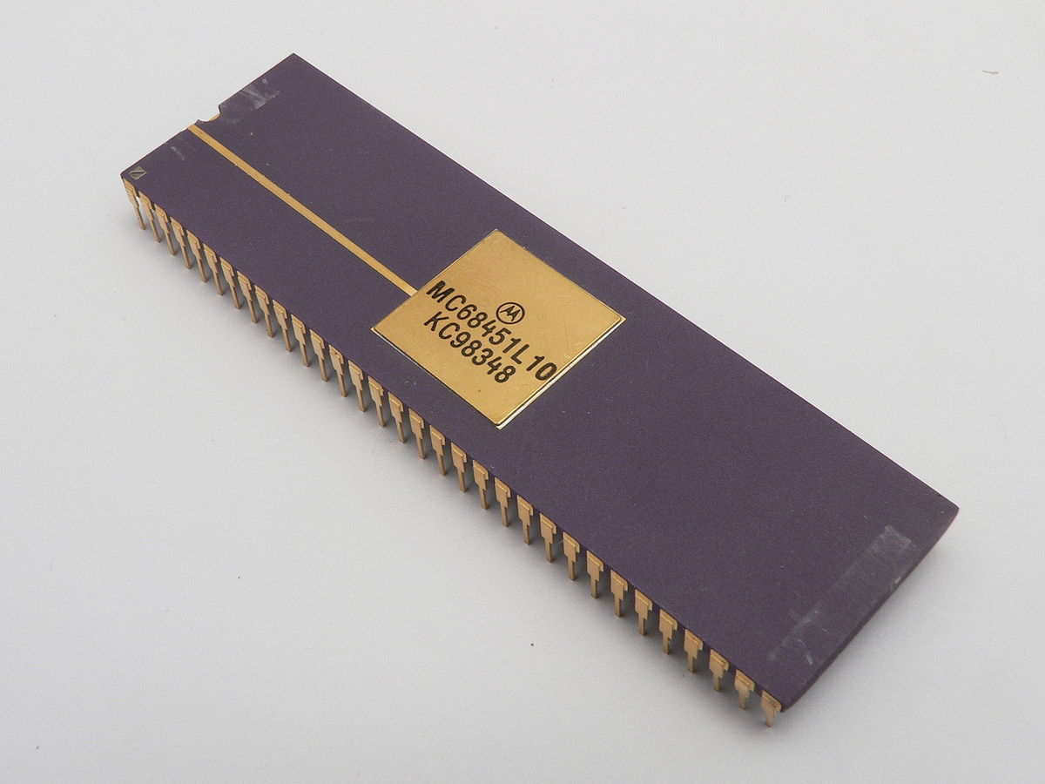
Paging
Process B has 6 pages
Allows processes to be comprised of a number of fixed-size blocks, called pages
Program references a word by means of a virtual address
    consists of a page number and an offset within the page
    each page may be located anywhere in main memory
    Provides for a dynamic mapping between the virtual address used in the program and a real (or physical) address in main memory
MMU
Notes:
Because processes vary in size, if the processor switches among a number of processes it is difficult to pack them compactly into main memory.
Paging systems were introduced, which allow processes to be comprised of a number of fixed-size blocks, called pages.
A program references a word by means of a virtual address consisting of a page number and an offset within the page.
Each page of a process may be located anywhere in main memory.
The paging system provides for a dynamic mapping between the virtual address used in the program and a real address , or physical address, in main memory.
With dynamic mapping hardware available, the next logical step was to
eliminate the requirement that all pages of a process reside in main memory simultaneously.
All the pages of a process are maintained on disk. When a process is
executing, some of its pages are in main memory. If reference is made to a page
that is not in main memory, the memory management hardware detects this and
arranges for the missing page to be loaded. Such a scheme is referred to as virtual
memory and is depicted in Figure 2.9 .
The processor hardware, together with the OS, provides the user with a
“virtual processor” that has access to a virtual memory. This memory may be a
linear address space or a collection of segments, which are variable-length blocks
of contiguous addresses. In either case, programming language instructions can
reference program and data locations in the virtual memory area. Process isolation
can be achieved by giving each process a unique, nonoverlapping virtual memory.
Memory sharing can be achieved by overlapping portions of two virtual memory
spaces. Files are maintained in a long-term store. Files and portions of files may be
copied into the virtual memory for manipulation by programs.

Slide 53
Scheduling and Resource Management
fairness
differential responsiveness
efficiency
Key responsibility of an OS is managing resources
Resource allocation policies must consider:
Notes:
A key responsibility of the OS is to manage the various resources available to it (main memory space, I/O devices, processors) and to schedule their use by the various active processes.
Any resource allocation and scheduling policy must consider three factors:
Fairness:
Typically, we would like all processes that are competing for the use of a particular resource to be given approximately equal and fair access to that resource.
This is especially so for jobs of the same class, that is, jobs of similar demands.
Differential responsiveness:
On the other hand, the OS may need to discriminate among different classes of jobs with different service requirements.
The OS should attempt to make allocation and scheduling decisions to meet the total set of requirements.
The OS should also make these decisions dynamically.
e.g. if a process is waiting for the use of an I/O device, the OS may wish to schedule that process for execution as soon as possible to free up the device for later demands from other processes.
Efficiency:
The OS should attempt to
maximize throughput,
minimize response time, and
accommodate as many users as possible.
These criteria conflict;
Finding the right balance for a particular situation is an ongoing problem for operating system research.

Slide 54
What is the element in each queue?
Notes:
Figure 2.11 suggests the major elements of the OS involved in the scheduling
of processes and the allocation of resources in a multiprogramming environment.
The OS maintains a number of queues, each of which is simply a list of processes
waiting for some resource. The short-term queue consists of processes that are in
main memory (or at least an essential minimum portion of each is in main memory)
and are ready to run as soon as the processor is made available. Any one of these
processes could use the processor next. It is up to the short-term scheduler, or
dispatcher, to pick one. A common strategy is to give each process in the queue
some time in turn; this is referred to as a round-robin technique. In effect, the
round-robin technique employs a circular queue. Another strategy is to assign
priority levels to the various processes, with the scheduler selecting processes in
priority order.
The long-term queue is a list of new jobs waiting to use the processor. The
OS adds jobs to the system by transferring a process from the long-term queue to
the short-term queue. At that time, a portion of main memory must be allocated
to the incoming process. Thus, the OS must be sure that it does not overcommit
memory or processing time by admitting too many processes to the system. There
is an I/O queue for each I/O device. More than one process may request the use of
the same I/O device. All processes waiting to use each device are lined up in that
device’s queue. Again, the OS must determine which process to assign to an available
I/O device.
The OS receives control of the processor at the interrupt handler if an interrupt
occurs. A process may specifically invoke some OS service, such as an I/O
device handler by means of a service call. In this case, a service call handler is the
entry point into the OS. In any case, once the interrupt or service call is handled, the
short-term scheduler is invoked to pick a process for execution.
The foregoing is a functional description; details and modular design of this
portion of the OS will differ in various systems. Much of the research and development
effort in operating systems has been directed at picking algorithms and data
structures for this function that provide fairness, differential responsiveness, and
efficiency.

Slide 55
PCB_{i}
_{PCB1}
_{PCB 5}
_{PCB 3}
Notes:
Figure 2.11 suggests the major elements of the OS involved in the scheduling
of processes and the allocation of resources in a multiprogramming environment.
The OS maintains a number of queues, each of which is simply a list of processes
waiting for some resource. The short-term queue consists of processes that are in
main memory (or at least an essential minimum portion of each is in main memory)
and are ready to run as soon as the processor is made available. Any one of these
processes could use the processor next. It is up to the short-term scheduler, or
dispatcher, to pick one. A common strategy is to give each process in the queue
some time in turn; this is referred to as a round-robin technique. In effect, the
round-robin technique employs a circular queue. Another strategy is to assign
priority levels to the various processes, with the scheduler selecting processes in
priority order.
The long-term queue is a list of new jobs waiting to use the processor. The
OS adds jobs to the system by transferring a process from the long-term queue to
the short-term queue. At that time, a portion of main memory must be allocated
to the incoming process. Thus, the OS must be sure that it does not overcommit
memory or processing time by admitting too many processes to the system. There
is an I/O queue for each I/O device. More than one process may request the use of
the same I/O device. All processes waiting to use each device are lined up in that
device’s queue. Again, the OS must determine which process to assign to an available
I/O device.
The OS receives control of the processor at the interrupt handler if an interrupt
occurs. A process may specifically invoke some OS service, such as an I/O
device handler by means of a service call. In this case, a service call handler is the
entry point into the OS. In any case, once the interrupt or service call is handled, the
short-term scheduler is invoked to pick a process for execution.
The foregoing is a functional description; details and modular design of this
portion of the OS will differ in various systems. Much of the research and development
effort in operating systems has been directed at picking algorithms and data
structures for this function that provide fairness, differential responsiveness, and
efficiency.

Slide 56

Causes of Errors
Improper synchronization
  a program must wait until the data are available in a buffer
  improper design of the signaling mechanism can result in loss or duplication
Nondeterminate program operation
  program execution is interleaved by the processor when memory is shared
  the order in which programs are scheduled may affect their outcome
Deadlocks
  it is possible for two or more programs to be hung up waiting for each other
  may depend on the chance timing of resource allocation and release
Failed mutual exclusion
  more than one user or program attempts to make use of a shared resource at the same time
  only one routine at a time allowed to perform an update against the file
Critical Section
Notes:
Efforts to design a system were vulnerable to subtle programming errors whose effects could be observed only when certain relatively rare sequences of actions occurred.
These errors were difficult to diagnose because they needed to be distinguished from application software errors and hardware errors.
Even when the error was detected, it was difficult to determine the cause, because the precise conditions under which the errors appeared were very hard to reproduce.
In general terms, there are four main causes of such errors:
Improper synchronization:
Often a routine must be suspended awaiting an event elsewhere in the system.
e.g. a program that initiates an I/O read must wait until the data are available in a buffer before proceeding.
In such cases, a signal from some other routine is required.
Improper design of the signalling mechanism can result in signals being lost or duplicate signals being received.
Failed mutual exclusion:
Often more than one user or program will attempt to make use of a shared resource at the same time.
e.g. two users may attempt to edit the same file at the same time.
If these accesses are not controlled, an error can occur.
There must be some sort of mutual exclusion mechanism that permits only one routine at a time to perform an update against the file.
Nondeterminate program operation:
The results of a particular program normally should depend only on the input to that program and not on the activities of other programs in a shared system.
But when programs share memory, and their execution is interleaved by the processor, they may interfere with each other by overwriting common memory areas in unpredictable ways.
Thus, the order in which various programs are scheduled may affect the outcome of any particular program.
Deadlocks:
It is possible for two or more programs to be hung up waiting for each other.
e.g. two programs may each require two I/O devices to perform some operation (e.g., disk to tape copy).
One of the programs has seized control of one of the devices and the other program has control of the other device.
Each is waiting for the other program to release the desired resource.
Such a deadlock may depend on the chance timing of resource allocation and release.

Slide 57
Different Architectural Approaches
Different approaches and design elements have been tried:
microkernel architecture
multithreading
symmetric multiprocessing
distributed operating systems
object-oriented design
Demands on operating systems require new ways of organizing the OS
Notes:
The rate of change in the demands on operating systems requires not just modifications and enhancements to existing architectures but new ways of organizing the OS.
A wide range of different approaches and design elements has been tried in both experimental and commercial operating systems, but much of the work fits into the following categories:
• Microkernel architecture
• Multithreading
• Symmetric multiprocessing
• Distributed operating systems
• Object-oriented design

Slide 58
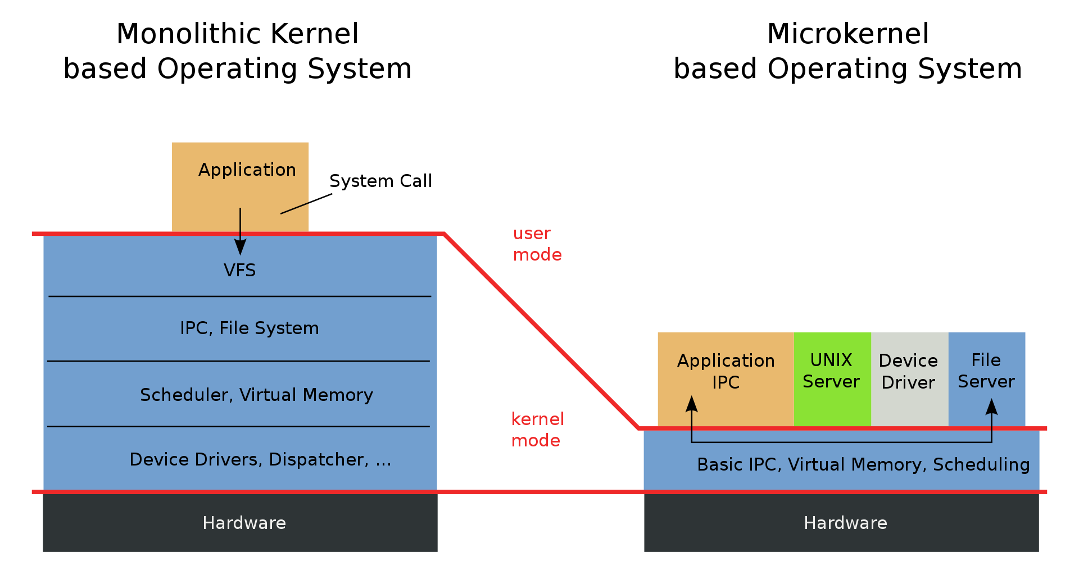
Microkernel Architecture
Microkernels are often smaller than monolithic kernels. The MINIX 3 microkernel, for example, has approximately 12,000 lines of code.
Notes:
Most operating systems, until recently, featured a large monolithic kernel .
Most of what is thought of as OS functionality is provided in these large kernels,
including scheduling, file system, networking, device drivers, memory management,
and more. Typically, a monolithic kernel is implemented as a single process, with
all elements sharing the same address space. A microkernel architecture assigns
only a few essential functions to the kernel, including address spaces, interprocess
communication (IPC), and basic scheduling. Other OS services are provided by
processes, sometimes called servers, that run in user mode and are treated like any
other application by the microkernel. This approach decouples kernel and server
development. Servers may be customized to specific application or environment
requirements. The microkernel approach simplifies implementation, provides flexibility,
and is well suited to a distributed environment. In essence, a microkernel
interacts with local and remote server processes in the same way, facilitating construction
of distributed systems.

Slide 59
Microkernel Architecture
Assigns only a few essential functions to the kernel:
  The approach:
address spaces
interprocess communication (IPC)
basic scheduling
simplifies implementation
provides flexibility
is well suited to a distributed/edge environment
Notes:
Most operating systems, until recently, featured a large monolithic kernel .
Most of what is thought of as OS functionality is provided in these large kernels,
including scheduling, file system, networking, device drivers, memory management,
and more. Typically, a monolithic kernel is implemented as a single process, with
all elements sharing the same address space. A microkernel architecture assigns
only a few essential functions to the kernel, including address spaces, interprocess
communication (IPC), and basic scheduling. Other OS services are provided by
processes, sometimes called servers, that run in user mode and are treated like any
other application by the microkernel. This approach decouples kernel and server
development. Servers may be customized to specific application or environment
requirements. The microkernel approach simplifies implementation, provides flexibility,
and is well suited to a distributed environment. In essence, a microkernel
interacts with local and remote server processes in the same way, facilitating construction
of distributed systems.

Slide 60
OS Design
Distributed Operating System
Object-Oriented Design
Provides the illusion of
  a single main memory space
  single secondary memory space
  unified access facilities
Used for adding modular extensions to a small kernel
Enables programmers to customize an operating system without disrupting system integrity
Eases the development of distributed tools and full-blown distributed operating systems
Notes:
A different problem is to provide the appearance of a single
system for a cluster of separate computers—a multicomputer system. In this
case, we are dealing with a collection of entities (computers), each with its own
main memory, secondary memory, and other I/O modules. A distributed operating
system provides the illusion of a single main memory space and a single secondary
memory space, plus other unified access facilities, such as a distributed file system.
Although clusters are becoming increasingly popular, and there are many cluster
products on the market, the state of the art for distributed operating systems lags
that of uniprocessor and SMP operating systems. We examine such systems in
Part Eight.
Another innovation in OS design is the use of object-oriented technologies.
Object-oriented design lends discipline to the process of adding modular extensions
to a small kernel. At the OS level, an object-based structure enables programmers
to customize an OS without disrupting system integrity. Object orientation also
eases the development of distributed tools and full-blown distributed operating
systems.

Slide 61
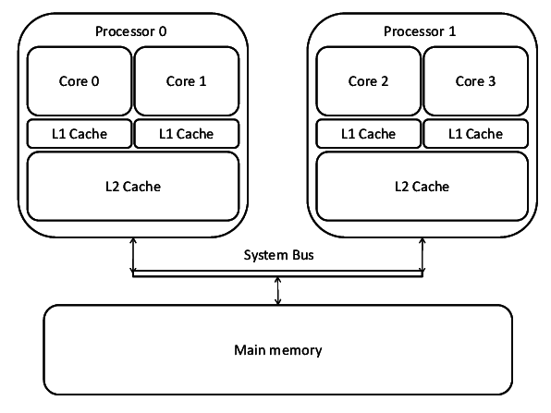
Symmetric Multiprocessing (SMP)
Term that refers to a computer
hardware architecture and also
to the OS behavior that exploits
that architecture
Several processes can run in parallel
Multiple processors are transparent to the user
    these processors share same main memory and I/O facilities
    all processors can perform the same functions
The OS takes care of scheduling of processes on individual processors and of synchronization among processors
Notes:
Symmetric multiprocessing (SMP) is a term that refers to a computer hardware
architecture (described in Chapter 1 ) and also to the OS behavior that exploits
that architecture. The OS of an SMP schedules processes or threads across all of the
processors.
Multithreading and SMP are often discussed together, but the two are
independent facilities. Even on a uniprocessor system, multithreading is useful for
structuring applications and kernel processes. An SMP system is useful even for
nonthreaded processes, because several processes can run in parallel. However, the
two facilities complement each other and can be used effectively together.
An attractive feature of an SMP is that the existence of multiple processors is
transparent to the user. The OS takes care of scheduling of threads or processes on
individual processors and of synchronization among processors.

Slide 62
Concurrent
Parallelism
Notes:
If the work to be done by a computer can be organized so that
some portions of the work can be done in parallel, then a system with multiple
processors will yield greater performance than one with a single processor of
the same type. This is illustrated in Figure 2.12 . With multiprogramming, only
one process can execute at a time; meanwhile all other processes are waiting
for the processor. With multiprocessing, more than one process can be running
simultaneously, each on a different processor.

Slide 63
SMP Advantages
Performance
more than one process can be running simultaneously, each on a different processor
Availability
failure of a single processor does not halt the system
Incremental Growth
performance of a system can be enhanced by adding an additional processor
Scaling
vendors can offer a range of products based on the number of processors configured in the system
Notes:
SMP has a number of potential advantages over uniprocessor architecture,
including the following:
• Performance: If the work to be done by a computer can be organized so that
some portions of the work can be done in parallel, then a system with multiple
processors will yield greater performance than one with a single processor of
the same type. This is illustrated in Figure 2.12 . With multiprogramming, only
one process can execute at a time; meanwhile all other processes are waiting
for the processor. With multiprocessing, more than one process can be running
simultaneously, each on a different processor.
• Availability: In a symmetric multiprocessor, because all processors can perform
the same functions, the failure of a single processor does not halt the
system. Instead, the system can continue to function at reduced performance.
• Incremental growth: A user can enhance the performance of a system by adding
an additional processor.
• Scaling: Vendors can offer a range of products with different price and performance
characteristics based on the number of processors configured in the
system.
It is important to note that these are potential, rather than guaranteed, benefits. The
OS must provide tools and functions to exploit the parallelism in an SMP system.

Slide 64
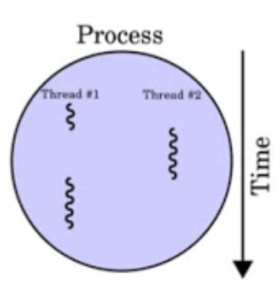
Multithreading
Technique in which a process, executing an application, is divided into threads that can run concurrently
Process
Typically independent
Separate address spaces
Thread
Subset of a process
Has more state information than threads
Multiple threads within a process share process state, memory etc.
Threads share their address space
Notes:
Multithreading is a technique in which a process, executing an application, is
divided into threads that can run concurrently. We can make the following distinction:
• Thread: A dispatchable unit of work. It includes a processor context (which
includes the program counter and stack pointer) and its own data area for a
stack (to enable subroutine branching). A thread executes sequentially and is
interruptible so that the processor can turn to another thread.
• Process : A collection of one or more threads and associated system resources
(such as memory containing both code and data, open files, and devices). This
corresponds closely to the concept of a program in execution. By breaking
a single application into multiple threads, the programmer has great control
over the modularity of the application and the timing of application-related
events.
Multithreading is useful for applications that perform a number of essentially
independent tasks that do not need to be serialized. An example is a database server
that listens for and processes numerous client requests. With multiple threads running
within the same process, switching back and forth among threads involves
less processor overhead than a major process switch between different processes.
Threads are also useful for structuring processes that are part of the OS kernel as
described in subsequent chapters.

Slide 65
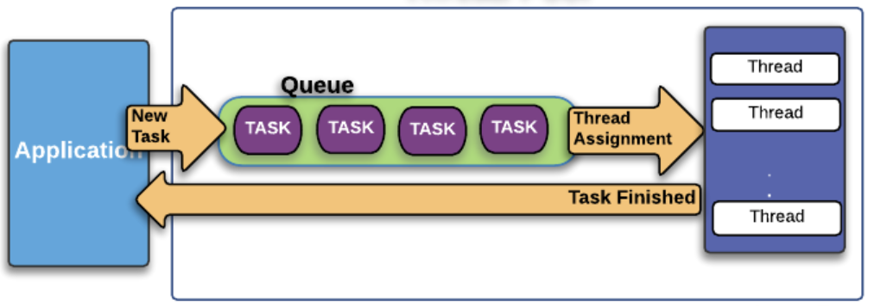
Grand Central Dispatch
Developer must decide what pieces can or should be executed simultaneously or in parallel
Grand Central Dispatch (GCD)
implemented in Mac Os X 10.6
helps a developer once something has been identified that can be split off into a separate task
thread pool mechanism
Notes:
Most applications can, in principle, be
subdivided into multiple tasks that can execute in parallel, with these tasks then
being implemented as multiple processes, perhaps each with multiple threads. The
difficulty is that the developer must decide how to split up the application work into
independently executable tasks. That is, the developer must decide what pieces can
or should be executed asynchronously or in parallel. It is primarily the compiler and
the programming language features that support the parallel programming design
process. But, the OS can support this design process, at minimum, by efficiently
allocating resources among parallel tasks as defined by the developer.
Perhaps the most effective initiative to support developers is implemented in
the latest release of the UNIX-based Mac OS X operating system. Mac OS X 10.6
includes a multicore support capability known as Grand Central Dispatch (GCD).
GCD does not help the developer decide how to break up a task or application into
separate concurrent parts. But once a developer has identified something that can
be split off into a separate task, GCD makes it as easy and noninvasive as possible
to actually do so.
In essence, GCD is a thread pool mechanism, in which the OS maps tasks onto
threads representing an available degree of concurrency (plus threads for blocking
on I/O). Windows also has a thread pool mechanism (since 2000), and thread
pools have been heavily used in server applications for years. What is new in GCD
is the extension to programming languages to allow anonymous functions (called
blocks) as a way of specifying tasks. GCD is hence not a major evolutionary step.
Nevertheless, it is a new and valuable tool for exploiting the available parallelism of
a multicore system.
One of Apple’s slogans for GCD is “islands of serialization in a sea of concurrency.”
That captures the practical reality of adding more concurrency to run-of-the-mill
desktop applications. Those islands are what isolate developers from the thorny
problems of simultaneous data access, deadlock, and other pitfalls of multithreading.
Developers are encouraged to identify functions of their applications that would be
better executed off the main thread, even if they are made up of several sequential or
otherwise partially interdependent tasks. GCD makes it easy to break off the entire
unit of work while maintaining the existing order and dependencies between subtasks.
In later chapters, we look at some of the details of GCD.

Slide 66
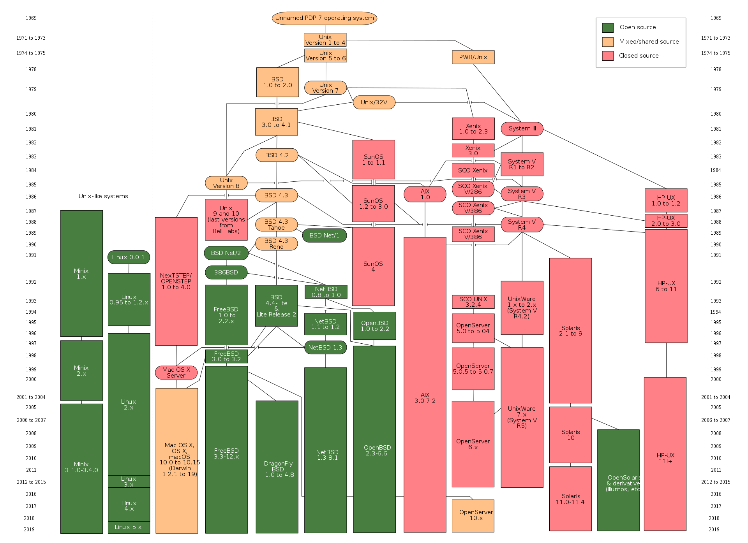
History of Linux

Slide 67
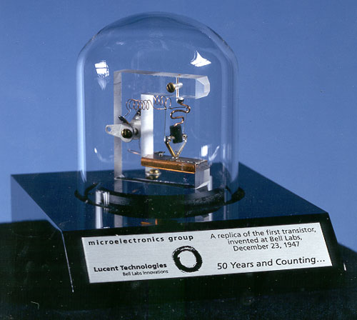
Traditional UNIX Systems
Were developed at Bell Labs and became operational on a PDP-7 in 1970
PDP-11 was a milestone because it first showed that UNIX would be an OS for all computers
Next milestone was rewriting UNIX in the programming language C
    It was generally felt that something as complex as an OS, which must deal with time-critical events, had to be written exclusively in assembly language
    demonstrated the advantages of using a high-level language for system code
    Version 7, released in 1978 is the ancestor of most modern UNIX systems
    Most important of the non-AT&T systems was UNIX BSD (Berkeley Software Distribution)
Notes:
The history of UNIX is an oft-told tale and will not be repeated in great detail here.
Instead, we provide a brief summary.
UNIX was initially developed at Bell Labs and became operational on a
PDP-7 in 1970. Some of the people involved at Bell Labs had also participated in
the time-sharing work being done at MIT’s Project MAC. That project led to the
development of first CTSS and then Multics. Although it is common to say that
the original UNIX was a scaled-down version of Multics, the developers of UNIX
actually claimed to be more influenced by CTSS [RITC78]. Nevertheless, UNIX
incorporated many ideas from Multics.
Work on UNIX at Bell Labs, and later elsewhere, produced a series of versions
of UNIX. The first notable milestone was porting the UNIX system from the PDP-7 to
the PDP-11. This was the first hint that UNIX would be an OS for all computers. The
next important milestone was the rewriting of UNIX in the programming language
C. This was an unheard-of strategy at the time. It was generally felt that something as
complex as an OS, which must deal with time-critical events, had to be written exclusively
in assembly language. Reasons for this attitude include the following:
• Memory (both RAM and secondary store) was small and expensive by today’s
standards, so effective use was important. This included various techniques for
overlaying memory with different code and data segments, and self-modifying
code.
• Even though compilers had been available since the 1950s, the computer
industry was generally skeptical of the quality of automatically generated
code. With resource capacity small, efficient code, both in terms of time and
space, was essential.
• Processor and bus speeds were relatively slow, so saving clock cycles could
make a substantial difference in execution time.
The C implementation demonstrated the advantages of using a high-level
language for most if not all of the system code. Today, virtually all UNIX implementations
are written in C.
These early versions of UNIX were popular within Bell Labs. In 1974, the
UNIX system was described in a technical journal for the first time [RITC74]. This
spurred great interest in the system. Licenses for UNIX were provided to commercial
institutions as well as universities. The first widely available version outside Bell
Labs was Version 6, in 1976. The follow-on Version 7, released in 1978, is the ancestor
of most modern UNIX systems. The most important of the non-AT&T systems
to be developed was done at the University of California at Berkeley, called UNIX
BSD (Berkeley Software Distribution), running first on PDP and then VAX computers.
AT&T continued to develop and refine the system. By 1982, Bell Labs had
combined several AT&T variants of UNIX into a single system, marketed commercially
as UNIX System III. A number of features was later added to the OS to
produce UNIX System V.

Slide 68
Notes:
Figure 2.15 provides a general description of the classic UNIX architecture. The
underlying hardware is surrounded by the OS software. The OS is often called the
system kernel, or simply the kernel, to emphasize its isolation from the user and applications.
It is the UNIX kernel that we will be concerned with in our use of UNIX as
an example in this book. UNIX also comes equipped with a number of user services
and interfaces that are considered part of the system. These can be grouped into
the shell, other interface software, and the components of the C compiler (compiler,
assembler, loader). The layer outside of this consists of user applications and the user
interface to the C compiler.

Slide 69
Notes:
A closer look at the kernel is provided in Figure 2.16 . User programs can
invoke OS services either directly or through library programs. The system call
interface is the boundary with the user and allows higher-level software to gain
access to specific kernel functions. At the other end, the OS contains primitive routines
that interact directly with the hardware. Between these two interfaces, the
system is divided into two main parts, one concerned with process control and the
other concerned with file management and I/O. The process control subsystem is
responsible for memory management, the scheduling and dispatching of processes,
and the synchronization and interprocess communication of processes. The file system
exchanges data between memory and external devices either as a stream of
characters or in blocks. To achieve this, a variety of device drivers are used. For
block-oriented transfers, a disk cache approach is used: A system buffer in main
memory is interposed between the user address space and the external device.

Slide 70
Notes:
As UNIX evolved, the number of different implementations proliferated, each providing
some useful features. There was a need to produce a new implementation that
unified many of the important innovations, added other modern OS design features,
and produced a more modular architecture. Typical of the modern UNIX kernel is
the architecture depicted in Figure 2.17 . There is a small core of facilities, written in
a modular fashion, that provide functions and services needed by a number of OS
processes. Each of the outer circles represents functions and an interface that may
be implemented in a variety of ways.

Slide 71
System V Release 4 (SVR4)
Developed jointly by AT&T and Sun Microsystems, first released in 1983.
Combines features from SVR3, 4.3BSD, Microsoft Xenix System V, and SunOS
New features in the release include:
    real-time processing support
    process scheduling classes
    dynamically allocated data structures
    virtual memory management
    virtual file system
    preemptive kernel
Notes:
SVR4, developed jointly by AT&T and Sun Microsystems, combines features from
SVR3, 4.3BSD, Microsoft Xenix System V, and SunOS. It was almost a total rewrite
of the System V kernel and produced a clean, if complex, implementation. New features
in the release include real-time processing support, process scheduling classes,
dynamically allocated data structures, virtual memory management, virtual file system,
and a preemptive kernel.
SVR4 draws on the efforts of both commercial and academic designers and
was developed to provide a uniform platform for commercial UNIX deployment. It
has succeeded in this objective and is perhaps the most important UNIX variant. It
incorporates most of the important features ever developed on any UNIX system
and does so in an integrated, commercially viable fashion. SVR4 runs on processors
ranging from 32-bit microprocessors up to supercomputers.

Slide 72
BSD
Berkeley Software Distribution
4.xBSD is widely used in academic installations and has served as the basis of a number of commercial UNIX products
4.4BSD was the final version of BSD to be released by Berkeley
    major upgrade to 4.3BSD
    includes
      a new virtual memory system
      changes in the kernel structure
      several other feature enhancements
FreeBSD
    one of the most widely used and best documented versions
    popular for Internet-based servers and firewalls
    used in a number of embedded systems
    Mac OS X is based on FreeBSD 5.0 and the Mach 3.0 microkernel
Notes:
The Berkeley Software Distribution (BSD) series of UNIX releases have played
a key role in the development of OS design theory. 4.xBSD is widely used in academic
installations and has served as the basis of a number of commercial UNIX
products. It is probably safe to say that BSD is responsible for much of the popularity
of UNIX and that most enhancements to UNIX first appeared in BSD versions.
4.4BSD was the final version of BSD to be released by Berkeley, with the design
and implementation organization subsequently dissolved. It is a major upgrade
to 4.3BSD and includes a new virtual memory system, changes in the kernel structure,
and a long list of other feature enhancements.
One of the most widely used and best documented versions of BSD is
FreeBSD. FreeBSD is popular for Internet-based servers and firewalls and is used
in a number of embedded systems.
The latest version of the Macintosh OS, Mac OS X, is based on FreeBSD 5.0
and the Mach 3.0 microkernel.

Slide 73
Solaris 10
Sun’s SVR4-based UNIX release
Provides all of the features of SVR4 plus a number of more advanced features such as:
    a fully preemptable, multithreaded kernel
    full support for SMP
    an object-oriented interface to file systems
Most widely used and most successful commercial UNIX implementation
Notes:
Solaris is Sun’s SVR4-based UNIX release, with the latest version being 10. Solaris
provides all of the features of SVR4 plus a number of more advanced features, such
as a fully preemptable, multithreaded kernel, full support for SMP, and an object oriented
interface to file systems. Solaris is the most widely used and most successful
commercial UNIX implementation.

Slide 74
LINUX Overview
Started out as a UNIX variant for the IBM PC
Linus Torvalds, a Finnish student of computer science, wrote the initial version
Linux was first posted on the Internet in 1991
Today it is a full-featured UNIX system that runs on several platforms
Is free and the source code is available
Key to success has been the availability of free software packages
Highly modular and easily configured
Notes:
Linux started out as a UNIX variant for the IBM PC (Intel 80386) architecture.
Linus Torvalds, a Finnish student of computer science, wrote the initial version.
Torvalds posted an early version of Linux on the Internet in 1991. Since then, a
number of people, collaborating over the Internet, have contributed to the development
of Linux, all under the control of Torvalds. Because Linux is free and the
source code is available, it became an early alternative to other UNIX workstations,
such as those offered by Sun Microsystems and IBM. Today, Linux is a full-featured
UNIX system that runs on all of these platforms and more, including Intel Pentium
and Itanium, and the Motorola/IBM PowerPC.
Key to the success of Linux has been the availability of free software packages
under the auspices of the Free Software Foundation (FSF). FSF’s goal is stable,
platform-independent software that is free, high quality, and embraced by the user
community. FSF’s GNU project 3 provides tools for software developers, and the
GNU Public License (GPL) is the FSF seal of approval. Torvalds used GNU tools
in developing his kernel, which he then released under the GPL. Thus, the Linux
distributions that you see today are the product of FSF’s GNU project, Torvald’s
individual effort, and the efforts of many collaborators all over the world.
In addition to its use by many individual programmers, Linux has now made
significant penetration into the corporate world. This is not only because of the
free software, but also because of the quality of the Linux kernel. Many talented
programmers have contributed to the current version, resulting in a technically
impressive product. Moreover, Linux is highly modular and easily configured. This
makes it easy to squeeze optimal performance from a variety of hardware platforms.
Plus, with the source code available, vendors can tweak applications and utilities to
meet specific requirements. Throughout this book, we will provide details of Linux
kernel internals based on the most recent version, Linux 3.10, released in June of 2013.

Slide 75
Modular Monolithic Kernel
Includes virtually all of the OS functionality in one large block of code that runs as a single process with a single address space
All the functional components of the kernel have access to all of its internal data structures and routines
Linux is structured as a collection of modules
Loadable Modules
Relatively independent blocks
A module is an object file whose code can be linked to and unlinked from the kernel at runtime
A module is executed in kernel mode on behalf of the current process
Have two important characteristics:
    dynamic linking
    stackable modules
Notes:
Although Linux does not use a microkernel approach, it achieves many of the potential advantages of this approach by means of its particular modular architecture.
Linux is structured as a collection of modules, a number of which can be automatically loaded and unloaded on demand.
These relatively independent blocks are referred to as loadable modules.
In essence, a module is an object file whose code can be linked to and unlinked from the kernel at runtime.
The Linux loadable modules have two important characteristics:
Dynamic linking: A kernel module can be loaded and linked into the kernel while the kernel is already in memory and executing.
A module can also be unlinked and removed from memory at any time.
Saves kernel memory.
Stackable modules: The modules are arranged in a hierarchy.
Individual modules serve as libraries when they are referenced by client modules higher up in the hierarchy, and as clients when they reference modules further down.

Slide 76
Notes:
Figure 2.18 is an example that illustrates the structures used by Linux to
manage modules. The figure shows the list of kernel modules after only two modules
have been loaded: FAT and VFAT. Each module is defined by two tables, the module
table and the symbol table. The module table includes the following elements:
• * next: Pointer to the following module. All modules are organized into a
linked list. The list begins with a pseudomodule (not shown in Figure 2.19 ).
• * name: Pointer to module name
• size: Module size in memory pages
• usecount: Module usage counter. The counter is incremented when an operation
involving the module’s functions is started and decremented when the
operation terminates.
flags: Module flags
• nsyms: Number of exported symbols
• ndeps: Number of referenced modules
• * syms: Pointer to this module’s symbol table.
• * deps: Pointer to list of modules that are referenced by this module.
• * refs: Pointer to list of modules that use this module.
The symbol table defines those symbols controlled by this module that are
used elsewhere.
Figure 2.18 shows that the VFAT module was loaded after the FAT module
and that the VFAT module is dependent on the FAT module.

Slide 77
Notes:
Figure 2.19 , taken from [MOSB02], shows the main components of the Linux kernel
as implemented on an IA-64 architecture (e.g., Intel Itanium). The figure shows
several processes running on top of the kernel. Each box indicates a separate process,
while each squiggly line with an arrowhead represents a thread of execution. 4
The kernel itself consists of an interacting collection of components, with arrows
indicating the main interactions. The underlying hardware is also depicted as a
set of components with arrows indicating which kernel components use or control
which hardware components. All of the kernel components, of course, execute on
the processor but, for simplicity, these relationships are not shown.

Slide 78
Linux Signals
Table 2.6 Some Linux Signals
Notes:
The kernel uses signals to call into a process. For example, signals are
used to notify a process of certain faults, such as division by zero. Table 2.6
gives a few examples of signals.

Slide 79
Table 2.7 Some Linux System Calls (page 1 of 2)
Notes:
System calls: The system call is the means by which a process requests a specific
kernel service. There are several hundred system calls, which can be roughly
grouped into six categories: file system, process, scheduling, interprocess communication,
socket (networking), and miscellaneous. Table 2.7 defines a few
examples in each category.
• Processes and scheduler: tes, manages, and schedules processes.
• Virtual memory: Allocates and manages virtual memory for processes.
• File systems: Provide a global, hierarchical namespace for files, directories,
and other file-related objects and provide file system functions.
• Network protocols: Support the Sockets interface to users for the TCP/IP protocol
suite.
• Character device drivers: Manage devices that require the kernel to send or
receive data one byte at a time, such as terminals, modems, and printers.
• Block device drivers: Manage devices that read and write data in blocks, such
as various forms of secondary memory (magnetic disks, CD-ROMs, etc.).
• Network device drivers: Manage network interface cards and communications
ports that connect to network devices, such as bridges and routers.
• Traps and faults: Handle traps and faults generated by the processor, such as a
memory fault.
• Physical memory: Manages the pool of page frames in real memory and allocates
pages for virtual memory.
• Interrupts Handle interrupts from peripheral devices.

Slide 80
Table 2.7 Some Linux System Calls (page 2 of 2)

Slide 81
Summary
Operating system objectives and functions
  User/computer interface
  Resource manager
    Evolution of operating systems
  Serial processing
  Simple/multiprogrammed/time-sharing batch systems
    Major achievements
    Developments leading to modern operating systems
    OS design considerations for multiprocessor and multicore
Traditional Unix systems
  History/description
Modern Unix systems
  System V Release 4 (SVR4), BSD, Solaris 10
Linux
  History
  Modular structure
  Kernel components
Notes:
Summary of Chapter 2.

Slide 82
Problem Time
Assume the scheduler in the OS will not start a job unless there are five tape drives available. When a job is started, five drives are assigned immediately and are not released until the job finishes. What is the maximum number of jobs that can be in progress at once? What are the maximum and minimum number of tape drives that may be left idle as a result of this policy?

Slide 83
Problem Time
Assume the scheduler in the OS will not start a job unless there are five tape drives available. When a job is started, five drives are assigned immediately and are not released until the job finishes. What is the maximum number of jobs that can be in progress at once? What are the maximum and minimum number of tape drives that may be left idle as a result of this policy?

Slide 84
Problem Time
b) Suggest an alternative policy to improve tape drive utilization and at the same time avoid system deadlock. What is the maximum number of jobs that can be in progress at once? What are the bounds on the number of idling tape drives?
Hold 3 and request additional 2
max number of jobs = 6,
max idle = 15
min idle = 0
Notes:
max number of jobs = 6, max idle = 15(or 2, depending on if drives are still
being utilized while waiting on last 2) min idle = 0

