Slide 1
Structural Patterns
Case: Document Editor

Slide 2
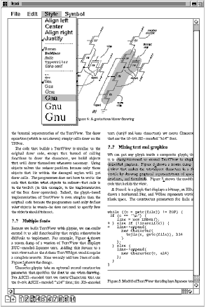
Document Editor
Classical example in the GoF book = Lexi
(modified)
Document is mix of graphics and text with formatting styles.
Surroundings are scrollbars, menus, page icons
Design problems
Document structure impacts the design of the rest of the application
Supporting multiple window systems
Effects and links on items in the document
Note: we design a document model and its rendering logic, not all interactions
Notes:
There are other design problems; we will revisit it later at behavioral design patterns.
Document structure. The choice of internal representation for the document affects nearly every aspect of Lexi's design. All editing, formatting, displaying, and textual analysis will require traversing the representation. The way we organize this information will impact the design of the rest of the application.
(LATER) Formatting. How does Lexi actually arrange text and graphics into lines and columns? What objects are responsible for carrying out different formatting policies? How do these policies interact with the document's internal representation?
Embellishing the user interface. Lexi's user interface includes scroll bars, borders, and drop shadows that embellish the WYSIWYG document interface. Such embellishments are likely to change as Lexi's user interface evolves. Hence it's important to be able to add and remove embellishments easily without affecting the rest of the application.
(CREATIONAL) Supporting multiple look-and-feel standards. Lexi should adapt easily to different look-and-feel standards such as Motif and Presentation Manager (PM) without major modification.
Supporting multiple window systems. Different look-and-feel standards are usually implemented on different window systems. Lexi's design should be as independent of the window system as possible.
(BEHAVIORAL)User operations. Users control Lexi through various user interfaces, including buttons and pull-down menus. The functionality behind these interfaces is scattered throughout the objects in the application. The challenge here is to provide a uniform mechanism both for accessing this scattered functionality and for undoing its effects.
(BEHAVIORAL)Spelling checking and hyphenation. How does Lexi support analytical operations such as checking for misspelled words and determining hyphenation points? How can we minimize the number of classes we have to modify to add a new analytical operation?

Slide 3
Requirements
Document structure:
Document contains text, images, and drawings
Fonts and style settings
Effects attached to anything
Hyperlinks, shadows, backgrounds
Support multiple window systems
portability
as independent of the window system as possible
Document can be processed on demand
Able to convert the document to other languages
Notes:
Document structure: The choice will affect rest of the application: editing, formatting, displaying, and textual analysis will require traversing the representation.
Supporting multiple window systems. as independent of the window system as possible

Slide 4
Document Structure: Req -1.1
Arrangement of text, lines, images, columns, figures, tables, …
Should allow manipulations as a group
e.g. refer to a table as a whole
e.g., treat a diagram as a unit rather than as a collection of individual graphical primitives
Simple interface for the client i.e. GUI objects (view)
Internal representation should support
Maintaining the physical structure
Generating and presenting the visuals
Reverse mapping positions to elements
i.e., Given a point, does it intersect with this element?
Notes:
Methods for:
Maintaining the document's physical structure, that is, the arrangement of text and graphics into lines, columns, tables, etc.
Generating and presenting the document visually. --draw
Mapping positions on the display to elements in the internal representation. This lets Lexi determine what the user is referring to when he points to something in the visual representation.
(Whenever the user clicks somewhere in the document, Lexi calls “intersect” to determine which glyph or glyph structure is under the mouse. )
Lexi's user interface should let users manipulate these substructures directly. For example, a user should be able to treat a diagram as a unit rather than as a collection of individual graphical primitives. The user should be able to refer to a table as a whole, not as an unstructured mass of text and graphics. That helps make the interface simple and intuitive. To give Lexi's implementation similar qualities, we'll choose an internal representation that matches the document's physical structure.

Slide 5
Document Structure: Req-1.2
Should treat text and graphics uniformly
Avoid treating graphics as special case of text
One set of manipulation mechanism should work for both text and graphics
No distinction between single elements or groups.
E.g., the 10th element in line 5 could be a single character, or a complex diagram comprising nested subparts.
As long as an element can draw itself and knows its dimensions, its complexity has no effect on how and where it should appear on the page.
Notes:
Opposing the second constraint, however, is the need to analyze the text for such things as spelling errors and potential hyphenation points. Often we don't care whether the element of a line is a simple or complex object. But sometimes an analysis depends on the objects being analyzed. It makes little sense, for example, to check the spelling of a polygon or to hyphenate it. The internal representation's design should take this and other potentially conflicting constraints into account.
--
First, we should treat text and graphics uniformly. The application's interface lets the user embed text within graphics freely and vice versa. We should avoid treating graphics as a special case of text or text as a special case of graphics; otherwise we'll end up with redundant formatting and manipulation mechanisms. One set of mechanisms should suffice for both text and graphics.
Second, our implementation shouldn't have to distinguish between single elements and groups of elements in the internal representation. Lexi should be able to treat simple and complex elements uniformly, thereby allowing arbitrarily complex documents. The tenth element in line five of column two, for instance, could be a single character or an intricate diagram with many subelements. As long as we know this element can draw itself and specify its dimensions, its complexity has no bearing on how and where it should appear on the page.

Slide 6
Document Structure
Arrangement of text, lines, images, columns, figures, tables
Image or Picture
Text
sequence of characters a.k.a letters
with different fonts and styles
Drawing
polygons, lines, text
Figure
Image, drawing, text, sub figure
Table
Rows and columns
Let’s have a common name: Glyph

Slide 7
Document Structure:
Composite pattern
Glyph
Note:
this one favors transparency.
alternative: child ops in composite
…operations..
+add(Glyph,int)
+remove(Glyph)
+getChild(int)
+getParent()
* children
Composite
Line
for(auto c:children)
c.operation();
….
+operation()
Text
Image
Rectangle
Table
Figure
Drawing

Slide 8
Design the Component/Glyph
Requirement
Internal representation should support
Generating and presenting the visuals
Reverse mapping positions to elements
Maintaining the physical structure
Responsibility
how to draw themselves,
what space they occupy, hit detection
Structure

Slide 9
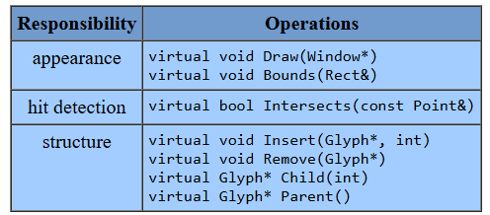
Design the Glyph Component
Responsibility | Operations
Appearance | abstract void draw(Window) abstract void bounds(Rect)
Hit detection | abstract boolean intersect(Point)
Structure:
abstract void addChild(Glyph)
abstract void remove(Glyph)
abstract Glyph getChild(int)
Glyph getParent()
Notes:
I want to implement child management with default behavior in the composite abstract class
The parent link is inside the Component interface; therefore, it is an abstract class in Java
The Bounds operation returns the rectangular area that the glyph occupies. It returns the opposite corners of the smallest rectangle that contains the glyph. Glyph subclasses redefine this operation to return the rectangular area in which they draw.

Slide 10
Images at startup
Expensive to create images, opening a document should be fast
Solution
Delay creation and loading of images until they are on demand
Load and draw the images that are only in the current page
A (virtual) Proxy in place of images in the document
Glyph
Image
ImageProxy
realImage

Slide 11
class ImageProxy : public Glyph {
public:
ImageProxy(const char* fileN);
virtual ~ImageProxy();
virtual void Draw(Window * w);
virtual void Bounds(Rect& r);
/* ..other methods …*/
protected:
Image* GetImage();
private:
Image* _image;
char* _fileName;
};
class Image : public Glyph {
public:
// loads image from a file
Image(const char* fileN);
virtual ~Image();
virtual void Draw(Window* w);
virtual void Bounds(Rect& r);
/*…other methods...*/
};
Client code:
Glyph doc; //……
doc->Insert(new ImageProxy("anImageFileName"),index);

Slide 12
class ImageProxy : public Glyph {
public:
ImageProxy(const char* fileN);
virtual ~ImageProxy();
virtual void Draw(Window * w);
virtual void Bounds(Rect& r);
/* ..other methods …*/
protected:
Image* GetImage();
private:
Image* _image;
char* _fileName;
};
ImageProxy::ImageProxy (const char* fileN) {
_fileName = strdup(fileN);
_image = 0;
}
Image* ImageProxy::GetImage() {
if (_image == 0) { //do this in a thread
_image = new Image(_fileName);
}
return _image;
}
void ImageProxy::Draw (Window* w) {
GetImage()->Draw(w);
//once image is loaded,
// this is a simple delegation
}
Client code:
Glyph doc; //……
doc->Insert(new ImageProxy("anImageFileName"),index);

Slide 13
Want to use an existing Text Impl
There is already a text class (TextView) with fonts associated to each letter
Designed earlier or came with a library
TextView does not support draw() and bounds(), instead it has printText() and getTextBounds()
Solution: Adapter
A Text object adapts TextView to Glyph
Notes:
This is not the TextView in Android

Slide 14
Adapting TextView
Glyph
…operations..
+add(Glyph,int)
+remove(Glyph)
+getChild(int)
+getParent()
* children
TextView
+printText()
+getTextBounds()
text
Composite
Line
Rectangle
Text
+draw()
+bounds()
+intersect()
Image
ImageProxy
Figure
Table
Drawing

Slide 15
Adapting TextView
Glyph
…operations..
+add(Glyph,int)
+remove(Glyph)
+getChild(int)
+getParent()
* children
TextView
+printText()
+getTextBounds()
text
Composite
Text
+draw()
+bounds()
+intersect()
// Text class is the Adapter
void Text::draw(Window* w) {
_adaptee->printText();
// The adapter forwards the call,
//translating the interface
}
Image
ImageProxy

Slide 16
R2:Adding the Effects and Links
Req: Effects can be attached to anything
Any Glyph (text, image, etc.) can have a hyperlink or a shadow
Hyperlinks, shadows can be added and removed at runtime
Inheritance is impractical
Don’t crowd the Glyph -ISP
Decorator
Hyperlink decorator
Shadow decorator
Notes:
Don’t crowd the glyph with flags or methods like following the link

Slide 17
Effects as Decorator
Glyph
inner
+draw(Window)
Image
Text
ADecorator
+draw()
+draw()
+draw(Window)
public void draw(Window w)
{ inner.draw(w);}
Make it default implementation
ShadowDecorator
HyperLinkDecorator
{ super.draw(w);
addShadow();}
isShadowed:boolean
+draw(Window w)
+draw(Window w)
+followLink()
Notes:
Adding new subclasses to the decorator

Slide 18
Usage
Create a text with shadow and hyperlink
Glyph component=new Text();
component=new ShadowDecorator(component);
//adding a shadow
component=new HyperlinkDecorator(component);
//adding a hyperlink
Now use this component in the windowing system. The window only sees it as a Glyph.
You can directly interact with it and follow the link as well.
Notes:
Can use builder as well
Decorator to extends the super class
Component.draw(), component.shadow()

Slide 19
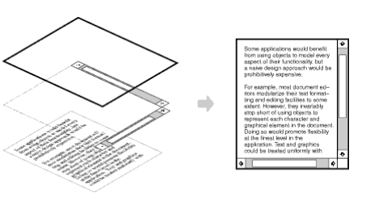
Borders and Scrollbar –GoF ex.
Add borders to any part: see Decorator lecture
*
children
Glyph
Text
Line
ADecorator
Composite
+
+draw
public void draw(Window w)
{ inner->draw(w);}
ShadowDecorator
HyperLinkDecorator
Border
Scrollbar
isShadowed:boolean
+draw(Window w)
+draw(Window w)
+followLink()
+draw(Window w)
+draw(Window w)
+scroll()
Notes:
Glyph and Adecorator should be solid line

Slide 20
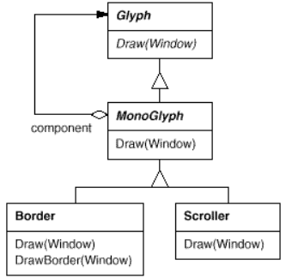


Borders and Scrollbar
MonoGlyph is the DefaultDecorator

Slide 21
R3: Support Multiple Window Systems
Window system portability
Multiplatform windows sys: Qt, GTK, wxWidgets
MS Windows, X Window, Quartz
We have several class hierarchies from different vendors.
highly unlikely these hierarchies are compatible
different window systems have incompatible programming interfaces.
Same problem for multiple DBMS
Notes:
“Suppose we already have several class hierarchies from different vendors, one for each look-and-feel standard. Of course, it's highly unlikely these hierarchies are compatible in any way. Hence we won't have a common abstract product class for each kind of widget ”
all window systems do generally the same thing. We need a uniform set of windowing abstractions that lets us take different window system implementations and slide any one of them under a common interface.

Slide 22
R3: Support Multiple Window Systems
Window system portability
We have several class hierarchies from different vendors.
Let’s say Qt and GTK
All window systems do the same thing.
We want a uniform set of windowing abstraction that lets us use any window system implementation
Use any one of them under a common interface
Notes:
“Suppose we already have several class hierarchies from different vendors, one for each look-and-feel standard. Of course, it's highly unlikely these hierarchies are compatible in any way. Hence we won't have a common abstract product class for each kind of widget ”
all window systems do generally the same thing. We need a uniform set of windowing abstractions that lets us take different window system implementations and slide any one of them under a common interface.

Slide 23
Portable to Window Systems
Bridge Pattern
// Client code that sets up the bridge
Window* myWindow = new ApplicationWindow();
WindowImp* imp = new XWindowImp(); //choose 1
myWindow->setImplementation(imp);
Window
WindowImpl
+drawRectangle()
+devDrawLine()
GTK_Impl
Qt_Impl
IconWindow
Dialog
XWindowsImpl
MSWindowsImpl
+devDrawLine()
+devDrawLine()

Slide 24
Window abstraction
Recall Glyph::draw(Window *w)
Window abstraction
provide operations for drawing basic geometric shapes. (graphics)
resize themselves. (window management)
iconify and de-iconify themselves. (window mng)
(re)draw their contents on demand,
for example, when they are de-iconified or when an overlapped and obscured portion of their screen space is exposed. (window management)
Alternatively, we may choose to intersect or to unify functionalities of each windowing system

Slide 25
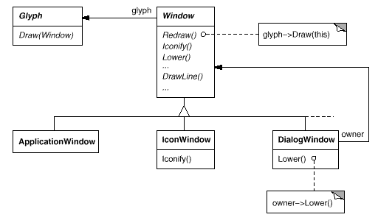
Window Abstraction
Client:
We could specialize Window abstraction as application windows, icon window, and warning dialogs

Slide 26
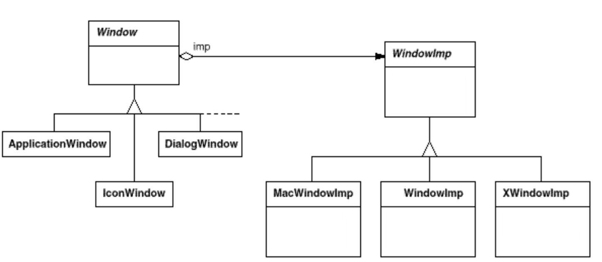
Bridge Pattern
drawLine
drawRectangle
…
devDrawLine
drawRect
….
MS
devDrawLine
drawRect
….
devDrawLine
drawRect
….
devDrawLine
drawRect
….
XWindow
+XDrawRectangle
….

Slide 27
Bridge in Action
public class Rectangle extends Glyph {
public void draw(Window w) { w.drawRectangle(x0,y0,x1,y1); }
...
}
public class Window {
public void drawRectangle(Coord x0,y0,x1,y1) {
imp.drawRect(x0,y0,x1,y1);
}
...
}
public class XWindowImp extends WindowImp {
public void drawRect(Coord x0,Coord y0,Coord x1,Coord y1) {
...
XDrawRectangle(display, _winId, graphics, x,y,w,h);
}
}

Slide 28
R4: Document Processing
R4:Process document on demand
There is have a subsystem that converts a document to other languages
Parser, dictionary, grammar rules, etc
Façade: Translator
Have a TranslatorFaçade to provide a unified interface of translation subsystem to the document editor
DocumentEditor
TranslatorFacade
+translate()
Parser
Dictionary
Translation subsystem
Notes:
The goal is to decouple the document editor from the complexity of the translation subsystem. This means you could completely replace the translation subsystem with a different one, and as long as the new one is wrapped in the same Façade, the document editor code would not need to change

Slide 29
R4: Document Processing
Façade: Translator
provides a unified interface of translation subsystem to the editor
Goal: decouple the Editor from the complexity of the translation subsystem.
we can completely replace the translation subsystem with a different one, and as long as the new one is wrapped in the same Façade, the document editor code would not need to change
DocumentEditor
TranslatorFacade
+translate()
Parser
Dictionary
Translation subsystem

Slide 30
Formatting Problem
Requirement: Each character in the document can have its own font, size, style (italic), and color.
Create a "Style" object for every single character?
Suppose we do not use an existing the Text manipulation class, TextView anymore.
Notes:
Editors do not use the flyweight pattern for individual characters. Word uses flyweights for formatting objects, keeping them separate from the text; there is no Letter class. VS Code uses ropes for string manipulation, also without a Letter class

Slide 31
Formatting Problem
Requirement: Each character in the document can have its own font, size, style (italic), and color.
Create a "Style" object for every single character?
Problem: This is incredibly wasteful.
If a paragraph of 500 characters is styled as "Arial 12pt," you would create 500 identical "Arial 12pt" objects.
This leads to massive memory consumption.
Suppose we do not use an existing the Text manipulation class, TextView anymore.
Notes:
Editors do not use the flyweight pattern for individual characters. Word uses flyweights for formatting objects, keeping them separate from the text; there is no Letter class. VS Code uses ropes for string manipulation, also without a Letter class

Slide 32
Flyweight for Formatting
# of unique formatting combinations is very small
share formatting objects. E.g. an object for Arial12pt.
Flyweight: Style objects.
Intrinsic State: use definition of the style
font name, size, color, italic, bold
"Arial", 12, "Bold", "Black"
Extrinsic State:
the range of characters that use this style
e.g., from character position 5,328 to 5,828.
this Context is managed by the document model

Slide 33
Flyweight
Glyph
*
Style
+apply(range)
+draw(Window)
TextGlyph
ConcreteStyle
-font: string
-size: int
-color: Color
+apply(range)
- textBuffer:GapBuffer
- context: List<StyleR>
+draw()
+applyStyle()
TexGlyph is the client
managing the context of styles
and the text.
A GUIcontroller may request
Styles from the StyleFactory
StyleFactory
-styles: map<string, Style>
+getStyle(font, size, color): Style
*
Notes:
Extra information:
look for what is GapBuffer. an array of characters with a contiguous block of empty space (gap) kept at the current cursor position.
Typing: When the user types, new characters are inserted directly into the gap. This is an extremely fast O(1) operation.
Deleting: Deleting characters simply makes the gap larger, also an O(1) operation.
Moving the Cursor: This is the only potentially slow operation. The buffer's content is shuffled to move the gap to the new cursor location. However, since users type far more than they move the cursor, this trade-off results in excellent overall performance.

Slide 34
public class TextGlyph extends Glyph {
private static class StyleR {
Style style; // The shared flyweight object
int start; int end; //extrinsic state
}
// context: list of StyleR mapping flyweights to character ranges
private List<StyleR> styleRuns;
// The raw character data, stored in a performance-oriented structure
private GapBuffer textBuffer;
//see the next slide for the use of context to draw the text.
public void applyStyle(int start, int end, Style stylefromfactory) {
// Logic to insert a new style-range for the given range.
styleRuns.add(new StyleR(stylefromfactory, start, end));
// A real implementation would need to handle splitting/merging existing runs.
}
public TextGlyph() {…} //initialize textBuffer and context
}

Slide 35
public void draw(Window w) {
// 1. Iterate through each StyleRun (the extrinsic context)
for (StyleR run : styleRuns) {
// 2. Get the shared Style flyweight for this run
Style currentStyle = run.style;
// 3. Iterate through the characters in this run's range
for (int i = run.start; i < run.end; i++) {
char currentChar = textBuffer.charAt(i); // Get char from buffer
Position currentPos = calculatePosition(i);
// 4. Pass extrinsic state (char, position) to the flyweight's method
currentStyle.draw(w, currentChar, currentPos);
}
}
}
Notes:
The TextGlyph would use a GapBuffer internally to manage its character data, while using the Flyweight pattern to manage the formatting data (Style objects). This combination addresses both performance and memory concerns.

Slide 36
Side note
editors do not use flyweights for induvial character objects
no per-character object
previously, I used a Letter class as a flyweight for characters and shared font objects as flyweights
Word uses flyweights for formatting objects (style) and keeps them separate from text
VS Code uses rope for string manipulation

Slide 37
discussion

Slide 38
Structural Patterns
Structural patterns are concerned with how classes and objects are composed to form larger structures.
Structural class patterns use inheritance to compose classes
Adapter Class pattern
While the Structural object patterns describe ways to assemble objects
Composite, decorator, flyweight, façade, Adapter object, bridge, proxy

Slide 39
Adapter vs Bridge
Adapter and Bridge, both promote flexibility by providing a level of indirection to another object.
Adapter and Bridge, both involve forwarding requests to this object from an interface other than its own.
Difference in their intents!

Slide 40
Adapter vs Bridge
Difference in their intents!
Adapter : making two independently designed classes work together without reimplementing them
Ignore how those interfaces are implemented, nor does it consider how they might evolve independently.
Bridge: bridges an abstraction and its potentially numerous implementations.
It provides a stable interface to clients even as it lets you vary the classes that implement it.
It also accommodates new implementations as the system evolves.

Slide 41
Adapter vs Bridge
Adapter and Bridge are often used at different points in the software lifecycle.
An adapter often becomes necessary when you discover that two incompatible classes should work together, generally to avoid replicating code. The coupling is unforeseen.
In contrast, the user of a bridge understands up-front that an abstraction must have several implementations, and both may evolve independently.
The Adapter pattern makes things work after they're designed; Bridge makes them work before they are.

Slide 42
Adapter vs Facade
Is façade an adapter to a set of other objects?
This interpretation overlooks that a facade defines a new interface
whereas an adapter reuses an old interface.
An adapter makes two existing interfaces work together as opposed to defining an entirely new one.

Slide 43
Composite vs Decorator
Decorator and Composite structure are similar but differ in intent.
Decorator: add responsibilities to objects without subclassing.
It avoids the explosion of subclasses that can arise from trying to cover every combination of responsibilities statically.
Composite: structuring classes so that many related objects can be treated uniformly, and multiple objects can be treated as one.
Its focus is not on embellishment but on representation.

Slide 44
Composite vs Decorator
Composite and Decorator patterns are often used together.
Their intents are distinct but complementary.
From the point of view of the Decorator pattern, a composite is a ConcreteComponent.
From the point of view of the Composite pattern, a decorator is a Leaf.
Both lead to a design in which you can build applications just by plugging objects together without defining any new classes.

Slide 45
Decorator vs Proxy
Both patterns introduce a level of indirection to an object,
Both proxy and decorator implementations keep a reference to another object to which they forward requests.
Both patterns compose an object and provides an identical interface to clients.
Difference in Intent
Unlike Decorator, the Proxy pattern is not concerned with attaching or detaching properties dynamically,
Proxy is a placeholder for a subject when it's inconvenient or undesirable to access the subject directly
because, for example, it lives on a remote machine, has restricted access, or is persistent.

Slide 46
Decorator vs Proxy
Decorator: the Component provides only part of the functionality, and one or more decorators furnish the rest.
Proxy: the Subject defines the key functionality, and the proxy provides (or refuses) access to it.

