Slide 1
Compound patterns
Model View Controller

Slide 2
Patterns are often used together, but…
do not force it
  A simpler solution is always better.
    do not strive to use a design pattern
Use a pattern when
  the need arises naturally
  the flexibility the pattern introduces will be used in the future
Notes:
Combines two or more patterns into a solution that solves a recurring or general problem
Patterns are often used together, but do not force it. A simpler solution is always better.
Use a pattern when the need arises naturally and the flexibility will be used in the future.
MVC is the most famous compound pattern, often considered an architectural pattern

Slide 3
Compound patterns
Compound pattern
  Combines two or more patterns into a solution that solves a recurring or a general problem
We can combine patterns to achieve a particular solution but
  Not every combination is a compound pattern ☺
Notes:
Combines two or more patterns into a solution that solves a recurring or general problem

Slide 4
Model View Controller
MVC is the most famous compound pattern
  an architectural pattern for applications with many User interfaces
First described in 1979 and published in 1987
  “Applications Programming in Smalltalk-80: How to use Model-View-Controller”
Separating View from domain concerns

Slide 5
Life without MVC
A huge GUI class that
  Displays data and
  captures user interactions and
  interprets/decides what to do and
  holds data structures and manipulates them
Developers used to create a View using window and then write all logical code
  View classes: button, panel, text area,….
  Logical code: Event handling, initialization and data model, …
Notes:
or, a domain class and a huge GUI class
GUI captures user interactions and interprets/decides what to do
Intermingled domain and GUI classes
→ This is bad as well. They don’t need to refer each other

Slide 6
Life without MVC
A huge GUI class that
  Displays data and
  captures user interactions and
  interprets/decides what to do and
  holds data structures and manipulates them
Everything is in one place is always a bad idea
Notes:
or, a domain class and a huge GUI class
GUI captures user interactions and interprets/decides what to do
Intermingled domain and GUI classes
→ This is bad as well. They don’t need to refer each other

Slide 7
Developing UI w/o separation
Everything is in one place is always a bad idea
  Maintainability: A bug in one part breaks everything.
    one developer's changes might break the other code.
  Collaboration: Two developers cannot work on it.
  Extendibility: How do you add a new feature?
  Testability: Cannot test logic without the UI.
Reason: there is a very tight coupling between visualization, handling interaction, data and business logic

Slide 8
Separate Model and View
class CalculatorModel {
private int result;
public void add(int x, int y) {
result = x + y;
}
public void subtract(int x, int y) {
result = x - y;
}
public void multiply(int x, int y) {
result = x * y;
}
public void divide(int x, int y) {
result = x / y;
}
public int getResult() {
return result;
}
}
Model holds data and logic.
It knows nothing about buttons or text fields.
It is pure, reusable logic.

Slide 9
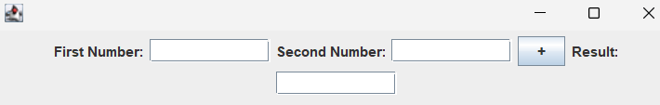
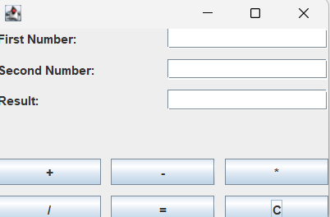
Reuse is easy
class CalculatorModel {
private int result;
public void add(int x, int y) {
result = x + y;
}
public void subtract(int x, int y) {
result = x - y;
}
public void multiply(int x, int y) {
result = x * y;
}
public void divide(int x, int y) {
result = x / y;
}
public int getResult() {
return result;
}
}

Slide 10
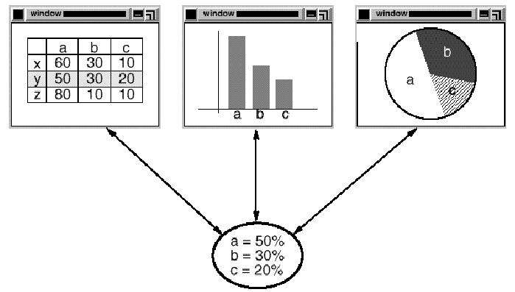
One Model and Many Views
views
Model

Slide 11
More decoupling…
View should be concerned only with the visual aspects of the application
What about the responsibilities for interacting with the model to carry out the user requests?
  Including the decisions about the interface behavior
The view knows nothing about how this gets done
Notes:
We need one more thing to separate the view from the model completely

Slide 12
MVC – the Controller
Controller is responsible for interacting with the model to carry out the user request
  View delegates the request to the controller and the controller translates them into actions to be performed by the model
  Controller decides what model operations to call
  Controller decides how the view should change
Now view and model are totally decoupled
  View is concerned only with the visual aspects of the application and delegates to the controller for any decisions about the interface behavior
Notes:
sits in the middle of the model and the View

Slide 13
Separate the concerns
VIEW
Handles the display of information
VIEW : displaying data
Controller: user event handling, reaction to user interaction
MODEL: data and application logic
CONTROLLER
Handles interactions
MODEL
Manages data, state, and business logic

Slide 14
MVC–Responsibilities
Model
  Holds data, state, and application logic
  Unaware of view and controller classes
View
  display model’s data
    gets the state and data from the model
  No application logic, no interaction logic –it is dumb
Controller
  Interacts with the model to carry out user requests coming from view.
    Calls the model operations to perform actions
Notes:
View is dumb. No application logic (model) no interaction logic (controller)
controller that is responsible for interacting with the model to carry out user requests. The view knows nothing about how this gets done.

Slide 15
MVC enables
Attach multiple presentation for a domain model
  a GUI, a command line, a web presentation
  Reuse the domain
Reuse the visual part for many domains
  Reuse View
Ability to change the way a view responds to user inputs
  change controllers

Slide 16
Problem1 -- Pattern #1
A view must ensure that its appearance reflects the state of the model
  Change the view whenever the model’s data changes
  Remember, the Model cannot and should not know about the View classes.
Ability to attach multiple
views and new ones
Each view gets an
opportunity to update itself

Slide 17
Pattern #1
A view must ensure that its appearance reflects the state of the model
Whenever the model’s data changes, the model notifies views that depend on it
Each view gets an opportunity to update itself
  Views communicate with the model to access the changes values
Notes:
Model is completely independent of the views

Slide 18
Pattern #1
Pattern name?
  General problem: Decoupling objects so that changes to one can affect any number of others without requiring the changed object to know details of the others.
Participants?

Slide 19
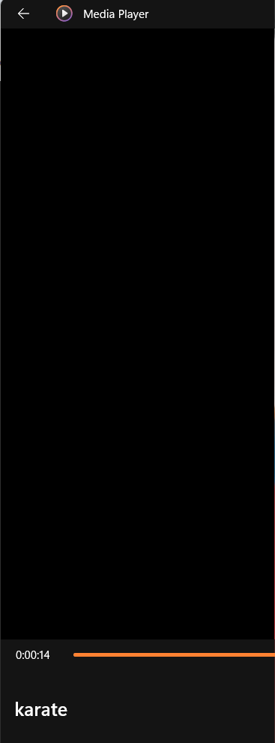
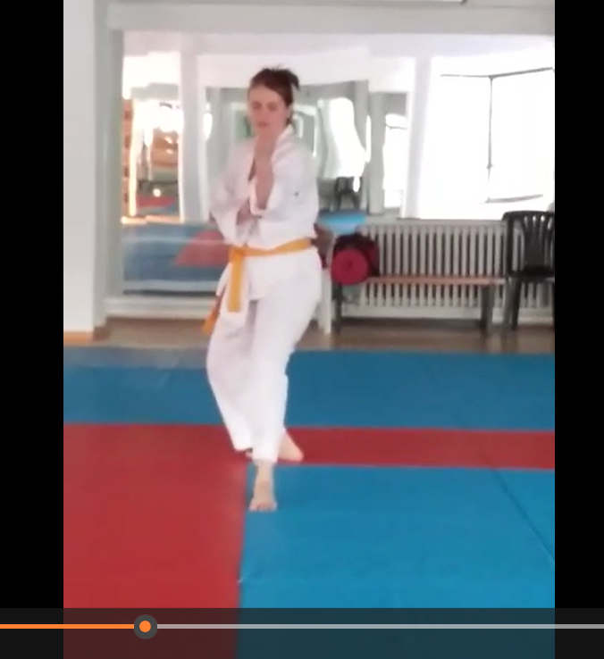
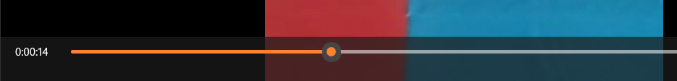

Pattern #1: Observer
View
Model
update
Player
play()
stop()
forward()
rewind()
View
Controller
Subject
Observers
Notes:
Controller observes model? Yes. Controller gets notifications so that it can change the view controls like enable buttons.
View is dumb. View only uses getter methods of model and displays data.

Slide 20
Observer pattern
Multiple views and controller observe the Model
  View gets the state/data from model
    Push or pull?
  Controller observes model so that it can change the view
    Disable widgets, open a dialog,…
Model is independent of views and controllers
  Reusable model
  Multiple views is possible

Slide 21
Pattern #1: Observer
Subject
+attach(observer)
+detach(observer)
+notify()
*
Observer
+update()
for all observers o
o.update();
Model
View1
View2
Controller

Slide 22
Problem2 --Pattern #2
We need to change a View’s response behavior without changing its visual presentation
  E.g. change respond to a user action, for example, use a pop-up menu instead of a new page
MVC encapsulates the response mechanism in a separate object: the Controller
  View (JButton) knows when a click happens, but not what to do.
  View delegates it to the response policy: the Controller

Slide 23
Pattern #2
A class hierarchy of controllers,
  making it easy to create a new controller as a variation on an existing one.
A view uses an instance of a Controller subclass to implement a particular response policy
  to implement a different response mechanism, simply replace the instance with a different kind of controller.
Change a view's controller at run-time to change the way it responds to user input.
  For example, a view can be disabled so that it doesn't accept input simply by giving it a controller that ignores input events.

Slide 24
Pattern #2
The View-Controller relationship is an example of which design pattern?
General problem: we want to replace the algorithm either statically or dynamically;
  we have a lot of variants of the algorithm;
  or the algorithm has complex data structures that we want to encapsulate.

Slide 25
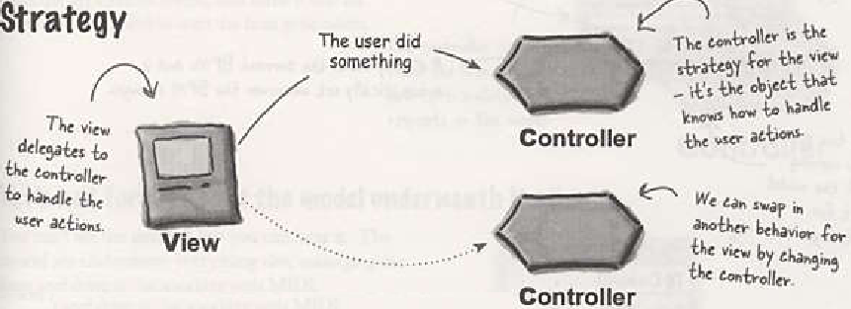
Pattern #2 -Strategy
View is an object configured with a strategy
We can swap in a different Controller to change the program’s behavior without touching the View's code.
Figure from Head First Design Patterns

Slide 26
Pattern#2 - alternative
In the classical MVC, the view is directly accessing the model to get data
  Does not happen in a mediator behavior
MVP: model-view-presenter
  Presenter acts as Mediator
  Model data change notifies Presenter, then Presenter reflects the change in the view.
    View does not access model at all.
  View sends user interactions to Presenter, then Presenter invokes the model accordingly.
Notes:
In mvpThe Presenter ensures that changes in the Model are reflected in the View. It orchestrates this communication.

Slide 27
MVC – The View
Views can be nested
  E.g. a control panel of buttons containing nested button views.
  E.g. The user interface for an object inspector can consist of nested views that may be reused in a debugger.
This is the standard now with GUI frameworks.
  It is the norm that we don’t realize the pattern anymore ☺
When the controller tells the view to update, it only needs to tell the top view component
  E.g When a Frame is told to update, it tells its children, like Panel`s, to update, and so on.

Slide 28
Pattern #3
MVC supports nested views
  A composite view can be used wherever a view can be used, but it also contains and manages nested views.
When the controller tells the view to update, it only needs to tell the top view component
The pattern is ….
  general problem: We want to group objects and treat the group like an individual object and give a part-whole hierarchy.

Slide 29
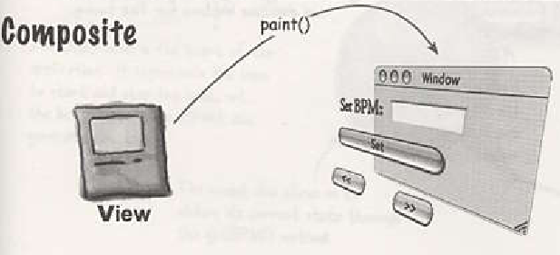
Pattern #3
The paint() or update() travels down the tree, and each object knows how to draw itself.
Figure from Head First Design Patterns

Slide 30
Patterns in MVC
Model
  Observer: model notifies views and controllers
View
  Composite: view elements in a hierarchy
Controller
  Strategy: controller is the action strategy of the view
  Adapter also comes along (adapt a new model to an existing view & controller)
Notes:
Read the code example in the head first design pattern book
https://courses.cs.duke.edu/compsci308/spring24/readings/mvc-hfdp.pdf

Slide 31
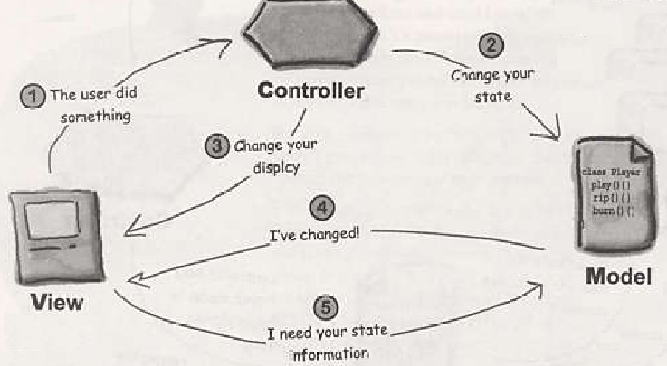
Collaborations in MVC
Figure from Head First Design Patterns

Slide 32
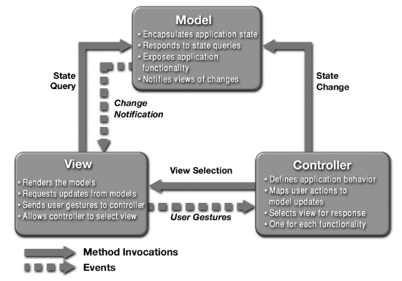
Passive Model Collaboration
Figure from http://java.sun.com/blueprints/guidelines/designing_enterprise_applications_2e/app-arch/app-arch2.html

Slide 33
Variations
MVC is an architectural pattern for GUI based software
Model2, or MVC2 for web development
  Servlet as the controller
  JSP is the View producing HTML
MVP: Presenter acts as Mediator
  When model changes, presenter updates the view
  Presenter implements the UI logic
MVVP: Model-View-ViewModel
  "Passive Model" is its direct ancestor.
  ViewModel is the state of the View.
  Changes in the ViewModel automatically update the View, and vice versa.
    Two-way data binding between View and ViewModel
    https://learn.microsoft.com/en-us/dotnet/architecture/maui/mvvm

Slide 34
With MVC
Separation of Concerns: The application is divided into three components: Model, View, and Controller.
Easier to Maintain: Changes in one component do not affect the others.
Improved Testability: Each component can be tested independently.

Slide 35
Recap: MVC
View
  A display of the model (its state and data)
Controller
  Takes user input and figures out what it means to the model
    Call model methods and view method to change them according to user interaction
Model
  Holds data, state and application logic
  Unaware of the controllers and the views
Read the code example in the head first design pattern book
https://courses.cs.duke.edu/compsci308/spring24/readings/mvc-hfdp.pdf
Notes:
View queries model and displays data

