Slide 1
Behavioral Patterns
Template Method
Strategy

Slide 2
Behavioral Patterns
Describe interactions between objects to achieve a complex behavior
Divide responsibilities across collaborating objects
Flexible and extensible
Enable changing behavior at runtime by switching objects

Slide 3
Behavioral Patterns
Chain of responsibility
Request delegated to the responsible service provider
Command
Request as first-class object
Iterator
Aggregate elements are accessed sequentially
Interpreter
Language interpreter for a small grammar
Template Method
Algorithm with some steps supplied by a derived class
Strategy
Abstraction for selecting one of many algorithms
Mediator
coordinates interactions between its colleagues
Memento
Snapshot captures and restores object states privately
Observer
Dependents update automatically when a subject changes
State
Object whose behavior depends on its state
Visitor
Operations applied to elements of a heterogeneous object structure

Slide 4
Behavioral Patterns
Chain of responsibility
Request delegated to the responsible service provider
Command
Request as first-class object
Iterator
Aggregate elements are accessed sequentially
Interpreter
Language interpreter for a small grammar
Template Method
Algorithm with some steps supplied by a derived class
Strategy
Abstraction for selecting one of many algorithms
Mediator
coordinates interactions between its colleagues
Memento
Snapshot captures and restores object states privately
Observer
Dependents update automatically when a subject changes
State
Object whose behavior depends on its state
Visitor
Operations applied to elements of a heterogeneous object structure

Slide 5
Algorithms sharing steps
Similar steps but specific details are different
e.g. retrieve OS name from a system spec
Algorithms with common structure are common
Read the JSON file | Read the XML file
Parse the JSON file into a JSON object | parse XML file into Document object
Get “OS Version” data | Get the element with “OS Version” tag

Slide 6
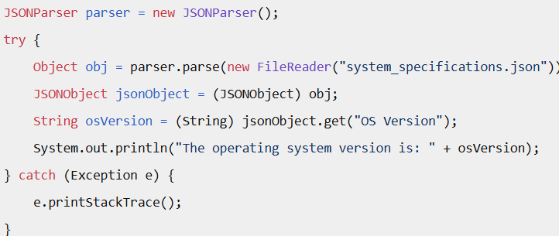
Read the JSON file | Read the XML file
Parse the JSON file into a JSON object | parse XML file into Document object
Get “OS Version” data | Get the element with “OS Version” tag
Notes:
{
"OSVersion": "Windows 11 Core",
"PreferredLanguages": ["en-US", "tr"],
"InstalledApps": [
"Google Chrome",
"Microsoft Teams",
"Visual Studio Code",
"Microsoft Edge"
]
}

Slide 7
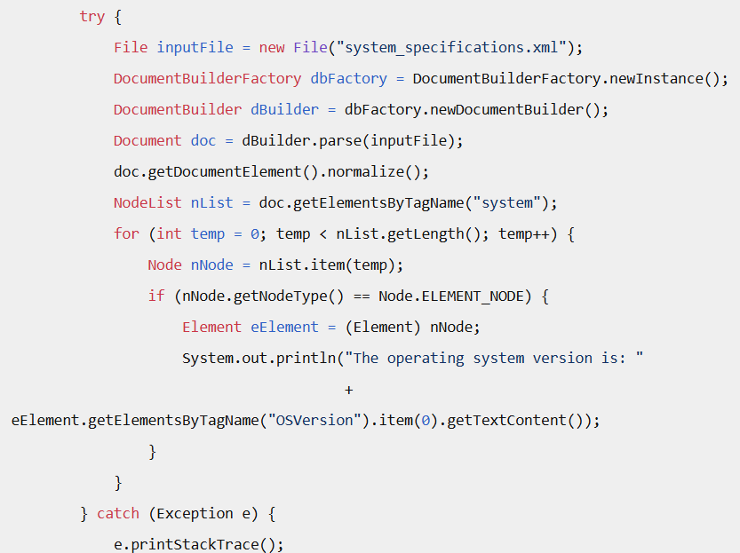
Refactored –click here
Notes:
<system>
<OSVersion>Windows 11 Core</OSVersion>
<PreferredLanguages>
<language>en-US</language>
<language>tr</language>
</PreferredLanguages>
<InstalledApps>
<app>Google Chrome</app>
<app>Microsoft Teams</app>
<app>Visual Studio Code</app>
<app>Microsoft Edge</app>
</InstalledApps>
</system>

Slide 8
Algorithms sharing steps
We are going to think about the steps of an algorithm
alg1:
1) doA;
2) doB;
3) doC;
Set the algorithm (order of steps) in stone
Leave out the details of the steps to be defined by someone else
alg1 does not know how to carry out doA, someone else will define it for me
Notes:
Think about recipes for a while

Slide 9
Structure –Template Method
AbstractClass
+templateMethod()
+primitiveOperation1()
+primitiveOperation2()
+hook()
//this is the algorithm
//do not override
……
+primitiveOperation1()
…..
+primitiveOperation2()
…….
ConcreteClass1
+primitiveOperation1()
+primitiveOperation2()
ConcreteClass2
+primitiveOperation1()
+primitiveOperation2()
+hook()
//must override primate operations
//may override hook

Slide 10
Example:Template Method
public void OpenDocument (String name) {
if (!CanOpenDocument(name)) { return; }
Document doc = createDocument();
if (doc != null) {
docs.AddDocument(doc);
AboutToOpenDocument(doc);
doc.Open();
doc.doRead();
}
}
The OpenDocument() method is a Template Method
The template method fixes the order of operations, but allows Application subclasses to vary those steps as needed
How to read the document and what kind of document to create is left to the subclass.

Slide 11
Template Method
AbstractClass
+openDocument()
+createDocument()
+doRead()
if (!CanOpenDocument(name)) {
return; }
Document doc = createDocument();
if (doc != null) {
docs.AddDocument(doc);
AboutToOpenDocument(doc);
doc.Open();
doc.doRead();
}
ConcreteClass1
+createDocument()
+doRead()

Slide 12
Template Method
Intent:
Define the skeleton of an algorithm in an operation, deferring some steps to subclasses
TM lets subclasses redefine certain steps of an algorithm without changing the algorithm's structure.
Removes code duplication!
Motivation
want to specify the order of operations that a method uses, but allow subclasses to provide their own implementations of some of these operations
This is a class pattern, so we use …

Slide 13
Participants
Template method ---Cannot be overridden
defines the algorithm skeleton
May call concrete operations, primitive operations and hooks
Primitive operations –must be overridden
The operations in the template that must be implemented by the subclasses
The diversity occurs here
Hooks –may be overridden
Superclass defines the default behavior
usually empty method body
Subclass may override it

Slide 14
Exercise 1: print documents
class PlainTextDocument{…
public void printPage (Page page){
System.out.println(page.title());
System.out.println(page.body());
System.out.println(page.date());
}
…}
class HtmlTextDocument{
public void printPage (Page page){
printHtmlTextHeader();
System.out.println(page.body());
printHtmlTextFooter(); }
…}
The order of tasks in printPage operations are the same
Make printPage() a template method in a superclass
Allow PlainTextDocument and HtmlTextDocument to provide their unique implementations of abstract methods to print the header and footer

Slide 15
Exercise 1:Template Method
public abstract class TextDocument {...
public final void printPage (Page page) { //final -- the algorithm is fixed
printTextHeader(page);
printTextBody(page);
printTextFooter();
}
public abstract void printTextHeader();
public final void printTextBody(Page page) {
System.out.println(page.body()); }
public abstract void printTextFooter();
}
public class PlainTextDocument extends TextDocument {...
public void printTextHeader (Page page) {
System.out.println(page.title()); }
public void printTextFooter () {}
}
All we have to do is provide the proper implementations of
the primitive operations
Notes:
This is common. Printing different documents, serializing documents in different formats

Slide 16
Applicability: Template Method
To implement the invariant parts of an algorithm once and leave it up to subclasses to implement the behavior that can vary
particularly important in class libraries, because they are the means for factoring out common behavior in library classes
New programmer cannot mess up the invariant
This is how we customize frameworks
Extend a class in the framework
Override some methods for customization

Slide 17
Applicability: Template Method
To implement the invariant parts of an algorithm once and leave it up to subclasses to implement the behavior that can vary
To localize common behavior among subclasses and place it in a common class to avoid code duplication.
Classic example of ”code refactoring”
the general workflow of the algorithm is implemented once in the abstract class's template method,
and necessary variations are implemented in the subclasses.

Slide 18
Applicability: Template Method
To implement the invariant parts of an algorithm once and leave it up to subclasses to implement the behavior that can vary
To localize common behavior among subclasses and place it in a common class to avoid code duplication.
Classic example of ”code refactoring”
To control how subclasses extend superclass operations.
You can define a template method that calls "hook" operations at specific points, hence permitting extensions only at those points.

Slide 19
TM controls extensions
controls the point(s) at which specialization is permitted.
If the subclasses were to simply override the template method, they could make radical and arbitrary changes to the workflow.
In contrast, by overriding only the hook methods, only certain specific details of the workflow can be changed,
and the overall workflow is left intact.

Slide 20
Example: Hook method
class Travel{
public:
void itenary(int days){
addTransport();
planDay(1);
addHotel();
planDay(days-1);
}
virtual void addHotel(){}
virtual void addTransport()=0;
virtual void planDay(int day)=0;
//…
}
AirTravelPackage subclass must override addTransport and planDay.
Adding a hotel is optional
Extension to the workflow by only adding the hotel and it will work only after the first day.
Notes:
see https://refactoring.guru/design-patterns/template-method for example codes

Slide 21
Hollywood principle
Template method uses inverted control structure.
from the superclass point of view:
“Don't call us, we'll call you”.
Instead of calling the methods of base class inside the subclass methods,
No super.doA()
the methods of subclass are called in the template method from superclass.

Slide 22
Hollywood principle
“Don’t call us, we’ll call you”
Seen this in frameworks and libraries
The framework carries out a computation/algorithm
Some parts are not specified. Your job is to implement those parts.
Your code does not call the framework functions, but the framework calls you
Opposite of using library functions
Notes:
Draw a call sequence

Slide 23
Hollywood Principle
Reduces coupling between lower and upper level object
Lower level object do not call upper levels unless they are called
upper level objects call each other and lower levels
Call directions
Notes:
Just like in real life: President of a Uni talks to president of another Uni

Slide 24
Consequences -Pros
Reduces code duplication
Enables customization of an algorithm in the subclasses
Decouple lower and upper level objects
Controls the extension of the workflow (hooks)
controls the point(s) at which specialization is permitted
Cannot change the algorithm drastically
Notes:
If a subclass is used where a base class is expected, it may behave poorly due to its implementation of primitive operations.

Slide 25
Consequences -Cons
Cannot change the algorithm drastically
LSP Risk: May violate Liskov substitution principle
If a subclass is used where a base class is expected, it may behave poorly due to its implementation of primitive operations.
Too many Primitive Operations
make subclassing tedious and error-prone: Maintenance
Subclasses may be forced to implement methods they don’t need.
Beware of Inheritance
Changes in base class may unintentionally affect all subclasses.
Hidden Dependencies
Subclasses must understand the order in TM
Notes:
Maintenance gets harder as the number of primitive operation increases

Slide 26
Example LSP violation
public class MaliciousXMLReader extends SysemSpecReader {
// VIOLATION: This primitive operation breaks the implicit contract.
public Object readFile() {
// Instead of reading the file, it unexpectedly throws a low-level error.
throw new IllegalStateException("File system access denied!");
}
// These methods must still be implemented, but will never be reached
public Object parseFile(Object fileObj) { return null; }
public String extractOSversion(Object parsedObj) { return null; }
}

Slide 27
Example: Travel Agency
The travel agency is managing each trip.
All the trips contain common behavior but there are several packages. For example each trip contains the basic steps: - The tourists are transported to the holiday location by plane/train/ships,... - Each day they are visiting something - They are returning back home.
http://www.oodesign.com/template-method-pattern.html

Slide 28
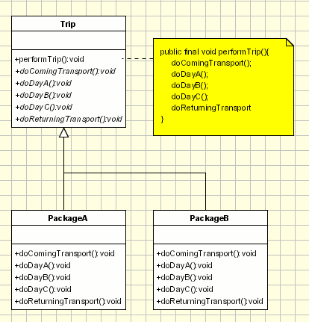

Slide 29
Related patterns
Template Method vs Factory Method
Factory method is a special primitive operation
Template Method vs Strategy (next)
TM: Skeleton of algorithm where realization of some steps are deferred
One algorithm but implementing the step varies
Strategy: interchangeable algorithms
Different algorithms for the same purpose
Notes:
The create method inside factory is a template method

Slide 30
Do not repeat code!
DefaultMazeBuilder::buildDoor(int r1, int r2) {
Door* door;
Room *room1 = getMaze().getRoom(r1);
Room *room2 = getMaze().getRoom(r2);
if( room1 == nullptr ) {
buildRoom(r1);
room1 = getMaze().getRoom(r1);
}
if( room2 == nullptr) {
buildRoom(r2);
room2 = getMaze().getRoom(r2);
}
door =new Door(room1, room2);
room1->setSide(commonWall(r1,r2), door);
room2->setSide(commonWall(r1,r2), door);
}
BombedMazeBuilder::buildDoor(int r1, int r2) {
Door* door;
Room *room1 = getMaze().getRoom(r1);
Room *room2 = getMaze().getRoom(r2);
if( room1 == nullptr ) {
buildRoom(r1);
room1 = getMaze().getRoom(r1);
}
if( room2 == nullptr ) {
buildRoom(r2);
room2 = getMaze().getRoom(r2);
}
door = new BombedDoor(room1, room2);
room1->setSide(commonWall(r1,r2), door);
room2->setSide(commonWall(r1,r2), door);
}
Notes:
CommonWall is a utility operation that determines the direction of the common wall between two rooms.

Slide 31
Do not repeat code!
DefaultMazeBuilder::buildDoor(int r1, int r2) {
Door* door;
Room *room1 = getMaze().getRoom(r1);
Room *room2 = getMaze().getRoom(r2);
if( room1 == nullptr ) {
buildRoom(r1);
room1 = getMaze().getRoom(r1);
}
if( room2 == nullptr) {
buildRoom(r2);
room2 = getMaze().getRoom(r2);
}
door =new Door(room1, room2);
room1->setSide(commonWall(r1,r2), door);
room2->setSide(commonWall(r1,r2), door);
}
Let’s tidy a bit
Room* checkroom(Room* room,int r){
if( room == nullptr ) buildRoom(r);
return getMaze().getRoom(r);
}
DefaultMazeBuilder::buildDoor(int r1, int r2) {
Door* door;
Room *room1 = getMaze().getRoom(r1);
Room *room2 = getMaze().getRoom(r2);
room1 =checkroom(room1);
room2 =checkroom(room2);
door =new Door(room1, room2);
room1->setSide(commonWall(r1,r2), door);
room2->setSide(commonWall(r1,r2), door);
}
Notes:
CommonWall is a utility operation that determines the direction of the common wall between two rooms.

Slide 32
Do not repeat code!
void MazeBuilder::buildDoor(int r1, int r2)
final //template method
{
Door* door;
Room *room1 = getMaze().getRoom(r1);
Room *room2 = getMaze().getRoom(r2);
room1=checkroom(room1);
room2=checkroom(room2);
door =makeDoor(room1, room2);
room1->setSide(commonWall(r1,r2), door);
room2->setSide(commonWall(r1,r2), door);
}
class MazeBuilder{ /….
virtual Door* makeDoor=0;
} //primitive operation
BombedMazeBuilder cannot override buildDoor.
BombedMazeBuilder cannot mess up the algorithm.
How does BombedMazeBuilder extends building doors to build bombed doors?
virtual Door*
BombedMazeBuilder::makeDoor
(Room* r1, Room* r2){
return new Door(r1,r2);
}
Same goes for the DefaultMazeBuilder
Notes:
CommonWall is a utility operation that determines the direction of the common wall between two rooms.

Slide 33
Do not repeat code!
void MazeBuilder::buildDoor(int r1, int r2)
final //template method
{
Door* door;
Room *room1 = getMaze().getRoom(r1);
Room *room2 = getMaze().getRoom(r2);
room1=checkroom(room1);
room2=checkroom(room2);
door =makeDoor(room1, room2);
room1->setSide(commonWall(r1,r2), door);
room2->setSide(commonWall(r1,r2), door);
}
class MazeBuilder{ /….
virtual Door* makeDoor=0;
} //primitive operation
BombedMazeBuilder cannot override buildDoor.
BombedMazeBuilder cannot mess up the algorithm.
How does BombedMazeBuilder extends building doors to build bombed doors?
virtual Door*
BombedMazeBuilder::makeDoor
(Room* r1, Room* r2){
return new Door(r1,r2);
}
Same goes for the DefaultMazeBuilder
Notes:
CommonWall is a utility operation that determines the direction of the common wall between two rooms.
Room* checkroom(Room* room,r1){
if( room == nullptr ) buildRoom(r1);
return getMaze().getRoom(r1);
}

Slide 34
Best Practices
Keep the number of primitive operations minimal and focused.
Document the expected behavior and call order of hooks and primitives.
Prefer composition if subclassing becomes too complex.
Testing
Test the template method independently to verify the algorithm structure.
Use mock implementations of primitive operations to isolate behavior.

Slide 35
Known uses
Libraries and frameworks (e.g. Swing)
All non-abstract methods of java.io.InputStream, java.io.OutputStream, java.io.Reader and java.io.Writer.
All non-abstract methods of java.util.AbstractList, java.util.AbstractSet and java.util.AbstractMap.
Template Method can be recognized if you see a method in base class that calls a bunch of other methods that are either abstract or empty.
https://refactoring.guru/design-patterns/template-method/java/example

Slide 36
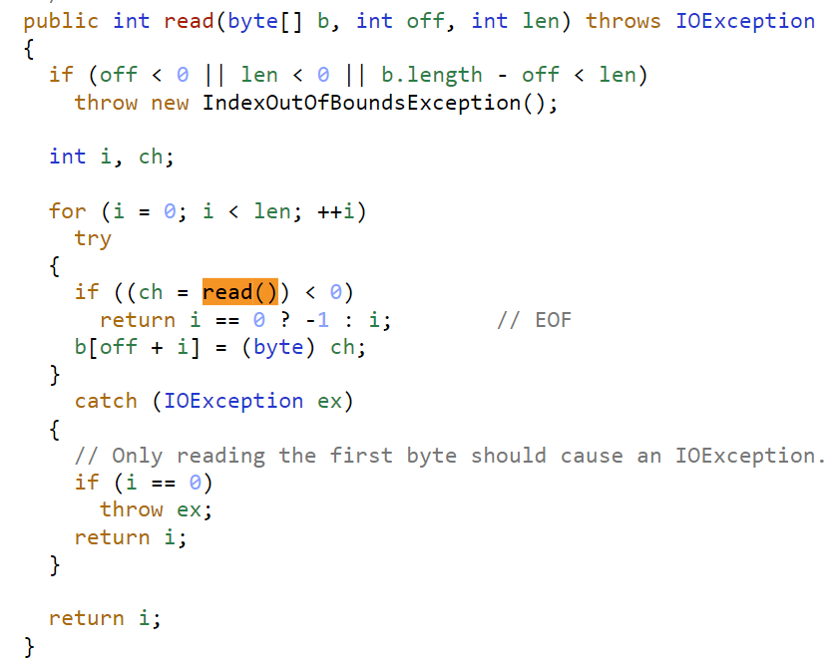
From java.io.InputStream source code:
Notes:
Subclass of inputsream may read from a buffer, from internet connection, from a file etc

Slide 37
More algorithms

Slide 38
Motivating Example
Users log in with password. We need to save these passwords in a DB in an encrypted form.
Currently we use 3 encryption algorithms.
Generate hash using one of them and then save in DB
Problem: How to write setPassword to support both encryption?
Later I may embed new encryptions
class User{
public: virtual bool setPassword(const String& passwd);
virtual bool checkPassword(const String& passwd);
….}

Slide 39
How to implement setPassword?
Soln1: conditionals in setPassword and getPassword method
Switch and long ifs are not extensible
Soln2: inheritance
Abstract User and Subclasses override setPassword and getPassword
Too many subclasses! One for each encryption
Should I use inheritance just to override 1 method?
Soln3: encapsulate what varies
What is varying?

Slide 40
How to implement setPassword?
What is varying? A function realization
Put it in a class -- a class for generateHash()
Choose the suitable function at runtime
Choose a suitable one from the
algorithm family at runtime
Delegation instead of inheritance
User
Encryption
Bcrypt
Scrypt
Argon2

Slide 41
Strategy
Intent:
Define a family of algorithms, encapsulate each one, and make them interchangeable.
Strategy lets the algorithm vary independently from clients that use it.
A.k.a. Policy

Slide 42
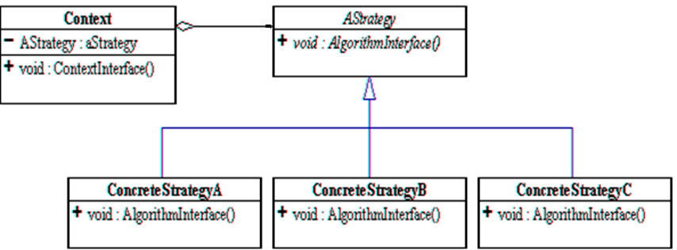
Strategy -Structure
Participants?

Slide 43
setPassword with Strategy
class User{
public:
virtual void setPassword(const String& passwd);
virtual bool checkPassword(const String& passwd);
User(Encryption* e); ~User()=default;
private: Encryption* strategy;
….}
void User::setPassword(const String& pass){
checkStrength(pass);
save(strategy ->generateHash(pass));
}
User::User(Encryption* e):strategy(e){…}
Participants?

Slide 44
Strategy - Collaborations
The context object receives requests from the client and delegates them to the strategy object.
Usually, the ConcreteStrategy is created by the client and passed to the context. From this point the clients interacts only with the context.
The Context objects contains a reference to the ConcreteStrategy that should be used.
When an operation is required then the algorithm is run from the strategy object.
The Context is not aware of the strategy implementation.
If necessary, additional objects can be defined to pass data from context object to strategy.

Slide 45
Recall the Car example 2nd week
Car class and its 2 operations/behaviors:
Brake and accelerate
These behaviors change frequently between models, so implement these behaviors in subclasses: overriding
For each new model, override
Beware: Code duplication across models
The work of managing these behaviors increases greatly as the number of models increases

Slide 46
Alternative1
BAD!
public class Car{
public void break(){
switch(model){
case Simple:
//reduce speed 5 unit/sec
case Sportcar:
//….with ABS
case EV:
//regenerative breaking
}
//other members
public void accelerate(){
switch(model){
case Simple:
//speed up 7u/s
case EV:
//smart speed up
case Sports: //….
}
as ugly as it gets,
useless when it comes to extensibility
throws out any hope of it being reusable.

Slide 47
Alternative 2:
BAD!
Car
+break()
+accelerate()
simple
+break()
+accelerate()
Sports
+break()
+accelerate()
EV
+break()
+accelerate()
break(){..//uses ABS }
accelerate(){..//smart speeds up}
break(){..//reduces speed 5unit/sec}
accelerate(){..//speeds up 7 units/sec}

Slide 48
Strategy Solution
Car
+break()
+accelerate()
Breaking
+break()
class Car{
private:
Breaking* breakS;
Accelerate( accelS;
…
public:
break(){
breakS->break();}
accelerate(){
accelS->accelerate();}
Car(Breaking* b,
Accelerate* a)
:breakS(b), accelS(a){}
void setBreakS(Breaking* b){
breakS=b;}
…
}
Break1
+break()
Break2
+break()
Accelarate
+accelerate()
Accelarate1
+accelerate()
Accelarate2
+accelerate()
Notes:
class Car{
Breaking breakS;
Accelerate accelS;
…
break(){
breakS.break();}
accelerate(){
accelS.accelerate();}

Slide 49
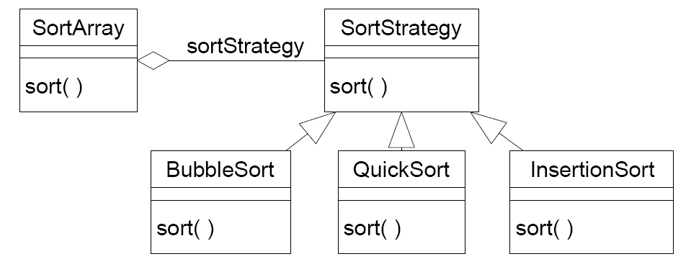
Example 3: Strategy
Application where the sorting algorithm is chosen at runtime

Slide 50
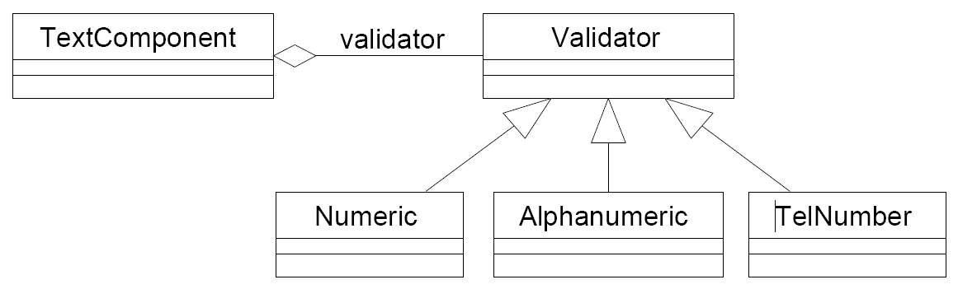
Example 4
A GUI text component object wants to decide at runtime what strategy it should use to validate user input.
Many different validation strategies are possible: numeric fields, alphanumeric fields, telephone-number fields, etc.
Notes:
Make the sorting algo stateless
Strategy makes good flyweight

Slide 51
Applicability -Strategy
Many related classes differ only in behavior
you can reduce these several objects to one class that uses several Strategies.
Need different variants of an algorithm
switch from one algorithm to another during runtime
Avoid exposing complex, algorithm specific data structures
E.g. intermediate data structure used for compression
A class defines many behaviors and chooses one with conditionals
Notes:
Need a family of algorithms
JPEG compression for images in a document, LZWR1 for text compression
to isolate the business logic of a class from the implementation details of algorithms that may not be as important in the context of that logic.
The Strategy pattern lets you isolate the code, internal data, and dependencies of various algorithms from the rest of the code. Various clients get a simple interface to execute the algorithms and switch them at runtime.
e.g. Huffman coding uses priority queue e.g. LZW uses dictionary (hash table)

Slide 52
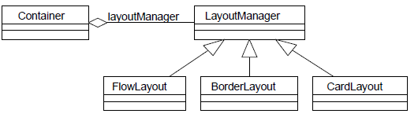
Example 5 – javax.swing
A GUI container object wants to decide at run-time what strategy it should use to layout the GUI components it contains. Many different layout strategies are already available.
Frame f = new Frame();
f.setLayout(new FlowLayout());
f.add(new Button(“Press”));

Slide 53
Strategy – other examples
Application where the compressing algorithm is chosen at runtime
Application where the provisioning algorithm is chosen at runtime depending on the user type

Slide 54
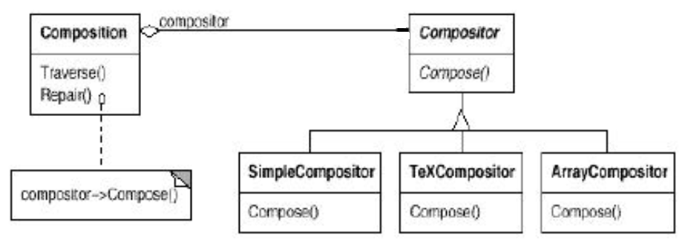
Strategy – another example
Composition is responsible for maintaining line breaks of a text displayed.
Compositor class has line breaking algorithms in its subclasses.

Slide 55
Example 6
There are numerous border types
Line, titled, edged,…
Each visual component draws itself with different bordering (assume they are not decorated)
All they differ is border drawing algorithm
There is a family of border drawing algorithm

Slide 56
Example
class JComponent{….
protected void paintBorder(Graphics g) { switch(getBorderType()) { case LINE_BORDER: paintLineBorder(g); break; case ETCHED_BORDER: paintEtchedBorder(g); break; case TITLED_BORDER: paintTitledBorder(g); break; ...}
}
// The actual implementation of the JComponent.paintBorder() method
protected void paintBorder(Graphics g) {
Border border = getBorder(); if (border != null) { border.paintBorder(this,g,0,0,getWidth(), getHeight()); }
}
Border Object has the drawing algorithm not the JComponent

Slide 57
Strategy – Consequences-1
Eliminates conditional statements
When you have several behaviors together in one class, you’ll use conditionals
With Strategies you won't need to check for anything, since whatever the current strategy is just executes without asking questions
Alternative to subclassing context object to achieve different behaviors
With Strategies all you need to do is switch the context's strategy and it will immediately change how it behaves.

Slide 58
Strategy – Consequences-2
Change the algorithm on the fly
We can introduce new strategies without having to change the context. (OCP)
Strategies can be shared
Increases number of objects and communication overhead btw strategy and context
See the implementation issues-2
Notes:
to isolate the business logic of a class from the implementation details of algorithms that may not be as important in the context of that logic.
See the GoF book example Compositor

Slide 59
Implementation issues-1
Lambda functions instead of explicit strategy classes
Cons: strategies will not be shared
Pro: less number of classes
class Car {
public:
std::function<void()> strategy;
Car(std::function<void()> strategy) : strategy(strategy) {}
void applyBrakes() { strategy(); }
};
int main() {
Car sportsCar( { std::cout << "Applying ABS brakes...\n"; });
sportsCar.applyBrakes();
}
Notes:
Alternative: Strategies as template parameters In C++ templates

Slide 60
Lambda
interface BrakingStrategy { void applyBrakes();}
class Car {
private BrakingStrategy strategy;
public Car(BrakingStrategy strategy) { this.strategy = strategy; }
public void applyBrakes(){ strategy.applyBrakes(); }
}
public static void main(String[] args) {
Car sportsCar = new Car(() ->
System.out.println("Applying ABS brakes..."));
sportsCar.applyBrakes();
}
//body of lambda implements a single abstract method
Notes:
);

Slide 61
Implementation issues -2
Data from Context to Strategy
Example: sorting strategy needs data to sort
Pass data as parameter
Not all strategies may need the same data
Pass the context reference
Strategy would query context what data it needs
Context’s interface with getters
Strategy is coupled with context
There is no best

Slide 62
Implementation issues-3
Default Strategy in the Context
Benefit: Clients don't have to deal with Strategy objects at all unless they don't like the default behavior
Make stateless Strategies
When Strategies are stateless, they can be shared
e.g. 3 users share Bcrypt for hashing their password
No need to clutter the memory with same objects
Strategies make good flyweights

Slide 63
Implementation issues-4
Using C++ templates : Cannot change strategy
template <class AStrategy> class Context {
void operation() { theStrategy.DoAlgorithm(); }
private:
AStrategy theStrategy;
};
//The class is then configured with a Strategy class when it's instantiated:
class MyStrategy {
public: void DoAlgorithm();
};
Context<MyStrategy> aContext;

Slide 64
Strategy: Key notes
Family of algorithms
One strategy class per algorithm
Make them interchangeable
Just change the current strategy object and the algorithm changes
Client of the context can use different algorithms easily
Alternative for subclassing

Slide 65
Question: why not delete?
class User{
public:
virtual void setPassword(const String& passwd);
virtual bool checkPassword(const String& passwd);
User(Encryption* e); ~User()=default;
private: Encryption* strategy;
….}
void User::setPassword(const String& pass){
checkStrength(pass);
save(strategy ->generateHash(pass));
}
User::User(Encryption* e):strategy(e){…}
Strategies
are shared:
flyweight
Notes:
flyweight

Slide 66
Strategy -Related patterns -1
Strategies can be flyweights
Template M vs Strategy
Template Method fixes skeleton of algorithm, variation in steps
Strategy changes the algorithm completely
Change mergesort to bublesort
Decorator vs Strategy
Both alternative to inheritance
Decorator adds functionality on top -wrapper
Strategy replaces functionality
Notes:
Decorator lets you change the skin of an object, while Strategy lets you change the guts.
TM lets you alter parts of an algorithm by extending those parts in subclasses.,
Strategy alter parts of the object’s behavior by supplying it with different strategies that correspond to that behavior

Slide 67
Strategy -Related patterns -2
Bridge and Strategy have the same Class diagram, but intent is different
strategy is related with the behavior and bridge is for structure.
the coupling between the context and strategies is tighter than the coupling between the abstraction and implementation in the bridge pattern.
State pattern (next) vs Strategy
Command (later)

Slide 68
Strategy –Known Use
java.util.Comparator with compare() method is a strategy used by many, e.g. sort method of Collections
Notes:
javax.servlet.Filter with doFilter()

