Slide 1
Creational Patterns
Builder

Slide 2
Motivation
Create an object that requires too many optional fields
Have multiple constructors: with 0,1,2,3,4,.. parameters
calling logic becomes more complex
Order of parameters difficult to remember by client programmer
Pizza(int size) { ... } Pizza(int size, boolean cheese) { ... } Pizza(int size, boolean cheese, boolean pepperoni) { ... } Pizza(int size, boolean cheese, boolean pepperoni, boolean olives) { ... }
/*Client code*/ Pizza myPizza = new Pizza(12, true, false, true); //??

Slide 3
Motivation
Create an object that requires too many optional fields
Have multiple constructors: with 0,1,2,3,4,.. parameters
Pizza(int size) { ... } Pizza(int size, boolean cheese) { ... } Pizza(int size, boolean cheese, boolean pepperoni) { ... }
// Client Code is hard to read:
Pizza myPizza = new Pizza(12, true, false, true);
// What do these booleans mean?
cluttered class and a hard to read client code
Notes:
Problems:
Client code is hard to read and write. It's easy to mistake one boolean for another.
The class becomes cluttered with many constructors.

Slide 4
Motivation Example
Create an object that requires too many optional fields
Have multiple constructors: with 0,1,2,3,4,.. Parameters
calling logic becomes more complex
Write an enormous constructor with a lot of functional logic.
too many ifs to check existence of valid parameter values
the code becomes more complex and harder to debug
Problems subclassing due to selection logic

Slide 5
Motivation Example
Create an object that requires too many optional fields
Have multiple constructors: with 0,1,2,3,4,.. Parameters
Write an enormous constructor with a lot of selection logic.
Have a null constructor and setter methods
Better than before but….

Slide 6
Motivation Example
Have a null constructor and setter methods
public class Pizza {
public Pizza() { } // Default constructor
public void setSize(int size) { ... }
public void setCheese(boolean hasCheese) { ... }
public void setPineapple(boolean hasPineapple) { ... }
….
// Client Code:
Pizza myPizza = new Pizza(); myPizza.setSize(12);
myPizza.setCheese(true);
// What if the pizza is passed to another method here? It's incomplete!
myPizza.setOlive(true); //now complete
The object is in an inconsistent state during its construction
since the class has setters, we can't create immutable objects
Notes:
Problems:
The object is in an inconsistent state during its construction. It only becomes "complete" after the last setter is called.
The class is mutable (it has setters), so we can't create immutable objects.

Slide 7
Motivation Example
Create an object that requires too many optional fields
Have multiple constructors: with 0,1,2,3,4,.. Parameters
Write an enormous constructor with a lot of selection logic.
Have a null constructor and setter methods
Better than before but….
Object in an unstable state may be used causing errors
Assume 5th value is required. Before the 5th set, the object is in unstable state. Some part of client might see the objects in 4th state and assume it is done.
Need extra effort in concurrency to ensure thread safety
What if order of set methods is important?
Cannot create immutable objects

Slide 8
How about..
Construct the object step by step
But hide the object during the creation and reveal only after the object is in a stable state
i.e. encapsulate the creation
Motivation1: staged object creation

Slide 9
Complex objects
Complex objects are made of parts made of other objects that need special care when being built.
An application might need a mechanism for building complex objects that is independent from the ones that make up the object
Motivation2 : complex object
The same parts, in a different assembly may result in different complex object

Slide 10
Builder
Intent: Separate the construction of a complex object from its representation so that the same construction process can create different representations.
Build different complex objects from the same set of component parts
Similar to Bridge, but Bridge is not about creating objects
Does this sound familiar?

Slide 11
Builder
Applicability
The algorithm for creation is independent of the parts and how they are assembled
Different construction processes results in different representation
building a complex object from possibly multiple different sources
Notes:
the algorithm for creating a complex object should be independent of the parts that make up the object and how they're assembled.
the construction process must allow different representations for the object that's constructed

Slide 12
Builder - Structure
Director
Builder
+construct()
+buildPart()
+getResult
for all objects in structure{
builder.buildPart()
}
ConcreteBuilder
+buildPart()
+getResult():Product
creates
Product

Slide 13
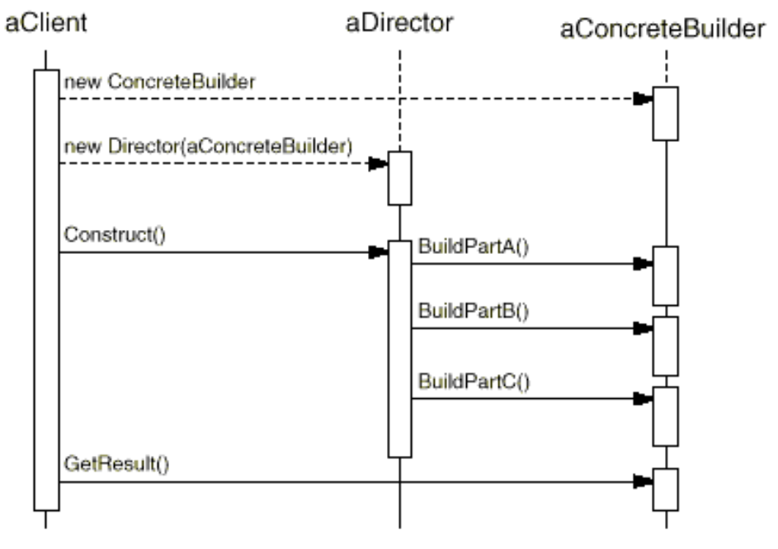
Collaborations

Slide 14
Back to Pizza Example
class Recipe{ // Director
public:
Recipe(PizzaBuilder* b);
void setBuilder(PizzaBuilder*b);
virtual void make(int s) {
builder->buildPizza(s);
builder->addCheese();
}
private: PizzaBuilder* builder;
}
class PizzaBuilder{
public:
PizzaBuilder();
virtual void buildPizza(int size);
virtual void addCheese();
virtual void addOlives();
//…
virtual Pizza* getResult();
private: Pizza* pizza;
}
Pizza(int size) { ... } Pizza(int size, boolean cheese) { ... } Pizza(int size, boolean cheese, boolean pepperoni) { ... } Pizza(int size, boolean cheese, boolean pepperoni, boolean olives) { ... }
Notes:
return builder->getResult();

Slide 15
Back to Pizza Example
class Recipe{
public:
Recipe(PizzaBuilder* b);
void setBuilder(PizzaBuilder*b);
virtual void make(int s) {
builder->buildPizza(s);
builder->addCheese();
}
private: PizzaBuilder* builder;
}
class PizzaBuilder{
public:
PizzaBuilder();
virtual void buildPizza(int size);
virtual void addCheese();
virtual void addOlives();
//…
virtual Pizza* getResult();
private: Pizza* pizza;
}
//client code
PizzaBuilder builder=new PizzaBuilder();
Recipe r (builder); r.make(12);
Pizza* cheesepizza= builder->getResult();
Notes:
I am omitting destructor, copy constructor etc for brevity

Slide 16
Exercise: Bike
Build a bike
Make wheels, steering, etc..
Participants
Client: asks for a bike
Director: instructs how to build the bike
Builder: builds the parts

Slide 17
Building a Bike
class Client{…
void mymethod(Builder* builder){
contractor.construct(builder);
Bike* mybike= builder->getResult();
}
}
class Director{
public:
construct(Builder* builder){
builder->makeBike();
builder->buildWheel(1);
builder->buildWheel(2);
builder->makeSteering();
}
…}
class Builder{
virtual void makeBike()=0;
virtual void buildWheel(int)=0;
virtual void makeSteering()=0;
virtual void trainingWheels() =0;
virtual Bike* getResult()=0;
}
Builder hides the internal representation of the product
You guess that there are classes for wheels and steering
But no hint whether there are classes for chains or gears.
Note: destructor, copy constructor etc not shown for brevity

Slide 18
Building a Bike
class DefaultBuilder: public Builder{
private: Bike* bike;
public:
void makeBike() {bike=new Bike();} //alt:prototype
void makeSteering (){…};
void makeHelperWheels(){…};
void buildWheel(int r){
if(bike->hasWheel(r)) return;
Wheel* w=new Wheel(r);
w->setGear(new Gear(4));
bike->add(w);
};
Bike* getResult(){return bike; }
}
You may guess that there are classes for wheels etc
But no hint whether there are classes for gears.

Slide 19
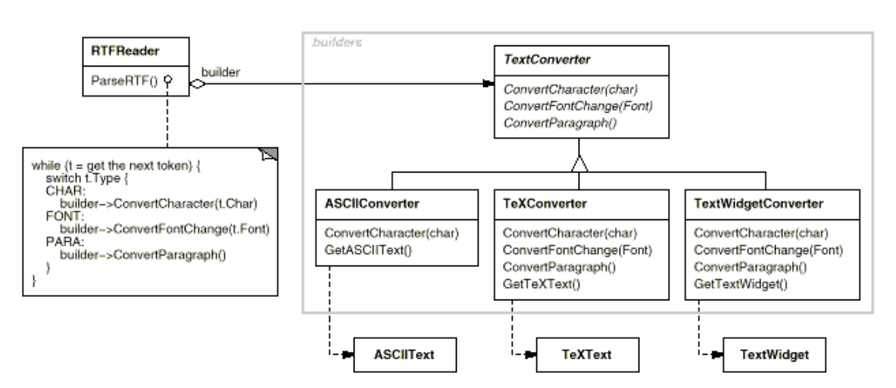
GoF Doc format converter

Slide 20
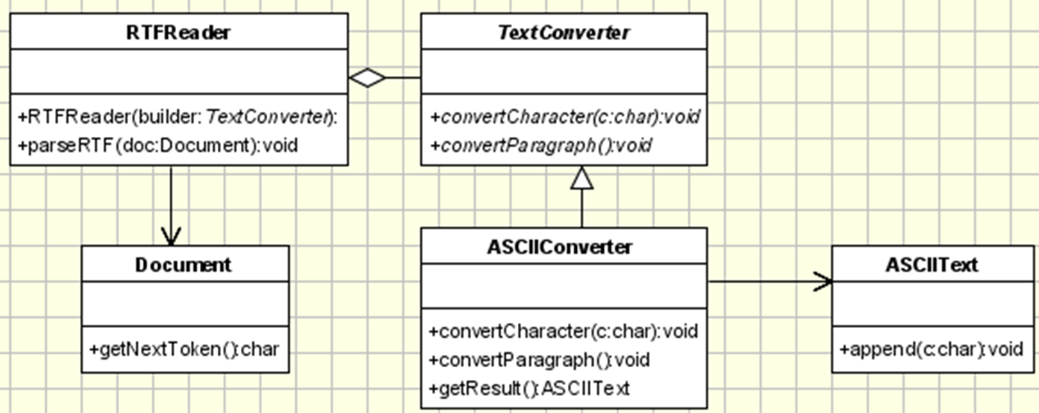
Example 3: Doc format converter
Get an RTF document, transform it
https://www.oodesign.com/builder-pattern

Slide 21
Example 3: Client code use
void createASCIIText(Document doc){
ASCIIConverter asciiBuilder = new ASCIIConverter();
RTFReader rtfReader = new RTFReader(asciiBuilder);
rtfReader.parseRTF(doc);
ASCIIText asciiText = asciiBuilder.getResult();}

Slide 22
//Abstract Builder
public interface TextConverter{
public void convertCharacter(char c);
public void convertParagraph();
}
//Director
class RTFReader{
private static final char EOF='0’;
final char CHAR='c'; final char PARA='p'; char t;
private TextConverter builder;
public RTFReader(TextConverter obj){ builder=obj; }
public void parseRTF(Document doc){
while ((t=doc.getNextToken())!= EOF){
switch (t){
case CHAR: builder.convertCharacter(t); break;
case PARA: builder.convertParagraph(); break;
}
}
}

Slide 23
//Concrete Builder
public class ASCIIConverter implements TextConverter{
private ASCIIText asciiTextObj;//resulting product
/*converts a character to target representation
and appends to the resulting*/
public void convertCharacter(char c){
char asciiChar = new Character(c).charValue(); //get char value
asciiTextObj.append(asciiChar);
}
public void convertParagraph(){/*nothing to do*/}
//These details are hidden from the Director.
public ASCIIText getResult(){ return asciiTextObj; }
}

Slide 24
GoF Doc format converter

Slide 25
Use builder when a class
Has complex internal structure
especially one with a variable set of related objects
Has attributes that depend on each other.
E.g. while building an order, set the country before billing since it may change the pricing
Builder can enforce staged construction of a complex object.
This would be required when the Product attributes depend on one another.
Notes:
As object creation increases in complexity, managing object creation from within the constructor method can become difficult.
This is especially true if the object does not depend exclusively on resources that are under its own control

Slide 26
The Builder coordinates the assembly of the product object:
creating resources,
storing intermediate results,
and providing functional structure for the creation.
Additionally, the Builder can acquire system resources required for construction of the product object.
Example: Business objects
frequently require data from a database for initialization
might need to associate with several other business objects to accurately represent the business model as soon as it’s created.

Slide 27
Immutable Complex Objects
Immutable: once created the fields cannot be reassigned
No setters
Builder helps creating immutable complex objects
Mechanism: Have a static builder class as an inner class of the Product.
Caution: not as flexible as the presented version of builder

Slide 28
class Entity{
private final int f1, f2;
public static class Builder{
private int requiredField;
private int optionalField;
public Builder (int required){
this.requiredField=required;}
public Builder option1(int optionalVal){
optionalField=optionalVal;
return this;
}
public Entity build(){
return new Entity(this);}
}
private Entity(Builder builder){
f1=builder.requiredField;
f2=builder.optionalField; }
} //no setter methods!
JAVA
Usage
Entity p1=new
Entity.Builder(12)
.option1(3)
.build();
No one can set/change the fields of this object
Did anyone used the StringBuilder?
Notes:
For chaining build functions, return “this” at all builder functions

Slide 29
class Entity {
public:
class Builder {
private: int requiredField, optionalField;
public:
Builder(int required) :
requiredField(required) {}
Builder& option1(int optionalVal) {
optionalField = optionalVal;
return *this; }
Entity build() { return Entity(*this); }
};
private: const int f1; const int f2;
Entity(const Builder& builder) :
f1(builder.requiredField),
f2(builder.optionalField) {}
}
C++
Usage
Entity p1=
Entity::Builder(12)
.option1(3)
.build();
No one can set/change the fields of this object

Slide 30
Side note: testing
Have you seen such code in testing?
m.expects(once())
.method(“someMethod")
.with(eq(1), eq(2))
.returns("someResponse");
This is jmock recording a scenario to be executed while testing a function.
Builder in action!

Slide 31
Build method chaining
Example:
m.expects(once())
.method(“someMethod")
.with(eq(1), eq(2))
.returns("someResponse");
Currently, most Builder implementations make their methods to return the builder object itself for method chaining
public StringBuilder append(String); //in StringBuilder

Slide 32
Builder Consequences -1
Enables to vary a product’s internal representation
Change the Builder, get a Product with different representation
Isolates code for construction and representation
Clients do not know component classes that does not appear in the interface
Different directors can reuse Builder to create Product variants from the same parts
Fine control over the construction process
Construct step by step and retrieve the product Only when it is finished
Director has fine control over which steps to execute
Notes:
It lets you vary a product's internal representation. The Builder object provides the director with an abstract interface for constructing the product. The interface lets the builder hide the representation and internal structure of the product. It also hides how the product gets assembled. Because the product is constructed through an abstract interface, all you have to do to change the product's internal representation is define a new kind of builder.
It isolates code for construction and representation. The Builder pattern improves modularity by encapsulating the way a complex object is constructed and represented. Clients needn't know anything about the classes that define the product's internal structure; such classes don't appear in Builder's interface.
It gives you finer control over the construction process. Unlike creational patterns that construct products in one shot, the Builder pattern constructs the product step by step under the director's control. Only when the product is finished does the director retrieve it from the builder. Hence the Builder interface reflects the process of constructing the product more than other creational patterns. This gives you finer control over the construction process and consequently the internal structure of the resulting product.

Slide 33
Consequence -2
For objects that require phased creation the Builder acts as a higher-level object to oversee the process. It can coordinate and validate the creation of all resources and if necessary, provide a fallback strategy if errors occur.
For objects that need existing system resources during creation, such as database connections or existing business objects, the Builder provides a central point to manage these resources.
a single point of creational control for its product,
easier for clients: since they need only access the Builder object to produce a resource.

Slide 34
Consequence -3
Drawback: tight coupling among the Builder, its product, and any other creational delegates used
Changes that occur for the product created by the Builder often result in modifications for both the Builder and its delegates.

Slide 35
Implementation issues
Which methods to be in the Builder class?
general enough to allow the construction of products for all kinds of concrete builders.
Assembly: Simple append mostly
Construction process may require previous parts
E.g. buildnode() returns the node created so that process can ask buildParent(node)
Chaining build methods via returning the Builder
Builder interface or class with empty methods
Have empty methods, subclass overrides only the supported build methods
No Product interface: Not very similar, no need
Notes:
But sometimes you might need access to parts of the product constructed earlier. In the Maze example we present in the Sample Code, the MazeBuilder interface lets you add a door between existing rooms. Tree structures such as parse trees that are built bottom-up are another example. In that case, the builder would return child nodes to the director, which then would pass them back to the builder to build the parent nodes.

Slide 36
Known uses
java.lang.StringBuilder
append() and toString() methods
java.lang.StringBuffer
java.util.stream.Stream.Builder

Slide 37
Builder vs Abstract Factory
Builder construct objects step by step
instruct the builder how to create the object and then asks for the result.
How the class is put together is up to the Builder
Returns the product as final step
Abstract Factory returns the object in 1 shot
is focused on family of product objects
Product is returned immediately

Slide 38
Related Patterns
Create Composite pattern objects with builder
Builder
Intent: Separate the construction of a complex object from its representation so that the same construction process can create different representations.

Slide 39
Creational Pattern Comparison
Abstract Factory
Emphasis on families of product objects
Builder
A director instructs step by step construction
Prototype
Cloning and filling in the details of the cloned class to behave as desired
you need to do cloning of the same object and may want try out different operation
Factory method
moves the object creation required by a class to its subclass
Singleton
Only one object with global access

