Slide 1
Behavioral Patterns
Strategy
State

Slide 2
Motivating Example
Users log in with password. We need to save these passwords in a DB in an encrypted form.
Currently we use 3 encryption algorithms.
  Generate hash using one of them and then save in DB
Problem: How to write setPassword to support both encryption?
  Later I may embed new encryptions
  class User{
  public: virtual bool setPassword(const String& passwd);
  virtual bool checkPassword(const String& passwd);
  ….}

Slide 3
How to implement setPassword?
Soln1: conditionals in setPassword and getPassword method
  Switch and long ifs are not extensible
Soln2: inheritance
  Abstract User and Subclasses override setPassword and getPassword
    Too many subclasses! One for each encryption
    Should I use inheritance just to override 1 method?
Soln3: encapsulate what varies
  What is varying?

Slide 4
How to implement setPassword?
What is varying? A function realization
  Put it in a class -- a class for generateHash()
  Choose the suitable function at runtime
Choose a suitable one from the
algorithm family at runtime
  Delegation instead of inheritance
User
Encryption
Bcrypt
Scrypt
Argon2

Slide 5
Strategy
Intent:
  Define a family of algorithms, encapsulate each one, and make them interchangeable.
  Strategy lets the algorithm vary independently from clients that use it.
A.k.a. Policy

Slide 6
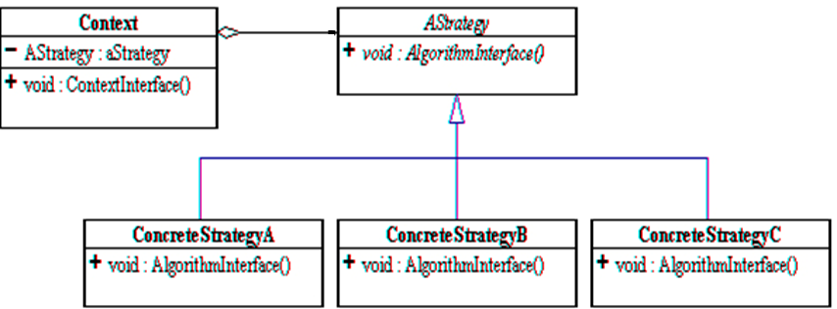
Strategy -Structure
Participants?

Slide 7
setPassword with Strategy
class User{
public:
virtual void setPassword(const String& passwd);
virtual bool checkPassword(const String& passwd);
User(Encryption* e); ~User()=default;
private: Encryption* strategy;
….}
void User::setPassword(const String& pass){
checkStrength(pass);
save(strategy ->generateHash(pass));
}
User::User(Encryption* e):strategy(e){…}
Participants?

Slide 8
Strategy - Collaborations
The context object receives requests from the client and delegates them to the strategy object.
  Usually, the ConcreteStrategy is created by the client and passed to the context. From this point the clients interacts only with the context.
The Context objects contains a reference to the ConcreteStrategy that should be used.
When an operation is required then the algorithm is run from the strategy object.
The Context is not aware of the strategy implementation.
If necessary, additional objects can be defined to pass data from context object to strategy.

Slide 9
Recall the Car example 2nd week
Car class and its 2 operations/behaviors:
  Brake and accelerate
These behaviors change frequently between models, so implement these behaviors in subclasses: overriding
  For each new model, override
    Beware: Code duplication across models
    The work of managing these behaviors increases greatly as the number of models increases

Slide 10
Alternative1
public class Car{
public void break(){
switch(model){
case Simple:
//reduce speed 5 unit/sec
case Sportcar:
//….with ABS
case EV:
//regenerative breaking
}
//other members
public void accelerate(){
switch(model){
case Simple:
//speed up 7u/s
case EV:
//smart speed up
case Sports: //….
}
as ugly as it gets,
useless when it comes to extensibility
throws out any hope of it being reusable.

Slide 11
Alternative 2:
Car
+break()
+accelerate()
simple
+break()
+accelerate()
Sports
+break()
+accelerate()
EV
+break()
+accelerate()
break(){..//uses ABS }
accelerate(){..//smart speeds up}
break(){..//reduces speed 5unit/sec}
accelerate(){..//speeds up 7 units/sec}

Slide 12
Strategy Solution
Car
+break()
+accelerate()
Breaking
+break()
class Car{
private:
Breaking* breakS;
Accelerate( accelS;
…
public:
break(){
breakS->break();}
accelerate(){
accelS->accelerate();}
Car(Breaking* b,
Accelerate* a)
:breakS(b), accelS(a){}
void setBreakS(Breaking* b){
breakS=b;}
…
}
Break1
+break()
Break2
+break()
Accelarate
+accelerate()
Accelarate1
+accelerate()
Accelarate2
+accelerate()
Notes:
class Car{
Breaking breakS;
Accelerate accelS;
…
break(){
breakS.break();}
accelerate(){
accelS.accelerate();}

Slide 13
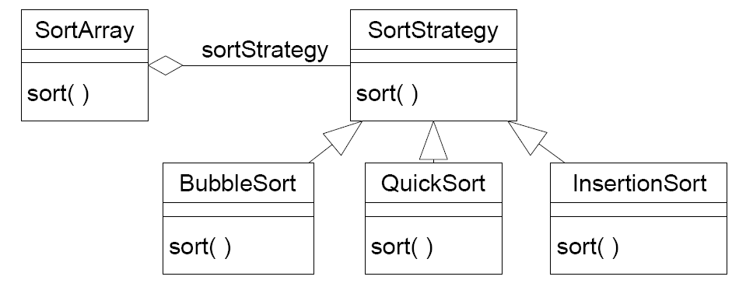
Example 3: Strategy
Application where the sorting algorithm is chosen at runtime

Slide 14
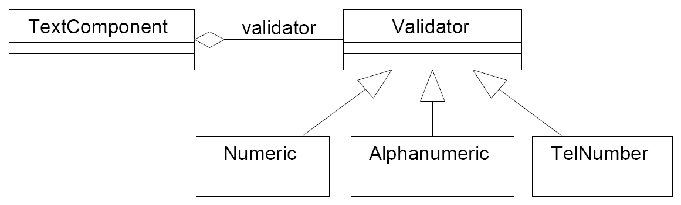
Example 4
A GUI text component object wants to decide at runtime what strategy it should use to validate user input.
Many different validation strategies are possible: numeric fields, alphanumeric fields, telephone-number fields, etc.

Slide 15
Applicability -Strategy
Many related classes differ only in behavior
  you can reduce these several objects to one class that uses several Strategies.
Need different variants of an algorithm
  switch from one algorithm to another during runtime
Avoid exposing complex, algorithm specific data structures
  E.g. intermediate data structure used for compression
A class defines many behaviors and chooses one with conditionals
Notes:
Need a family of algorithms
JPEG compression for images in a document, LZWR1 for text compression
to isolate the business logic of a class from the implementation details of algorithms that may not be as important in the context of that logic.
The Strategy pattern lets you isolate the code, internal data, and dependencies of various algorithms from the rest of the code. Various clients get a simple interface to execute the algorithms and switch them at runtime.
e.g. Huffman coding uses priority queue e.g. LZW uses dictionary (hash table)

Slide 16
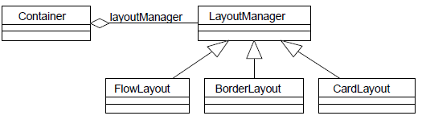
Example 5 – javax.swing
A GUI container object wants to decide at run-time what strategy it should use to layout the GUI components it contains. Many different layout strategies are already available.
Frame f = new Frame();
f.setLayout(new FlowLayout());
f.add(new Button(“Press”));

Slide 17
Strategy – other examples
Application where the compressing algorithm is chosen at runtime
Application where the provisioning algorithm is chosen at runtime depending on the user type

Slide 18
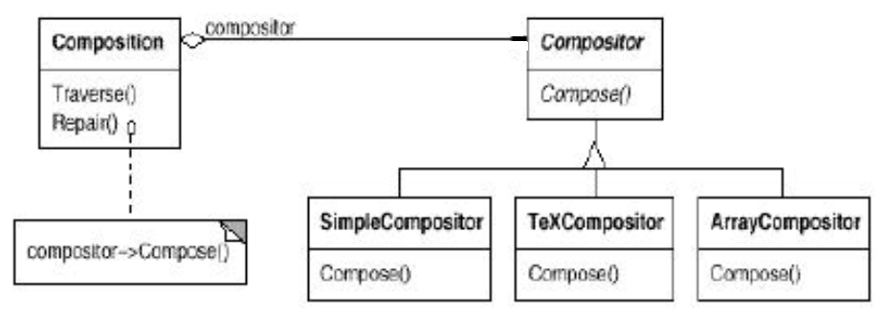
Strategy – another example
Composition is responsible for maintaining line breaks of a text displayed.
Compositor class has line breaking algorithms in its subclasses.

Slide 19
Example 6
There are numerous border types
  Line, titled, edged,…
Each visual component draws itself with different bordering (assume they are not decorated)
All they differ is border drawing algorithm
  There is a family of border drawing algorithm

Slide 20
Example
class JComponent{….
protected void paintBorder(Graphics g) {
switch(getBorderType()) {
case LINE_BORDER: paintLineBorder(g); break;
case ETCHED_BORDER: paintEtchedBorder(g); break;
case TITLED_BORDER: paintTitledBorder(g); break;
...}
}
// The actual implementation of the JComponent.paintBorder() method
protected void paintBorder(Graphics g) {
Border border = getBorder();
if (border != null) {
border.paintBorder(this,g,0,0,getWidth(), getHeight()); }
}
Border Object has the drawing algorithm not the JComponent

Slide 22
Strategy – Consequences-1
Eliminates conditional statements
  When you have several behaviors together in one class, you’ll use conditionals
  With Strategies you won't need to check for anything, since whatever the current strategy is just executes without asking questions
Alternative to subclassing context object to achieve different behaviors
  With Strategies all you need to do is switch the context's strategy and it will immediately change how it behaves.

Slide 23
Strategy – Consequences-2
Change the algorithm on the fly
We can introduce new strategies without having to change the context. (OCP)
Strategies can be shared
Increases number of objects and communication overhead btw strategy and context
  See the implementation issues-2
Notes:
to isolate the business logic of a class from the implementation details of algorithms that may not be as important in the context of that logic.
See the GoF book example Compositor

Slide 25
Strategy: Key notes
Family of algorithms
  One strategy class per algorithm
Make them interchangeable
  Just change the current strategy object and the algorithm changes
Client of the context can use different algorithms easily
Strategy is about delegating how an action is performed.
Alternative for subclassing

Slide 26
Implementation issues-1
Lambda functions instead of explicit strategy classes
  Cons: strategies will not be shared
  Pro: less number of classes
class Car {
public:
std::function<void()> strategy;
Car(std::function<void()> strategy) : strategy(strategy) {}
void applyBrakes() { strategy(); }
};
int main() {
Car sportsCar( { std::cout << "Applying ABS brakes...\n"; });
sportsCar.applyBrakes();
}
Notes:
Alternative: Strategies as template parameters In C++ templates

Slide 27
Lambda
interface BrakingStrategy { void applyBrakes();} //JAVA
class Car {
private BrakingStrategy strategy;
public Car(BrakingStrategy strategy) { this.strategy = strategy; }
public void applyBrakes(){ strategy.applyBrakes(); }
}
public static void main(String[] args) {
Car sportsCar = new Car(() ->
System.out.println("Applying ABS brakes..."));
sportsCar.applyBrakes();
}
//body of lambda implements a single abstract method
Notes:
);

Slide 28
Using C++ templates
  Cons: Cannot change strategy
template <class AStrategy> class Context {
void operation() {
theStrategy.DoAlgorithm();
//delegate to strategy
}
private:
AStrategy theStrategy;
};
class MyStrategy {
public: void DoAlgorithm();
};
//The class is then configured //with a Strategy class when it’s //instantiated:
Context<MyStrategy> aContext;

Slide 29
Implementation issues -2
Data from Context to Strategy
  Pass data as parameter
    strategy->execute(data1, data2);
    Not all strategies may need the same data
  Pass the context reference
    strategy->execute(this);
    Strategy would query context what data it needs
    Context’s interface with getters
    Strategy is tightly coupled with context
  There is no best

Slide 30
Implementation issues-3
Default Strategy in the Context
  Benefit: Clients don't have to deal with Strategy objects at all unless they don't like the default behavior
Make stateless Strategies
  When Strategies are stateless, they can be shared
  E.g. 3 users share Bcrypt for hashing their password
  No need to clutter the memory with same objects
  Strategies make good flyweights

Slide 31
Stateless strategies
If a Strategy object has no instance variables, it is stateless.
All its data comes from parameters (or the Context).
We can share a single instance of a stateless strategy across all Context objects.
This is the Flyweight pattern.
  public static final Strategy FAST_STRATEGY = new FastStrategy();
  public static final Strategy ACCURATE_STRATEGY = new AccurateStrategy();
  A good flyweight implementation would use a Flyweight factory.

Slide 32
Question: why not delete?
class User{
public:
virtual void setPassword(const String& passwd);
virtual bool checkPassword(const String& passwd);
User(Encryption* e); ~User()=default;
private: Encryption* strategy;
….}
void User::setPassword(const String& pass){
checkStrength(pass);
save(strategy ->generateHash(pass));
}
User::User(Encryption* e):strategy(e){…}
Strategies
are shared:
flyweight
Notes:
flyweight

Slide 33
Strategy -Related patterns -1
Strategies can be flyweights
Template M vs Strategy
  Template Method fixes skeleton of algorithm, variation in steps
  Strategy changes the algorithm completely
    Change mergesort to bublesort
Decorator vs Strategy
  Both alternative to inheritance
  Decorator adds functionality on top -wrapper
  Strategy replaces functionality
Notes:
Decorator lets you change the skin of an object, while Strategy lets you change the guts.
TM lets you alter parts of an algorithm by extending those parts in subclasses.,
Strategy alter parts of the object’s behavior by supplying it with different strategies that correspond to that behavior

Slide 34
Strategy -Related patterns -2
Bridge and Strategy have the same Class diagram, but intent is different
  strategy is related with the behavior and bridge is for structure.
  the coupling between the context and strategies is tighter than the coupling between the abstraction and implementation in the bridge pattern.
State pattern (next) vs Strategy
Command (later)

Slide 35
Strategy –Known Use
java.util.Comparator with compare() method is a strategy used by many, e.g. sort method of Collections
Notes:
javax.servlet.Filter with doFilter()

Slide 37
Objects with modes
Objects may respond differently to the same event in different modes
Example: a Vending machine button press
  If no coins inserted, ask for payment
  If correct payment, dispense the product
  If out of product, return coins
  Let’s draw a state diagram: nocoins, soldOut,…
  How would you implement the dispense method?
Notes:
first, what is a state diagram.
States are different configurations of the vending machine that behave in a certain way
and need some action to take them to another state
To go to another state you need to do something. E.g insert coin
This is state transition

Slide 38
pressbutton2
pressbutton2
idle
insert
has1coin
pressbutton1
pressbutton1
pressbutton1
insert
pressbutton2
has2coin
Coffee
1
Latte
2
insert1coin
pressbutton1
pressbutton2

Slide 39
Problem: a class whose behavior depends on some internal state.
A FSM implemented with a long if/else or switch statement.
void handle(Event e) {`
if (state == STATE_A) { ... if (e == X) state = STATE_B; }`
else if (state == STATE_B) { ... if (e == Y) state = STATE_A; }
}
This is hard to maintain and violates the Open-Closed Principle.

Slide 40
Change the behavior…
Now, I need to change the behavior of the vending machine to ask for 3 coins as payment
How will your code get effected?
How many places need to change?

Slide 41
State Pattern
Intent
  Allow an object to alter its behavior when its internal state changes.
  The object will appear to change its class.
    As if a totally different implementation has taken place at runtime
Soln: encapsulate each state in its own object.
The Context (the FSM) will delegate all state-specific behavior to its current state object.
Notes:
Operations have large, multipart conditional statements that depend on the object's state. This state is usually represented by one or more enumerated constants. Often, several operations will contain this same conditional structure. The State pattern puts each branch of the conditional in a separate class. This lets you treat the object's state as an object in its own right that can vary independently from other objects.

Slide 42
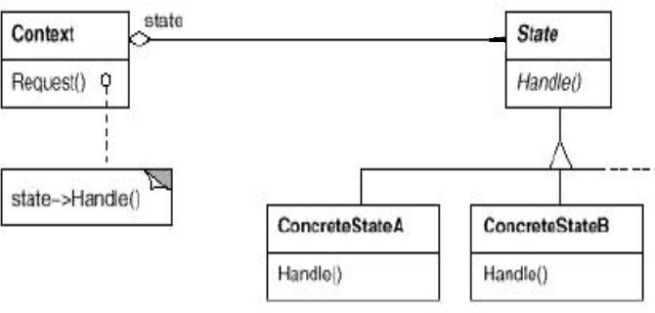
State -Structure
Context is the class that
has a number of internal states
It is delegating the behavior
To a state instance
Handle each request
based on the specific state

Slide 43
State Pattern
Intent
  Allow an object to alter its behavior when its internal state changes.
Applicability
  An object's behavior depends on its state, and it must change its behavior at run-time depending on that state
  Operations have large, multipart conditional statements that depend on the object's state.
    The State pattern puts each branch of the conditional in a separate class.
    Especially useful when state-specific code change frequently
Notes:
Operations have large, multipart conditional statements that depend on the object's state. This state is usually represented by one or more enumerated constants. Often, several operations will contain this same conditional structure. The State pattern puts each branch of the conditional in a separate class. This lets you treat the object's state as an object in its own right that can vary independently from other objects.

Slide 44
State-Collaborations
Context delegates state-specific requests to the current ConcreteState object.
A context may pass itself as an argument to the State object handling the request.
  This lets the State object access the context if necessary.
Context is the primary interface for clients. Clients can configure a context with State objects.
  Once a context is configured, its clients don't have to deal with the State objects directly.
Either Context or the ConcreteState subclasses can decide which state succeeds another and under what circumstances.

Slide 45
public class VendingMachine{ //the Context
public final State nocoins=new NoCoinState();
//states as flyweights
….
State currentState;
public VendingMachine(){ … currentState=noCoins; …}
public void insertCoin(){
currentState.insertCoin(this); //delegate action
}
public void buttonpressed(){
currentState.buttonpressed(this); //delegate
}
…
//methods for state transition
void setState(State s){currentState=s;}
State getNoCoinState(){return nocoins;}
…//other getstate methods
Notes:
State transition operations are package public. This may be a problem.
In c++ we can declare them private and make friends with state
How to overcome? Maybe state as inner class?

Slide 46
public interface State{ //issue-should this be a class?
void insertCoin(VendingMachine machine);
void buttonPressed(VendingMachine machine);
//other actions
}
public class NoCoinState implements State{
void insertCoin(VendingMachine machine){
  //do the state transition
  machine.setState( new HasCoinState()); //issue
  }
  void buttonpressed(VendingMachine machine){
  print(“sorry, no coins in the machine”);
  }
}
Notes:
Easy to forbit unallowed actions in a state….eject quarter in a noquarter state

Slide 47
Who determines the next state?
Context
  If the state transition is fixed yes, but it is not flexible
  If the states will be used in different state machines with different transitions
  Centralized and visible transitions
  Context:: changeState(){currentstate=…}
Concrete state
  How to do in states
    context.changeState(new XXXState()); //no
    context.changeState(context. getXXXState ());
    context.changeState(XXXState.getInstance());
  Code change request is handled similar to adding a node into a linked list
Notes:
Do you see flyweight?

Slide 48
Effect of change
Now, the change the payment to 4 coins.
How many places in the code to change?

Slide 49
State pattern
Localize the behavior for each state into its own class
  so that if one state is modified, other states are not messed up
  every state just implements its own actions
Helps to remove “if”s that are difficult to maintain
Closed each state for modification and left the machine open to extension by adding new states
  Easier to add new states in the machine
Have a structure that maps the state diagram

Slide 50
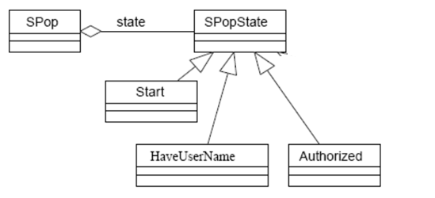
Example 2: Simple POP
Simple POP (Post Office Protocol)
  Get user name (USER)
  Get password (PASS)
  Get the size of all messages (LIST)
  Retrieve a message (RETR)
  Quit
Notes:
First one is user
After user, pass or quit
If user and pass ok, you can use other commands like list and retrieve until quit

Slide 51
Simple POP implementation
Java illustration
public class SPopState {
public SPopState user(SPOP context,String userName) {
//default action here}
public SPopState pass(SPOP context,String password) {
//default action here}
public SPopState list(SPOP context){
//default action here}
public SPopState retr(SPOP context,int messageNumber){
//default action here}
public SPopState quit(SPOP context,) {
//default action here}
}
Why default action?

Slide 52
Simple POP implementation
Java illustration
public class Authorized extends SPopState {
public void quit (SPOP context) {
//state transition
context.setState(context.getStart());
}
public void list (SPOP context) {
//list emails
//no state transition: stay in this state.
}
public void retr (SPOP context,int messageNumber) {
//list emails
//no state transition: stay in this state.
}
}
State classes determine
the next state
Notes:
States are flyweghts. Who is the flyweight manager?

Slide 53
Simple POP implementation
Java illustration
public class Start extends SPopState {
public void user (SPOP context, String userName) {
//state transition
context.setState(new HaveUserName(userName));}
}
public class HaveUserName extends SPopState {
private String userName; // CANNOT SHARE!
public HaveUserName(String u){this.userName=u;}
public void pass(SPOP context. String password) {
if (validateUser(userName, password)
context.setState(context.getAutherized());
else
context.setState(context.getStart());}
}
State classes determine
the next state
Notes:
States are flyweghts. Who is the flyweight manager?

Slide 54
and the context is…
public class SPop{
private SPopState state=new Start();
public void user(String name){
state.user(this,name);}
public void pass(String pwd){
state.pass(this,pwd);}
public void list(){ state.list();}
……
}

Slide 55
State vs. Strategy
Strategy
Who Drives Change? Client (externally).
  context.setStrategy(new FastSort())
Intent: Answers "How" to do an action.
  How to sort? How to encrypt?
The Context is given a behavior
State
Who Drives Change? Context or State (internally). account.setState(OVERDRAWN_STATE)
Intent: Answers "What" to do (or "When") based on the situation.
  What do I do when `withdraw` is called in this state?
The Context is a behavior.

Slide 56
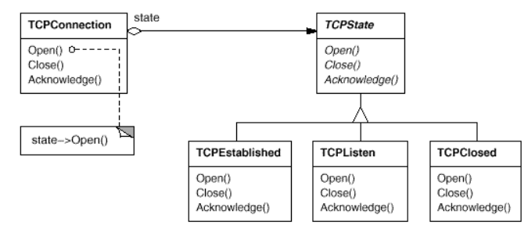
GoF example – C++ illustration

Slide 57
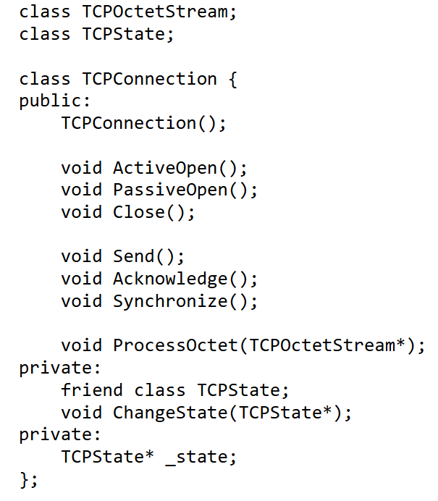
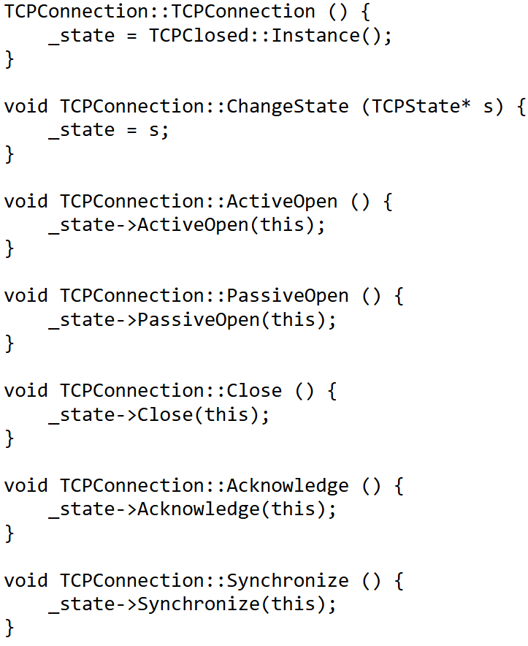
Notes:
Why friend?

Slide 58
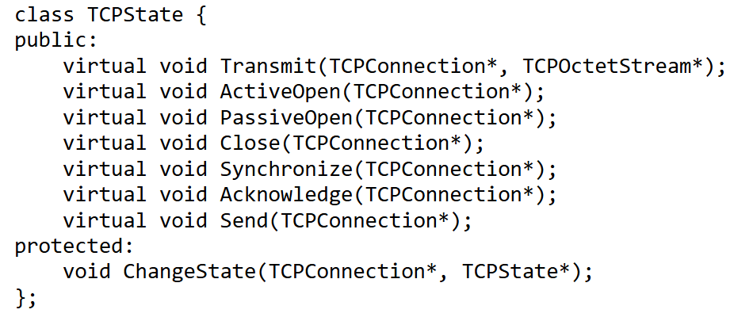
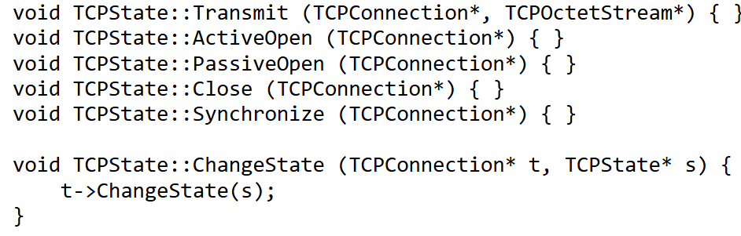
Notes:
Or, default action could be exception or some message

Slide 59
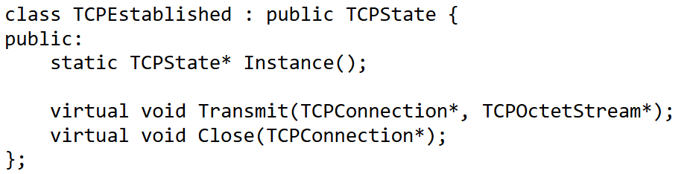
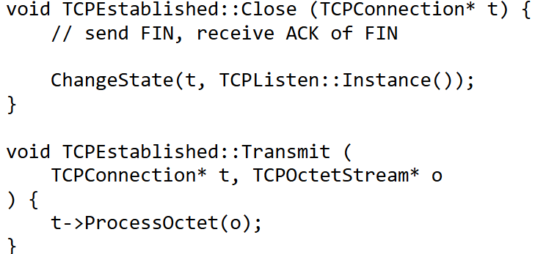
A State Subclass implements its state specific behavior only
State transition
How is it implemented?
Notes:
After performing state-specific work, these operations call the ChangeState operation to change the state of the TCPConnection. TCPConnection itself doesn't know a thing about the TCP connection protocol; it's the TCPState subclasses that define each state transition and action in TCP.

Slide 60
State-Consequences -1
Puts all behavior associated with a state into one object
  It localizes state-specific behavior and partitions behavior for different states.
  Because all state-specific code lives in a State subclass, new states and transitions can be added easily by defining new subclasses.
Notes:
Encapsulating each state transition and action in a class elevates the idea of an execution state to full object status. That imposes structure on the code and makes its intent clearer.
Single Responsibility Principle. Organize the code related to particular states into separate classes.
Open/Closed Principle. Introduce new states without changing existing state classes or the context.
Simplify the code of the context by eliminating bulky state machine conditionals.

Slide 61
State – Consequences-2
Makes state transition explicit
  Assume we are not using the state pattern
  Recall that, object state is valuation of its attributes
    Let numCoins, numProd be attributes of Machine
    A machine object with numCoins=10, numProd=5
    A machine object with numCoins=12, numProd=3
  A state change occur as assignment to some of object’s attributes
    Machine::insert(){numCoins++;}
    Machine::pushButton(){ if(numCoins>prevNum) numProd--;}
  Introducing separate objects for different states makes the transitions more explicit.
I could achieve same effect with an integer variable denoting the state.
Why not use that?
Notes:
when an object defines its current state solely in terms of internal data values, its state transitions have no explicit representation; they only show up as assignments to some variables. Introducing separate objects for different states makes the transitions more explicit. Also, State objects can protect the Context from inconsistent internal states, because state transitions are atomic from the Context's perspective—they happen by rebinding one variable (the Context's State object variable), not several

Slide 62
State – Consequences-3
State transition logic is partitioned between the State subclasses rather than in a switch statement
  Supports open-close principle
  Removes look-alike conditionals or case statements scattered throughout Context's implementation.
  Otherwise, adding a new state could require changing several operations, which complicates maintenance.
Helps avoid inconsistent states since state changes occur using just the one state object and not several objects or attributes

Slide 63
State – Consequences-4
Easy to forbit unallowed actions in a state
  E.g. eject quarter in a noquater state
States objects can be shared
  Especially when they have no instance variables
Can be overkill if a state machine has only a few states or rarely changes.
More objects, rather than a single class
  Since the pattern distributes behavior for different states across several State subclasses.
  Such distribution is actually good if there are many states, which would otherwise require large conditional statements.
Notes:
Alternative to State pattern: State table.
. For each state, a table maps every possible input to a succeeding state. In effect, this approach converts conditional code (and virtual functions, in the case of the State pattern) into a table look-up.
The State pattern models state-specific behavior, whereas the table-driven approach focuses on defining state transitions.

Slide 64
Thread safety
State change need to be protected in multithreaded programs
Consider locking Context methods before delegating to state object
  Might be inefficient
Make states immutable as well
Beware: when locking before state delegation, we might end up with deadlock if there is locking inside the state method too

Slide 65
State-Known use
javax.faces.lifecycle.LifeCycle,
  controlled by FacesServlet,
  the behavior of execute method is dependent on current phase (state) of JSF lifecycle
READ https://gameprogrammingpatterns.com/state.html

Slide 66
State vs. Strategy
Strategy
Who Drives Change? Client (externally).
  context.setStrategy(new FastSort())
Intent: Answers "How" to do an action.
  How to sort? How to encrypt?
The Context is given a behavior
State
Who Drives Change? Context or State (internally). account.setState(OVERDRAWN_STATE)
Intent: Answers "What" to do (or "When") based on the situation.
  What do I do when `withdraw` is called in this state?
The Context is a behavior.

Slide 67
State vs Strategy
Same structure but different intents
  What are the intents?
  State object encapsulates a state-dependent behavior (and possibly the transition)
  Strategy object encapsulates algorithm
State object in a context will be changed, Strategy may change
Notes:
State: set of behaviors encapsulated in state objects. Context will change state and hence context behavior will change. However, the client of the context knows nothing or very little about the state objects
State transitions is well defined, there is an order. Strategy may change but there is no order in the strategy changes
Either context or state decides to next state. In strategy, client is also in play
Strategy: client specifies which strategy the context will use. Client will make the context change its behavior with a strategy. It is alternative to subclassing… attaching a behavior at runtime
Stragety: alternative to subclassing
State: alternative to lots of conditionals

