Slide 1
Behavioral Patterns
Observer

Slide 2
Back to Traffic Flow
Consider the Traffic flow simulation
When a traffic light on a crosswalk changes to red
  Motorized vehicles stop
  Pedestrians cross the road
Polling is not always a good idea
  Like “are we there yet?” every other second

Slide 3
Common problem
What if a group of objects needs to update themselves when some object changes state?
  Common problem!
    Data changes, update the view (MVC)
    Traffic Light changes, vehicles and peds need to update themselves (take action)
    Following in social media
Solution: subscribe and get notifications
i.e. The Observer pattern
Notes:
The Observer pattern is the basis of event based systems

Slide 4
Back to Traffic Flow
Consider the Traffic flow simulation
When a traffic light on a crosswalk changes to red
  Motorized vehicles stop
  Pedestrians cross the road
Polling is not always a good idea
The waiting queues and people on each side should be notified when light changes
  Observer pattern

Slide 5
Observer Pattern
:TrafficLight
:Pedestrian
:VehicleQueue
addObserver(this)
addObserver(this)
Traffic light
becomes red
update()
update()
Traffic light notifies all of its observers at once
TrafficLight::notify(){ for each observer o o.update();}

Slide 6
Observer Pattern
There is a one-to-many dependence
  Many objects are interested in the Traffic Light
Observers (Waiting queues, pedestrians) register to the Subject (Traffic Light)
  Observers can change at runtime
Change of state (light change) of the Subject notifies the observers
  Observers get notified about any events that happen in the Subject
  Change of state, events ….
Observers take action upon notification
  Update themselves

Slide 7
Structure: Observer Pattern
Subject
+attach(observer)
+detach(observer)
+notify()
*
Observer
+update()
for all observers o
o.update();
ConcreteObserver
observerState
+update()
ConcreteSubject
subjectState
Participants?
Notes:
Can I have object that’s both subject and observer? Yes (listeners could also be observersr)

Slide 8
Observer
Intent: Define a one-to-many dependency between objects so that when one object changes state, all its dependents are notified and updated automatically.
A.k.a. Publish/Subscribe
Motivation:
  Need to maintain consistency between related objects without tight coupling

Slide 9
Exercise: Observing Traffic Light
Make the Traffic Light observable
public interface Subject{
public void attach(Observer o);
public void remove(Observer o);
public void notify();
}
public class TrafficLight implements Subject{
private List<Observer> observers;
private RGY light; //state variable
…//implement instance methods
//implement the Subject interface

Slide 10
public class TrafficLight implements Subject{
private List<Observer> observers;
private RGY light; //state variable
public void attach(Observer o)
{observers.add(o);}
public void remove(Observer o)
{observers.remove(o);}
public void notify(){ //broadcasting the event
for(var ob:observers)
ob.update();
}
public void changeLight(){
//change to Red, Yellow, Green
notify(); //issue-2: who and when should notify
}
}

Slide 11
Exercise: Observing Traffic Light
public interface Observer{
public void update(); //issue-1
}
public class Pedestrian implements Observer{
public void update(){ //issue-1
//cross the road if light is green
//stop observing the light issue-3
}
//other instance methods
}
public class MVehicleQueue implements Observer{
public void update(){…}
}
Notes:
The only thing common between pedestrian and the queue is both observing the traffic light

Slide 12
Exercise: Observing Traffic Light
public interface Observer{
public void update(); //issue-1
}
public class Pedestrian implements Observer{..}
public class VehicleQueue implements Observer{..}
See the loose coupling
The only thing common between these two classes
is the Observer interface.
Subject is unaware of their primary job
OCP: new observer types do not affect the subject
Notes:
The only thing common between pedestrian and the queue is both observing the traffic light

Slide 13
Observer -- Loose coupling
Subject only know interface.
  Don’t know or care what any concrete observer does
Add new observers at anytime
  Runtime registration and remove
Do not modify subject when new kinds of observers come to play
Reuse subject and observer independently of each other
Changes in subject or an observer will not affect each other –as long as they implement the interfaces
Dependency Inversion

Slide 14
When to use Observer: Applicability
A change to one object requires changing other objects and the actual set of objects is unknown beforehand or changes dynamically
  notify other objects without making assumptions about who they are
Need to maintain consistency between related objects without tight coupling
An abstraction has two aspects, one dependent on the other. Encapsulate these aspects in separate objects lets you vary and reuse them independently
Notes:
An observer may observe multiple subjects
A Variation
An observer may query Subject’s state to make its own state consistent

Slide 15
Implementation Issues / Choices
Issue1: arguments of update()
  Pedestrian will cross the road if the light of TrafficLight object is Green
Choice 1: Subject sends the data
public void update (RGY light)
  Push model: push the data observers need
  Subject sends detailed information to observers about its state
  observers less reusable, fixed update method signature
Notes:
When subject’s code change, maybe it pushes more

Slide 16
Exercise: Observing Traffic Light
public class Pedestrian implements Observer{
public void update(RGY light){ //issue-1
if(light==RGY.Green)
//cross the road
}//other methods…
}
Pro:Pedestrian is unaware it is observing a TrafficLight object.
Cons: When subject’s code change, maybe it pushes more
Cons: Not all observers may need all the data subject pushes

Slide 17
Implementation Issues / Choices
Issue1: arguments of update()
  Pedestrian will cross the road if the light of TrafficLight object is Green
Choice 1: Subject sends the data
public void update (RGY light) ;
  Push model: push the data observers need
Choice 2: Observers query the subject
public void update (Subject s) ;
  Pull model: Send the Subject reference, observers asks for details explicitly afterwards
  Subject is ignorant of observers
  Observers call Subject back to get the state

Slide 18
Exercise: Observing Traffic Light
public class Pedestrian implements Observer{
public void update(Subject s){ //issue-1
if(s.equals(mylight)){
if(s.getLight()==RGY.Green)
//cross the road
} }//other methods…
private Subject mylight;
}
the Subject interface needs getter methods
public interface Subject{
public RGY getLight();
public void attach(Observer o);
public void remove(Observer o);
public void notify();}

Slide 19
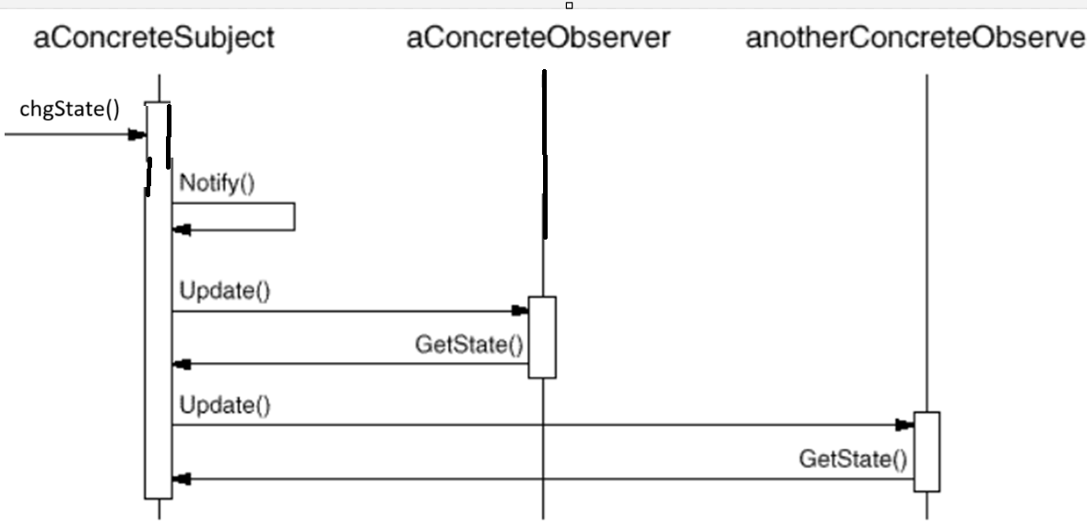
Observer -Collaborations
Pull model is mostly preferred

Slide 20
Push vs Pull Models
Pull Model is more decoupled
  Pro: observers are reusable
  Pro: subject does not assume what observers need
  Cons: observers have to call subject
    1K subscribers/observers call your method to check what happened
  Cons: subject has to provide getter methods
Push model is more efficient
  Pro: Subject controls what info to reveal
  Cons: restricted observers

Slide 21
Implementation issues /Choices
Issue2: Who triggers the notify and when?
Subject calls notify after each state changing operation
  Pro: Clients do not have to remember to call notify
  Cons: when series of operation, consecutive updates results in inefficiency
Clients (users of subject) call notify at right time
  Pro: update after a series of operation
  Cons: client may forget it
Notes:
several consecutive operations will cause several consecutive updates, which may be inefficient.

Slide 22
Implementation issues /Choices
Issue2: Who triggers the notify and when?
Subject calls notify after each state changing operation
  Pro: Clients do not have to remember to call notify
  Cons: when series of operation, consecutive updates results in inefficiency
  setChanged() after series of operations,
    Notify ignores when isChanged is not set
Clients (users of subject) call notify at right time
Notes:
Java.util.Observable does have setChanged()

Slide 23
Implementing issues -3
Observing more than one subject
  Which subject is notifying?
  Subject passes itself via update method as a parameter
How does an Observer remove itself?
  Store Subject references
  Sometimes observers remove themselves as a reaction to some event.
  Subject passes itself via update method as a parameter, remove yourself using the reference
Notes:
Observing more than one subject. It might make sense in some situations for an observer to depend on more than one subject. For example, a spreadsheet may depend on more than one data source. It's necessary to extend the Update interface in such cases to let the observer know which subject is sending the notification. The subject can simply pass itself as a parameter in the Update operation, thereby letting the observer know which subject to examine.

Slide 24
Exercise: Observing Traffic Light
public class Pedestrian implements Observer{
public void update(RGY light){ //push
if(light==RGY.Green){
//cross the road
//how to stop observing the light?
mysubject.remove(this);
}
}
public void atIntersection(Subject s){
mySubject=s;
}
//other methods…
}

Slide 25
Exercise: Observing Traffic Light
public class Pedestrian implements Observer{
public void update(Subject s){ //pull
if(s.equals(mylight)){
if(s.getLight()==RGY.Green)
//cross the road
s.remove(this);//stop observing the light
}
public void atIntersection(Subject s){
mylight=s;
}//other methods…
private Subject mylight;
}

Slide 26
Implementation issues -4,5,6
Can an observer be also a subject?
Do not assume an order of updates in Subject::notify
Destructor method of Subject (C++)
  Deleting a subject should not produce dangling references in its observers.
  Make the subject notify its observers as it is deleted so that they can reset their reference to it.
  Do not delete observers.
    other objects may reference them
    they may be observing other subjects as well.

Slide 27
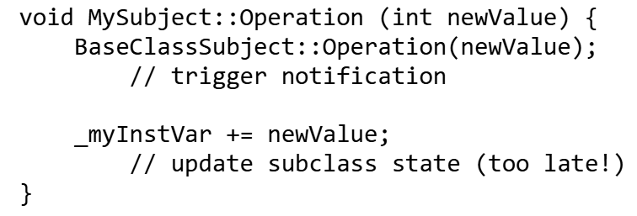
Implementation issues -7
Make sure the subject updates its state before sending out notifications
  Do not notify in the middle of change
  A problem caused by inheritance usually
BaseClassSubject calls notify itself inside the operation (see issue-2)

Slide 28
public class CSubject{
int state = 0;
public change(int increment){
state = state + increment;
notify();
}
//…
}
public class CSubSubject extends CSubject{
int additionalState = 0;
public change(int increment){
super.change(increment); //notified
additionalState = additionalState + increment;
// the state is changed after the notifiers are updated
}
}
make the order of operation
Constant
Make the change
Notify

Slide 29
Template Method to rescue
public class CSubject{
int state = 0;
public void final change(int increment) {
doUpdateState(increment);
notifyObservers();
}
public void doUpdateState(int increment){
state = state + increment; }
}
class CSubSubject extends CSubject{
public void doUpdateState(int increment){
super.doUpdateState(increment); // the observers are not notified
additionalState = additionalState + increment;
}

Slide 30
Implementation issue (optional)
Lambda and function references (advanced)
  If you understood the mechanics of Observer, you may replace the observer interface with function references
class Subject{…
typedef std::function<void(Subject*)> ObserverFunction;
void attach(ObserverFunction observer) {
observers.push_back(observer); }
void notify() { for (auto& observer : observers) { observer(this); }
};

Slide 31
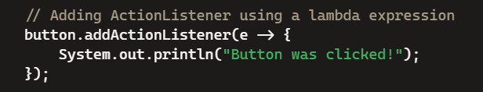
Implementation issue (optional)
Lambda and function references (advanced)
Observer attaches itself with a lambda
subject.attach(this { this->update(s); }); //inside an observer
Another Example:

Slide 32
Example Scenario
A news agency gather news and publish them to different subscribers.
We need to create a framework for and agency to be able to inform immediately, when event occurs, its subscribers about the event.
The subscribers can receive the news in different ways: Emails, SMS, ...
The solution need to be extensively enough to support new types of subscribers
  maybe new communication technologies will appear.

Slide 33
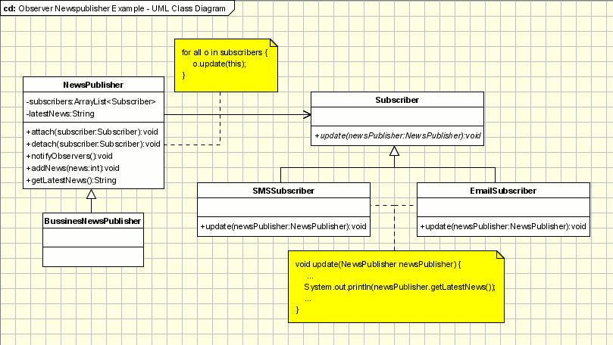
http://www.oodesign.com/observer-pattern.html

Slide 34
Exercise 2
Weather station keep tracks of the recent temperature and pressure
  setMeasurement(float temperature, float pressure)
There are several weather data display
  CurrentConditionDisplay
    Prints current conditions
  ForecastDisplay
    Calculate prediction using the current data

Slide 35
Subject
Which update model does this code implement?
Push or Pull
public class WeatherStation implements Subject {
private List<Observer> observers=new ArrayList<>();
private float temperature;
private float pressure;
public void registerObserver(Observer o) { observers.add(o);}
public void removeObserver(Observer o) { observers.remove(o); }
public void notifyObservers() {
for (Observer observer : observers)
observer.update(temperature, pressure);
}
public void setMeasurements(float temperature, float pressure) {
this.temperature = temperature;
this.pressure = pressure;
notifyObservers();
}
}

Slide 36
Weather data Observer
How to implement a ForecastDisplay
  Gets current data from 2 stations
  Makes prediction and display
  pull model or push model?

Slide 37
Alternative: Pull model
public class ForecastDisplay implements Observer {
private WeatherStation myStation;
public ForecastDisplay(WeatherStation station) {
this.myStation = station;
station.registerObserver(this); // Register itself
}
public void update(Subject s) {
if (s == myStation) {
float temp = myStation.getTemperature(); //pull
float pressure = myStation.getPressure(); //pull
//do the work
System.out.println("Forecasting with temp: " + temp);
}
}
}
Notes:
// Inside WeatherStation class
public void notifyObservers() {
for (Observer observer : observers) {
observer.update(this); // "this" is the Subject
}
}

Slide 38
Alternative: Pull model
public class ForecastDisplay implements Observer {
private WeatherStation myStation;
public ForecastDisplay(WeatherStation station) {
this.myStation = station;
station.registerObserver(this); // Register itself
}
public void update(Subject s) {
if (s == myStation) {
float temp = myStation.getTemperature(); //pull
float pressure = myStation.getPressure(); //pull
//do the work
System.out.println("Forecasting with temp: " + temp);
}
}
}
// Inside WeatherStation class
public void notifyObservers() {
for (Observer observer : observers) {
observer.update(this); // "this" is the Subject
}
}
Notes:
// Inside WeatherStation class
public void notifyObservers() {
for (Observer observer : observers) {
observer.update(this); // "this" is the Subject
}
}

Slide 39
Observer – Consequences-1
Subject and observers are loosely coupled
  Subject need not know concrete observers just knows each observer implements the update()
  Can reuse subjects without reusing their observers and vice versa
  Observers can be added without modifying the subject
  Subject and observer can belong to different abstraction layers
Notes:
Cyclic dependencies could be a problem

Slide 40
Observer – Consequences-2
Support for broadcasting
  All observers are notified
  The subject does not care how many interested objects exist
  Freedom to add/remove Observers any time
  It's up to the observer to handle or ignore a notification
Unexpected updates
  An operation on the subject may cause a cascade of updates to observers and their dependent objects
Notes:
Moreover, dependency criteria that aren't well-defined or maintained usually lead to spurious updates, which can be hard to track down.This problem is aggravated by the fact that the simple update protocol provides no details on what changed in the subject. Without additional protocol to help observers discover what changed, they may be forced to work hard to deduce the changes.
Cyclic dependencies could be a problem

Slide 41
Event based systems
Publish/subscribe is observer
Event based architectures
Put queues/topics or messaging services in between
  Publisher(Subject) send events/notifications/messages to the topic/queue
  Subscribers get notified and consume events/messages from the topic/queue
  Security, availability, recoverability, persistency,….

Slide 42
This code is not thread safe (Java)
public class Subject{ //lazy init and not thread safe
private List<Observer> observers=null;
private void createObservers(){
observers=new ArrayList<Observer>();}
public void attach (Observer o) {
if(observers==null) createObservers();
observers.add(o);}
public void detach (Observer o) {
if (observers!=null) observers.remove(o); }
public void notify () {
if (observers==null) return;
for (Observer o: observers) o.update(this);}
}

Slide 43
Not thread safe
public void detach (Observer o) { observers.remove(o); }
public void notify () {
if (observers==null) return;
for (Observer o: observers) o.update(this);
}
What happens one thread is executing detach(o) while another thread is in notify()?
ConcurrentModificationException

Slide 44
Not thread safe
public void attach (Observer o) {
if(observers==null) createObservers();
observers.add(o);
}
What happens when thread 1 see null observers and just before calling createObservers, thread 2 started and completed attach(o)?

Slide 45
Not thread-safe (C++)
No lazy initialization but still not thread safe
void Subject::attach (Observer* o) { observers->push_back(o);}
void Subject::detach (Observer* o) { observers->remove(o); }
void Subject::notify () {
for (auto it = _observers.begin(); it != observers.end(); ++it)
it->update(this);
}
Race condition: What happens one thread is executing detach(o) while another thread is in notify()?
Same question is valid for Java implementation

Slide 46
Thread safe Subject
Use a thread safe Collection
public class Subject{
private final List<Observer> observers= new
CopyOnWriteArrayList<Observer>(); //in concurrency package
public void attach (Observer o) {
observers.add(o);}
public void detach (Observer o) { observers.remove(o); }
public void notify () {
for (Observer o: observers) o.update(this);}
} //final makes it initiated once. –no lazy init
//CopyOnWriteArrayList is thread safe data structure
There are libraries for C++ that provides thread safe data structures (e.g. Boost)

Slide 47
Thread safe Subject -synchronized
public class Subject{
private List<Observer> observers=null;
private void createObservers(){
observers=new ArrayList<Observer>();}
public void synchronized attach (Observer o) {
if(observers==null) createObservers();
observers.add(o);}
public void synchronized detach (Observer o) {
if(observers!=null) observers.remove(o); }
//see next slide
This is Java synchronized.
There are C++ libraries with locking mechanism

Slide 48
Thread safe Subject -synchronized
public void synchronized detach (Observer o) {
observers.remove(o); }
public void notify () {
List<Observer> copy;
synchronized(this){
if (observers==null) return;
copy=new ArrayList<>(observers); //shallow copy
}
for (Observer o: copy) o.update(this);}
} //lazy init and pull method
If notify is synchronized, deadlock!
  Use reentrant locks or concurrent.CopyOnWriteArrayList
Notes:
If notify method is synchronized:
notify() holds the lock on this (the Subject).
It calls o.update(this) on one of the observers.
Inside update(), the observer calls back into detach() (which is synchronized).
detach() tries to acquire the same lock on this — but it's already held by notify().
Since notify() is waiting for update() to finish, and update() is waiting for detach() to acquire the lock, you get a classic deadlock.

Slide 49
Observer –Known uses
Event based systems
Listeners in Java
  implementations of java.util.EventListener
  All Listeners in javax.swing
  javax.servlet.http.HttpSessionBindingListener
Any publish/subscriber is an observer
Submit a task to cloud, do something else while waiting for task ended notification
READ https://gameprogrammingpatterns.com/observer.html
Notes:
We can implement observer as function references
typedef std::function<void(Subject*)> ObserverFunction;
void attach(ObserverFunction observer) { observers.push_back(observer); }
void notify() { for (auto& observer : observers) { observer(this); } }
Observer is
subject.attach(this { this->update(s); });

Slide 50
Layered Systems and Observers
In layered systems, objects in different layers should be loosely coupled
communication between layers
  Top layer calls bottom layer to perform task
    FACADE
  If bottom object calls upper one directly, it violates layering
    put them in the same layer?
    classes end up in inappropriate layers
  observer
    upper layer observes the lower layer subject
    coupling only at interface level

Slide 51
Related patterns
Mediator (next)
  when we have cases of complex cases of many subjects an many observers
Chain of responsibility (next week)
  Observer notifies all registered handlers at once.
  CoR sequentially looks for handlers
    The linked observers in game patterns reading is CoR
Command (next week)
Notes:
Chain of responsibility (next week)
Both patterns decouple sender from receiver
CoR sequentially looks for handlers
Observer notifies all registered handlers at once.
Command establishes unidirectional connections between senders and receivers.
Both patterns decouple sender from receiver

