Slide 1
Structural Patterns
Intro
Adapter
Façade

Slide 2
Structural Patterns
How classes and objects are composed to form larger structures
How to form larger structures from individual parts, generally of different classes
How to glue different pieces of a system together in a flexible and extensible fashion.
How to recast pieces that don't fit (but that you need to use) into pieces that do fit.
Helps to guarantee that when one of the parts changes, the entire structure does not need to change.
Notes:
Structural object patterns compose objects to realize new functionality. The added flexibility of object composition comes from the ability to change the composition at run-time, which is impossible with static class composition.
They work with the way objects are connected with other objects to ensure that changes in the system do not require changes to those connections.

Slide 3
Structural design patterns
Similar to data structures, but
structural design patterns also specify the methods that connect objects, not merely the references between them.
A structural design pattern also describes how data moves through the pattern whereas data structures only describe how data is arranged in the structure.

Slide 4
Structural Patterns
Adapter
To convert interface of one class to another, so that unrelated or incompatible classes can work together
Bridge
To decouple abstraction from implementation, so that they can vary independently
Composite
To treat elements of a tree structure, both individual and composite elements uniformly
Decorator
To add responsibilities to objects dynamically
Façade
To provide unified interface to a set of subsystems for ease of use
Flyweight
To support large number of fine-grained objects efficiently
Proxy
To provide a placeholder for an object to control access to it.
Notes:
Adapter-façade-decorator-proxy
Composite
Bridge
flyweight

Slide 5
adAPTER

Slide 6
Motivating example:
We are developing an e-commerce platform that initially uses the payment gateway, called PayFast, for processing payments.
Unfortunately, our code is tightly coupled with the PayFast API.
Now, we want to expand our platform to support another payment gateway, QuickPay, without changing the existing codebase that interacts with PayFast.

Slide 7
Motivating example
Problem: PayFast and QuickPay APIs have different interfaces.
PayFast::pay() but QuickPay::qpay()
The existing codebase is designed to work with PayFast, and directly integrating QuickPay requires significant changes.
Maybe even introduce conditionals all over the place.
General problem: How to make unrelated or incompatible classes work together?

Slide 8
Adapter
Intent
Convert interface of one class to another, so that unrelated or incompatible classes can work together
A.k.a Wrapper
Applicability
You want to use an existing class, and its interface does not match the one you need
You want to create a reusable class that collaborates with unrelated or unforeseen classes, i.e. don’t have compatible interfaces.
Notes:
2nd applicability: I want to draw shapes and t

Slide 9
Adapter
Adapter lets classes work together that couldn’t otherwise because of incompatible interfaces
Incompatible method signatures
In short: When you’ve got this, and you need that, Adapter solves the problem.
Notes:
2nd applicability: I want to draw shapes and t

Slide 10
Example
I am implementing a DrawingEditor that draws Lines, Circles, and Text.
DrawingEditor::drawAll(){
for(auto& s:elem) s.draw();
}
But, Text does not support a “draw” method, it has “print” method.
I want “draw” but I have “print”
I want to work with unrelated classes (text and Circle)
Notes:
https://medium.com/@hooman.the1/adapter-design-pattern-in-typescript-part-2-intent-motivation-04c42002c86c

Slide 11
Defining problem
class Incompatible {
public void g() {…}
public void h() {…}
}
interface WhatIWant {
void f();
}
Mycode(){
WhatIwant target=…;
target.f();
}
Convert interface of one class to another, so that unrelated or incompatible classes can work together

Slide 12
Adapter-Structure
Client
Target
Adaptee
+request()
+specificRequest()
Adapter
{return super.specificRequest();}
+request()
Class Adapter pattern
Notes:
Commited to 1 adaptee.
Huge + : don’t have to reimplement the entire adapteee. Can also override the behavior of the adaptee (because of subclassig) if it is needed
More efficient than object adapter, since there is 1 object only at runtime (otherwise you have adapter and adaptee objects)

Slide 13
Adapter-Structure
Java
Client
Target
Adaptee
+request()
+specificRequest()
Adapter
{return super.specificRequest();}
+request()
class Adaptee { //Adaptee
public void g() {…}
public void h() {…}
}
interface WhatIWant {//Target
public void f();
}
class Adapter
extends Adaptee
implements WhatIWant{
void f(){
super.g();
super.h();}
}
JAVA

Slide 14
Adapter-Structure
C++
Client
Target
Adaptee
+request()
+specificRequest()
Adapter
{return specificRequest();}
+request()
class Adaptee { //Adaptee
public: void g() {….}
void h() {…..}
};
class WhatIWant {//Target
public:
virtual void f()=0;
};
class
Adapter: public Adaptee,
private WhatIHave {
public:
void f()
{
g();h();
}
}
Notes:
Private adaptee, public target inheritance -> Adapter would be a subtype of Target but not of Adaptee.

Slide 15
Adapter-Structure
Object Adapter pattern
Client
Target
Adaptee
+request()
+specificRequest()
Adapter
adaptee
{return adaptee.specificRequest();}
+request()
Notes:
Can adapt any subclass of adaptee
More flexible than class adaptee

Slide 16
Adapter-Structure
JAVA
class Adaptee { //Adaptee
public void g() {…}
public void h() {…}
}
interface WhatIWant { //Target
public void f();
}
class Adapter
implements WhatIWant{
private Adaptee adaptee;
public void f(){
adaptee.g();
adaptee.h();}
}
Client
Target
Adaptee
+request()
+specificRequest()
Adapter
adaptee
{return adaptee.specificRequest();}
+request()
Notes:
Adapter may directly forward the requests; common in adapter implementations
Adapter may call more then one method of the adaptee

Slide 17
Adapter-Structure
C++
class Adaptee { //Adaptee
public: void g() {…}
void h() {…}
};
class WhatIWant { //Target
public: virtual void f()=0;
};
class Adapter: public WhatIWant{
private:
Adaptee* adaptee;
public:
void f(){ adaptee.g();
adaptee.h();}
};
Client
Target
Adaptee
+request()
+specificRequest()
Adapter
adaptee
{return adaptee.specificRequest();}
+request()

Slide 18
Adapter-Structure
Client
Target
Adaptee
+request()
+specificRequest()
Adapter
{return super.specificRequest();}
+request()
Client
Target
Adaptee
+request()
+specificRequest()
Adapter
adaptee
{return adaptee.specificRequest();}
+request()
Notes:
Sadece method delegation degil, bazen de voltaj degistiren adapter gibi calisiyor
i.e. request(){adaptee.req1(); adaptee.req2();} gibi olabilir.

Slide 19
Example
Stack
+push(Object)
+pop():Object
+top():Object
DLinkedList
+insert(Node,Object)
+insertTail(Object)
+remove(Node,Object)
+removeTai:Object
+getTail():Object
+………..
DListStack
Client program uses a Stack.
There is a double linked list implementation
Adapt the linked list to a Stack interface
class DListStack implements Stack {
private DLinkedList dlist;
public DListStack(){dlist = new DLinkedList(); }
public void push(Object o){dlist.insertTail (o);}
public Object pop(){return dlist.removeTail ();}
public Object top(){return dlist.getTail ();}}
Notes:
Client{ … Stack stack=new DListStack(); // or create a dlist and wrap it with the adapter
In STL , stack is adapting deque. Some cases list.

Slide 20
Example: Adapters in STL (C++)
std:stack adapts deque, list, vector
std:queue adapts deque and list
std:priority_queue adapts vector and list
They convert one interface into another interface clients expect
i.e. implement priority_queue operations using vector operations via delegation.

Slide 21
Possible uses of adapter
We cannot change the library interface(code), since we may not have its source code.
Even if we did have the source code, we probably should not change the library for each domain-specific application.
Sometimes a toolkit or class library cannot be used because its interface is incompatible with the interface required by an application.
Want to create a reusable class that cooperates with unrelated classes with incompatible interfaces.

Slide 22
Example
I have legacy Java CGI web server programs written using a java library .
Servlets provide functionality similar to CGI programs, but are considerably more efficient.
CGIVariables class in the old library stores all CGI environment variables in a hash table and allows access to them via a get(String evName) method.
The servlet library has an HttpServletRequest class which has a getX() method for each CGI environment variable.
We want to use servlets. Should we rewrite all of our existing Java CGI programs??
Roger Whitney San Diego State U
Notes:
"AUTH_TYPE"REMOTE_USER

Slide 23
Soln: Let’s minimize the recoding
CGIAdapter class with the same interface (a get() method) as the original CGIVariables class, but puts a wrapper around the HttpServletRequest class.
Change CGIVariables to CGIAdapter class in existing code
but the form of the get() method invocations need not change.

Slide 24
Sample code
public class CGIAdapter {
Hashtable CGIVariables = new Hashtable(20);
public CGIAdapter(HttpServletRequest CGIEnvironment) {
CGIVariables.put("AUTH_TYPE",
CGIEnvironment.getAuthType());
CGIVariables.put("REMOTE_USER",
CGIEnvironment.getRemoteUser());
//………….
}
public Object get(Object key) {
return CGIvariables.get(key);}
}

Slide 25
Implementation issues
C++ adapters with multiple inheritance
Inherit publicly form Target but privately from Adaptee
So that the Adapter would be a subtype of Target but not of Adaptee.
How much adaptation?
Simple interface conversion that just changes operation names and order of arguments
Totally different set of operations

Slide 26
Implementation issues
two-way adapter
Useful if you need to use both the old and the new interface
when some components use the old, some use the new
A two-way adapter supports both the Target and the Adaptee interface.
It allows an adapted object (Adapter) to appear as an Adaptee object or a Target object
Two-way adapter conforms to both of the adapted classes and can work in either system.
Notes:
when two different clients need to view an object differently

Slide 27
2 –way adapter example
We want an adapter that acts as
a SquarePeg or a RoundPeg
public interface IRoundPeg {
public void insertIntoHole(String msg); }
public interface ISquarePeg {
public void insert(String str);}
In C++ multiple inheritance will do the job
Adapted from Bob Tarr at UMBC

Slide 28
C++
class IRoundPeg {
public: virtual void insertIntoHole(const String& msg)=0;
};
class ISquarePeg {
public: virtual void insert(const String& str) =0;
};
class PegAdapter: public ISquarePeg, public IRoundPeg {
public:
void insert(const String& str) override{
insertIntoHole(str);}
void insertIntoHole (const String& msg) override {
insert(msg);}
};

Slide 29
JAVA
public class PegAdapter
implements ISquarePeg, IRoundPeg {
private RoundPeg roundPeg;
private SquarePeg squarePeg;
public PegAdapter(RoundPeg pegR, SquarePeg pegS ) {
this.roundPeg = pegR;
this.squarePeg = pegS;
}
public void insert(String str) {
roundPeg.insertIntoHole(str);
}
public void insertIntoHole(String msg){
squarePeg.insert(msg);}
}

Slide 30
Client code example
public class TestPegs {
public static void main(String args[]) {
RoundPeg roundPeg = new RoundPeg(); // Create some pegs.
SquarePeg squarePeg = new SquarePeg();
// Create a two-way adapter and do an insert with it.
ISquarePeg roundToSquare = new PegAdapter(roundPeg);
roundToSquare.insert("Inserting round peg...");
// Create a two-way adapter and do an insert with it.
IRoundPeg squareToRound = new PegAdapter(squarePeg);
squareToRound.insertIntoHole("Inserting square peg...");
}

Slide 31
Adapter-Consequences
Class Adapter
Lets Adapter to overwrite some adaptee behavior
Introduces only one object, no additional indirection needed to get to the adaptee
Won’t work when we want to adapt a class and all its subclasses
Object Adapter
A single Adapter can work with many adaptees
Harder to overwrite some adaptee behavior

Slide 32
Adapter -Known uses
Adapters in Java IO
java.io.InputStreamReader adapts java.io.InputStream to have a correct java.io.Reader interface
java.io.OutputStreamWriter adapts OutputStream to a Writer interface
STL adaptors in C++:
Container adaptors include stack, queue, priority queue
Iterator adaptors include reverse iterators, std::back_inserter() iterators
Function adaptors include negators and binders
Notes:
Binders (bind1st() & bind2nd()) bind one of their arguments – Negators (not1 & not2) adapt functors by negating arguments – Member functions (ptr fun & mem fun) allow functors to be class members

Slide 33
Adapter -Known uses
Stack is an adapter
Converts interface of deque into a stack interface
May adapt vector and list as well
back_inserter() returns an adapter
Looks like an iterator on a container
Calls containers’s push_back when the container needs to grow
e.g. std:copy (iiterS,iterE,oiter) called with
std:copy(v.begin(),v.end(),back_inserter(a)); //a is an empty container
Notes:
Where std::vector<int>a; /*empty */ and std::vector<int> v={3,24,6}
Bind1st eskimis. Illaki functor istiyor. Bind ise normal function da aliyor icine. Wrapper aslinda . Wrapper == adapter yada decorator
auto f =bind( myDiff, 5, _1); ///int myDiff(int x, int y){return x-y;}
cout<<f(3)<<endl; //prints 2

Slide 34
Adapter
Intent
Convert interface of one class to another, so that unrelated or incompatible classes can work together
Applicability
You want to use an existing class and its interface does not match the one you need
You want to create a reusable class that collaborates with unrelated or unforeseen classes, i.e. don’t have compatible interfaces.
(object adapter only) You need to use several existing subclasses, but it's impractical to adapt their interface by subclassing each one. An object adapter can adapt the interface of its parent class.
Notes:
Object Adapter and Class Adapter
convert an existing interface into another interface you expect

Slide 35
Facade

Slide 36
Façade
“If something is ugly, hide it inside an object.”
If you have a rather confusing collection of classes and interactions
that the client programmer doesn’t really need to see,
Create an interface that is useful for the client programmer and that only presents what’s necessary.
Only clients needing more customizability will need to look beyond the facade

Slide 37
Façade
Intent
Provide unified interface to a set of interfaces of a subsystem. Defines higher-level interface that makes the subsystem easier to use
Applicability
You want to provide a simple interface to a complex subsystem
When there are many dependencies between clients and the implementation classes
You want to layer your subsystem

Slide 38
Façade Applicability
You want to provide a simple interface to a complex subsystem
Good enough for most clients
When there are many dependencies between clients and the implementation classes of an abstraction
Decouple clients from subsystem via façade
Subsystem portability and independence
You want to layer your subsystem
Each Façade will be entry point of a subsystem
If subsystems are dependent, they’ll communicate through their facades -> less coupling

Slide 39
Client2
Client1
Client2
Client1
Facade
subsystem classes
Coupling reduced
Too much coupling to low level classes

Slide 40
Façade -Structure
Client
Facade
subsystem classes
For example, the java.net.URL is a façade.
This class provides access to the contents of URLs
and hides many classes from its clients

Slide 41
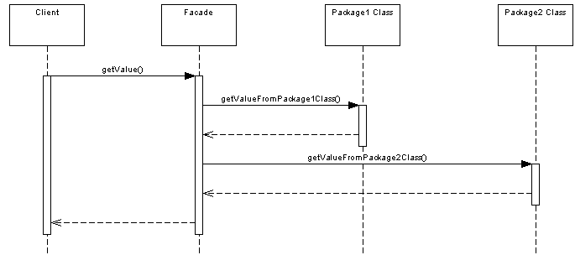
How façade works

Slide 42
Example from the GOF book
Compiler Façade offers a single, simple interface to the compiler subsystem.
It makes life easier for most programmers without hiding lower-level functionality
from the few programmers that need it.

Slide 43
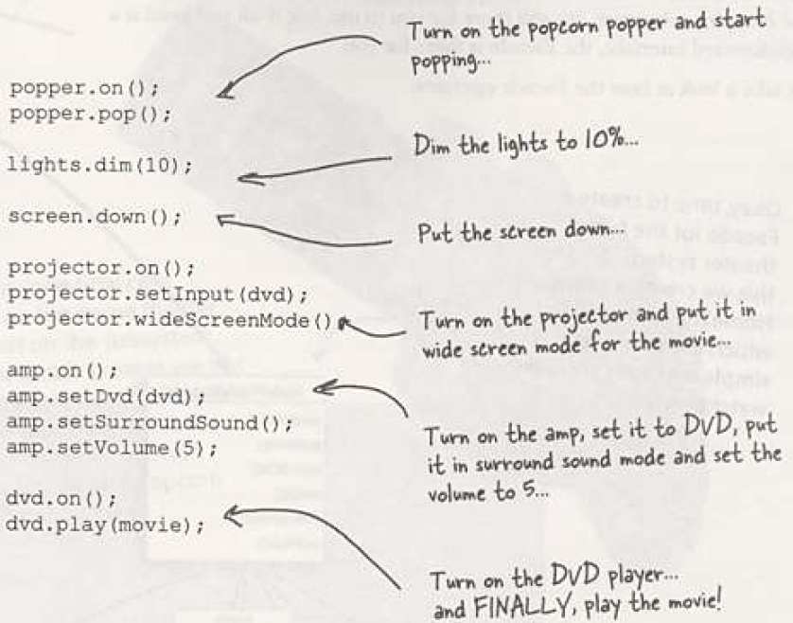
Watching a movie : head first design patterns

Slide 44
Movie system setup
When movie is over, how to turn everything off?
Do all these steps in reverse?
Listen to cd or the radio?
If you want to upgrade your system, you need to have to learn the new procedure

Slide 45
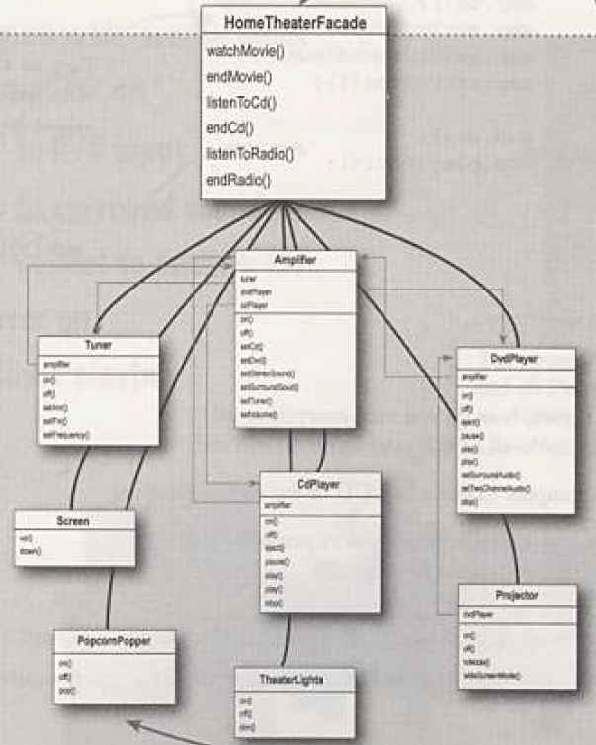

Slide 46
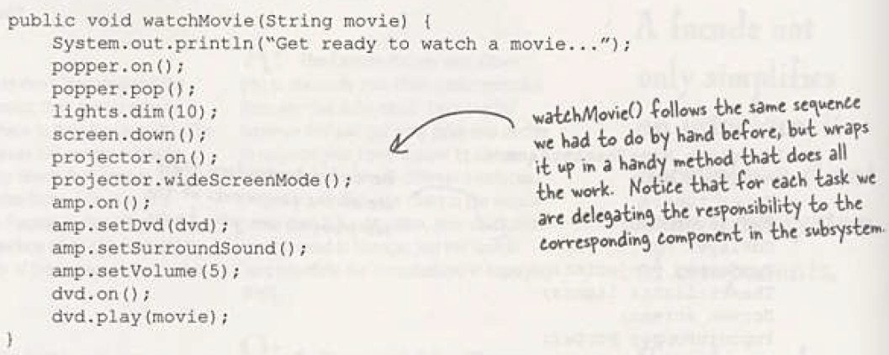
Movie System Facade

Slide 47
Client code
public class Driver{
public static void main(String[] args){
//instantiate the individual components e.g. tuner
HomeTheatherFacade homeTheater=
new HomeTeatherFacade(amp,, tuner, dvd,cd,
projector, popper, screen, lights);
homeTheather.watchMovie (“mymovie”);
homeTheather.endMovie ();
}
}

Slide 48
Example from the GOF book
Compiler Façade offers a single, simple interface to the compiler subsystem.
It makes life easier for most programmers without hiding lower-level functionality
from the few programmers that need it.

Slide 49
C++ implementation
class Compiler {
public:
Compiler();
void Compiler::Compile (istream& input, BytecodeStream& output) {
Scanner scanner(input);
ProgramNodeBuilder builder;
Parser parser;
parser.Parse(scanner, builder);
RISCCodeGenerator generator(output);
ProgramNode* parseTree =
builder.GetRootNode();
parseTree->Traverse(generator);
}
class Scanner {
public:…. Scanner(istream&);
};
class Parser {…
virtual void Parse(Scanner&,
ProgramNodeBuilder&);
};
class ProgramNodeBuilder {
public: ……
ProgramNode* GetRootNode();
virtual ProgramNode* NewAssign (…..) const;
};
class CodeGenerator {…}
class ProgramNode {…
virtual void
Traverse(CodeGenerator&);
};

Slide 50
Implementation issues
Façade is coupled with the subsystem below
If subsystem never changes, it is ok
Else, changes in subsystem may broke your facade
Solution1: Façade Interface or Abstract Façade
Concrete classes make the actual coupling with the subsystem classes
Solution 2: configure Façade with different subsystem objects (dependency injection)

Slide 51
Façade –Consequences
A simple default view of the subsystem that is good enough for most clients
Shields clients from subsystem components
Clients will deal with less number of objects, much easier
Promotes subsystem independence and portability
Helps layering a system
Reduces compilation dependencies in large systems
Promotes low coupling between subsystem and its clients
Change subsystem without affecting the clients
Notes:
It shields clients from subsystem components, thereby reducing the number of objects that clients deal with and making the subsystem easier to use.
It promotes weak coupling between the subsystem and its clients. Often the components in a subsystem are strongly coupled. Weak coupling lets you vary the components of the subsystem without affecting its clients. Facades help layer a system and the dependencies between objects. They can eliminate complex or circular dependencies. This can be an important consequence when the client and the subsystem are implemented independently.Reducing compilation dependencies is vital in large software systems. You want to save time by minimizing recompilation when subsystem classes change. Reducing compilation dependencies with facades can limit the recompilation needed for a small change in an important subsystem. A facade can also simplify porting systems to other platforms, because it's less likely that building one subsystem requires building all others.
It doesn't prevent applications from using subsystem classes if they need to. Thus you can choose between ease of use and generality.

Slide 52
Facade does not add any functionality,
it just simplifies interfaces
It does not prevent sophisticated clients from accessing the underlying classes

Slide 53
Adapter vs Facade
The Intent !
Adapter alters the interface so that it matches the one the client expects
Façade simplifies the interface of a subsystem

