Slide 1
Behavioral Patterns
Iterator
Visitor

Slide 2
class ProductCatalog<T> {
private Node<T> productRoot; // This is a BST
public Node<T> getElements() {
return this.productRoot; // DESIGN FLAW
} //… methods to manage catalog item like add in BST
}
class Client {
public <T> void printCatalog (ProductCatalog<T> catalog) {
Node<T> root = catalog.getElements();
this.printInOrder(root);
//Client is forced to write its own logic, go left/right etc
}
private <T> void printInOrder(Node<T> node) { /* ... */ }
}

Slide 3
Iterator is a GoF pattern ☺
They are so good and part of languages
  Iterator library - cppreference.com
  Iterator (Java Platform SE 8 ) (oracle.com)
Traverse the elements of an aggregate without exposing the underlying implementation
  Aggregate can be a collection, an array,…

Slide 4
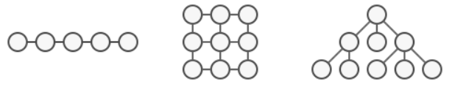
Iterator Pattern
Intent
  Provide a way to access the elements of an aggregate object sequentially without exposing its underlying representation
  An aggregate object is an object that contains other objects for the purpose of grouping those objects as a unit.

Slide 5
Why talk about iterator?
We can write our own iterator!
  Customized iterator for our own classes
  Customized traversal algorithms for our own classes
When should we use an iterator?
Why using iterators make sense?
You know how to use it. Today, why we must have it
Suggestion: use an existing iterator if possible.
Notes:
You know how to use it. Today, you learned why we must have it

Slide 6
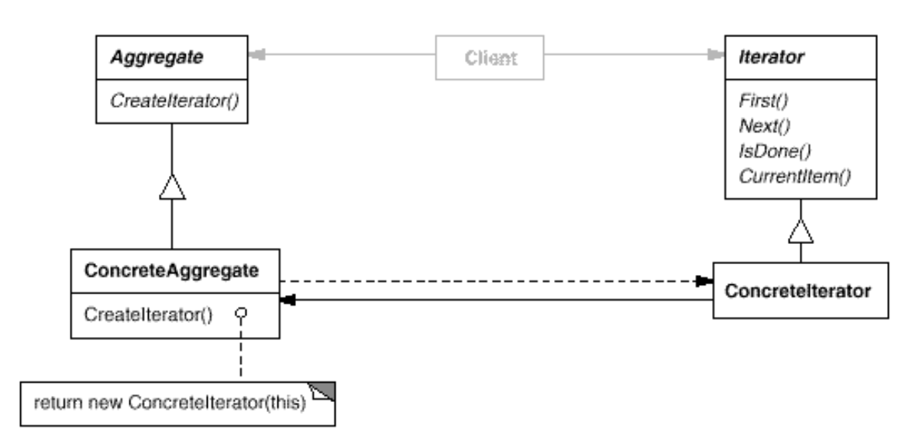
Structure –GoF
iterator(); next(); hasNext(); Java alternative
begin(); it++; end(); C++ alternative
Foreach loops are using iterators behind the scene

Slide 7
Why iterator anyway?
Iterator hides internal representation
  Iterator of a any collection has the same interface
  List, Set, PriorityQueue …all create iterator with the same interface
Encapsulate traversal of a collection
  Clients do not have to implement them
Simpler aggregates: when the collection itself provides traversal, it will be a mess
  Many traversal happen at the same time
  Many object will call next(), how to save the position of the traversal for each of them?

Slide 8
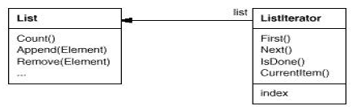
Iterator
<creates>
Traveling task is on the iterator, not on the aggregate
Simplifying the aggregate interface
Relieves the aggregate from the traversing responsibility (more cohesive)
Multiple traversal
List<Object> lst=new ArrayList<Object>();
Iterator it1=lst.iterator(); it1.next(); //traversal one
Iterator it2=lst.iterator(); it2.next(); it2.next(); //traversal two

Slide 9
Different traversal
Complex aggregates may be traversed many ways
Example: Tree
  in-order, pre-order, post-order
Other traversals
  Forward, backward
  Skip even, skip odd , ….
For each algorithm, have one concrete iterator
java.util.TreeSet has 2 iterators
  iterator(): returns an Iterator, for ascending order
  descendingIterator():returns an Iterator, for descending order

Slide 10
Applicability
Need access an aggregate object's contents without exposing its internal representation.
Need to support multiple traversals of aggregate objects.
  allow different traversal methods
    Forward, backward, DFS, BFS, traverse odds,…
  support multiple traversals to be in progress
  Serving more than one client
Need to provide a uniform interface for traversing different aggregate structures
  Helps when types of the structures are unknown beforehand
  Implement client code w.r.t iterator interface
Notes:
Use exiting iterator, but sometimes you might need your own as well.

Slide 11
More applicability…
when the collection has a complex data structure, and you want to hide its complexity from clients
  either for convenience or security reasons.
when you want your code to be able to traverse different data structures
  Instead of special treatment for each data structure
To reduce duplication of the traversal code across your program.
  Each iterator is a traversal code(own iterator)
Notes:
Iterator (refactoring.guru)

Slide 12
Implement to Interface
Client depends on Collections and Iterators
int main(){ //assume initialization
List<Stamp> c1=stamps.getElements();
TreeSet<Stamp> c2=sorted.getContents();
Stamp[ ] c3= mystamps.getstamps();
//How to print all of the stamps?
Best practice: Never return internal representation, return iterator instead.
  Why? OCP

Slide 13
Implement to Interface
Client depends on Collections and Iterators
int main(){ //assume initialization
Collection<Stamp> c1=stamps.getElements();
Collection<Stamp> c2=sorted.getContents();
Collection<Stamp> c3=Arrays.asList(mystamps.getstamps());
//when there is an array iterator
print(c1.iterator()); print(c2.iterator());
print(c3.iterator());
}
void print(Iterator it){
while(it.hasNext()) { Stamp s=it.next(); s.print();}
}
This one implements to interface.
Can we do better?
Notes:
Collection or List or any other common abstraction.

Slide 14
Implement to Interface
Client depends on Collections and Iterators
int main(){ //assume initialization
Iterator <Stamp> it1=stamps.getElements();
Iterator<Stamp> it2=sorted.getContents();
Iterator<Stamp> it3=Arrays.asList(mystamps.getstamps());
//when there is an array iterator
print(it1); print(it2);
print(it3);
}
void print(Iterator it){
while(it.hasNext()) { Stamp s=it.next(); s.print();}
}
Better!
Notes:
Collection or List or any other common abstraction.

Slide 15
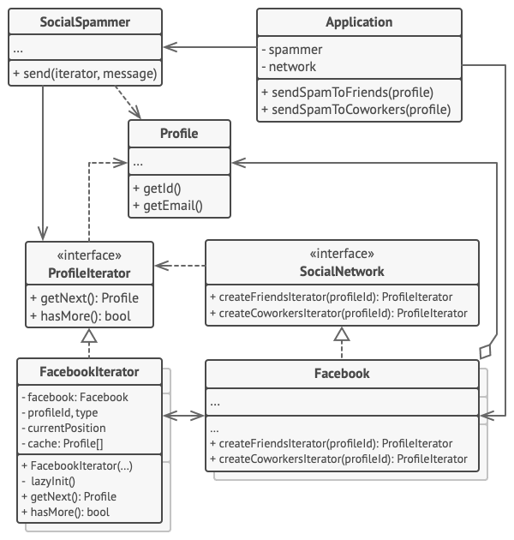
Example:Writing your own iterator
If the language provides iterator that fits, no need to reinvent the wheel.
Source: Dive into Design Patterns

Slide 16
Structure (polymorphic iterator)
Each concrete aggregate is responsible to create the appropriate concrete iterator
The iterator implementation w.r.t. underlying data structure.
e.g. cursor : index of an array
e.g. cursor: pointer to a node

Slide 17
Structure (polymorphic iterator)
Each concrete aggregate is responsible to create the appropriate concrete iterator
CreateIterator() method lets the subclasses to decide which concrete iterator to create. Is this familiar?

Slide 18
Iterator -Consequences
Simplifies the interface of the Aggregate by not polluting it with traversal methods
Supports multiple, concurrent traversals
Supports variant traversal techniques

Slide 19
Language support
C++ STL library has 6 iterators
  input_iterator, output_iterator, forward_iterator, bidirectional_iterator, random_access_iterator, contiguous_iterator
Java has basic 3 iterators
  Collection<t> extends Iterable<T> interface, all collections return an iterator
  There is indirect support to create iterators for arrays
STL weakens the iterator intent “sequential” access, also support bidirection
Java ListIterator is bidirectional

Slide 20
Related patterns
Iterator can traverse a Composite.
Polymorphic Iterators rely on Factory Methods to instantiate the appropriate Iterator subclass.
Memento is often used in conjunction with Iterator.
  An Iterator can use a Memento to capture the state of an iteration. The Iterator stores the Memento internally.
Visitor (next) and Iterator both traverse a structure

Slide 21
implementation issues
Can the aggregate be modified while a traversal is ongoing?
  An iterator that allows insertion and deletions without affecting the traversal and without making a copy of the aggregate is called a robust iterator.
  C++ STL provides such iterators
  Java throws ConcurrentModificationException
Use library iterators to avoid pitfalls
  Might want to implement iterator for your own complex data structure
    When there are traversal code in many places
  Might use library iterators inside your own iterator
Notes:
A robust iterator ensures that insertions and removals won't interfere with traversal, and it does it without copying the aggregate. There are many ways to implement robust iterators. Most rely on registering the iterator with the aggregate. On insertion or removal, the aggregate either adjusts the internal state of iterators it has produced, or it maintains information internally to ensure proper traversal.

Slide 22
implementation issues
Who defines the traversal algorithm?
  The iterator => more common; easier to have variant traversal techniques
    E.g ListIterator::next() {return list.get(current);}
  The aggregate => iterator only keeps state of the iteration.
    A client will invoke the Next operation on the aggregate with the cursor as an argument, and the Next operation will change the state of the cursor.
Iterator may need Collection to expose its internals --friend

Slide 23
Iterator and multithreading
Iterator does not raise special problems when the collection used from different threads as long the collection is not changed.
Collection changes and iterator:
A new element is added/removed to the collection (at the end). The iterator should be aware of the new size of the collection and to iterate till the end.
A new element is added/removed to the collection before the current element. In this case all the iterators of the collection should be aware of this.
Multithreading iterator should be a robust iterator and have locking mechanism (synchronization)
Languages support iterators for multi-threaded. Use them.

Slide 24
visitor

Slide 25
General Problem
There are many objects of different types
  Some share the same interface, some not.
We want to apply operation to several or all of them
  Cannot foresee all the operations we will need
Additionally
  These operations are not primary responsibilities of the objects
  We want to add new operations without modifying the object classes

Slide 26
Example Scenarios
Scenario 1:
There are a collection of chapter, section, paragraph classes
Adding secondary operations: Table of Contents, word count operation
Scenario 2:
There are a different types of products in an e-commerce site
Adding discount, exporting info to different formats.

Slide 27
Creating Table of Contents
Document
Chapter
Paragraph
Section
  Classes contain methods related to edit, format and display texts
  I want to add the functionality “create table of Contents”

Slide 28
Attempt 1:
Document
Chapter
t.add(title);
for each section s
t.addS(s.createTOC());
return t;
+createTOC()
+createTOC()
Paragraph
Section
{return “”}
{return title}
+createTOC()
+createTOC()

Slide 29
Attempt 1:
Document
Chapter
t.add(title);
for each section s
t.addS(s.createTOC());
return t;
+createTOC()
+createTOC()
Paragraph
Section
{return “”}
{return title}
+createTOC()
+createTOC()
Need to change the code of all classes.
  What if I am not permitted to change these code?
createToC logic is spread all over
This is not the primary job of theses classes (SRP?)
There will be word count operation later. (modify all)

Slide 30
Constraints
Keep the classes cohesive
  Focus on primary job and provide a point to add secondary responsibilities
    I will add count words later
Put the gathering ToC info job in its dedicated class
  Bring the distributed logic in one place
Preemptive
  mechanism for adding new operations later
  Might not have permission to change the classes

Slide 31
Attempt 1:
Document
Chapter
t.add(title);
for each section s
t.addS(s.createTOC());
return t;
+createTOC()
+createTOC()
Paragraph
Section
{return “”}
{return title}
+createTOC()
+createTOC()

Slide 32
Towards Solution 1:
Document
Chapter
Paragraph
Section
ToCVisitor
visitPragraph()
visitSection()
visitChapter()
t.add(title);
for each section s
t.addS(s.createTOC());
return t;
{return “”}
{return title}

Slide 33
Towards Solution 2:
Document
Chapter
//call
v.visitChapter(this)
+accept(Visitor v)
Paragraph
Section
+accept(Visitor)
+accept(Visitor)
call
ToCVisitor
visitPragraph(P)
visitSection(S)
visitChapter(C)
t.add(title);
for each section s
t.addS(s.createTOC());
return t;
{return “”}
{return title}

Slide 34
Extensible Solution:
Document
Chapter
+accept(Visitor v)
v.visitChapter(this)
Paragraph
Section
+accept(Visitor)
+accept(Visitor)
Visitor
visitPragraph()
visitSection()
visitChapter()
ToCVisitor
WordCountVisitor

Slide 35
Visitor Solution
  Gather related operations from each class in a separate object
    Gather all the createTOC methods in an object
    In other words, put all the TOC collecting logic into a separate class (TOCvisitor)
  The elements provide a method accepting visitor v that redirect v to the correct visit method
  Traverse the elements bringing TOCVisitor along with you
When a new operation is needed, only write a new visitor for that operation.
Notes:
Another example: Traversing an abstract syntax tree

Slide 36
Visitor
Intent:
  Represent an operation to be performed on the elements of an object structure.
  Visitor lets you define new operation without changing the classes the elements.
Allows adding further operations to objects without modifying them.
Notes:
Allows adding further operations to objects without modifying them.

Slide 37
Visitor
Intent:
  Represent an operation to be performed on the elements of an object structure. Visitor lets you define new operation without changing the classes the elements.
Applicability: When..
  Object structure has many classes with different interfaces
  Don’t want to pollute with many unrelated operations – ISP and SRP
  Classes defining the object structure rarely change but you want to add new operations.
    You may not be allowed to change

Slide 38
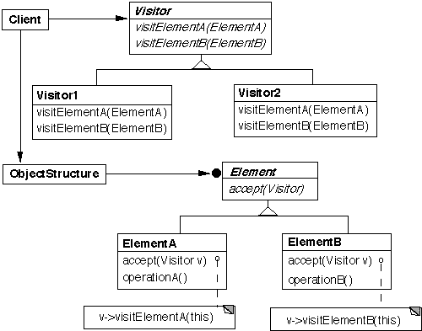
Visitor – not using overloading

Slide 39
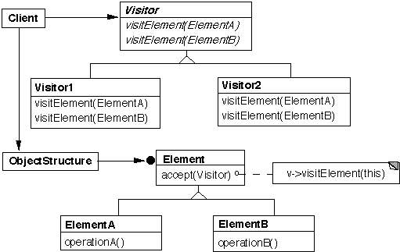
Visitor structure (overload visit)
Using overloading

Slide 40
Visitor - Collaborations
We have visitor that collects ToC information from chapter, section, paragraph
  visit(Chapter c), visit(Section), visit(Paragraph)
  They access object’s data c->getTitle();
We have object structure that chooses the right visit method when receiving a visitor
  accept(Visitor& v){ v.visit(this);}
Need a mechanism for visitor objects to traverse the objects – not yet defined
  3 options

Slide 41
Visitor -Traversals
Traversing different types of objects
  Some are data structure or collection
  for (Node node : collection) {
  node.accept(visitor);
  }
    Iterator is very helpful
  Some not
  obj1.accept(visitor);
  obj2.accept(visitor);
  Neither visit nor accept method makes the traversal

Slide 42
Exercise 1:
Asteroid, Spaceship, Alien classes
Print names of all
int main(){
list<Asteroid*>as=Factory.getInstance().makeAsteroid(10);
Spaceship ship;
list<Alien*>aliens=Factory.getInstance().makeAlien(5);
Visitor* visitor=new PrintVisitor();
for(auto asteroid: as) asteroid->accept(*visitor);
ship.accept(*visitor);
for(auto alien: aliens) alien->accept(*visitor);
}
Implement the visitor interface, visit alien, and Alien::accept

Slide 43
Visitor -Traversals
Traversing different types of objects and collections
obj1.accept(visitor);
  for (Node node : collection) {
  node.accept(visitor);}
  Iterator is very helpful
  Neither visit() nor accept() does traversal
Traversing a recursive structure or a composite pattern
  Structure propagates accept() using existing links
  Leveraging the composite
    root.accept(visitor)

Slide 44
Visitable Composite
public class Composite{/…
public void accept(Visitor v){
v.visit(this);//get the info or do what you need
for(Component child : children)
child.accept(v);
}
}
void Composite::accept(Visitor& v){
for(Component* child : children)
child->accept(v);
v.visit(this);
}
Notes:
I prefer overloading visit methods

Slide 45
Visitor- structure leads the traversal
:client
c1:ConcElemA
c2:ConcElemB
v:Visitor
accept(v)
visit(c1)
operationA()
accept(v)
visit(c2)
operationB()

Slide 46
Exercise 2: make ToC
public class Document{ //…
private List<Chapter> chapters;
private List<Page> frontmatter;
public void createToC(){
Visitor v=new ToCVisitor();
for(Chapter c:chapters) c.accept(v);
frontmatter.add(v.getToC());
}
public void makeListofFigures(){
Visitor v=new ListFigureVisitor();
for(Chapter c:chapters) c.accept(v);
frontmatter.add(v.getFigureList());
}
}
After class, refactor and remove this repetition

Slide 47
Exercise 2.1: make ToC
public interface Visitor{
void visit(Chapter c); Visitor can traverse
void visit(Section s); through hierarchies
void visit(Paragraph p);
} Chapter and Section do not
public class Chapter { have a common interface
private String title; //…
private List<Section> parts; //Chapter has Sections
public void accept(Visitor v){
v.visit(this);
for(var section: parts) section.accept(v);
}
public String getTitle(){ return title;}
}

Slide 48
Exercise 2.2: make ToC
public interface Visitor{
void visit(Chapter c);
void visit(Section s);
void visit(Paragraph p);
} // Let’s use the Composite pattern
public class Chapter extends CompositeNode{
private String title; //….
private List<Node> parts;//chapter has paragraphs and sections
public void accept(Visitor v){ //an operation for composite
v.visit(this);
for(var node: parts) node.accept(v);
}
public String getTitle(){ return title;}
}

Slide 49
Exercise 2: make ToC
public class ToCVisitor{
private Page page=new Page(); int ccnt=0; int scnt=0;
public void visit(Chapter c){ page.add(++ccnt,c.getTitle();}
public void visit(Section s);{ page.add(ccnt,++scnt, s.getTitle();}
public void visit(Paragraph p){}
public Page getToC(){ return page;}
} //no traversal logic in the visitor
public class Chapter extends CompositeNode{
public void accept(Visitor v){ //an operation for composite
v.visit(this);
for(var node: parts) node.accept(v);
} //…
}

Slide 50
Visitor -Traversals
Traversing nodes of a data structure using iterator
  Chapter::accept(Visitor& v){v.visit(this);}
  Visit methods collect data or perform operation
Traversing a composite pattern
  Composite::accept(v) → all children accept(v) and v.visit(this)
  Visit methods collect data or perform operation
Visitor decides what to visit next
  visit(Chapter* c){
  accumulator=c->getTitle();//actual purpose
  for(auto s:c->sections) s->accept(v);
  }
  Chapter::accept(Visitor& v){v.visit(this);}

Slide 51
Visitor -visitor leads the traversal
:client
c1:ConcElemA
c2:ConcElemB
v:Visitor
accept(v)
visit(c1)
operationA()
getNext()
c2
accept(v)
visit(c2)
operationB()

Slide 52
Example 3: visitors for AST
Abstract Syntax Tree
  Print visitor
  Type checker visitor
  Visitors for several static analyses
  Code generating visitors
Visitor interface
  void visit(ClassDeclarationNode node);
  void visit(MethodDeclarationNode node);
  void visit(VariableDeclarationNode node);
  void visit(AssignmentNode node);
  void visit(IfElseNode node);
  void visit(WhileNode node);
  // …visit methods for other types of nodes.

Slide 53
Exercise 3: visitor of AST
Example: PrintVisitor
void PrintVisitor::visit(IfElseNode* node) {
cout<<"If: " + node->getCondition()<<endl;
node->getThen()->accept(this);
cout<<"Else:“<<endl;
node.getElse().accept(this);
}
class IfElseNode:public Node{
private:
Node* condition; Node* thenStmt; Node* elseStmt;
public: //constructors, getters, etc
void accept(Visitor& v){v.visit(this);}
}; //no traversal logic in the Visitable

Slide 54
When to Use Visitor
When an object structure contains many classes of objects with differing interfaces, and you want to perform operations on these objects that depend on their concrete classes
When many distinct and unrelated operations need to be performed on objects in an object structure and you want to avoid cluttering the classes with these operations
When the classes defining the structure rarely change, but you often want to define new operations over the structure
  If the object structure classes change often, then it's probably better to define the operations in those classes

Slide 55
Exercise:
Our app is used for human resources
It reflects the organization hierarchy of the customer company.
You are not permitted to change the code frequently. We are shipping first version soon.
Customer want additional modules
  Report vacation days left for the for selected departments or all departments
  Report total budget left at each department including their subdivisions
Note: if you were allowed to change, these reports may be an operation of the object structure

Slide 56
Exercise 2:
In the application there are a collection of Customers.
Customers make orders and each order consists of items.
We want to create a reporting module in our application to make statistics about a group of customers.
The first statistics is which customer (no personal info) has made which purchases
  Print orders and items into
  Print how much the customer spent

Slide 57
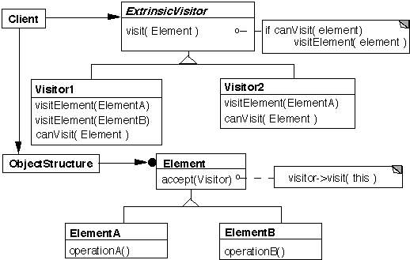
Variation : extrinsic visitor
Notes:
the above is slightly modified from the original ExtrinsicVisitor patternIn the original
Element does not have an accept method
The visit method of ExtrinsicVisitor does not call canVisit
ObjectStructure calls canVisit to determine if an element can be visited, then calls visit
The visitElement methods are not over loaded

Slide 58
Extrinsic visitor
The Visitor takes the responsibility of making sure a visitor can visit a particular concrete element
  Each Visitor knows which types of concrete classes it can visit
  The canVisit method of each visitor returns true is that visitor can visit that concrete type
New visitors can be created without changing the Element classes
New Element classes can be added without having to change old visitors

Slide 59
Visitor-Consequences -1
Visitors makes adding new operations easier
  If the structure involves many different classes, then adding a new operation to the structure requires changing all those classes
  Coding a new Visitor does not affect the structure
Visitors gathers related operations, separates unrelated ones
  Related behavior is not spread over the classes defining the object structure; it's localized in a visitor.
  Unrelated sets of behavior are partitioned in their own visitor subclasses.
  A print visitor could have all the different ways to print

Slide 60
Visitor-Consequences -2
Accumulating state
  A visitor can accumulate information as it traverses the object structure.
  Without a visitor, this state would have to be passed as extra arguments to the operations that perform the traversal.
Visiting across class hierarchies
  It can visit objects that do not have a common parent class

Slide 61
Consequence
Adding new ConcreteElement classes is hard
  To add a new ConcreteElement we need to change all existing visitors
  i.e. Add a new abstract operation on Visitor and a corresponding implementation in every Concrete Visitor class.
Breaking encapsulation
  The ConcreteElement interface must be powerful enough to let visitors do their job.
  We may be forced to provide public operations that access an element's internal state, which may compromise its encapsulation.
  C++ friends are useful here
Notes:
Allows adding further operations to objects without modifying them.

Slide 62
Known uses
java.nio.file.FileVisitor and SimpleFileVisitor
javax.faces.component.visit.VisitContext and VisitCallback
javax.lang.model.element.AnnotationValue and AnnotationValueVisitor
javax.lang.model.element.Element and ElementVisitor
javax.lang.model.type.TypeMirror and TypeVisitor

Slide 63
Related Patterns
Visitors and Composites
  The visitor pattern can be used together with the composite pattern.
  The object structure would be a composite structure.
  Leveraging that an operation of the composite tells all the children do the operation
    implementation of the accept method of the composite object invokes the accept methods of the component object

Slide 64
Visitors and Iterators
Both are used to traverse object structures.
Iterator can help visitor, but visitor can manage its own traversal, like on a tree.
Intents are different: encapsulating operation vs traversal
Iterator only traverses; performs no operation itself.
  type-blind: just gives you the next element (could be a base type, like Shape).
  client "pulls" an element, then decides what to do.
Visitor: Performs an operation across a structure of different concrete types.
  type-aware: uses double-dispatch (e.g., visit(Circle), visit(Square)) to run the correct logic.
  the operation is "pushed" to the element element.accept(visitor)

Slide 65
Extra slides

Slide 66
Another code example
public abstract class Component {
protected String name;
public Component(String name) {this.name = name;}
public String getName() { return name; }
public void setName(String name) { this.name = name; }
public abstract double getPrice();
public abstract void accept(ComponentVisitor v);
}
Using the lecture notes of Bob Tarr

Slide 67
Leaf of composite
public class Widget extends Component {
protected double price;
public Widget(String name, double price) {
super(name); this.price = price; }
public void setPrice(double price) { this.price = price; }
public double getPrice() { return price; }
public void accept (ComponentVisitor v) { v.visit(this); }
}

Slide 68
public class WidgetAssembly extends Component {
protected Vector<Component> components;
public WidgetAssembly (String name) {
super(name); components = new Vector()<Component>; }
public void addComponent (Component c) {..}
public void removeComponent (Component c) { ..}
public double getPrice() {
double totalPrice = 0.0;
for(Component c: components)
totalPrice += c.getPrice();
return totalPrice;
}
public void accept (ComponentVisitor v) {
v.visit(this); for(Component c: components) c.accept (v);}
}

Slide 69
Visitors
Structure is ready.
Now the visitors.
public abstract class ComponentVisitor {
public abstract void visit(Widget w);
public abstract void visit(WidgetAssembly wa);
}

Slide 70
Visitors
public class SimpleVisitor extends ComponentVisitor {
public SimpleVisitor() {}
public void visit (Widget w) {
System.out.println("Visiting a Widget");
}
public void visit (WidgetAssembly wa) {
System.out.println("Visiting a WidgetAssembly");
}
}

Slide 71
Have another visitor
public class PriceVisitor extends ComponentVisitor {
private double maxPrice;
public PriceVisitor(double maxPrice) {
this.maxPrice = maxPrice; }
public void visit (Widget w) {
double price = w.getPrice();
if (price > maxPrice)
System.out.println("Don't Buy! Widget price of " +
price + " exceeds maximum price (" + maxPrice + ").");
else
System.out.println("Buy! Widget price of " + price +
" is less than maximum price (" + maxPrice + ").");
}

Slide 72
public void visit (WidgetAssembly wa) {
double price = wa.getPrice();
if (price > maxPrice)
System.out.println("Don't Buy! WidgetAssembly price of " +
price + " exceeds maximum price (" + maxPrice + ").");
else
System.out.println("Buy! WidgetAssembly price of " +
price + " is less than maximum price (" + maxPrice + ").");
}
}

Slide 73
Some tests
public class VisitorTest {
public static void main (String[] args) {
// Create some widgets.
Widget w1 = new Widget("Widget1", 10.00);
Widget w2 = new Widget("Widget2", 20.00);
Widget w3 = new Widget("Widget3", 30.00);
// Add then to a widget assembly.
WidgetAssembly wa = new WidgetAssembly("Chassis");
wa.addComponent(w1);
wa.addComponent(w2);
wa.addComponent(w3);

Slide 74
// Visit some nodes with a SimpleVisitor.
SimpleVisitor sv = new SimpleVisitor();
w1.accept(sv);
w2.accept(sv);
w3.accept(sv);
wa.accept(sv);
// Visit some nodes with a PriceVisitor.
PriceVisitor pv = new PriceVisitor(25.00);
w1.accept(pv);
w2.accept(pv);
w3.accept(pv);
wa.accept(pv);
}
}

Slide 75
output
Visiting a Widget
Visiting a Widget
Visiting a Widget
Visiting a WidgetAssembly
Buy! Widget price of 10.0 is less than maximum price (25.0).
Buy! Widget price of 20.0 is less than maximum price (25.0).
Don't Buy! Widget price of 30.0 exceeds maximum price (25.0).
Don't Buy! WidgetAssembly price of 60.0 exceeds maximum price
(25.0).

