Slide 1
Behavioral Patterns
Command
Memento

Slide 2
We will discuss
Separating request generator and request handler
  What to do when you want to give more than one object a chance to handle a request
    Observer
    Chain of Responsibility
  Encapsulate method invocation
    Command pattern
Without exposing internal representation
  of an object, save/restore the state of it
    Memento
  of an aggregate object, access the elements of it sequentially
    Iterator

Slide 3

Decoupling sender and receiver of a request
  Observer
  Command -- Today
  Chain of responsibility
  Mediator

Slide 4
  COMMAND
  Turning a method invocation into an object

Slide 5
Motivation Example
Editor with Buttons, Menu, Shortcut Keys
Req1: I want to save document with
  Button click
  Selecting a MenuItem
  Using a shortcut CTLR+S
Req2: I want to open and print a document with a Button instance, MenuItem, and shortcuts

Slide 6
Motivation Example
Editor with Buttons, Menu, Shortcut Keys
Req1: I want to save document with
  Button click
  Selecting a MenuItem
  Using a shortcut CTLR+S
Attemp1:
  Hard code the request in all three classes
Button::onClick(){ document.save();}

Slide 7
Motivation Example
Editor with Buttons, Menu, Shortcut Keys
Req2: I want to open and print a document with a Button instance, MenuItem, and shortcuts
  Attempt1 hard coded the request in all three classes
Button::onClick(){ document.save();}
  Subclassing?
    SaveButton, OpenButton, PrintButton
    SaveMenuIte, OpenMenuItem, PrintMenuItem

Slide 8
The Problem
Problem: Different Invokers need to issue requests to objects without knowing anything about the operation being requested or the receiver of the request.
Invokers:
  Button
  MenuItem
  ShortcutKey
  Subclassing leads to 9 sublasses
Operation and Receivers:
  Document.save();
  Document.open();
  Document.print();

Slide 9
Command Pattern
Intent
  Encapsulate a request as an object, thereby letting you parameterize clients with different requests, queue or log requests, and support undoable operations
  Convert an operation into an object
    an object can be stored, passed, staged, shared, loaded in a table, ….

Slide 10
Command Pattern
Command pattern turns the request itself into an object
Each concrete Command class specifies a receiver-action pair by storing the Receiver as an instance variable
  callee.action(); becomes an object
class Command{
private Receiver callee;
public void execute(){ callee.action();}
}

Slide 11
Compose invokers with Commands
Operation and Receivers:
  Document.save();
  Document.open();
  Document.print();
Invokers:
  Button
  MenuItem
  ShortcutKey
b1:Button
:SaveCommand
execute(){doc.save();}
mi1:MenuItem
b2:Button
:OpenCommand
execute(){doc.open();}
mi2:MenuItem
b3:Button
:PrintCommand
execute(){doc.print();}
mi3:MenuItem

Slide 12
Structure – Command Pattern
Participants?
Client
Invoker
Command
execute()
Receiver
action()
ConcreteCommand
-Receiver receiver
+execute()
<<creates>>
{receiver.action()}
A concrete command has an instance of the receiver of the action
  and an execute method that invokes the receiver’s operation

Slide 13
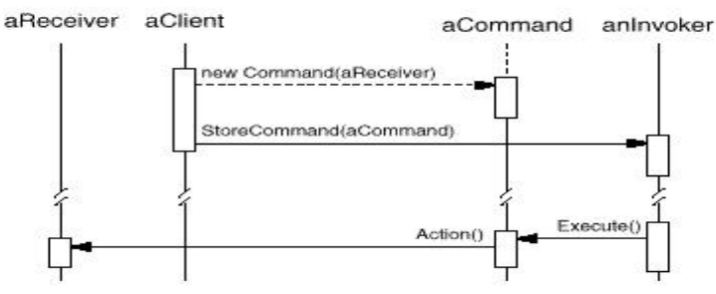
Structure – Command Pattern

Slide 14
Sequence Diagram – Save Button
receiver
invoker
doc:Document
e:Editor
b:Button
c:SaveCommand
create(doc)
storeCommand(c)
save()
execute()
click
Notes:
flexibility: paste command associated with menuitem and button

Slide 15
Sequence Diagram --Copy
receiver
invoker
doc:Document
e:Editor
b:Button
c:CopyCommand
create(doc,
start,text)
storeCommand(c)
copy(start,text)
execute()
click
We can also encapsulate an operation with parameters as a Command object
Notes:
flexibility: paste command associated with menuitem and button

Slide 16
Configuring Invoker with Commands
b1:Button
:SaveCommand
execute(){doc.save();}
mi1:MenuItem
You can express such parameterization in a procedural language with a callback function,
  callback: a function that is registered somewhere to be called at a later point.
Commands are an object-oriented replacement for callbacks.

Slide 17
Exercise : Task Schedular
We want to write a class that can periodically execute one or more methods of various objects.
  Example: we want to run a backup operation every hour and a disk status operation every ten minutes.
But we do not want the class to know the details of these operations or the objects that provide them.
We want to decouple the class that schedules the execution of these methods with the classes that actually do the behavior we want to execute.
Draw a class diagram

Slide 18
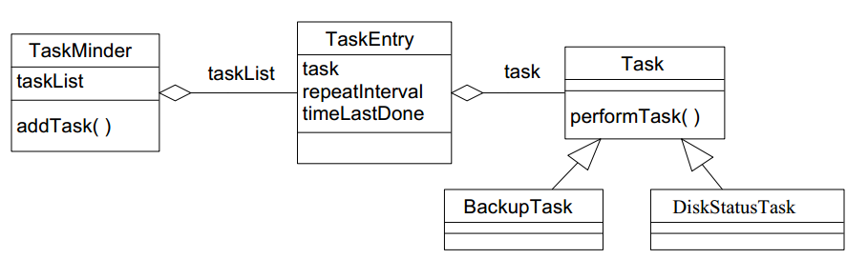
Exercise: Class diagram
execute()
Disk
+backup()
+checkstatus()
public interface Task {
public void execute();
}

Slide 19
Command Pattern
Can do fancy things
  Attach a method call to an object at runtime
  Logging the requests
  Queuing the requests
  Deferring the execution of the request
  Package the request and send it to another process
  Undo the request
  Reuse a command
    multiple invokers, macro-commands
Cannot do these easily if the client directly calls the receiver of the request
  Invoker::foo(){receiver.request();} cannot do these
Notes:
Dynamic dispatching with commands – we will see examples in refactoring

Slide 20
Applicability –when..
Need to parametrize objects with actions
Need to specify, queue, and execute requests at different times.
  Since a Command object can have a lifetime independent of the original request.
  Queuing the requests
  Deferring the execution of the request
  Package the request and send it to another process
    If the receiver of a request can be represented in an address space-independent way, then you can transfer a command object for the request to a different process and fulfill the request there.

Slide 21
Applicability –when..
Need to support logging the requests
  Log them so that they can be reapplied in case of a system crash.
    By augmenting the Command interface with load and store operations, you can keep a persistent log of changes.
    Recovering from a crash involves reloading logged commands from disk and re-executing them with execute() operation.

Slide 22
Applicability –when..
Need to support transactions
  Transactions consists of series operations as a single logical work of unit.
  A Macro-Command consisting of multiple commands (Composite)
    Sequencing of commands
    Same interface as Command
    easy to extend the system with new transactions.

Slide 23
Macro Command Implementation
class MacroCommand : public Command {
public:
virtual void add(Command*);
virtual void remove(Command*);
virtual void execute();
//…constructors, destructor
private:
List<Command*>* cmds;
};
void MacroCommand::execute () {
for (const auto &cmd: *cmds) cmd->execute();
}
C++

Slide 24
Macro Command Implementation
class CompositeCommand implements Command {
List<Command> commands;
public void execute() {
commands.forEach(Command::execute);
}
//add, remove, constructor implementations
}
//alternative
public void execute() {
for(Command cmd: commands) cmd.execute();
}
Java

Slide 25
Applicability –when..
Need to support undo the request.
  Undo last operation
  Support both undo and redo
  Multi-level undo and redo

Slide 26
Implementation issue-1: Undo
Supporting undo and redo.
Command interface supporting undo
public interface UndoableCommand{
public void execute();
public void undo();
}
A ConcreteCommand class might need to store additional data to undo the operation.
  the arguments to the operation performed on the receiver, and
  any original values in the receiver that can change as a result of handling the request.
Receiver has operations that lets command restore the state. Light::on() and Light::off()

Slide 27
Example: Undoable Command
class MoveUnitCommand : public UndoableCommand{
public:
MoveUnitCommand(Unit* unit, int x, int y)
: receiver(unit), xBefore_(0), yBefore_(0), x_(x), y_(y) {}
virtual void execute() {
// to remember the unit's position before the move
xBefore_ = receiver->x();
yBefore_ = receiver->y();
//action
receiver->moveTo(x_, y_);
}
virtual void undo() { receiver->moveTo(xBefore_, yBefore_); }
private:
Unit* receiver; int xBefore_, yBefore_; int x_, y_;
};
Notes:
Source: https://gameprogrammingpatterns.com/command.html

Slide 28
Example: Undoable Command
Occasionally, we do not have to save the state
public class LightOnCmd implements UndoableCommand{
private Light receiver;
public LightOnCmd(Light light){receiver=light;}
public void execute(){
receiver.on();
}
public void undo(){
receiver.off();
}
}

Slide 29
Undo/Redo
Saving the last command executed is sufficient for one-level undo.
Multi-level undo
  Need a history list
  A CommandManager that keeps a history
    Undoable command list(?)
    Redoable command list(?)
Notes:
Undo: traversing backward through the list and call undo() of commands
Redo: traversing forward and execute() of commands re-executes them.

Slide 30
How does undo work?
Ever used PhotoShop?
  There is a stack of commands on the right
Execution sequence
  When ResizeCommand is activated, put it into the history
  After a while, user chooses undo several times until that resize
    All of the commands unexecute until then
  ResizeCommand unexecutes and resize back
  Suggest a data structure…

Slide 31
public class CommandManager{
private Stack<Command> undoHistory;
private Stack<Command> redoHistory;
public void invoke (Command c){
if(c instance of UndoableCommand){
undoHistory.push(c);
}else{
undoHistory.clear(); redoHistory.clear(); //my choice
}
c.execute();
}
public void undo(){
UndoableCommand c=(UndoableCommand) undoHistory.pop();
c.undo();
redoHistory.push(c);
}
public void redo(){
Command c=redoHistory.pop();
c.execute();
undoHistory.push( c);
}}

Slide 32
Multi level undo/redo
Photoshop has a list of commands executed on the right
Execution sequence –undo any action
  User chooses one of the operations in the history list to cancel/undo
  Undo: traversing backward through the list while calling undo() of commands
  Redo: traversing forward and execute() of commands
  Suggest a data structure
Notes:
Undo(int index), redu(int index). Invoke stays the same

Slide 33
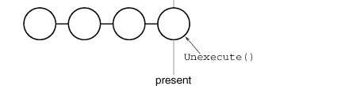


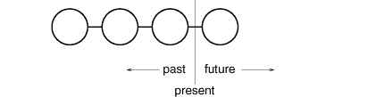
Command History
two stacks, or
History list
undo
redo

Slide 34
Impl. Issues – Undo/Redo
Save a copy of the Command object in the history
  When Command object has state how to undo that operation
  for distinguishing different invocations of the same command if its state can vary across invocations.
Example: a DeleteCommand that deletes selected text must store different text and position each time it is executed.
  Save a copy of the current DeleteCommand in the history.
    Which pattern?
  DeleteCommand object can delete some other text later
if the command's state never changes, put only a command reference in the history
  E.g. LightOnCommand

Slide 35
public class DeleteCmd implements UndoableCommand{
private Document doc; private int start, end;
private FormattedString text; //saving state
public DeleteCmd(Document d, int start, int end){..}
public void execute(){
text=doc.delete(start,end); //remember for undo
}
public void undo(){
doc.insert(start, text);
}
}
//setup
JButton deleteButton=new JButton(“insert”);
deleteButton.addActionListener(){
new ActionListener{
public void actionPerformed(ActionEvent e){
Command c=new DeleteCmd(doc,getSelection().start(), getSelection().end());
commandManager.invoke(c.clone());}
});

Slide 36
Commands can be shared
Undo action can be shared
ActionListener undoAction= new ActionListener{
public void actionPerformed(ActionEvent e){
commandManager.undo(); }
}); //yes, ActionListener is both observer and command
JButton undoButton=new JButton(“undo”);
undoButton.addActionListener(undoAction);
JMenuItem undoItem=new JMenuItem(“undo”);
undoItem.addActionListener(undoAction);

Slide 37
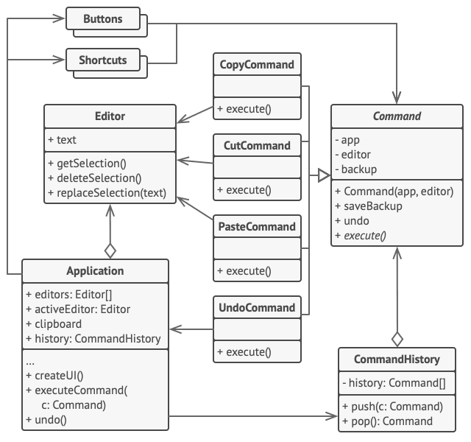
An alternative design.
Command is abstract class implemented as a base for Editor commands.
Application acts as command manager
https://refactoring.guru/design-patterns/command

Slide 38
Implementation issues -2
How intelligent should a command be?
At one extreme it merely defines a binding between a receiver and the actions that carry out the request.
At the other extreme it implements everything itself without delegating to a receiver at all.
  When you want to define commands that are independent of existing classes,
  When no suitable receiver exists, or
  When a command knows its receiver implicitly.
  e.g., a command that creates another application window may be just as capable of creating the window as any other object.
Somewhere in between these extremes are commands that have enough knowledge to find their receiver dynamically.

Slide 39
Implementation issues -3
Function pointer and C++ templates.
For commands that (1) are not undoable and (2) do not require arguments
template <class Receiver>
class SimpleCommand : public Command {
public:
typedef void (Receiver::* Action)();
SimpleCommand(Receiver* r, Action a) : receiver(r), action(a) { }
virtual void execute();
private:
Action action;
Receiver* receiver;
};
template <class Receiver>
void SimpleCommand<Receiver>::execute () { (receiver->*action)(); }

Slide 40
Implementation issues-3
Function pointer and C++ templates.
template <class Receiver>
class SimpleCommand : public Command {
public:
typedef void (Receiver::* action)();
SimpleCommand(Receiver* r, Action a) : receiver(r), action(a) { }
virtual void execute();
private:
Action action;
Receiver* receiver;
};
template <class Receiver>
void SimpleCommand<Receiver>::execute () { (receiver->*action)(); }
int main(){
MyClass* receiver = new MyClass;
Command* aCommand =
new SimpleCommand<MyClass>(receiver, &MyClass::operation);

Slide 41
C++ Functors as Command
Implementation alternative -3
class Command { //FUNCTOR
public: virtual ~Command(){}
virtual void operator ()()=0;
};
class LightOnCmd : public Command {
public:
LightOnCmd(Light& l,const string& m) :
light(l), msg(m) {}
// Override the "execute" operator
void operator()() override {
light.on(msg); }
private:
Light& light; string msg;
};
class Light{ //Receiver
public: void on(const string& msg);
void off();
};
int main() {
Light light; RemoteControl remote;
// Turn on the light
remote.setCmd(
new LightOnCmd(light, "on"));
remote.pressButton();
}
// Invoker
class RemoteControl {
public:
void setCmd( Command* cmd) {
command.reset( cmd);}
void pressButton() {
if (command) (* command)(); } //calling!
private:
std::unique_ptr<Command> command;
};

Slide 42
STL Functors as Command
Implementation alternative -4
#include <functional>
// Command
using Command = std::function<void()>;
// Invoker
class RemoteControl {
public:
void setCmd(const Command& cmd) {
command = cmd;}
void pressButton() { command(); }
private:
Command command;
};
class Light{//Receiver
public: void on(const string& msg);
void off();
};
int main() {
Light light;
RemoteControl remote;
// Turn on the light
remote.setCmd([& ]{ light.on(“on”); });
remote.pressButton();
// Turn off the light
remote.setCmd([&] { light.off(); });
remote.pressButton();
}
Notes:
Functors can have state, function pointers cannot

Slide 43
Using Lambda as command
Implementation alternative -5
Assume
  class Invoker{public void addCommand(Command c ){..}..}
  public interface Command{
public void execute();}
Creating a command object
  public void someMethod(Invoker invoker){
  Document receiver=createDoc();
  invoker.addCommand( () -> receiver.save() );
Lambda captures the receiver in the lexical closure.
Invoker says cmd.execute()
Notes:
Invoker says cmd.execute();

Slide 44
Lambda in remote command
Invoker has addCommand(MyCommand c){..}
public interface MyCommand extends Runnable, Serializable { }
  This is a marker interface
  We might send the command on another JVM
  Using the public void run() of Runnable as the execute method
invoker.addCommand(
() -> System.out.println(“a simple command") );
https://blogs.oracle.com/javamagazine/post/the-command-pattern-in-depth

Slide 45
Command- Consequences
Complete decoupling between the sender and the receiver
  Receiver knows how to perform the action
  Invoker is unaware who performs the action
A request becomes a command object that can be manipulated and extended like any other object
  Command is a first-class object
Commands can be assembled into a composite command
Enables to implement deferred execution of operations
Easy to add new commands, because you don't have to change the existing classes.

Slide 46
Known uses
All implementations of java.lang.Runnable
All implementations of javax.swing.Action
ActionListener is both Observer and Command
  addListener(new ActionListener{
  public void actionPerformed(ActionEvent e){
  //this is the execute method
  //it is the update method as well
  }
  });

Slide 47
Thread safety
Command manager –use a thread safe data structure and make it final
  Final to eliminate race conditions at initialization
  Thread safe data structure for swapping command between lists safely
  Same goes for command queues
The receiver methods that Command::execute invokes should be thread safe
  Be careful about deadlock: threads holding locks waiting each other to release lock
Commands do not have state, but if they do make it immutable

Slide 48
Related patterns
Macrocommands with Composite
Chain of Responsibility can use Command to represent Requests as objects.
Handlers in CoR can be implemented as Commands.
  we can execute a lot of different operations over the same context object, represented by a request.
A command that must be copied before being placed on the history list acts as a Prototype

Slide 49
Related patterns
Decoupling request sender and receiver
  Observer broadcast
  Mediator is centralized communication control
  CoR sends request down the chain
  Command, invoker is unaware of receiver and the action
Strategy and Command
  use both to parameterize an object with some action.
  Intents! Strategy lets us swap algorithms in a context
  Command converts an operation into an object, puts them into operation queue, make history, undo them
Memento (next)

Slide 50
Can I undo any command?
PhotoShop with a history list on the right
Execution sequence- undo last action
  When BlurCommand is activated, put it into a stack – keep a history
  After a while, user chooses undo the last operation
  BlurCommand unexecutes the blurring action
    What? How?
How to undo irreversible action?
  Do not support undo; print a message
  Save the previous image with Memento (next pattern)

Slide 51
memento

Slide 52
Restoring a previous state
Undo an irreversible action
  How much information to store about the old state?
  Who creates the info to store?
  Who should store this info for later use? Command?
  How to keep the visibility restrictions of the document intact?
  How would the image restore itself the previous state?
Restore the game to a checkpoint
Restore a repository to one of the previous state

Slide 53
Memento
Intent
Without violating encapsulation, capture and externalize an object’s state so that the object can be restored to this state later

Slide 54
Memento - Collaborations
:CareTaker
:Originator
m1:Memento
saveState()
createMemento()
m1
restore(m1)
getState()
The Caretaker holds the Memento, but cannot look inside.
Notes:
Promote undo or rollback to full object status.
A magic cookie that encapsulates a "check point" capability.

Slide 55
Memento-Collaborations
A backup is requested from an originator,
  a memento object is created,
  populated with the originator’s private information,
  returned to the caretaker.
The caretaker cannot view this information
Originator and memento classes share information without exposing any of it to other classes
Caretaker wants to restore
  return the memento to the originator
  have the originator’s private attributes reset to the earlier state
Notes:
C++ use friend
Java: clone or serialize

Slide 56
Restore to a checkpoint
:UserInterface
:Game
m1:Memento
saveProgress()
createMemento()
m1
restore(m1)
getState()
Promote undo or rollback to full object status.
A magic cookie that encapsulates a "check point" capability.

Slide 57
Memento Answers
How much information to store about the old state?
Originator, the object itself knows best what it needs to restore back.
Who creates the info to store, i.e. the Memento?
Originator creates the Memento. Originator puts its confidential information inside the Memento
Who should store this info for later use?
Just like in games and code repositories, we need a caretaker. Database, file, dictionary, etc.
How to keep the visibility restrictions of the document intact?
How would the Originator restore itself the previous state?

Slide 58
Design Forces
Do not violate encapsulation!
  Originator’s state is stored in a memento
  Only the originator should be able to see the internal information
When the caretaker wants to restore
  Return the memento to the originator
  Originator sets it state back
  Caretaker cannot see/examine the memento’s internals

Slide 59
How not to break encapsulation?
Memento has two interfaces.
  Wide interface for originator
    Getter methods or access to fields
  Narrow interface for everyone else
    Private Getter methods and fields
C++ friends keyword makes it easy
  Caretaker sees the memento interface that expose no information
  Originator is a “friend” of memento
In Java, a little complicated…
BAD: public methods and 'hoping' no one misuses the memento.
Notes:
Memento as inner class of Originator
Originator returns type Object as memento

Slide 60
Originator is a friend of Memento
C++
class Memento {
public:
// narrow public interface. Zero service.
virtual ~Memento();
private:
// private members accessible only to Originator
friend class Originator;
Memento(); //nobody else should create a memento
//setter and getters for attributes that helps originator to restore
void setAttribute(Field*);
Field* getAttribute();
private: //fields that stores the originator’s info
};
Notes:
class Originator {
public:
Memento* CreateMemento();
void SetMemento(const Memento*);
// ...
private:
State* _state; // internal data structures
// ...
};

Slide 61
Originator sees the wide interface
class Originator {
public: // ...
Memento* createMemento();
void restore(const Memento*);
private:
Field* f1; …. // internal data structures
};
Memento* Originator::createMemento(){
Memento* m=new Memento(); //private, but I am a friend
m->f1=this->f1; /*save necessary info to remember*/
return m; }
void Originator::restore(const Memento* m){ if(m==0) return;
this->f1=m->f1; //some mechanism to restore the internal values
}

Slide 62
Memento is an inner class Object
Java
public class Originator{
private Field1 f1; //..and other fields.
public Object saveState(){ //or createMemento
return new Memento();
} //narrow interface is the Object interface
public void restore(Object o){
if(!o instanceof Memento)) { //it is not mine
printErrorMsg(); return;}
Memento m=(Memento) o; //now it has wide interface
f1=m.mf1; ….//restore the fields using memento’s fields
}
private class Memento{
Field mf1; /// and other fields
Memento(){mf1=f1; …..} //save the values of necessary Originator fields
}}
This is a suggestion.
Any implementation that gives a wide interface to the Originator and a narrow interface to anything else is welcome

Slide 63
Implementation issues
Memento could have less state information than the originator
  Store only the changing parts
  Memento could just save incremental changes when there is a predictable change sequence
If you need all private information, create the memento by cloning the original object.
  Alternatively, toString() and write to a file
Serialization is a creation of memento

Slide 64
Undo and memento
Many possibilities
  Command object itself can be the caretaker (better)
  If not, save the command and memento as a pair in the undo/redo history
  Commands in the history are in execution order, so memento could save only incremental changes
The memento pattern does not specify how caretaker works other than it should see the narrow interface

Slide 65
class TypingCommand implements Command { //caretaker
private TextEditor editor;
private String textToAdd;
private Memento backup; // Magic token!
public TypingCommand(TextEditor editor, String text) {
this.editor = editor; this.textToAdd = text; }
public void execute() {
backup = editor.save();
editor.addText(textToAdd);
}
public void undo() { //restore the originator using memento
if (backup != null) editor.restore(backup); }
}
Originator of Memento AND
Receiver of Command
Originator creates memento. Command is the caretaker of it.

Slide 66
Memento - Consequences
Simplifies the originator
  No storage management for copies in the originator
  Not keeping track of its previous state since this is the responsibility of the CareTaker
Memento avoid exposing information anyone other than the originator
  Preserving encapsulation
Might be expensive
  Depends on copy cost, storage cost
Notes:
Preserving encapsulation boundaries. Memento avoids exposing information that only an originator should manage but that must be stored nevertheless outside the originator. The pattern shields other objects from potentially complex Originator internals, thereby preserving encapsulation boundaries.
It simplifies Originator. In other encapsulation-preserving designs, Originator keeps the versions of internal state that clients have requested. That puts all the storage management burden on Originator. Having clients manage the state they ask for simplifies Originator and keeps clients from having to notify originators when they're done.
Using mementos might be expensive. Mementos might incur considerable overhead if Originator must copy large amounts of information to store in the memento or if clients create and return mementos to the originator often enough. Unless encapsulating and restoring Originator state is cheap, the pattern might not be appropriate.
Defining narrow and wide interfaces. It may be difficult in some languages to ensure that only the originator can access the memento's state.
Hidden costs in caring for mementos. A caretaker is responsible for deleting the mementos it cares for. However, the caretaker has no idea how much state is in the memento. Hence an otherwise lightweight caretaker might incur large storage costs when it stores mementos.

Slide 67
Known uses
All implementations of java.io.Serializable
All implementations of javax.faces.component.StateHolder
Load and save checkpoints

Slide 68
Related patterns
Command can use Memento to maintain the state required for an undo operation.
Command and Memento act as magic tokens to be passed around and invoked at a later time.
  In Command, the token represents a request;
  in Memento, it represents the internal state of an object at a particular time.
An iterator can use a Memento to capture the state of an iteration.
  Iterator stores the memento internally
Notes:
Polymorphism is important to Command, but not to Memento because its interface is so narrow that a memento can only be passed as a value.

Slide 69
References
Design Patterns: Elements of Reusable Object-Oriented Software. Gamma, E., Helm, R., Johnson, R., & Vlissides, J. (1994).
  GoF book
Dive Into Design Patterns, Refactoring guru, A. Shvets, (2021)
Game programming patterns, R. Nystrom (2014)
Head First Design Patterns. Freeman, E., Robson, E., Sierra, K., & Bates, B. (2004).

